Slide 1
Types of Cellular Networks

Slide 2
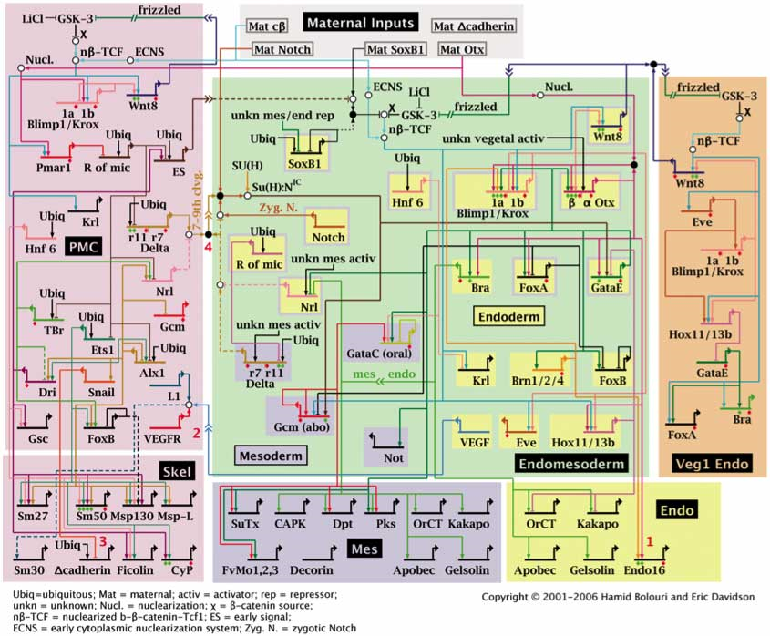
Gene Regulatory Networks
http://scienceblogs.com/pharyngula/2006/06/modules_and_the_promise_of_the.php

Slide 3
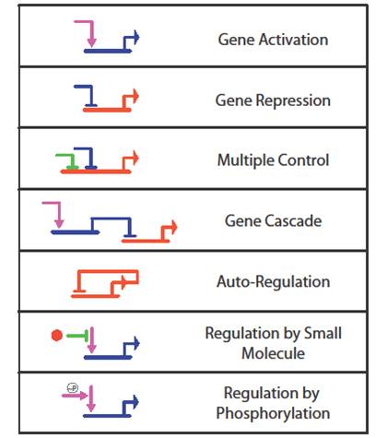
Gene Regulatory Network Basic Operations

Slide 4
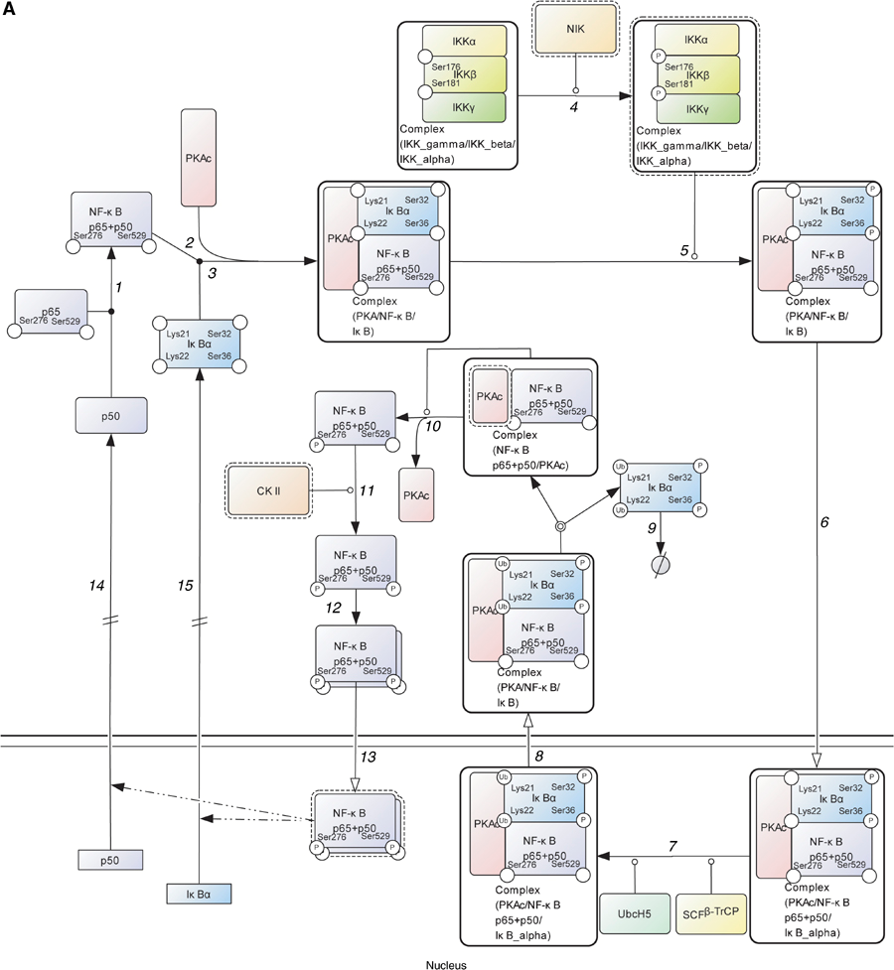
Protein Signaling Networks
http://www.nature.com/msb/journal/v2/n1/full/msb4100088.html

Slide 5
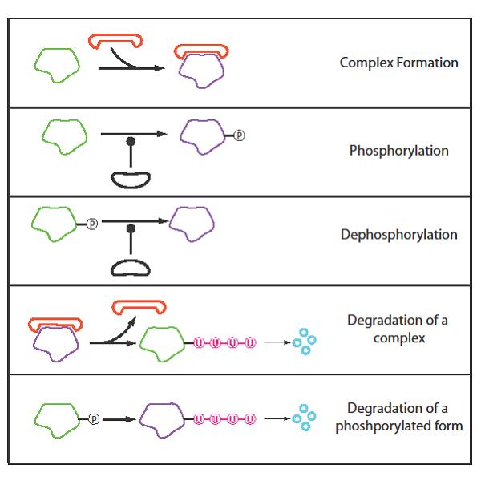
Protein Signaling Networks Basic Operations

Slide 6
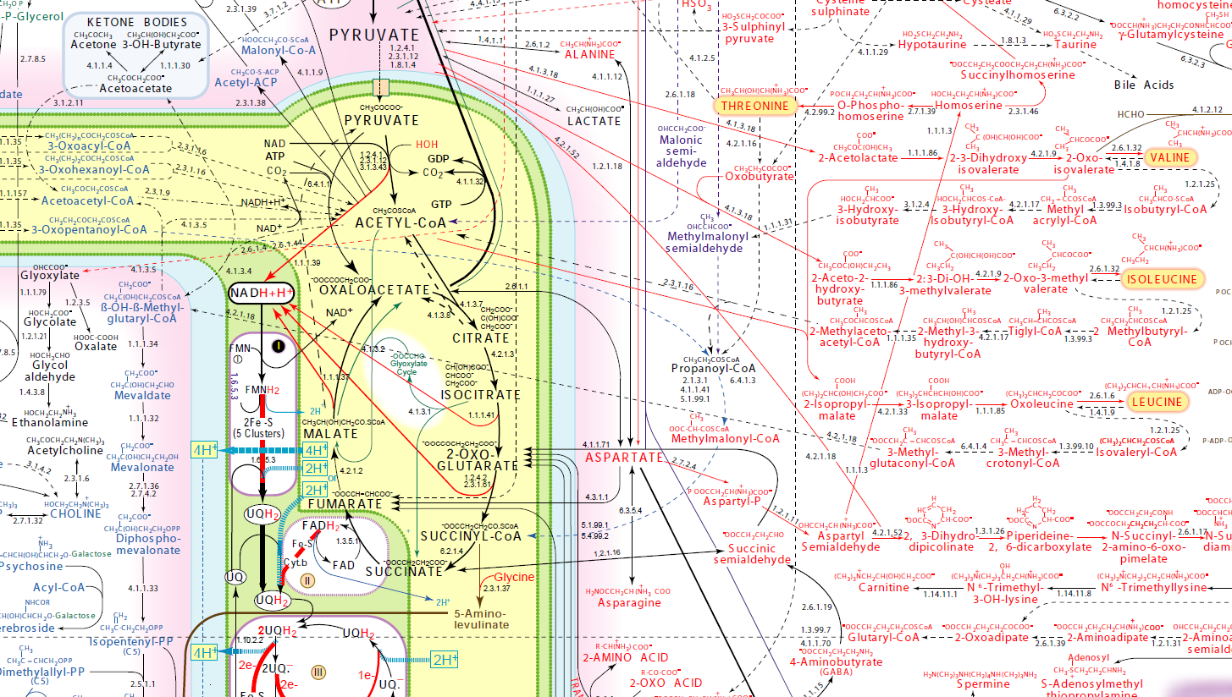
Metabolic Networks
http://www.iubmb-nicholson.org/chart.html

Slide 7
Some Characteristics
Network | Speed | Purpose | ‘Technology’
Gene | Slow to medium | Remodeling signaling and metabolic networks | DNA binding to control expression
Protein | Medium to fast | Signal processing | Protein covalent modification and sequestration
Metabolic | Fast | Manufacturing, energy systems | Enzymes, allosteric control

Slide 8
Software for Network Visualization Does not include ball-stick networks, eg cytoscape

Slide 9
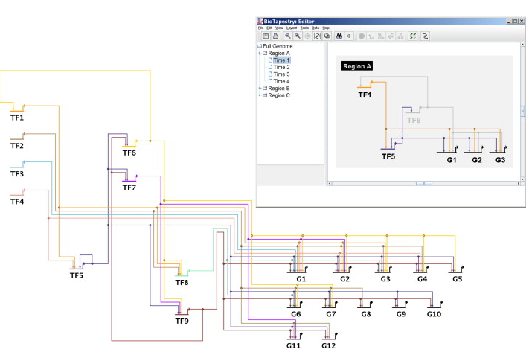
Gene Regulatory Networks
BioTapestry
Cross-platform,
Java, Open Source,
SBML?, no simulation
Biotapestry.org

Slide 10
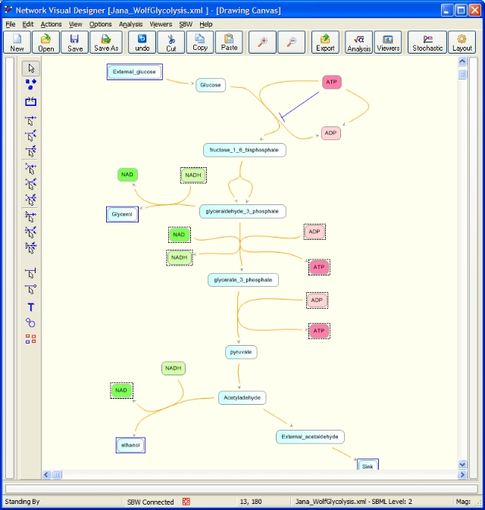
Metabolic and Protein Networks JDesigner
Windows,
Delphi, open source
SBML, Part of SBW

Slide 11
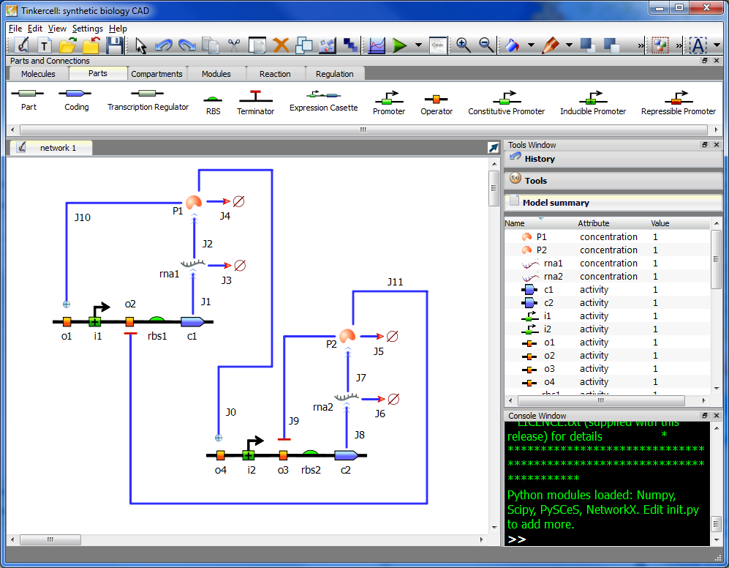
Gene Protein and Metabolic Networks
TinkerCell
Cross-platform,
Open source,
C/C++, Qt, Python,
SBML?
tinkercell.com

Slide 12
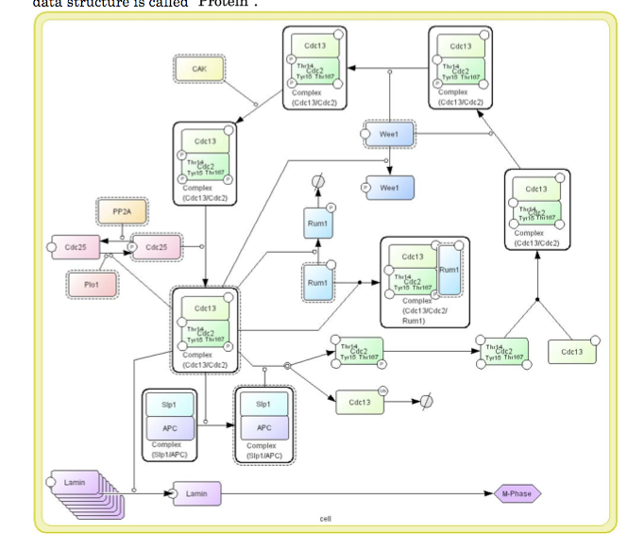
Metabolic and Protein Networks CellDesigner
Cross-platform
Works with SBW,
Java, SBML
http://celldesigner.org

