Slide 1
Toymodel & Full FBA model
https://github.com/dagwa/wholecell-metabolism.git
Toymodel
https://github.com/dagwa/wholecell-metabolism/tree/master/mkoenig/python/metabolism/toymodel
toy_comp.xml
toy_ode_model.xml
toy_ode_update.xml
toy_ode_bounds.xml
toy_fba.xml
Full FBA model
https://github.com/dagwa/wholecell-metabolism/tree/master/mkoenig/results
Metabolism_matrices_08_L3V1.xml
Metabolism_matrices_annotated_08_L3V1.xml

Slide 2
FBA Submodel
R1 <= ub_R1
R2
R3
A
B1
B2
C
v_R1
v_R2
v_R3

Slide 3
Kinetic Submodel
v_R3
R4: k_R4*C
C
D
v_R3

Slide 4
toy model
kinetic submodel (arbitrary complexity)
toy_ode_model.xml
SSA/ODE
SBO:0000062:continous
species: C, D
replaces: extern C
kinetic model
calculates update of metabolite counts based on FBA fluxes
toy_comp.xml
toy_ode_update.xml
toy_ode_bounds.xml
replaces: ub_R1
compartments: extern, cell
species: C
parameters: ub_R1, v_R1, v_R2, v_R3
SBO:0000062:continous
species: A, B1, B2, C
SBO:0000062:continous
Calculates:
p: ub_R1
replaces: extern, cell
C v_R1, v_R2, v_R3
kinetic model
calculates the new flux bounds (ub & lb)
p: ub_R1 → p: ub_R1
p: v_R1 → p: v_R1
p: v_R2 → p: v_R2
p: v_R3 → p: v_R3
toy_fba.xml
FBA
replaces:
extern, cell ub_R1, v_R1, v_R2, v_R3
FBA model
calculates fluxes with updated flux bounds
SBO:0000624:FBA
species: A, B1, B2, C
Calculates fluxes R1, R2, R3 & stores in
p: v_R1, v_R2, v_R3

Slide 5
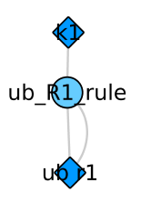
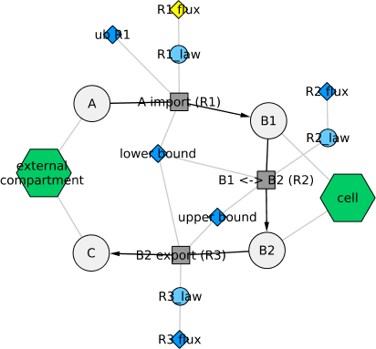
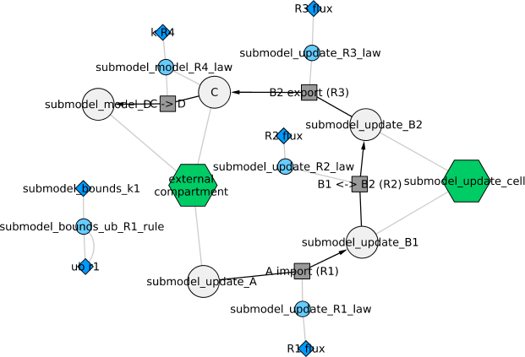
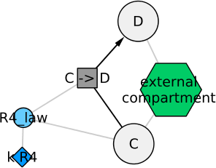
toy_bounds.xml
toy_fba.xml & toy_ode_update.xml
toy_comp.xml (flattened)
toy_model.xml

Slide 6
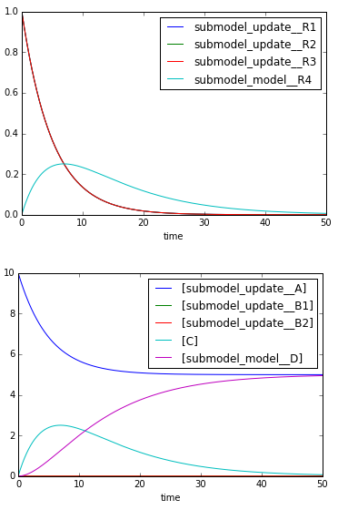
Version: 61004733ca7
Solution for
simulate(tend=50.0, step_size=0.01)
Initial Values
Parameters
ub_R1 = 1.0
ub = 1000
lb = 0
Species
A = 10.0
B1 = 0.0
B2 = 0.0
C = 0.0
D = 0.0
Compartments
ext = 1.0
cell = 1.0
FluxBounds
lb <= R1 <= r1
lb <= R2 <= ub
lb <= R3 <= ub
Objective
maximize : 1.0*R3

