Slide 1


Dynamic Flux Balance Analysis (DFBA)
with SBML (core, comp, fbc)
sbmlutils
Leandro Watanabe, Matthias König & Chris Meyers

Slide 2
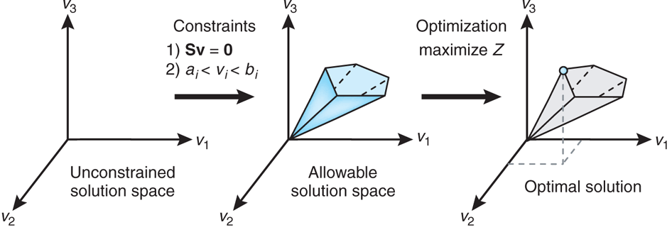
Dynamic FBA (DFBA)
Coupling of dynamical model parts to
steady state networks (FBA)
Subset of general problem of coupling models with different simulation frameworks
  Deterministic
  Constraint-based
  Logical/boolean models
  Stochastic simulations
Approaches
  Coupling of ODE to FBA model
    Direct embedding of LP-Solver in ODE solver
      execution in every time step
      complex implementation (high level expertise on ODE solver design)
      Stiffness of system at borders of flux-cone
    Stationary Optimization Approach (SOA)
      Iterative stepwise evaluation of FBA problem
      Assumption: constant solution over step size
    Dynamic Optimization Approach (DOA)
Resource allocation (creating large optimization problem based)
    Very large optimization problems (explosion of dimensions via time discretization)
    Dynamic achieved via optimization boundary conditions

Slide 3
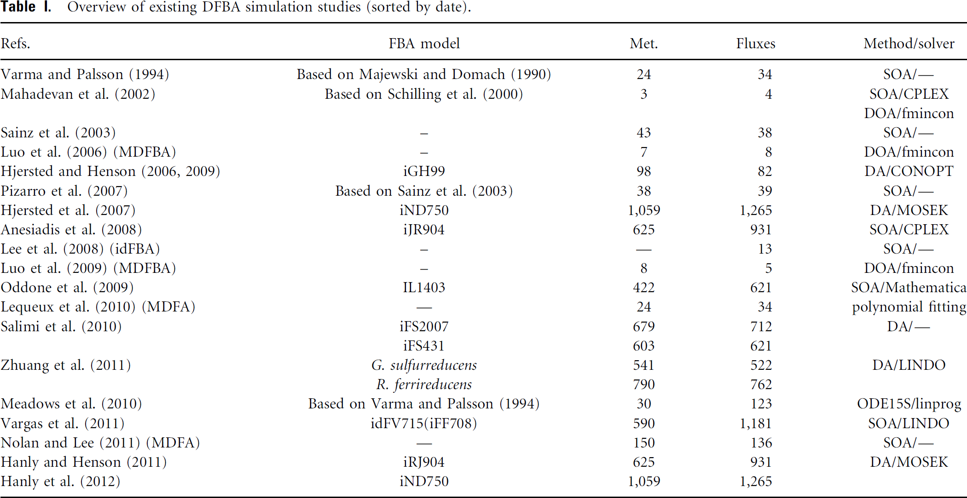
DFBA Examples
Whole-cell model (Karr et al)

Slide 4
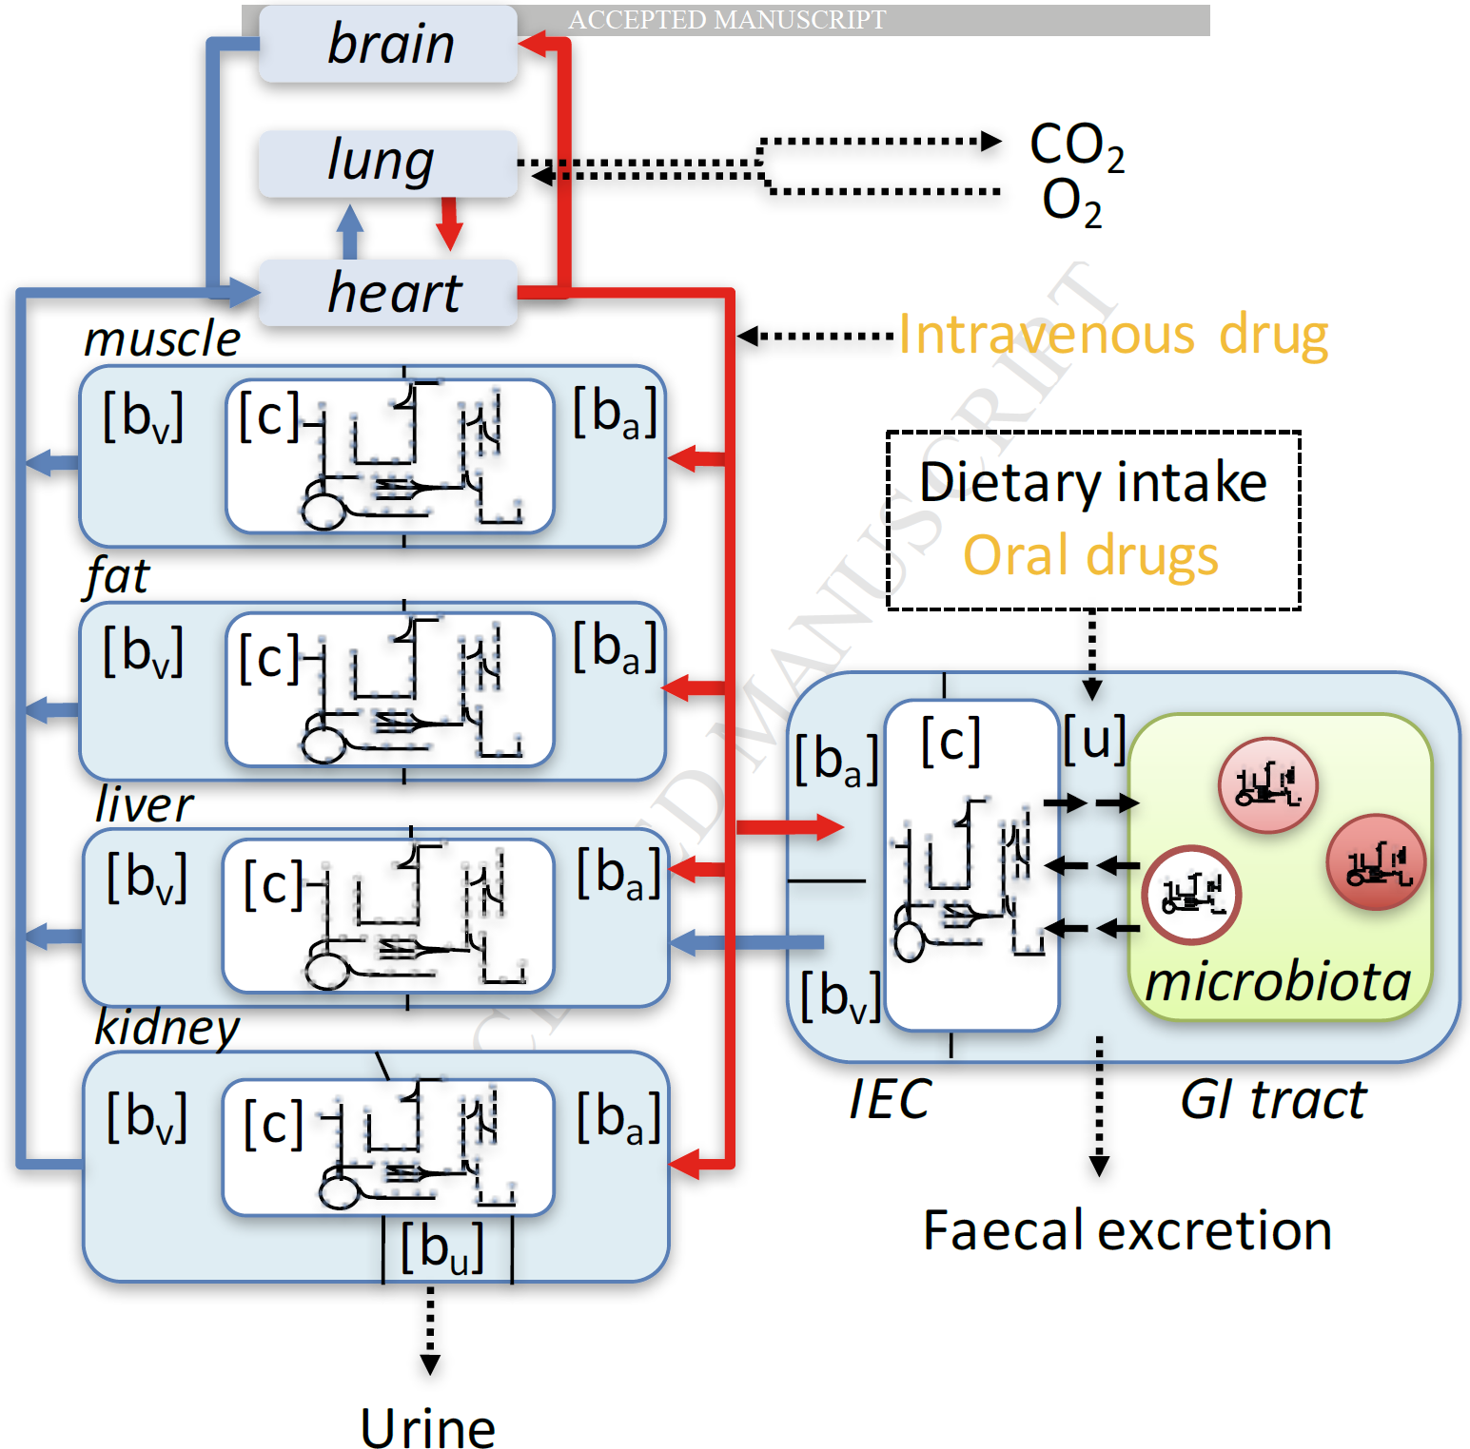
Applications & Use cases
Model embedding
  Coupling ODE pathway models to genome-scale metabolic models (liver)
  Exchange interfaces
Whole-body PKPD
  Coupling of tissue specific FBA models to whole body PKPD
  Glucose regulation (liver, muscle, fat, pancreas, stomach)
  Cori cycle & other multi-tissue physiological cycles
    Glucose – alanine/pyruvate shuttle
Wholecell model
Microbiome, biofilms, ...
Thiele2017

Slide 5
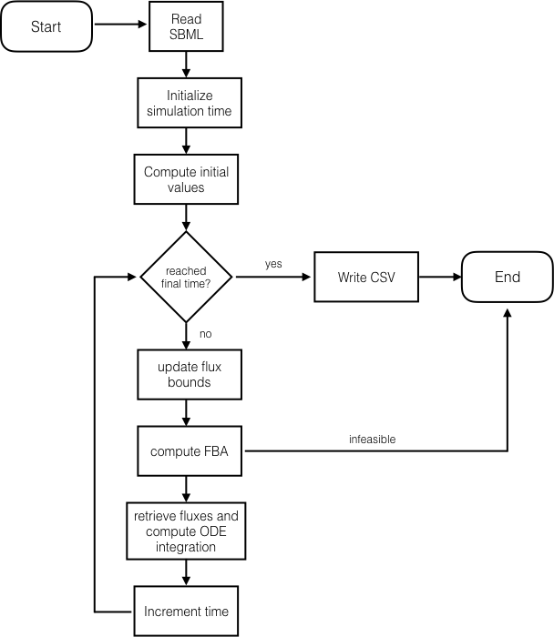
Simulation Algorithm
Implementations
sbmlutilhttps://github.com/matthiaskoenig/sbmlutils
iBioSimhttps://github.com/MyersResearchGroup/iBioSim

Slide 6
SBML encoding
Good description for kinetic and FBA models.
But no description of how to encode DFBA in SBML?
  Core
    Kinetic models
    Compartments, Parameters, Species, Reactions, RateRules, AssignmentRules, Events, FunctionDefinitions)
  fbc
    FBA encoding
    Objective functions, flux bounds, GPR encoding
  comp
    Coupling of models
    ExternalModelDefinitions, ModelDefinitions replacements, replacedBy, deletions, ports, submodels
  Annotation of model components
    SBO terms
    allows automatized coupling

Slide 7
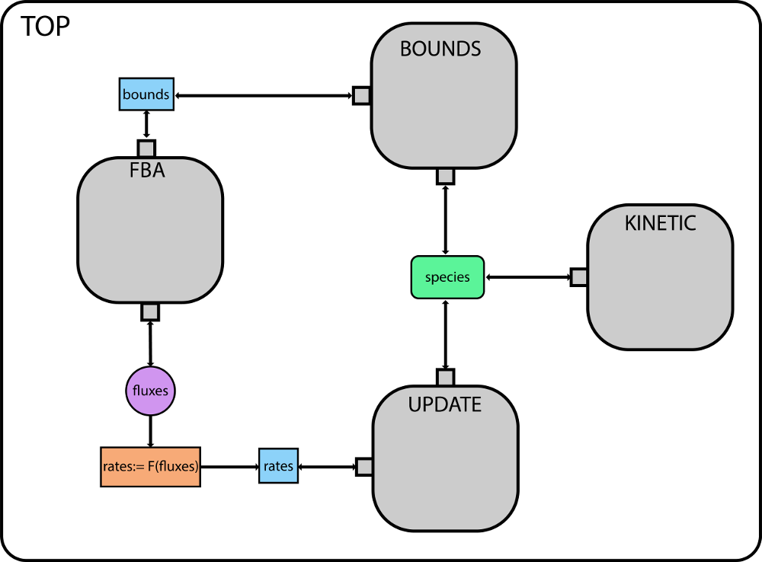
Comp submodels
Splitting problem in clearly defined subproblems with interfaces.
TOP
(kinetic) equations & coupling of submodels
BOUNDS
(kinetic) bounds calculation
UPDATE
(kinetic) update of species with fluxes from FBA
FBA
(constraint) FBA problem
Interface
  exchange reactions
    What is taken up, what is imported, how unbalanced are metabolites?
  update kinetics
    How does flux change metabolites (scaling by biomass, …)
  bound kinetics
    How do kinetic players effect bounds
  Limiting FBA fluxes via available resources for time step (bounds)
  dt (time step)
    required for bounds update
    defines steps in DFBA time course

Slide 8
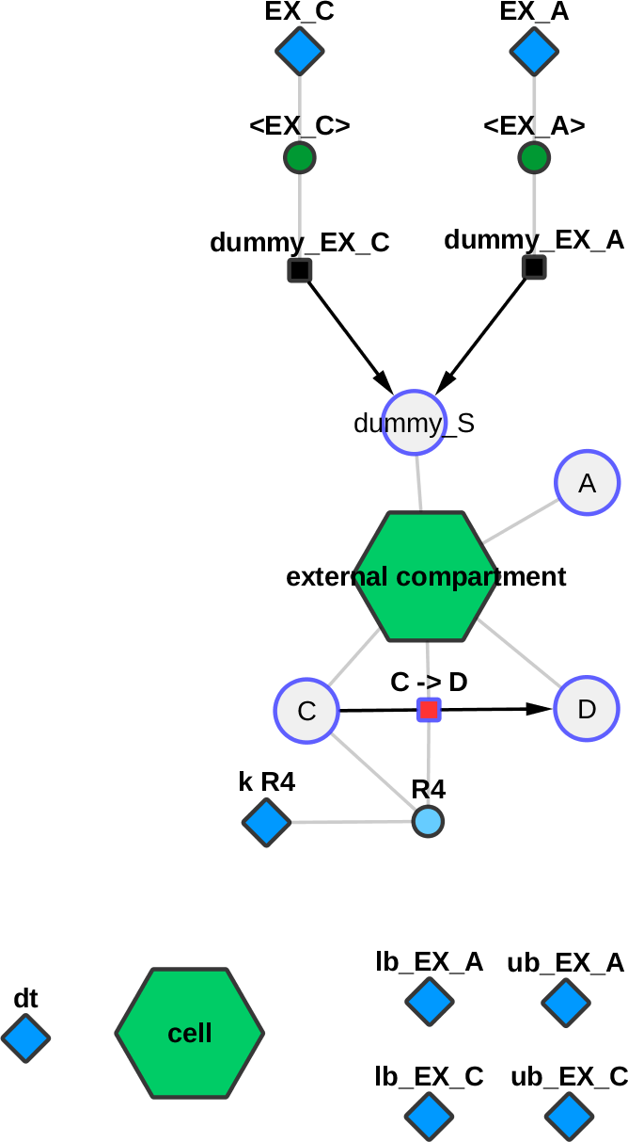
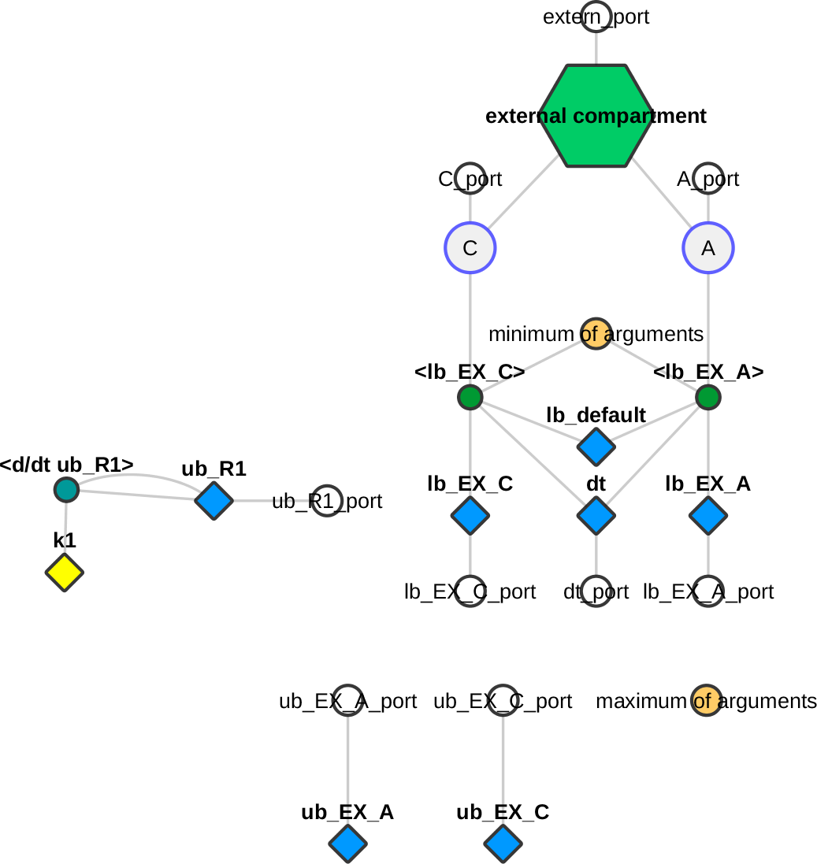
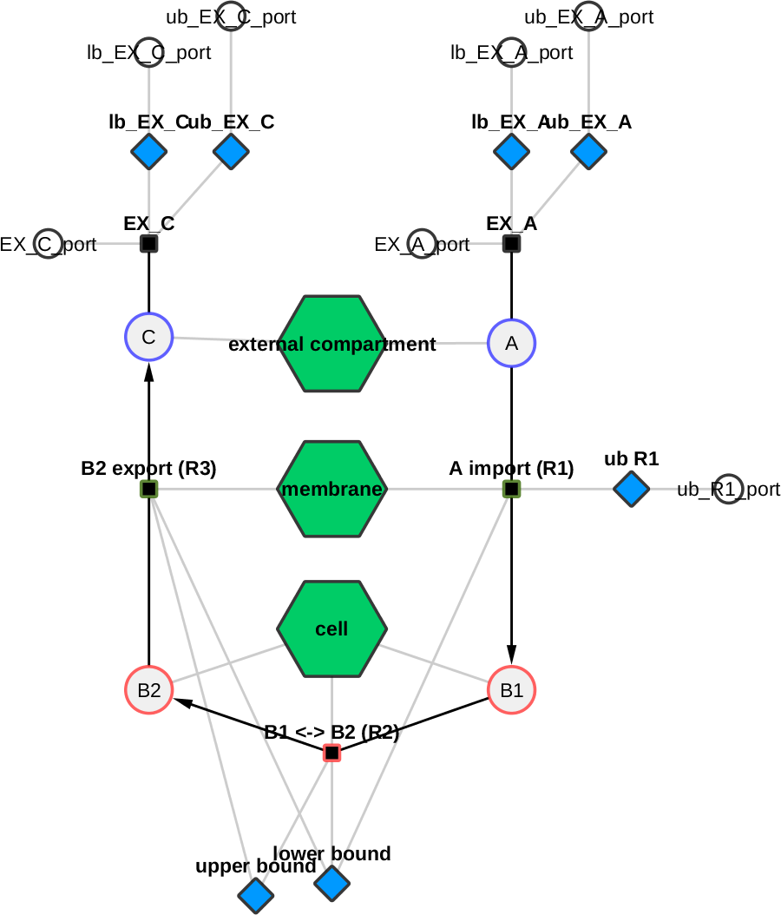
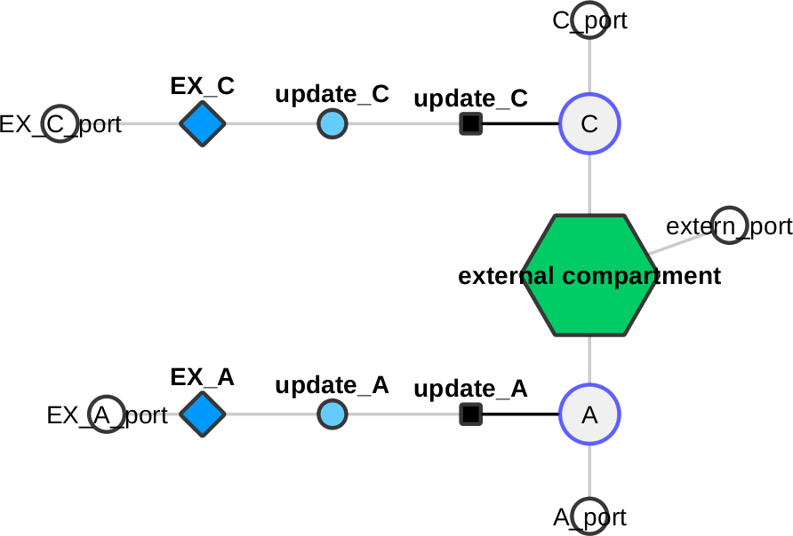
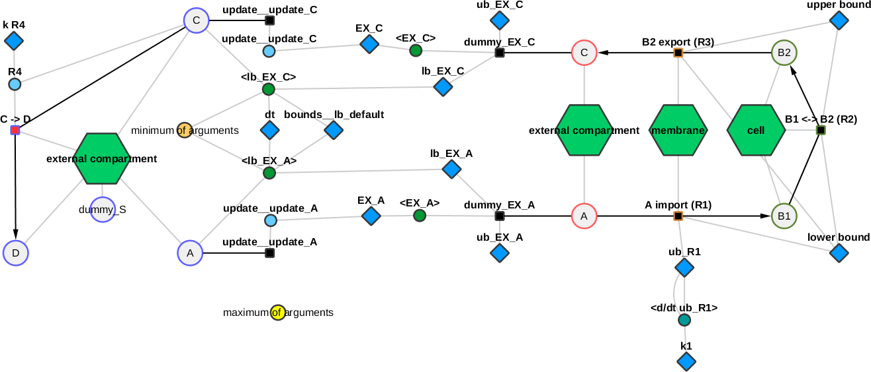
Toy wholecell
BOUNDS
FBA
TOP
UPDATE
Flattened

Slide 9
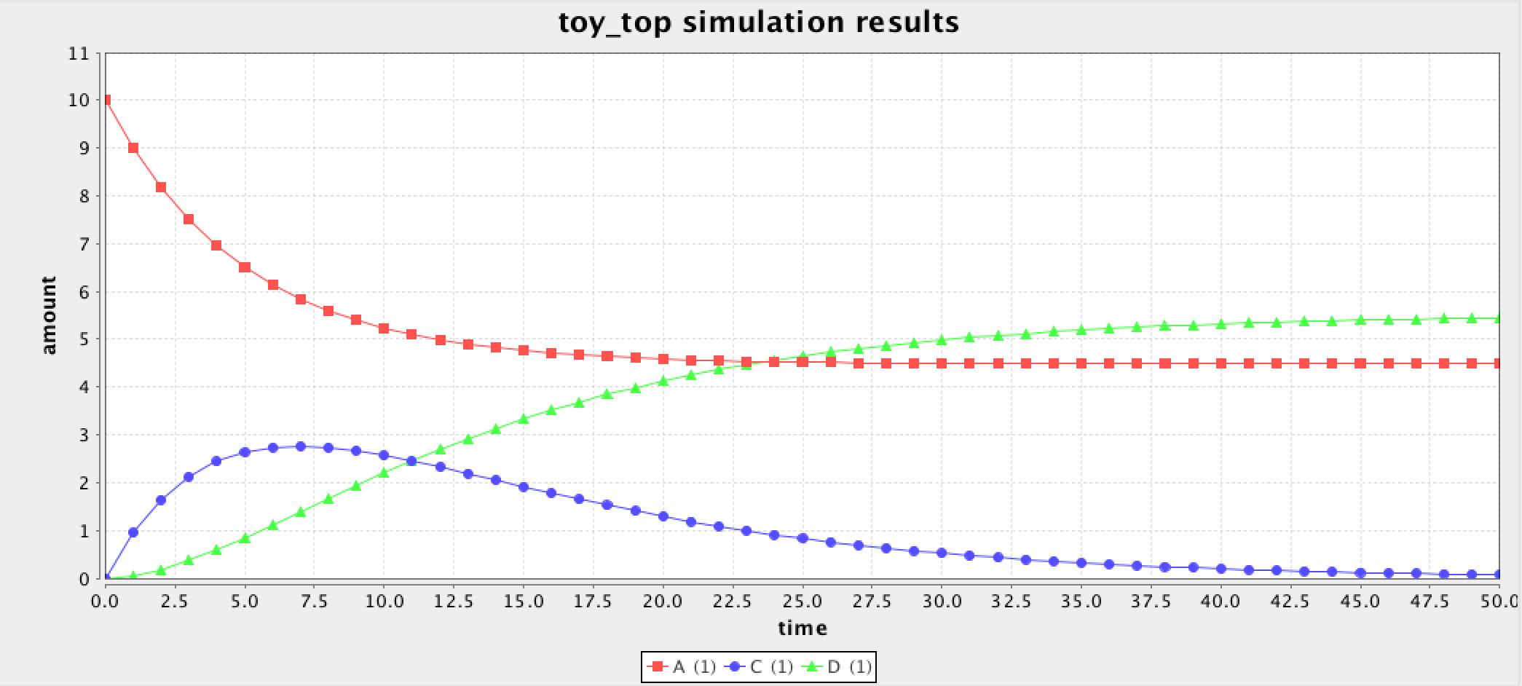
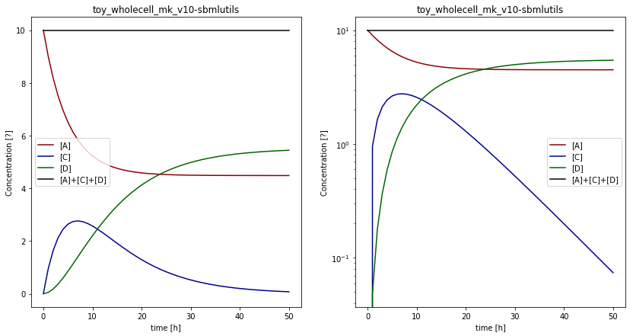
Toy wholecell
3 reactions, linear chain
2 exchange reactions (A, C)
Identical results
file:///home/mkoenig/git/sbmlutils/sbmlutils/dfba/toy_wholecell/results/v12/index.html

Slide 10
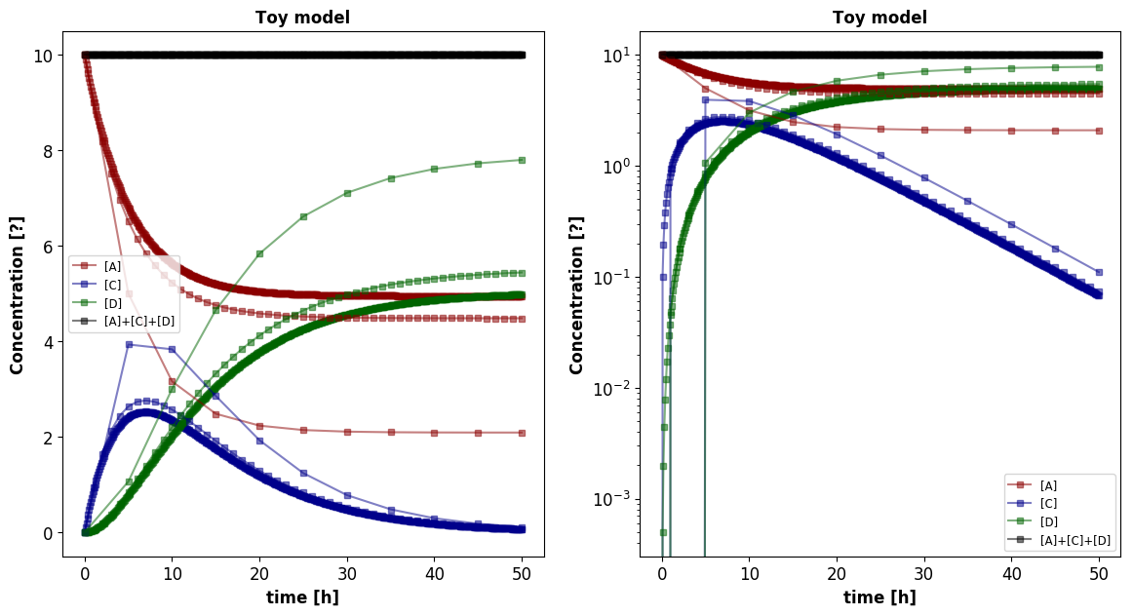
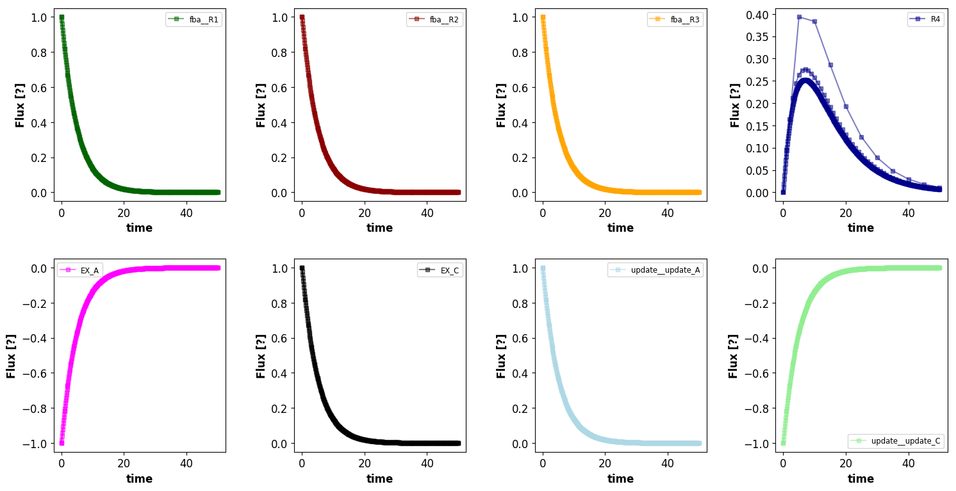
Step size dt [0.1, 1.0, 5.0]

Slide 11
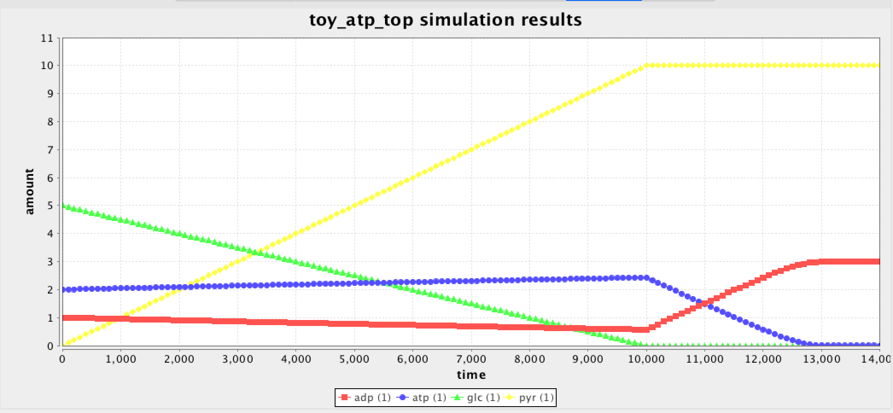
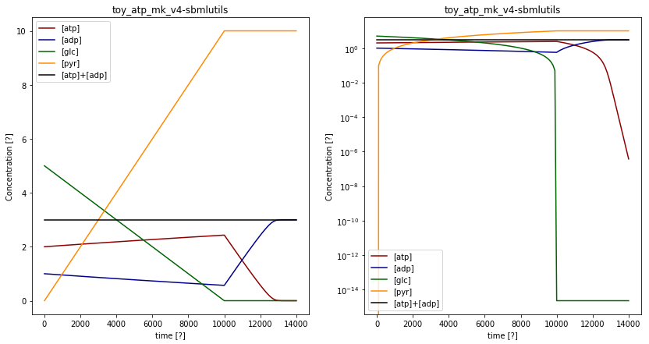
Toy ATP
Simplified glycolysis
file:///home/mkoenig/git/sbmlutils/sbmlutils/dfba/toy_atp/results/v10/index.html

Slide 12
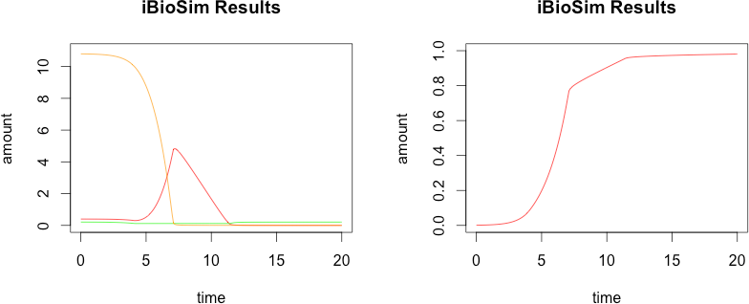
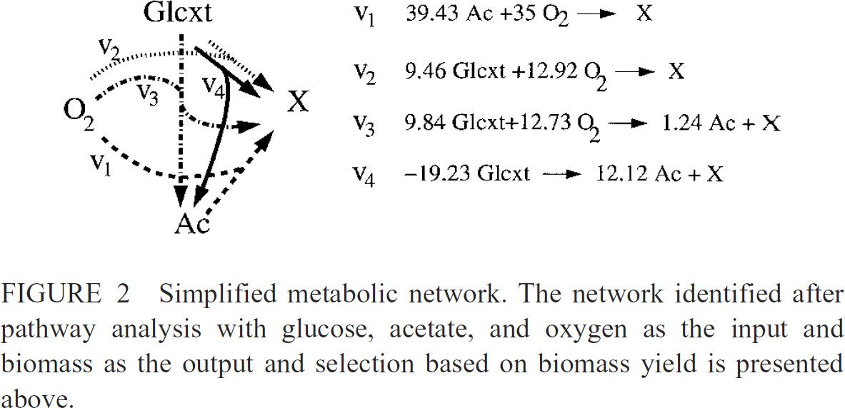
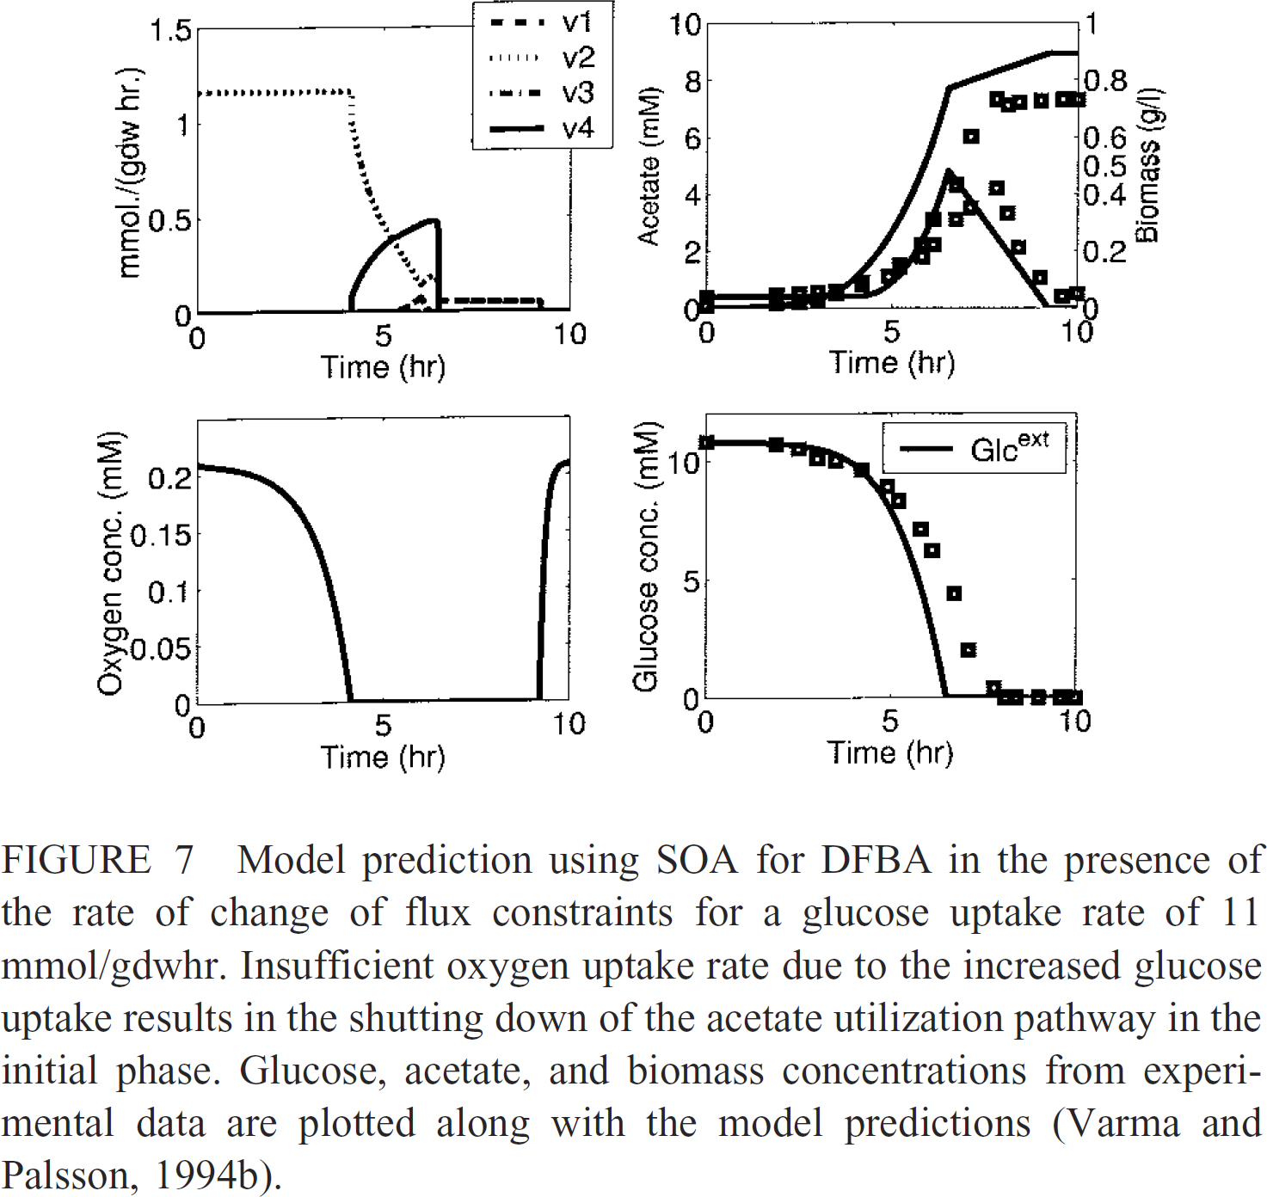
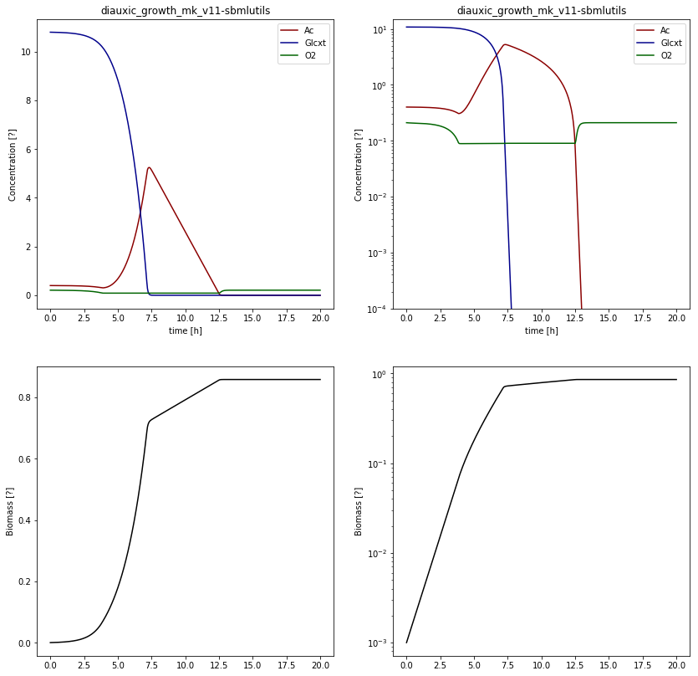
Diauxic growth
Mahadevan2002

Slide 13
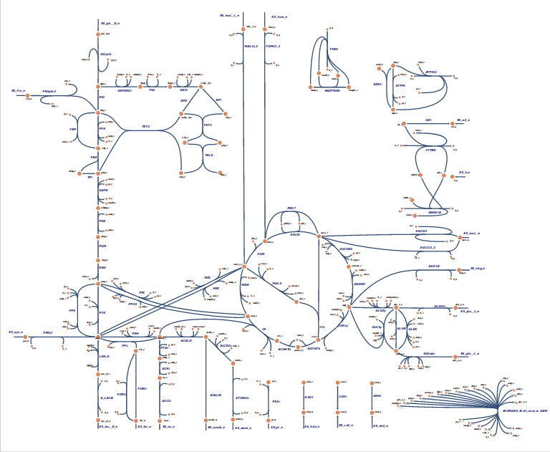
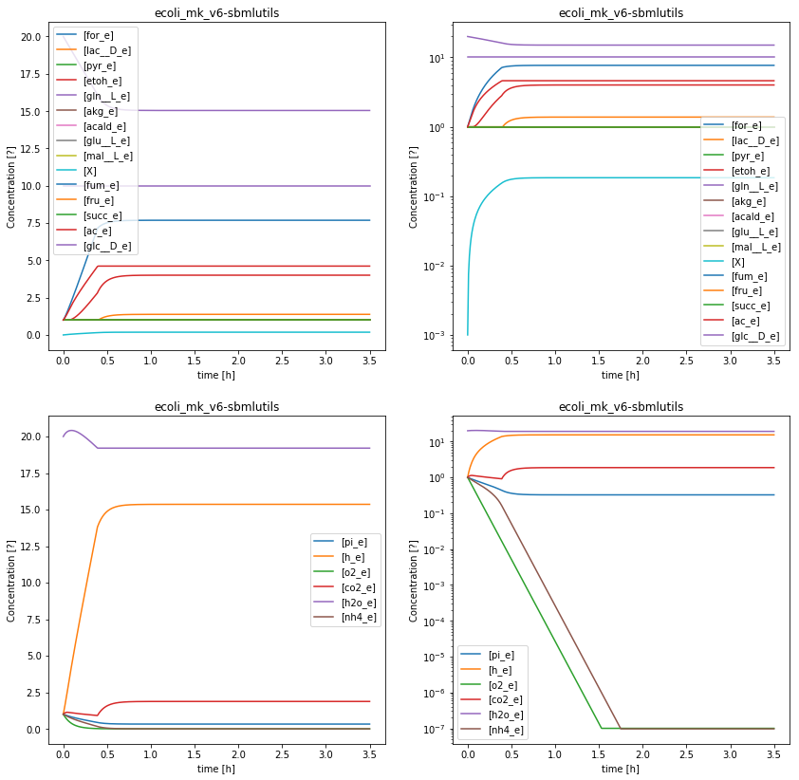
E.coli core (BiGG)
95 reactions, 72 metabolites, 137 genes, 4 exchange reactions)
automatic scripts to generate DFBA models from FBA models (via exchange reactions)
http://bigg.ucsd.edu/models/e_coli_core
* not-unique, infeasible issues (iBioSim)

Slide 14
Guidelines for DFBA encoding
https://github.com/matthiaskoenig/dfba
https://github.com/matthiaskoenig/dfba/blob/master/DFBA%20models%20in%20SBML.md

Slide 15
Toy wholecell
BOUNDS
FBA
TOP
UPDATE
Flattened

Slide 16
Issues & Outlook
Uniqueness of solutions
  FVA, sampling from solution space
Flattening of larger models (memory issues RBC model, flattening slow)
Encoding issues in fbc
  Additional LP constraints like (v1 + v2 = 10; v1 < v3)
  More complex optimizations like parsimonous FBA
    2 step optimizations
    Kisao terms
  Biomass weighting
    Via conversion factors
General issues
  the (in)famous hack: if (c<0): c = 0
  Only covers
Outlook
Combine archives (comp files, SED-ML, results)
Extension to coupling multiple, large FBA models
Coupling other simulation frameworks

Slide 17
FBC unit challenges
Biomass scaling
Often FBA fluxes must be scaled with biomass for update of the species in kinetic part (resulted in many unit issues, different flux units)
  Depends on DFBA model (either biomass weighted results or ot)
  FBA fluxes per gDW
    e.g [mmol/h/g]
  Kinetic fluxes in [mmol/h], not normalized on biomass
  Biomass species X in [g/l] (other species in [mmol/l]
    Scaling factor to convert to amount
  Updates via:
    update_Ac = -pEX_Ac * X
Unit challenges
Reaction flux units defined via units of bounds on reaction
https://docs.google.com/document/d/1KqERrNr7Iptos6cyYekIOkx9L3ZBVb4SWav8vrn4GAY/edit#

