Slide 1
Politician
Bitcoin | Fiat
Anarchist Libertarian | Statist
Borderless | Nationalism
Privacy is a fundamental human right | AML/KYC
Freedom of speech | Censorship needed in some cases
Freedom of association | Financial exclusion is acceptable
Burn electricity to create security (cost to the environment is acceptable) | Use centralized authority to determine what the correct state of the ledger is

Slide 2


Slide 3
Economist
Bitcoin | Fiat
Classical Economics; Austrian Economics | Neoclassical Economics; Keynesian Economics
Hayek | Keynes
Must avoid boom-bust cycles (long term focus) | Must pull economy out of bust (short term focus)
People are rational | People have chaotic ‘animal spirit’
The economy must consist of free market forces | The economy can be steered
Markets are not easily predictable | A ‘circular flow of income’ exists
Economic regulation is bad | Economic regulation is good
Bail-outs are bad | Bail-outs are good
Anti-Governement (causes malinvestment) People act in their own best interest | Pro-Government Government acts in best interest of public
Savings should be hoarded for future (classical view) | Savings should be spent now
Liquidation of bad businesses necessary | Kept bad businesses afloat to protect jobs
Economy will settle at optimal level unhindered | Economy can settle at sub-optimal level without help
Respect for entrepreneurship and economic stability | Respect for human suffering and job protection

Slide 4
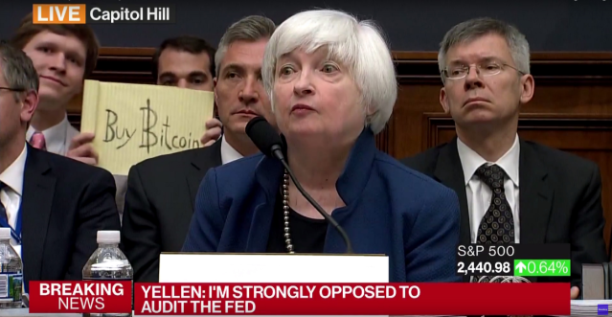

Slide 5
Data Scientist
Bitcoin | Fiat
Immutable blockchain | Mutable files including spreadsheets, SQL databases and word documents
Trade level data available since genesis | Data can be aggregated, purged
Limit on daily transactions (currently 350,000) | Unlimitted transactions
Data cannot be changed | Manual adjustments (including backdated if needed)
Complies with double bookkeeping | Debit not equal to credit acceptable in some cases
Scaling can be done offchain via payment channels | Scaling done by increasing the database size

Slide 6
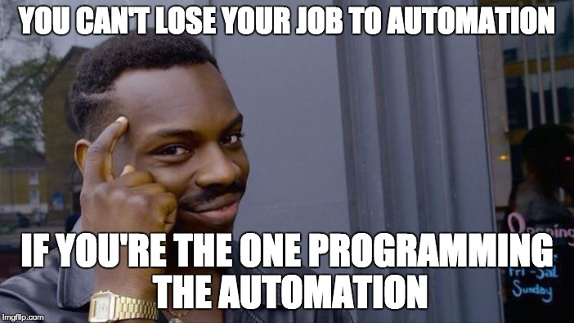

Slide 7
Speculator
Bitcoin | Fiat
HODL (misspelling of hold) | Borrow and invest
There will be no bail-out if the value drops | Needs guarantees and protection from third parties
Automous audit using cryptocraphic proof (self regulate) | Audit is done/approved via an authority

Slide 8


Slide 9

Q&A
Read the original 9 page whitepaper: https://bitcoin.org/bitcoin.pdf

