Slide 1
TECHNICAL
ECONOMICS
Is bitcoin a ponzi?
Bitcoin competitors
Austrian versus Keynesian
Origins of money
Protocol, proof of work
POLITICS
OPPORTUNITIES
Private money
Transparency versus surveillance
Privacy versus secrecy
Financial inclusion
Proof of reserve
Shared custody customer experience
Trading
Second layer payments systems

Slide 2
CONCLUSION
Bitcoin has clean data
Debit is always equal to credit
No double spending
Trade/transaction level historical data
Updated every 10 minutes
No reconciliation required
No manual adjustments required/possible
Immutable
Nobody has to be trusted

Slide 3


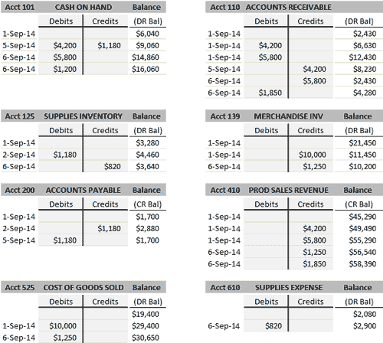
CENTRAL BANKING
Alice
Request payment
Bob
Big Brother
Commit payment
Charlie
CLIENT SERVER NETWORK

Slide 4
BITCOIN
Alice
David
BROADCAST TRANSACTION
Charlie
Bob
PEER TO PEER NETWORK

Slide 5
https://tradeblock.com/bitcoin/
https://tradeblock.com/bitcoin/address/1NE54U3haTsTksveVprS28DHdqX62P3fJU

Slide 8
MEMPOOL

Slide 9
MEMPOOL

Slide 10
MEMPOOL

Slide 11
MEMPOOL
v

Slide 12
Alice
David
Charlie
Bob

Slide 13
1
Alice
David
Charlie
Bob

Slide 14
1
v
Alice
David
v
v
Charlie
Bob

Slide 15
1
2
Alice
David
Charlie
Bob

Slide 16
1
v
v
2
Alice
David
v
Charlie
Bob

Slide 17
1
2
Alice
David
3
Charlie
Bob

Slide 18
1
v
v
2
Alice
David
3
v
Charlie
Bob

Slide 19
1
2
Alice
David
3
Charlie
Bob
4

Slide 20
1
v
2
Alice
David
3
v
v
Charlie
Bob
4

Slide 21
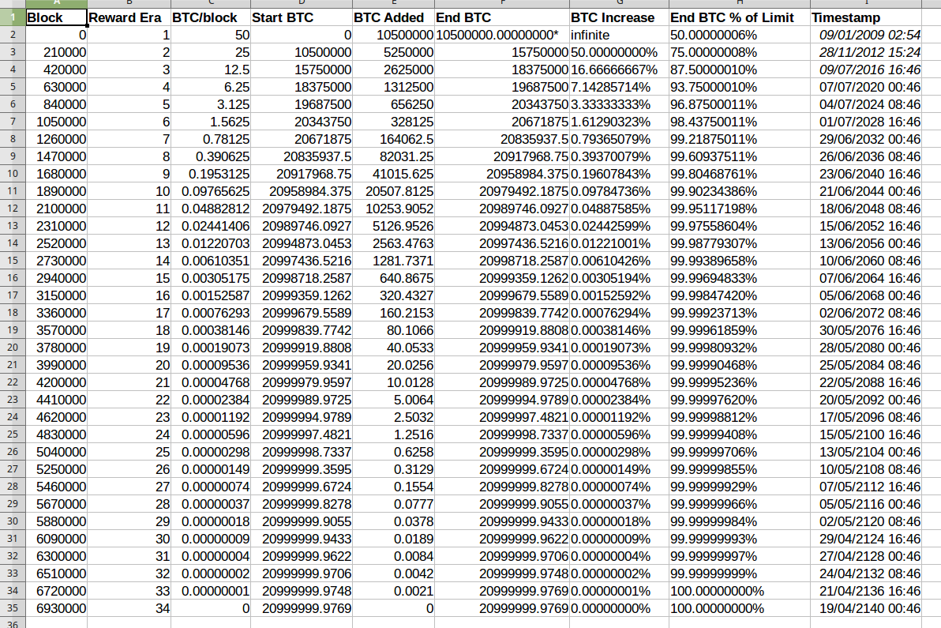
MONETARY POLICY

Slide 22
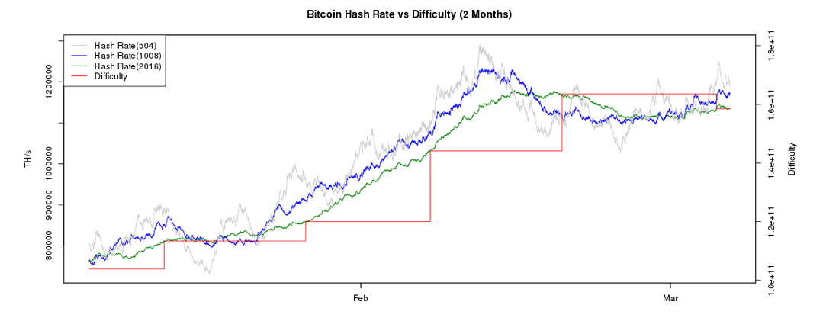

Slide 23
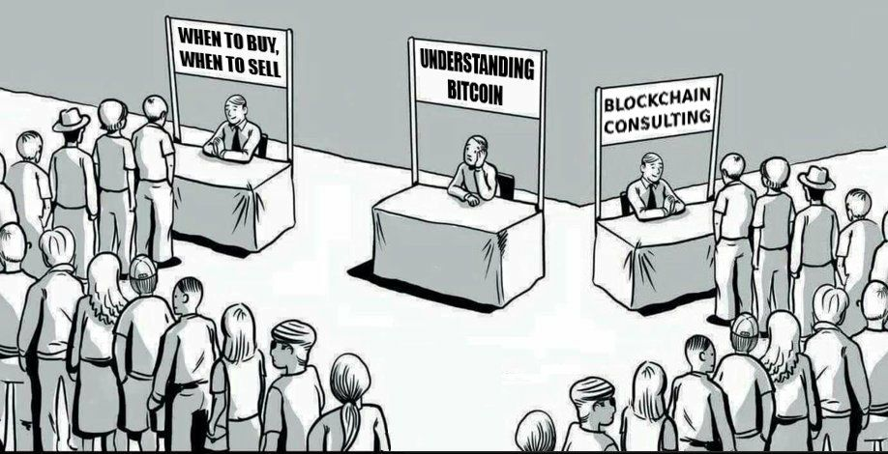
Q&A
by @AltsBryan
by @AltsBryan
Read the original 9 page whitepaper: https://bitcoin.org/bitcoin.pdf

