Slide 2
Plan
Introduction
Clinical data
Viral data
Host exome data
G2G of asian subpopulation
Interpretation of results

Slide 3
Introduction
Clinical data
Viral variants
Host exome data

Slide 4
Introduction
Clinical data
Pathogen
GWAS
Traditional
GWAS
Viral variants
Host exome data
G2G analysis

Slide 5
Introduction
1
Clinical data
Pathogen
GWAS
Traditional
GWAS
4
Viral variants
Host exome data
G2G analysis
3
2
5

Slide 6
Clinical data
725 individuals
21 variables (age, sex, viral GT, race, ids, ...)

Slide 7
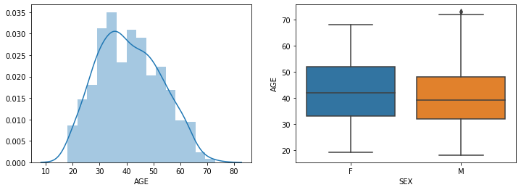
Clinical data - AGE

Slide 8
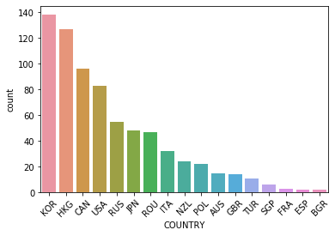
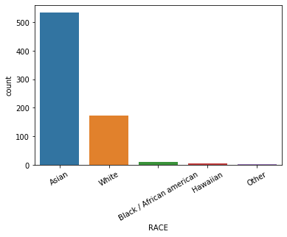
Clinical data – Populations

Slide 9
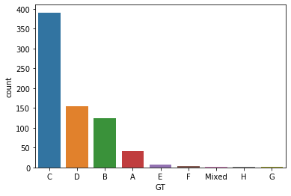
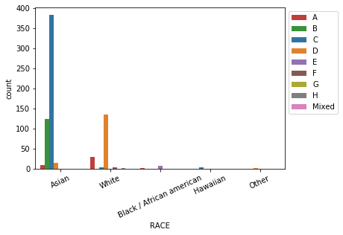
Clinical data – Reported viral genotypes
TODO :
- report known GT distributions
- right hand side plot: choose this one or the one with countries (or both ?)

Slide 10
Clinical data – OTHERS ??
Country vs age ?
Genotype vs age ?
Genotype/AGE/Country vs viral load ??

Slide 11
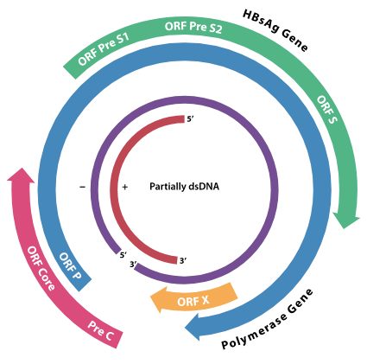
Viral data
Data:
790 individuals
5394 variants (binary)
1613 positions
HBV genome:
3215 bp
Partially dsDNA
4 overlapping genes
Image source: www.wikipedia.org

Slide 12
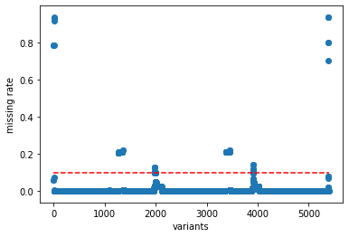
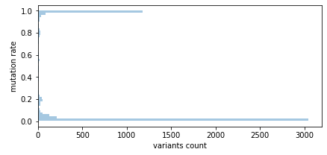
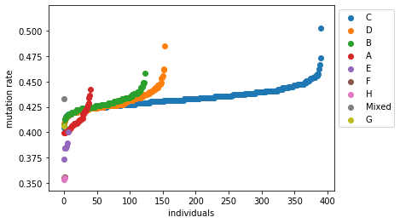
Viral data – Quality control
Raw data
5’394 variants 1’613 positions
790 individuals
Variant missingness
treatment
Threshold 10%
5’212 variants 1’579 positions
Sample missingness
treatment
Threshold 10%
789 individuals
Variant frequency
treatment
Bilateral threshold 5%
744 variants
347 positions

Slide 13
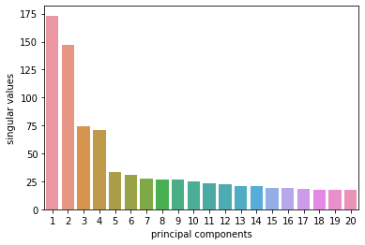
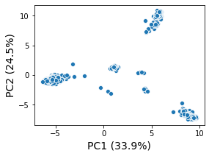
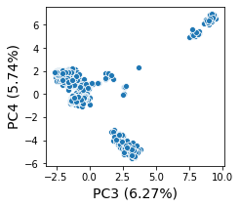
Viral data - PCA
First 4 PCs: 70.4%

Slide 14
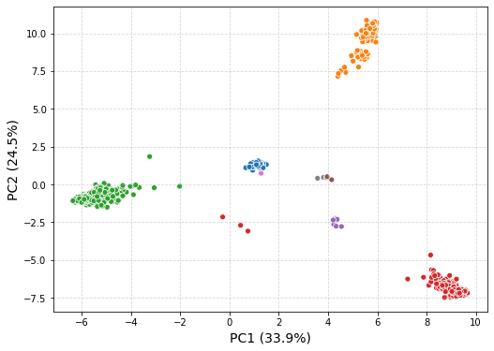
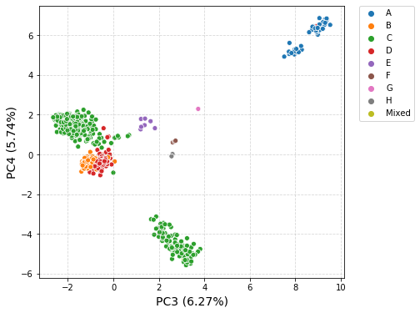
Viral data – PCA – Viral GTs

Slide 15
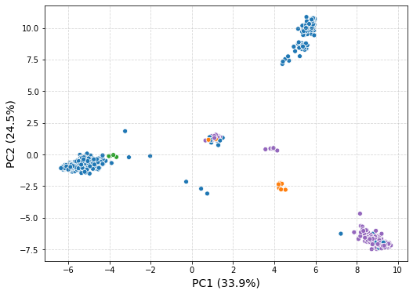
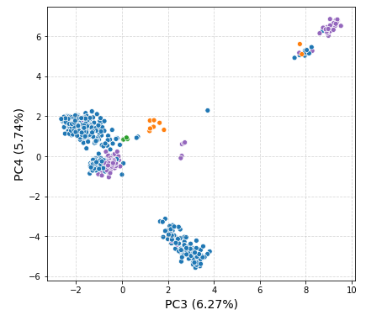

Viral data – PCA – Race

