Slide 1
Reproducible research with R
12th June 2013

Slide 2
Outline
Part I – version control
Introduction
Reproducibility of analysis
Version control
Project design
What is version controlled?
Data persistence
Using version control with R
Setting up a project
Using Git with R

Slide 3
Outline
Part I – version control
Introduction
Reproducibility of analysis
Version control
Project design
What is version controlled?
Data persistence
Using version control with R
Setting up a project
Using Git with R

Slide 4
Outline
Part I – version control
Introduction
Reproducibility of analysis
Version control
Project design
What is version controlled?
Data persistence
Using version control with R
Setting up a project
Using Git with R

Slide 5
Outline
Part I – version control
Introduction
Reproducibility of analysis
Version control
Project design
What is version controlled?
Data persistence
Using version control with R
Setting up a project
Using Git with R

Slide 6
Outline
Part II – Report generation
Introduction
Report generation
Tools
Markdown – HTML output
Markdown language
Exercises with R
Sweave and LateX – PDF output
Latex
Exercises with R

Slide 7
Outline
Part II – Report generation
Introduction
Report generation
Tools
Markdown – HTML output
Markdown language
Exercises with R
Sweave and LateX – PDF output
Latex
Exercises with R

Slide 8
Outline
Part II – Report generation
Introduction
Report generation
Tools
Markdown – HTML output
Markdown language
Exercises with R
Sweave and LateX – PDF output
Latex
Exercises with R

Slide 9
Outline
Part II – Report generation
Introduction
Report generation
Tools
Markdown – HTML output
Markdown language
Exercises with R
Sweave and LateX – PDF output
Latex
Exercises with R

Slide 10
Outline
Bonus – figure generation with make
Introduction
Presentation of make
Interest for figure building
Using make
Rules
Simple example
Automatic figure building
Exercises with R and make

Slide 11
Outline
Bonus – figure generation with make
Introduction
Presentation of make
Interest for figure building
Using make
Rules
Simple example
Automatic figure building
Exercises with R and make

Slide 12
Outline
Bonus – figure generation with make
Introduction
Presentation of make
Interest for figure building
Using make
Rules
Simple example
Automatic figure building
Exercises with R and make

Slide 13
Outline
Bonus – figure generation with make
Introduction
Presentation of make
Interest for figure building
Using make
Rules
Simple example
Automatic figure building
Exercises with R and make

Slide 14
Part I
General concepts
Version control

Slide 15
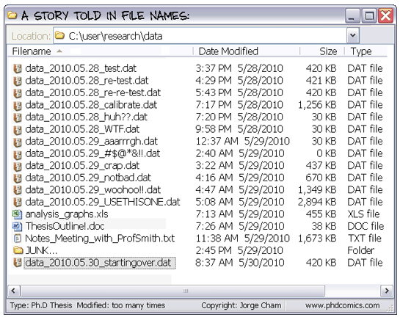
A common problem
Introduction
Project design
Version control with R
Not only for data, but for scripts also

Slide 16
A common problem
Introduction
Project design
Version control with R
Not only for data, but for scripts also

Slide 17
Reproducibility?
Introduction
Project design
Version control with R
Research should be reproducible by others.
This refers to the experiments generating the data, but also to the analysis of the data.
The first researcher who will need to reproduce the results is likely to be you.

Slide 18
Reproducibility?
Introduction
Project design
Version control with R
Research should be reproducible by others.
This refers to the experiments generating the data, but also to the analysis of the data.
The first researcher who will need to reproduce the results is likely to be you.

Slide 19
Reproducibility?
Introduction
Project design
Version control with R
Research should be reproducible by others.
This refers to the experiments generating the data, but also to the analysis of the data.
The first researcher who will need to reproduce the results is likely to be you.

Slide 20
Reproducibility of analysis
Introduction
Project design
Version control with R
Lab books make lab work traceable. Analysis should also be traceable.
Analysis steps must be recorded, and reverting to any previous step must be possible.
This ensures that we always exactly know how a result was generated.

Slide 21
Reproducibility of analysis
Introduction
Project design
Version control with R
Lab books make lab work traceable. Analysis should also be traceable.
Analysis steps must be recorded, and reverting to any previous step must be possible.
This ensures that we always exactly know how a result was generated.

Slide 22
Reproducibility of analysis
Introduction
Project design
Version control with R
Lab books make lab work traceable. Analysis should also be traceable.
Analysis steps must be recorded, and reverting to any previous step must be possible.
This ensures that we always exactly know how a result was generated.

Slide 23
Version control
Introduction
Project design
Version control with R
Version control is a tool to keep track of file changes.
However, version control softwares offer more than simply recording successive versions of a file.
Version controlled projects can be splitted, merged and shared with collaborators.

Slide 24
Version control
Introduction
Project design
Version control with R
Version control is a tool to keep track of file changes.
However, version control softwares offer more than simply recording successive versions of a file.
Version controlled projects can be splitted, merged and shared with collaborators.

Slide 25
Version control
Introduction
Project design
Version control with R
Version control is a tool to keep track of file changes.
However, version control softwares offer more than simply recording successive versions of a file.
Version controlled projects can be splitted, merged and shared with collaborators.

Slide 26
Version control flow
Introduction
Project design
Version control with R
V1

Slide 27
Version control flow
Introduction
Project design
Version control with R
V1
V2

Slide 28
Version control flow
Introduction
Project design
Version control with R
V1
V2
V3

Slide 29
Version control flow
Introduction
Project design
Version control with R
V1
V2
V3
V4

Slide 30
Version control flow
Introduction
Project design
Version control with R
V1
V2
V3
V4

Slide 31
Version control flow
Introduction
Project design
Version control with R
V1
V2
V3
V4

Slide 32
Version control flow
Introduction
Project design
Version control with R
V1
V2
V3
V4
V4

Slide 33
Version control flow
Introduction
Project design
Version control with R
V1
V2
V3
V4
V4
V5

Slide 34
Version control flow
Introduction
Project design
Version control with R
V1
V2
V3
V4
V4
V5
V6

Slide 35
Version control flow
Introduction
Project design
Version control with R
V1
V2
V3
V4
V4
V5
V6
V6b

Slide 36
Version control flow
Introduction
Project design
Version control with R
V1
V2
V3
V4
V4
V5
V6
V6b
V7b

Slide 37
Version control flow
Introduction
Project design
Version control with R
V1
V2
V3
V4
V4
V5
V6
V8
V6b
V7b

Slide 38
Version control flow
Introduction
Project design
Version control with R
V1
V2
V3
V4
V4
V5
V6
V8
V9
V6b
V7b

Slide 39
Version control flow
Introduction
Project design
Version control with R
V1
V2
V3
V4
V4
V5
V6
V8
V9
V10
V6b
V7b

Slide 40
Version control flow
Introduction
Project design
Version control with R
In the usual approach, each version would have been a set of different files, with not-so-meaningful names.
With version control, every change is tracked, can be reverted, and each branch is a clean set of files.

Slide 41
Version control flow
Introduction
Project design
Version control with R
In the usual approach, each version would have been a set of different files, with not-so-meaningful names.
With version control, every change is tracked, can be reverted, and each branch is a clean set of files.

Slide 42
Project design

Slide 43
Structure of a project folder
Introduction
Project design
Version control with R
Project
Data
R source files
Results
Figures
analysis.R
(shamelessly modified from http://nicercode.github.io/blog/2013-04-05-projects/)

Slide 44
Structure of a project folder
Introduction
Project design
Version control with R
Project
Data
R source files
Results
Figures
analysis.R
(shamelessly modified from http://nicercode.github.io/blog/2013-04-05-projects/)

Slide 45
Structure of a project folder
Introduction
Project design
Version control with R
Project
Data
This is read-only. It is not version controlled but it is backed up.
R source files
Results
Figures
analysis.R
(shamelessly modified from http://nicercode.github.io/blog/2013-04-05-projects/)

Slide 46
Structure of a project folder
Introduction
Project design
Version control with R
Project
Data
R source files
This is version controlled.
Results
Figures
analysis.R
(shamelessly modified from http://nicercode.github.io/blog/2013-04-05-projects/)

Slide 47
Structure of a project folder
Introduction
Project design
Version control with R
Project
Data
R source files
Results
This is generated from the two previous. It is not version controlled nor backed up. It is disposable.
Figures
analysis.R
(shamelessly modified from http://nicercode.github.io/blog/2013-04-05-projects/)

Slide 48
Structure of a project folder
Introduction
Project design
Version control with R
Project
Data
R source files
Results
Figures
This is also generated from the two previous and disposable.
analysis.R
(shamelessly modified from http://nicercode.github.io/blog/2013-04-05-projects/)

Slide 49
Structure of a project folder
Introduction
Project design
Version control with R
Project
Data
R source files
Results
Figures
analysis.R
This is the main script using the R source files to do the analysis. It is version controlled.
(shamelessly modified from http://nicercode.github.io/blog/2013-04-05-projects/)

Slide 50
Structure of a project folder
Introduction
Project design
Version control with R
Project
Data
Mass spectrometry data
Some data is produced in-house.
Database from NCBI
readme
R source files
Results
Figures
analysis.R
(shamelessly modified from http://nicercode.github.io/blog/2013-04-05-projects/)

Slide 51
Structure of a project folder
Introduction
Project design
Version control with R
Project
Data
Mass spectrometry data
Database from NCBI
Some data is downloaded from other sources.
readme
R source files
Results
Figures
analysis.R
(shamelessly modified from http://nicercode.github.io/blog/2013-04-05-projects/)

Slide 52
Structure of a project folder
Introduction
Project design
Version control with R
Project
Data
Mass spectrometry data
Database from NCBI
readme
Data provenance can be easily managed by version controlled readme files.
R source files
Results
Figures
analysis.R
(shamelessly modified from http://nicercode.github.io/blog/2013-04-05-projects/)

Slide 53
Using version control with R

Slide 54

Version control tool: Git
Introduction
Project design
Version control with R
Several version control tools exist. Git is recent and reputed fast and efficient.
R Studio can interact with Git through its graphical interface for the most basic actions.
Git has many features accessible from the command line and can be used for any project, not just for R.

Slide 55
Version control tool: Git
Introduction
Project design
Version control with R
Several version control tools exist. Git is recent and reputed fast and efficient.
R Studio can interact with Git through its graphical interface for the most basic actions.
Git has many features accessible from the command line and can be used for any project, not just for R.

Slide 56
Version control tool: Git
Introduction
Project design
Version control with R
Several version control tools exist. Git is recent and reputed fast and efficient.
R Studio can interact with Git through its graphical interface for the most basic actions.
Git has many features accessible from the command line and can be used for any project, not just for R.

Slide 57
Practical:
setting up a project

Slide 58
Setting up a project
Introduction
Project design
Version control with R
R Studio can create a new empty project, or add a project environment to an existing directory.
We are going to use an existing folder containing data and set up a project using this folder.
The exercise folder is Baltic_Sea_project. Our goal is to study temporal and spatial variations of temperature in the Baltic Sea.

Slide 59
Setting up a project
Introduction
Project design
Version control with R
The data folder is already present in Baltic_Sea_project.
We prepare the project environment by creating the other folders:
  R_source
  figures
  results
We will create the R files directly from R Studio.

Slide 60
Setting up a project
Introduction
Project design
Version control with R
We open R Studio and we create a project by 'Project > Create project…' and using an existing directory (Baltic_Sea_project).
We turn on the version control by 'Tools > Version control > Project Setup…' and select Git as the version control tool.

Slide 61
Setting up a project
Introduction
Project design
Version control with R
For the first use of Git, we must specify who we are in order to correctly track who made changes.
We must do this from the Git prompt ('Tools > Shell…'):
  git config --global user.email "mdjbru@utu.fi"
  git config --global user.name "Matthieu Bruneaux"
Now we can create two new files ('File > New > R Script') and save them as analysis.R and R_source/source.R.

Slide 62
Setting up a project
Introduction
Project design
Version control with R
Each file we want to track has to be brought to Git’s attention. In the Git tab (next to History), we add analysis.R and R_source/source.R to the tracking list.
Now is time for the first commit. We click 'Commit' to tell Git we want to record a snapshot of the current state.
In the Review Changes window, we specify a commit message before submitting the commit. Commit messages should be short and informative. For now we can just type "Initial commit".

Slide 63
Setting up a project
Introduction
Project design
Version control with R
We can have a look at the Git tab again: analysis.R and source.R are no longer visible because there is no change since the last commit.
We can also check Git history by 'More > History' in the Git tab. There is now one commit saved in the history.
Now let's code !

Slide 64
Practical:
Temporal and spatial variations of Baltic Sea temperature

Slide 65
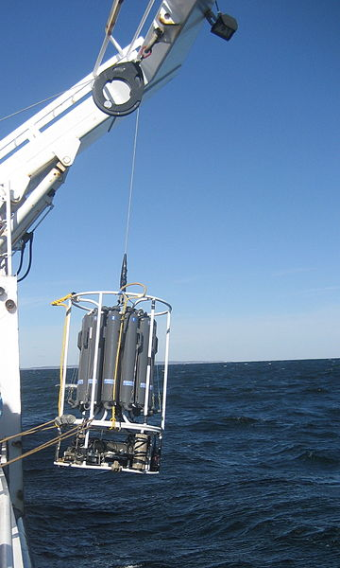
Baltic Sea temperature
Introduction
Project design
Version control with R
Bathymetric and CTD data were downloaded from publicly available databases.
CTD data (conductivity temperature depth) are collected in the water column by research vessels and are sometimes associated with oxygen profiles.
(from http://en.wikipedia.org/wiki/Conductivity,_temperature,_depth)

Slide 66
Baltic Sea temperature
Introduction
Project design
Version control with R
Throughout the practical, we will copy and paste chunks of code from the reference files to our working files, analysis.R and source.R.
Let’s make our first version of analysis.R by copying:
  # Load the R source code
  # Load the CTD data
We only need to copy a function to source.R:
  # Process a CTD data frame

Slide 67
R Studio shortcuts
Introduction
Project design
Version control with R
Run the current line: ctrl + enter
Run the selection: ctrl + enter
Run the previous selection again: ctrl + shift + P
Run the whole script: ctrl + shift + S

Slide 68
Baltic Sea temperature
Introduction
Project design
Version control with R
First commit
We can save analysis.R and source.R.
The Git tab now shows that those files are modified. When we run analysis.R, everything seems to be working fine.
Let’s commit the changes: in the Git tab, we stage both R files and we click 'Commit' and as a commit message, we put "CTD data loaded and processed".

Slide 69
Baltic Sea temperature
Introduction
Project design
Version control with R
History
If we have a look at the Git history, there is now a new commit displayed.
There is only one branch (master). As shown by the position of HEAD, we are now in the master branch, but there is not really any other choice for the moment.
We can also see the differences between the two last commits for each file, but for now it actually consists of the whole of each file.

Slide 70
Baltic Sea temperature
Introduction
Project design
Version control with R
New commit
Let's add the bathymetry data.
  analysis.R
  # Load the topography data (for bathymetry)
  source.R
  # Decrease a topography grid resolution
As always, we carefully check and test the new code .
If we are happy, we save the files, stage them and commit the changes ("Bathymetry data loaded and grid resolution decreased").

Slide 71
Baltic Sea temperature
Introduction
Project design
Version control with R
New commit
So far so good. Let's plot the bathymetric map.
  analysis.R
  # Draw a bathymetric map of the Baltic Sea
  source.R
  # Add a color value for the sea depth to a topography grid
The map looks good. We can commit again now ("Bathymetric map Baltic Sea").

Slide 72
Baltic Sea temperature
Introduction
Project design
Version control with R
Differences
We want to focus on the area between the Aland Islands and the Gulf of Finland.
  analysis.R
  (Note: to place before # Draw a bathymetric map...)
  # Filter the data for a specific area
  source.R
  # Filter a table based on coordinates
Let's commit ("Area restricted to central Baltic Sea"). If we look at the differences for each file now, we can see that Git shows precisely where the insertions occurred.

Slide 73
Baltic Sea temperature
Introduction
Project design
Version control with R
Differences
We changed our mind and we want to look at the northern part of the Gulf of Bothnia. Let's use those coordinates for the area limits:
  x_lon_limits = c(19.3, 26.9) # North of Gulf of Bothnia
  y_lat_limits = c(62.7, 66.1)
Let's commit ("Area restricted to North of Gulf of Bothnia"). Only analysis.R was changed this time. Again, Git is good at underlining the differences clearly within a file. This is a very handy feature that gives you fine control over your changes.

Slide 74
Baltic Sea temperature
Introduction
Project design
Version control with R
Reverting to a previous version
Wait, finally the Central Baltic is probably more interesting... Let's revert back to the previous version.
To revert analysis.R to its previous state, we have to go to the shell and type one of those:
  git checkout HEAD~1 analysis.R
  git checkout <commit-hash> analysis.R
HEAD~n means the n^{th} state before the current. The hash of each commit is contained in the SHA field in Git history.

Slide 75
Baltic Sea temperature
Introduction
Project design
Version control with R
Branching
We want to explore if something interesting can come from surface temperature evolution over the last decades.
We create a new branch for this (from the shell):
  git branch surface_temperature
We now switch to this branch:
  git checkout surface_temperature
In real life we wouldn't need a whole branch for such a simple exploratory analysis.

Slide 76
Baltic Sea temperature
Introduction
Project design
Version control with R
New commit
Let's add more code:
  source.R
  # Filter a table based on depth and date
  # Calculate average temperature per year for depth and date ranges
  analysis.R
  # Evolution of summer surface temperature
We commit the changes ("Surface temperature temporal trend").
Actually, it turns out there is not enough data for a long-term analysis.

Slide 77
Baltic Sea temperature
Introduction
Project design
Version control with R
Changing branch
We now want to go back to the master branch, and from there start a new branch looking at variation of temperature with depth.
From the shell:
  git checkout master
  git branch temperature_depth
  git checkout temperature_depth

Slide 78
Baltic Sea temperature
Introduction
Project design
Version control with R
New commit
Let's add more code:
  analysis.R
  # Temperature profile in relation with depth
We commit the changes ("Temperature profile in relation with depth").
If we look at Git history and select '(all branches)', we can see how the project is evolving.

Slide 79
Baltic Sea temperature
Introduction
Project design
Version control with R
New commit
The previous plot showed nicely how temperature is more stable below 50m. However, we are using temperature from all seasons. Let's correct this and compare winter and summer profiles.
Let's add more code:
  analysis.R
  replace
  # Temperature profile in relation with depth
  with
  # Seasonal temperature profile in relation with depth
  source.R
  # Filter a table based on year day

Slide 80
Baltic Sea temperature
Introduction
Project design
Version control with R
New commit
We commit ("Temperature profile plotted for winter and summer")
The seasonal plots show clearly the different patterns between the surface and the deeper water.
Now let's try to improve a bit our bathymetric map.

Slide 81
Baltic Sea temperature
Introduction
Project design
Version control with R
Changing branch
We now want to go back to the master branch, and from there start a new branch focusing on the bathymetric map.
From the shell:
  git checkout master
  git branch bathymetric_map_ggplot2
  git checkout bathymetric_map_ggplot2

Slide 82
Baltic Sea temperature
Introduction
Project design
Version control with R
New commit
Let's add more code:
  analysis.R
  # Bathymetric map with ggplot2
We commit the changes ("Bathymetric map with ggplot2").
We can now see the three branches in Git history.
We were really over-enthusiastic about branching here.

Slide 83
Baltic Sea temperature
Introduction
Project design
Version control with R
New commit
Let's add the location of the CTD on the map:
  analysis.R
  # Draw the CTD locations on the map
We commit the changes ("CTD locations added to the map").

Slide 84
Baltic Sea temperature
Introduction
Project design
Version control with R
Merging branches
Now we are happy with the map and we would like to merge the branches temperature_depth and bathymetric_map_ggplot2 to have everything in one script.
From the shell:
  git merge temperature_depth
Conflicts might arise when there is ambiguous file changes. We have to solve them manually.

Slide 85
Baltic Sea temperature
Introduction
Project design
Version control with R
Solving conflicts
Git tries to merge as much as it can and shows remaining conflicts with <<<<< and >>>>> in the file.
We try to solve them manually, then commit ("Successful merge").
If it is too hard to do, we cancel the merge (shell) and rethink our strategy:
  git merge --abort
In real life, single-user projects rarely need branching.

Slide 86
Baltic Sea temperature
Introduction
Project design
Version control with R
Generating figures
We can save the temperature profiles in our figures folder:
  analysis.R
  # Save figures for temperature profiles
Commit ("Figures for temperature profiles").
It would be nice to keep track of the Git commit hash to know which version generated which figure.

Slide 87
Baltic Sea temperature
Introduction
Project design
Version control with R
Generating figures
A bit of code can do this:
  analysis.R
  replace
  # Save figures for temperature profiles
  with
  # Save figures for temperature profiles with Git hash
  source.R
  # Get current Git hash
Commit ("Figures tagged with Git hash").

Slide 88
Baltic Sea temperature
Introduction
Project design
Version control with R
Generating figures
Let's add some color with the parameters col="blue" and col="red" added to the plot commands for the winter and summer profiles, respectively.
Commit ("Color added to the temperature profiles").
If we generate the figures again, the Git hash is also updated. This means we can now reproduce any figure we made at any point, as long as a commit was done before generating the figure.

Slide 89
Baltic Sea temperature
Introduction
Project design
Version control with R
Generating tables
We can save the temperature profile values in our results folder:
  analysis.R
  # Save tables for temperature profiles
Commit ("Tables for temperature profiles").
Now our table output is also traceable using the Git hash.

Slide 90
Baltic Sea temperature
Introduction
Project design
Version control with R
Tagging a commit point
When we reach a milestone in our analysis development, we want to be able to mark it and retrieve it easily in the commit flow.
We can tag it with Git (from the shell):
  git tag -a v1.0 -m "Figures and tables of the temperature profiles in relation with depth for the central Baltic Sea, separated by season"
The format for tagging, getting the list of tags and showing a tag information is:
  git tag -a <tag_name> -m <tag_comment>
  git tag
  git show <tag_name>

Slide 91
Structure of a project folder
Introduction
Project design
Version control with R
Clear and run again
Project
Data
R source files
Our project is now version controlled and every figure and table produced is traceable.
Results
Figures
analysis.R
We can generate a clean set of figures and tables by deleting the contents of figures and results, and running again analysis.R.

Slide 92
Further reading and references

Slide 93
Further reading and references
Reproducibility of analysis, data management
Project design:
  http://nicercode.github.io/blog/2013-04-05-projects/
Data management:
  http://software-carpentry.org/4_0/data/mgmt.html
Using Git
Using Git with R Studio:
  http://nicercode.github.io/git/
Git reference:
  see the previous link and http://git-scm.com/documentation

Slide 94
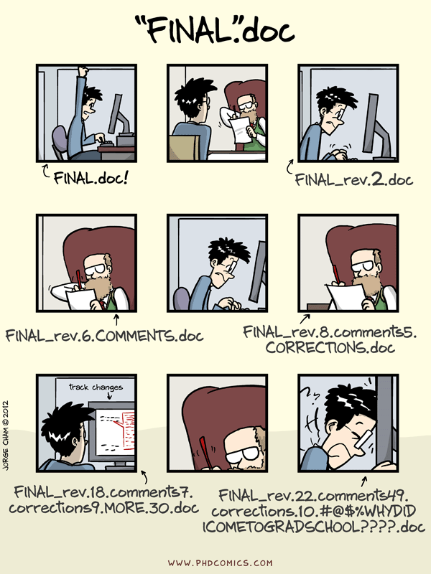
A common problem

Slide 95
Next Part
Report generation

