Slide 1
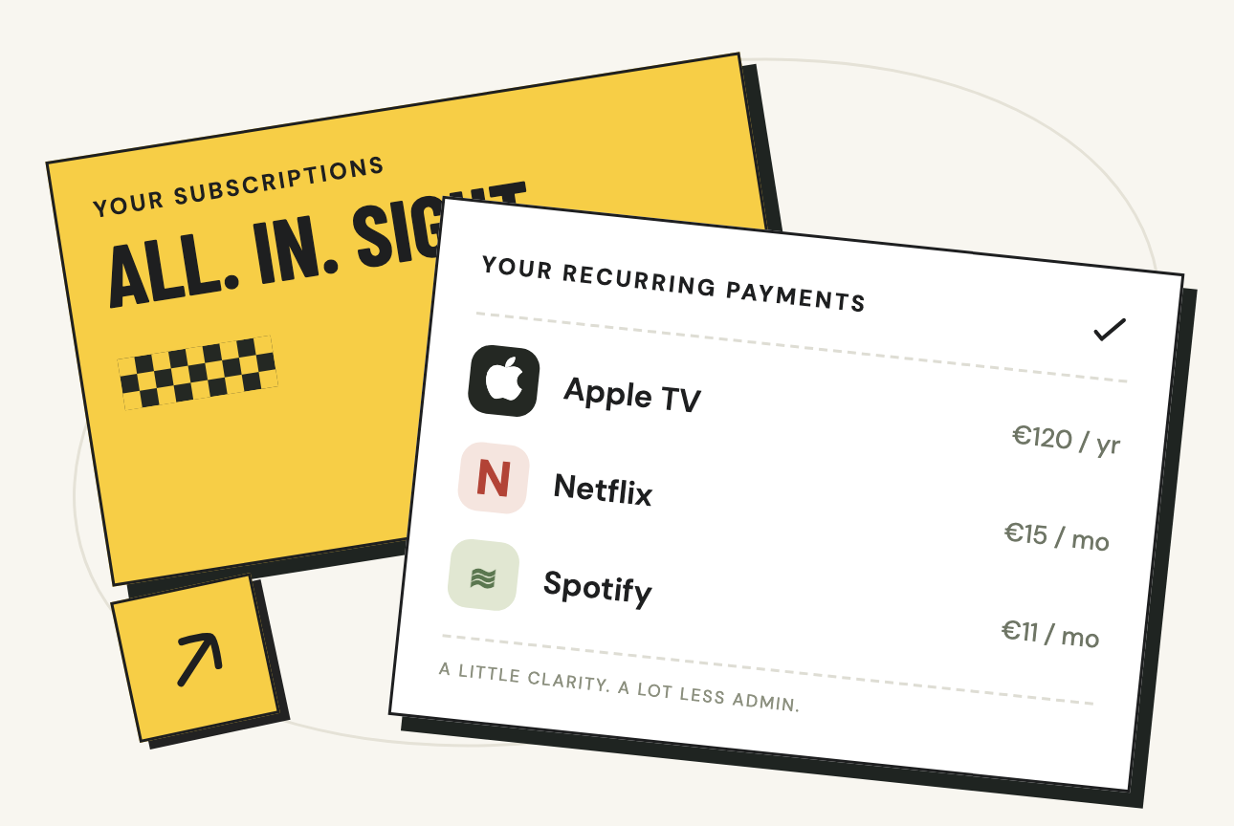
subscript.
01
CLEAR COSTS.
CONFIDENT RENEWAL
DECISIONS.
Review a subscription renewal,
then keep, edit or cancel.
ONE RENEWAL JOURNEY
1 See subscriptions and billing frequency
2 Review Apple TV’s €120 yearly renewal
3 Keep, correct, or cancel with Apple
Matthieu Duchatellier and Alexandru Oprea
UX Writing Final Workshop
Notes:
UX Writing Final Workshop. Authors: Matthieu Duchatellier and Alexandru Oprea. Source: saved final workshop content read in Aside on 11 October 2026. https://skema-immerse-learn.lovable.app/workshop/final-workshop?room=e4460260-b740-460c-91d8-c3aa16c3ff76
Design: yellow prototype src/styles.css, src/flows.css and src/main.tsx. Barlow Condensed bold uppercase headings, DM Sans body text, warm paper #F8F6F0, charcoal #1E1F20 and yellow #F7CE46.
Scope starts after account sync: see subscriptions and billing frequency. Review Apple TV’s estimated €120 yearly renewal and the observed payment history. Keep it, correct details, or cancel with Apple before updating Subscript’s record. Users must distinguish averaged costs, renewal estimates, and cancellation with the provider. Artwork: existing yellow prototype welcome screen receipt illustration, captured from the live browser.
Yellow edition: same nine-slide workshop narrative as the blue v4 presentation. Screen-label quotations are aligned with the yellow interface. Typography files are taken directly from the yellow application dependencies.

Slide 2
subscript.
02
VOICE & PERSONA
A CLEVER, KNOWLEDGEABLE FRIEND
Friendly in everyday moments. Clear when money is involved.
ALEX
Conversational
A natural question, a personal welcome.
“What should we call you?”
Working persona
A busy young professional with several monthly services and one yearly streaming plan.
Knowledgeable
Explain costs and how we calculate them.
“Monthly equivalent” / “Annual plans spread across 12 months.”
Wants one clear overview of costs and renewals.
Worries about forgotten renewals, averages that look like bills, and whether cancellation stopped payments.
Lightly playful
“Meet your regulars.” “No accounts? No rush.”
A little wit, with room to choose.
Notes:
UX Writing Final Workshop. Authors: Matthieu Duchatellier and Alexandru Oprea. Source: saved final workshop content read in Aside on 11 October 2026. https://skema-immerse-learn.lovable.app/workshop/final-workshop?room=e4460260-b740-460c-91d8-c3aa16c3ff76
Design: yellow prototype src/styles.css, src/flows.css and src/main.tsx. Barlow Condensed bold uppercase headings, DM Sans body text, warm paper #F8F6F0, charcoal #1E1F20 and yellow #F7CE46.
The app uses Recorded payment for historical entries and Estimated next payment for future dates. Verification now says Enter the demo code and explains that no email was sent. Cancellation stays calm and explicit about the provider action.
Current voice examples from both prototypes and voice-and-tone.md: They renew. You remember.; Meet your regulars.; No accounts? No rush.; Glad you asked. Headlines and supporting copy carry the personality. Amounts, dates, action labels, and cancellation consequences remain explicit.
Yellow edition: same nine-slide workshop narrative as the blue v4 presentation. Screen-label quotations are aligned with the yellow interface. Typography files are taken directly from the yellow application dependencies.

Slide 3
subscript.
03
SEMANTIC RESEARCH
Public desk research. These are forum posts, not interviews.
“I did not expect it to auto-renew.”
Words we reuse
Company wording | User wording
Predicted renewal | Estimated next payment
Ongoing subscription portfolio | Your subscriptions
Normalized annual expenditure | Yearly plans divided by 12
Provider handoff / cancellation status update | Cancel with Apple, then update Subscript
r/Windscribe
“I’ve been trying to cancel my subscription for almost an hour now and it’s driving me mental.”
r/appletv
“I want to find an easy way to keep track of everything and review it from time to time.”
r/budgetingforbeginners
“Yes, I’ve forgotten about subscriptions. I forgot to cancel my ancestry subscription last month.”
r/Millennials
Notes:
UX Writing Final Workshop. Authors: Matthieu Duchatellier and Alexandru Oprea. Source: saved final workshop content read in Aside on 11 October 2026. https://skema-immerse-learn.lovable.app/workshop/final-workshop?room=e4460260-b740-460c-91d8-c3aa16c3ff76
Design: yellow prototype src/styles.css, src/flows.css and src/main.tsx. Barlow Condensed bold uppercase headings, DM Sans body text, warm paper #F8F6F0, charcoal #1E1F20 and yellow #F7CE46.
Research quotes retained from the saved workshop and verified against public Reddit pages on 11 October 2026. Qualitative signals, not prevalence estimates.
“I did not expect it to auto-renew.”
r/Windscribe: https://www.reddit.com/r/Windscribe/comments/1gttu9i/denied_refund_after_my_subscription_autorenewed/
“I’ve been trying to cancel my subscription for almost an hour now and it’s driving me mental.”
r/appletv: https://www.reddit.com/r/appletv/comments/wxle7w/why_is_it_nearly_impossible_to_cancel_my_apple_tv/
“I want to find an easy way to keep track of everything and review it from time to time.”
r/budgetingforbeginners: https://www.reddit.com/r/budgetingforbeginners/comments/1vbvho6/how_do_you_keep_track_of_all_your_subscriptions/
“Yes, I’ve forgotten about subscriptions. I forgot to cancel my ancestry subscription last month.”
r/Millennials: https://www.reddit.com/r/Millennials/comments/1qv9rbe/are_forgotten_subscriptions_that_big_of_a_problem/
Yellow edition: same nine-slide workshop narrative as the blue v4 presentation. Screen-label quotations are aligned with the yellow interface. Typography files are taken directly from the yellow application dependencies.

Slide 4
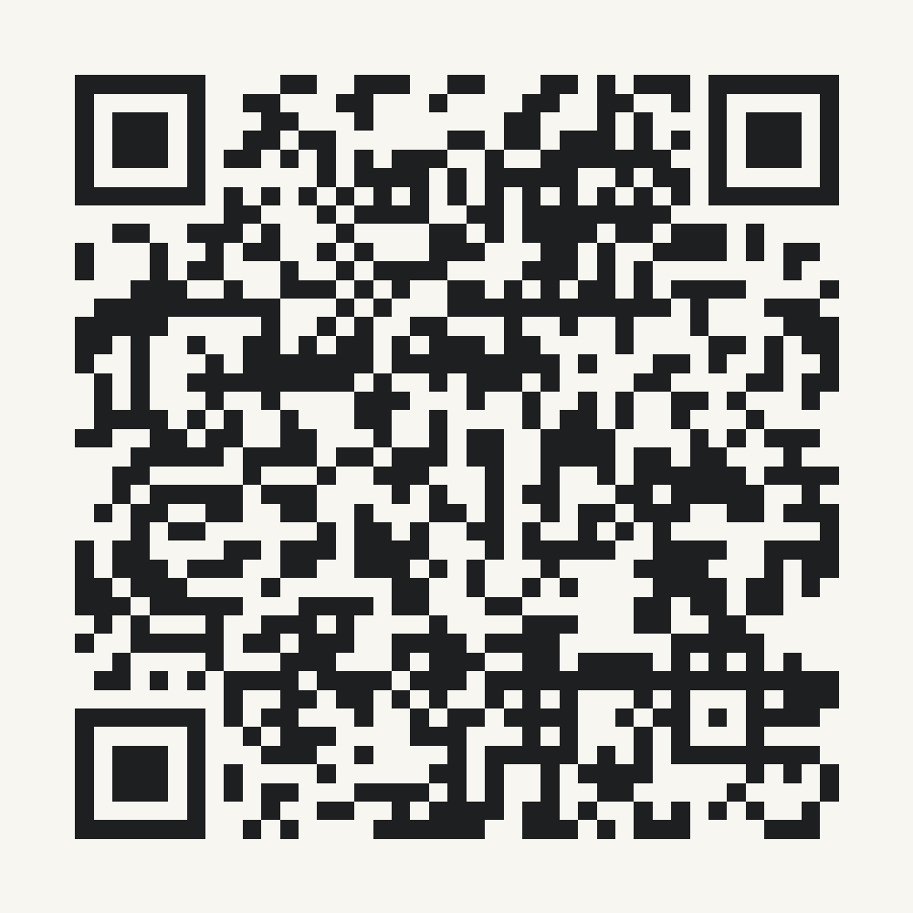
subscript.
04
THE INTERACTIVE DEMOS
Scan for the yellow prototype
BOTH PROTOTYPES, ONE VOICE
Blue prototype
subscription-app-alpha-vert.vercel.app
Yellow prototype
subscript-yellow-prototype.vercel.app
Choose “Explore the demo” in either prototype.
Open Apple TV to review its renewal and cancellation steps.
Sample data only. No real bank connection or payment.
Notes:
Live prototypes: Blue: https://subscription-app-alpha-vert.vercel.app. Yellow: https://subscript-yellow-prototype.vercel.app. The QR opens the yellow prototype. Both links are clickable. Choose Explore the demo to open Home. Email demo verification code: 123456. Sample data only; no real bank access, payments, or cancellations. Both prototypes share the revised voice.
Yellow edition: same nine-slide workshop narrative as the blue v4 presentation. Screen-label quotations are aligned with the yellow interface. Typography files are taken directly from the yellow application dependencies.

Slide 5
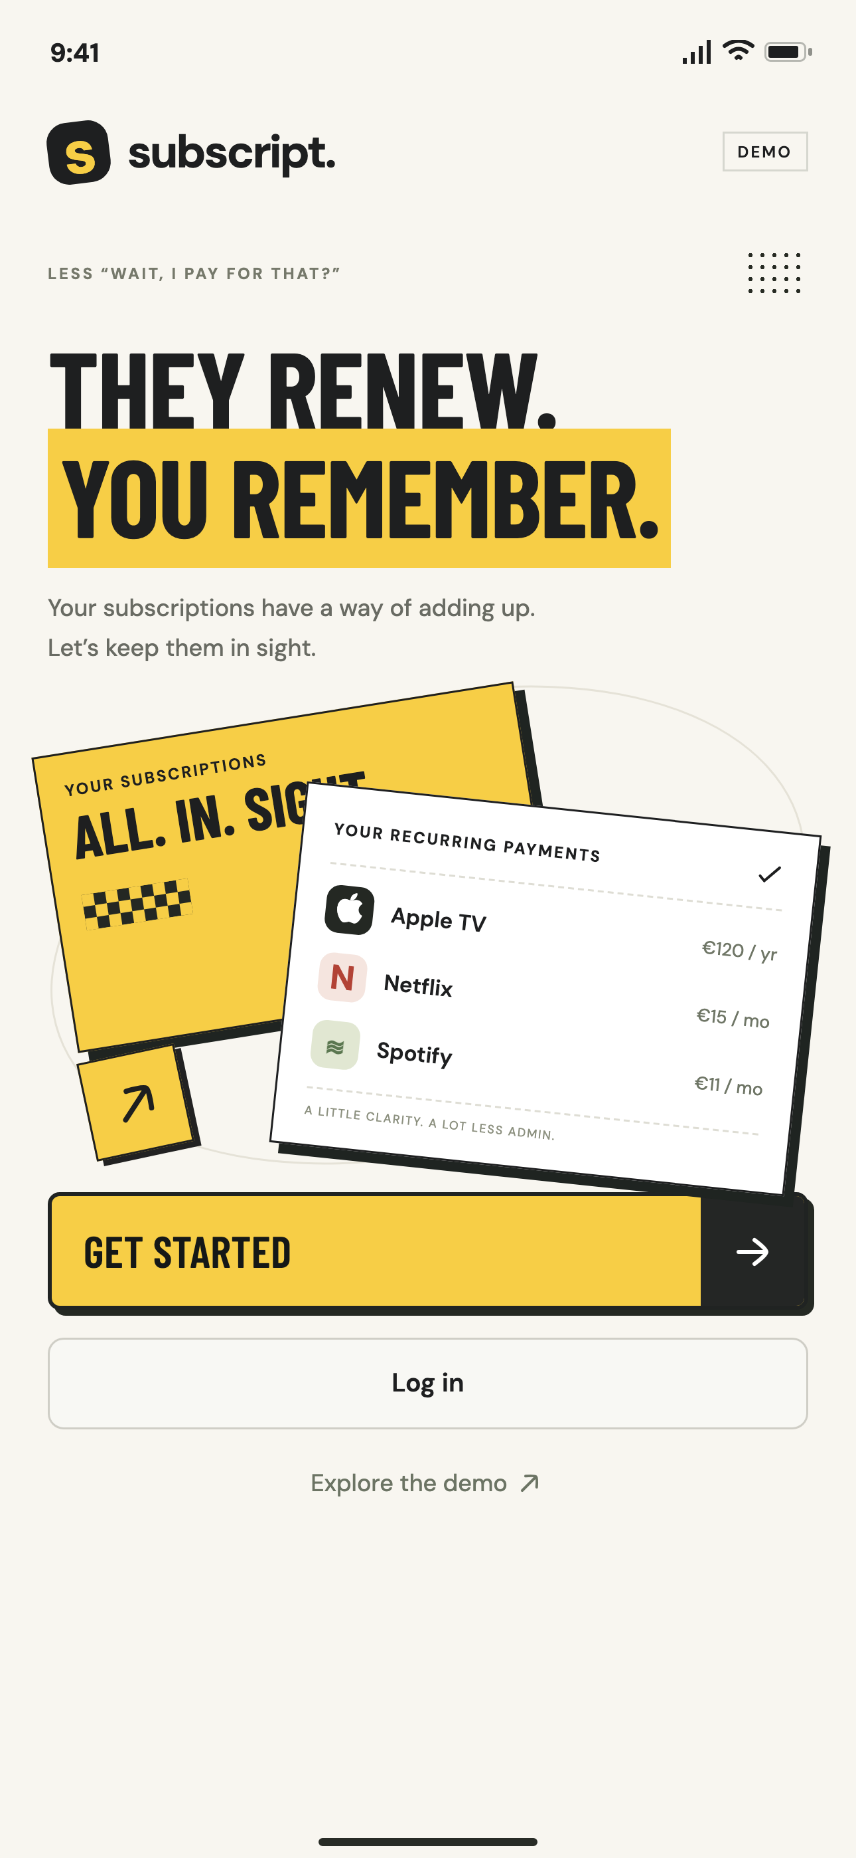
subscript.
05
THE FIRST SCREEN
A FAMILIAR MOMENT,
A FRIENDLY INVITATION
“They renew. You remember.”
A short, memorable reminder of what Subscript helps you track.
“Your subscriptions have a way of adding up.”
A knowing smile in the welcome. Clear buttons still explain what happens next.
Notes:
UX Writing Final Workshop. Authors: Matthieu Duchatellier and Alexandru Oprea. Source: saved final workshop content read in Aside on 11 October 2026. https://skema-immerse-learn.lovable.app/workshop/final-workshop?room=e4460260-b740-460c-91d8-c3aa16c3ff76
Design: yellow prototype src/styles.css, src/flows.css and src/main.tsx. Barlow Condensed bold uppercase headings, DM Sans body text, warm paper #F8F6F0, charcoal #1E1F20 and yellow #F7CE46.
Screenshot: live yellow prototype at https://subscript-yellow-prototype.vercel.app, captured on 12 October 2026. Browser viewport 430 × 932 CSS pixels, 1290 × 2796 image pixels. Browser capture shown in the existing presentation phone frame.
The yellow prototype uses the same welcome headline and supporting copy. Demo disclosures and action labels remain explicit in both versions.
Yellow edition: same nine-slide workshop narrative as the blue v4 presentation. Screen-label quotations are aligned with the yellow interface. Typography files are taken directly from the yellow application dependencies.

Slide 6
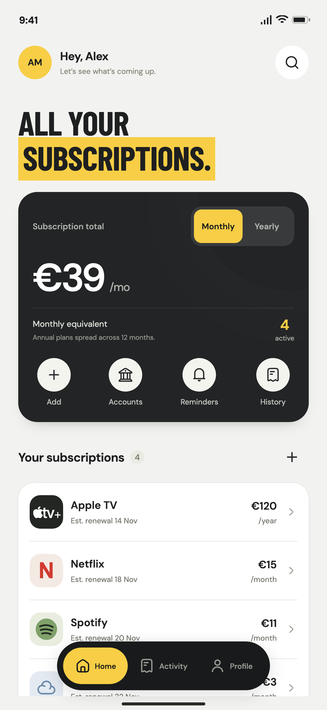
subscript.
06
HOME
ONE OVERVIEW OF
COSTS AND RENEWALS
“Monthly equivalent” with the calculation
“Annual plans spread across 12 months” explains what the €39 represents.
“Your subscriptions” and estimated renewals
Apple TV still shows €120, billed yearly. Its €10 monthly average helps compare costs without changing the bill.
Demo snapshot: November 2026
Notes:
UX Writing Final Workshop. Authors: Matthieu Duchatellier and Alexandru Oprea. Source: saved final workshop content read in Aside on 11 October 2026. https://skema-immerse-learn.lovable.app/workshop/final-workshop?room=e4460260-b740-460c-91d8-c3aa16c3ff76
Design: yellow prototype src/styles.css, src/flows.css and src/main.tsx. Barlow Condensed bold uppercase headings, DM Sans body text, warm paper #F8F6F0, charcoal #1E1F20 and yellow #F7CE46.
Screenshot: live yellow prototype at https://subscript-yellow-prototype.vercel.app, captured on 12 October 2026. Browser viewport 430 × 932 CSS pixels, 1290 × 2796 image pixels. Browser capture shown in the existing presentation phone frame.
Amounts are fictional prototype data. The initial four subscriptions have a €39 monthly average or €468 yearly estimate. Apple TV costs €120/year and contributes €10 to the monthly average. Upcoming dates are estimates. The revised UI names the average and explains yearly plans divided by 12 immediately below it. User testing should still check comprehension.
Yellow edition: same nine-slide workshop narrative as the blue v4 presentation. Screen-label quotations are aligned with the yellow interface. Typography files are taken directly from the yellow application dependencies.
Yellow UI wording: Monthly equivalent; Annual plans spread across 12 months; Your subscriptions; Est. renewal. The underlying cost-comprehension lesson and amounts are unchanged.

Slide 7
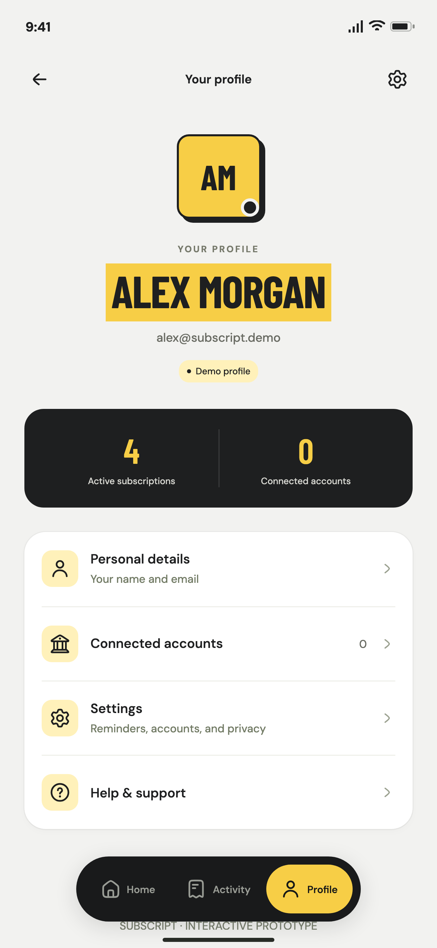
subscript.
07
PROFILE
ACCOUNT INFORMATION
AND CONTROLS TOGETHER
“Connected accounts” and “Active subscriptions”
Visible counts make the current account state easy to read.
“Glad you asked” in Help
Questions get a warm welcome. Account and privacy controls keep familiar labels.
Alex Morgan is the fictional demo profile.
Notes:
UX Writing Final Workshop. Authors: Matthieu Duchatellier and Alexandru Oprea. Source: saved final workshop content read in Aside on 11 October 2026. https://skema-immerse-learn.lovable.app/workshop/final-workshop?room=e4460260-b740-460c-91d8-c3aa16c3ff76
Design: yellow prototype src/styles.css, src/flows.css and src/main.tsx. Barlow Condensed bold uppercase headings, DM Sans body text, warm paper #F8F6F0, charcoal #1E1F20 and yellow #F7CE46.
Screenshot: live yellow prototype at https://subscript-yellow-prototype.vercel.app, captured on 12 October 2026. Browser viewport 430 × 932 CSS pixels, 1290 × 2796 image pixels. Browser capture shown in the existing presentation phone frame.
The profile screenshot comes from the yellow production prototype.
Yellow edition: same nine-slide workshop narrative as the blue v4 presentation. Screen-label quotations are aligned with the yellow interface. Typography files are taken directly from the yellow application dependencies.

Slide 8
subscript.
08
CONCLUSION
A FRIENDLY VOICE MAKES THE APP APPROACHABLE.
PRECISE PAYMENT AND CANCELLATION COPY
HELPS PEOPLE DECIDE WHAT TO DO.
Cost comprehension
Cancellation clarity
Decision confidence
Fewer questions about the €39 monthly average and the €120 yearly payment.
Fewer mistaken cancellation reports and billing-support requests.
More confident keep, edit or cancel decisions.
Measure whether users explain the difference.
Test whether users identify Apple as the canceller.
Measure completion and perceived clarity.
Expected impacts to test, not measured results or verified savings.
Notes:
UX Writing Final Workshop. Authors: Matthieu Duchatellier and Alexandru Oprea. Source: saved final workshop content read in Aside on 11 October 2026. https://skema-immerse-learn.lovable.app/workshop/final-workshop?room=e4460260-b740-460c-91d8-c3aa16c3ff76
Design: yellow prototype src/styles.css, src/flows.css and src/main.tsx. Barlow Condensed bold uppercase headings, DM Sans body text, warm paper #F8F6F0, charcoal #1E1F20 and yellow #F7CE46.
Yellow edition: same nine-slide workshop narrative as the blue v4 presentation. Screen-label quotations are aligned with the yellow interface. Typography files are taken directly from the yellow application dependencies.

Slide 9
subscript.
09
GOING FURTHER
01
FIVE MODERATED TESTS
Ask users to explain €39 versus €120, identify the estimated date, and show where billing is stopped.
02
VERIFIED CANCELLATION GUIDANCE
Check Apple’s current route. Add guidance for each platform, then test reporting, correcting and undoing a status.
03
COPY COMPARISON AND VOICE RULES
Compare both prototypes for clarity and warmth. Test the revised copy, then refine the shared voice guide.
Notes:
UX Writing Final Workshop. Authors: Matthieu Duchatellier and Alexandru Oprea. Source: saved final workshop content read in Aside on 11 October 2026. https://skema-immerse-learn.lovable.app/workshop/final-workshop?room=e4460260-b740-460c-91d8-c3aa16c3ff76
Design: yellow prototype src/styles.css, src/flows.css and src/main.tsx. Barlow Condensed bold uppercase headings, DM Sans body text, warm paper #F8F6F0, charcoal #1E1F20 and yellow #F7CE46.
Yellow edition: same nine-slide workshop narrative as the blue v4 presentation. Screen-label quotations are aligned with the yellow interface. Typography files are taken directly from the yellow application dependencies.

