Slide 1

Subscript
01
Clear costs.
Confident renewal
decisions.
Review a subscription renewal,
then keep, edit or cancel.
ONE RENEWAL JOURNEY
1 See subscriptions and billing frequency
2 Review Apple TV’s €120 yearly renewal
3 Keep, correct, or cancel with Apple
Matthieu Duchatellier
SKEMA final workshop
Notes:
Source: saved final workshop content supplied by Matthieu Duchatellier, read in Aside on 11 October 2026. https://skema-immerse-learn.lovable.app/workshop/final-workshop?room=e4460260-b740-460c-91d8-c3aa16c3ff76
Design: mobile-revolut/src/theme.ts and mobile-revolut/App.tsx. Geist typography, navy and black backgrounds, blue gradients.
Scope starts after account sync: see subscriptions and billing frequency. Review Apple TV’s estimated €120 yearly renewal and the observed payment history. Keep it, correct details, or cancel with Apple before updating Subscript’s record. Users must distinguish averaged costs, renewal estimates, and cancellation with the provider. Artwork: existing prototype asset mobile-revolut/assets/welcome-hero.png, generated for this prototype.

Slide 2
Subscript
02
Voice & persona
A clever, knowledgeable friend
Casual and upbeat, precise about money, never judgmental.
Alex
Conversational
Everyday words and natural contractions.
Working persona
A busy young professional with several monthly services and one yearly streaming plan.
Knowledgeable
Explain estimates, costs and who does what.
Wants one clear overview of costs and renewals.
Worries about forgotten renewals, averages that look like bills, and whether cancellation stopped payments.
Lightly playful
Warmth in headlines. Clarity in money and actions.
Notes:
Source: saved final workshop content supplied by Matthieu Duchatellier, read in Aside on 11 October 2026. https://skema-immerse-learn.lovable.app/workshop/final-workshop?room=e4460260-b740-460c-91d8-c3aa16c3ff76
Design: mobile-revolut/src/theme.ts and mobile-revolut/App.tsx. Geist typography, navy and black backgrounds, blue gradients.

Slide 3
Subscript
03
Semantic research
Public desk research. These are forum posts, not interviews.
“I did not expect it to auto-renew.”
Words we reuse
Company wording | User wording
Predicted renewal | Estimated next payment
Ongoing subscription portfolio | Your subscriptions
Normalized annual expenditure | Yearly plans divided by 12
Provider handoff / cancellation status update | Cancel with Apple, then update Subscript
r/Windscribe
“I’ve been trying to cancel my subscription for almost an hour now and it’s driving me mental.”
r/appletv
“I want to find an easy way to keep track of everything and review it from time to time.”
r/budgetingforbeginners
“Yes, I’ve forgotten about subscriptions. I forgot to cancel my ancestry subscription last month.”
r/Millennials
Notes:
Source: saved final workshop content supplied by Matthieu Duchatellier, read in Aside on 11 October 2026. https://skema-immerse-learn.lovable.app/workshop/final-workshop?room=e4460260-b740-460c-91d8-c3aa16c3ff76
Design: mobile-revolut/src/theme.ts and mobile-revolut/App.tsx. Geist typography, navy and black backgrounds, blue gradients.
Research quotes retained from the saved workshop and verified against public Reddit pages on 11 October 2026. Qualitative signals, not prevalence estimates.
“I did not expect it to auto-renew.”
r/Windscribe: https://www.reddit.com/r/Windscribe/comments/1gttu9i/denied_refund_after_my_subscription_autorenewed/
“I’ve been trying to cancel my subscription for almost an hour now and it’s driving me mental.”
r/appletv: https://www.reddit.com/r/appletv/comments/wxle7w/why_is_it_nearly_impossible_to_cancel_my_apple_tv/
“I want to find an easy way to keep track of everything and review it from time to time.”
r/budgetingforbeginners: https://www.reddit.com/r/budgetingforbeginners/comments/1vbvho6/how_do_you_keep_track_of_all_your_subscriptions/
“Yes, I’ve forgotten about subscriptions. I forgot to cancel my ancestry subscription last month.”
r/Millennials: https://www.reddit.com/r/Millennials/comments/1qv9rbe/are_forgotten_subscriptions_that_big_of_a_problem/

Slide 4
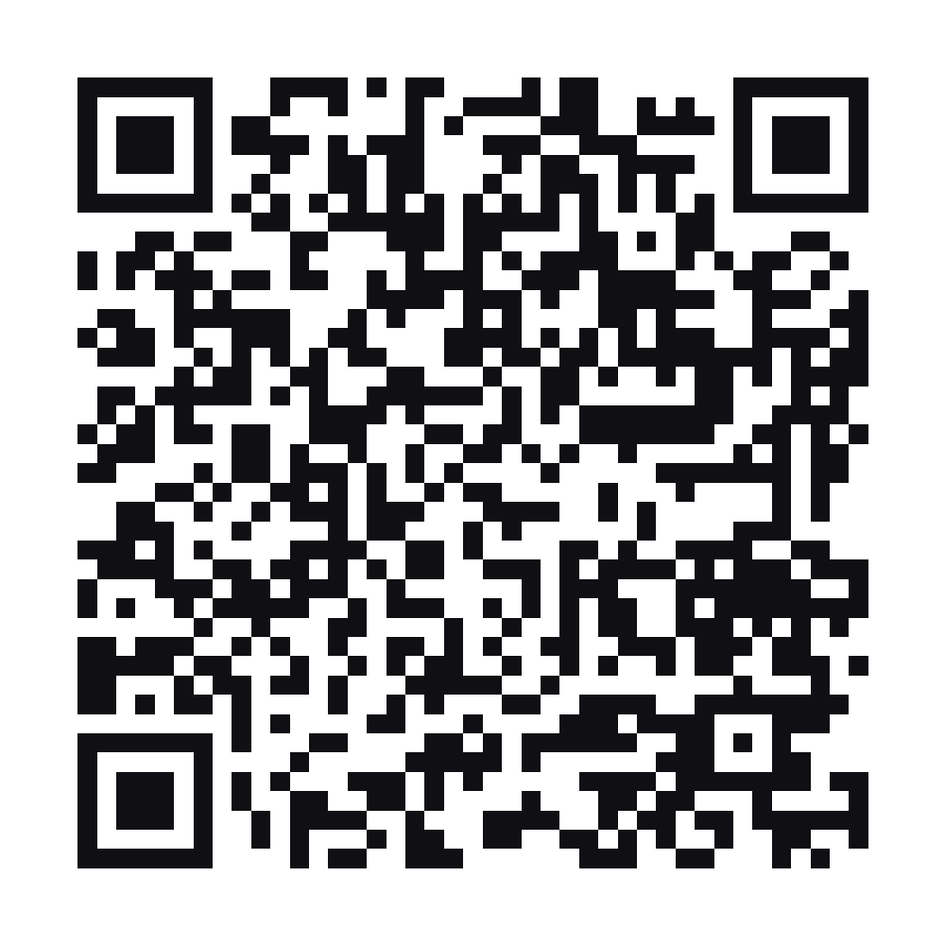
Subscript
04
The interactive demo
Open Subscript
subscription-app-alpha-vert.vercel.app
Scan the QR code or click the link.
Choose “Explore the demo” to open Home.
Open Apple TV to review the renewal and cancellation flow.
Sample data only. No real bank connection or payment.
Notes:
Source: saved final workshop content supplied by Matthieu Duchatellier, read in Aside on 11 October 2026. https://skema-immerse-learn.lovable.app/workshop/final-workshop?room=e4460260-b740-460c-91d8-c3aa16c3ff76
Design: mobile-revolut/src/theme.ts and mobile-revolut/App.tsx. Geist typography, navy and black backgrounds, blue gradients.
Demo URL: https://subscription-app-alpha-vert.vercel.app. Vercel project subscription-app serves mobile-revolut. Verified welcome, Home and Profile through the public alias. QR encodes this exact URL. Browser data is stored locally. Explore the demo bypasses onboarding. Email demo verification code, if needed: 123456.

Slide 5
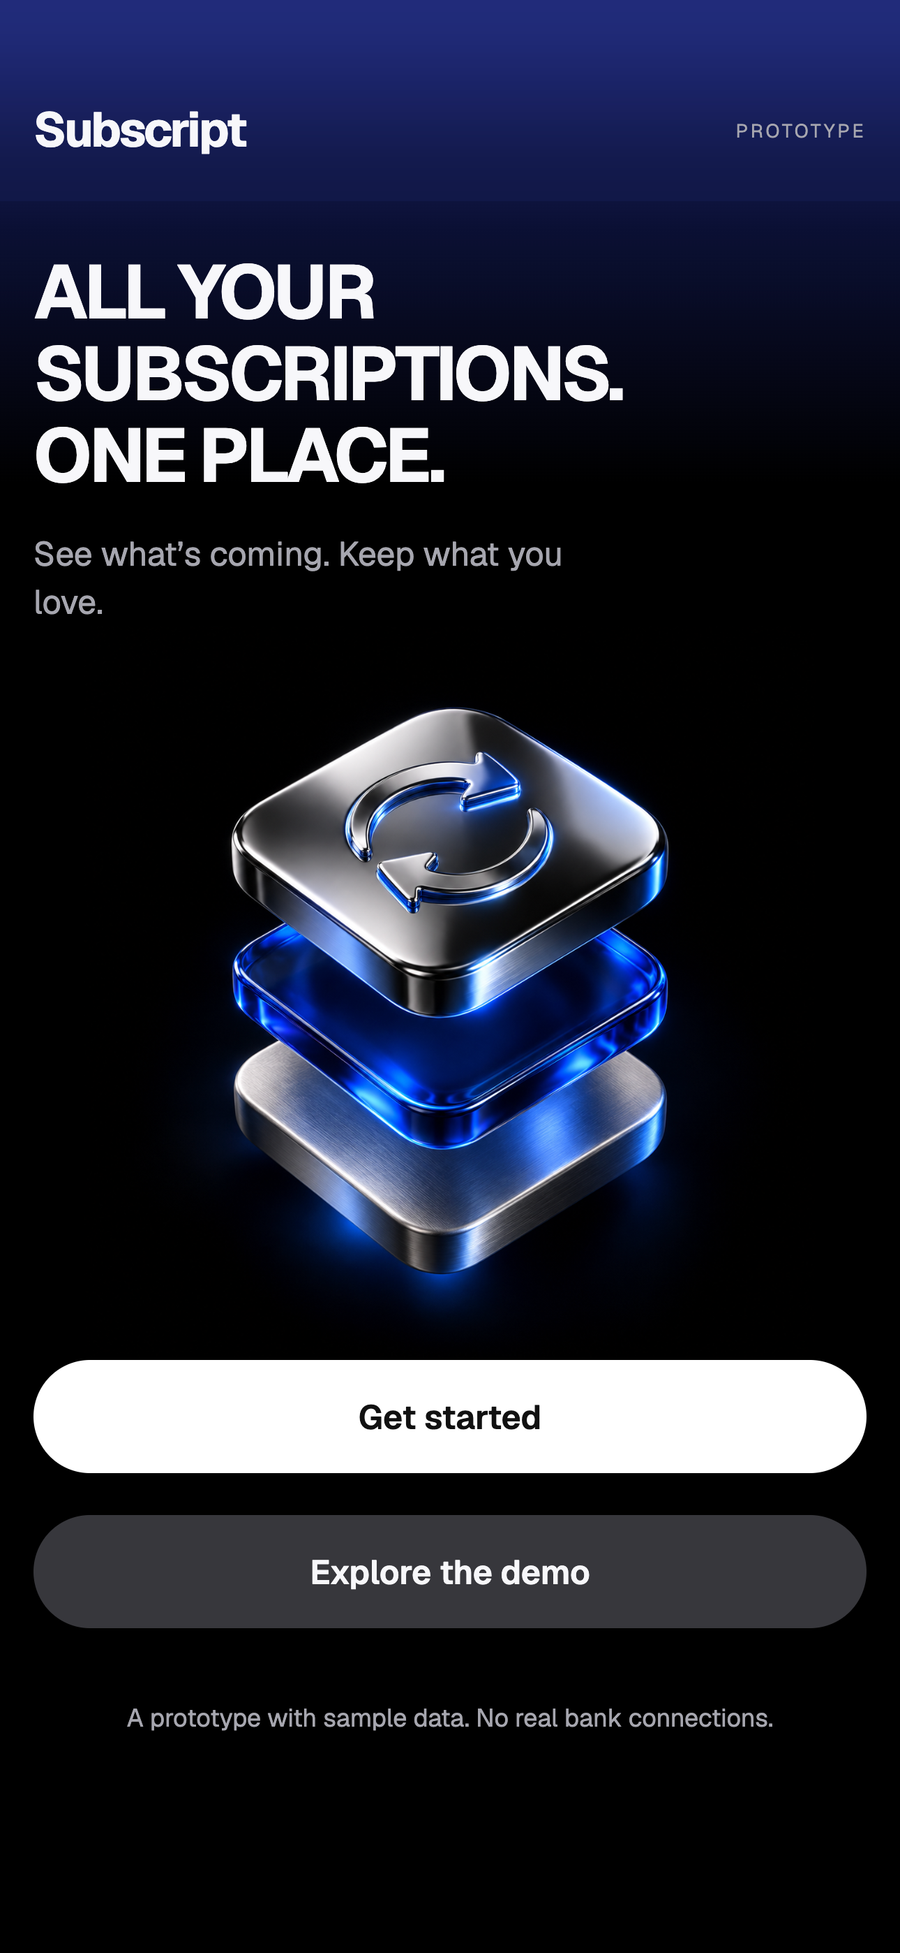
Subscript
05
The first screen
A clear promise,
a visible next step
“All your subscriptions. One place.”
The headline explains the product in familiar words.
“Get started” and “Explore the demo”
Two direct paths let people set up or try the sample data.
Notes:
Source: saved final workshop content supplied by Matthieu Duchatellier, read in Aside on 11 October 2026. https://skema-immerse-learn.lovable.app/workshop/final-workshop?room=e4460260-b740-460c-91d8-c3aa16c3ff76
Design: mobile-revolut/src/theme.ts and mobile-revolut/App.tsx. Geist typography, navy and black backgrounds, blue gradients.
Screenshot: https://subscription-app-alpha-vert.vercel.app. Aside browser capture, 430 × 932 CSS pixels, 1290 × 2796 image pixels, 11 October 2026. iPhone 14 Pro Max browser preset in a generic iPhone-style presentation frame, approved by the user instead of a physical iPhone 18 Pro capture. It does not demonstrate native iOS Liquid Glass or haptics.

Slide 6
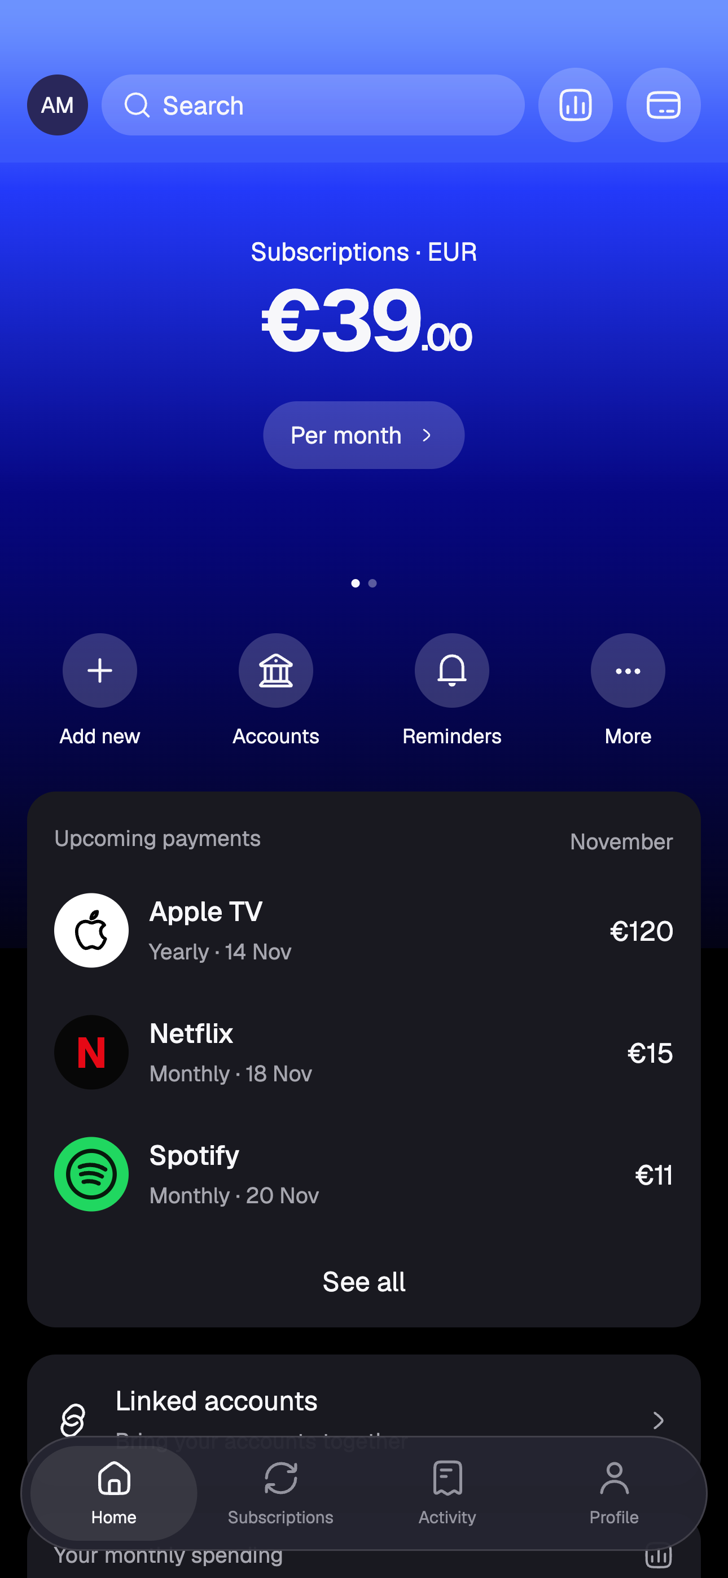
Subscript
06
Home
One overview of
costs and renewals
€39 per month across four subscriptions
The total expresses every plan at a monthly rate.
Apple TV: €120, billed yearly
Billing frequency stays beside the service. The yearly plan contributes €10 to the monthly total.
Demo snapshot: November 2026
Notes:
Source: saved final workshop content supplied by Matthieu Duchatellier, read in Aside on 11 October 2026. https://skema-immerse-learn.lovable.app/workshop/final-workshop?room=e4460260-b740-460c-91d8-c3aa16c3ff76
Design: mobile-revolut/src/theme.ts and mobile-revolut/App.tsx. Geist typography, navy and black backgrounds, blue gradients.
Screenshot: https://subscription-app-alpha-vert.vercel.app. Aside browser capture, 430 × 932 CSS pixels, 1290 × 2796 image pixels, 11 October 2026. iPhone 14 Pro Max browser preset in a generic iPhone-style presentation frame, approved by the user instead of a physical iPhone 18 Pro capture. It does not demonstrate native iOS Liquid Glass or haptics.
Amounts are fictional prototype data. The initial four subscriptions total €39/month or €468/year. Apple TV is €120/year, a €10 monthly equivalent. Upcoming dates are estimates. The screenshot shows the actual current UI; further copy testing should check whether the average/payment distinction is clear enough.

Slide 7
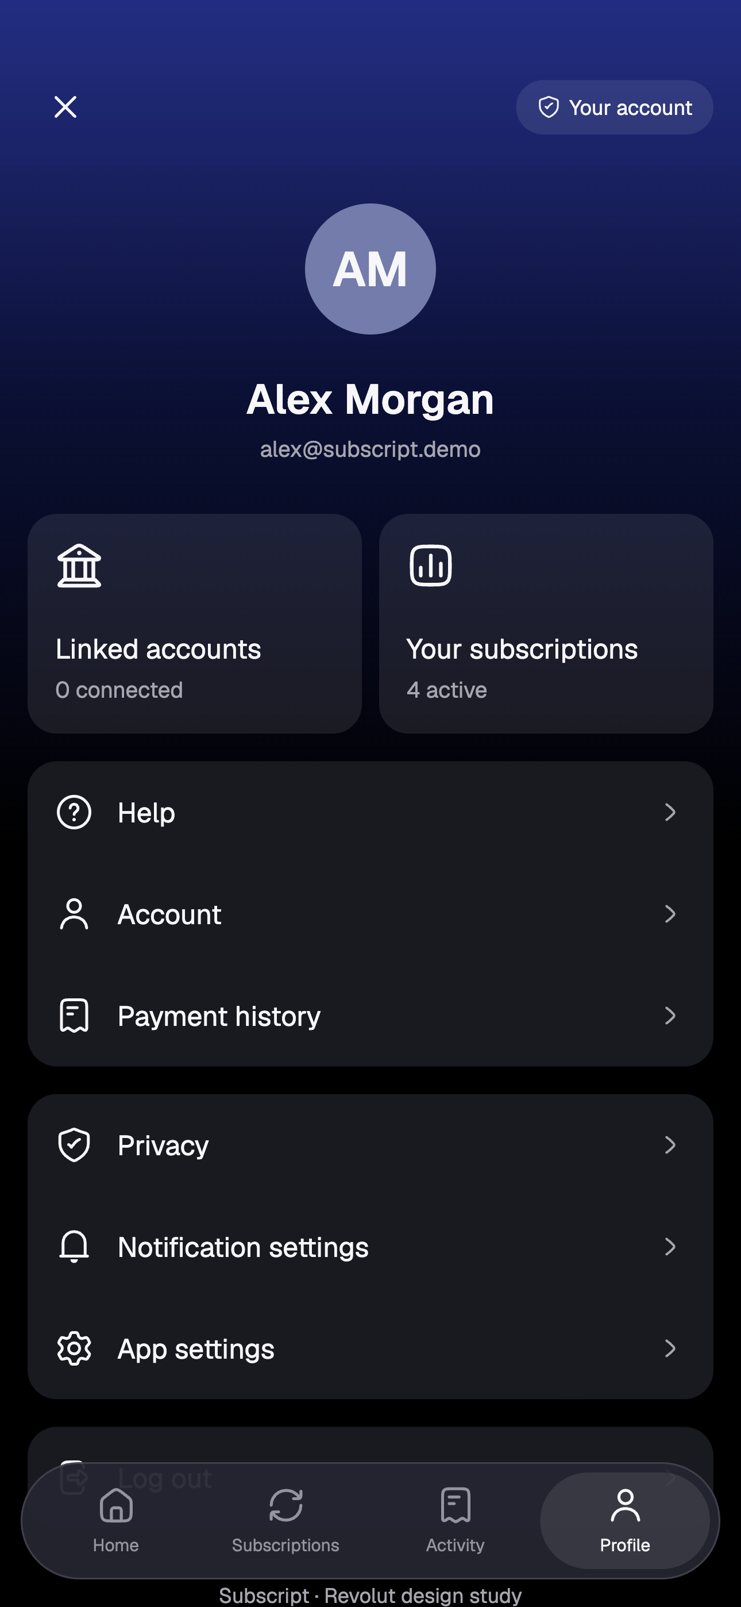
Subscript
07
Profile
Account information
and controls together
“Linked accounts” and “Your subscriptions”
Visible counts make the current account state easy to read.
“Privacy” and “Notification settings”
Concrete labels help people find the control they need.
Alex Morgan is the fictional demo profile.
Notes:
Source: saved final workshop content supplied by Matthieu Duchatellier, read in Aside on 11 October 2026. https://skema-immerse-learn.lovable.app/workshop/final-workshop?room=e4460260-b740-460c-91d8-c3aa16c3ff76
Design: mobile-revolut/src/theme.ts and mobile-revolut/App.tsx. Geist typography, navy and black backgrounds, blue gradients.
Screenshot: https://subscription-app-alpha-vert.vercel.app. Aside browser capture, 430 × 932 CSS pixels, 1290 × 2796 image pixels, 11 October 2026. iPhone 14 Pro Max browser preset in a generic iPhone-style presentation frame, approved by the user instead of a physical iPhone 18 Pro capture. It does not demonstrate native iOS Liquid Glass or haptics.

Slide 8
Subscript
08
Conclusion
Clear words help users understand costs,
judge renewal estimates and cancel
with the right provider.
Cost comprehension
Cancellation clarity
Decision confidence
Fewer questions about the €39 monthly equivalent and the €120 yearly payment.
Fewer mistaken cancellation reports and billing-support requests.
More confident keep, edit or cancel decisions.
Measure whether users explain the difference.
Test whether users identify Apple as the canceller.
Measure completion and perceived clarity.
Expected impacts to test, not measured results or verified savings.
Notes:
Source: saved final workshop content supplied by Matthieu Duchatellier, read in Aside on 11 October 2026. https://skema-immerse-learn.lovable.app/workshop/final-workshop?room=e4460260-b740-460c-91d8-c3aa16c3ff76
Design: mobile-revolut/src/theme.ts and mobile-revolut/App.tsx. Geist typography, navy and black backgrounds, blue gradients.

Slide 9
Subscript
09
Going further
01
Five moderated tests
Ask users to explain €39 versus €120, identify the estimated date, and show where billing is stopped.
02
Verified cancellation guidance
Check Apple’s current route. Add guidance for each platform, then test reporting, correcting and undoing a status.
03
Copy comparison and voice rules
Compare original and revised copy on comprehension, completion and confidence. Refine and document the voice, estimate and status rules.
Notes:
Source: saved final workshop content supplied by Matthieu Duchatellier, read in Aside on 11 October 2026. https://skema-immerse-learn.lovable.app/workshop/final-workshop?room=e4460260-b740-460c-91d8-c3aa16c3ff76
Design: mobile-revolut/src/theme.ts and mobile-revolut/App.tsx. Geist typography, navy and black backgrounds, blue gradients.

