Slide 1



Who is the Expert?
Combining Intention and Knowledge of Online Discussants in Collaborative RE Tasks
Itzel Morales-Ramirez^{1,2}, Matthieu Vergne^{1,2}, Mirko Morandini¹, Alberto Siena¹, Anna Perini¹, and Angelo Susi¹
{imramirez,vergne,morandini,siena,perini,susi}@fbk.eu
¹Fondazione Bruno Kessler, Trento, Italy
²ICT Doctoral School, University of Trento, Italy
Hyderabad, India
NIER track
ICSE 2014

Slide 2
Agenda
Motivation
Novelty
Emergent results
Impact
Who is the Expert? Combining Intention and Knowledge of Online Discussants in Collaborative RE Tasks
Notes:
Each paper will be presented in 10 minutes, with a specific NIER constraint: the authors must explicitly address three questions in their presentation:
Motivation and problem
how novel is the idea presented in this work?
to what extent are the new results emerging?
what is the potential impact of this work?

Slide 3
Motivation
Mailing list discussions are a typical communication channel for collaborative software development in Open Source communities
Hard to identify experts in dynamic and heterogeneous communities
Actual approaches address the problem of expert finding by exploiting content and social dimensions
However, another dimension should be considered, i.e. the intention of the discussants
Who is the Expert? Combining Intention and Knowledge of Online Discussants in Collaborative RE Tasks
Notes:
Itzel starts and asks Matthieu
Heterogeneous: different culture, knowledge, background

Slide 4
Novel idea (1)
Discussants’ knowledge: content in messages
Discussants' intentions: asking, suggesting, stating problems or answering questions
Our approach addresses the expert finding problem by considering the content- and intent- dimensions
Terms written in messages
such as nouns, adj+nouns
Intention identified by a specific sentence structure
Who is the Expert? Combining Intention and Knowledge of Online Discussants in Collaborative RE Tasks
Notes:
Matthieu- Well, so far there are approaches that address…
.
.
.
Where content refers to the terms (nouns, adjectives) used
For instance..
We may argue that a participant that is often asking about a topic, without using appropriate technical terminology is less expert than another providing suggestions or answers.
We believe that when using this type of online resources to extract information about who is expert on a topic, we need to take into account discussant intentions together with the knowledge expressed in the content of their contributions.

Slide 5
Novel idea (2)
Input: mailing list
From: Arthur
Subject: hacked server
Hi folks,
I suggest to use the Apache server because it is more secure, …
--------------------
From: Sam
Subject: RE: hacked server
I agree. I would also suggest …
--------------------
…
Who is the Expert? Combining Intention and Knowledge of Online Discussants in Collaborative RE Tasks
Notes:
Itzel: But let me explain you how we exploit the content and intentions found in mailing list discussions to find the experts

Slide 6
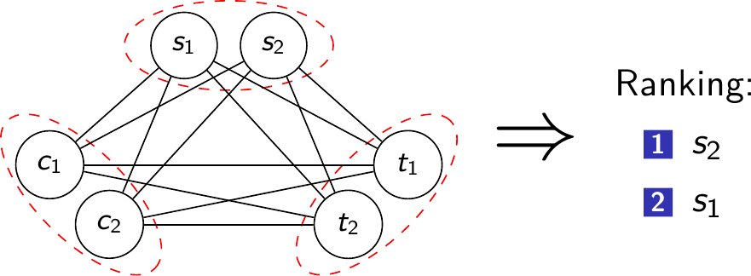
Novel idea (2)
Extract key elements in messages
Extract relations between the key elements
Combine content- and intent-based information to weight the relations
Use Markov Network (MN) to infer the expert stakeholders for a set of topics
Topic: hacked server
From: Arthur
Subject: RV: hacked server
Hi folks,
I suggest to use the Apache server because it is more secure, …
Stakeholder: Arthur
Stakeholder
Topic
weight
Intention
Term: Apache server
Term: secure
Intention: I suggest
Term
Who is the Expert? Combining Intention and Knowledge of Online Discussants in Collaborative RE Tasks
Notes:
Itzel: But let me explain you how we exploit the content and intentions found in mailing list discussions to find the experts

Slide 7
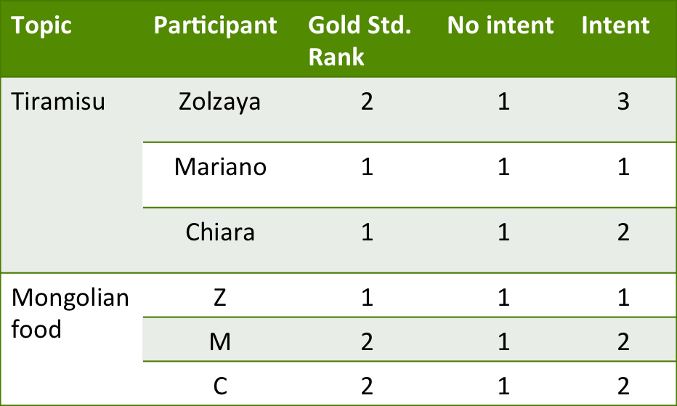
Emergent results
Illustrative example
2 topics
3 participants
30 messages
Gold-standard: participants’ self-evaluation
MN with and without intentions
Larger scaled example (ongoing work)
2 topics
14 participants
71 messages
Gold-standard: external evaluation with a control experiment
MN with and without intentions
Who is the Expert? Combining Intention and Knowledge of Online Discussants in Collaborative RE Tasks
Notes:
Mn, No intent it is only considered the counting the relations between the terms

Slide 8
Impact of the work
Capacity to deal with expert finding in heterogeneous and dynamic contexts like OSS
Experts may be identified not only by the terms they employ but also by the way they usually write
Fake experts or spammers in OSS communities may also be revealed
Who is the Expert? Combining Intention and Knowledge of Online Discussants in Collaborative RE Tasks
Notes:
Twitchell- conversation analysis: use of speech acts to revealed deceptive participants

Slide 9
Future work
Ongoing
  Input: XWiki discussion threads (6 months data) (http://www.xwiki.org/xwiki/bin/view/Main/WebHome)
  Improve performances (MN time in inference, intention extraction)
  Systematically evaluate the approach
Future
  Other sources representing knowledge as content: ontologies and organizational models
  Consider roles for social dimension
More detail will appear at:
-CAiSE’14 Vergne et al., Morales et al.
-ER’14 Morales et al.
Who is the Expert? Combining Intention and Knowledge of Online Discussants in Collaborative RE Tasks
Notes:
----- Meeting Notes (5/27/14 10:47) -----
complexity of the algorithm
Systematically evaluate the approach

Slide 10

Thank you for your attention!
Questions?
Who is the Expert? Combining Intention and Knowledge of Online Discussants in Collaborative RE Tasks

Slide 11
How the gold standard was built?
(illustrative example)
Selection of 3 participants
Task: discuss 2 topics through the exchange of email messages
Application of a post questionnaire to assess participants’ perception about their expertise in the topic
Elaborate the gold standard based on the answers
Who is the Expert? Combining Intention and Knowledge of Online Discussants in Collaborative RE Tasks

Slide 12

How the gold standard is built?
(ongoing work)
Extract key elements from OSS dataset
Analyse topics (number of messages)
Select 2 topics:
  reasonable number of messages (human evaluation VS informativity)
  reasonable number of discussions (diversity VS development)
  reasonable meaning (practical topic)
  topics similar on the previous dimensions
Controlled experiment to get rankings from RE students and professionals
Who is the Expert? Combining Intention and Knowledge of Online Discussants in Collaborative RE Tasks

Slide 13
MN Building & Inference
Key element → binary random variable (true/false)
Relation → potential function on variables' pair
  various functions can be used
  function's value depends on variables states
Compute probabilities P(s|t)
Build ranking (most > least probable expert)
Who is the Expert? Combining Intention and Knowledge of Online Discussants in Collaborative RE Tasks

Slide 14
MN Computation
MN = N nodes + M relations
Naive computation: 2^N x M
Complexity: #P-complete
  NP = Is there a solution to X?
  #P = How many solutions for X? (harder)
Tool: libDai (UAI 2010 Challenge winner)
http://staff.science.uva.nl/~jmooij1/libDAI/
Approximation: timeout
Who is the Expert? Combining Intention and Knowledge of Online Discussants in Collaborative RE Tasks

