Slide 1
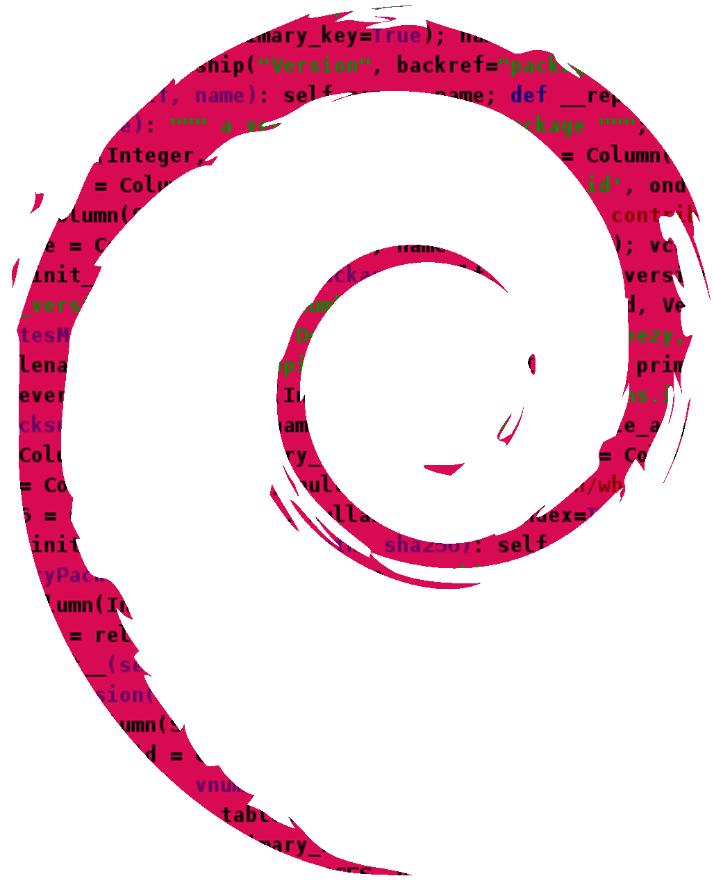
Debsources on mobile
(all the source code on your phone!)
https://sources.debian.net
Matthieu Caneill, DebConf16 @ Cape Town
<matt@brokenwa.re>

Slide 2
Outline
(short) Introduction to Debsources
New stable features: patch tracker, copyright tracker
Incoming: Debsources on mobile!

Slide 3
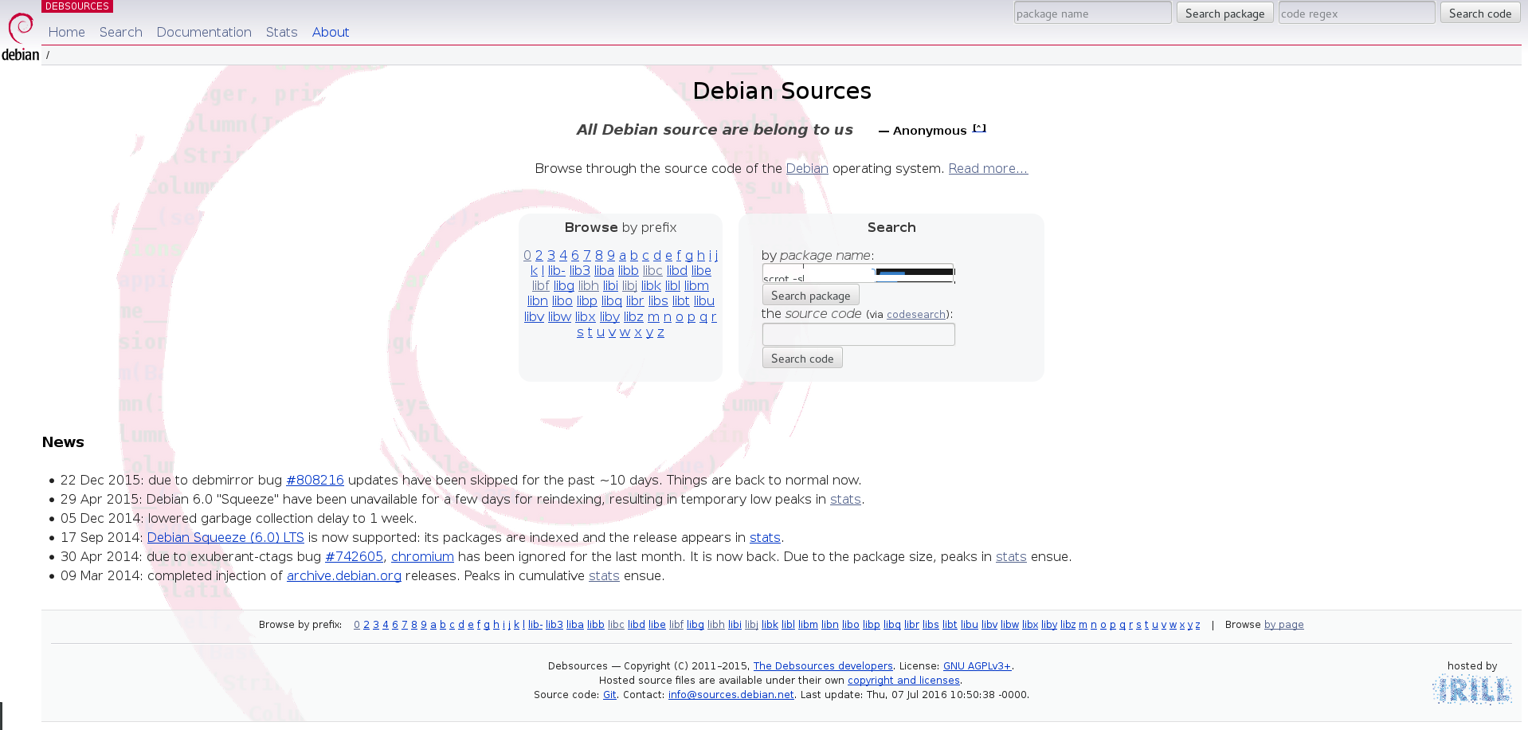

Slide 4
In a nutshell
View the source code of any package
Search the source code (via codesearch.d.n)
Enjoy interesting statistics

Slide 5
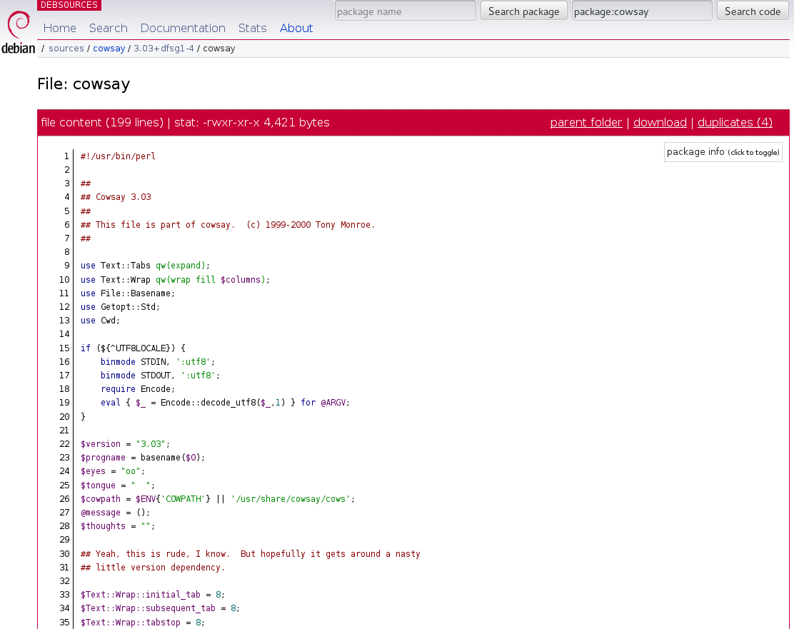

Slide 6
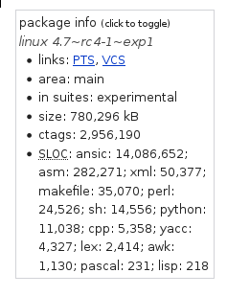
SLOC (source lines of code)
suite | SLOC (millions)
squeeze | 463
wheezy | 682
jessie | 825
stretch | 874
sid | 1168

Slide 7
Last year at Debconf, we announced
a patch tracker, and a copyright tracker

Slide 8
… it works!
All credits go to Orestis Ioannou

Slide 9
https://sources.debian.net/patches/

Slide 10
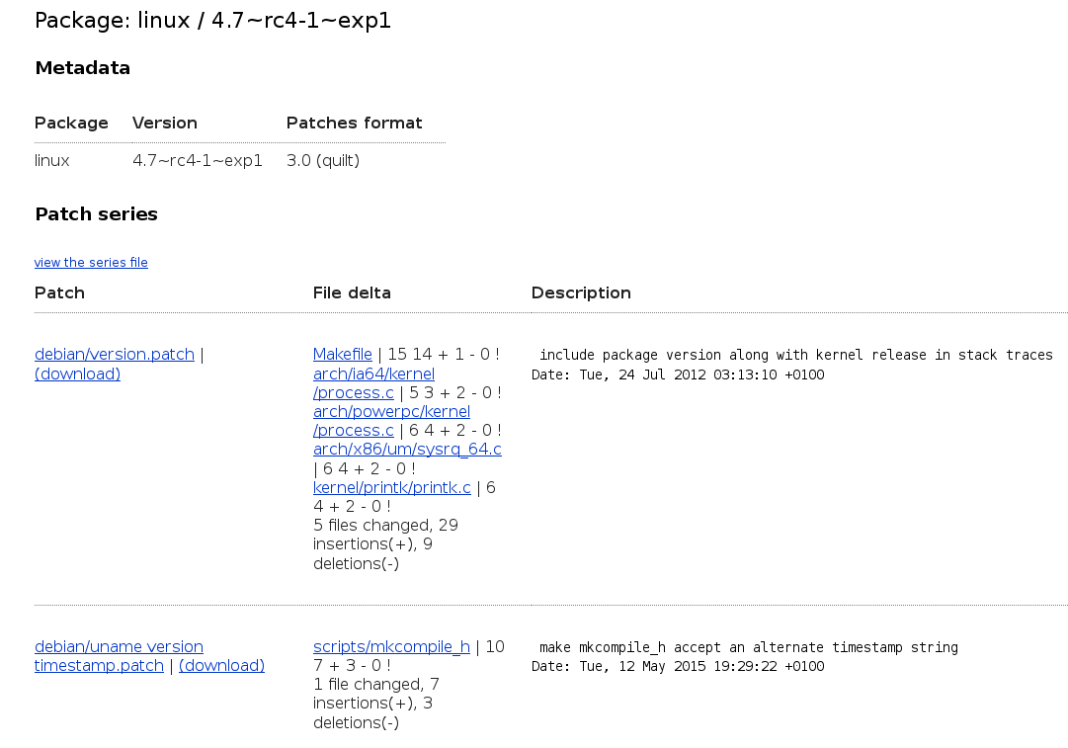

Slide 11
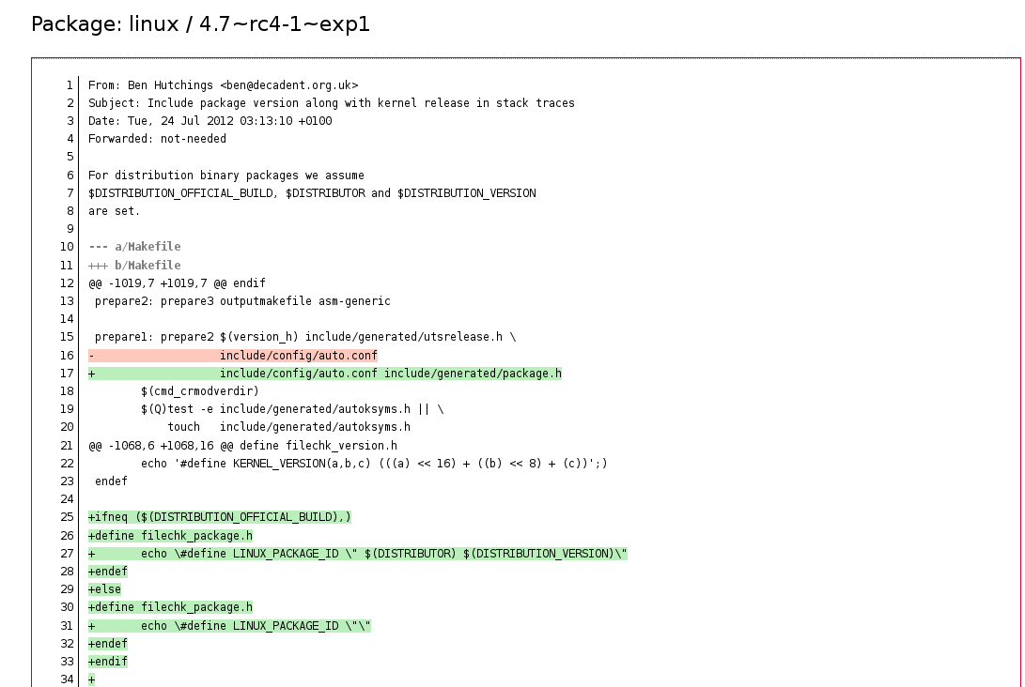

Slide 12
https://sources.debian.net/copyright/

Slide 13
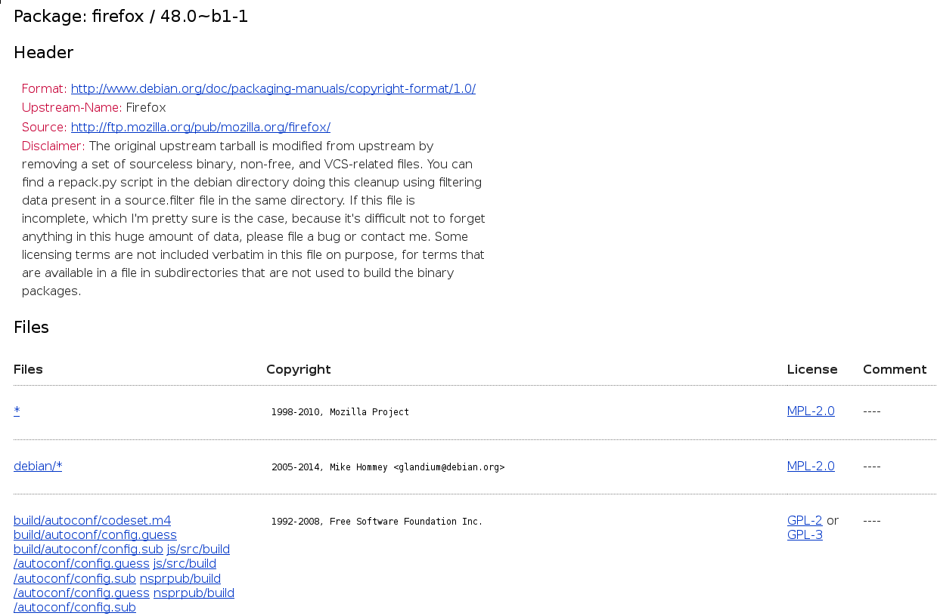

Slide 14
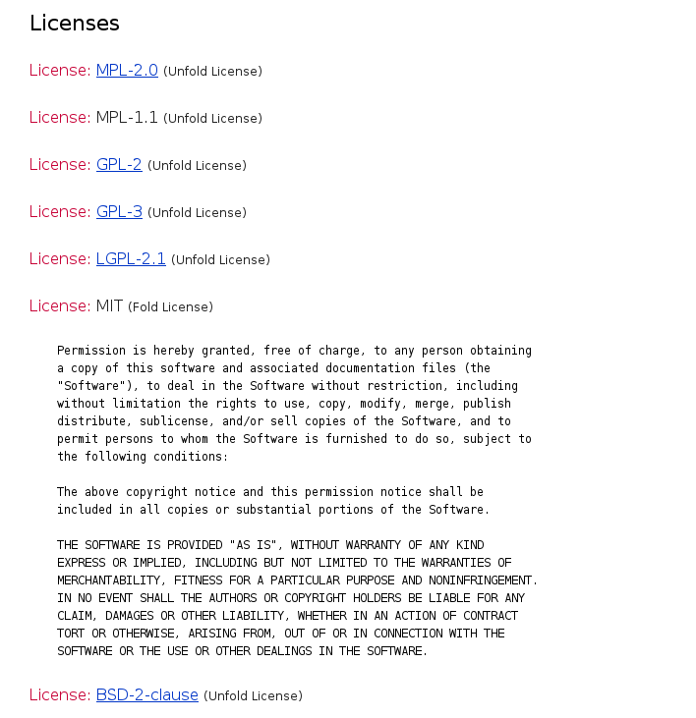

Slide 15
Restrictions: we need machine-parsable data
3.0 (quilt)
debian/copyright

Slide 16
Go mobile

Slide 17
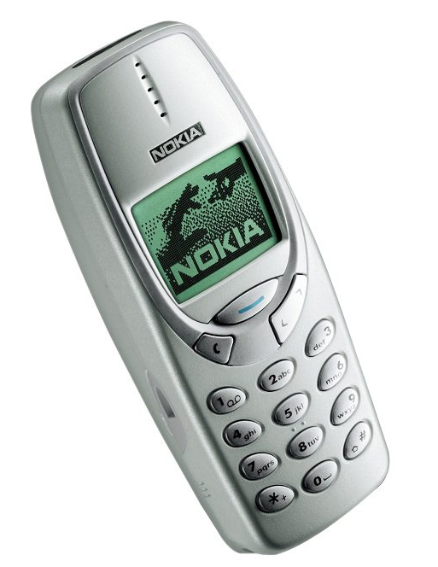

Slide 18
Source code in your pocket (raise your hands if you're bored while commuting!)
Fancier design (lynx-compatible, no worries)
New features incoming!

Slide 19
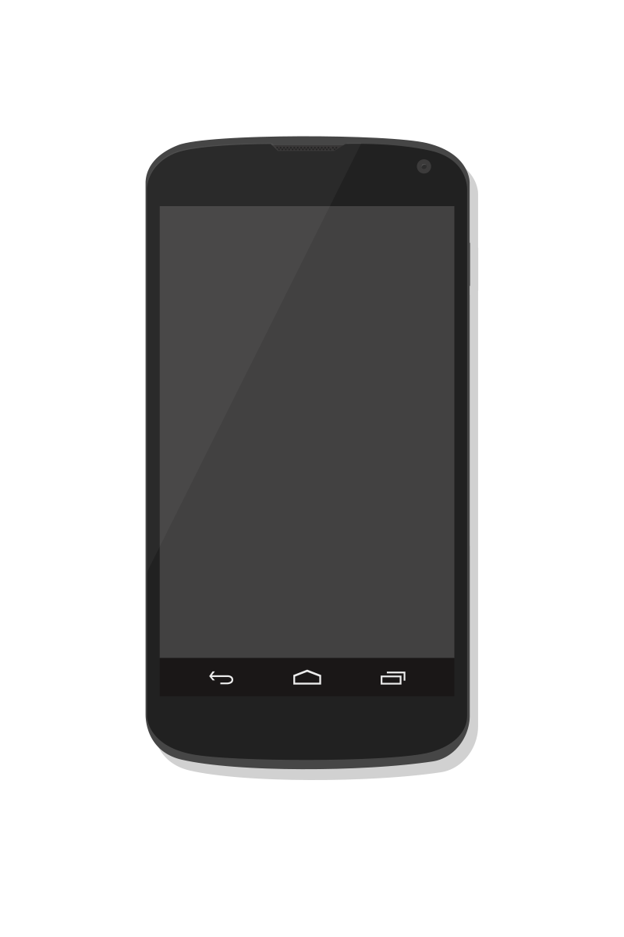
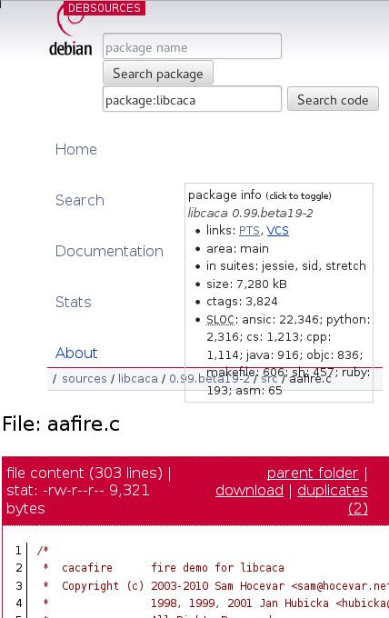

Slide 20
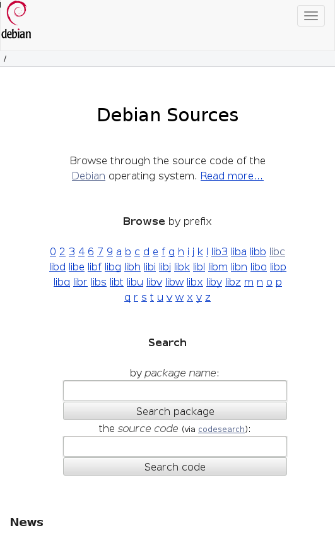

Slide 21
In-browser edition of files
Works with Firefox/Chromium plugins (credits go to Raphael Geissert)
We want it native in Debsources
For desktop and mobile

Slide 22
Current status
Work in progress
GsoC student (Aaron Delaney)
Help and patches always welcome!

Slide 23
Thank you! Questions?
Matthieu Caneill, DebConf16 @ Cape Town
<matt@brokenwa.re>

