Slide 1

50.039 Theory and Practice of Deep Learning W1 - Intro
Matthieu De Mari

Slide 2
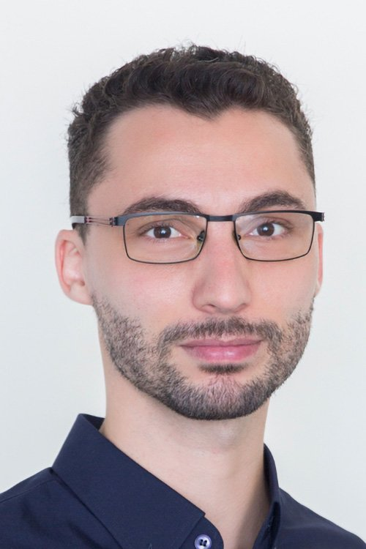
About me
Dr. Matt (Matthieu) DE MARI
Lecturer at SUTD (Python, Deep Learning, AI, and more)
Information Systems Technology and Design (ISTD) pillar/faculty
PhD from CentraleSupelec (France)
Email: matthieu_demari@sutd.edu.sg
Office @ SUTD: 1.702.27

Slide 3
Recap: Weeks 1-6
Week 1: General introduction, linear model for regression and classification, recap on gradients for machine learning.
Week 2: Introduction to PyTorch, classification using logistic regression. Basic concepts of Neural Networks.
Week 3: Backpropagation, initialization and data augmentation. Convolutional Neural Networks. PyTorch practice.
Week 4: Advanced optimizers and better ways to apply gradients. Transfer learning, brief state-of-the-art on computer vision architectures (ResNets, etc.). More PyTorch practice.
Week 5: Recurrent neural networks (RNNs) architectures.
Week 6: Conference. Midterm exam.

Slide 4

What is coming next?
At this point, you have learnt the basics of Deep Learning, i.e., what most online courses teach.
Advanced concepts are often missing online, as they are
open questions in research,
too niche for an online course
or simply not yet prepared into an online course.
In this second half of the 50.039 DL course, we propose to discuss some of these advanced concepts and research directions.

Slide 5
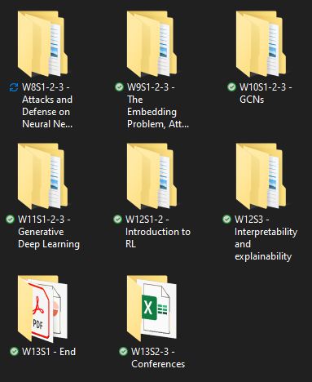
The way I teach things
Each week has a specific topic.
Notebooks demos that you can reuse for practice (autonomy is key).
Discussions about more advanced concepts (often out-of-scope).
Extra readings for those who are curious.
If time allows, homeworks/projects/exam feedbacks.
Materials uploaded each morning before class (or the day before class).
Homeworks given on Fridays.
Project announced on W5.

