Slide 1

50.039 Theory and Practice of Deep Learning W13S1 – End and Review
Matthieu De Mari

Slide 2
Some admin stuff
Final exam
Content will be everything from W1 to W12 included.
Similar format as MidTerm.
Details for exam (location, assignments, etc.) to be sent via email.
Regarding your project
No extension will be given (have to give grades to OSA!)
And want to be able to see your projects before presentations and discussions on W13.
Check schedule for presentation timeslots.

Slide 3
So this is the end
What’s next?

Slide 4
Develop a deeper understanding of…
Improving training procedures (W2++)
At the moment, mostly using gradient descent algorithms to train our models…
Many different directions have been considered, for instance:
Using Forward-Forward (2022 proposal from Hinton, to replace our conventional backprop?): https://arxiv.org/abs/2212.13345
Training AIs to train other AIs?: “learning to learn” or “meta-learning” Curious?: https://machinelearningmastery.com/meta-learning-in-machine-learning/

Slide 5
On top of everything we have seen…
Advanced Computer Vision (W4++ and W10++)
Consider enrolling for the Computer Vision Term 7 course for more advanced concepts on CV, such as:
More advanced loss functions like triplet loss,
Advanced architectures like Siamese networks,
Video data models,
Etc.
https://istd.sutd.edu.sg/undergraduate/courses/50035-computer-vision

Slide 6
Develop a deeper understanding of…
Advanced attacks and Defense mechanisms (W5++)
Many more mechanisms when it comes to attacking and defending a Neural Network, e.g. new types of attacks, such as:
Poisoning attacks (attempt to poison the dataset so the NN cannot re-train properly, especially if online learning is used),
Weights changes (attempt to change a small subset of the weights of the NN to prevent it from working in certain ways),
Etc.
https://www.comp.nus.edu.sg/~reza/courses/cs6231/

Slide 7
Develop a deeper understanding of…
Advanced word embedding and NLP problems (W6++ and W8++)
Many more mechanisms when it comes to embedding and language related problems.
E.g. more advanced embeddings
Typical tasks in NLP (chatbots, context propagation, sentiment analysis, translation, etc.)
Go for the Term 7 NLP course!
https://istd.sutd.edu.sg/undergraduate/courses/50040-natural-language-processing

Slide 8
Develop a deeper understanding of…
Advanced Graph Neural Networks (W9++)
We barely scratched the surface of Graph Theory. If you need to study a new math theory, let it be graph theory!
Good graph theory course here:
https://ocw.mit.edu/courses/mathematics/18-217-graph-theory-and-additive-combinatorics-fall-2019/
More advanced problems and concepts on Graph Neural Networks in lectures 1-9 of course here:
https://www.cs.ox.ac.uk/teaching/courses/2020-2021/advml/

Slide 9
Develop a deeper understanding of…
Advanced Graph Neural Networks (W9++)
Also, keep in mind that Neural Networks are graphs…
So technically, we could build a Neural Network, which receives another Neural Network as its input…!
What could be the uses for such a technique?
Meta-learning? (i.e. training an AI to train another AI?!) https://machinelearningmastery.com/meta-learning-in-machine-learning/

Slide 10
Develop a deeper understanding of…
Advanced Generative Models (W10++)
Advanced GANs, operating on other types of data than just images (sound, text, etc.)
Very good online course here:
https://cs236g.stanford.edu/
Any good course about advanced diffusion models and advanced generative models (Dall-E and MidJourney) would also be worth considering.
https://www.fast.ai/posts/part2-2023.html
Might be covered in Term 7 Computer Vision?

Slide 11
Develop a deeper understanding of…
Advanced Reinforcement Learning (W11++)
Barely scratched the surface about Reinforcement Learning.
Currently considering to create a Reinforcement Learning elective course at SUTD for Term 8. Any thoughts?
Otherwise, the reference course on RL is the one from David Sliver (the man behind AlphaGo!)
https://deepmind.com/learning-resources/-introduction-reinforcement-learning-david-silver
And https://www.davidsilver.uk/teaching/

Slide 12
Develop a deeper understanding of…
Advanced Interpretability (W12++)
Rather an ongoing field in research at the moment.
Not that many courses out there, but worth keeping an eye out…

Slide 13
On top of everything we have seen…
More concepts, problems and architectures on Computer Vision
Also, always good to go for an image processing course to understand typical image transformation and problems out there.
https://www.coursera.org/learn/image-processing?ranMID=40328&ranEAID=*GqSdLGGurk&ranSiteID=.GqSdLGGurk-GV4LxEnPMuMd1.8y4AurRA&siteID=.GqSdLGGurk-GV4LxEnPMuMd1.8y4AurRA&utm_content=10&utm_medium=partners&utm_source=linkshare&utm_campaign=*GqSdLGGurk

Slide 14
On top of everything we have seen…
Bayesian and Statistical Learning (Variational AutoEncoders were 101, more on diffusion models).
A good entry point for Bayesian Deep Learning
https://medium.com/@ODSC/introduction-to-bayesian-deep-learning-f7568f524c90
Lectures 10-End
https://www.cs.ox.ac.uk/teaching/courses/2020-2021/advml/

Slide 15
On top of everything we have seen…
A bit of advanced optimization and game theory never hurts…
Especially when trying to optimize two cooperating or competing neural networks! (GANs, actor-critic, etc.)
Great courses here:
https://oyc.yale.edu/economics/econ-159
And
https://online.stanford.edu/courses/soe-ycs0002-game-theory

Slide 16
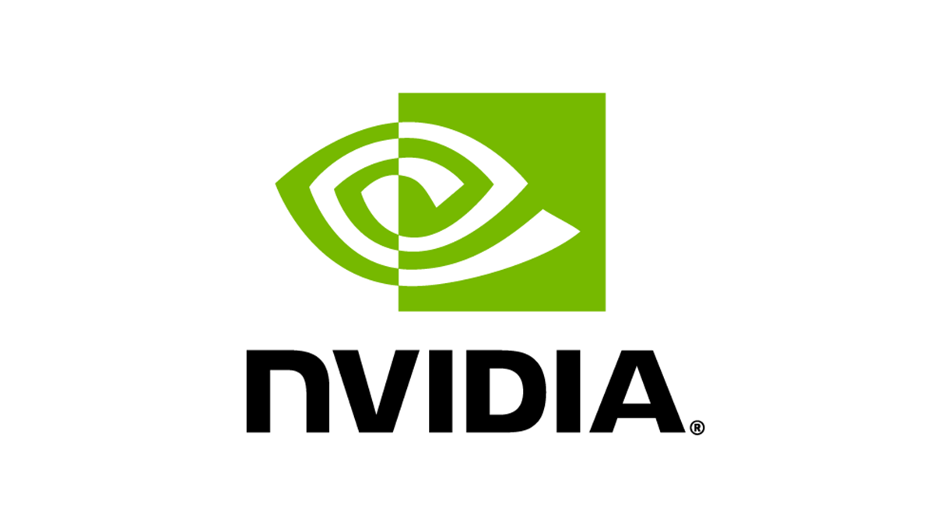
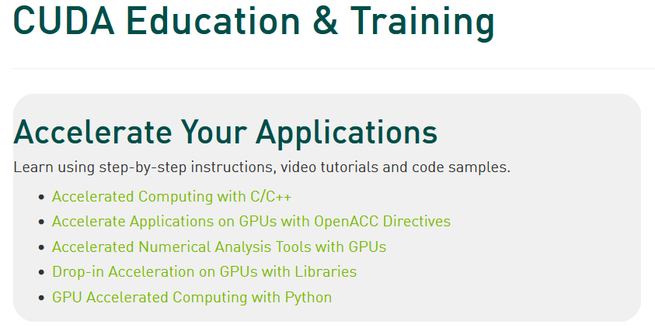
On top of everything we have seen…
CUDA masters are the king of the world these days…
BigTech companies are looking for experts that can help with machine learning and custom GPU implementations
The most obvious way to learn is from Nvidia courses themselves, some give certifications, but it is an investment...
https://developer.nvidia.com/cuda-education-training

Slide 17
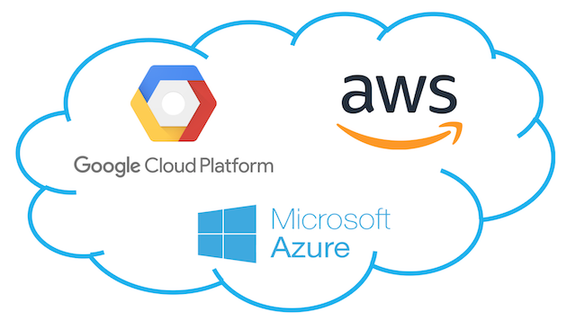
On top of everything we have seen…
Could computing is also very valuable…
Similarly, a certification in AWS or Microsoft Azure of Google Cloud for cloud computing machine/deep learning is of high value these days!

Slide 18
On top of everything we have seen…
Quantum is the next best thing?
Quantum computers are expected to be the next big thing in Computer Science in general.
This will also apply to AI/ML/DL…
This means we will get to train larger networks, faster. (This is currently a limit for many applications these days).
Picking up on quantum computing is never a bad idea (but careful, possibly the most difficult topic out there!)
https://towardsdatascience.com/dont-ask-what-quantum-computing-can-do-for-machine-learning-cc44feeb51e8
https://pennylane.ai/qml/whatisqml.html

Slide 19
On top of everything we have seen…
So, I hear you’re into physics?
Physics-informed neural networks (PINNs) are a type of universal function approximators that can embed the knowledge of any physical laws that govern a given dataset in the learning process
Typically, they can be used to describe, otherwise hard-to-solve, partial differential equations (PDEs).
Curious? A tutorial below.
https://towardsdatascience.com/solving-differential-equations-with-neural-networks-afdcf7b8bcc4

Slide 20
On top of everything we have seen…
More stuff
Advanced Probability and Statistics (a.k.a. Statistical Learning) is always a great plus… https://www.statlearning.com/
Neuroscience should probably be part of any serious AI curriculum… [NeuroAI] Barron et al., “What insects can tell us about the origins of consciousness”, 2015. [Kurzweil] R. Kurzweil, “How to Create a Mind: The Secret of Human Thought Revealed”, 2012. [Marcus] G. Marcus, “The Future of the Brain”, 2014.
Etc.

Slide 21
On top of everything we have seen…
More stuff
Many more courses available for free/cheap out there…
https://www.linkedin.com/posts/endritrestelica_ai-artificialintelliegence-activity-7069768595978776576-Cvsk/
https://www.linkedin.com/posts/amanc_artificialintelligence-machinelearning-ai-activity-7052863983908753408-OPfM/
Possibly the best repo ever created on GitHub for CS stuff…
https://github.com/Developer-Y/cs-video-courses

Slide 22
On top of everything we have seen…
More stuff
Using DL to solve complex differential equations. https://medium.com/swlh/artificial-intelligence-can-now-solve-a-mathematical-problem-that-can-make-researchers-life-easier-9602c869128
General AI, i.e. designing an AI will full human cognitive capabilities (vision, hearing, speech, movement, etc.). https://www.forbes.com/sites/forbestechcouncil/2021/07/16/the-future-of-artificial-general-intelligence/?sh=c9223323ba99
Etc.

Slide 23
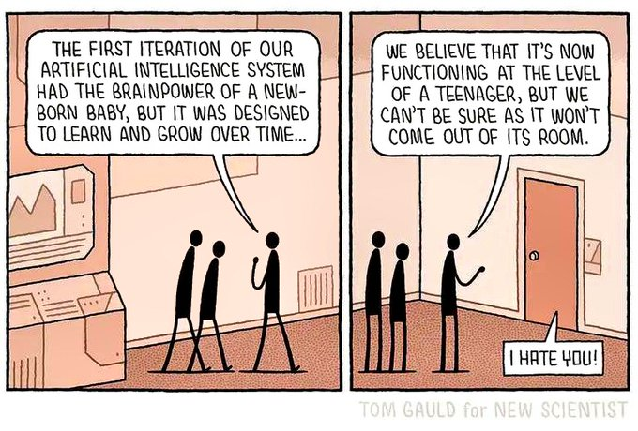
Debates about AGI
AGI: Artificial General Intelligence, naming the idea of an AI that would match all the cognitive abilities of a human.
At the moment, definitely a dream, but the ultimate goal.
Very active discussion topic after ChatGPT has been released.
ChatGPT is nowhere near AGI, but is it a big step in that direction?
I’m staying out of this debate! (Still watching it unfold though *popcorn*)
https://openai.com/blog/planning-for-agi-and-beyond

Slide 24
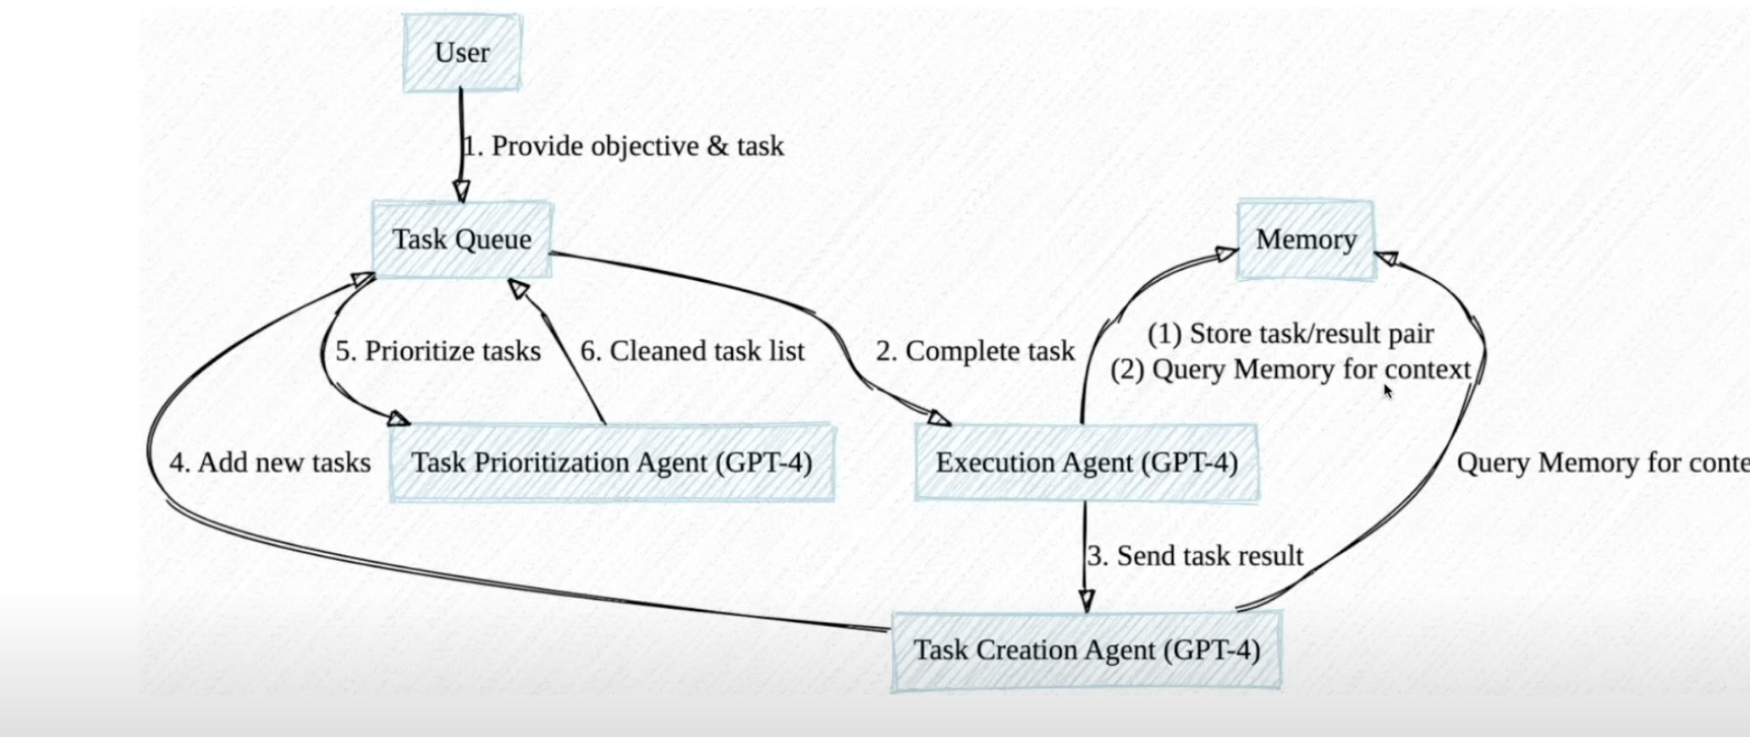
A good pointer: the babyAGI project
https://twitter.com/yoheinakajima?ref_src=twsrc%5Egoogle%7Ctwcamp%5Eserp%7Ctwgr%5Eauthor
https://github.com/yoheinakajima/babyagi

Slide 25
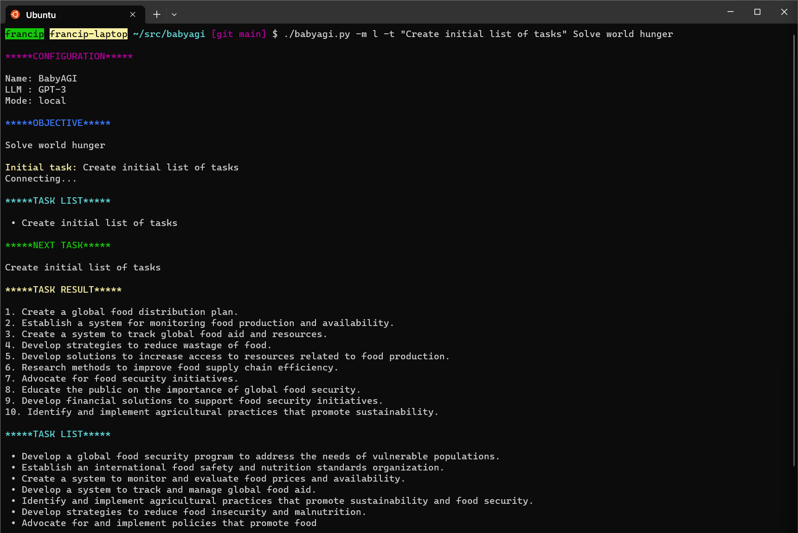
A good pointer: the babyAGI project
https://twitter.com/yoheinakajima?ref_src=twsrc%5Egoogle%7Ctwcamp%5Eserp%7Ctwgr%5Eauthor
https://github.com/yoheinakajima/babyagi

Slide 26
The important message is…
Your learning should not stop after SUTD…
Keep learning to stay up to date, this is a very fast evolving field…
So, good luck on your continuing studies!

Slide 27
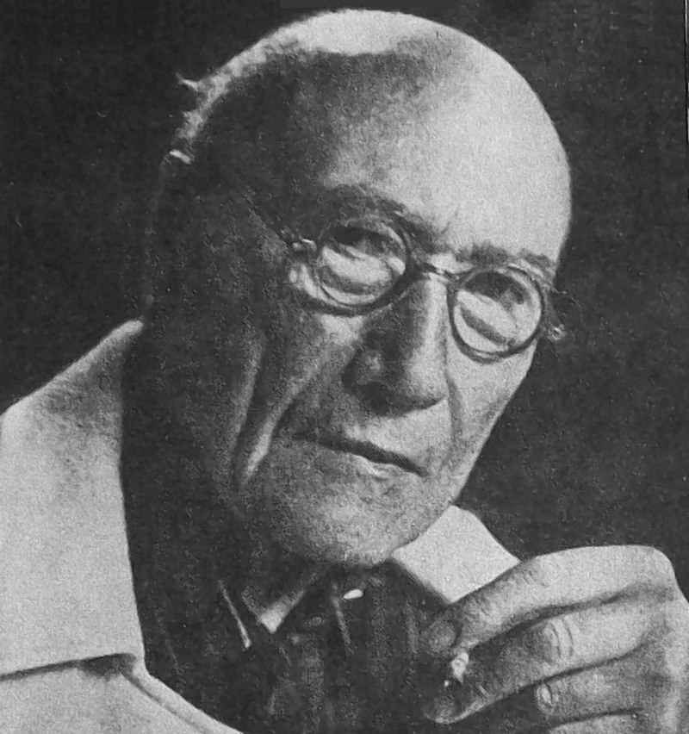
More importantly
DL/AI is a very active and fast-paced field.
Keep your watchlist of papers and authors up to date.
I have mentioned researchers, which I believe are among the most notable influencers of the Deep Learning community.
Will be adding some more names on the next slides.
“A good professor should have this constant concern: teaching his students how to continue without him.“ – André Gide, Nobel Prize of Literature in 1947

Slide 28
Add these researchers, companies and research groupes to your watchlist
Demis Hassabis: Co-founder of DeepMind, AlphaGo. Several contributions in Reinforcement Learning. https://scholar.google.com/citations?hl=en&user=dYpPMQEAAAAJ
Alex Graves: Professor at University of Toronto. Several contributions in Reinforcement Learning. https://scholar.google.co.uk/citations?user=DaFHynwAAAAJ&hl=en
Michael I. Jordan: Professor at UC Berkeley, co-inventor of LDA. https://scholar.google.com/citations?user=yxUduqMAAAAJ&hl=fr
Terrence Sejnowski: Professor at UC San Diego, Boltzmann machines. https://scholar.google.ca/citations?user=m1qAiOUAAAAJ&hl=en

Slide 29
Add these researchers, companies and research groupes to your watchlist
Peter Norvig: Director of Research at Google, co-author of the other Bible of Deep Learning https://scholar.google.com/citations?user=Ol0vcWgAAAAJ&hl=en http://aima.cs.berkeley.edu/
Stuart Russell: Professor at UC Berkely, co-author of the other Bible of Deep Learning https://scholar.google.com/citations?user=2oy3OXYAAAAJ&hl=en
Francois Chollet: Researcher at Google. The man behind the Keras framework and Xception. https://scholar.google.com/citations?user=VfYhf2wAAAAJ&hl=en

Slide 30
Add these researchers, companies and research groupes to your watchlist
Trevor Hastie: Professor at Stanford, co-autor of the Bible of Statistical Learning. https://scholar.google.ca/citations?user=tQVe-fAAAAAJ&hl=en https://hastie.su.domains/ElemStatLearn/download.html
Robert Tibshirani: Professor at Stanford, co-autor of the Bible of Statistical Learning. Inventor of the LASSO algorithm. https://scholar.google.ca/citations?user=ZpG_cJwAAAAJ&hl=en
Vladimir Vapnik: Retired Professor, inventor of SVMs and many other concepts. Worked with Yann LeCun at Facebook AI. https://scholar.google.com/citations?user=vtegaJgAAAAJ&hl=fr

Slide 31
Add these researchers, companies and research groupes to your watchlist
Fred Cummins: Professor at University College Dublin, contributions to LSTMs and NLP. https://scholar.google.com/citations?user=E-vg2zQAAAAJ&hl=fr
Andrej Karpathy: Former Director of AI at Tesla. Many contributions to Computer Vision (Imagenet) and NLP (RNNs). (Probably better to follow him than Elon Musk.) https://scholar.google.com/citations?user=l8WuQJgAAAAJ&hl=fr
Li Fei-Fei: Professor at Stanford. Many contributions to Computer Vision (Imagenet). https://scholar.google.com/citations?user=rDfyQnIAAAAJ&hl=fr
Pieter Abbeel: Professor at UC Berkeley, and a leading researcher in reinforcement learning and robotics. https://scholar.google.com/citations?user=vtwH6GkAAAAJ&hl=en

Slide 32
Add these researchers, companies and research groupes to your watchlist
Anil K. Jain: Professor at Michigan State University. Many contributions to Computer Vision and Statistical Learning. https://scholar.google.com/citations?user=g-_ZXGsAAAAJ&hl=fr
Jitendra Malik: Professor at UC Berkeley. Many contributions to Computer Vision and Statistical Learning. https://scholar.google.com/citations?user=oY9R5YQAAAAJ&hl=fr
Sebastian Thrun: Stanford, cool stuff on robotics. https://scholar.google.com/citations?user=7K34d7cAAAAJ&hl=fr
Daphne Koller: CEO at InSitro, some cool courses on Coursera, she might be the co-founder of Coursera (?). https://scholar.google.com/citations?user=5Iqe53IAAAAJ&hl=en

Slide 33
Add these researchers, companies and research groupes to your watchlist
Andrew Ng: Professor at Stanford, co-creator of Coursera. Has one of the best online courses on Deep Learning. https://scholar.google.com/citations?user=mG4imMEAAAAJ&hl=en
Jeremy Howard: Research Scientist at University of San Francisco, a good scout for notable research papers on Twitter and TED talks. https://scholar.google.com/citations?user=ZWdEJ54AAAAJ&hl=en
Yaser S. Abu-Mostafa: Professor at CalTech, one of the best professors for Deep Learning out there. https://dblp.org/pid/69/3008.html
Rachel L. Thomas: University of San Francisco, FastAI, some great TED conferences on AI and Deep Learning. https://scholar.google.com/citations?user=BDsAYUsAAAAJ&hl=en

Slide 34
Also worth subscribing to a few free newsletters about AI/DL
The Batch newsletter by DeepLearning.ai (https://www.deeplearning.ai/the-batch/)
The Algorithm by MIT Tech Review (https://www.technologyreview.com/newsletter-preferences/)
The TLDR; newsletter (https://tldr.tech/)
The NLP Newsletter (https://www.ruder.io/nlp-news/)
The AlphaSignal newsletter (https://alphasignal.ai/)
Some Medium subscription never hurts (sometimes nice, easy and accessible discussions about AI).
But most seriously though, go for Twitter and follow people.

Slide 35
Cracking the Deep Learning interview
Most BigTech companies out there will test you on your CS/DL skills upon applying to positions/jobs in their companies.
Train!
Many flashcards with typical AI/ML/DL questions and tasks given in technical interviews at BigTech companies.
https://www.algoexpert.io/machine-learning/product
https://www.mlexpert.io/

Slide 36
Cracking the Deep Learning interview
More importantly, polish your GitHub with some nice ML/AI/DL projects that you can show and discuss in interviews!
Document your codes and notebooks over the summer break!
Many problems out there, easily investigated.
https://twitter.com/0xbnomial/status/1523256409529667584?t=YWXdKryCUrrJSCKWLiT4Tg&s=03
Other possible idea: Find one problem for each concept we discussed each week this term and make a repo/project about it!

Slide 37
A quick word on PyTorch 2.0
PyTorch 2.0, released on 23 March 2023.
If you go for it, make sure to correctly set your CUDA (will most likely not be the same version of CUDA if you were using 1.13 before!)
https://pytorch.org/get-started/pytorch-2.0/
New and remarkable features:
Fully backward compatible (all previous codes should still work).
More advanced compile function (three modes) to transform model written in Python into something very fast to execute.
(More primitive functions and user experience tools.)

Slide 38
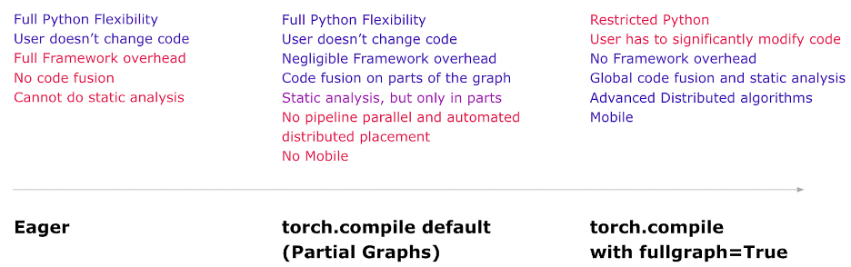
A quick word on PyTorch 2.0
More advanced compile() function (three modes) to transform model written in Python into something very fast to execute.

Slide 39
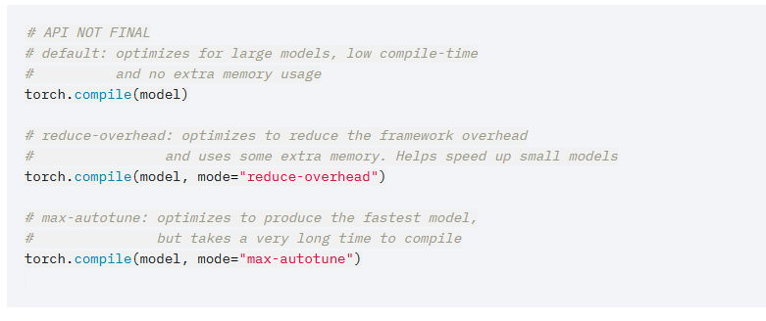
A quick word on PyTorch 2.0
More advanced compile() function (three modes) to transform model written in Python into something very fast to execute.
From what I have tested:
Little improvements on small sized Linear and Conv models. (Typically the ones in Notebooks)
1.5x-2x faster to train on large-scale transformer architectures?

Slide 40
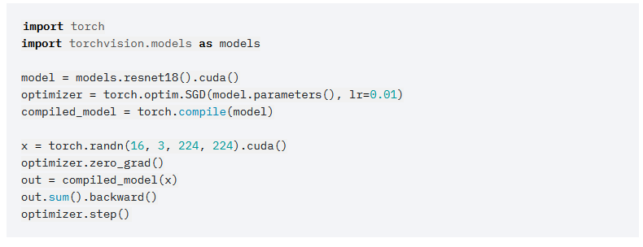
A quick word on PyTorch 2.0
More advanced compile() function (three modes) to transform model written in Python into something very fast to execute.
From what I have tested:
Little improvements on small sized Linear and Conv models. (Typically the ones in Notebooks)
1.5x-2x faster to train on large-scale transformer architectures?

