Slide 1

50.051 Programming Language Concepts W8-S2 Introduction to Compilers and Course Outline
Matthieu De Mari

Slide 2
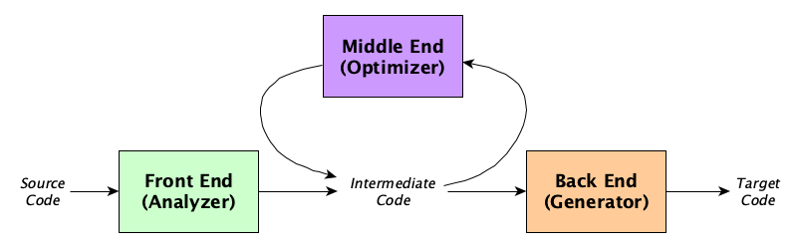
The architecture of a compiler
Definition (the three parts of a typical compiler architecture):
A typical compiler architecture consists of three main components: the front-end, middle-end, and back-end.
Each component is responsible for a specific set of tasks and works together to generate the final executable code.

Slide 3
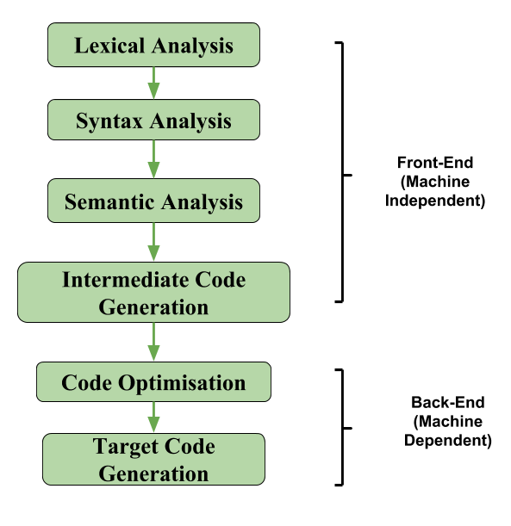
The architecture of a compiler
Definition (the three parts of a typical compiler architecture):
A typical compiler architecture consists of three main components: the front-end, middle-end, and back-end.
Each component is responsible for a specific set of tasks and works together to generate the final executable code.

Slide 4
The front-end of a compiler
Definition (The front-end part of a compiler):
The front-end of a compiler is responsible for analysing the source code, and converting it into a form that can be used by the rest of the compiler.
It involves tasks, such as:
Lexical analysis,
Syntax analysis,
and Semantic analysis.

Slide 5
The middle-end of a compiler
Definition (The middle-end part of a compiler):
The middle-end of a compiler follows the front-end analysis and it consists of a series of operations and transformations to optimize and improve its efficiency.
It involves tasks, such as:
Intermediate code generation
Code optimization,
and Data-flow analysis.

Slide 6
Intermediate code generation
Definition (Intermediate code generation):
Intermediate code generation is the process of transforming the source code into a code that is more abstract and closer to machine language.
Making a direct jump from source code to target code might prove difficult.
Intermediate code
Source code
Target code

Slide 7
Intermediate code generation
Definition (Intermediate code generation):
Intermediate code generation is the process of transforming the source code into a code that is more abstract and closer to machine language.
Making a direct jump from source code to target code might prove difficult.
For this reason, an intermediate code representation is often easier to manipulate and allows for optimization.
The intermediate code is not specific to any particular hardware or operating system and can be easily transformed into the final machine code during the backend phase of the compilation process.

Slide 8
Code optimization
Definition (Code optimization):
Code optimization is a critical process that involves analysing and modifying the intermediate code to make it run faster and consume fewer resources. Some of the optimizations typically include:
Dead code elimination: identify and remove dead code that is not executed during program execution. This allows to reduce the size of the final compiled code.

Slide 9
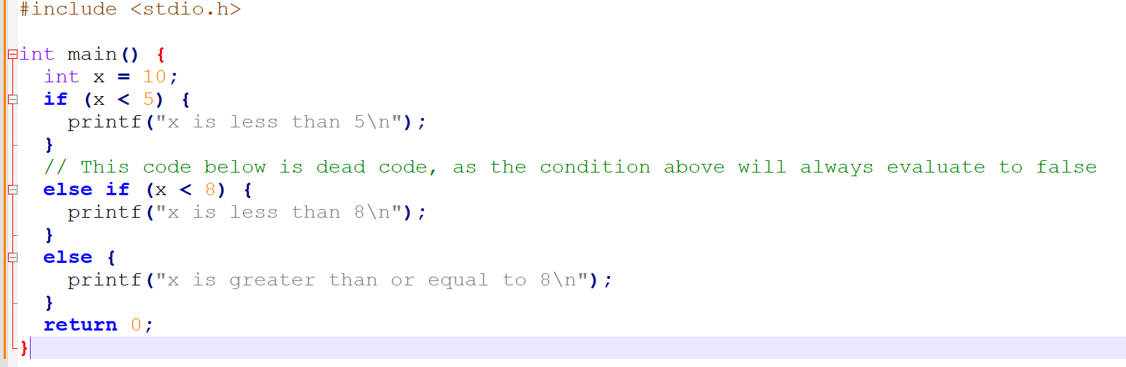
Dead code
Definition (dead code):
Dead code is code that is never executed during the runtime of a program, often following from bad code logic or design.

Slide 10
Dead code
Question: Can you see why the code shown on the right is containing some dead code?

Slide 11
Dead code
Answer: The else if statement is the dead code, as the preceding if statement will always evaluate to false since x is initialized to 10.

Slide 12
Dead code
Definition (dead code):
Dead code is code that is never executed during the runtime of a program, often following from bad code logic or design.

Slide 13
Code optimization
Definition (Code optimization):
Code optimization is a critical process that involves analysing and modifying the intermediate code to make it run faster and consume fewer resources. Some of the optimizations typically include:
Constant folding: replace multiple expressions that involve constant values with their computed values. This allows to reduce the number of computations performed during program execution.

Slide 14
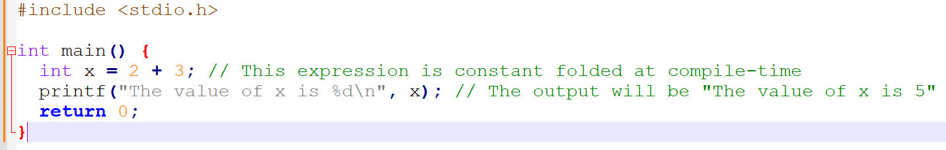
Constant folding
As an example of constant folding…
In the code below, the expression x = 2 + 3 can be folded into a simpler expression x = 5 during compilation, eliminating the need to perform the addition operation at runtime.

Slide 15
Code optimization
Definition (Code optimization):
Code optimization is a critical process that involves analysing and modifying the intermediate code to make it run faster and consume fewer resources. Some of the optimizations typically include:
Control flow optimization: optimize the instructions and the order of instructions being executed. This allows, for instance, to reduce the number of necessary branch instructions, removing parts that could almost be considered dead code (even though they did not follow from bad logic this time).

Slide 16
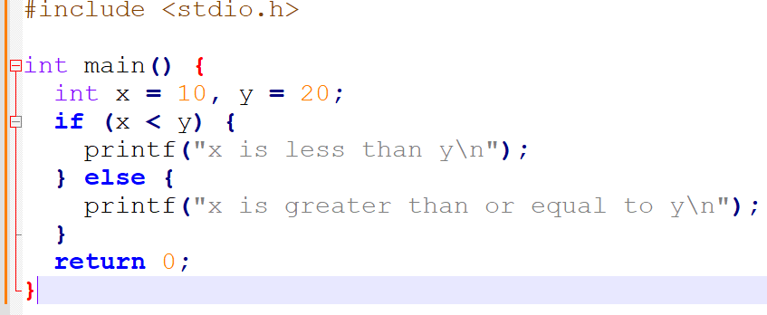
Control flow optimization
As an example of control flow optimization…
The program below uses an if-else statement to check if the value of x is less than the value of y.

Slide 17
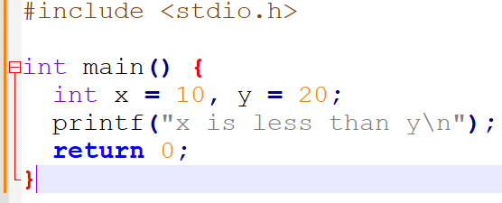
Control flow optimization
As an example of control flow optimization…
The program below uses an if-else statement to check if the value of x is less than the value of y.
Control flow optimization analyses the code and can determine that x will always be less than y, as they are constants.
It can simplify the code to eliminate the unnecessary if-else statement and simplify the code even further.

Slide 18
Code optimization
Definition (Code optimization):
Code optimization is a critical process that involves analysing and modifying the intermediate code to make it run faster and consume fewer resources. Some of the optimizations typically include:
Dead code elimination,
Constant folding,
Control flow optimization,
Also, Function Inlining (substituting secondary functions into main), Loop Unrolling (replaces a loop with a fixed number of iterations with a series of unrolled iterations), etc.
(More on this in Week 10).

Slide 19
Code optimization
Definition (Code optimization):
Code optimization is a critical process that involves analysing and modifying the intermediate code to make it run faster and consume fewer resources. Some of the optimizations typically include:
Dead code elimination,
Constant folding,
Control flow optimization.
Also, Function Inlining (substituting secondary functions into main), Loop Unrolling (replaces a loop with a fixed number of iterations with a series of unrolled iterations), etc.
(More on this in Week 10).

Slide 20
Intermediate code representations
Definition (intermediate code representations):
The intermediate code generated during this phase is often represented in a language that is easier to manipulate than the original source code.
Some examples of intermediate code representation languages that we will investigate in Week 11, are:
Three-address code,
Virtual machine code,
and Abstract syntax trees.

Slide 21
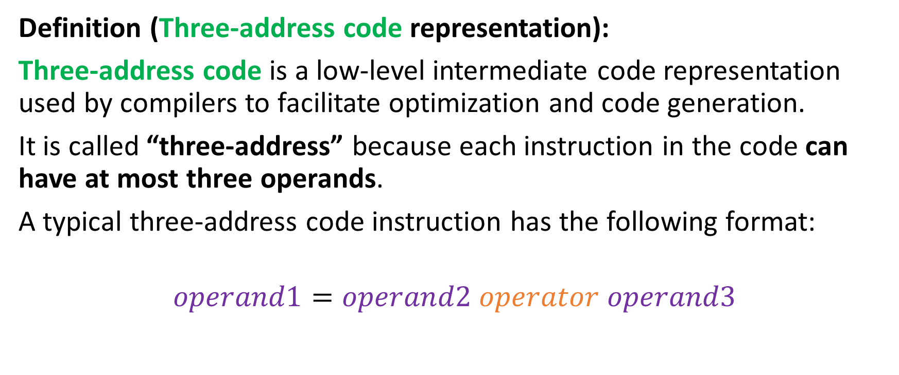
Three-address code representation
Definition (Three-address code representation):
Three-address code is a low-level intermediate code representation used by compilers to facilitate optimization and code generation.
It is called “three-address” because each instruction in the code can have at most three operands.
A typical three-address code instruction has the following format:
$$operand1=operand2 operator operand3$$

Slide 22
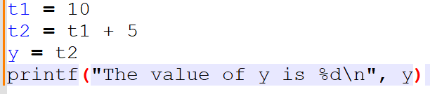
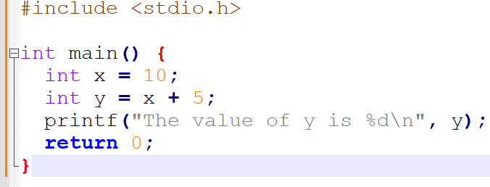
Three-address code representation
For instance, the C code below can be transformed…
…into its equivalent three-address code representation.

Slide 23
Virtual Machine code representation
Definition (Virtual Machine code representation):
Virtual Machine code (VM code) is an intermediate representation of code that is designed to be executed on a virtual machine rather than on the hardware directly.
It is typically used by compilers that target virtual machines (e.g. the Java Virtual Machine or the .NET Common Language Runtime).
It is a stack-based representation, where each operation is performed on values that are pushed onto and popped off of a stack. Each VM instruction typically consists of an opcode and zero or more operands.

Slide 24
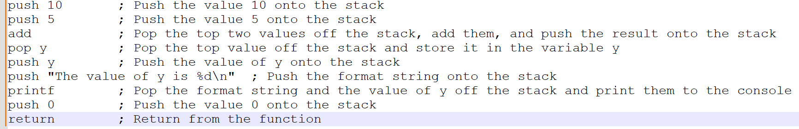
Virtual Machine code representation
For instance, the C code on the right can be transformed…
…into its equivalent VM code representation, below.

Slide 25
Abstract syntax trees code representation
Definition (Abstract Syntax Tree representation):
The Abstract Syntax Tree (AST) representation is a tree representation of the syntactic structure of a program that is generated by a compiler during the front-end phase.
Each node in the tree then corresponds to a syntactic construct in the program, such as an operation, expression or statement.
While a lot more advanced, the tree structure makes it easy for compilers to analyse and manipulate the program syntax and perform optimizations.

Slide 26
Abstract syntax trees code representation
For instance, the C code below can be transformed…

Slide 27
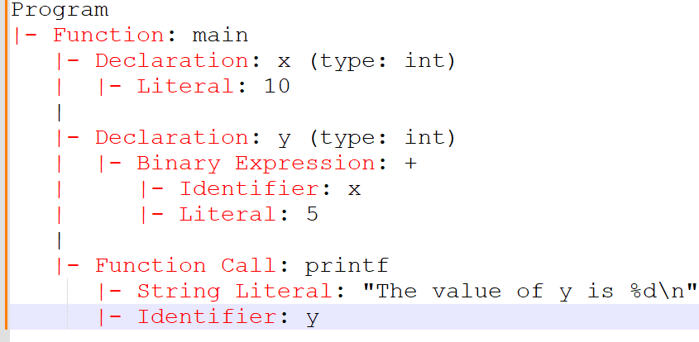
Abstract syntax trees code representation
For instance, the C code below can be transformed…
…into its equivalent abstract syntax tree code representation.

Slide 28
Intermediate code representations
Definition (intermediate code representations):
The intermediate code generated during this phase is often represented in a language that is easier to manipulate than the original source code.
Some examples of intermediate code representation languages that we will investigate in Week 11, are:
Three-address code,
Virtual machine code,
and Abstract syntax trees.
(More on this during Week 11).

Slide 29
Data-flow analysis
Definition (Data-flow analysis):
Data-flow analysis is another task performed during the middle-end stage, which analyses the flow of data in the program and identifies opportunities for optimization.
In data-flow analysis, the program is modelled as a set of variables and operations that manipulate each variable. Each variable has a defined value at each point in the program, and the analysis tracks how the value of each variable changes as the program executes.
Typically, it tracks how variables are defined and used throughout the program and performs optimizations such as dead code elimination (again!) and constant propagation (also!).

Slide 30
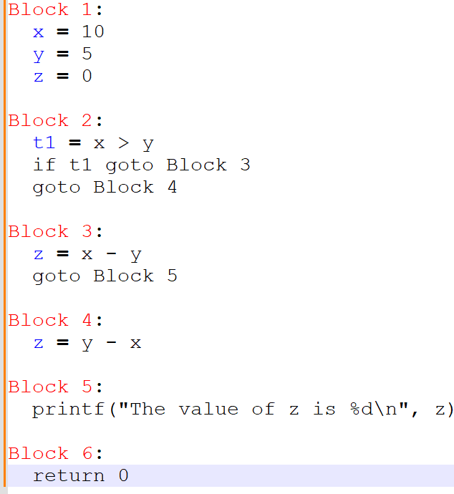
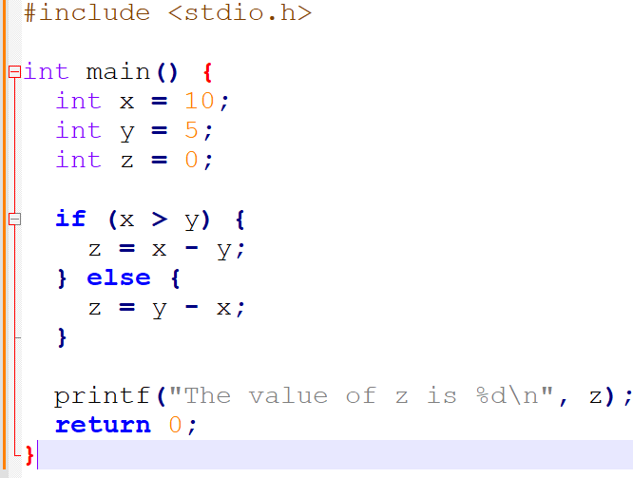
Data-flow analysis
…the Data-flow analysis gives
For this code, in C…

Slide 31
Data-flow analysis
In this data-flow analysis, the program is divided into basic blocks, each representing a sequence of instructions with no branches or jumps (apart for jumping to other blocks).
Using this data-flow analysis, the compiler can perform optimizations such as constant propagation and dead code elimination.

Slide 32
Data-flow analysis
For instance…
Since the value of x is never modified, the compiler can replace all occurrences of x with the constant value 10. Same for y.
Both values of x and y being constants, the compiler can perform the comparison x > y and computation of z at compilation time.
This eventually eliminates the need for the if conditional statement and reduces the program to its minimal form.

Slide 33
Data-flow analysis
In this data-flow analysis, the program is divided into basic blocks, each representing a sequence of instructions with no branches or jumps (apart for jumping to other blocks).
Using this data-flow analysis, the compiler can perform optimizations such as constant propagation and dead code elimination.
(More about this on Week 11).

Slide 34
The back-end of a compiler
Definition (The back-end part of a compiler):
The back-end of a compiler takes the optimized and transformed code generated by the middle-end and translates it into machine code that can be executed.
It involves tasks, such as:
Instruction selection/ordering,
Register allocation,
and Code generation.

Slide 35
Instruction Selection
Definition (Instruction Selection):
During instruction selection, the compiler chooses the specific machine code instructions (mov, add, jmp, etc) to use to implement each operation in the program.
During this step, it might perform additional transformations on the generated code to improve performance and reduce code size.
Typically, there might be multiple equivalent ways to choose and order instructions

Slide 36
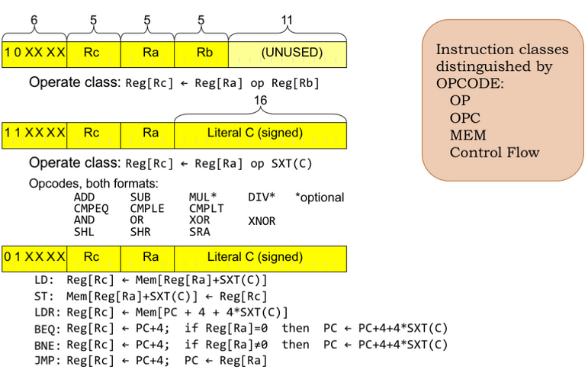
Instruction Selection
Definition (Instruction Selection):
During instruction selection, the compiler chooses the specific machine code instructions (move, add, jmp, etc) to use to implement each operation in the program.

Slide 37
Instruction Selection
Definition (Instruction Selection):
During instruction selection, the compiler chooses the specific machine code instructions (mov, add, jmp, etc) to use to implement each operation in the program.
During this step, it might perform some final transformations on the generated code to improve performance and reduce code size.
Typically, there might be multiple ways to choose and order machine code instructions. Some might be equivalent, others might allow to save memory/register space, etc.

Slide 38
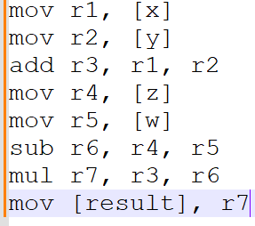
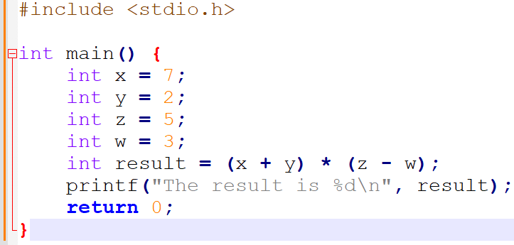
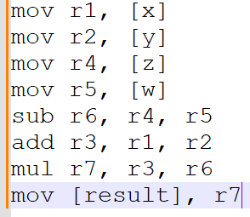
Instruction Selection

Slide 39
Instruction Ordering/Scheduling
Definition (Instruction Ordering/Scheduling):
The instruction ordering (or scheduling) phase is responsible for rearranging the order of instructions in the program to improve performance.
This typically involves reordering instructions to take advantage of the parallelism and pipelining features of modern processors (with many cores running in parallel, for instance).
The instruction scheduler takes into account the dependencies between instructions and the specific features of the processor.
(Too advanced, out-of-scope).

Slide 40
Register Allocation
Definition (Register Allocation):
During the register allocation phase, the compiler assigns program variables to machine registers in an efficient way.
As seen in 50.002 Computation Structures, this is important because register access is much faster than memory access and can then improve the program performance.
The register allocator must take into account the constraints imposed by the target architecture, such as the number and type of available registers.
(Could have been interesting, but probably out-of-scope).

Slide 41
Code generation
Definition (code generation):
The code generation phase is responsible for generating machine code based on the intermediate code representation of the program produced by the middle-end part of the compiler.
This involves translating the intermediate representation into a low-level machine language that can be executed by the CPU (or GPU!).
In its most advanced versions, the code generator must take into account the specifics of the target architecture, such as the instruction set, memory hierarchy, and addressing modes.
And then, after the machine code is ready, we execute it, as explained in 50.002 Computation Structures!

Slide 42
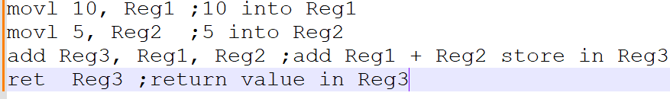
Recall your machine code from 50.002!
The machine code, to be executed by the CPU has
Decomposed the source code into basic instructions understandable by the CPU (or GPU),
Identified registers to use to store (and free) variables for each of these operations.
Need a refresher? Have a look at your 50.002 Computation Structures!

Slide 43
Recall your machine code from 50.002!
The machine code, to be executed by the CPU has
Decomposed the source code into basic instructions understandable by the CPU (or GPU),
Identified registers to use to store (and free) variables for each of these operations.
Need a refresher? Have a look at your 50.002 Computation Structures!

Slide 44
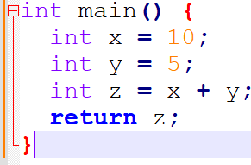
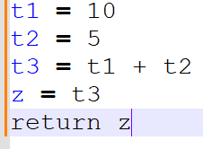
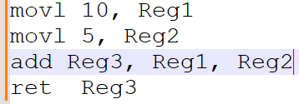
Source code (C)
Front-end
Lexical Analysis Syntax Analysis Semantic Analysis
After front-end, intermediate code (Three-address) and optimizations
Machine instructions after code generation and execution

Slide 45
The back-end of a compiler
Definition (The back-end part of a compiler):
The back-end of a compiler takes the optimized and transformed code generated by the middle-end and translates it into machine code that can be executed.
Instruction selection/ordering,
Register allocation,
and Code generation.
(Briefly discussed in W12-13).

Slide 46
The architecture of a compiler
Definition (the three parts of a typical compiler architecture):
A typical compiler architecture consists of three main components: the front-end, middle-end, and back-end.
Each component is responsible for a specific set of tasks and works together to generate the final executable code.
Hopefully, this gives us a roadmap!

Slide 47
Quiz
What is the middle-end phase of a compiler?
The phase that analyses and optimizes an abstract syntax tree or another intermediate code representation.
The phase that generates machine code from the intermediate representation (IR) code.
The phase that performs lexical analysis and tokenization of the source code.
The phase that performs typos checking and reporting.

Slide 48
Quiz
What is the middle-end phase of a compiler?
The phase that analyses and optimizes an abstract syntax tree or another intermediate code representation.
The phase that generates machine code from the intermediate representation (IR) code.
The phase that performs lexical analysis and tokenization of the source code.
The phase that performs typos checking and reporting.

Slide 49
Quiz
What is the purpose of instruction selection in a compiler?
To perform static analysis of the program to identify possible runtime errors.
To generate an optimized intermediate representation (IR) that can be used for code generation.
To map high-level or intermediate-level language constructs to low-level machine instructions that can be executed by the processor.
To optimize the code for specific target architectures and instruction sets.

Slide 50
Quiz
What is the purpose of instruction selection in a compiler?
To perform static analysis of the program to identify possible runtime errors.
To generate an optimized intermediate representation (IR) that can be used for code generation.
To map high-level or intermediate-level language constructs to low-level machine instructions that can be executed by the processor.
To optimize the code for specific target architectures and instruction sets.

Slide 51
Quiz
What is register allocation in a compiler?
The process of mapping variables to their literal values.
The process of transforming high-level language constructs into low-level machine code.
The process of selecting the best set of machine instructions to implement a program.
The process of mapping variables to hardware registers in the target architecture (CPU or GPU).

Slide 52
Quiz
What is register allocation in a compiler?
The process of mapping variables to their literal values.
The process of transforming high-level language constructs into low-level machine code.
The process of selecting the best set of machine instructions to implement a program.
The process of mapping variables to hardware registers in the target architecture (CPU or GPU).

Slide 53
Quiz
The compiler is a computer program, and this program has necessarily been compiled at some point. Which language has then been used to write the C compiler?
HTML and PHP…!
A language older than C like Fortran?
C itself?!
Machine code only?!!?

Slide 54
Quiz
The compiler is a computer program, and this program has necessarily been compiled at some point. Which language has then been used to write the C compiler?
HTML and PHP (lol)
A language older than C like Fortran?
C itself?!
Machine code only?!!?

Slide 55
Quiz
The compiler is a computer program, and this program has necessarily been compiled at some point. Which language has then been used to write the C compiler?
HTML and PHP (lol)
A language older than C like Fortran? (No, because it would not resolve the problem of which language was used to compile this compiler in Fortran then)
C itself?!
Machine code only?!!?

Slide 56
Quiz
The compiler is a computer program, and this program has necessarily been compiled at some point. Which language has then been used to write the C compiler?
HTML and PHP (lol)
A language older than C like Fortran? (No, because it would not resolve the problem of which language was used to compile this compiler in Fortran then)
C itself?!
Machine code only?!!?

Slide 57
Bootstrapping
Definition (Bootstrapping):
The latest version of the C compiler is typically written in C itself.
The source code for latest version of the C compiler is then compiled using an older version of the compiler that is already available.
This process is called bootstrapping, and it allows a C compiler to be built from scratch by reusing and improving an existing compiler.
Once a basic C compiler is built, it can be used to compile other programs written in C, including newer versions of the C compiler itself with more advanced features.

Slide 58
Bootstrapping
Definition (Bootstrapping):
The latest version of the C compiler is typically written in C itself.
The source code for latest version of the C compiler is then compiled using an older version of the compiler that is already available.
This process is called bootstrapping, and it allows a C compiler to be built from scratch by reusing and improving an existing compiler.
Once a basic C compiler is built, it can be used to compile other programs written in C, including newer versions of the C compiler itself with more advanced features.
→ Cool, but then what was the language used for the “first” compiler?

Slide 59
Quiz
The compiler is a computer program, and this program has necessarily been compiled at some point. Which language has then been used to write the C compiler?
HTML and PHP (lol)
A language older than C like Fortran? (No, because it would not resolve the problem of which language was used to compile this compiler in Fortran then)
C itself?!
Machine code only?!!?

Slide 60
The mother of all compilers
Cool, but then what was the language used for the “first” compiler?
The first C compiler was developed by Dennis Ritchie at Bell Labs in the early 1970s (this is the same person who invented the language).
The first C compiler was written in assembly language.
After that, every time a new version of the C compiler was needed, we would use bootstrapping.

Slide 61
The mother of all compilers
This “first” compiler had several basic features:
It supported the basic features of the C language, including data types, control structures, and functions.
It produced assembly language code as output, which could be assembled into machine code using a separate assembler.
It used a simple two-pass compiler architecture, where the first pass performed lexical analysis and created a symbol table, and the second pass performed syntax analysis and code generation.
It included a rudimentary optimizer that performed simple optimizations such as constant folding and algebraic simplification.
It had a limited set of error messages and debugging capabilities, which made it difficult to diagnose and fix errors in the code.

Slide 62
The mother of all compilers
Despite its limitations, this “first” C compiler was a significant achievement because it allowed C to become a popular language for system programming and operating systems development.
The availability of a reliable and efficient C compiler helped to make C a popular choice for operating system development, as well as for writing other higher-level programming compilers/interpreters.
Learn more about Dennis Ritchie and his founding (and very much underrated) work on C and compilers: https://www.youtube.com/watch?v=g3jOJfrOknA

Slide 63
A bit of history on compilers
References and extra reading, if any (for those of you who are curious):
Learn more about Dennis Ritchie and his founding work on compilers: https://www.youtube.com/watch?v=g3jOJfrOknA
Refresh your skills from 50.002 Computation Structures, and see how this course will provide the missing link! https://istd.sutd.edu.sg/undergraduate/courses/50002-computation-structures/
And, more importantly, https://natalieagus.github.io/50002/
(That would be your homework for this week!)

