Slide 1

50.051 Programming Language Concepts W9-S1 Regular Expressions
Matthieu De Mari

Slide 2
Finite State Machine
Definition (Finite State Machine):
A Finite State Machine (FSM), or finite automaton, is a mathematical model used to represent systems
that have a finite number of possible states,
and can transition between these states based on given inputs.
An FSM can be represented using a graph representation, known as a state diagram, which shows the possible states of the system and the transitions between them.
FSMs are used in a wide variety of applications (control systems, communication protocols, digital circuits, etc.). In our case, FSMs are at the center of the compiling process.

Slide 3
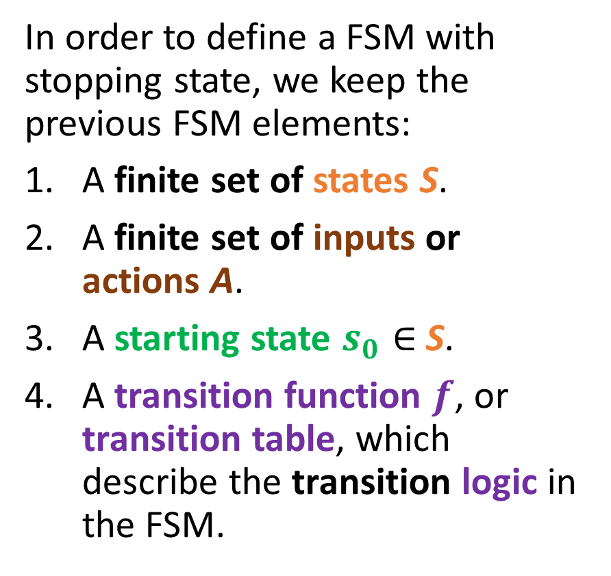
Elements of an FSM with stopping states
In order to define a FSM with stopping state, we keep the previous FSM elements:
A finite set of states S.
A finite set of inputs or actions A.
A starting state $s_{0}∈$S.
A transition function $f$, or transition table, which describe the transition logic in the FSM.
Start
0
1
0
1
0
1
1
0

Slide 4
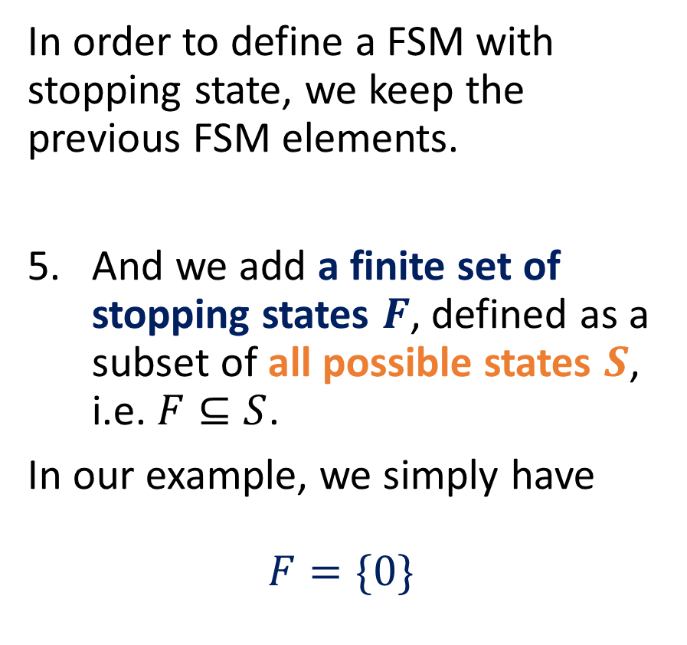
Elements of an FSM with stopping states
In order to define a FSM with stopping state, we keep the previous FSM elements.
And we add a finite set of stopping states $F$, defined as a subset of all possible states $S$, i.e. $F⊆S$.
In our example, we simply have
$$F=\{0\}$$
Start
0
1
0
1
0
1
1
0

Slide 5
Elements of an FSM with outputs
In general, outputs with stopping or accepting states are useful, but limited in terms of applications.
A stronger version of the FSM consists of the FSM with outputs.
It simply replaces the stopping states with outputs being produced every time an action is taken.
Start
0
1
0
1
0
1
1
0

Slide 6

Elements of an FSM with outputs
In order to define a FSM with outputs, we keep the previous FSM elements:
A finite set of states S.
A finite set of inputs or actions A.
A starting state $s_{0}∈$S.
A transition function $f$, or transition table, which describe the transition logic in the FSM.
Start
0
1
0
1
0
1
1
0

Slide 7
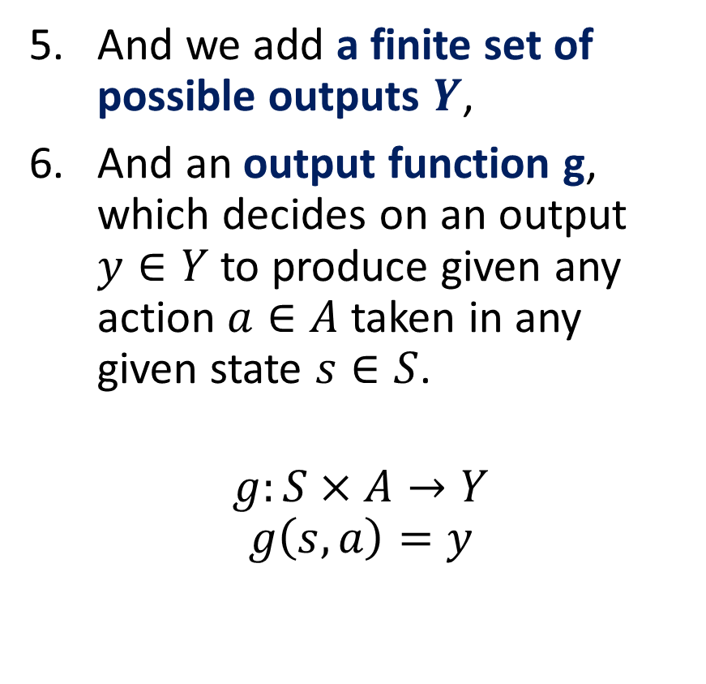
Elements of an FSM with outputs
And we add a finite set of possible outputs $Y$,
And an output function g, which decides on an output $y∈Y$ to produce given any action $a∈A$ taken in any given state $s∈S$.
$$g:S×A→Y$$
$$g\left(s,a\right)=y$$
Start
0
1
0
1
0
1
1
0

Slide 8
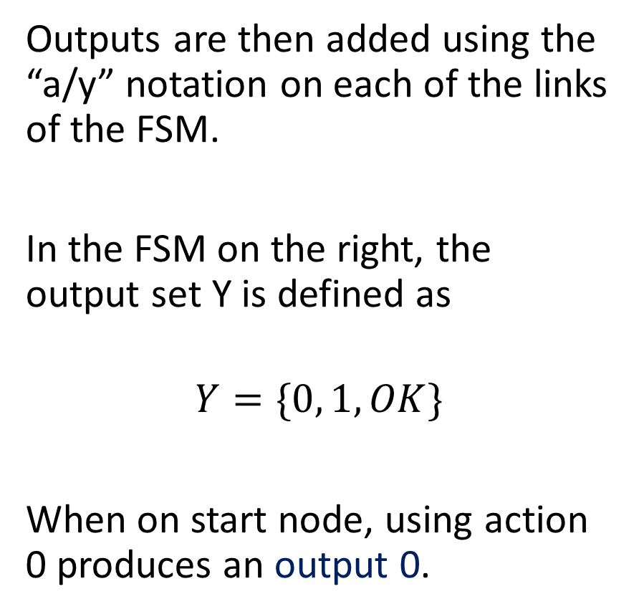
Elements of an FSM with outputs
Outputs are then added using the “a/y” notation on each of the links of the FSM.
In the FSM on the right, the output set Y is defined as
$$Y=\{0, 1, OK\}$$
When on start node, using action 0 produces an output 0.
Start
0/0
1/1
0/”OK”
1/1
0
1/1
1
0/0

