Slide 1

50.051 Programming Language Concepts W10-S3 From Context-Free Grammars to Syntax-Directed Translation
Matthieu De Mari

Slide 2
Introducing Context Free Grammars
Definition (Context-Free Grammars):
A Context-Free Grammar (CFG) is a formal system used to generate and describe sets of strings based on a specific set of syntax rules.
It is particularly useful for defining the syntax of programming languages and the structure of natural languages.
The term "context-free" means that the production rules of the CFG are applied independently of the surrounding context.
A context free grammar is defined by four elements: a set of terminals and non-terminals, a start symbol and a set of production rules.

Slide 3
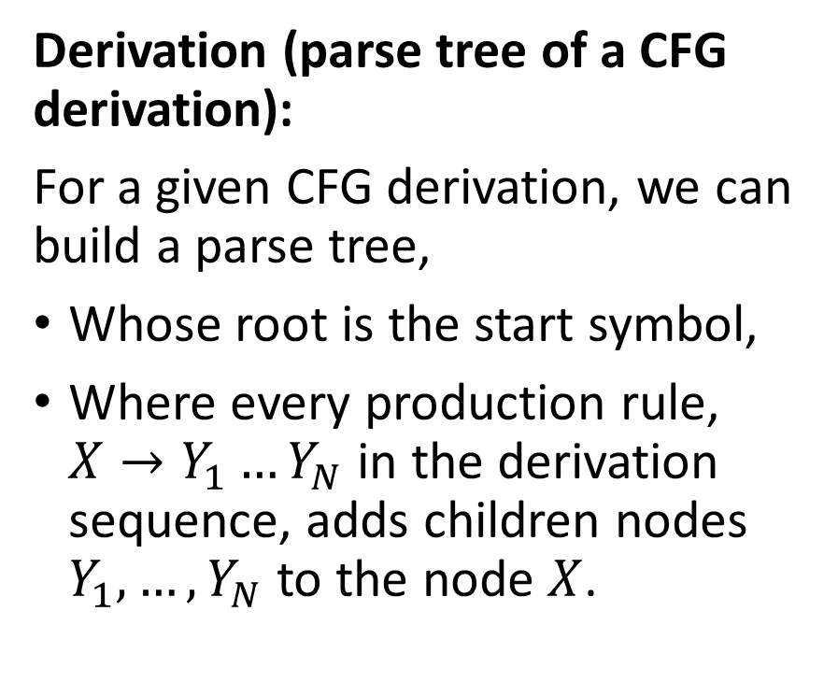
Parse tree of a derivation
Expr
Expr
+
Expr
Derivation (parse tree of a CFG derivation):
For a given CFG derivation, we can build a parse tree,
Whose root is the start symbol,
Where every production rule, $X→Y_{1}…Y_{N}$ in the derivation sequence, adds children nodes $Y_{1},…, Y_{N}$ to the node $X$.
Expr
+
Expr
Term
Term
Term
Num
Num
Num
9
2
7
This parse tree is interesting because it shows the order in which we should compute the different operations, starting with 2 and 7, then 2+7, and finally (2+7)+9.

Slide 4
Ambiguity
Definition (Ambiguity in a CFG derivation):
When using a CFG to check the syntax validity of an expression and building a parse tree, we say that a CFG is ambiguous if it can lead to two different parse trees with different results.
In the case of arithmetic expressions and programming languages, this means that
Two different derivations might exist,
Producing two different parse trees,
And the result of both operations following the two parse trees might differ and lead to different outcomes for a given program (not good!).

Slide 5
Checking ambiguity algorithmically
Theorem (On checking the ambiguity of a CFG algorithmically):
Let us consider a given CFG.
There is no algorithm to check if a given CFG is ambiguous or not.
This is known as the ambiguity problem for context-free grammars, and it is proven to be an undecidable problem.
(Note: Similarly, there is no general algorithm that can determine whether a given program contains an infinite loop. This is known as the Halting problem, and means that you cannot define a compiler program that can check for the presence of infinite loops in the compiled source code, let alone fix them.)

Slide 6
Ambiguous grammars and compilers
Ambiguous grammars can cause significant problems in compilers.
They make it challenging to derive the intended meaning or structure of the input program.
Moreover, they can lead to incorrect parsing, which may result in incorrect code generation or even compiler crashes.
Therefore, it is crucial to eliminate ambiguity in context-free grammars used in compiler design.
While checking that a CFG might be ambiguous is impossible algorithmically, there are however manual methods for designing CFGs that will be non-ambiguous.

Slide 7
Ambiguous grammars and compilers
Not all context-free grammars can be made non-ambiguous.
Most CFGs used in programming, such as the CFG for checking balanced parentheses or the CFG for arithmetic expressions, can be represented using non-ambiguous grammars (that’s a relief!).
But, ultimately, it is your responsibility as a programming language designer to define rules for the syntax of your programming language that can be translated into non-ambiguous CFGs!
Keep in mind that ambiguous grammars can often appear more concise or easier to define than their non-ambiguous counterparts. However, the problems they cause in compiler design often outweigh the benefits of simplicity or conciseness.

Slide 8
Ambiguous grammars and compilers
To ensure that there is only one correct parse tree for a given string, it is essential to eliminate ambiguity in the grammar.
Some techniques for resolving ambiguity in CFGs manually:
Rewriting the grammar entirely,
Introducing precedence,
Introducing delimiters,
Introducing associativity rules.

Slide 9
Rewriting a CFG
All approaches to eliminate ambiguity will require to rewrite the grammar. And to do so, in a way that eliminates the multiple parse trees for a given input string.
The rewriting task involves following simple rules that will:
Restructure the production rules,
And/or introduce new non-terminal symbols to more clearly define the intended structure of the language.
By doing this, we ensure that there is only one possible derivation for each string, leading to a unique parse tree.

Slide 10
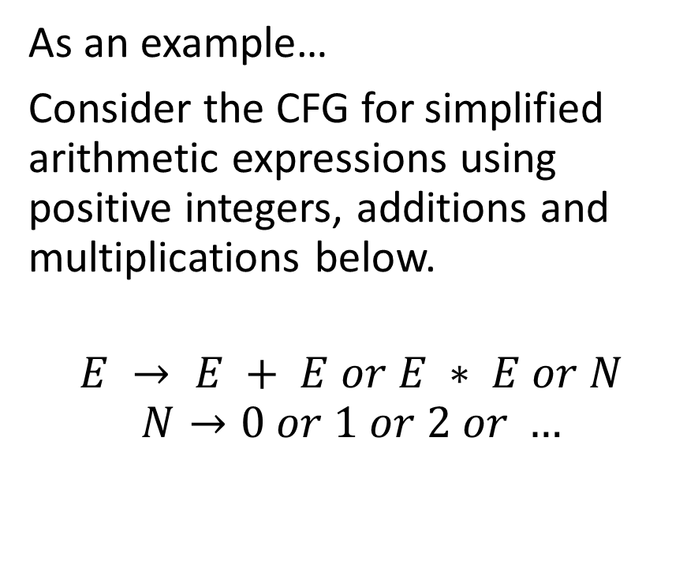
A first disambiguation example
As an example…
Consider the CFG for simplified arithmetic expressions using positive integers, additions and multiplications below.
$$E → E + E or E ∗ E or N$$
$$N→0 or 1 or 2 or …$$
This grammar is ambiguous, because it does not specify the precedence of + and *.
As we have seen in the previous lesson, it might lead to two different parse trees for the string 2*3+7, with completely different behaviours corresponding to two operations:
(2*3)+7
2*(3+7)

Slide 11
Two parse trees for 2+7*9
Expr
But what if we were building parse trees for 2+7*9 instead?
The right tree represents 2+(7*9).
The left one represents (2+7)*9.
The order matters in that case!
Expr
Expr
*
Expr
Expr
+
Expr
Expr
+
Expr
Term
Term
Expr
*
Expr
Term
Term
Num
Num
Term
Term
Num
Num
9
2
Num
Num
2
7
7
9

Slide 12
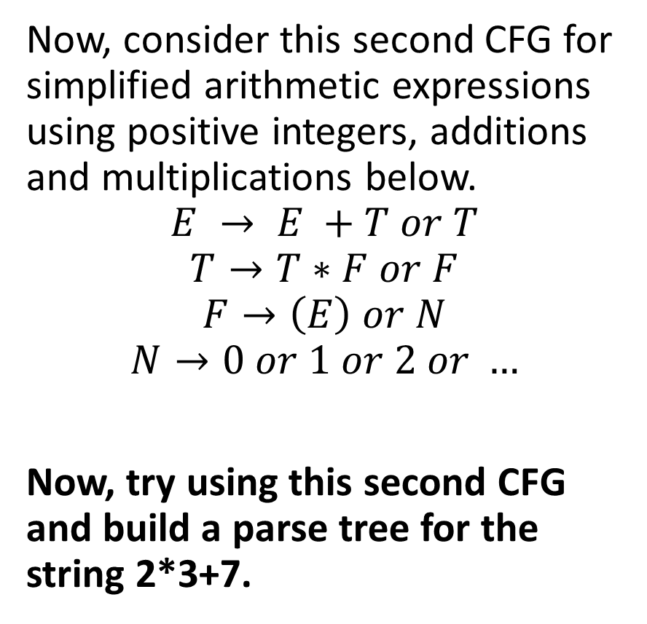
A first disambiguation example
Now, consider this second CFG for simplified arithmetic expressions using positive integers, additions and multiplications below.
$$E → E +T or T$$
$$T→T∗F or F$$
$$F→\left(E\right) or N$$
$$N→0 or 1 or 2 or …$$
Now, try using this second CFG and build a parse tree for the string 2*3+7.

Slide 13
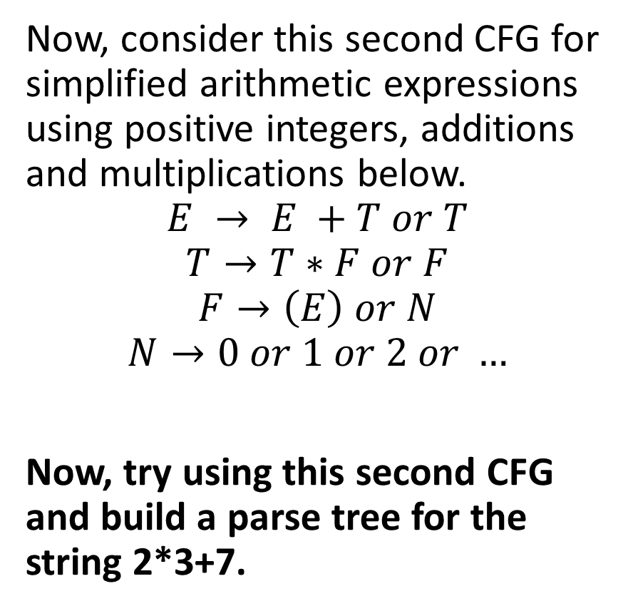
A first disambiguation example
Only one possible tree and correct precedence!
Now, consider this second CFG for simplified arithmetic expressions using positive integers, additions and multiplications below.
$$E → E +T or T$$
$$T→T∗F or F$$
$$F→\left(E\right) or N$$
$$N→0 or 1 or 2 or …$$
Now, try using this second CFG and build a parse tree for the string 2*3+7.
E
E
+
T
T
*
F
F
F
N
N
N
3
7
2

Slide 14
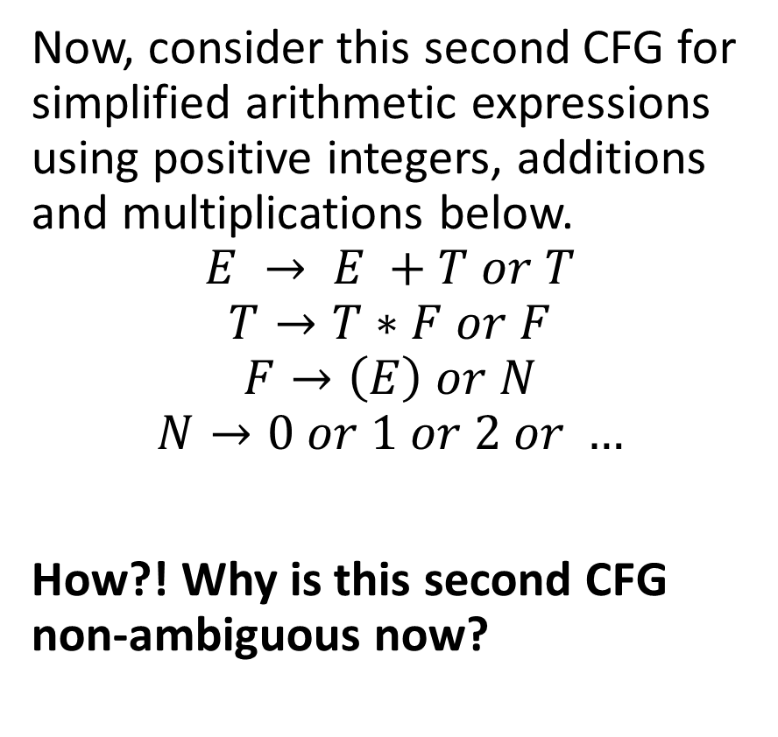
A first disambiguation example
Now, consider this second CFG for simplified arithmetic expressions using positive integers, additions and multiplications below.
$$E → E +T or T$$
$$T→T∗F or F$$
$$F→\left(E\right) or N$$
$$N→0 or 1 or 2 or …$$
How?! Why is this second CFG non-ambiguous now?
We introduced new non-terminal symbols T and F to represent terms and factors, respectively.
By doing so, we effectively established that multiplication has higher precedence than addition, as the * operator is now closer to the leaves of the parse tree.
Only one parse tree for each arithmetic expression!

Slide 15
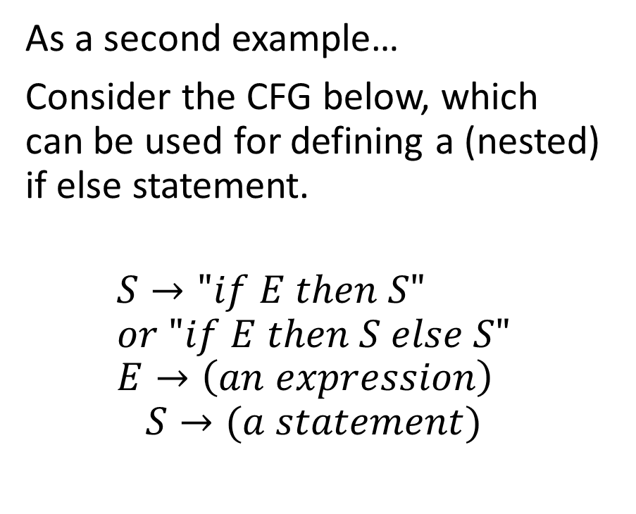
A second disambiguation example
As a second example…
Consider the CFG below, which can be used for defining a (nested) if else statement.
$$S→"if E then S" \\ or "if E then S else S" \\ E→\left(an expression\right)$$
$$S→(a statement)$$
This grammar is ambiguous and can lead to a problem called the dangling else problem.
Consider the string of tokens “if a then if b then s1 else s2”.
Which if does the else refer to?

Slide 16
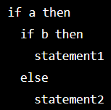
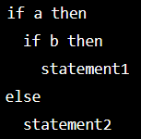
A second disambiguation example
As a second example…
Consider the CFG below, which can be used for defining a (nested) if else statement.
$$S→"if E then S" \\ or "if E then S else S" \\ E→\left(an expression\right)$$
$$S→(a statement)$$
This grammar is ambiguous and can lead to a problem called the dangling else problem.
Consider the string of tokens “if a then if b then s1 else s2”.
Which if does the else refer to?

Slide 17

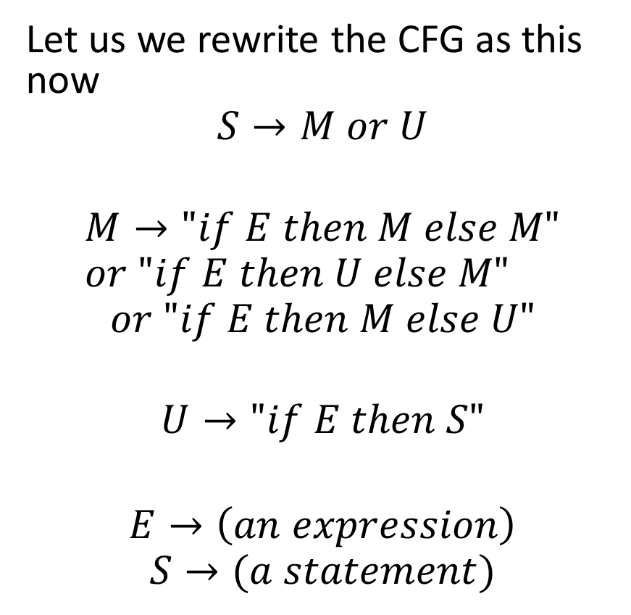
A second disambiguation example
Let us we rewrite the CFG as this now
$$S→M or U$$
$$M→"if E then M else M" \\ or "if E then U else M"$$
$$or "if E then M else U"$$
$$U→"if E then S"$$ $$E→\left(an expression\right)$$
$$S→(a statement)$$
This CFG is no longer ambiguous, as it now establishes a precedence: The first if that has not yet a matching else will now receive the else clause.

Slide 18
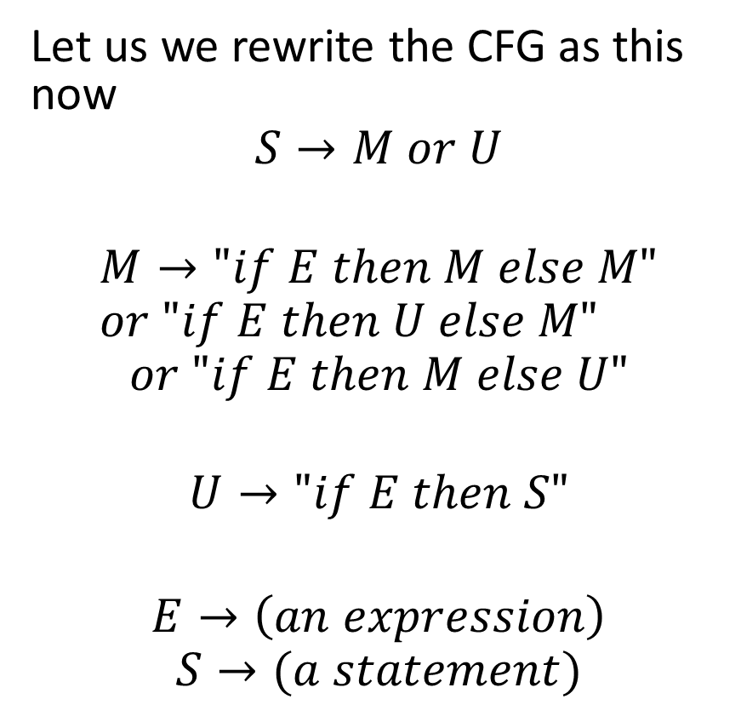
A second disambiguation example
Let us we rewrite the CFG as this now
$$S→M or U$$
$$M→"if E then M else M" \\ or "if E then U else M"$$
$$or "if E then M else U"$$
$$U→"if E then S"$$ $$E→\left(an expression\right)$$
$$S→(a statement)$$
This CFG is no longer ambiguous, as it now establishes a precedence: The first if that has not yet a matching else will now receive the else clause.
But wait, is that even correct to have such a precedence rule?!

Slide 19
A second disambiguation example
But wait, is that even correct to have such a precedence rule?!
This CFG is no longer ambiguous, as it now establishes a precedence: The first if that has not yet a matching else will now receive the else clause.

Slide 20
A second disambiguation example
But wait, is that even correct to have such a precedence rule?!
No it is not.
In fact that is the reason why programming languages will use additional delimiters for such statements.
In C, { and }.
In Python, indentation.
These delimiters should appear in the CFG production rules!
This CFG is no longer ambiguous, as it now establishes a precedence: The first if that has not yet a matching else will now receive the else clause.

Slide 21
A second disambiguation example
But wait, is that even correct to have such a precedence rule?!
No it is not.
In fact that is the reason why programming languages will use additional delimiters for such statements.
In C, { and }.
In Python, indentation.
These delimiters should appear in the CFG production rules!
This CFG is no longer ambiguous, as it now establishes a precedence: The first if that has not yet a matching else will now receive the else clause.

Slide 22
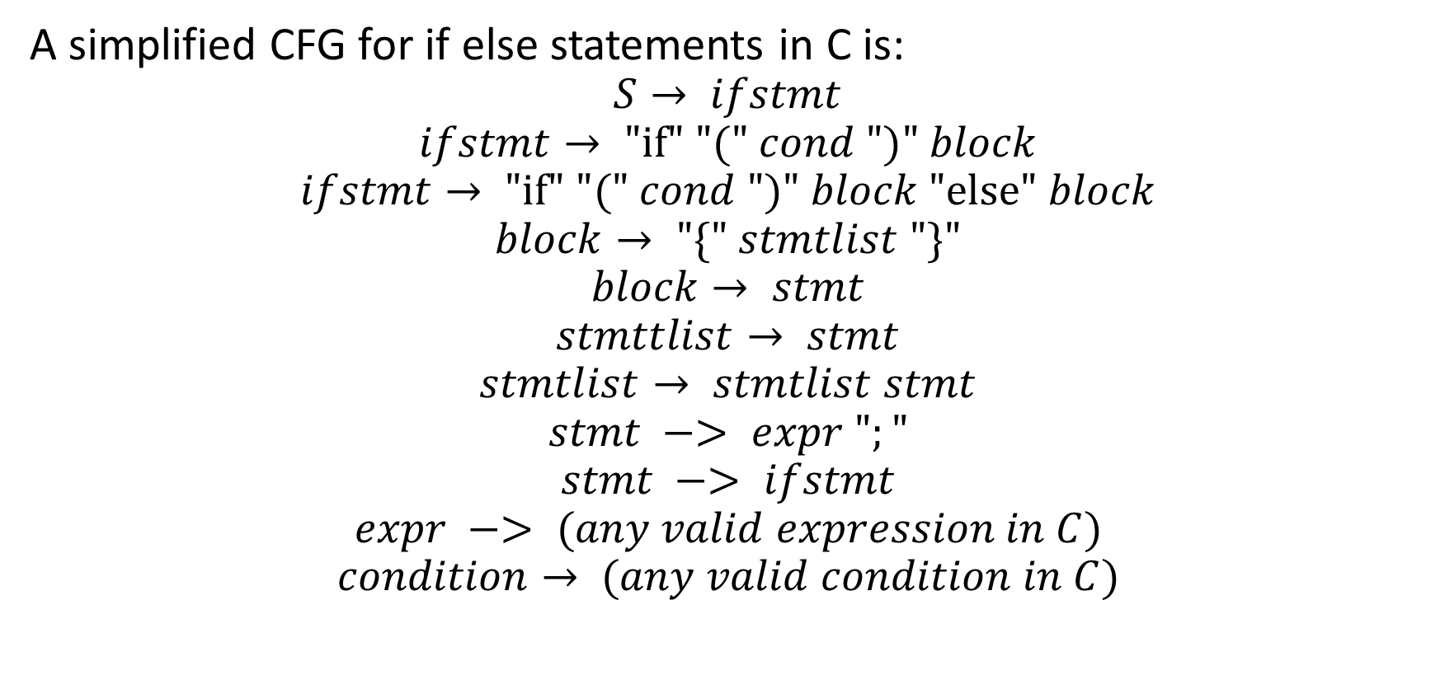
A CFG for if-else with delimiters
A simplified CFG for if else statements in C is:
$$S→ ifstmt$$
$$ifstmt→ "if" "(" cond ")" block$$
$$ifstmt→ "if" "(" cond ")" block "else" block$$
$$block→ "\{" stmtlist "\}"$$
$$block→ stmt$$
$$stmttlist→ stmt$$
$$stmtlist→ stmtlist stmt$$
$$stmt −> expr ";"$$
$$stmt −> ifstmt$$
$$expr −> (any valid expression in C)$$
$$condition→ (any valid condition in C)$$

Slide 23
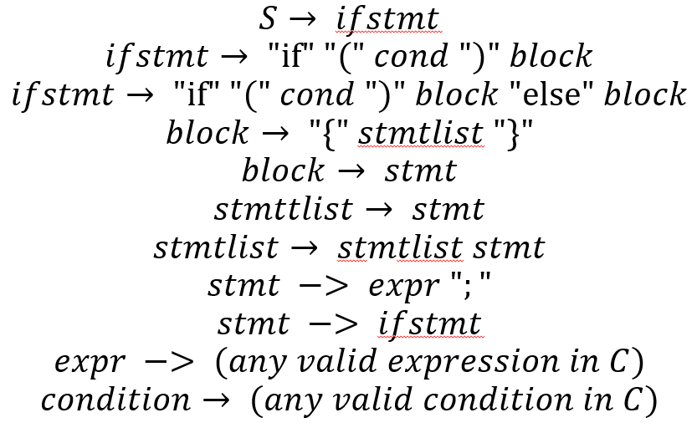
A CFG for if-else with delimiters
This CFG:
Lifts ambiguity by introducing delimiters (the { and } symbols).
Reuses also the CFG for checking what a valid expression in C might be,
Reuses the CFG checking what a valid condition/Boolean could look like.
Eventually, something similar for while, for, etc.

Slide 24
Associativity rules
Definition (Associativity):
Left-associativity and right-associativity refer to the order in which operations of the same precedence level are evaluated in an expression.
These concepts are important when designing CFGs for programming languages (or other formal languages), as they determine how expressions involving multiple occurrences of the same operator should be parsed and evaluated.

Slide 25
Associativity rules
Definition (Associativity):
An operator is left-associative if operations are evaluated from left to right.
When multiple occurrences of operators with same precedence appear in an expression, the leftmost operators are evaluated first.
This is the default associativity for most arithmetic operators in programming languages, such as addition.
For instance, in the expression 3 - 2 + 1, the subtraction operation would be evaluated first because of left-associativity, which would be equivalent to (3 - 2) + 1.

Slide 26
Associativity rules
Definition (Right-associativity):
An operator is right-associative, if operations are evaluated from right to left.
When multiple occurrences of operators with same precedence appear in an expression, the rightmost operators are evaluated first.
This is typically the associativity used for exponentiation or assignment operators in programming languages.
For instance, in the expression 2**3**2 (in Python, because C does not have an exponentiation operator?!), the second exponentiation operation would be evaluated first because of right-associativity. This would be equivalent to 2**(3**2).

Slide 27
Associativity rules
Definition (Associativity):
Left-associativity and right-associativity refer to the order in which operations of the same precedence level are evaluated in an expression.
These concepts are important when designing CFGs for programming languages (or other formal languages), as they determine how expressions involving multiple occurrences of the same operator should be parsed and evaluated.
This can be reflected in the way to write CFGs, so that derivations will generate parse trees with the correct sequence of operations.

Slide 28
A left-associative example: addition
Addition is left-associative.
7+2+3 should be computed as (7+2)+3.
Can be implemented with
E → E + F
E → F
F → (a number)
Using E+F instead of F+E makes derivations and parsing trees implement left-associativity.
E
E
+
F
E
+
F
3
F
2
7

Slide 29
A left-associative example: addition
Exponentiation is right-associative.
7**2**3 should be computed as 7**(2**3).
Can be implemented with
E → F ** E
E → F
F → (a number)
Using F**E instead of E**F makes derivations and parsing trees implement right-associativity.
E
F
**
E
7
F
**
E
2
F
3

Slide 30
Quiz time!
Consider the operation below, in Python. Which one are Left-Associative? Right-Associative? Which ones could be Both?
Subtraction, e.g. 7 – 2 – 3 .
Multiplication, e.g. 2 * 5 * 3.
Division, e.g. 8 / 4 / 2.
Assignment, e.g. x = y = z = 7.
Boolean or, e.g. x or y or z.

Slide 31
Quiz time!
Consider the operation below, in Python. Which one are Left-Associative? Right-Associative? Which ones could be Both?
Subtraction, e.g. 7 – 2 – 3 .
Multiplication, e.g. 2 * 5 * 3.
Division, e.g. 8 / 4 / 2.
Assignment, e.g. x = y = z = 7.
Boolean or, e.g. x or y or z.

Slide 32
Quiz time!
Consider the operation below, in Python. Which one are Left-Associative? Right-Associative? Which ones could be Both?
Subtraction, e.g. 7 – 2 – 3 .
Multiplication, e.g. 2 * 5 * 3.
Division, e.g. 8 / 4 / 2.
Assignment, e.g. x = y = z = 7.
Boolean or, e.g. x or y or z.

Slide 33
Quiz time!
Consider the operation below, in Python. Which one are Left-Associative? Right-Associative? Which ones could be Both?
Subtraction, e.g. 7 – 2 – 3 .
Multiplication, e.g. 2 * 5 * 3.
Division, e.g. 8 / 4 / 2.
Assignment, e.g. x = y = z = 7.
Boolean or, e.g. x or y or z.

Slide 34
Quiz time!
Consider the operation below, in Python. Which one are Left-Associative? Right-Associative? Which ones could be Both?
Subtraction, e.g. 7 – 2 – 3 .
Multiplication, e.g. 2 * 5 * 3.
Division, e.g. 8 / 4 / 2.
Assignment, e.g. x = y = z = 7.
Boolean or, e.g. x or y or z.

Slide 35
Quiz time!
Consider the operation below, in Python. Which one are Left-Associative? Right-Associative? Which ones could be Both?
Subtraction, e.g. 7 – 2 – 3 .
Multiplication, e.g. 2 * 5 * 3.
Division, e.g. 8 / 4 / 2.
Assignment, e.g. x = y = z = 7.
Boolean or, e.g. x or y or z.

Slide 36
Ambiguous grammars and fixing CFGs
To guarantee non-ambiguity for our CFGs and ensure that there is only one correct parse tree for any given string, there are a few manual techniques we can implement.
Some techniques for resolving ambiguity in CFGs manually:
Rewriting the grammar entirely,
Introducing precedence,
Introducing delimiters,
Introducing associativity rules.

Slide 37
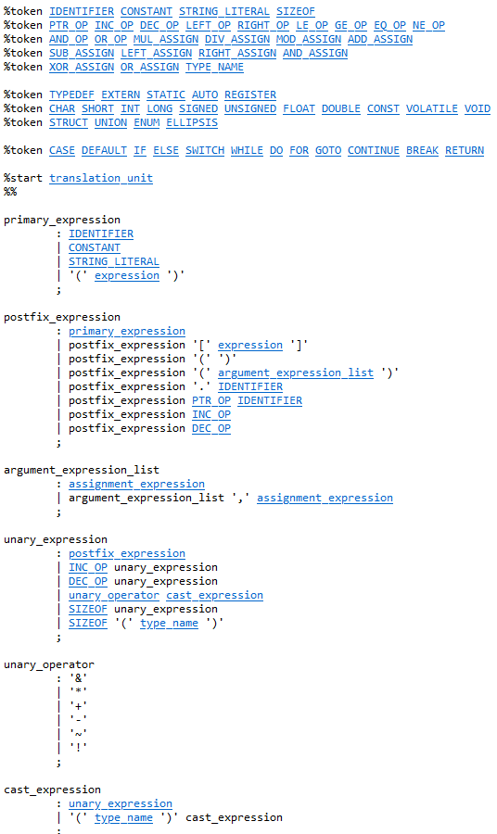
CFG for the whole language of C?!
Good news!
The entirety of the C language syntax rules can be described using a CFG of some sort!
(That is the sign of a well-designed syntax in a given programming language!)

Slide 38
CFG for the whole language of C?!
Writing a CFG for the whole language of C is hard, but a much needed task.
Approach it step-by-step by
Figuring out CFGs for expressions first (numerical, Boolean, strings, etc.),
Figuring out CFGs block structures (if, for, while, functions, classes, etc.),
Assembling everything (!)

Slide 39
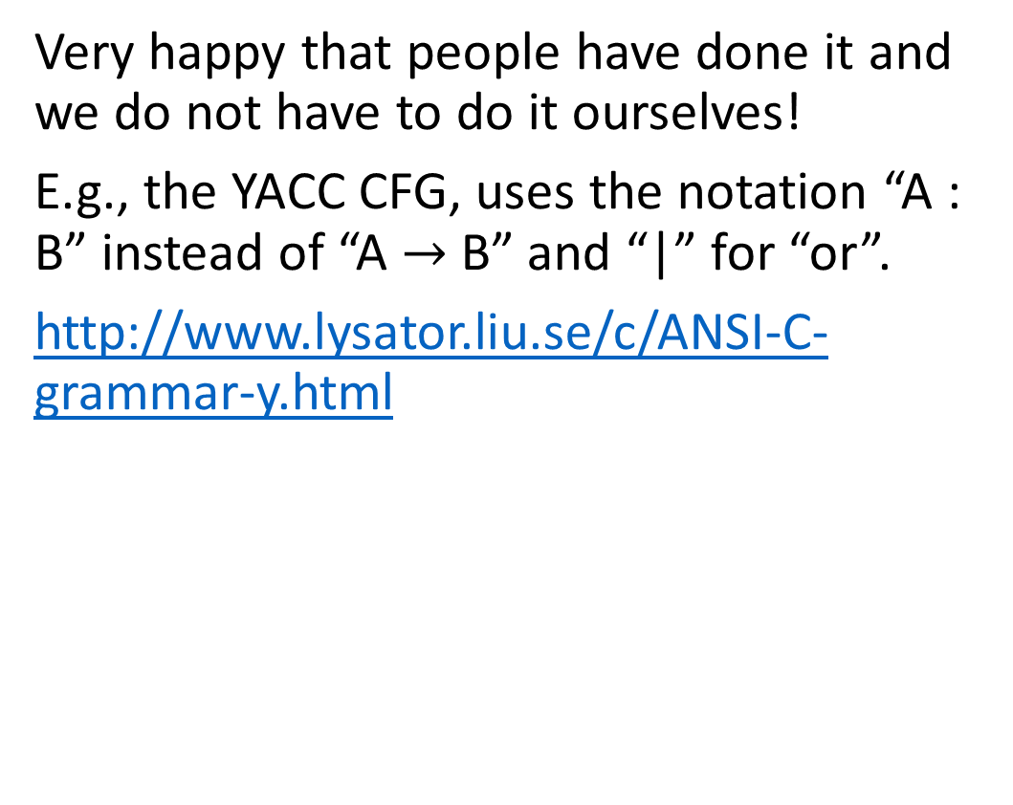
CFG for the whole language of C?!
Very happy that people have done it and we do not have to do it ourselves!
E.g., the YACC CFG, uses the notation “A : B” instead of “A $→$B” and “|” for “or”.
http://www.lysator.liu.se/c/ANSI-C-grammar-y.html

Slide 40
CFG for the whole language of C?!
But, of course, if you plan to create your own programming language…
…Then figuring out the CFG for the syntax of your language is your job!
Difficult! (so maybe do not try and make your own programming language…!)
But not impossible (just requires to be very very well-organized…)

Slide 41
About Syntax Directed Translation
In this next part of the lecture, we will introduce Syntax-Directed Translation (SDT) and Abstract Syntax Trees (AST).
SDT combines the syntactic structure of a source language
With semantic rules to generate a target language representation, such as intermediate code, abstract syntax trees, or later on the target machine code we want as the result of compilation.
In a sense, we are already looking ahead, at the next steps,
Trying to connect our parse trees,
With the semantic analysis and the intermediate code generation.
(To be discussed on Week 12!).

Slide 42
Syntax Directed Translation: definitions
Definition (Syntax-Directed Translation):
Syntax-directed Translation is a formalism used to describe the translation process in the parse trees generated by a given CFG.
They associate
Semantic actions and attribute computations
With the production rules, that have been used in a parse tree.
This enables a systematic approach to generating target language representations from source language constructs.
Syntax-directed definitions consist of two main components, added to a CFG definition, namely attributes and rules.

Slide 43
Syntax Directed Translation: definitions
Definition (Attributes):
Attributes are properties associated with grammar symbols, for both terminals symbols (typically represented as tokens, resulting from the Tokenization) and non-terminals symbols.
These attributes store semantic information required for the translation process. Attributes will typically be used to:
Hold intermediate results,
Hold information about the structure of the source language,
Or store information about the target language representation.
Two types of attributes: synthesized attributes and inherited attributes.

Slide 44
Syntax Directed Translation: definitions
Definition (Synthetized Attributes):
Synthesized Attributes are information contained in the children nodes in the parse tree, and are often following from the tokens descriptions.
These attributes propagate information up the tree, from the leaves (terminals) towards the root (start symbol).
E
E
+
F
E
+
F
3
F
2
7

Slide 45
Syntax Directed Translation: definitions
Consider a production E → E2 + F, with E and E2 being a non-terminal symbol representing expressions, and F being a non-terminal symbol representing a term.
We can define a synthesized attribute 'value' for E2 and F to compute the value of the expression E.
The value of E would be calculated using the values of E2 and F, as in E.value = E2.value + F.value.
E
E2
+
F
E3
+
F
3
F
2
7

Slide 46
Syntax Directed Translation: definitions
Consider a production E → E2 + F, with E and E2 being a non-terminal symbol representing expressions, and F being a non-terminal symbol representing a term.
We can define a synthesized attribute 'value' for E2 and F to compute the value of the expression E.
The value of E would be calculated using the values of E2 and F, as in E.value = E2.value + F.value.
E
E2
+
F
E3
+
F
3
F
2
7

Slide 47
Syntax Directed Translation: definitions
Consider a production E → E2 + F, with E and E2 being a non-terminal symbol representing expressions, and F being a non-terminal symbol representing a term.
We can define a synthesized attribute 'value' for E2 and F to compute the value of the expression E.
The value of E would be calculated using the values of E2 and F, as in E.value = E2.value + F.value.
E
E2
+
F
E3
+
F
3
F.Val = 7
F
2
7

Slide 48
Syntax Directed Translation: definitions
Consider a production E → E2 + F, with E and E2 being a non-terminal symbol representing expressions, and F being a non-terminal symbol representing a term.
We can define a synthesized attribute 'value' for E2 and F to compute the value of the expression E.
The value of E would be calculated using the values of E2 and F, as in E.value = E2.value + F.value.
E
E2
+
F
E3
+
F
3
E3.Val = 7
F.Val = 2
F.Val = 7
F
2
7

Slide 49
Syntax Directed Translation: definitions
Consider a production E → E2 + F, with E and E2 being a non-terminal symbol representing expressions, and F being a non-terminal symbol representing a term.
We can define a synthesized attribute 'value' for E2 and F to compute the value of the expression E.
The value of E would be calculated using the values of E2 and F, as in E.value = E2.value + F.value.
E
E2.Val = E3.Val + F.Val = 7 + 2 = 9
E2
+
F
E3
+
F
3
E3.Val = 7
F.Val = 2
F.Val = 7
F
2
7

Slide 50
Syntax Directed Translation: definitions
Definition (Inherited Attributes):
Inherited attributes are computed from the attribute values of the parent nodes and siblings nodes in the parse tree.
They propagate information around and down the tree, from the root (start symbol) towards the leaves (terminals).
Inherited attributes are useful for passing context information from higher-level constructs to lower-level constructs in the parse tree.
S
TypeDecl
=
Type
Var
Expr
int
x
E3
+
F
F
Var
7
y

Slide 51
Syntax Directed Translation: definitions
For example, consider the expression below.
int x = 7 + y;
The “int” declaration, probably resolved last in the parse tree for this expression, enforces a constraint on the type of the literal “7” and the identifier “y”, which will both need to be of type int as well.
This information will typically be propagated around and, eventually, down the tree.
S
TypeDecl
=
Type
Var
Expr
int
x
E3
+
F
F
Var
7
y

Slide 52
Syntax Directed Translation: definitions
Definition (Rules):
Rules in SDTs associate semantic actions and attribute computations with grammar productions.
They define how attribute values are computed and propagated in the parse tree and how they will later contribute to the translation process.
Each rule consists of an addendum, applied to any CFG production rule and usually defines a set of attribute computation equations.
The equations specify how the attributes of the non-terminal symbols in the production are computed from the attributes of their children or from the attributes of the parent and siblings.

Slide 53
Syntax Directed Translation: definitions
In this previous example…
E.value = E2.value + F.value
Was the SDT rule added to the production rule E → E2 + F.
E
E2.Val = E3.Val + F.Val = 7 + 2 = 9
E2
+
F
E3
+
F
3
E3.Val = 7
F.Val = 2
F.Val = 7
F
2
7

Slide 54
Implementing an SDT for Arithmetic CFG
Consider the CFG below.
E → E + T
E → T
T → (any number)
We have used this one many times to check the syntax of simple arithmetic strings.

Slide 55
Implementing an SDT for Arithmetic CFG
Consider the CFG below.
It can be modified with the following SDT rules.
E → E + T (E.val = E.val + T.val)
E → T (E.val = T.val)
T → (any number) (T.val = number.val)
These rules specify how to compute the value of each non-terminal symbol based on the values of its children.
(Could be extended to more arithmetic operations…)

Slide 56
Implementing an SDT for Arithmetic CFG
Consider the CFG below, modified with the following SDT rules.
E → E + T (E.val = E.val + T.val)
E → T (E.val = T.val)
T → (any number) (T.val = number.val)
This CFG/SDT could later be extended to
More arithmetic operations,
More programming operations, (assignments, function declarations, etc.)
Block structures (if, for, while, switch, etc.)
Etc.

Slide 57
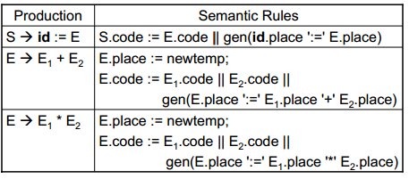
Implementing an SDT for Arithmetic CFG
Basically, all the production rules of the YACC CFG will have an SDT rule implemented! (And we are quite grateful, we do not have to figure them out ourselves, even though we could!)

Slide 58
AST building procedure
To demonstrate how to build an Abstract Syntax Tree (AST), let us consider an arithmetic CFG and its SDT rules, and an arithmetic expression, for instance the string x = “26*5 + 7”. Several steps are involved:
Use the CFG production rules to find a derivation for string x.
If no derivation can be found, stop, because invalid syntax in x.
Otherwise, list the production rules you have used.
Build the parse tree for this derivation.
Transform the list of production rules into a list of SDT rules to use on the parse tree to propagate information.
Produce an AST, which is the propagated version of the parse tree.

Slide 59
Implementing an SDT for Arithmetic CFG
Consider the CFG below, modified with the following SDT rules.
E → E + T (E.val = E.val + T.val)
E → T (E.val = T.val)
T → (any number) (T.val = number.val)
This CFG/SDT could later be extended to
More arithmetic operations,
More programming operations, (assignments, function declarations, etc.)
Block structures (if, for, while, switch, etc.)
Etc.

Slide 60
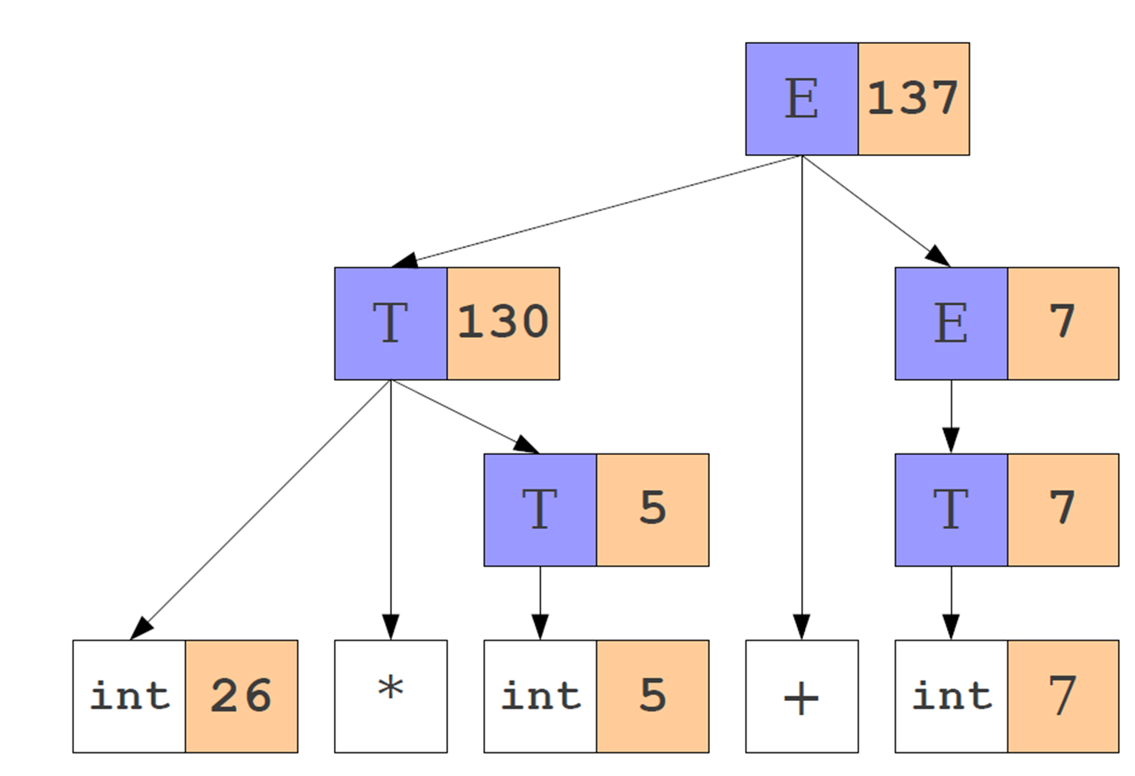
Implementing an SDT for Arithmetic CFG
Using these steps, on the string “26*5 + 7”, then gives the following Abstract Syntax Tree and list of SDT rules…
And the list of operations below:
I1.val = 26
I2.val = 5
T1.val = i2.val
T2.val = T1.val*i1.val
I3.val = 7
T3.val = i3.val
E1.val = T3.val
E.val = T2.val + E1.val

Slide 61
From CFG to SDT
Syntax-directed definitions provide a systematic way of associating
Semantic actions,
And attribute computations,
With grammar productions.
By combining synthesized and inherited attributes with appropriate rules and building our Abstract Syntax Tree, it is possible to define a translation process that generates target language representations from source language constructs in a well-defined manner.

Slide 62
Remember: Intermediate code representations
Definition (intermediate code representations):
The intermediate code generated during this phase is often represented in a language that is easier to manipulate than the original source code.
Some examples of intermediate code representation languages that we will investigate in Week 12, are:
Three-address code,
Virtual machine code,
and Abstract syntax trees.

Slide 63
Remember: Three-address code representation
Definition (Three-address code representation):
Three-address code is a low-level intermediate code representation used by compilers to facilitate optimization and code generation.
It is called “three-address” because each instruction in the code can have at most three operands.
A typical three-address code instruction has the following format:
$$operand1=operand2 operator operand3$$

Slide 64
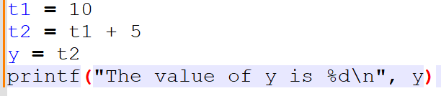
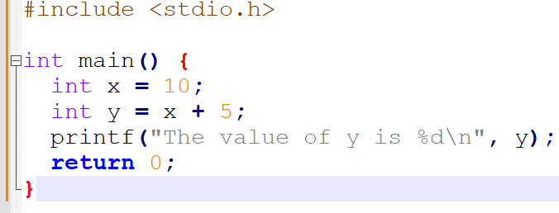
Remember: Three-address code representation
For instance, the C code below can be transformed…
…into its equivalent three-address code representation.

Slide 65
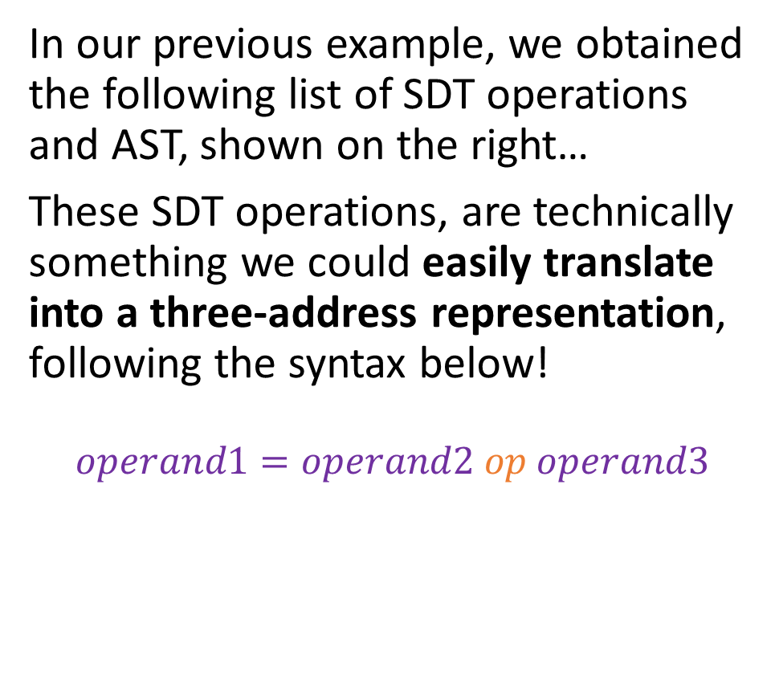
From CFG to SDT to IR?!
In our previous example, we obtained the following list of SDT operations and AST, shown on the right…
These SDT operations, are technically something we could easily translate into a three-address representation, following the syntax below!
$$operand1=operand2 op operand3$$
I1.val = 26
I2.val = 5
T1.val = i2.val
T2.val = T1.val*i1.val
I3.val = 7
T3.val = i3.val
E1.val = T3.val
E.val = T2.val + E1.val

Slide 66
From CFG to SDT to IR?!
Having an Abstract Syntax Tree, following from using SDT Rules on our Parse Tree/CFG, brings us very close to being able to produce an Intermediate Code Representation!
I1.val = 26
I2.val = 5
T1.val = i2.val
T2.val = T1.val*i1.val
I3.val = 7
T3.val = i3.val
E1.val = T3.val
E.val = T2.val + E1.val

Slide 67
From CFG to SDT to IR?!
Having an Abstract Syntax Tree, following from using SDT Rules on our Parse Tree/CFG, brings us very close to being able to produce an Intermediate Code Representation!
Two problems, however…
I1.val = 26
I2.val = 5
T1.val = i2.val
T2.val = T1.val*i1.val
I3.val = 7
T3.val = i3.val
E1.val = T3.val
E.val = T2.val + E1.val

Slide 68
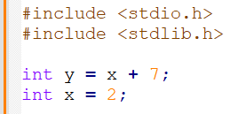
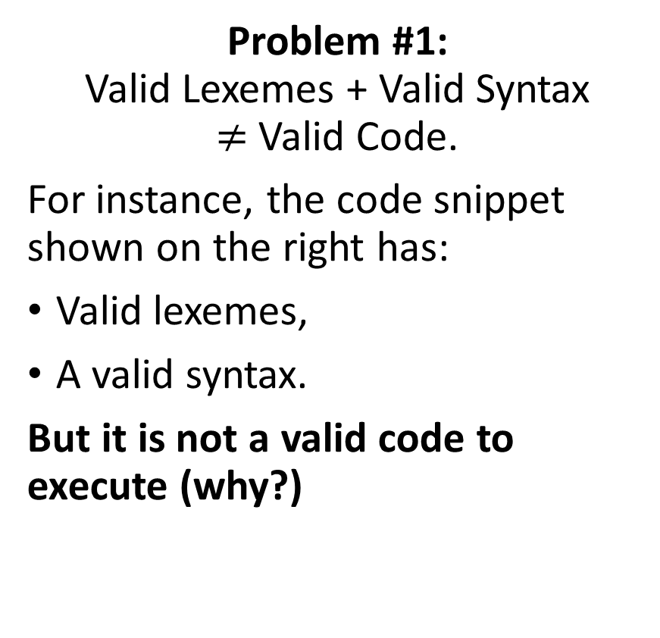
Problem #1
Problem #1: Valid Lexemes + Valid Syntax $≠$ Valid Code.
For instance, the code snippet shown on the right has:
Valid lexemes,
A valid syntax.
But it is not a valid code to execute (why?)

Slide 69
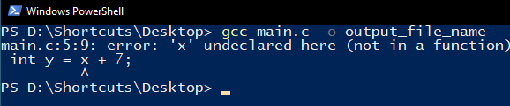
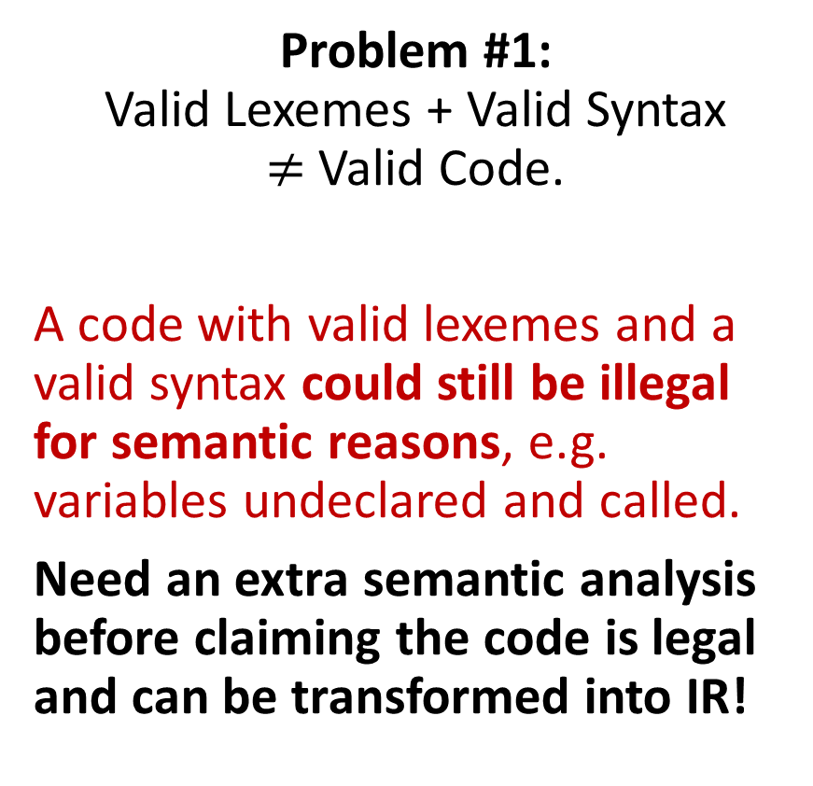
Problem #1
Problem #1: Valid Lexemes + Valid Syntax $≠$ Valid Code.
A code with valid lexemes and a valid syntax could still be illegal for semantic reasons, e.g. variables undeclared and called.
Need an extra semantic analysis before claiming the code is legal and can be transformed into IR!

Slide 70
The unspoken problem #2
Given a CFG and a string x whose syntax needs to be verified
We understand how to use production rules and apply them manually to eventually find the string x.
We understand how to derive a parse tree for the derivation.
We understand how to add syntax-directed rules to our production rules and use them in the derivation.
We understand how to use syntax-directed rules to transform our parse tree into an AST.
We are good with the syntax analysis right?

Slide 71
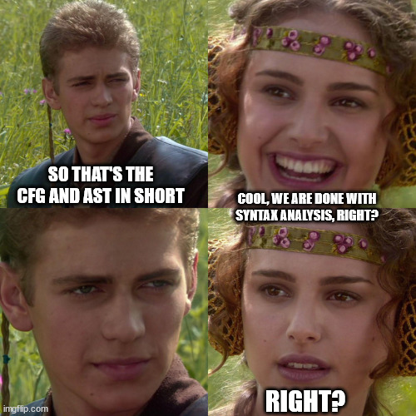
The unspoken problem
Given a CFG and a string x whose syntax needs to be verified
We understand how to use production rules and apply them manually to eventually find the string x.
We understand how to derive a parse tree for the derivation.
We understand how to add syntax-directed rules to our production rules and use them in the derivation.
We understand how to use syntax-directed rules to transform our parse tree into an AST.
We are good with the syntax analysis right?

Slide 72
The unspoken problem
We are good with the syntax analysis part, right?
Oh my dear, if only…

Slide 73
The unspoken problem
For syntax analysis, we still need
An algorithm to find if a given string of tokens x has a valid syntax and admits a valid derivation for our given CFG,
And one that will return the derivation, parse tree and abstract syntax tree produced for any syntactically valid string x!
Small tiny teeny issue: This is absolutely not an easy problem algorithmically speaking! (It is very much NP-Hard!) Will take us the next three lectures…! And we will not even dare to implement said algorithms…!

Slide 74
Quiz time!
Which problem can be caused by ambiguous grammars in compilers?
Performance issues
Parsing errors and code being incorrectly computed
A valid source code being recognized as faulty by the compiler
None of the above

Slide 75
Quiz time!
Which problem can be caused by ambiguous grammars in compilers?
Performance issues
Parsing errors and code being incorrectly computed
A valid source code being recognized as faulty by the compiler
None of the above

Slide 76
Quiz time!
What is the main goal of Syntax-Directed Translation (SDT)?
To create an efficient parser
To translate operations in a source code, in a sequence of simple operations, that can later easily translate into intermediate code
To optimize the source code
To detect syntax errors in the source program

Slide 77
Quiz time!
What is the main goal of Syntax-Directed Translation (SDT)?
To create an efficient parser
To translate operations in a source code, in a sequence of simple operations, that can later easily translate into intermediate code
To optimize the source code
To detect syntax errors in the source program

Slide 78
Quiz time!
In Syntax-Directed Translation, what are inherited attributes?
Attributes that are passed from parent to child nodes
Attributes that are passed from child to parent nodes
Attributes that are shared between sibling nodes
Attributes that are only associated with terminal nodes

Slide 79
Quiz time!
In Syntax-Directed Translation, what are inherited attributes?
Attributes that are passed from parent to child nodes
Attributes that are passed from child to parent nodes
Attributes that are shared between sibling nodes
Attributes that are only associated with terminal nodes

Slide 80
Quiz time!
What is a great benefit, following from using Abstract Syntax Trees compared to parse trees only?
ASTs include only the essential information required to compute a given expression and break the computation into elementary steps
ASTs are guaranteed to be symmetrical, while parse trees are not
ASTs and parse trees are the same
Both A and B

Slide 81
Quiz time!
What is a great benefit, following from using Abstract Syntax Trees compared to parse trees only?
ASTs include only the essential information required to compute a given expression and break the computation into elementary steps
ASTs are guaranteed to be symmetrical, while parse trees are not
ASTs and parse trees are the same
Both A and B

Slide 82
Quiz time!
In programming languages, which of the following can be represented using an Abstract Syntax Tree?
Arithmetic expressions
Boolean expressions
Simple programming language constructs, like if and while
All of the above
None of the above

Slide 83
Quiz time!
In programming languages, which of the following can be represented using an Abstract Syntax Tree?
Arithmetic expressions
Boolean expressions
Simple programming language constructs, like if and while
All of the above
None of the above

Slide 84
If time allows, practice
Practice 1: Precedence and associativity
Consider the three Boolean expressions below.
TRUE AND FALSE OR NOT TRUE
NOT (TRUE OR FALSE) AND TRUE
(NOT TRUE OR FALSE) AND (TRUE OR NOT FALSE)
Question: What is the precedence order between the different operators in these expressions? For each of the typical Boolean operations, are they left-associative or right-associative?

Slide 85
If time allows, practice
Practice 2: Grammar Rewriting
Consider the CFG below, for Boolean expressions, which will check any string of Booleans consisting of combinations of the words true, false, and, or and not, along with parentheses. As or, is now a keyword, we use | as in RegEx to separate different possible outputs for prod. rules.
E → E and E | E or E | not E | (E) | T
T → true | false
Question: Is this CFG ambiguous?
If so, can you provide an example of a string that generates two parse trees with opposite behaviors?
And if so, can you rewrite the CFG in a non-ambiguous manner?

Slide 86
If time allows, practice
Practice 2: Grammar Rewriting
Answer: Yes it is ambiguous. The problem has to do with precedence between and/or/not and many problematic strings can be considered.
A possible way to rewrite the CFG to make it not ambiguous is shown below. It accounts for associativity and precedence on each operator.
E → E or T
T → T and F | F
F → not F | (E) | L
L → true | false

Slide 87
If time allows, practice
Practice 3: From CFG to SDT
Question: Consider the CFG below, being the non-ambiguous answer provided to the previous question. Which SDT rules would you add to each of the production rules below?
E → E or T
T → T and F
T → F
F → not F
F → (E)
F → L
L → true | false

Slide 88
If time allows, practice
Practice 4: SDT, and AST construction
Consider the CFG and SDT rules (between {}) below.
E → E + T {E.val = E1.val + T.val}
E → T {E.val = T.val}
T → T * F {T.val = T1.val * F.val}
T → F {T.val = F.val}
F → (E) {F.val = E.val}
F → num {F.val = num.val}
Question: Build an AST and find the list of three-address operations resulting from the arithmetic string “(4+3)*2 + 8*7 + 3”.

