Slide 1

50.051 Programming Language Concepts W12-S1 Semantic Analysis and Intermediate Representations
Matthieu De Mari

Slide 2
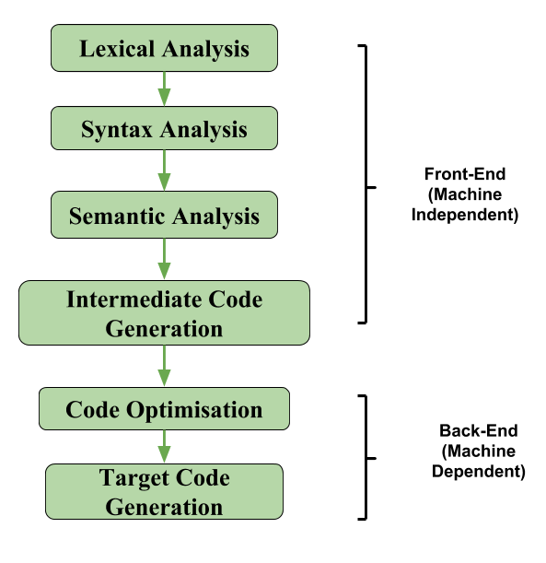
The front-end of a compiler
Definition (The front-end part of a compiler):
The front-end of a compiler is responsible for analysing the source code, and converting it into a form that can be used by the rest of the compiler.
It involves tasks, such as:
Lexical analysis,
Syntax analysis,
and Semantic analysis.

Slide 3
The front-end of a compiler
Lexical Analysis
Detects illegal tokens in source code (e.g. incorrect use of identifiers, literals, etc.)
Syntax Analysis
Detects inputs that violate the syntax rules of the language
Will typically result in impossible-to-form or ill-formed parsing trees.

Slide 4
The front-end of a compiler
Semantic Analysis
Final step in the “front-end” phase, whose job is to check that the source code is legal.
Ensures that the program has a well-defined meaning.
Should catch all remaining errors that lexical analysis and syntax analysis could not catch.
Errors that require contextual information about the code.

Slide 5
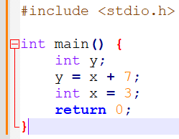
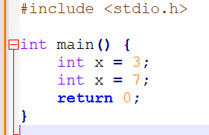
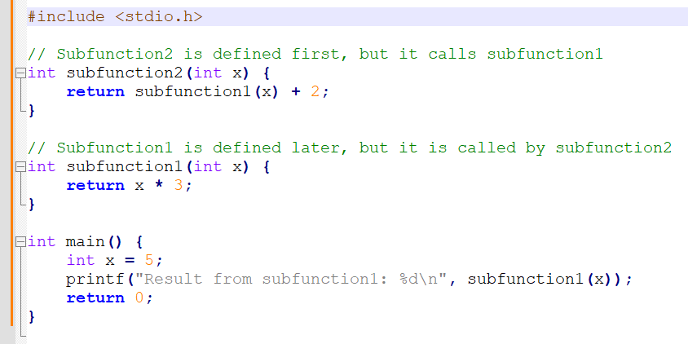
Examples of remaining errors
Scope problems
A variable is defined after it is called for the first time.
A function is defined after it is called for the first time and no function prototypes were mentioned.
A variable defined in a function is called outside of the function.
A variable name is defined twice.
Etc.

Slide 6
Examples of remaining errors
Why cannot we just catch these errors during parsing?
Try writing a CFG that will be able to prevent duplicate variable definitions?
For most programming languages, using a CFG to do that is provably impossible.
Proof using the pumping lemma for context-free languages, or Ogden's lemma.

Slide 7
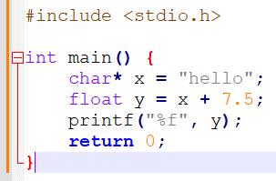
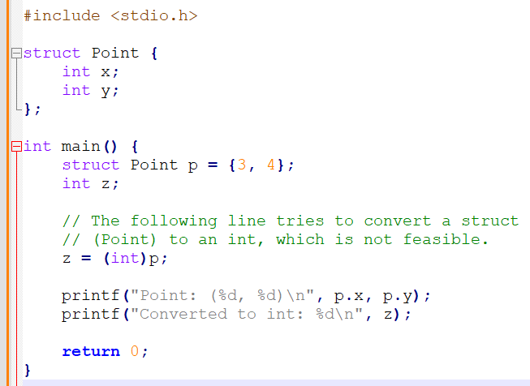
Examples of remaining errors
Type problems
An operation attempts to combine two invalid types together (e.g. summing a string and a float together).
An operation attempts to convert a variable of a certain type in another type that is not feasible.
Etc.

Slide 8
Examples of remaining errors
And more problems that have to do with classes!
A class inherits from another class that is not defined yet.
A child class attempts to use a method that was neither defined in the child class itself, nor the parent class it inherited from.
Operators on custom classes being used incorrectly.
Etc.

Slide 9
Examples of remaining errors
Important fact: These errors cannot be checked during the lexical analysis or the syntax analysis, as they require some context.
Cannot be checked by a context-free grammar.
Often depends on values and context, not syntax.
May sometimes require and involve computation.
What to do then?
Instead, will need to define a set of semantic rules for scoping and types explicitly.
And then, perform additional checks after parsing.
These checks will be implemented in the form of “if-else” checks.

Slide 10
Where are we at now?
At the end of the lexical analysis and parsing phase.
We have successfully tokenized our source code and produced a stream of Tokens objects (containing information about token type, lexeme, value, line number/position, etc.).
We have established a derivation for the language CFG and the given stream of tokens.
We have produced a parse tree following from that derivation.
Using Syntax Directed Translation, we could define a list of elementary operations to be executed, matching each production rule we used and eventually obtain an Abstract Syntax Tree.

Slide 11
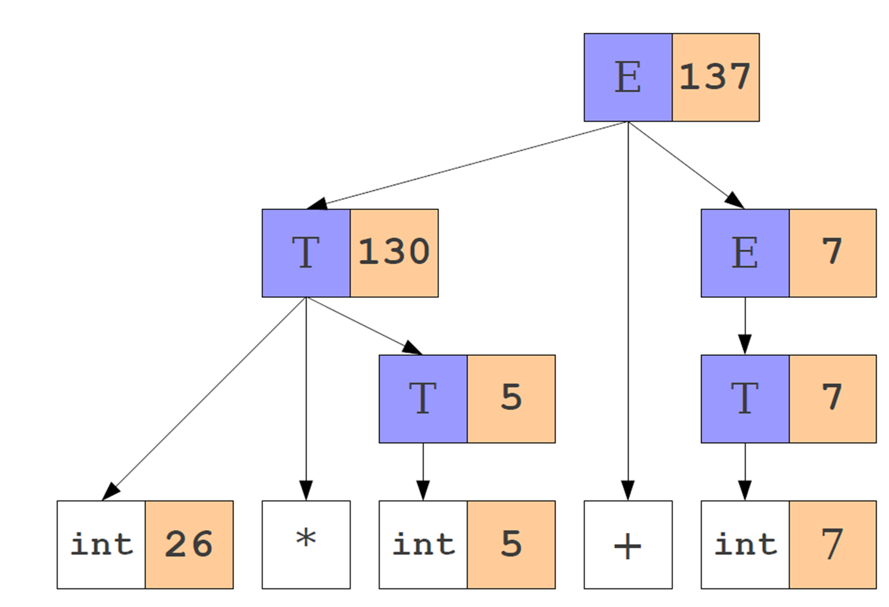
Implementing an SDT for Arithmetic CFG
Consider the CFG below, modified with the following SDT rules.
E → E + T {E.val = E1.val + T.val}
E → T {E.val = T.val}
T → T * F {T.val = T1.val * F.val}
T → F {T.val = F.val}
F → (E) {F.val = E.val}
F → num {F.val = num.val}
Using this CFG/SDT on 26*5 + 7 gives the following derivation and parse tree.
Sequence of operations in parse tree = bottom-up reading = DFS!

Slide 12
Implementing an SDT for Arithmetic CFG
Using these steps, on the string “26*5 + 7”, then gives the following Abstract Syntax Tree and list of SDT rules…
And the list of operations below:
I1.val = 26
I2.val = 5
T1.val = i2.val
T2.val = T1.val*i1.val
I3.val = 7
T3.val = i3.val
E1.val = T3.val
E.val = T2.val + E1.val

Slide 13
Semantic analysis and ASTs
Objective: The answer to the semantic problems
Scope problems,
Type problems,
And more,…
And the checks to be conducted, both rely on the Abstract Syntax Tree produced by the syntax analysis step.

Slide 14
Problem #1: Scope
Scope problems
A variable is defined after it is called for the first time.
A function is defined after it is called for the first time and no function prototypes were mentioned.
A variable defined in a function is called outside of the function.
A variable name is defined twice.
Etc.

Slide 15
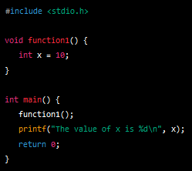
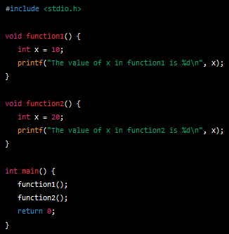
First things first
Definition (Scope):
The scope of an identifier (variable/function name, etc.) is the portion of the program in which this identifier is accessible.
Decides if a variable can be called outside of a function,
Resolves ambiguity about identifiers with similar names used in different functions,
Etc.

Slide 16
First things first
Definition (Static and Dynamic Scope):
Most languages have a static scope.
A static scope depends only on the program code, not its runtime behaviour.
Typically C and Java.
Some languages are dynamically scoped.
A dynamic scope may depend on the execution of the program and is decided during runtime.
For instance, JavaScript (?) and LaTeX.
Is static better than dynamic? Not a kind of debate I want to participate in!

Slide 17
Static scoping
Let us start with static scoping.
Some questions that need to be answered for static scoping are:
How can we tell what object a particular identifier refers to?
How do we store this information?
Need a symbol table to keep track of symbols/identifiers!
(Note: Dynamic scoping follows roughly the same ideas, just not happening during compile time, but during runtime instead!)

Slide 18
Symbol table
Definition (symbol table in a compiler):
A symbol table contains information about identifiers, that might prove useful to the compiler. It simply represents a mapping from a name to the thing that name refers to. This information typically consists of
Textual name,
Data type,
Declaration procedure,
If array, number and size of dimensions,
If procedure, number and type of parameters, location for function definition and procedure to be run by function when called,
Etc.

Slide 19
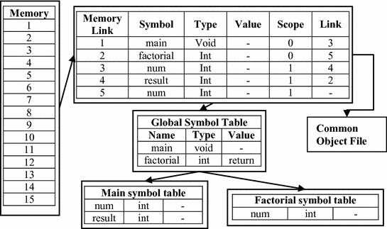
Implementing a symbol table
Simple solution: Define our symbol table as a hash table of some sort.
As we run our semantic analysis, continuously update the symbol table with information about what is in scope.
What does this look like in practice?
What operations need to be defined on it?
How do we implement it?
Forgot about hash tables?
Time to go back to the contents of 50.004 Algorithms!

Slide 20
Implementing a symbol table
For simplicity: can be implemented as a stack of maps.
Each map corresponds to a particular scope.
Stack allows for easy “enter” and “exit” operations.
Symbol table operations are
Push scope: Enter a new scope.
Pop scope: Leave a scope, discarding all declarations in it.
Insert symbol: Add a new entry to the current scope.
Lookup symbol: Find what an identifier name corresponds to.
Remove symbol: Remove entry from the current scope.

Slide 21
Implementing an SDT for Arithmetic CFG
Consider the CFG below, modified with the following SDT rules.
E → E + T {E.val = E1.val + T.val}
E → T {E.val = T.val}
T → T * F {T.val = T1.val * F.val}
T → F {T.val = F.val}
F → (E) {F.val = E.val}
F → num {F.val = num.val}
In practice, the symbol table actions could be added to our Syntax-Driven Translation rules!
We would then have two SDT instructions per CFG rule:
One that defines the elementary operation to be used (in a language close to the 3-address format),
And one describing the symbol table updates.

Slide 22
Implementing a symbol table
Before demo: the idea is to process each portion of the program that creates a scope independently (e.g. block statements, function calls, classes, etc.):
Start by entering a new scope.
Add all variable declarations to the symbol table.
Process the body of the block/function/class.
Exit the scope.
Most of the semantic analysis is defined in terms of recursive AST traversals like this.

Slide 23
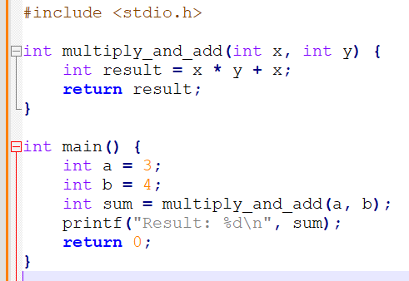
Implementing a symbol table
Consider the code below.
During execution, the symbol table will be created as follows.
Global scope

Slide 24
Implementing a symbol table
Consider the code below.
During execution, the symbol table will be created as follows.
Global scope
├ multiply_and_add (function) (could also add information about parameters types and return types)
Add identifier for function to scope

Slide 25
Implementing a symbol table
Consider the code below.
During execution, the symbol table will be created as follows.
Global scope
├ multiply_and_add (function)
└─ main (func. scope)
Skipped for now
Open new scope with name main()

Slide 26
Implementing a symbol table
Consider the code below.
During execution, the symbol table will be created as follows.
Global scope
├ multiply_and_add (function)
└─ main (func. scope)
├ a (int, 3)
Add identifier for variable to scope

Slide 27
Implementing a symbol table
Consider the code below.
During execution, the symbol table will be created as follows.
Global scope
├ multiply_and_add (function)
└─ main (func. scope)
├ a (int, 3)
├ b (int, 4)
Add identifier for variable to scope

Slide 28
Implementing a symbol table
Consider the code below.
During execution, the symbol table will be created as follows.
Global scope
├ multiply_and_add (function)
└─ main (func. scope)
├ a (int, 3)
├ b (int, 4)
└─ sum (int, ?)
├ multiply_and_add (func. scope)
Add identifier for variable to scope
Also, open a new scope for function call

Slide 29
Implementing a symbol table
Consider the code below.
During execution, the symbol table will be created as follows.
Global scope
├ multiply_and_add (function)
└─ main (func. scope)
├ a (int, 3)
├ b (int, 4)
└─ sum (int, ?)
├ multiply_and_add (func. scope)
├ x (int, parameter, 3)
├ y (int, parameter, 4)
Add identifiers for variable to scope

Slide 30
Implementing a symbol table
Consider the code below.
During execution, the symbol table will be created as follows.
Global scope
├ multiply_and_add (function)
└─ main (func. scope)
├ a (int, 3)
├ b (int, 4)
└─ sum (int, ?)
├ multiply_and_add (func. scope)
├ x (int, parameter, 3)
├ y (int, parameter, 4)
└─ result (int, 15)
Add identifier for variable to scope

Slide 31
Implementing a symbol table
Consider the code below.
During execution, the symbol table will be created as follows.
Global scope
├ multiply_and_add (function)
└─ main (func. scope)
├ a (int, 3)
├ b (int, 4)
└─ sum (int, 15)
├ multiply_and_add (func. scope)
├ x (int, parameter, 3)
├ y (int, parameter, 4)
└─ result (int, 15)
Return = transfer value of identifier result to identifier sum and close function scope

Slide 32
Implementing a symbol table
Consider the code below.
During execution, the symbol table will be created as follows.
Global scope
├ multiply_and_add (function)
└─ main (func. scope)
├ a (int, 3)
├ b (int, 4)
└─ sum (int, 15)
Return = transfer value of identifier result to identifier sum and close function scope

Slide 33
Implementing a symbol table
Consider the code below.
During execution, the symbol table will be created as follows.
Global scope
├ multiply_and_add (function)
└─ main (func. scope)
├ a (int)
├ b (int)
└─ sum (int)
Print fetches identifier sum from symbol table

Slide 34
Implementing a symbol table
Consider the code below.
During execution, the symbol table will be created as follows.
Global scope
├ multiply_and_add (function)
└─ main (func. scope)
├ a (int, 3)
├ b (int, 4)
└─ sum (int, 15)
Return 0 and close function scope main()

Slide 35
Implementing a symbol table
Consider the code below.
During execution, the symbol table will be created as follows.
Global scope
├ multiply_and_add (function)
Return 0 and close function scope main()

Slide 36
Implementing a symbol table
Consider the code below.
During execution, the symbol table will be created as follows.
Global scope
In fact, close global scope and end

Slide 37
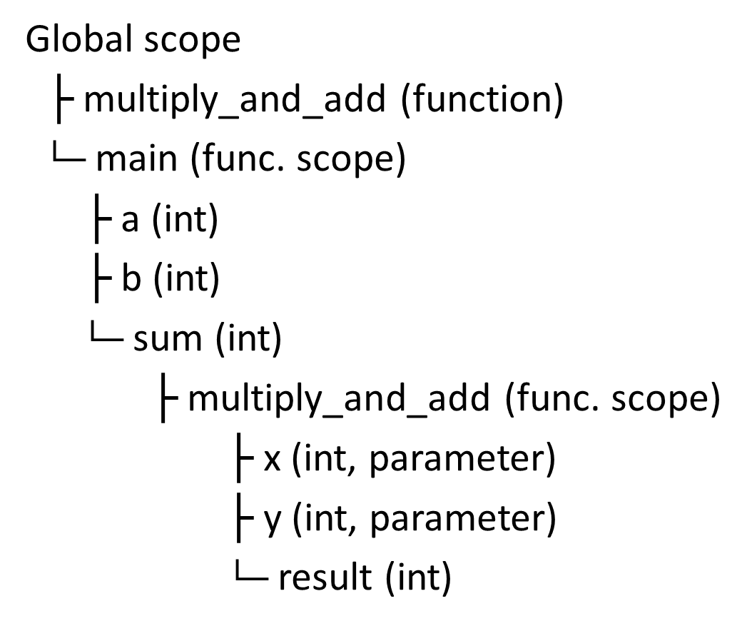
Representing the symbol table as a stack
Technically, two ways to represent the symbol table below.
Simple stack
Spaghetti stack

Slide 38
Representing the symbol table as a stack
Technically, two ways to represent the symbol table below.
Simple stack
Spaghetti stack
Simple stack
Opening a new scope simply adds on top of the existing stack.
Global scope

Slide 39
Representing the symbol table as a stack
Technically, two ways to represent the symbol table below.
Simple stack
Spaghetti stack
Simple stack
Opening a new scope simply adds on top of the existing stack.
Global scope
Function id multiply_and_add

Slide 40
Representing the symbol table as a stack
Technically, two ways to represent the symbol table below.
Simple stack
Spaghetti stack
Simple stack
Opening a new scope simply adds on top of the existing stack.
Global scope
Function id multiply_and_add
Main scope
Integer id a
Integer id b
Integer id sum

Slide 41
Representing the symbol table as a stack
Technically, two ways to represent the symbol table below.
Simple stack
Spaghetti stack
Simple stack
Opening a new scope simply adds on top of the existing stack.
Global scope
Function id multiply_and_add
Main scope
Integer id a
Integer id b
Integer id sum
Multiply_and_add func. scope
Integer id x
Integer id y
Integer id result

Slide 42
Representing the symbol table as a stack
Technically, two ways to represent the symbol table below.
Simple stack
Spaghetti stack
Simple stack
Opening a new scope simply adds on top of the existing stack.
Global scope
Function id multiply_and_add
Main scope
Integer id a
Integer id b
Integer id sum

Slide 43
Representing the symbol table as a stack
Technically, two ways to represent the symbol table below.
Simple stack
Spaghetti stack
Simple stack
Opening a new scope simply adds on top of the existing stack.
Global scope
Function id multiply_and_add

Slide 44
Representing the symbol table as a stack
Technically, two ways to represent the symbol table below.
Simple stack
Spaghetti stack
Simple stack
Opening a new scope simply adds on top of the existing stack.
Global scope

Slide 45
Representing the symbol table as a stack
Spaghetti stack
Treat the symbol table as a linked structure of scopes.
Each scope stores a pointer to its parents, but not vice-versa.
Global scope

Slide 46
Representing the symbol table as a stack
Spaghetti stack
Treat the symbol table as a linked structure of scopes.
Each scope stores a pointer to its parents, but not vice-versa.
Global scope
Function id multiply_and_add

Slide 47
Representing the symbol table as a stack
Spaghetti stack
Treat the symbol table as a linked structure of scopes.
Each scope stores a pointer to its parents, but not vice-versa.
Global scope
Function id multiply_and_add
Main scope
Integer id a
Integer id b
Integer id sum

Slide 48
Representing the symbol table as a stack
Spaghetti stack
Treat the symbol table as a linked structure of scopes.
Each scope stores a pointer to its parents, but not vice-versa.
Global scope
Function id multiply_and_add
Main scope
Integer id a
Integer id b
Integer id sum
Multiply_and_add func. scope
Integer id x
Integer id y
Integer id result

Slide 49
Representing the symbol table as a stack
Spaghetti stack
Treat the symbol table as a linked structure of scopes.
Each scope stores a pointer to its parents, but not vice-versa.
Global scope
Function id multiply_and_add
Main scope
Integer id a
Integer id b
Integer id sum

Slide 50
Representing the symbol table as a stack
Spaghetti stack
Treat the symbol table as a linked structure of scopes.
Each scope stores a pointer to its parents, but not vice-versa.
Global scope
Function id multiply_and_add

Slide 51
Representing the symbol table as a stack
Spaghetti stack
Treat the symbol table as a linked structure of scopes.
Each scope stores a pointer to its parents, but not vice-versa.
Global scope

Slide 52
Representing the symbol table as a stack
Spaghetti stack
Treat the symbol table as a linked structure of scopes.
Each scope stores a pointer to its parents, but not vice-versa.
Observation: From any point in the program, symbol table appears to be a simple stack containing elements of the scope and the scope only.
Better?
Global scope
Function id multiply_and_add
Main scope
Integer id a
Integer id b
Integer id sum
Multiply_and_add func. scope
Integer id x
Integer id y
Integer id result

Slide 53
Catching scope errors
Scope problems
A variable is defined after it is called for the first time.
A function is defined after it is called for the first time and no function prototypes were mentioned.
A variable defined in a function is called outside of the function.
A variable name is defined twice.
Etc.
Most scope problems will be caught when
An operation retrieving something from the symbol table fails (variable/function undefined in scope, etc.).
An operation tries adding a variable/function with an identifier name that already exists in table (identifier defined twice in same scope).

Slide 54
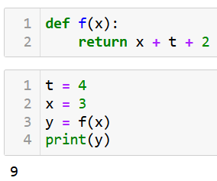
Saving the day?
Consider the example on the right.
Function f() requires two parameters x and t to compute the returned value.
But t is not in the scope of the function, it is in the global scope instead.
Question: How does Python save the day, in your opinion?

Slide 55
Saving the day?
Reason: In Python, when you reference a variable inside a function, it first looks for that variable within the local scope of the function.
If it does not find it there, it tries searching for it in the next enclosing scope, which in this case is the global scope.
Global scope
Function id f
Integer id x
Integer id t
Integer id y
f() func. scope
Integer id x

Slide 56
The LEGB rule
In fact: The scoping rule used in Python is called the “LEGB” rule, which stands for Local, Enclosing, Global, and Built-in.
It is a spaghetti stack with different levels of scope.
When a variable is referenced, Python searches in the following order.
Local scope: variables defined within the function.
Enclosing scope: variables defined in any enclosing functions, from innermost to outermost.
Global scope: variables defined at the top level.
Built-in scope: predefined built-in names in Python, like print(), sum(), etc.

Slide 57
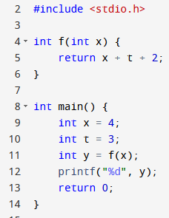
How about C then?
Consider the example on the right.
Function f() requires two parameters x and t to compute the returned value.
But t is not in the scope of the function, it is in the global scope instead.
Question #2: Also works in the equivalent implementation in C?

Slide 58
How about C then?
Answer: In C, variables have a block scope, which means that a variable is only accessible within the block of code it is defined in.
Better or worse than LEGB?
Usually more stable and simpler to encoder in a compiler than “LEGB”, very stable/strict and less friendly on “mistakes”.
Not an easy question…

Slide 59
In short, the block scope (C)
Advantages:
Encourages local reasoning: You can understand the behavior of a variable just by looking at the block of code it is defined in.
Reduces the chance of accidentally using the wrong variable, as variables with the same name in different scopes do not conflict.
Disadvantages:
Requires the use of global variables or explicit parameter passing to share data between functions, which can make the code more complex and error-prone.

Slide 60
In short, the LEGB scope (Python)
Advantages:
Provides more flexibility in accessing variables from different scopes, which can make code shorter and more convenient to write.
Allows for closures, which are functions that remember the environment they were created in, enabling more functional programming techniques.
Disadvantages:
Can lead to unintended side effects if a variable from an outer scope is accidentally used or modified.
Can make it harder to reason about the code since a variable might be accessed or modified in multiple scopes.

Slide 61
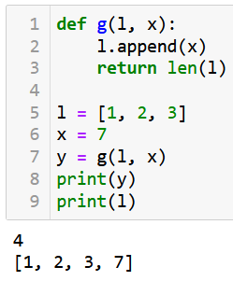
In short, the LEGB scope (Python)
Advantages:
Provides more flexibility in accessing variables from different scopes, which can make code shorter and more convenient to write.
Allows for closures, which are functions that remember the environment they were created in, enabling more functional programming techniques.
Disadvantages:
Can lead to unintended side effects if a variable from an outer scope is accidentally used or modified.
Can make it harder to reason about the code since a variable might be accessed or modified in multiple scopes.

Slide 62
Single-pass vs. multi-pass compilers
Definition (single-pass vs. multi-pass compilers):
Some compilers can combine scanning, parsing, semantic analysis, and code generation into the same pass. These are called single-pass compilers.
Other compilers rescan the input multiple times. These are called multi-pass compilers.

Slide 63
What happens in multi-pass compilers
For instance, on each pass, the compiler could check one specific aspect of the source code. For instance,
Do lexical analysis, produce tokens stream and completely parse the input file into an abstract syntax tree (first pass).
Walk the AST, gathering information about classes definitions (second pass).
Walk the AST gathering information about functions definitions (third pass).
Etc.
Could combine some of these, though they are logically distinct.

Slide 64

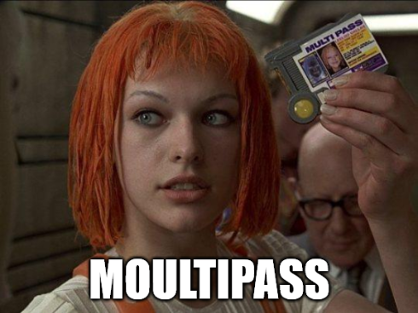
Single-pass vs. multi-pass compilers
Which is better: single-pass or multi-pass compilers?
In general, single-pass compilers are usually faster than multi-pass compilers, but the logic complexity they can check is reduced.
Another debate I do not want to be part of!

Slide 65
Quiz time!
What is the primary purpose of semantic analysis in a compiler?
To generate intermediate code
To check the syntax of the input code
To optimize the generated code
To ensure the input code is semantically correct and meaningful

Slide 66
Quiz time!
What is the primary purpose of semantic analysis in a compiler?
To generate intermediate code
To check the syntax of the input code
To optimize the generated code
To ensure the input code is semantically correct and meaningful

Slide 67
Quiz time!
What is a symbol table used for in a compiler?
To store the intermediate code representation
To store information about variables, functions, and other identifiers
To store the parse tree of the input code
To store the machine code generated by the compiler

Slide 68
Quiz time!
What is a symbol table used for in a compiler?
To store the intermediate code representation
To store information about variables, functions, and other identifiers
To store the parse tree of the input code
To store the machine code generated by the compiler

Slide 69
Quiz time!
Which of the following best describes a static scoping rule?
The visibility of a variable only depends on its position in the source code
The visibility of a variable depends on the call history of functions
The visibility of a variable depends on the order of function calls at runtime
The visibility of a variable depends on the values assigned to it

Slide 70
Quiz time!
Which of the following best describes a static scoping rule?
The visibility of a variable only depends on its position in the source code
The visibility of a variable depends on the call history of functions
The visibility of a variable depends on the order of function calls at runtime
The visibility of a variable depends on the values assigned to it

Slide 71
Quiz time!
In a compiler that uses syntax-directed translation, what is the purpose of the SDT instructions?
To perform lexical analysis
To create a parse tree
To replace each production rule used in a derivation with intermediate code instructions
To let us know how to update the symbol table
To convert intermediate code to machine code

Slide 72
Quiz time!
In a compiler that uses syntax-directed translation, what is the purpose of the SDT instructions?
To perform lexical analysis
To create a parse tree
To replace each production rule used in a derivation with intermediate code instructions
To let us know how to update the symbol table
To convert intermediate code to machine code

Slide 73
Quiz time!
In a compiler, what is the purpose of a "spaghetti stack"?
To optimize memory usage during parsing
To store the parse tree during syntax analysis
To maintain the symbol table as a linked structure of scopes
To generate machine code for the target architecture

Slide 74
Quiz time!
In a compiler, what is the purpose of a "spaghetti stack"?
To optimize memory usage during parsing
To store the parse tree during syntax analysis
To maintain the symbol table as a linked structure of scopes
To generate machine code for the target architecture

Slide 75
Conclusion
Semantic analysis verifies that a syntactically valid program is correctly-formed and computes additional information about the meaning of the program.
Scope checking determines what variables, functions or classes are referred to by each name in the program.
Scope checking is usually done with a symbol table implemented either as a stack or spaghetti stack.
Simple semantic analysers will operate in a single pass, while some semantic analysers operate in multiple passes in order to gain more information about the program.

