Slide 1

50.051 Programming Language Concepts W13-S3 End
Matthieu De Mari

Slide 2
What we have seen this term
About the C/C++ language

Slide 3
In C/C++
A good introduction to the C/C++ programming language
Ability to program in C and C++
Understand how memory is used to store data and instructions, when dynamic typing is not a feature (data types declarations, arrays, pointers, etc.)
Understand the imperative programming paradigm
A cleaner object-oriented framework in the case of C++ (because the Python framework is kind-of-bad, to be honest).
(The mother of all programming languages?)

Slide 4
Perfect your learning of C/C++
Important: 6 weeks of C/C++ is not enough to master the language!
Keep on practicing!
Try coming up with a portfolio of projects in C/C++?
Some ideas could include translating your previous Python projects in C, or additional ideas.
Keep it fun for you!
Some general ideas: https://hackr.io/blog/cpp-projects

Slide 5
Learn C#
In the same family of C/C++, it might be worth looking at C# as well
C# is a high-level, object-oriented programming language that was developed by Microsoft as part of the .NET platform.
C# is designed to be simple, modern, and easy to learn.
It offers features such as garbage collection, type safety, and simplified memory management, that C/C++ does not have.
Good online course, here: https://learn.microsoft.com/en-us/shows/csharp-fundamentals-for-absolute-beginners/

Slide 6
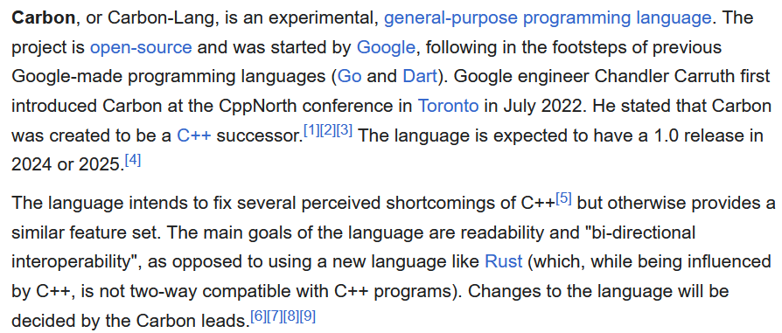
Keep an eye on Google Carbon?
From Wikipedia: https://en.wikipedia.org/wiki/Carbon_(programming_language)
Some courses start to emerge: https://betterprogramming.pub/carbon-programming-language-tutorial-6d67b4cc16ae

Slide 7
What we have seen this term
About compilers

Slide 8
Compiler: a definition
Program in a given language (source language)
Definition (Compilers): Compilers are computer programs whose purpose is to
Translate a program written in one language (called source language),
Into a program written in another language (called target language).
Target language is often machine code or bytecode.
Compiler
Program in another language
(target language, often machine code, or bytecode)

Slide 9
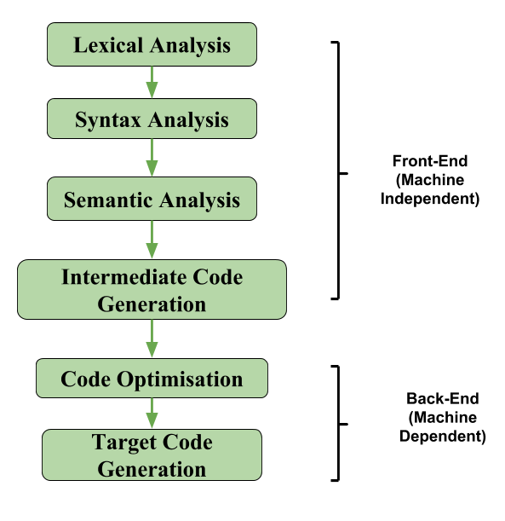
The architecture of a compiler
Definition (the three parts of a typical compiler architecture):
A typical compiler architecture consists of three main components: the front-end, middle-end, and back-end.
Front-end: checks source code is legal (90% of the compiler job!).
Middle-end (optional?): IR code generation and optimization.
Back-end: Final translation and handover to CPU!

Slide 10
How to continue your learning
Because you should!

Slide 11
Continue your learning
W8S3 – W9S1: FSMs and their implementation
Continue with more advanced types of FSMs (non-deterministic, push automatons, etc.).
Learn how to convert any NDFSM into its equivalent FSM (tedious, but possible all the time).
Good online courses:
MIT Theory of Computation
Stanford Automata Theory

Slide 12
Continue your learning
W9S2: RegEx and their implementation
Not much else in terms of implementing FSMs and RegEx.
Maybe try making your own RegEx engine that takes any RegEx expression (basic operations only) and generates the correct FSM.
Then use said FSM to check validity of a given string.
Learn to recognize the RegEx behind any given FSM.
Good online courses:
Few good courses will teach you about implementation in C…
Maybe this one?

Slide 13
Continue your learning
W9S3-W10S1: Tokenization
Not much else on this topic.
Possible improvement #1: We generate/compile the RegEx FSM every time we call said RegEx function. Would be better to only generate it once?
How to handle the C pre-processing instructions before tokenization?

Slide 14
Continue your learning
W10S2: CFGs
How to implement a CFG?
For a given set of production rules to use, write an algorithm that would build the parse tree matching a given derivation.
Good online courses:
Very few, most of the time, better to check Github for implementations.
Maybe this? (not C)

Slide 15
Continue your learning
W10S2: SDTs
How to implement an SDT, and following the idea of the parse tree generating algorithm, how would you build an abstract syntax tree?
Good online courses:
As with CFGs, very few courses online, most of the time, better to check Github for implementations.

Slide 16
Continue your learning
W11: Parsing
Try implementing both the DFS and LFS algorithm in top-down parsing.
Try implementing LR(0) and LR(1) algorithms as shown in HW2 and in class!
Learn about more classes of LR parsers like SLR and LALR.
Good course:
SUTD Term 7 course? 50.054 Compiler Design and Program Analysis, by Prof. Kenny Lu (in the case of functional programming).

Slide 17
Continue your learning
W12S1-2: Semantics
Try implementing a symbol table, as a simple stack, or better, a spaghetti stack! Later on, implement your own scope checking for the semantics analysis.
Try implementing your own type checking rules and operation tables. Later on, implement your own type checking for the semantics analysis.
Good online courses:
As with CFGs/SDTs, very few courses online, most of the time, better to check Github for implementations.

Slide 18
Continue your learning
W12S3: TAC code generation
Write your own CFG and SDT for the TAC language.
Write your own translator function that reads an AST and produces the TAC accordingly.
Work out more cgen() functions for while loops, for loops, break, functions calls, class definitions and methods, etc.
Good online courses:
As with CFGs/SDTs, very few courses online, most of the time, better to check Github for implementations.

Slide 19
Continue your learning
W13S1: TAC code optimization
Try implementing the Copy Propagation optimization procedure.
Try implementing a liveness analysis (challenging!).
Try implementing a Dead Code Elimination optimization procedure.
Chain them, rinse and repeat local optimization function for all basic blocks in your code!
Try implementing more local optimization techniques (arithmetic simplifications, short-circuit evaluation, constant folding, etc.)
Eventually, try writing a control-flow graph representation for your TAC code and study/implement more advanced (global) optimization procedures.

Slide 20
Continue your learning
W13S2: Backend
Try writing a simple translator that reads TAC code (either as a string of text of a control-flow graph), and produces assembly code (following the Beta CPU instruction set from 50.002).
Try implementing a few register allocation algorithm (naïve, linear scan, etc.)
Try your hands on the graph coloring problem and the Chaitin algorithm implementation!
More backend stuff (runtime, garbage collection, code optimization and clock cycles optimization on your CPU by performing instruction ordering/section, parallelism, etc.)

Slide 21
And interpreters in all of this?
Definition (Interpreters):
Many of you have probably heard about the compilers vs. interpreters paradigm, but what is it about?
Interpreters have the same objective as compilers, i.e. translate a source program into target code which can be executed by the CPU.
What changes is the translation and execution procedure:
Compilers will translate the source code into target code in its entirety first, and THEN will execute the target code.
Interpreters, on the other hand, will translate each line of the source code one line at a time, and execute each one of them in succession.

Slide 22
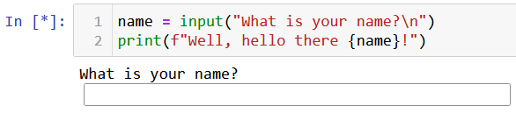



Source Program (Python)
Interpreter
…
Line 1
Line 2
Line N
Source Program (Python)
Source Program (Python)
Translate, check for errors, etc. and execute
Translate, check for errors, etc. and execute
…
Results
Results
Results

Slide 23
Reference courses, in short
If interested to learn more about parsers, the reference course is the Compiler course from Stanford
https://web.stanford.edu/class/cs143/
Available for free online and comes with video recordings
https://www.edx.org/course/compilers
SUTD Term 7 course? 50.054 Compiler Design and Program Analysis, by Prof. Kenny Lu (in the case of functional programming).
(Not yet added to ISTD course catalog as of 20/04/2023.)
(Tentative syllabus to be shown in class!)

Slide 24
Your feedback matters!
It is our first time trying this course, and as instructors, we learned a lot by trying it, but also realized a few things did not work out…
Typically, 6 weeks is too short to teach all the concepts of compilers correctly (maybe we should shorten the C/C++ part to make room for compilers?).
A lab session or two to have you implement some parsing/semantics checks, in a guided manner, would have been nice.
Will improve for next run.
Let us know if you have more feedback for us!

Slide 25

The End
Also, remember: if the code is legal, but does not produce the behavior you expect, then it is not the compiler’s fault…
The problem is…

Slide 26
The End
Also, remember: if the code is legal, but does not produce the behavior you expect, then it is not the compiler’s fault…
The problem, in that case, is… You!
It is not the compiler’s job to figure out the logic you want your code to have!
And debug it for you if it fails!
(How would the compiler do it anyway?)

