Slide 1

50.051 Programming Language Concepts W13-S2 Code Generation, Register Allocation and Linking/Loading
Matthieu De Mari

Slide 2
At this point
At this point, we have optimized IR code that needs to be converted into the target language (e.g. assembly, machine code).
Goal of this stage:
Choose the appropriate machine instructions for each IR instruction.
Allocate the processor resources (registers, caches, etc.)
Implement low-level details of the runtime environment.
Machine-specific optimizations are often done here, though some are often treated as part of a final optimization phase.

Slide 3
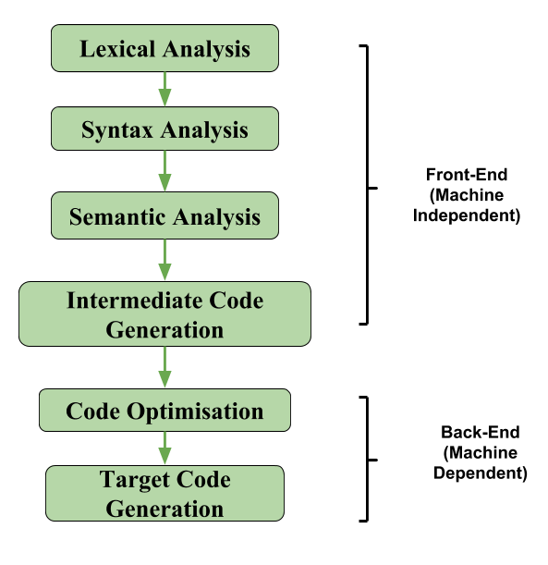
The back-end of a compiler
Definition (The back-end part of a compiler):
The back-end of a compiler takes the optimized and transformed code generated by the middle-end and translates it into machine code that can be executed.
It involves tasks, such as:
Instruction selection/ordering,
Register allocation,
and Code generation.

Slide 4
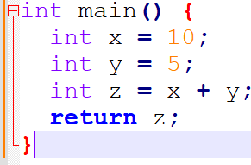
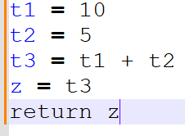
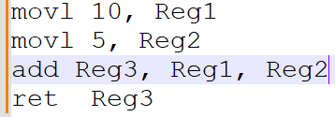
Source code (C)
Front-end
Lexical Analysis Syntax Analysis Semantic Analysis
After front-end, intermediate code (Three-address) and optimizations
Machine instructions after code generation and execution

Slide 5
Instruction Selection
Definition (Instruction Selection):
During instruction selection, the compiler chooses the specific machine code instructions (mov, add, jmp, etc) to use to implement each operation in the program.
During this step, it might perform some final transformations on the generated code to improve performance and reduce code size.
Typically, there might be multiple ways to choose and order machine code instructions. Some might be equivalent, others might allow to save memory/register space, etc.

Slide 6
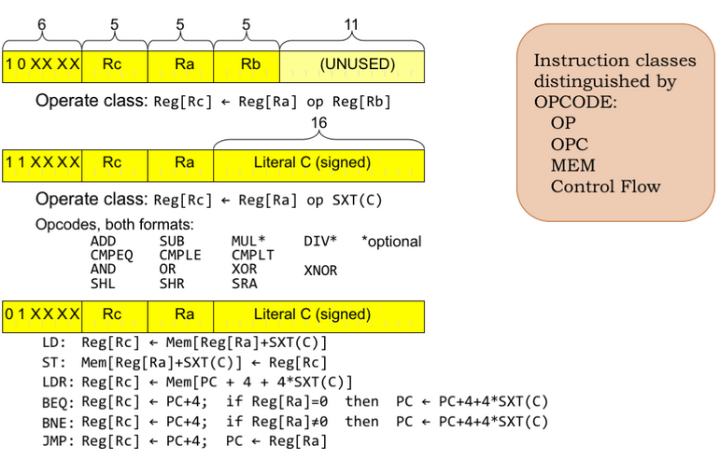
Instruction Selection
Definition (Instruction Selection):
During instruction selection, the compiler chooses the specific machine code instructions (mov, add, jmp, etc) to use to implement each operation in the program.
During this step, it might perform some final transformations on the generated code to improve performance and reduce code size.
Typically, there might be multiple ways to choose and order machine code instructions. Some might be equivalent, others might allow to save memory/register space, etc.

Slide 7
Instruction Ordering/Scheduling
Definition (Instruction Ordering/Scheduling):
The instruction ordering (or scheduling) phase is responsible for rearranging the order of instructions in the program to improve performance.
This typically involves reordering instructions to take advantage of the parallelism and pipelining features of modern processors (with many cores running in parallel, for instance).
The instruction scheduler takes into account the dependencies between instructions and the specific features of the processor.
(Too advanced, out-of-scope).

Slide 8
Intuition for code generation
Consider the TAC code below,
t1 = a + b
t2 = t1 * c
Intuition: This TAC code could be easily mapped to a sequence of machine code instructions, as shown on the right.
https://natalieagus.github.io/50002/notes/instructionset#opcode
Machine Code?
LOAD R1, a
LOAD R2, b
ADD R1, R1, R2
STORE t1, R1
LOAD R3, t1
LOAD R4, c
MUL R3, R3, R4
STORE t2, R3

Slide 9
Breakdown of the Machine Code Translation
This final translation is typically broken down in a few steps.
Basic block identification: The compiler identifies the basic blocks in the TAC code, i.e. sequences of instructions that are always executed together and can be used as units for generating machine code.
Instruction selection: For each operation in the TAC, the compiler selects an appropriate instruction or sequence of instructions in the machine assembly language. The choice may depend on the available instruction set, addressing modes, and architectural constraints.
For simplicity, we will stick to an instruction set similar to the one you used in 50.002 Computation Structures! (https://natalieagus.github.io/50002/notes/instructionset)

Slide 10
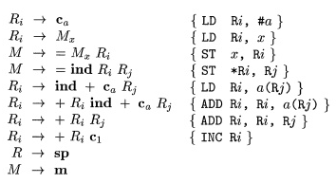
Instruction Selection (Simple Version?)
In our simpler version: the instruction selection, as a mapping could be easily done, by using a Syntax-Directed Translation (another one!) on our three-address code CFG!

Slide 11
Instruction Selection (Hard Version?)
Advanced compilers, however, might often rely on more advanced techniques, like tree matching and dynamic programming.
Tree pattern matching involves representing TAC operations as trees and searching for matching patterns in a database of target machine instructions.
Other techniques, like optimal code generation using dynamic programming, find the optimal sequence of target instructions by considering all possible combinations and selecting the one with the lowest cost (memory, computation, time, etc.).
This last set of techniques is much more advanced and out-of-scope.

Slide 12
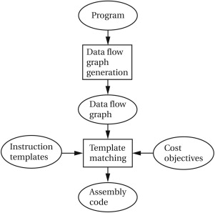
Instruction Selection (mapping vs. advanced)
Note: These advanced techniques will often require solving optimization problems on graphs that are NP-Hard!
Definitely out-of-scope! (It would require an advanced course on Graph Theory to simply explain some of them!)

Slide 13
Instruction Selection (Harder Version?)
In addition, advanced compilers, might also use several intermediate representations in a row, instead of jumping straight from TAC to machine code.
Abstract Syntax Tree Representation
High-level Intermediate Representation (e.g. TAC)
Lower-level Intermediate Representations (e.g. SSA, RTL, VM, etc.)
Assembly code (our target code)
Machine code in binary (but technically more 50.002 than 50.051)

Slide 14
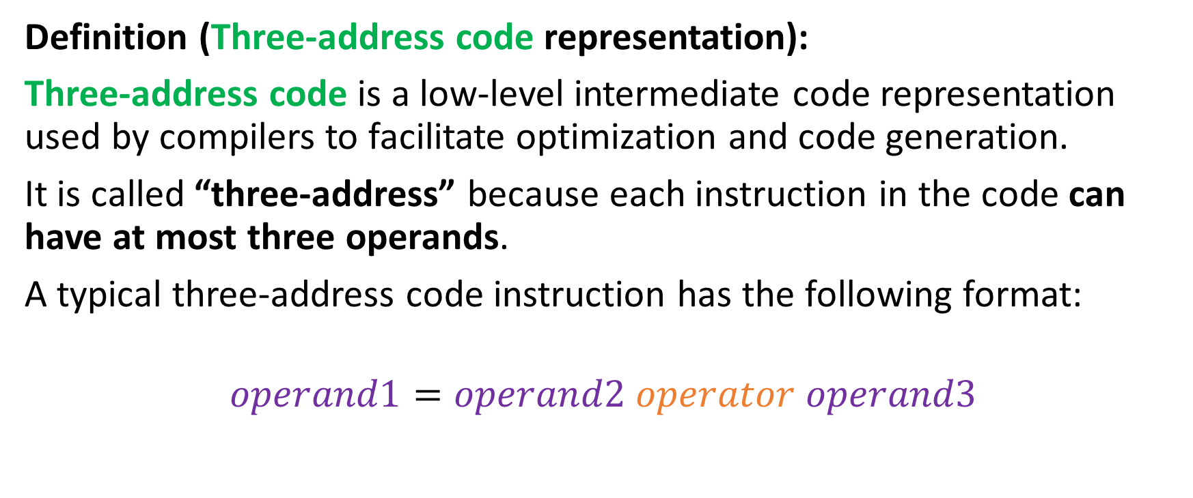
Three-address code representation
Definition (Three-address code representation):
Three-address code is a low-level intermediate code representation used by compilers to facilitate optimization and code generation.
It is called “three-address” because each instruction in the code can have at most three operands.
A typical three-address code instruction has the following format:
$$operand1=operand2 operator operand3$$

Slide 15
Virtual Machine code representation
Definition (Virtual Machine code representation):
Virtual Machine code (VM code) is an intermediate representation of code that is designed to be executed on a virtual machine rather than on the hardware directly.
It is typically used by compilers that target virtual machines (e.g. the Java Virtual Machine or the .NET Common Language Runtime).
It is a stack-based representation, where each operation is performed on values that are pushed onto and popped off of a stack. Each VM instruction typically consists of an opcode and zero or more operands.

Slide 16
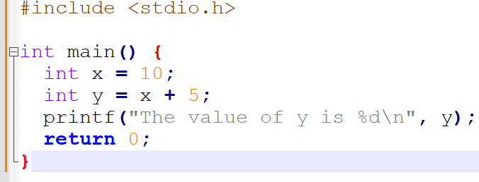
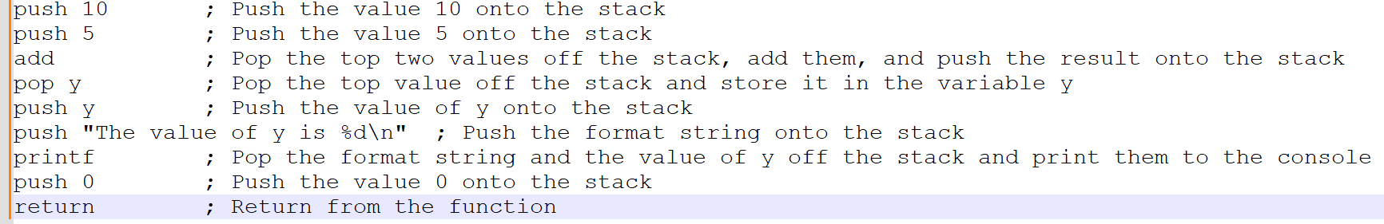
Virtual Machine code representation
For instance, the C code on the right can be transformed…
…into its equivalent VM code representation, below.

Slide 17
A quick word on instruction scheduling

Slide 18
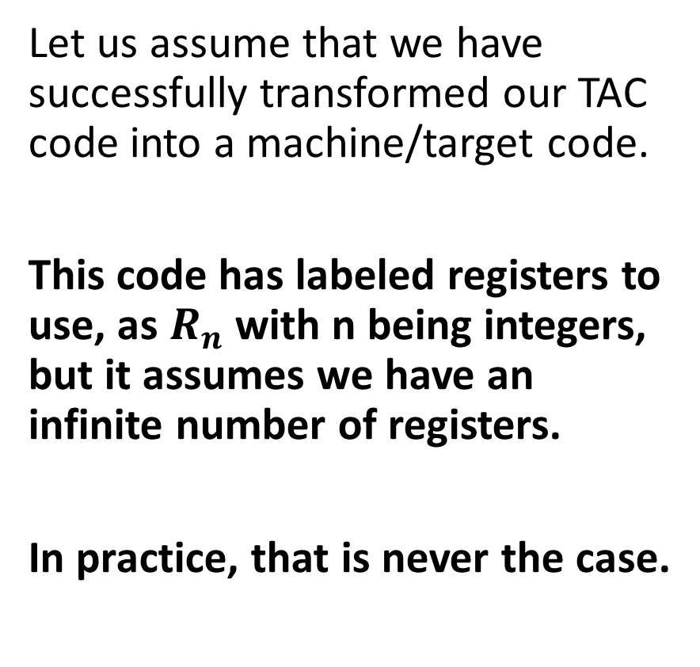
Intuition for register allocation
Let us assume that we have successfully transformed our TAC code into a machine/target code.
This code has labeled registers to use, as $R_{n}$with n being integers, but it assumes we have an infinite number of registers.
In practice, that is never the case.
Machine Code?
LOAD R1, a
LOAD R2, b
ADD R1, R1, R2
STORE t1, R1
LOAD R3, t1
LOAD R4, c
MUL R3, R3, R4
STORE t2, R3

Slide 19
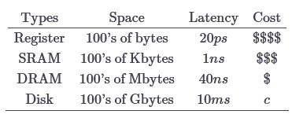
Memory Hierarchy
Definition (Memory Hierarchy):
In practice, not all memory locations are equal, there is a memory hierarchy.
Registers: very few of them, fast and expensive.
SRAM: few of them, slightly slower, but still quite fast.
DRAM: more of them, slower.
Disk: Potentially unlimited space, but very slow.
Need a refresher from 50.002?
https://natalieagus.github.io/50002/notes/memoryhierarchy
Cheap/Plenty
Computational Speed

Slide 20
A resource allocation problem
How would you decide which variables to prioritize and assign to registers, and which variables to keep in other memory locations?
Objective: Position objects in memory in a way that takes maximum advantage of the memory hierarchy and speeds up computation.
Additional challenge: Do so without hints from the programmer.
Why it is important: A good register allocator can generate code orders of magnitude better than a bad register allocator.

Slide 21
Possible algorithms to investigate
The register allocation problem is not an easy one to solve! (NP-hard).
We propose to briefly explore three algorithms for register allocation:
Naïve (“no”) register allocation.
Linear scan register allocation.
Graph-coloring register allocation.
Their implementations might require tools from graph theory (especially the last one), and are therefore out-of-scope.

Slide 22
A starting idea
Starting idea: Store every value in main memory, loading values only when they are needed.
To generate a code that performs a computation:
Generate load instructions to pull the values from main memory into registers.
Only use three registers at any given time, because that is the maximal number of operands in TAC/assembly instruction anyway.
Generate code to perform the computation on these registers.
Generate store instructions to store the result back into main memory.

Slide 23
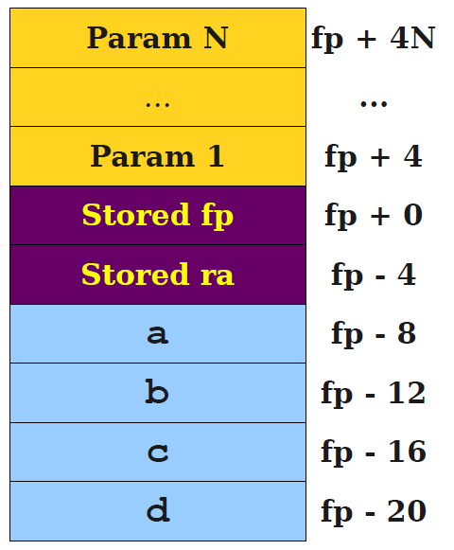
A starting idea
Our TAC code (for a function of some sort)
a = b + c;
d = a;
c = a + d;
lw $t0, -12(fp)
lw $t1, -16(fp)
add $t2, $t0, $t1
sw $t2, -8(fp)
lw $t0, -8(fp)
sw $t0, -20(fp)
lw $t0, -8(fp)
lw $t1, -20(fp)
add $t2, $t0, $t1
sw $t2, -16(fp)

Slide 24
Analysis of this first naïve register allocation
Disadvantage: Gross inefficiency.
Issues unnecessary loads and stores by the dozen.
Wastes space on values that could be stored purely in registers.
Easily an order of magnitude or two slower than necessary.
Unacceptable in any production compiler.
Advantage: Simplicity.
Can translate each piece of IR directly to assembly as we go.
Never need to worry about running out of registers.
Never need to worry about function calls or special-purpose registers.
Good if you just needed to get a prototype compiler up and running.

Slide 25
A slightly better approach
New idea: In practice, we have very few registers, but definitely more than just three! Try to hold as many variables in registers as possible.
Hopefully, this will reduce memory reads/writes and reduces total memory usage.
However, we will need to address these questions:
Which registers do we put variables in?
How do we recognize that we have run out of registers?
What do we do when we run out of registers?

Slide 26
A slightly better approach
Fact #1: At each program point, each register holds at most one live variable (otherwise, there is a memory conflict).
This means that we could assign several variables the same register, as long as no two of them ever will be read together.
The liveness analysis we used earlier in the IR optimization phase could therefore hold the key as to which variables need to be live (and therefore in a register somewhere) at any given point?
At any point of the program, liveness analysis lets us know when variables are live and for how long.

Slide 27
Live range and live interval
Definition (live range):
The live range for a variable is the set of program points at which that variable is live.
Definition (live interval):
The live interval for a variable is the smallest subrange of the IR code containing all a variable’s live ranges.
A property of the IR code, not the CFG.
Less precise than live ranges, but simpler to work with.

Slide 28
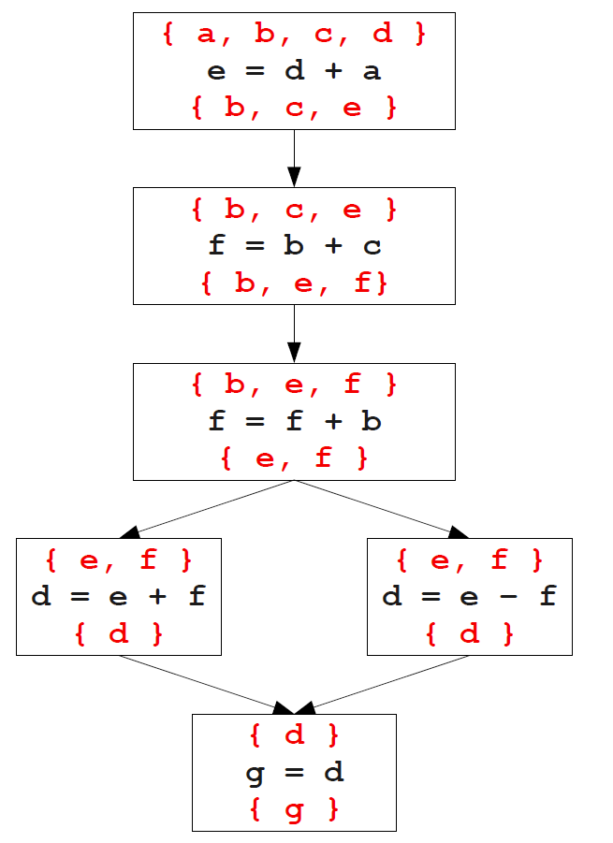
Live range and live intervals: demo
Consider the TAC code below.
L0:
e = d + a
f = b + c
f = f + b
if e goto L1
d = e + f
jump L2;
L1:
d = e - f
L2:
g = d
After control-flow and liveness analysis

Slide 29
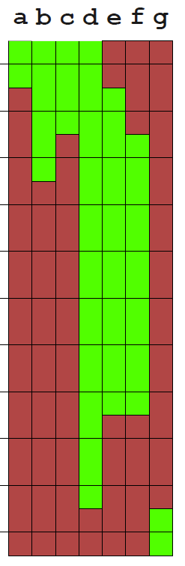
Live range and live intervals: demo
Consider the TAC code below.
L0:
e = d + a
f = b + c
f = f + b
if e goto L1
d = e + f
jump L2;
L1:
d = e - f
L2:
g = d
After control-flow and liveness analysis
Live intervals

Slide 30
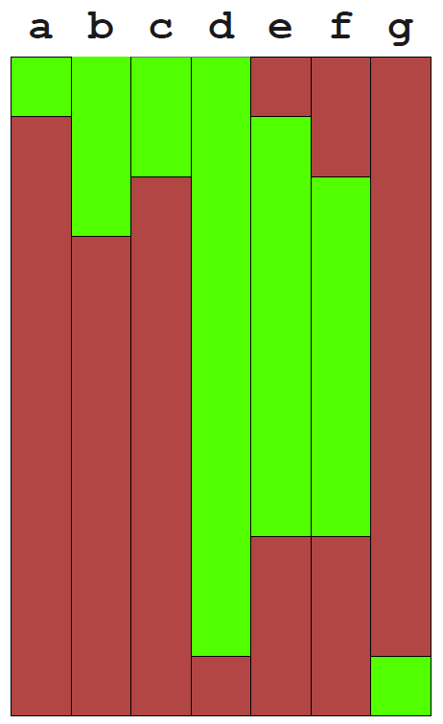
Using live ranges
Idea (continued): Given the live intervals for all the variables/IR registers in the TAC program, we can allocate registers using a simple greedy algorithm.
Track which registers are free.
When a live interval begins, give that variable a free register.
When a live interval ends, the register could be freed without consequences.

Slide 31
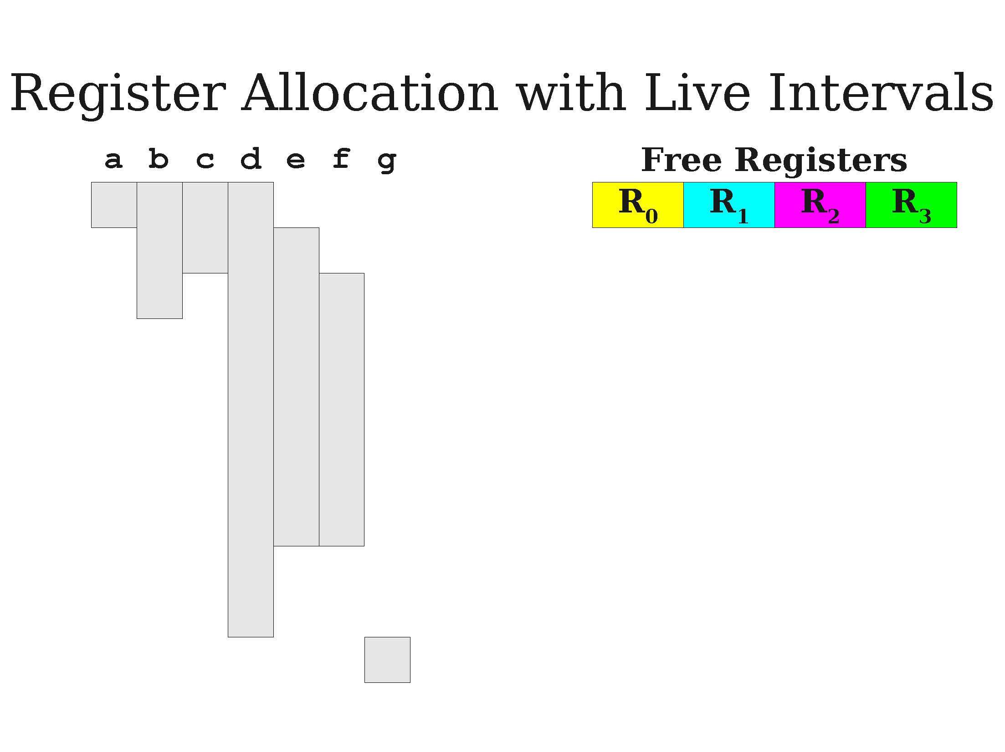
A first demo of greedy allocation

Slide 32
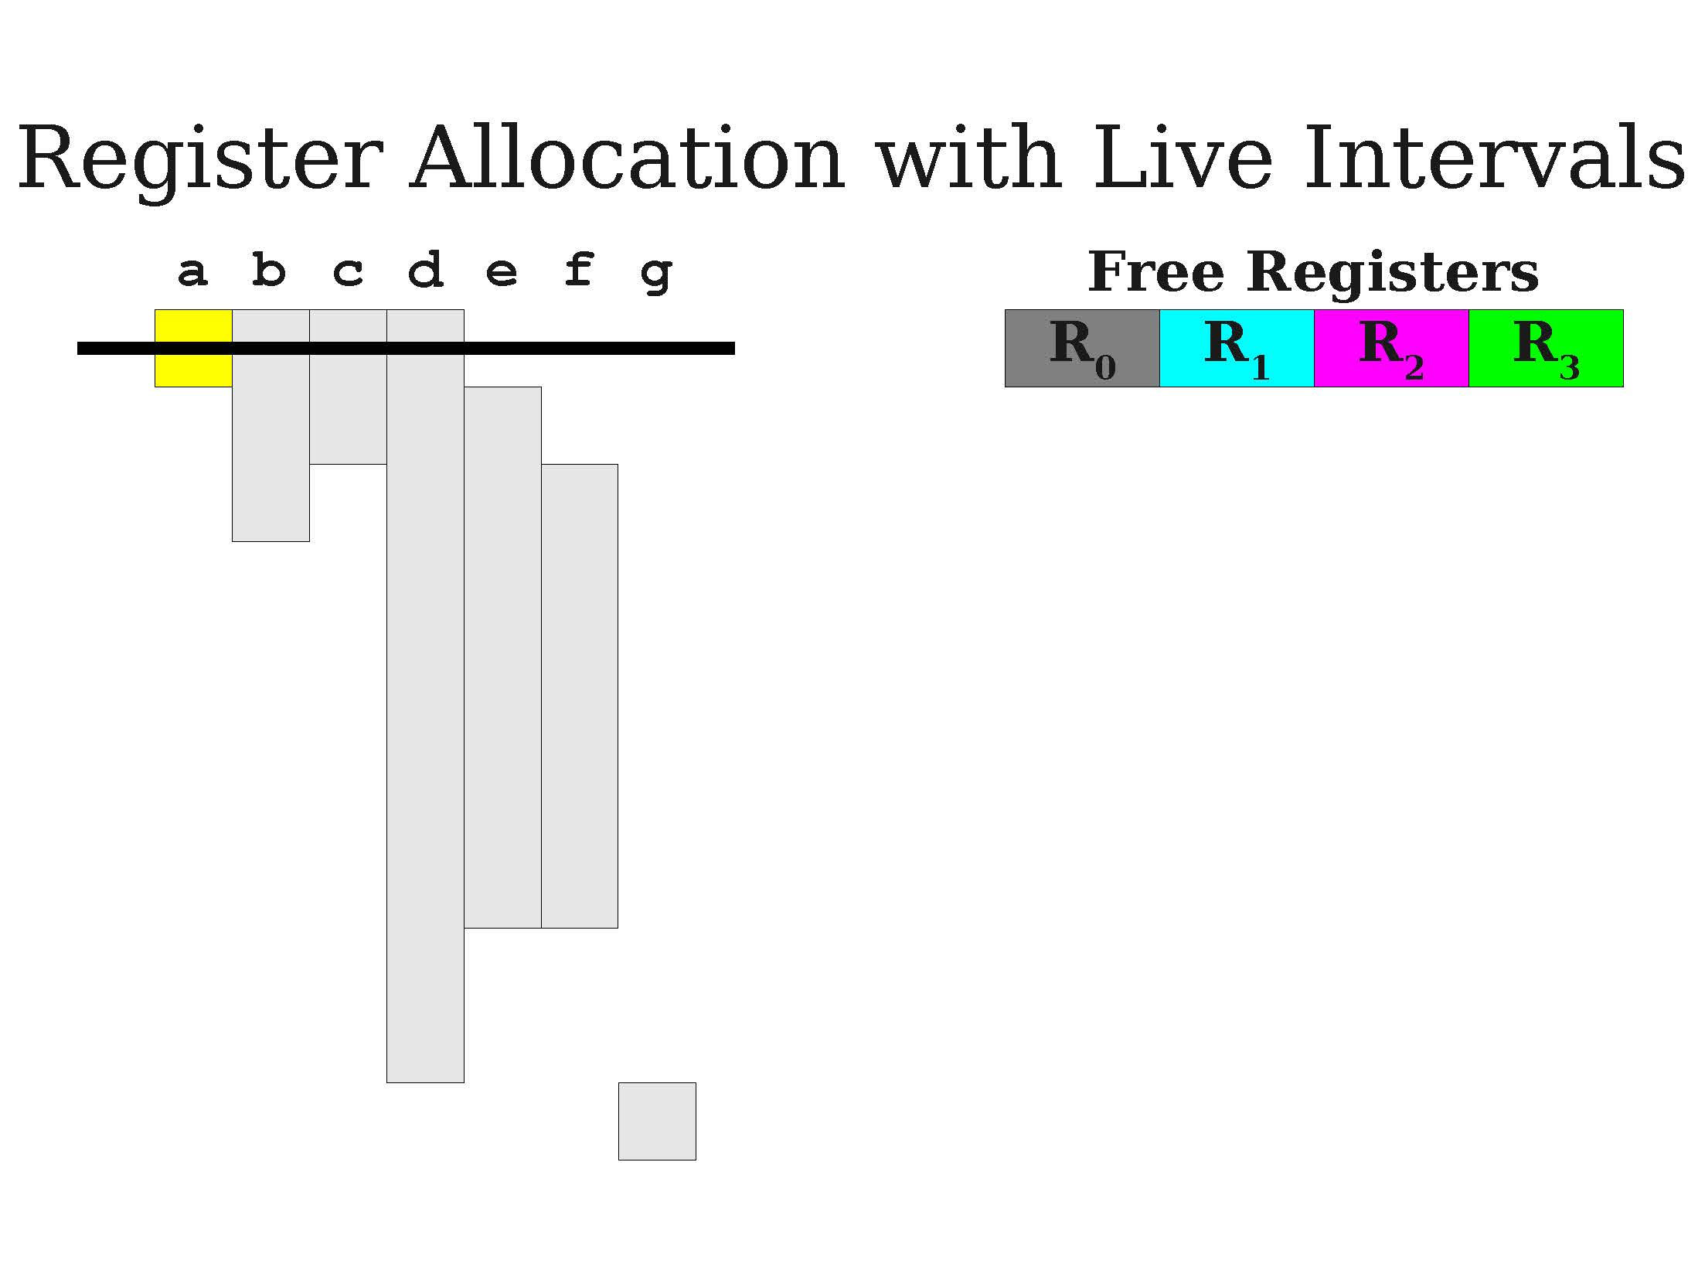
A first demo of greedy allocation

Slide 33
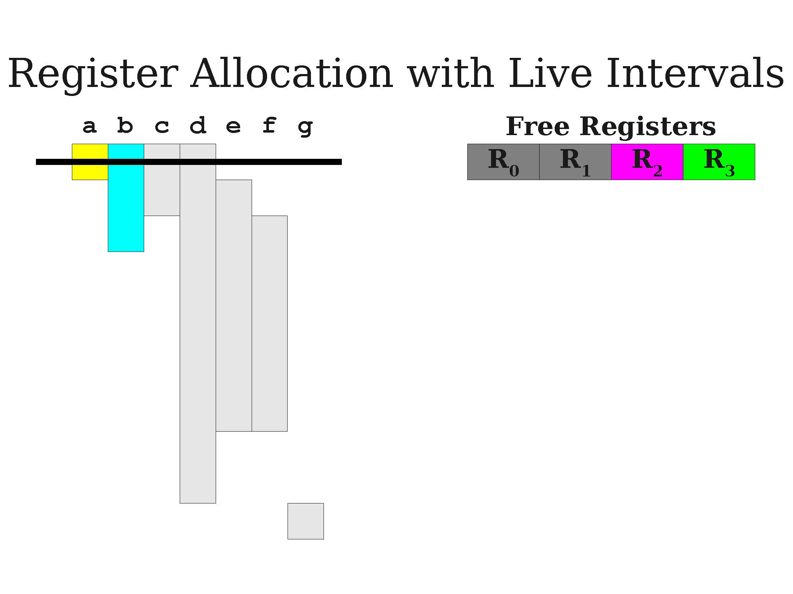
A first demo of greedy allocation

Slide 34
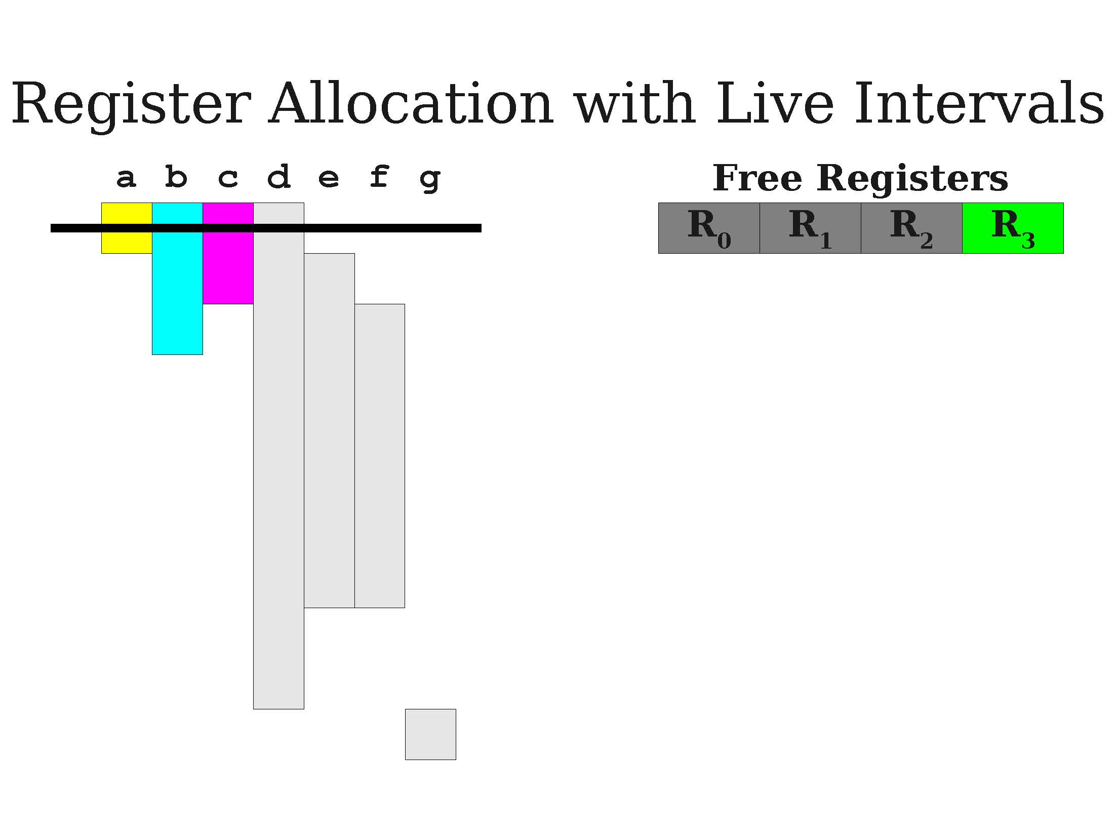
A first demo of greedy allocation

Slide 35
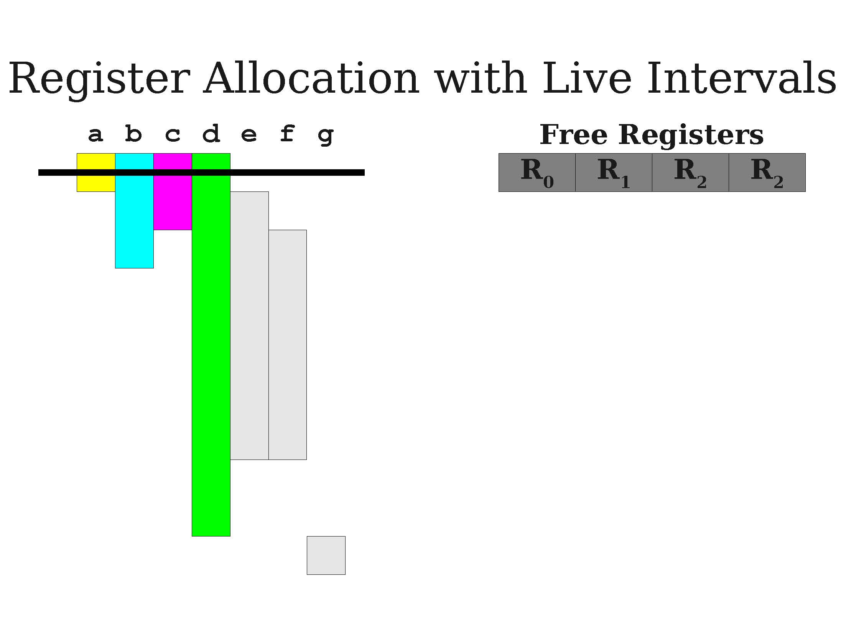
A first demo of greedy allocation

Slide 36
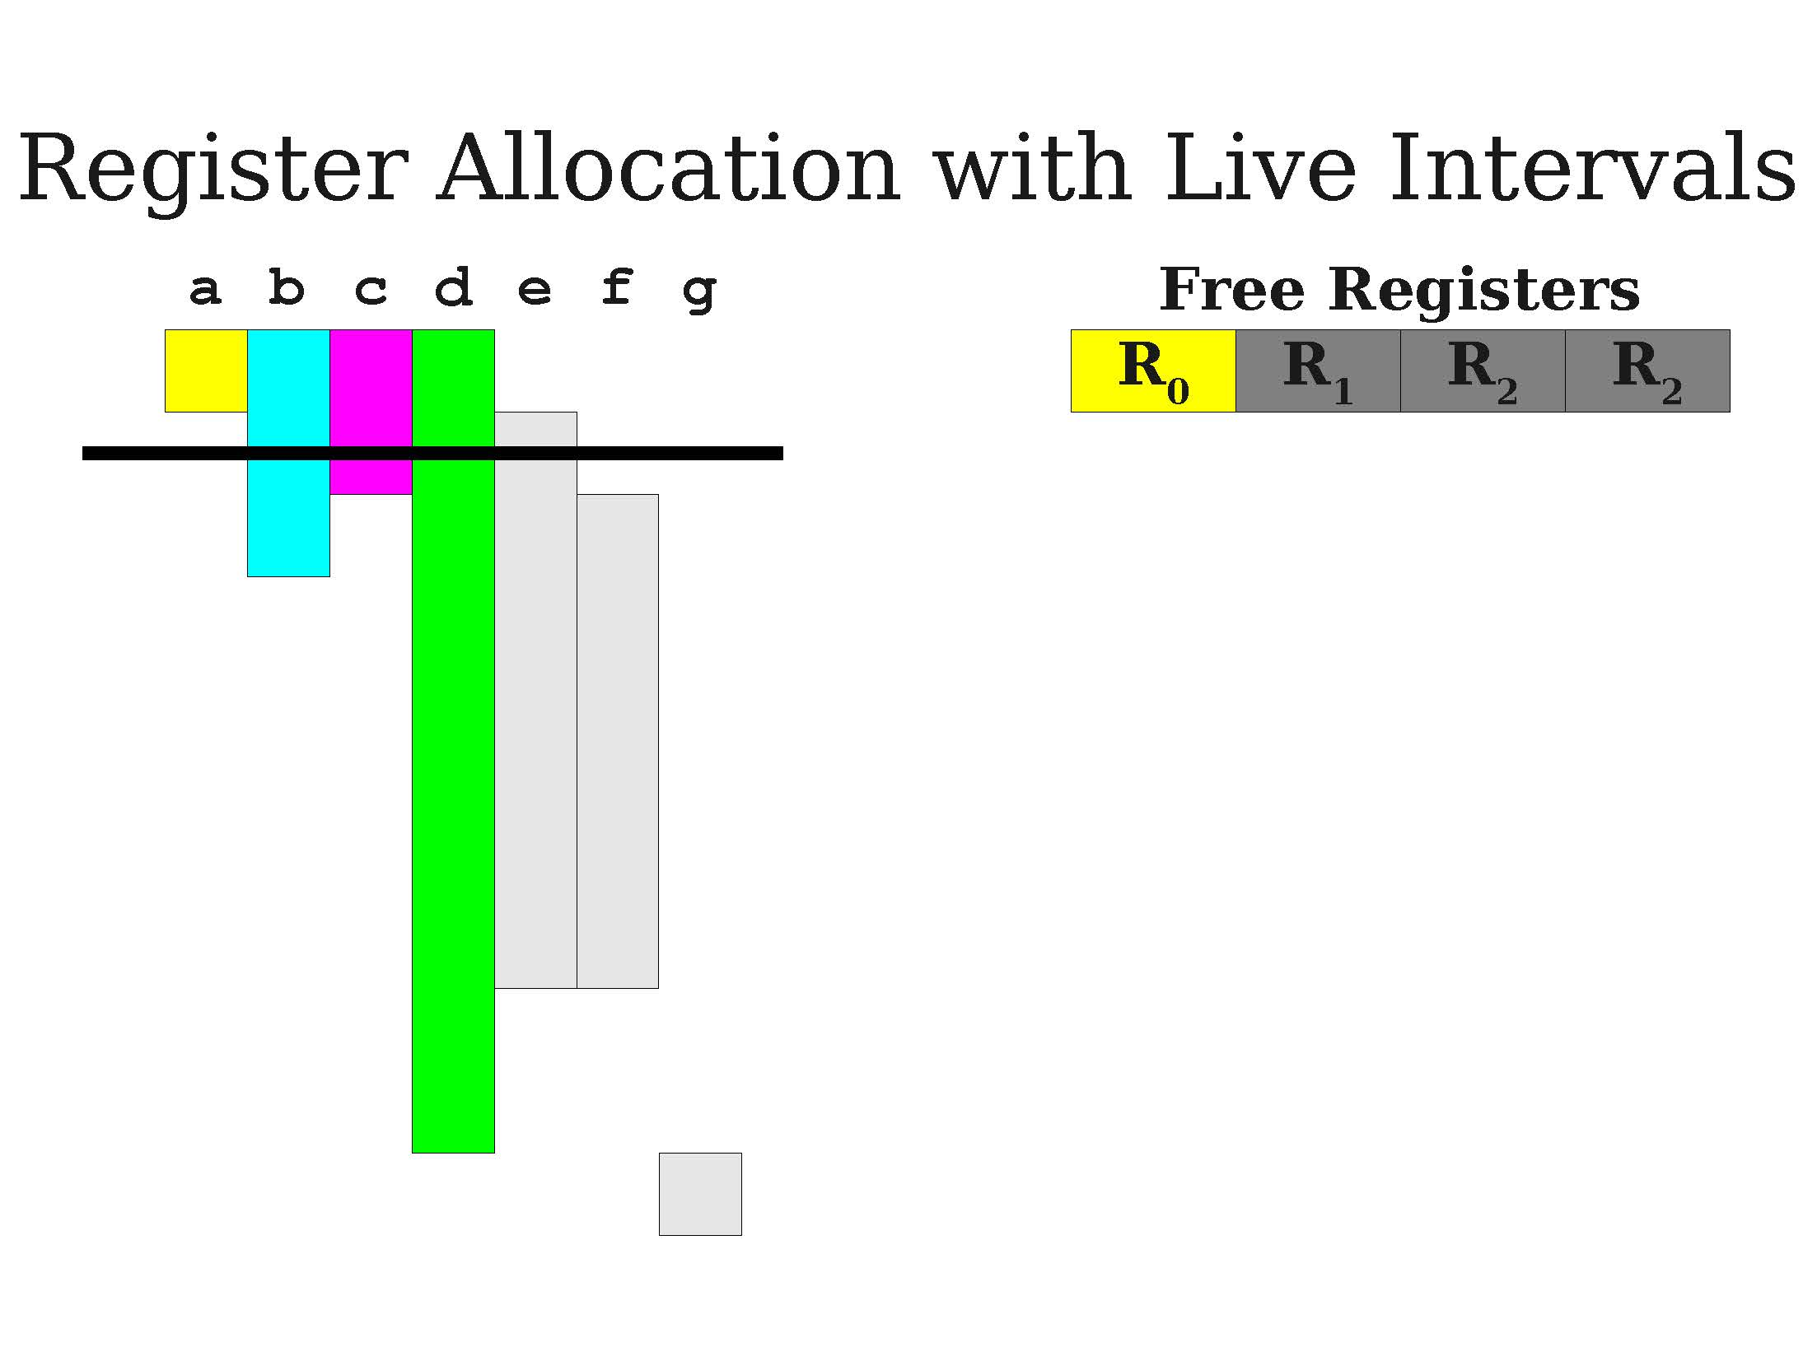
A first demo of greedy allocation

Slide 37
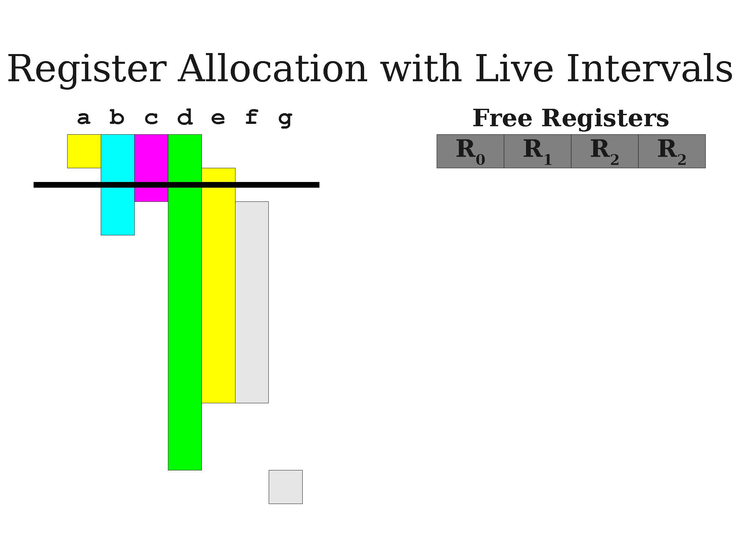
A first demo of greedy allocation

Slide 38
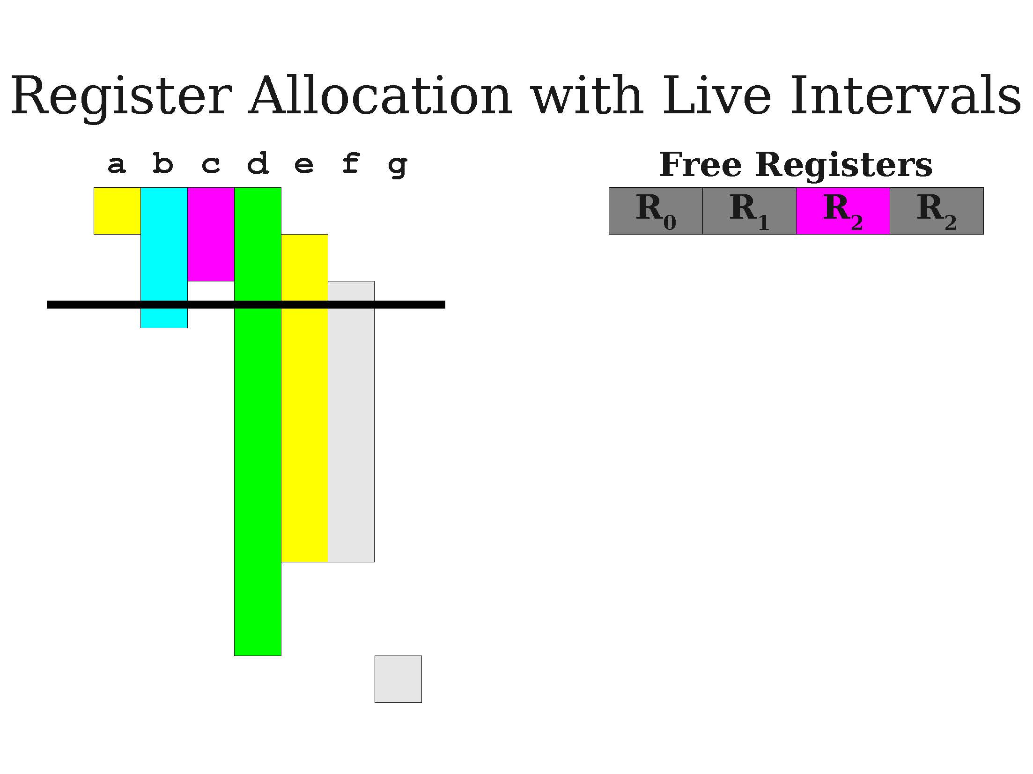

Slide 39
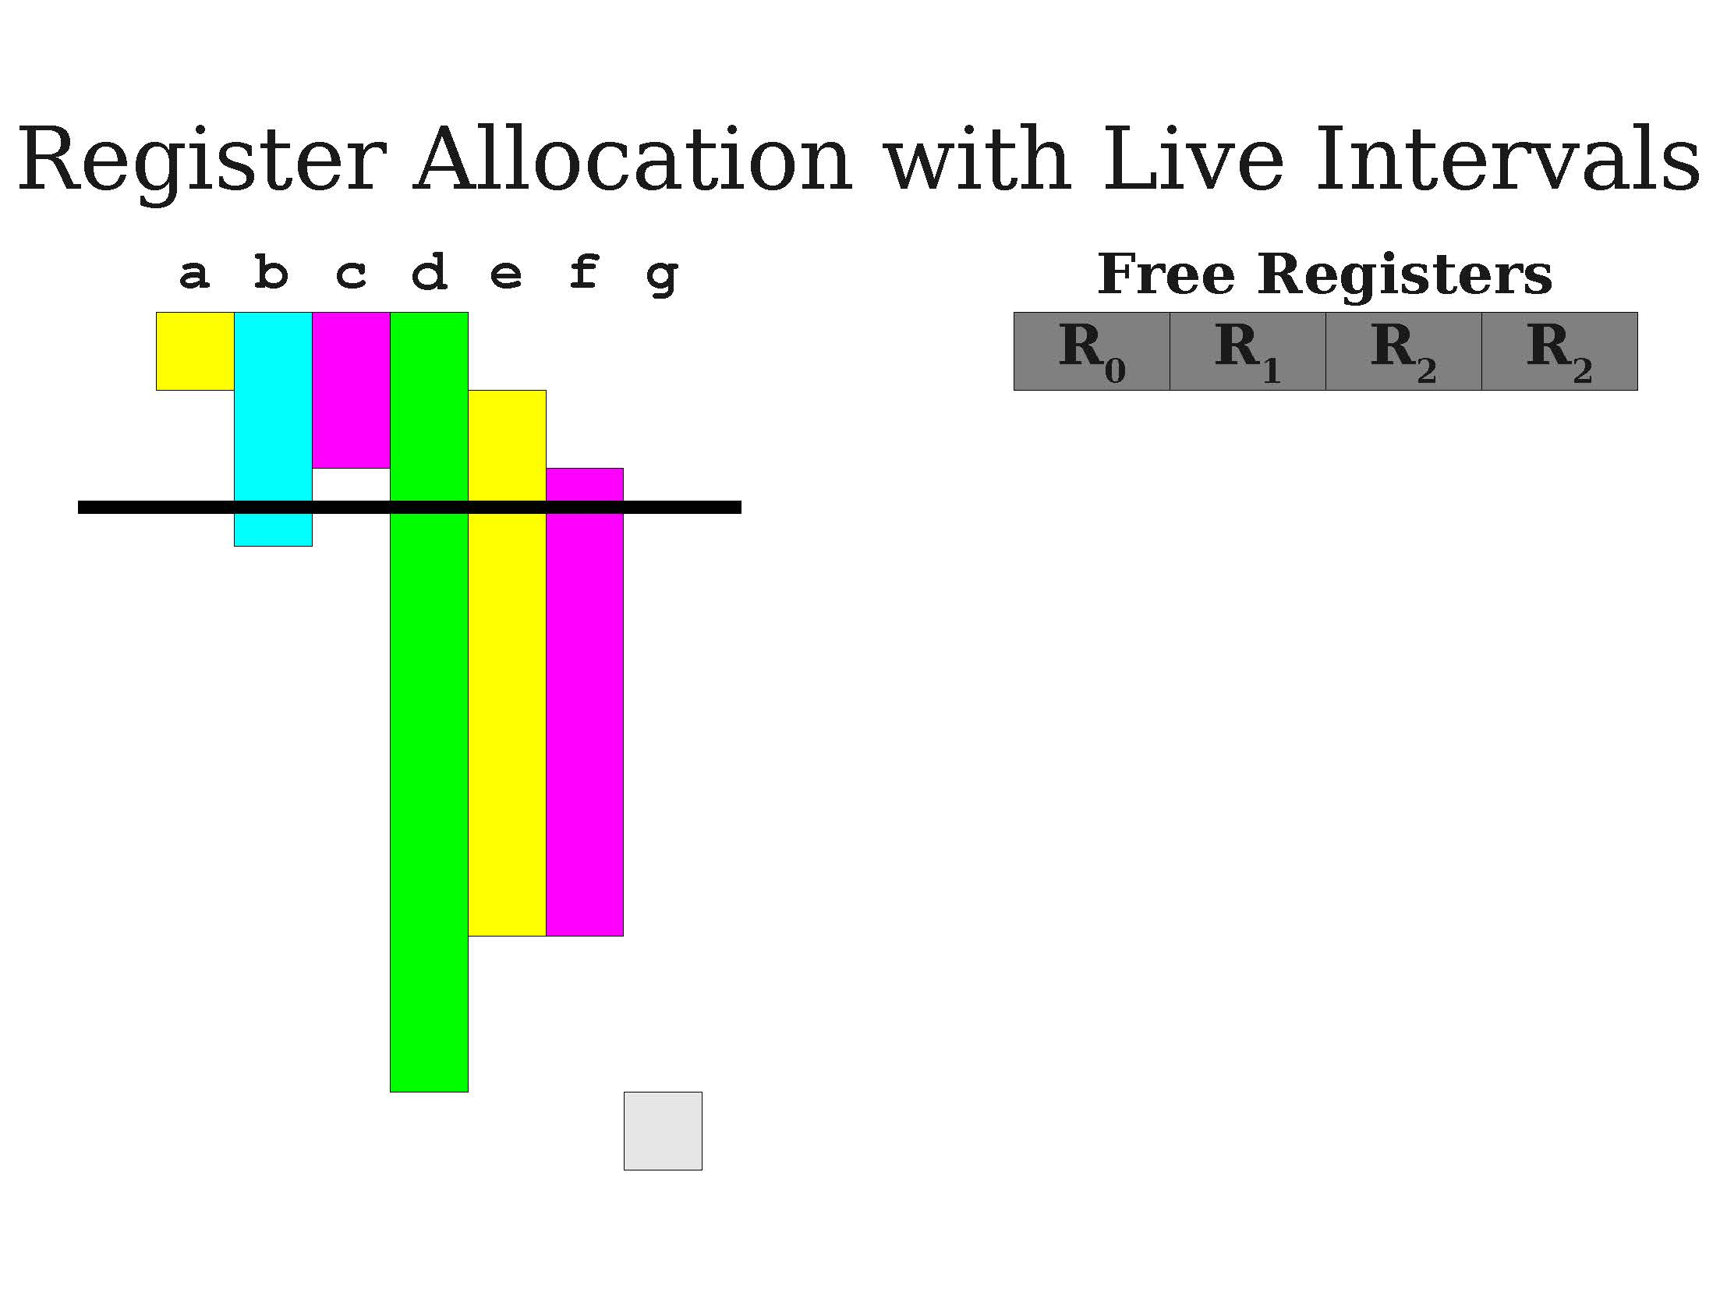
A first demo of greedy allocation

Slide 40
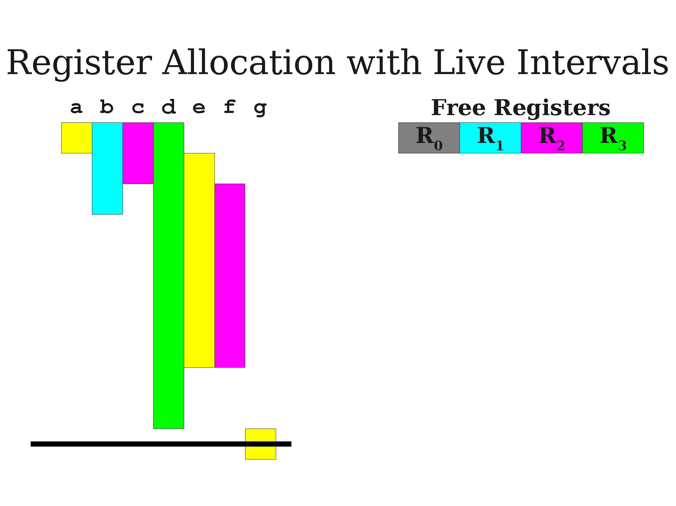
A first demo of greedy allocation

Slide 41
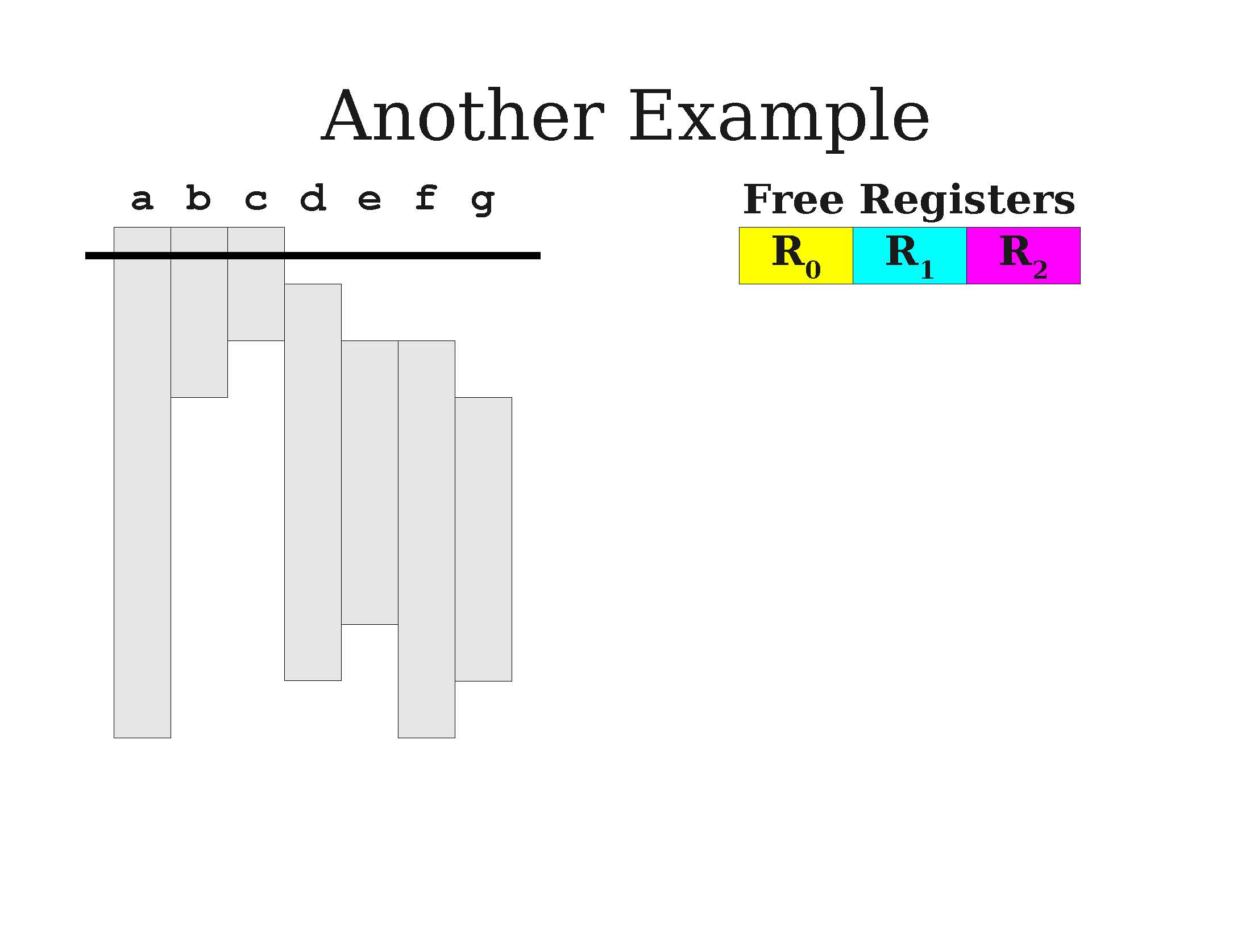
A second demo of greedy allocation

Slide 42
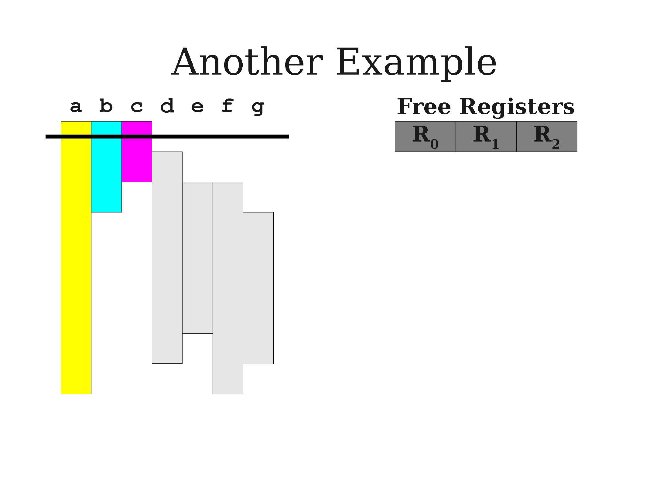
A second demo of greedy allocation

Slide 43
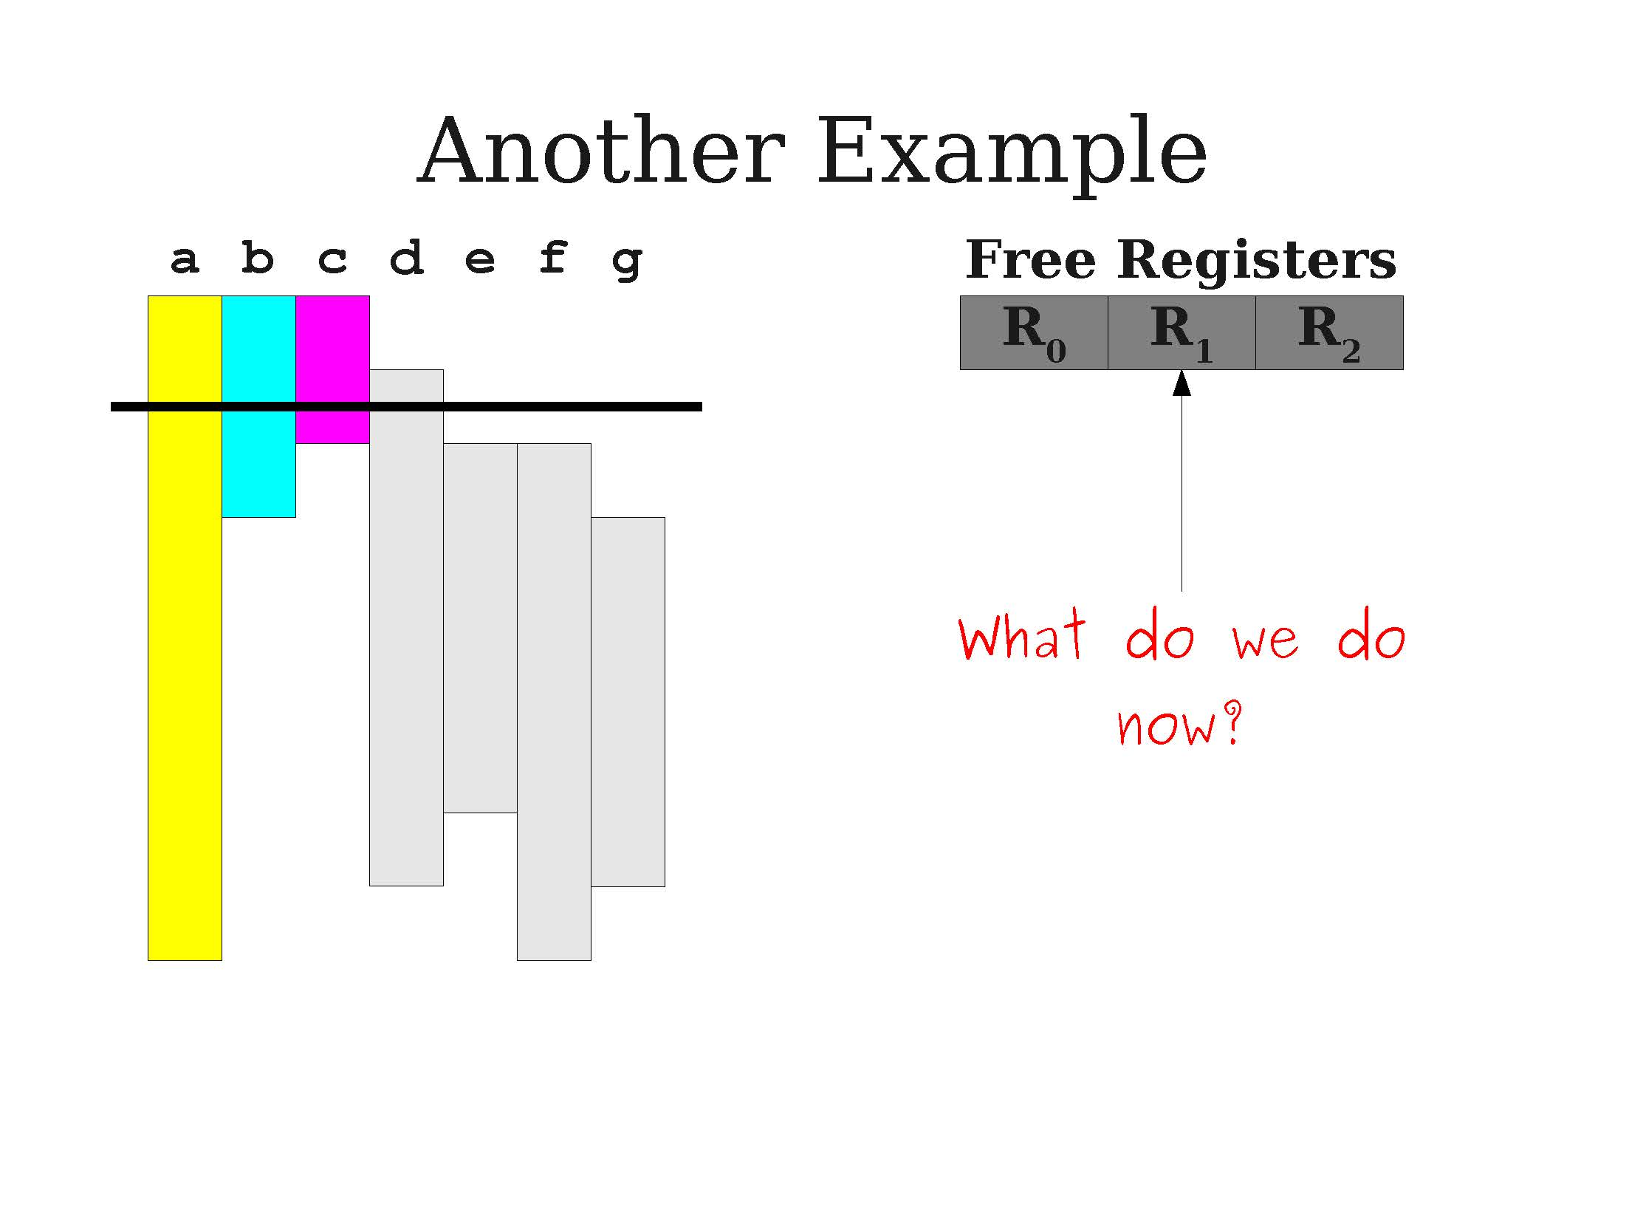
A second demo of greedy allocation
We need a register for d, but we are out of free registers at the moment!
What to do?

Slide 44
Using live ranges
Idea (continued): Given the live intervals for all the variables/IR registers in the TAC program, we can allocate registers using a simple greedy algorithm.
Track which registers are free.
When a live interval begins, give that variable a free register.
When a live interval ends, the register could be freed without consequences.
Works if live variables sets is smaller than number of registers. What to do if not?

Slide 45
Register spilling
Definition (Register Spilling):
If, at a given time, a free register cannot be found for a live variable v, we will need to spill a variable. When a variable is spilled, it is stored in a secondary/less efficient memory location rather than a register.
When we need a register for the spilled variable:
Evict some existing register to a secondary memory location.
Load the variable into the register.
When done, write the register back to memory and reload the register with its original value.
Spilling is slow, but sometimes necessary.

Slide 46
A second demo of greedy allocation
We need a register for d, but we are out of free registers at the moment!
What to do?

Slide 47
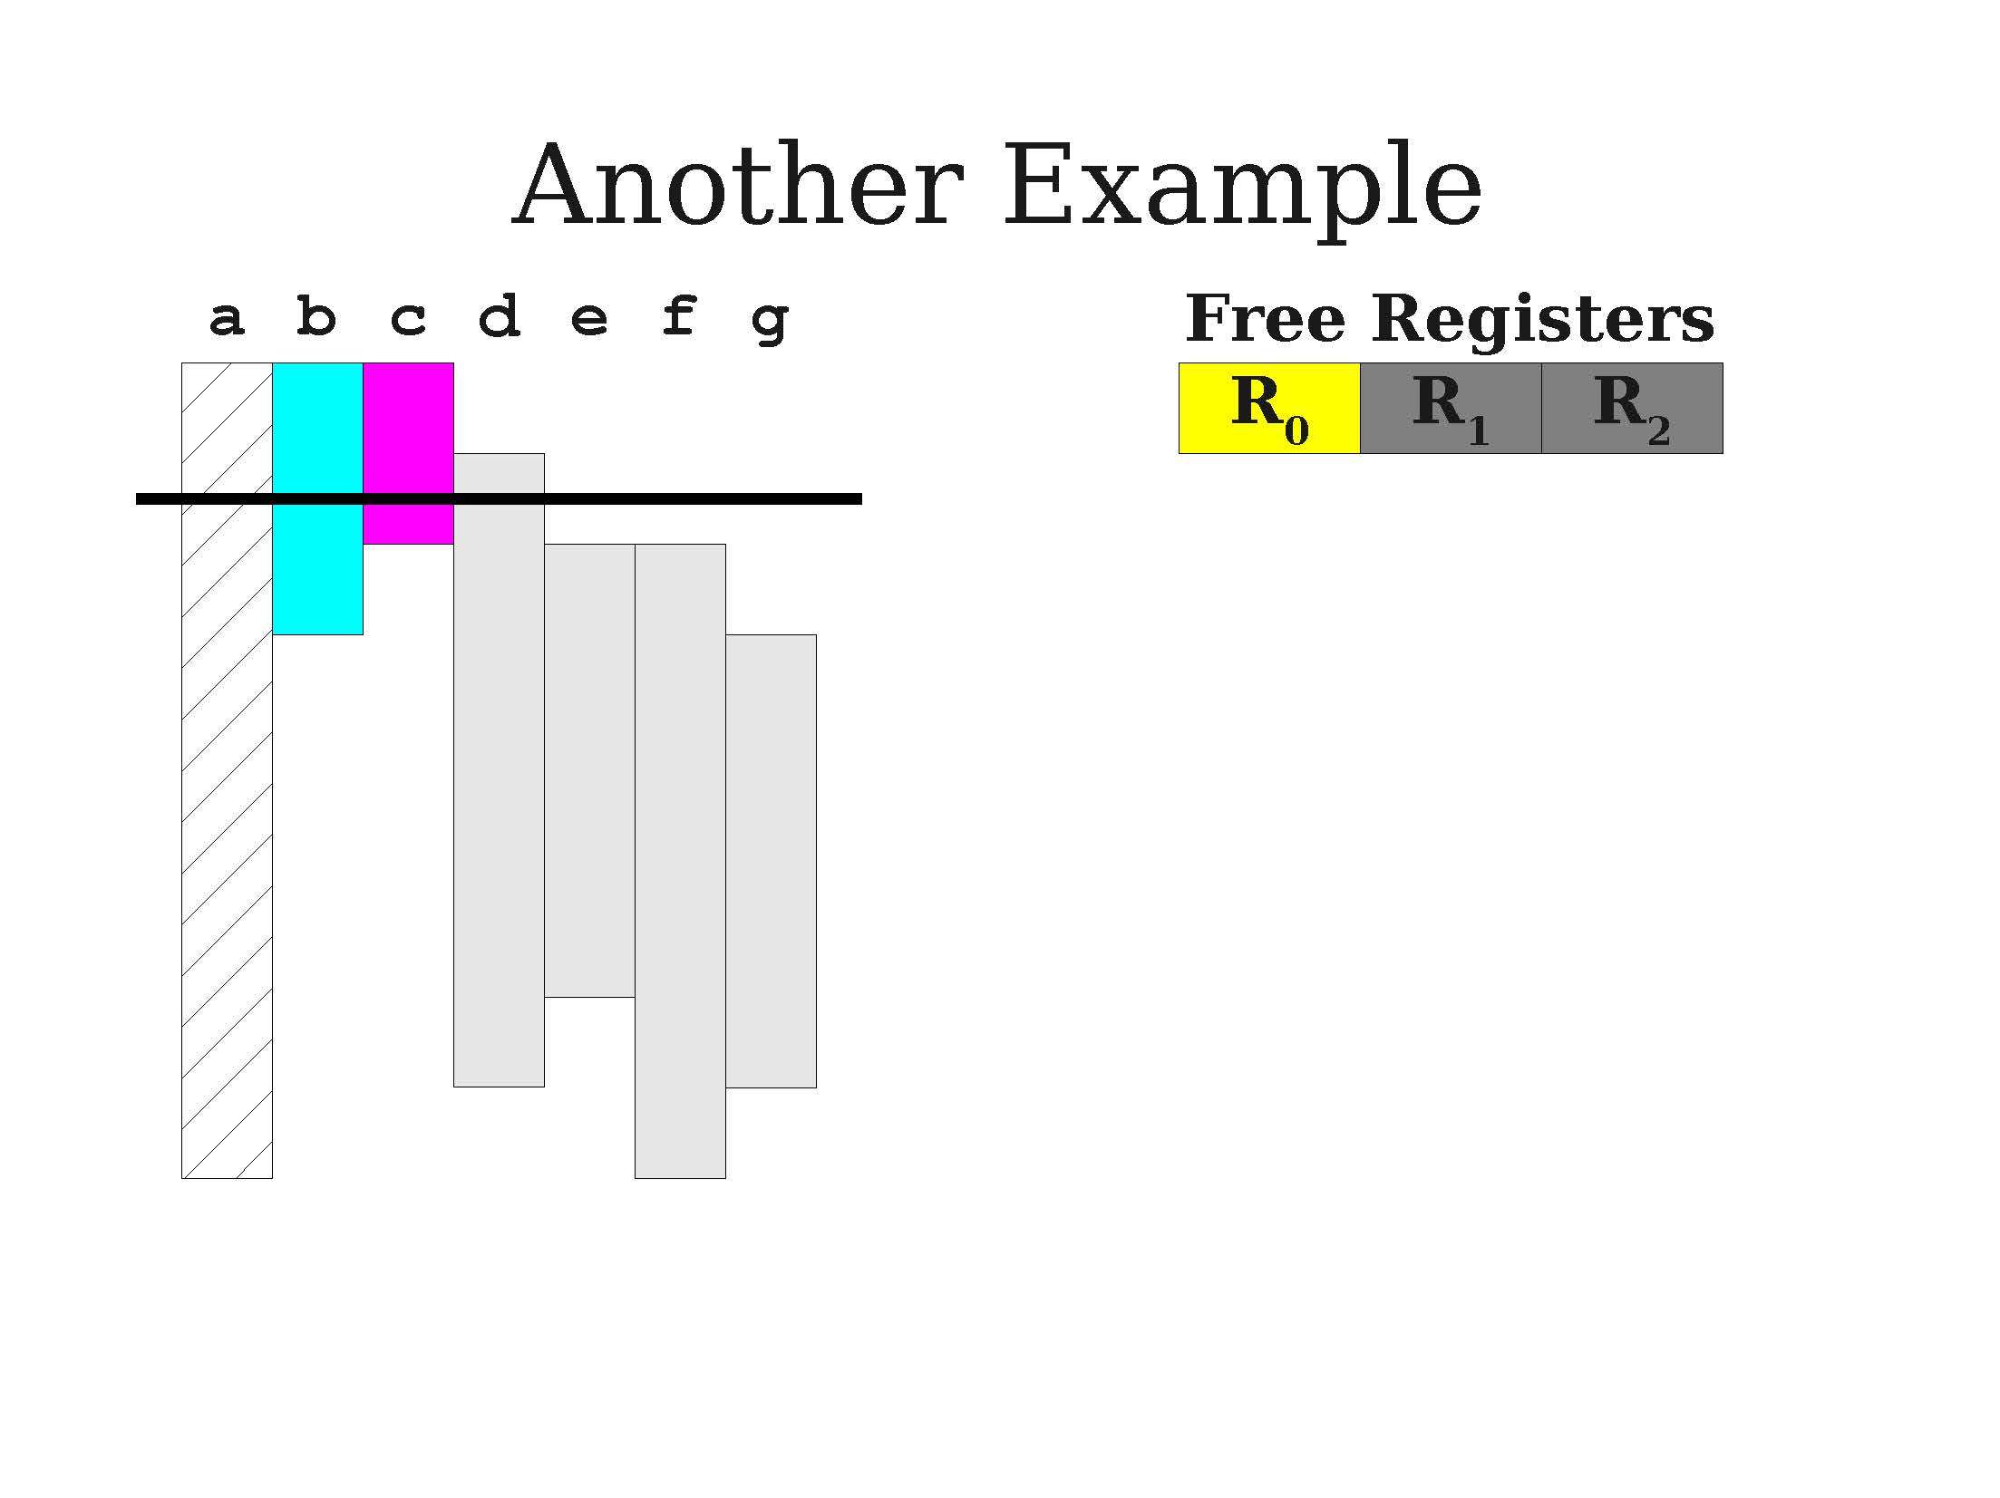
A second demo of greedy allocation
We need a register for d, but we are out of free registers at the moment!
What to do?
Spill variable a for now. Give R1 to d

Slide 48
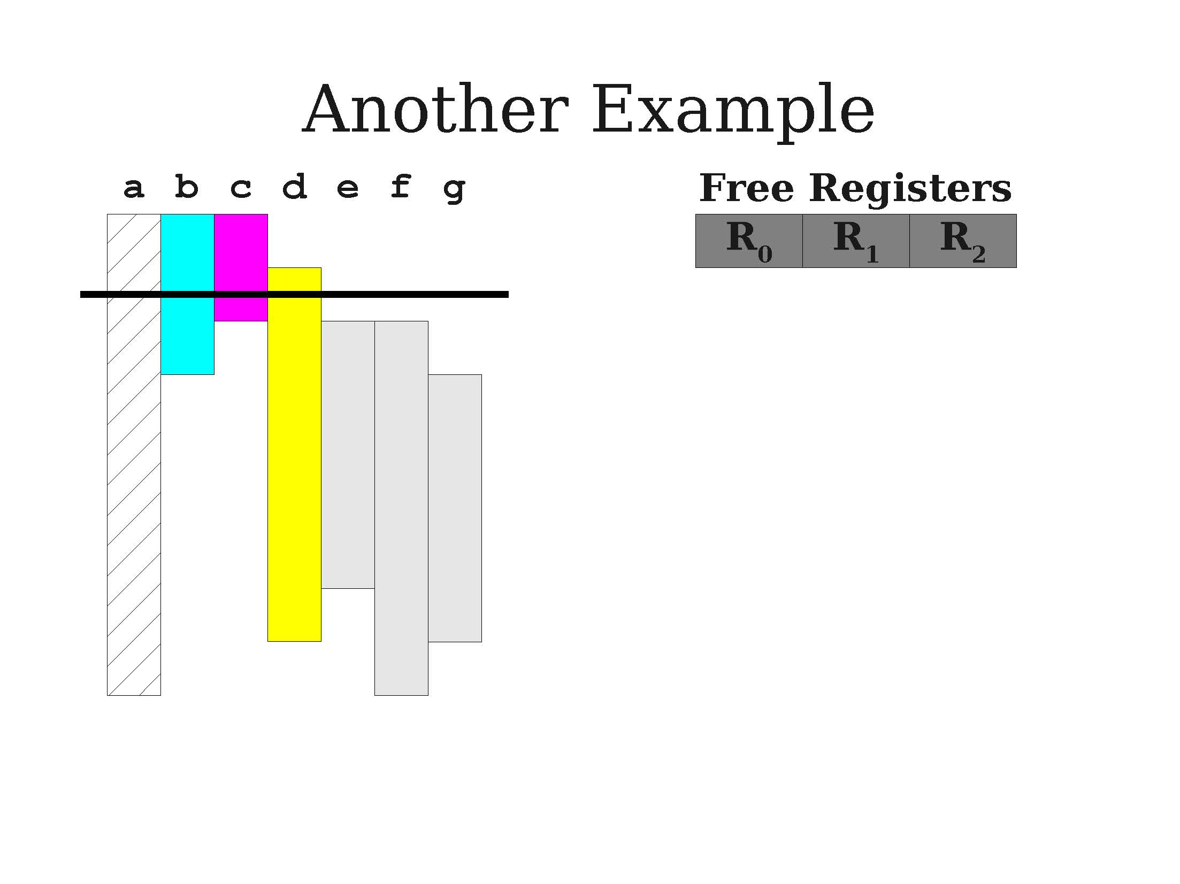
A second demo of greedy allocation
We need a register for d, but we are out of free registers at the moment!
What to do?
Spill variable a for now. Give R1 to d

Slide 49
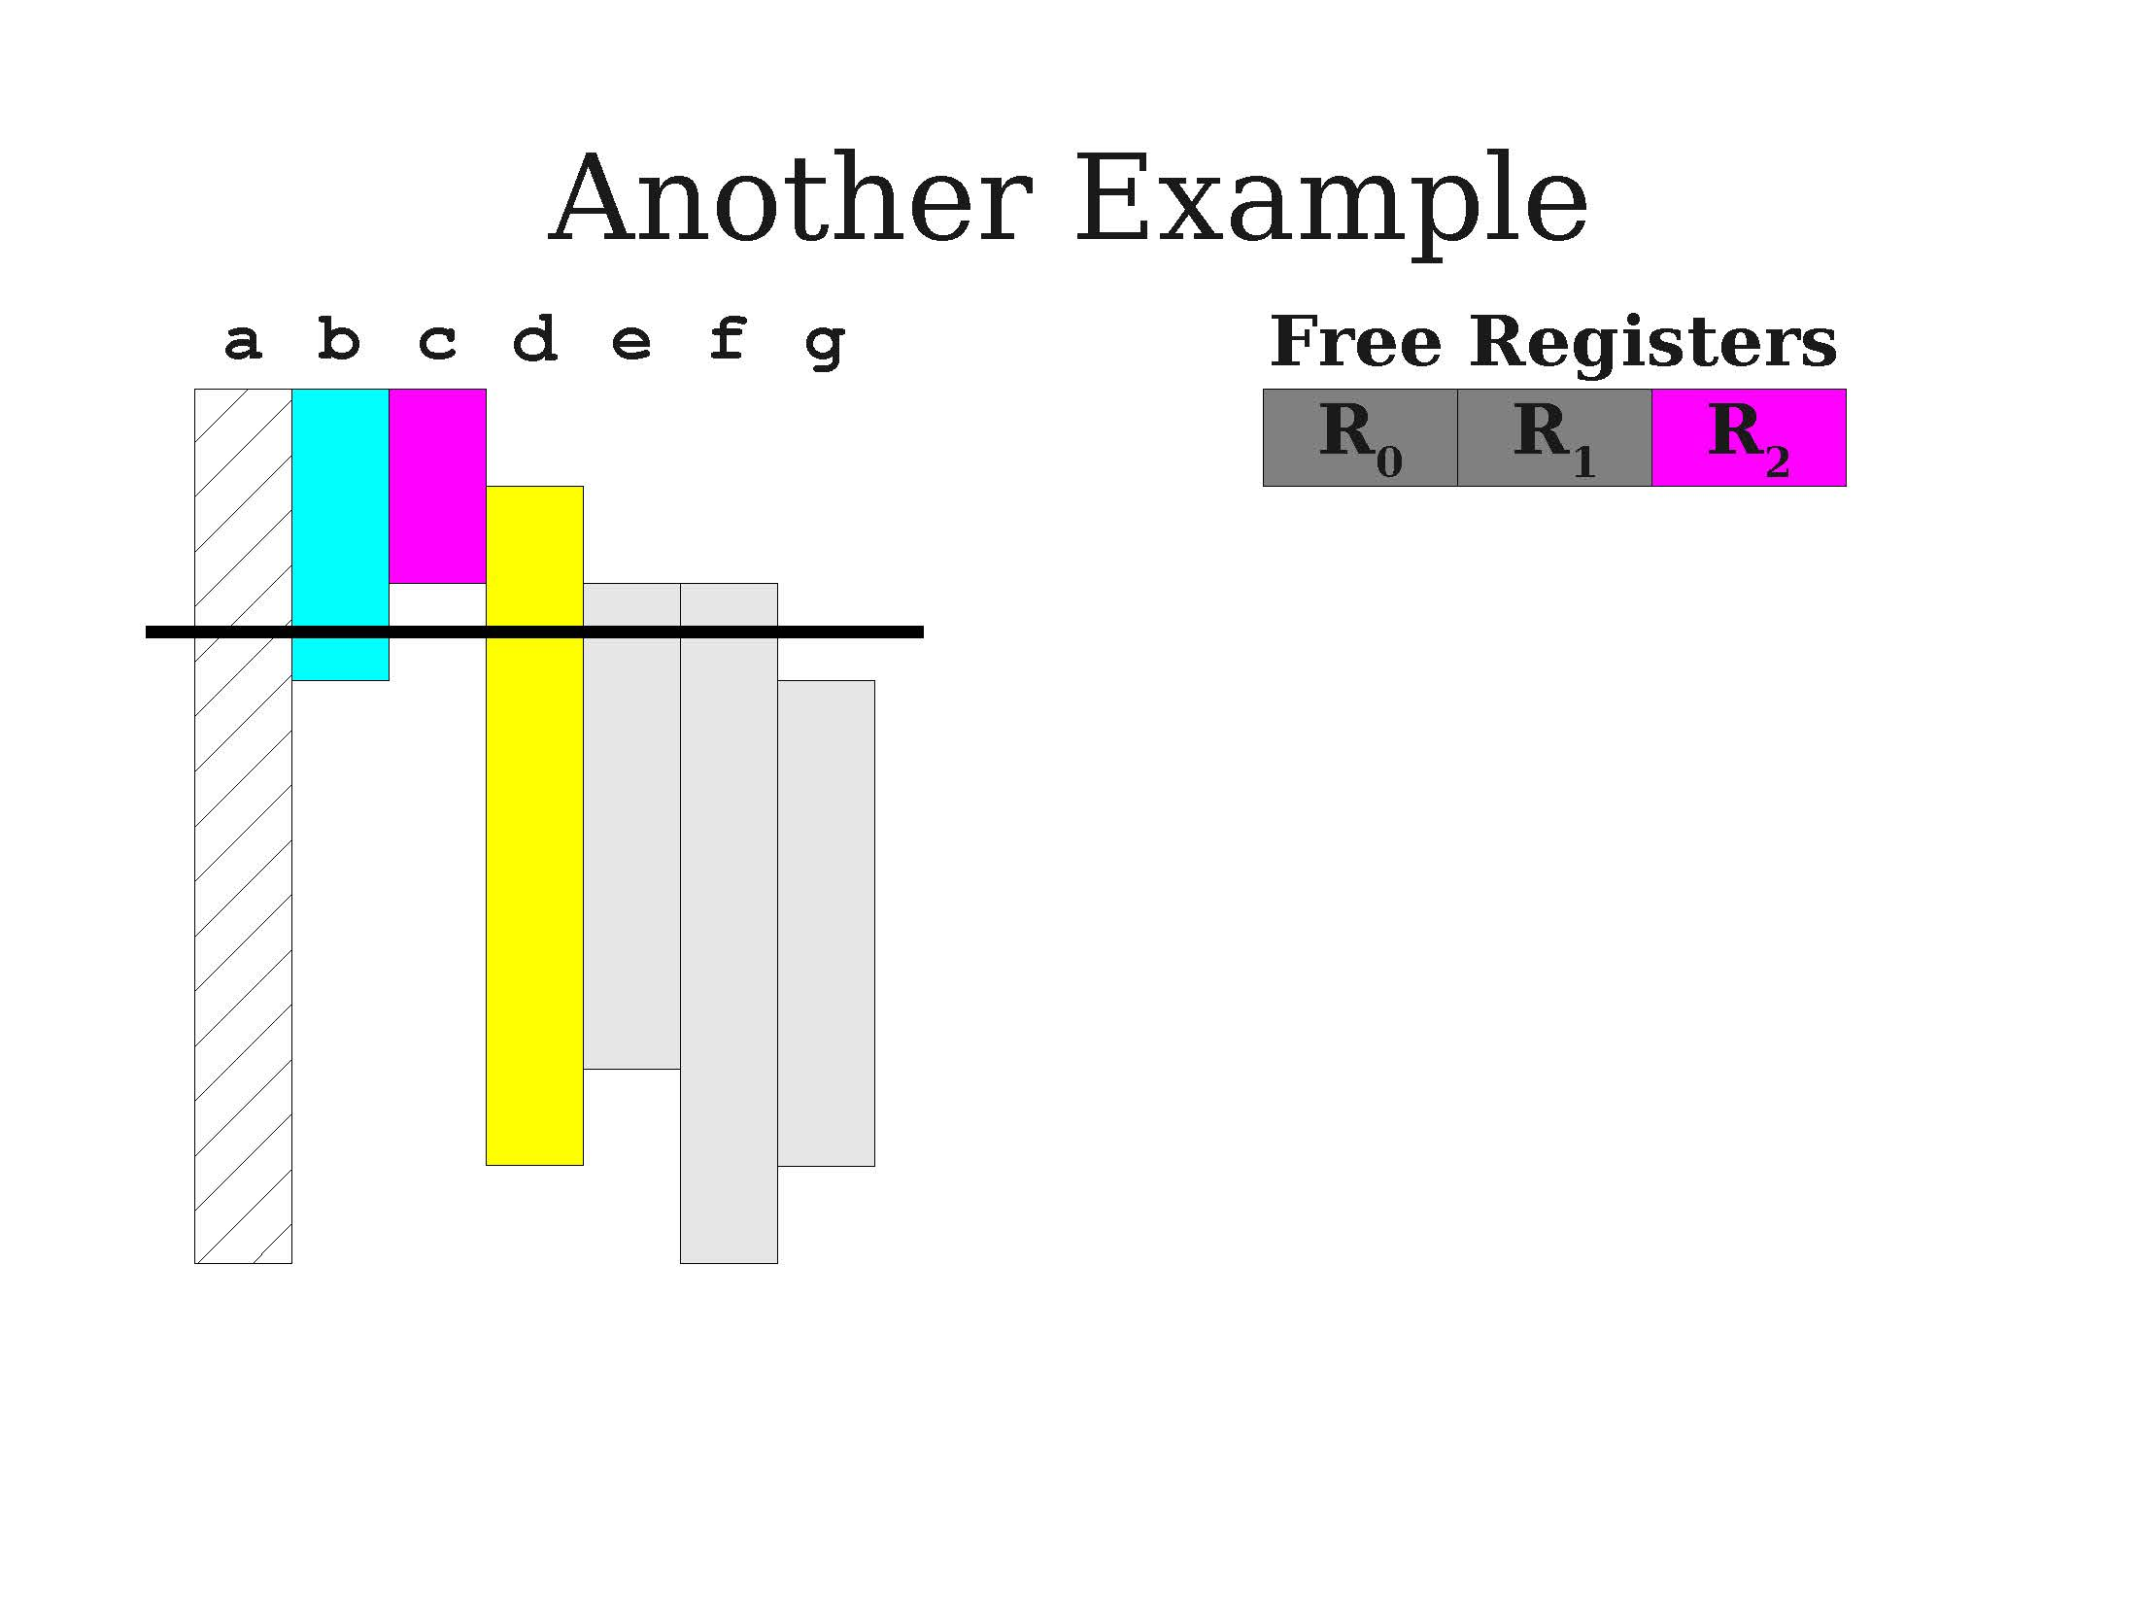
A second demo of greedy allocation

Slide 50
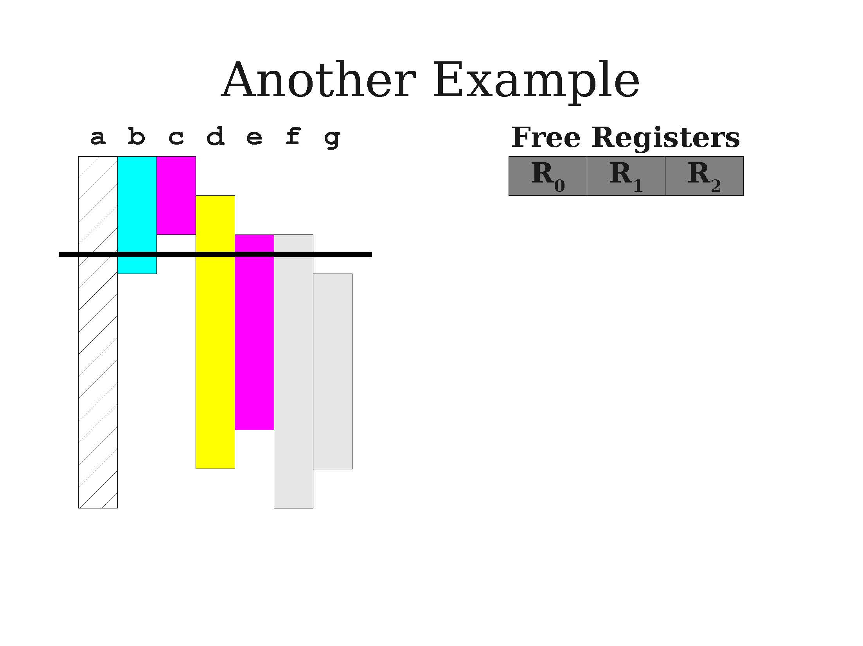
A second demo of greedy allocation

Slide 51
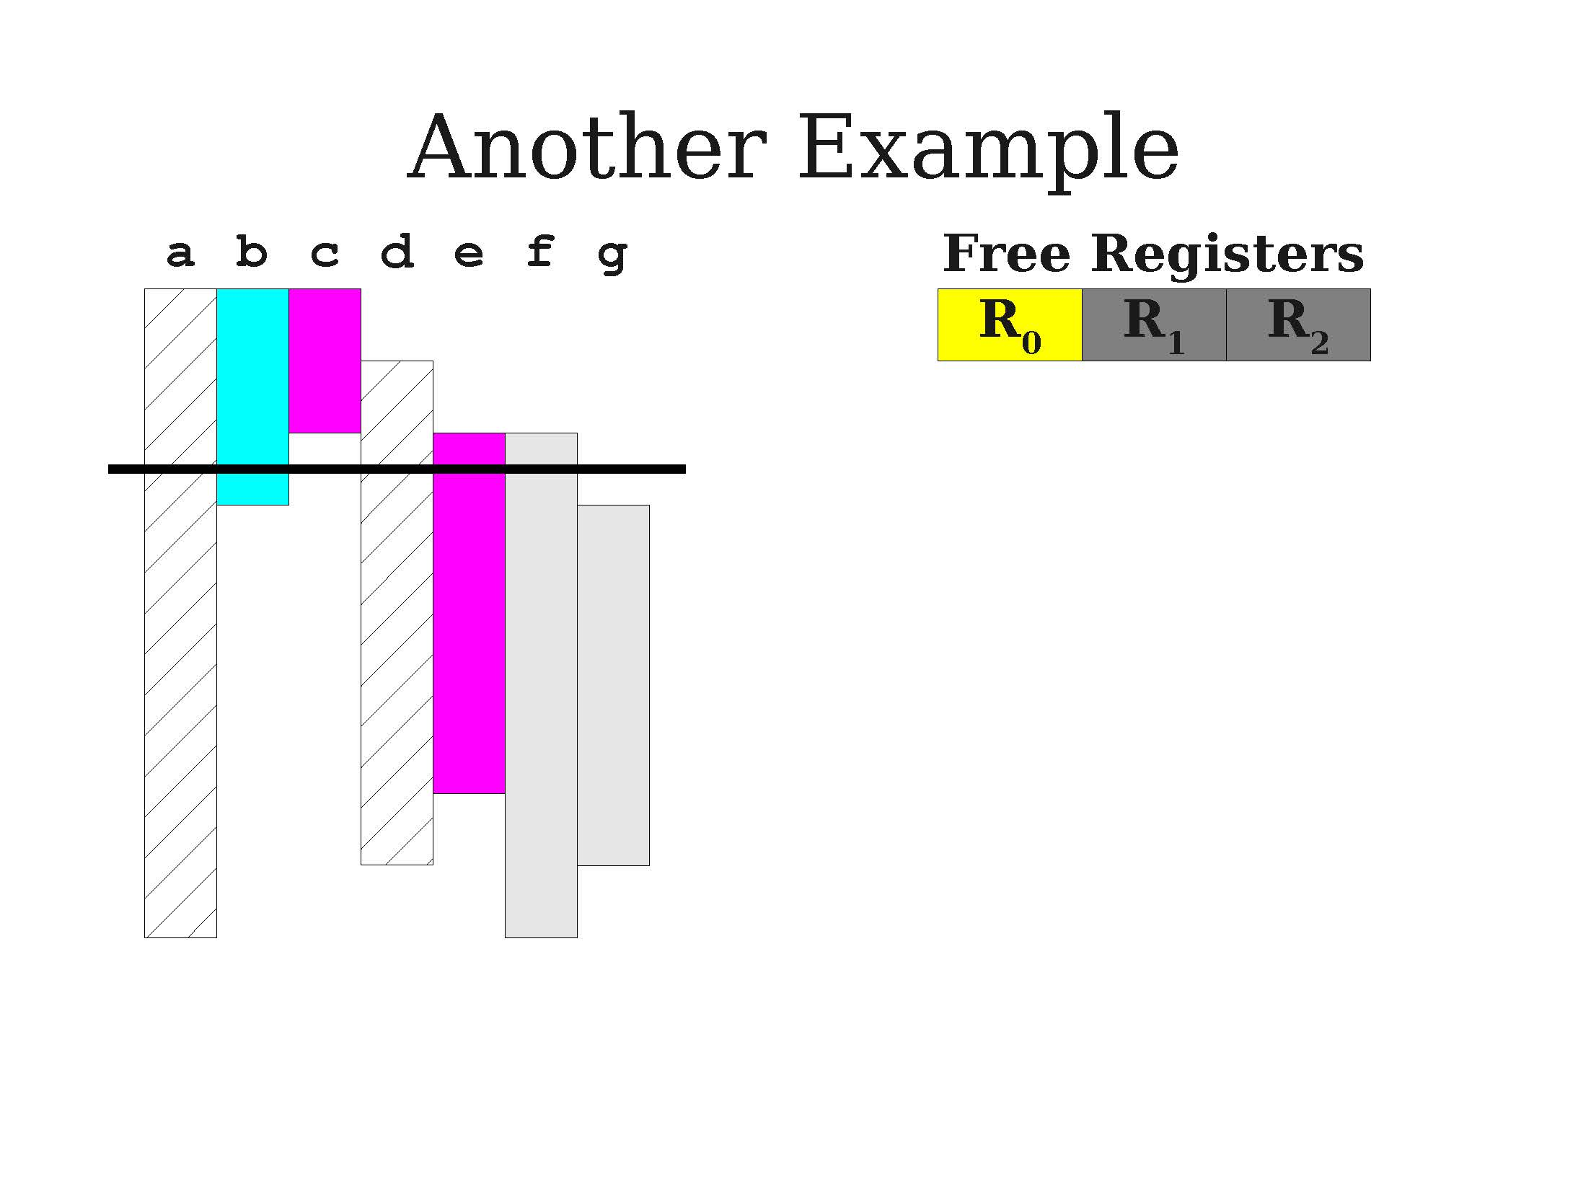
A second demo of greedy allocation

Slide 52
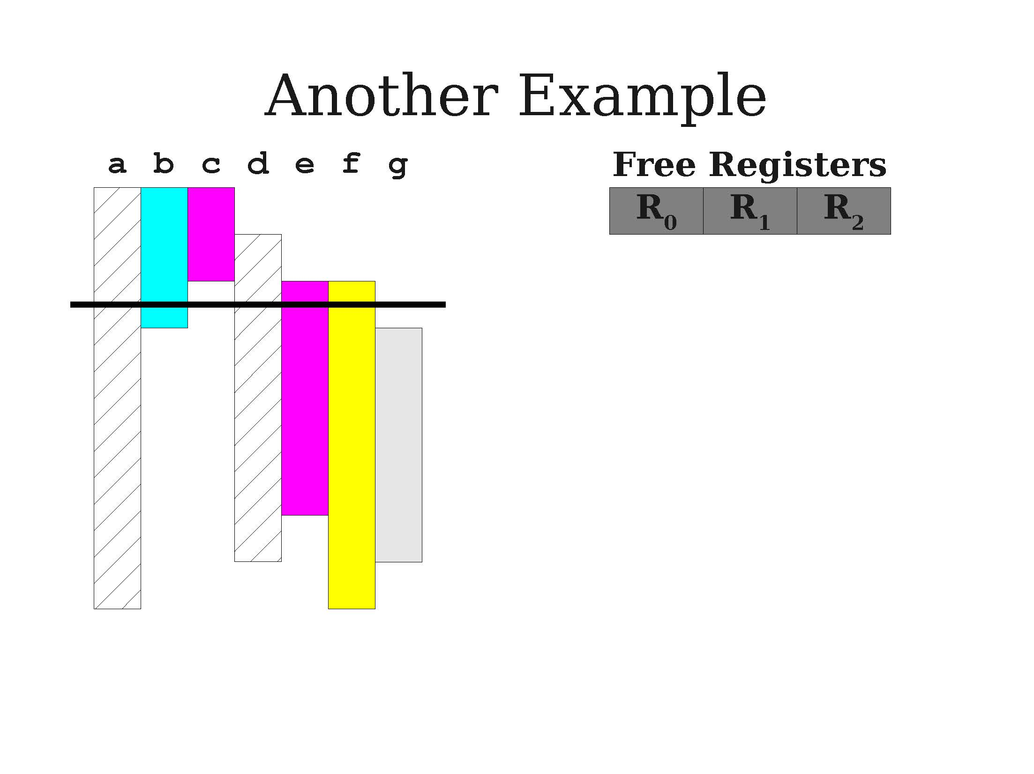
A second demo of greedy allocation

Slide 53
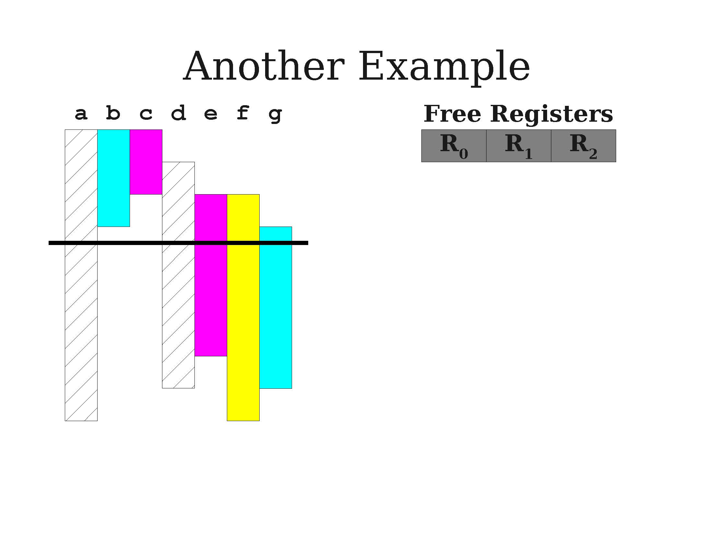
A second demo of greedy allocation

Slide 54
Linear scan register allocation
This greedy algorithm with register spilling is called the linear scan register allocation algorithm.
Advantages:
Very efficient (after computing live intervals, runs in linear time)
Produces good code in many instances.
Allocation step works in one pass; can generate code during iteration.
Disadvantages:
Imprecise due to use of live intervals rather than live ranges.
Other techniques known to be superior in many cases.

Slide 55
Linear scan register allocation
This greedy algorithm with register spilling is called the linear scan register allocation algorithm.
More advanced versions of this algorithm exist, for instance the linear scan register allocation with second-chance bin packing algorithm.
If a variable must be spilled, do not spill all uses of it.
A later live range might still fit into a register.
Requires a final data-flow analysis to confirm variables are assigned consistent locations.

Slide 56
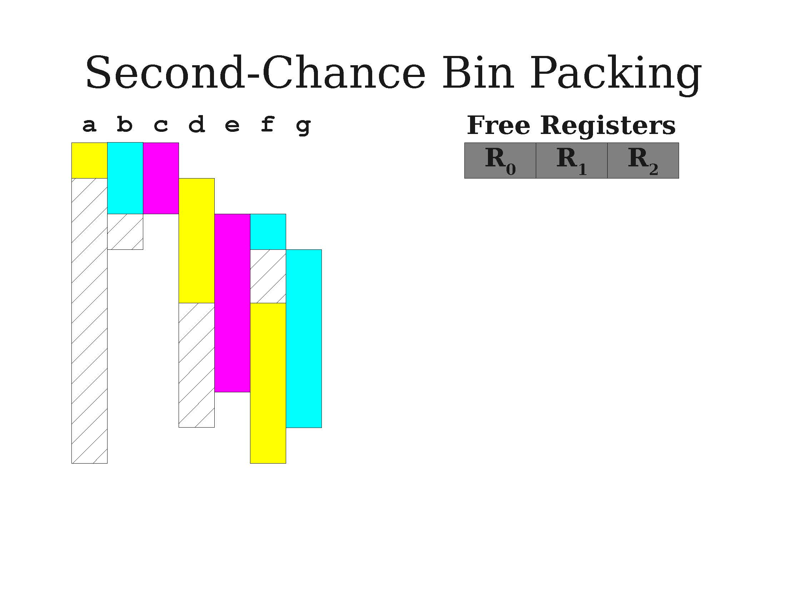
A visual idea for second-chance bin packing
A first demo of greedy allocation

Slide 57
Live interval dependency graph
Definition (Live Interval Dependency Graph):
The more advanced resource allocation algorithms require to understand which variables might happen to be live at the same time.
Represent these dependencies using a graph, where:
Nodes are variables,
Edges describe if two variables will have to be live at the same time at a given point of the program.
This defines a live interval dependency graph for live variables. Also sometimes called register interference graph.

Slide 58
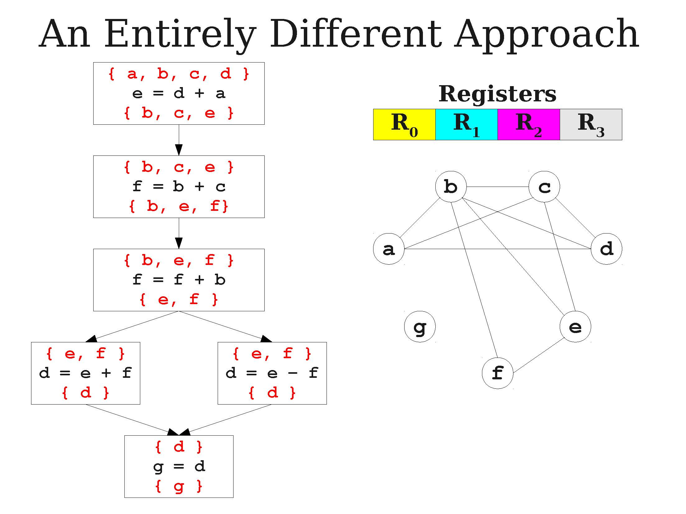
A live dependency graph example

Slide 59
Resolving assignments via the graph
Idea: If we know which variables are supposed to be live together at any given point, then
We can decide, optimally, on the minimum number of memory locations required at any given time to store live variables.
We can decide which memory location to assign to any given variable.
All we need is to assign registers to variables
And make sure no two variables connected by an edge in our live dependency graph are assigned to the same memory location!

Slide 60
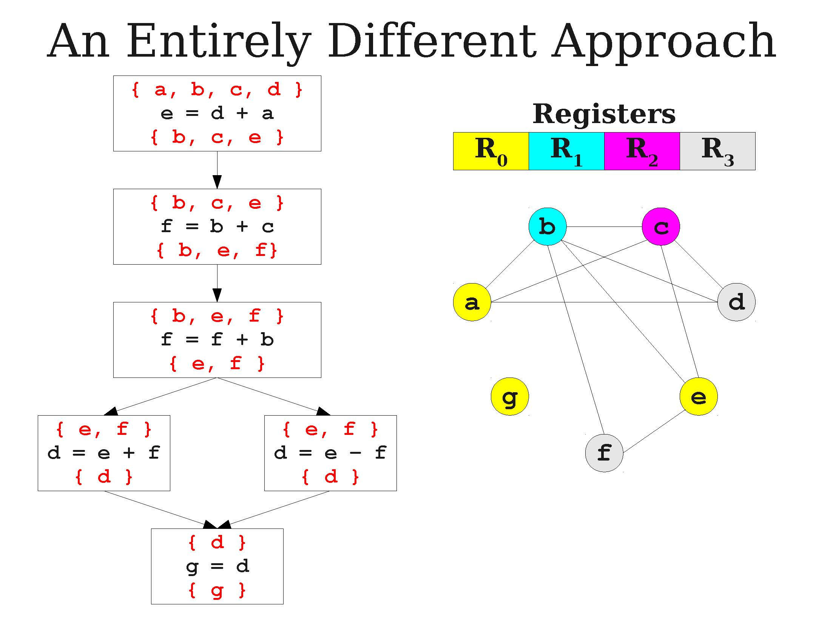
A live dependency graph example

Slide 61
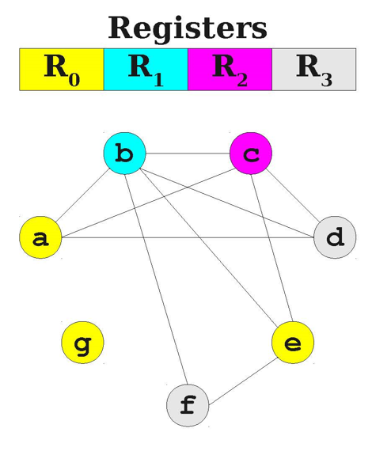
Graph coloring problem
Definition (graph coloring problem):
This problem is a well-known problem in graph theory, called the graph coloring problem.
Typically, try to colorize each node, with no two nodes with the same color connected via an edge.
Small problem, it is NP-hard (again!).
Some heuristics exist (e.g. Chaitin’s algorithm), but still pretty much an open problem in graph theory! (out-of-scope)

Slide 62
Possible algorithms to investigate
Lesson: The register allocation problem, like many other problems in compilers, is not an easy one to solve! (NP-hard).
Naïve (“no”) register allocation.
Linear scan register allocation.
Graph-coloring register allocation.
In addition: Advanced versions of these algorithms might need to discuss with the processor and the OS as to what resources are available (e.g. other programs running, multi-core CPUs, parallelised computing, number of registers, GPU computing, etc.).
These are, again, too advanced and out-of-scope.

Slide 63
A quick word on garbage collection

