Slide 1

50.051 Programming Language Concepts W9-S2 Regular Expressions and Pattern Recognition in C
Matthieu De Mari

Slide 2
Regular Expressions
Definition (Regular Expressions, or RegEx):
Regular Expressions (or Regex) are a powerful tool for pattern matching and searching in text.
They are used in many programming languages and applications to find, extract, and manipulate text based on specific patterns.
Regular expressions can be seen as a concise way of describing a set of strings that share a certain structure or patterns.
Later on, RegEx will be very useful for us to recognize substrings of text that exhibit a certain pattern (they consist of a certain keyword, start with “, etc.).

Slide 3
Regular Expressions
Definition (Regular Language):
Regular Language consists of the possible strings that exhibit the pattern defined by a given Regular Expression.
For instance, if the Regular Expression consists of all the binary strings finishing with a 0…
…Then, all of these strings (100, 10100, 1110, 10, 1101010011010, etc.) will be considered Regular Language for the given Regular Expression we have defined above.

Slide 4
Technically, we have already played with RegEx FSMs! (Remember previous activities).
Can we use FSM to recognize to implement RegEx?
Yes!
Our Finite State Machines (FSM) can be used to recognize regular languages, which are sets of strings that can be described by regular expressions.
There is a strong connection between regular expressions and FSMs: for every regular expression, there exists an equivalent FSM that recognizes the same language.

Slide 5
Technically, we have already played with RegEx FSMs! (Remember this activity).
We would like to write an FSM with stopping states that will take strings x consisting of combinations of four characters: S, U, T and D.
Possible combinations for the string x include, among many others, “USD”, “SUUUUTD”, and the only acceptable input “SUTD”.
Draw a FSM state diagram, which:
Has 7 possible States (Start, S, U, T, D, Valid, Invalid),
Has 4 possible Actions (S, U, T, D),
Has the Start state defined as the starting state,
Has the Valid state defined as the only stopping state,
Has the FSM stop in this state, if and only x is SUTD; otherwise, it stops in another state (Invalid or something else).

Slide 6
The most basic RegEx
Definition (the most basic RegEx):
The most basic regex attempts to recognize a string s consisting of the single letter "a". Every other string (“A”, “aa”, “ba”, “”, etc.) is not considered as regular language for this regular expression.
This regular expression is then simply defined as “a”.

Slide 7
The most basic RegEx
This can be simply implemented with the FSM shown.
The FSM uses outputs and no stopping states, and will stop early when an output 0 is produced.
The only acceptable input strings, will therefore be the ones that never produce a 0 output.
That is s = “a”.
VALID
Any character/0
NOT VALID
a/1
Anything but a/0

Slide 8
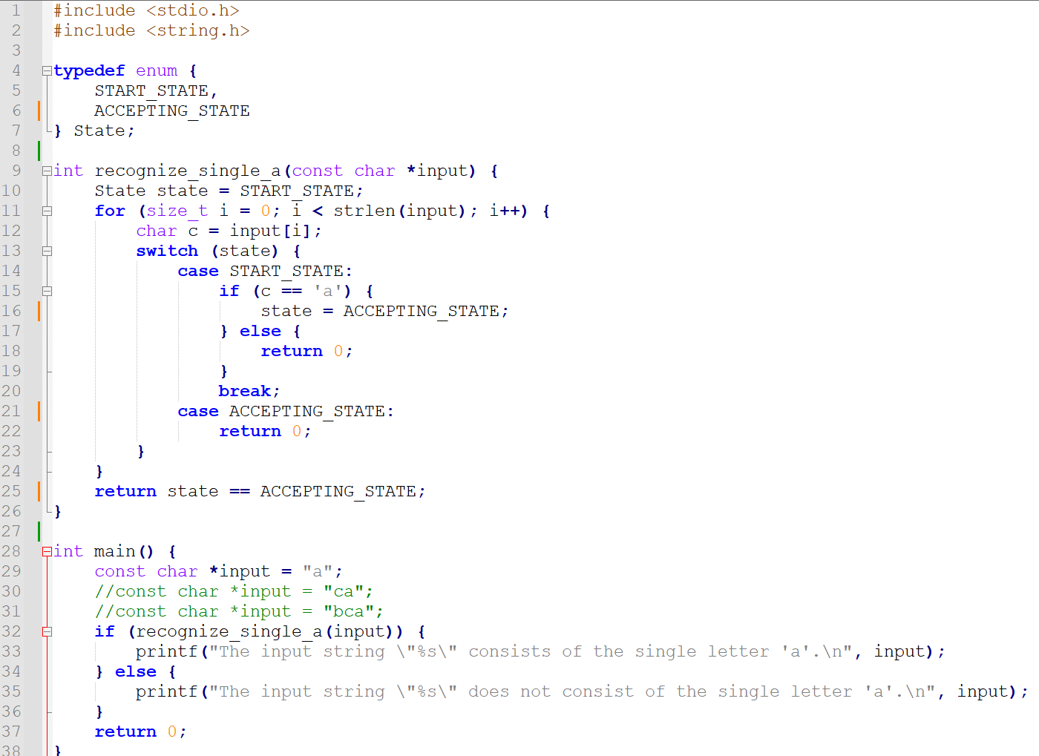

Slide 9
The most basic RegEx
This can be also be implemented as an FSM with stopping state being VALID.
We will then stop the FSM prematurely if the next state being produced at any given time is NOT_VALID (except for starting).
This is roughly equivalent.
VALID
Any character
NOT VALID
VALID
a
Anything else

Slide 10
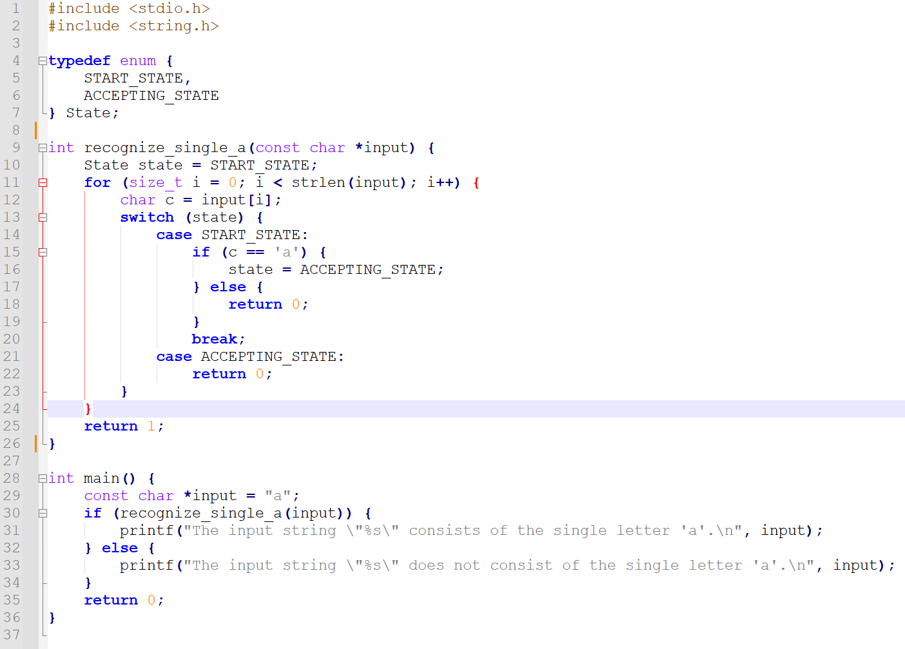

Slide 11
The infamous Epsilon transition
Definition (the Epsilon transition):
In (Non-deterministic) Finite State Machines, the Epsilon transition is an optional transition which offers to advance to a next state, without consuming any character from the input string s.
In Layman terms, an epsilon transition literally means “you may choose to go to the next state (or not) without checking the next input character”.

Slide 12







An example of a use for Epsilon
As an example of the use for the Epsilon transition, consider the FSM on the right.
Question: What are acceptable inputs for this FSM?
NOT VALID
$$0 or 1$$
$$0$$
$$1$$
$$0$$
s3
s2
s1
s0
VALID
$$0$$
$$1$$
$$ε$$
1

Slide 13
An example of a use for Epsilon
As an example of the use for the Epsilon transition, consider the FSM on the right.
Question: What are acceptable inputs for this FSM?
Answer: Any string that consists of any number of ones (at least one), and then finishes with exactly one zero (e.g. 10, 110, 1110, 111111110, etc.)
NOT VALID
$$0 or 1$$
$$0$$
$$1$$
$$0$$
s3
s2
s1
s0
VALID
$$0$$
$$1$$
$$ε$$
1

Slide 14
An example of a use for Epsilon
Why is the Epsilon useful here?
Try writing this FSM without using an Epsilon transition for this FSM and see for yourself!
NOT VALID
$$0 or 1$$
$$0$$
$$1$$
$$0$$
s3
s2
s1
s0
VALID
$$0$$
$$1$$
$$ε$$
1

Slide 15
On the use of the Epsilon Transitions in RegEx
Definition (Epsilon transitions in RegEx):
One important use of epsilon transitions is in the construction of non-deterministic finite automata (NFAs) for RegEx.
In this context, an epsilon transition is used to represent the empty string, which is a valid input for many regular expressions.
By including epsilon transitions in the FSM of your RegEx,
the regular expression can be represented more compactly,
and you may use it to combine several RegEx into a single combined one (as will be shown next).

Slide 16
Concatenation of RegEx
s1
Any character/0
s0
Theorem (Concatenation of RegEx):
Assume that we have two RegEx.
E.g., our first RegEx is “a” and our second RegEx is “b”, and we have defined their respective two FSMs.
a/1
Anything but a/0
s3
Any character/0
s2
b/1
Anything but b/0

Slide 17

Concatenation of RegEx
s1
Any character/0
s0
Theorem (Concatenation of RegEx):
Assume that we have two RegEx.
E.g., our first RegEx is “a” and our second RegEx is “b”, and we have defined their respective two FSMs.
The concatenated RegEx “ab”, can then be built by combining the two FSMs, connecting them with an Epsilon transition.
a/1
Anything but a/0
$ε$/1
s3
Any character/0
s2
b/1
Anything but b/0

Slide 18
Concatenation of RegEx
s1
Any character/0
s0
Theorem (Concatenation of RegEx):
Assume that we have two RegEx.
E.g., our first RegEx is “a” and our second RegEx is “b”, and we have defined their respective two FSMs.
The concatenated RegEx “ab”, can then be built by combining the two FSMs, connecting them with an Epsilon transition.
Later on, this FSM can be simplified by removing the Epsilon as shown.
a/1
Anything but a/0
Any character/0
b/1
s3
Any character/0
s2
b/1
Anything but b/0

Slide 19
What we have done in W8S3 Practice 2!
We would like to write an FSM with stopping states that will take strings x consisting of combinations of four characters: S, U, T and D.
Possible combinations for the string x include, among many others, “USD”, “SUUUUTD”, and the only acceptable input “SUTD”.
Draw a FSM state diagram, which:
Has 7 possible States (Start, S, U, T, D, Valid, Invalid),
Has 4 possible Actions (S, U, T, D),
Has the Start state defined as the starting state,
Has the Valid state defined as the only stopping state,
Has the FSM stop in this state, if and only x is SUTD; otherwise, it stops in another state (Invalid or something else).

Slide 20


Choice of RegEx
Any character/0
s0
Theorem (Choice operator in RegEx):
Assume that we have two RegEx.
E.g., our first RegEx is “a” and our second RegEx is “b”, and we have defined their respective two FSMs.
The choice operator | between both RegEx “a|b” can be used to define two regular language consisting of the two strings “a” and “b”.
It can then be built by combining the two FSMs, in parallel.
$$ε/1$$
$$ε/1$$
s1
s2
a/1
b/1
s3
Anything/0

Slide 21
On the use of parentheses in RegEx
Definition (On the use of parentheses in RegEx):
Parentheses can be used in RegEx to separate operations.
For instance, we could write the RegEx “(a|b)c”, whose acceptable language consists then of the two strings “ac” and “bc”.
It should not be confused with “a|bc”, whose regular language is then “a” and “bc”.
In this second case, a|bc is equivalent to a|(bc).

Slide 22
On the use of the escape character in RegEx
Definition (On the use of the escape character in RegEx):
The Escape character \ can be used in RegEx to indicate that a special symbol – which normally has an effect in RegEx – should in fact appear in the string.
For instance, we could write the RegEx “\(a\)c”, whose regular language consists then of the string “(ac)”.

Slide 23
On the use of parentheses in RegEx
Definition (On the use of parentheses in RegEx):
Parentheses is a special character in RegEx, which can be used to separate operations.
For instance, we could write the RegEx “(a|b)c”, whose regular language consists then of the two strings “ac” and “bc”.
It should not be confused with “a|bc”, whose regular language consists of the two strings “a” and “bc”.

Slide 24
Closure or Kleene operator
Theorem (Closure or Kleene operator in RegEx):
Assume that we have a RegEx “a” and its respective FSM.
The Closure (or Kleene) operator * can be used to define the RegEx a*.
Its regular language consists of all the strings containing zero or more repetitions of the character a, i.e. “”, “a”, “aa”, “aaa”, “aaaaaaa”, etc.

Slide 25
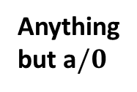

Closure or Kleene operator
Theorem (Closure or Kleene operator in RegEx):
Assume that we have a RegEx “a” and its respective FSM.
The Closure (or Kleene) operator * can be used to define the RegEx a*.
Its regular language consists of all the strings containing zero or more repetitions of the character a, i.e. “”, “a”, “aa”, “aaa”, “aaaaaaa”, etc.
Its FSM is based on the one for “a” and is shown below.
$ε$or a$/1$
Anything but a$/0$
s0
s1

Slide 26
Variations of the Kleene operator
Theorem (Plus or Kleene Plus operator in RegEx):
Assume that we have a RegEx “a” and its respective FSM.
The Plus (or Kleene Plus) operator + is used to define the RegEx a+.
Its regular language consists of all the strings containing one or more repetitions of the character a, i.e. “a”, “aa”, “aaa”, “aaaaa”, etc.
Theorem (Question Mark or Optional operator in RegEx):
Assume that we have a RegEx “a” and its respective FSM.
The Question Mark (or Optional operator operator) ? is used to define the RegEx a?.
Its regular language consists of all the strings containing zero or one repetitions of the character a, i.e. “” and “a” only.

Slide 27
Quiz Time!
Which regular expression would exactly match the two strings "cat" and "bat"?
(c|b)at
(c|b)*at
c|bat
(c|b)+(at)

Slide 28
Quiz Time!
Which regular expression would exactly match the two strings "cat" and "bat"?
(c|b)at
(c|b)*at
c|bat
(c|b)+at

Slide 29
Quiz Time!
What does the Kleene star (*) operator represent in regular expressions?
Match exactly one character
Match zero or more repetitions of a character
Match one or more repetitions of a character
Match any single character

Slide 30
Quiz Time!
What does the Kleene star (*) operator represent in regular expressions?
Match exactly one character
Match zero or more repetitions of a character
Match one or more repetitions of a character
Match any single character

Slide 31
Quiz Time!
Which regular expression would match the strings "ab", "abb", "abbb", and so on?
abb*
ab
ab+
a+ab

Slide 32
Quiz Time!
Which regular expression would match the strings "ab", "abb", "abbb", and so on?
abb* (but is considered malpractice)
ab
ab+
a+ab

Slide 33
Quiz Time!
Which of the strings below is considered regular language for the regular expression “a\?b” ?
a
ab
a?b
a\b

Slide 34
Quiz Time!
Which of the strings below is considered regular language for the regular expression “a\?b” ?
a
ab
a?b
a\

Slide 35
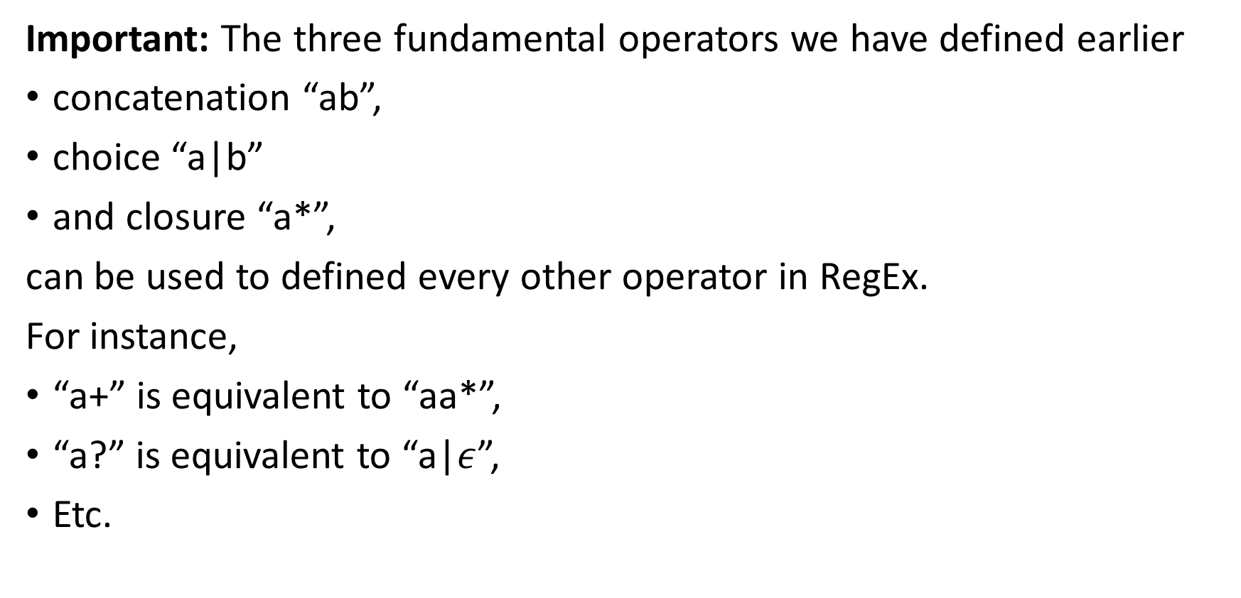
Some equivalences
Important: The three fundamental operators we have defined earlier
concatenation “ab”,
choice “a|b”
and closure “a*”,
can be used to defined every other operator in RegEx.
For instance,
“a+” is equivalent to “aa*”,
“a?” is equivalent to “a|$ε$”,
Etc.

