Slide 1

50.051 Programming Language Concepts W13-S1 Optimization and Middle-End
Matthieu De Mari

Slide 2
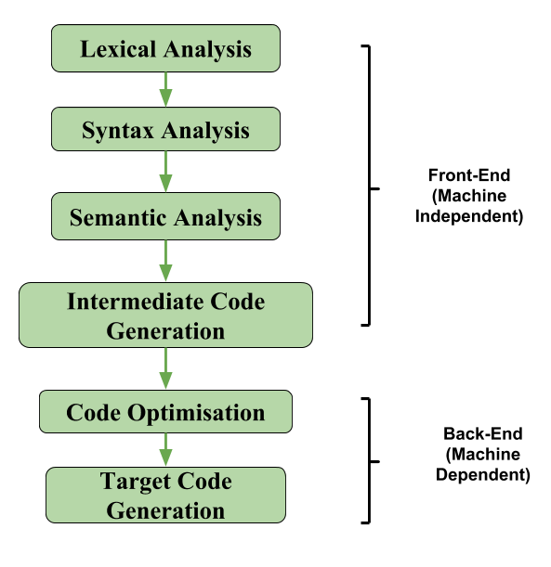
The middle-end of a compiler
Definition (The middle-end part of a compiler):
The middle-end of a compiler follows the front-end analysis and it consists of a series of operations and transformations to optimize and improve its efficiency.
It involves tasks, such as:
Intermediate code generation
Code optimization,
and Data-flow analysis.

Slide 3
Last lecture
TAC code
L0:
_t7 := x
_t4 := _t7
_t8 := y
_t5 := _t8
_t6 := _t4 < _t5
_t0 := _t6
if _t0 goto L1
jump L2
L1:
z := x
_t1 := null
jump L3
L2:
x := y
_t2 := null
jump L3
L3:
During the last lecture, we
Found a way to use the Abstract Syntax Tree representation of our source code after syntax analysis,
Came up with a translation set of function called cgen() functions, that would translate any basic operation into its equivalent Three-Address Code (TAC) representation.
Worked for basic arithmetic/boolean operations, control structures, loops, functions calls, etc.

Slide 4
Last lecture
TAC code
L0:
_t7 := x
_t4 := _t7
_t8 := y
_t5 := _t8
_t6 := _t4 < _t5
_t0 := _t6
if _t0 goto L1
jump L2
L1:
z := x
_t1 := null
jump L3
L2:
z := y
_t2 := null
jump L3
L3:
Observation: This TAC code is valid in terms of operations and expected outcomes.
Problem: It is clearly not optimal!
Many redundancies,
Some variables are not getting values,
Some variables might have been assigned but are never used (dead code).
Etc.

Slide 5
Last lecture
TAC code
L0:
_t7 := x
_t4 := _t7
_t8 := y
_t5 := _t8
_t6 := _t4 < _t5
_t0 := _t6
if _t0 goto L1
jump L2
L1:
z := x
_t1 := null
jump L3
L2:
z := y
_t2 := null
jump L3
L3:
Objective for IR optimization/middle-end: Improve the IR generated by the previous translation step to take better advantage of resources (memory, computational, etc.).
A very important and complex topic, actively researched at the moment.
Often NP-hard (or worse).
Optimization techniques could be local or global.
Subject to an optimization trade-off.

Slide 6
Last lecture
Definition (local optimization):
In middle-end compilers, we call a local optimization, any technique that attempts to optimize and modify the code contained in a single basic block of TAC code, without looking at the rest of the code.
Typical local optimization techniques include:
Common subexpression elimination,
Copy propagation,
Dead code elimination,
Etc.

Slide 7
Basic block in TAC
Definition (basic block in TAC):
A basic block consists of a sequence of instructions in TAC, with:
No labels (except at the first instruction),
No jumps (except at the last instruction of the block).
Core idea behind basic blocks:
Cannot jump in the middle of a basic block, only the beginning,
Cannot jump out of a block, except at the end of it,
Basic block is then a single-entry and single-exit code segment.

Slide 8
Why basic blocks are nice
The only way to find out what a program will actually do is to run it.
Problems:
The program might not terminate.
The program might have some behaviour we did not see when we ran it on a particular input.
However, this is not a problem inside a basic block.
Basic blocks contain no loops.
There is only one path through the basic block.
Easy to optimize and modify without messing it up!

Slide 9
Last lecture
Definition (Global and interprocedural optimization):
In middle-end compilers, we call a global optimization, any technique that attempts to optimize and modify some code contained in a single basic block of TAC code, using information gathered by looking at the rest of the code and other basic blocks.
Usually a bit more advanced, as it requires to analyse the entire control-flow graph of the TAC code.
The optimization technique is even called multiprocedural if it looks at multiple control-flow graphs of multiple functions.
We will briefly discuss it, but most likely out-of-scope.

Slide 10
Control flow graph
L0:
x := 1
i := 1
L1:
x := x*x
i := i+1
if i < 10 goto L1
jump L2
L2:
y := 10
Definition (control-flow graph):
A control-flow graph is a directed graph with basic blocks as nodes, and an edge from block A to block B if the execution can pass from the last instruction in A to the first instruction in B.
E.g., the last instruction in A is jump LB
E.g., execution can fall-through from block A to block B

Slide 11
An important note before we start
Definition (soundness):
In order to optimize a given program, the compiler has to be able to reason about the properties of said program.
An analysis is called sound if it never asserts an incorrect fact about the program.
All the optimization techniques we will discuss in this class will rely on sound analysis techniques.
Note that some more advanced optimization techniques might throw this soundness idea away, but they are usually more advanced (because they are more risky?!) and out-of-scope for this class.

Slide 12
An important note before we start
Definition (semantics-preserving optimization):
This soundness concept is usually important as we often want to implement optimizations that preserve the semantics of an original program (i.e. semantics-preserving optimization).
For instance, we are okay with the idea of removing dead code, redundancy, as they would not change the logic of the source code per se (i.e. would preserve the original semantics).
Optimization techniques that would replace a bubble sort with a quicksort in our code, would not be considered as semantics-preserving optimization techniques. These could be interesting to study, but they are also out-of-scope.

Slide 13
Three important ideas
Idea #1: The term optimization implies looking for an “optimal” piece of code that could replace a given source program, and produce the exact same outcome.
This is, in general, undecidable and falls in the category of algorithmically unprovable problems.
Prefer to approach it heuristically, using some techniques that have been proved as simplifying the code, rather that optimizing it.
Technically, we should rather refer to this step as “IR improvement” rather than “IR optimization”.

Slide 14
Three important ideas
Idea #2: What are we even optimizing?
There are many possible parameters we could consider when optimizing, but one that is terrible for sure is: “an optimal TAC code should use the fewest number of lines as possible”.
Instead, we will often look at a combination of parameters:
Runtime: how long would it take to run the TAC code.
Memory: how many temporary variables do you need for that code?
Power consumption: not all instructions are equal, use the ones that are simpler (e.g. dividing an integer by 4 is equivalent to bitshift by 2 but the latter is far simpler to implement and less costly).

Slide 15
Three important ideas
Idea #3: How optimal do we even want the code to be anyway?
More specifically, how long do we want to spend optimizing the code before running it?
Question: Does it make sense to spend 1 minute compiling and optimizing the code if it makes use gain 0.1sec of execution?
Maybe it does (if code is going to be executed a million times, or if optimization leads to drastic improvement in memory consumption).
Maybe it does not (if you are prototyping an algorithm and using it once or twice only).
There is a trade-off to be found between the time spent optimizing and the gains we could hope to obtain anyway.

Slide 16
Common Subexpression Elimination
Definition (Common Subexpression Elimination):
If, in the same basic block, we have two variable assignments
v1 = a op b
…
v2 = a op b
And the values of v1, a and b have not changed between the declarations of v1 and v2, we can perform common subexpression elimination (CSE) and rewrite the v2 assignment as
v2 = v1
It eliminates useless calculation and paves the way for more optimization.

Slide 17
Common Subexpression Elimination
Consider the code below, which needs common subexpression elimination.
x = a + b
y = a * c
z = a + b
w = a * c
t = x + z

Slide 18
Common Subexpression Elimination
Consider the code below, which needs common subexpression elimination.
x = a + b
y = a * c
z = a + b
w = a * c
t = x + z
Step 1: Recognize that x = a + b and z = a + b are two candidate expressions that could require common subexpression elimination.

Slide 19
Common Subexpression Elimination
Consider the code below, which needs common subexpression elimination.
x = a + b
y = a * c
z = a + b
w = a * c
t = x + z
Step 2: Neither x, a or b have changed between these two statements (it only consists of y = a * c, which does not change either of these values.)
It qualifies for common subexpression elimination!

Slide 20
Common Subexpression Elimination
Consider the code below, which needs common subexpression elimination.
x = a + b
y = a * c
z = x
w = a * c
t = x + z
Step 3: Replace z = a + b with z = x.

Slide 21
Common Subexpression Elimination
Consider the code below, which needs common subexpression elimination.
x = a + b
y = a * c
z = x
w = a * c
t = x + z
Step 4: Rinse and repeat?

Slide 22
Common Subexpression Elimination
Consider the code below, which needs common subexpression elimination.
x = a + b
y = a * c
z = x
w = y
t = x + z
Step 4: Rinse and repeat?

Slide 23
Implementing CSE
To perform CSE within each basic block, do the following steps:
Initialize an empty dictionary or hash table to store expressions and their corresponding variables.
Iterate through the statements in the basic block.
For each statement, check if the expression on the right-hand side is already present in the dictionary.
If the expression is not present in the dictionary, add the expression as a key and the variable on the left-hand side as the value.
If the expression is present in the dictionary, replace the right-hand side of the statement with the corresponding variable from the dictionary.
Update the basic block with the optimized statements.

Slide 24
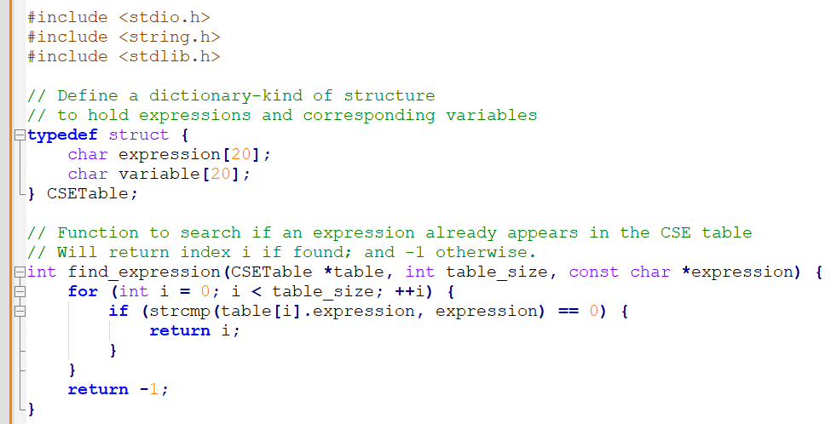
Implementing CSE: structure and search

Slide 25
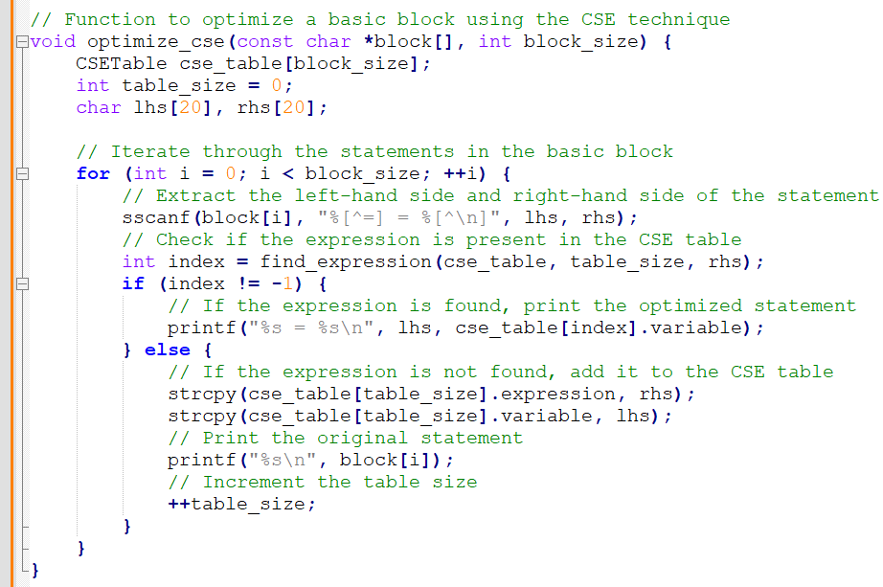
Implementing CSE: optimization

Slide 26
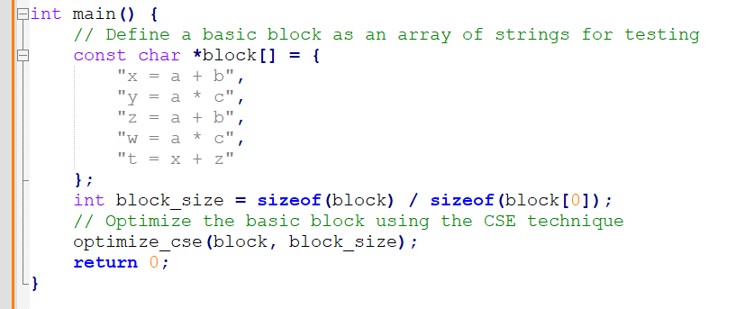
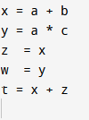
Implementing CSE: optimization
In Code files/1.

Slide 27
Copy Propagation
Definition (Copy Propagation):
If, in the same basic block, we have two variable assignments
v1 = a
…
v2 = v1
And the values of v1 or a have not changed between the declarations of v1 and v2, we can perform copy propagation (CP) and rewrite the v2 assignment as
v2 = a
It will help to immensely simplify our code later on.

Slide 28
Copy Propagation
Consider the code below, which needs copy propagation.
x = a + b
y = a * c
z = x
w = z
t = x + z

Slide 29
Copy Propagation
Consider the code below, which needs copy propagation.
x = a + b
y = a * c
z = x
w = z
t = x + z
Step 1: Identify two expressions that match the copy propagation pattern.

Slide 30
Copy Propagation
Consider the code below, which needs copy propagation.
x = a + b
y = a * c
z = x
w = z
t = x + z
Step 2: The value of the right-hand variable of the second expression (in our case, z) has not changed between both statements.
The second statement therefore qualifies for copy propagation.

Slide 31
Copy Propagation
Consider the code below, which needs copy propagation.
x = a + b
y = a * c
z = x
w = x
t = x + z
Step 3: Replace the right-hand side of the second expression with the right-hand side value of the first expression.

Slide 32
Copy Propagation
Consider the code below, which needs copy propagation.
x = a + b
y = a * c
z = x
w = x
t = x + z
Step 4: As before, rinse and repeat as required.

Slide 33
Implementing CP (almost like CSE)
To perform Copy Propagation within each basic block, do the following steps:
Initialize an empty dictionary or hash table to store variables and their corresponding values.
Iterate through the statements in the basic block.
For each statement, check if the right-hand side is a single variable (not an expression). If the right-hand side is a single variable, search for the variable in the dictionary.
If the variable is not present in the dictionary, add the variable as a key and the left-hand side as the value.
If the variable is present in the dictionary, replace the right-hand side of the statement with the corresponding value from the dictionary.
Update the basic block with the optimized statements.

Slide 34
Implementing CP (almost like CSE)
Question (for now): Should it work for partial expressions also? Should we replace the code as shown below? What would change in the algorithm discussed in previous slide?
x = 4
y = 2
w = 4 + y
z = 2*w
x = 4
y = 2
w = x + y
z = 2*w

Slide 35
Implementing CP (almost like CSE)
Question (for now): Should it work for partial expressions also? Should we replace the code as shown below? What would change in the algorithm discussed in previous slide?
Answer: Yes! This should be allowed. Leads to a reworked definition for copy propagation.
x = 4
y = 2
w = 4 + y
z = 2*w
x = 4
y = 2
w = x + y
z = 2*w

Slide 36
Copy Propagation - Updated
Definition (Copy Propagation - Updated):
If, in the same basic block, we have two variable assignments
v1 = a
…
v2 = … v1 …
And the values of v1 or a have not changed between the declarations of v1 and v2, we can perform copy propagation (CP) and rewrite the v2 expression as
v2 = … a …
It will help to immensely simplify our code later on.

Slide 37
Implementing CP (almost like CSE)
Question (for now): Should it work for partial expressions also? Should we replace the code as shown below? What would change in the algorithm discussed in previous slide?
(Practice (for later): Following the idea of the implementation of the CSE optimization, could you figure out how to implement the full CP?)
x = 4
y = 2
w = 4 + y
z = 2*w
x = 4
y = 2
w = x + y
z = 2*w

Slide 38
Dead code elimination
Definition (Dead Code Elimination):
In IR optimization, we say that a variable is dead if the value of that assignment is never called anywhere else.
For instance, in the code below, the variable w is dead.
x = 4
y = 2
z = x + y
w = z + 2
q = z + 1
printf(q)

Slide 39
Dead code elimination
Definition (Dead Code Elimination):
In IR optimization, we say that a variable is dead if the value of that assignment is never called anywhere else.
Dead code elimination simply removes dead variables assignments from a given IR. Dead code elimination is then the process of removing parts of the code that do not affect the program's behavior.
This can include unused variable assignments, unreachable code, or redundant operations.

Slide 40
Implementing Dead Code Elimination
The dead code elimination is a two-step process
Identify live variables, or liveness analysis: Start by analysing the code in reverse order and mark variables as live if they are used in later operations.
Remove dead variables: Iterate through the statements in the code, and if a variable is assigned a value but is not marked as live, remove the assignment statement. Plain and simple
Rinse and repeat
Definition (live variables):
Variables are considered live if their values are used in subsequent operations or if they are used as output.

Slide 41
Live variables
To know if a variable will be used at some point, we iterate across the statements in a basic block in reverse order.
Initially, some small set of values are known to be live (which ones depends on the particular program).
When we see the statement a = b + c:
Just before the statement, a is not alive, since its value is about to be overwritten.
Just before the statement, both b and c are alive, since we are about to read their values.
(Question: What if we have a = a + b?)

Slide 42
Live variables, in action
Consider a function that returns/prints the values of b and d at the end of its calculations.
The TAC code for this function is given in italic.
Here, {} denotes the list of live variables at any given point of the TAC code.
{}
a = b;
{}
c = a;
{}
d = a + b;
{}
e = d;
{}
d = a;
{}
f = e;
{}
printf(b, d)

Slide 43
Live variables, in action
Consider a function that returns/prints the values of b and d at the end of its calculations.
The TAC code for this function is given in italic.
Here, {} denotes the list of live variables at any given point of the TAC code.
{ b, d }
a = b;
{ a, b, d }
c = a;
{ a, b, d }
d = a + b;
{ a, b, d }
e = d;
{ a, b, d, e }
d = a;
{ a, b, e }
// Variable 'd' is no longer live after this assignment since its value has been updated
f = e;
{ b, d }
// Variable 'e' is not live after this assignment since its value is not used in the subsequent statement
printf(b, d)

Slide 44
Live variables, in action
Using DCE:
If a variable f is not live after its assignment, then it is a dead variable.
DCE suggests to simply remove said statement.
Here f = e; is a dead variable and should be removed.
{ b, d }
a = b;
{ a, b, d }
c = a;
{ a, b, d }
d = a + b;
{ a, b, d }
e = d;
{ a, b, d, e }
d = a;
{ a, b, e }
// Variable 'd' is no longer live after this assignment since its value has been updated
f = e;
{ b, d }
// Variable 'e' is no longer live after this assignment since its value is not used in the subsequent statement
printf(b, d)

Slide 45
Live variables, in action
Using DCE:
If a variable f is not live after its assignment, then it is a dead variable.
DCE suggests to simply remove said statement.
Here f = e; is a dead variable and should be removed.
{ b, d }
a = b;
{ a, b, d }
c = a;
{ a, b, d }
d = a + b;
{ a, b, d }
e = d;
{ a, b, d, e }
d = a;
{ a, b, e }
// Variable 'd' is no longer live after this assignment since its value has been updated
f = e;
{ b, d }
// Variable 'e' is no longer live after this assignment since its value is not used in the subsequent statement
printf(b, d)

Slide 46
Live variables, in action
Using DCE:
If a variable f is not live after its assignment, then it is a dead variable.
DCE suggests to simply remove said statement.
Here f = e; is a dead variable and should be removed.
Which other variable is a dead variable?
{ b, d }
a = b;
{ a, b, d }
c = a;
{ a, b, d }
d = a + b;
{ a, b, d }
e = d;
{ a, b, d, e }
d = a;
{ a, b, e }
// Variable 'd' is no longer live after this assignment since its value has been updated
{ b, d }
// Variable 'e' is no longer live after this assignment since its value is not used in the subsequent statement
printf(b, d)

Slide 47
Live variables, in action
Using DCE:
If a variable f is not live after its assignment, then it is a dead variable.
DCE suggests to simply remove said statement.
Here f = e; is a dead variable and should be removed.
Which other variable is a dead variable?
{ b, d }
a = b;
{ a, b, d }
c = a;
{ a, b, d }
d = a + b;
{ a, b, d }
e = d;
{ a, b, d, e }
d = a;
{ a, b, e }
// Variable 'd' is no longer live after this assignment since its value has been updated
{ b, d }
// Variable 'e' is no longer live after this assignment since its value is not used in the subsequent statement
printf(b, d)

Slide 48
Live variables, in action
Using DCE:
If a variable f is not live after its assignment, then it is a dead variable.
DCE suggests to simply remove said statement.
Here f = e; is a dead variable and should be removed.
Which other variable is a dead variable?
{ b, d }
a = b;
{ a, b, d }
{ a, b, d }
d = a + b;
{ a, b, d }
e = d;
{ a, b, d, e }
d = a;
{ a, b, e }
// Variable 'd' is no longer live after this assignment since its value has been updated
{ b, d }
// Variable 'e' is no longer live after this assignment since its value is not used in the subsequent statement
printf(b, d)

Slide 49
Live variables, in action
Rinse and repeat the process once more!
{ b, d }
a = b;
{ a, b, d }
{ a, b, d }
d = a + b;
{ a, b, d }
e = d;
{ a, b, d, e }
d = a;
{ a, b, e }
// Variable 'd' is no longer live after this assignment since its value has been updated
{ b, d }
// Variable 'e' is no longer live after this assignment since its value is not used in the subsequent statement
printf(b, d)

Slide 50
Live variables, in action
Rinse and repeat the process once more!
{}
a = b;
{}
d = a + b;
{}
e = d;
{}
d = a;
{}
printf(b, d)

Slide 51
Live variables, in action
Rinse and repeat the process once more!
Step 1: Liveness analysis, first.
Step 2: Dead code elimination, again.
{ b }
a = b;
{ a, b }
d = a + b;
{ d }
e = d;
{ b, d }
d = a;
{ b, d }
printf(b, d)

Slide 52
Live variables, in action
Rinse and repeat the process once more!
Step 1: Liveness analysis, first.
{ b }
a = b;
{ a ,b, d }
d = a + b;
{ a, b, d }
e = d;
{ a, b, d }
d = a;
{ b, d }
printf(b, d)

Slide 53
Live variables, in action
Rinse and repeat the process once more!
Step 1: Liveness analysis, first.
Step 2: Dead code elimination, again.
{ b }
a = b;
{ a ,b, d }
d = a + b;
{ a, b, d }
{ a, b, d }
d = a;
{ b, d }
printf(b, d)

Slide 54
Live variables, in action
Rinse and repeat the process once more!
Step 1: Liveness analysis, first.
Step 2: Dead code elimination, again.
a = b;
d = a + b;
d = a;
printf(b, d)
Question: It is somewhat obvious that d = a + b; should be removed here, as it will be replaced by d = a; later on.
Is this optimization relying on the idea of dead code elimination, or something else?
Could we simplify the TAC even more? If so, how?

Slide 55
Live variables, in action
Rinse and repeat the process once more!
Step 1: Liveness analysis, first.
Step 2: Dead code elimination, again.
a = b;
d = a + b;
d = a;
printf(b, d)
(Practice (for later): How would you implement the DCE optimization?
Is it again similar to what the CSE and CP do?)

Slide 56
Combining the local optimization techniques
The different optimizations we have seen so far all take care of just a small piece of the optimization.
Common subexpression elimination eliminates unnecessary statements.
Copy propagation helps identify dead code.
Dead code elimination removes statements that are no longer needed.
To get maximum effect, we may have to apply these optimizations several times in a row.

Slide 57
Combining the local optimization techniques
Consider the TAC code below, which will be simplified
b = a*a;
c = a*a;
d = b + c;
e = b + b;
f = a;
printf(e)

Slide 58
Combining the local optimization techniques
Consider the TAC code below, which will be simplified
b = a*a;
c = a*a;
d = b + c;
e = b + b;
f = a;
printf(e)
→ Use CSE on these two statements.

Slide 59
Combining the local optimization techniques
Consider the TAC code below, which will be simplified
b = a*a;
c = b;
d = b + c;
e = b + b;
f = a;
printf(e)
→ Use CSE on these two statements.

Slide 60
Combining the local optimization techniques
Consider the TAC code below, which will be simplified
b = a*a;
c = b;
d = b + c;
e = b + b;
f = a;
printf(e)
→ Use CP on these two statements.

Slide 61
Combining the local optimization techniques
Consider the TAC code below, which will be simplified
b = a*a;
c = b;
d = b + b;
e = b + b;
f = a;
printf(e)
→ Use CP on these two statements.

Slide 62
Combining the local optimization techniques
Consider the TAC code below, which will be simplified
b = a*a;
c = b;
d = b + b;
e = b + b;
f = a;
printf(e)
→ Use CSE on these two statements.

Slide 63
Combining the local optimization techniques
Consider the TAC code below, which will be simplified
b = a*a;
c = b;
d = b + b;
e = d;
f = a;
printf(e)
→ Use CSE on these two statements.

Slide 64
Combining the local optimization techniques
Consider the TAC code below, which will be simplified
b = a*a;
c = b;
d = b + b;
e = d;
f = a;
printf(e)
→ Use DCE on these two statements.

Slide 65
Combining the local optimization techniques
Consider the TAC code below, which will be simplified
b = a*a;
d = b + b;
e = d;
printf(e)
→ Use DCE on these two statements.

Slide 66
Combining the local optimization techniques
Consider the TAC code below, which will be simplified
b = a*a;
d = b + b;
e = d;
printf(e)
Question: How would you continue after this?
Question #2: Is there a precedence order we should respect on these optimization techniques?

Slide 67
More types of local optimizations
Arithmetic simplifications
Replace hard operations with easier ones, e.g. rewrite x = 4*a; as x = a << 2; instead.
Short-circuit evaluation
If x = a and b; and a computes as False in the TAC, then make x = False and treat b as a dead variable.
Constant folding
If an operation consists of two literals (e.g. x = 4*5;), then replace it by its evaluated version x = 20; directly.
And many more!

Slide 68
A quick word on global optimization
Definition (Interprocedural analysis):
Interprocedural analysis involves analysing the interactions between different functions in a program.
Interprocedural optimizations can include:
Function inlining (replacing a function call with the actual function code),
Eliminating dead functions (removing functions that are never called),
And performing constant propagation across function boundaries.

Slide 69
A quick word on global optimization
Definition (Loop optimizations):
Loop optimizations focus on improving the performance of loops within a program. Examples include
Loop unrolling (repeating the loop body multiple times to reduce the loop overhead),
Loop fusion (combining multiple loops that have the same iteration space, enumerate/zip style),
And loop-invariant code motion (moving code that does not change within the loop outside the loop).

Slide 70
A quick word on global optimization
Definition (Global dead code elimination):
We could extend this local technique to the globality of the control-flow diagram to remove unused code, variables, or functions throughout the entire program, as opposed to just within basic blocks.
Global dead code elimination can help reduce code size and improve performance by eliminating unnecessary computations.

Slide 71
A quick word on global optimization
Definition (Global common subexpression elimination):
As with global dead code elimination, this technique identifies and eliminates redundant computations across the entire program or function scope.
By reusing the results of previous computations, global common subexpression elimination can help reduce the overall number of computations and improve performance.

Slide 72
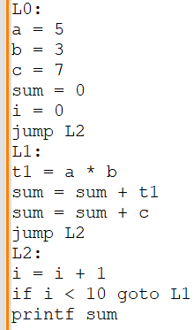
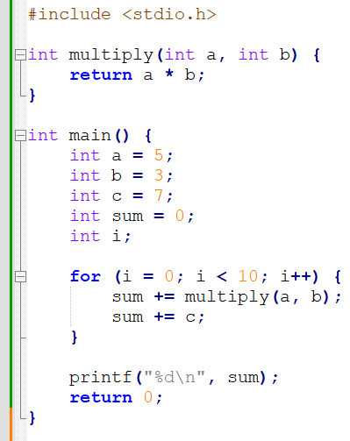
A quick word on global optimization
Consider the C code on the right.
And its TAC representation.

Slide 73
A quick word on global optimization
Consider the C code on the right.
And its TAC representation.
Function inlining: replace any call of multiply(a, b), with a simple a*b.
Note: we already replaced it (the function call produced a much longer TAC, not shown on slides!)

Slide 74
A quick word on global optimization
Consider the C code on the right.
And its TAC representation.
Loop optimization: The computation a * b does not change within the loop, so it can be moved outside the loop to reduce redundant computations.
Move operation to L0.

Slide 75
A quick word on global optimization
Consider the C code on the right.
And its TAC representation.
Global dead code and common subexpression elimination?
Constant folding on some operations (e.g. a*b with a and b being constants literals)?
More stuff?

Slide 76
Last lecture
Definition (Global and interprocedural optimization):
In middle-end compilers, we call a global optimization, any technique that attempts to optimize and modify some code contained in a single basic block of TAC code, using information gathered by looking at the rest of the code and other basic blocks.
Usually a bit more advanced, as it requires to analyse the entire control-flow graph of the TAC code (sometimes very challenging!).
The optimization technique is even called multiprocedural if it looks at multiple control-flow graphs of multiple functions.
We will briefly discuss it, but most likely out-of-scope.

Slide 77
Quiz time!
What is the main purpose of common subexpression elimination in three-address code optimization?
To inline function calls
To reduce redundant computations
To remove dead code
To simplify loop structures

Slide 78
Quiz time!
What is the main purpose of common subexpression elimination in three-address code optimization?
To inline function calls
To reduce redundant computations
To remove dead code
To simplify loop structures

Slide 79
Quiz time!
What is the main goal of dead code elimination in three-address code optimization?
To remove statements that have no effect on the program's output
To eliminate function calls with inlining
To reduce the number of loop iterations
To simplify arithmetic expressions

Slide 80
Quiz time!
What is the main goal of dead code elimination in three-address code optimization?
To remove statements that have no effect on the program's output
To eliminate function calls with inlining
To reduce the number of loop iterations
To simplify arithmetic expressions

Slide 81
Quiz time!
In three-address code optimization, which technique is used to replace occurrences of a variable with its assigned value if the value does not change in the meantime?
Common subexpression elimination
Dead code elimination
Copy propagation
Constant folding

Slide 82
Quiz time!
In three-address code optimization, which technique is used to replace occurrences of a variable with its assigned value if the value does not change in the meantime?
Common subexpression elimination
Dead code elimination
Copy propagation
Constant folding

Slide 83
Quiz time!
Which of the following optimization techniques can be applied both locally and globally?
Dead code elimination
Constant folding
Loop-invariant code motion
Both A and B

Slide 84
Quiz time!
Which of the following optimization techniques can be applied both locally and globally?
Dead code elimination
Constant folding
Loop-invariant code motion
Both A and B

Slide 85
Implementing CP (almost like CSE)
Question (for now): Should it work for partial expressions also? Should we replace the code as shown below? What would change in the algorithm discussed in previous slide?
Practice (for later): Following the idea of the implementation of the CSE optimization, could you figure out how to implement the full CP?
x = 4
y = 2
w = 4 + y
z = 2*w
x = 4
y = 2
w = x + y
z = 2*w

Slide 86
Live variables, in action
Rinse and repeat the process once more!
Step 1: Liveness analysis, first.
Step 2: Dead code elimination, again.
a = b;
d = a + b;
d = a;
printf(b, d)
Practice (for later): How would you implement the DCE optimization?
Is it again similar to what the CSE and CP do?

Slide 87
Combining the local optimization techniques
The different optimizations we have seen so far all take care of just a small piece of the optimization.
Common subexpression elimination eliminates unnecessary statements.
Copy propagation helps identify dead code.
Dead code elimination removes statements that are no longer needed.
Practice: how would you implement these operations to get maximum effect? We may have to apply these them several times in a row.

