Slide 1

50.051 Programming Language Concepts W13-S2 Code Generation, Register Allocation and Linking/Loading
Matthieu De Mari

Slide 3
Intuition for code generation
For instance, consider
the TAC code below,
t1 = a + b
t2 = t1 * c
Intuition: This TAC code could be easily mapped to a sequence of machine code instructions, as shown on the right.
Machine Code?
LOAD R1, a
LOAD R2, b
ADD R1, R1, R2
STORE t1, R1
LOAD R3, t1
LOAD R4, c
MUL R3, R3, R4
STORE t2, R3

Slide 4
Breakdown of the Machine Code Translation
This final translation is typically broken down in a few steps.
Basic block identification: The compiler identifies the basic blocks in the TAC code, i.e. sequences of instructions that are always executed together and can be used as units for generating machine code.
Instruction selection: For each operation in the TAC, the compiler selects an appropriate instruction or sequence of instructions in the machine assembly language. The choice may depend on the available instruction set, addressing modes, and architectural constraints.
For simplicity, we will stick to an instruction set similar to the one you used in 50.002 Computation Structures! (https://natalieagus.github.io/50002/notes/instructionset)

Slide 5
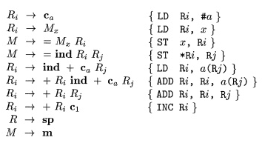
Instruction Selection (Simple Version?)
In our simpler version: the instruction selection, as a mapping could be easily done, by using a Syntax-Directed Translation (another one!) on our three-address code CFG!

Slide 6
Instruction Selection (Hard Version?)
Advanced compilers, however, might often rely on more advanced techniques, like tree matching and dynamic programming.
Tree pattern matching involves representing TAC operations as trees and searching for matching patterns in a database of target machine instructions.
Other techniques, like optimal code generation using dynamic programming, find the optimal sequence of target instructions by considering all possible combinations and selecting the one with the lowest cost (memory, computation, time, etc.).
This last set of techniques is much more advanced and out-of-scope.

Slide 7
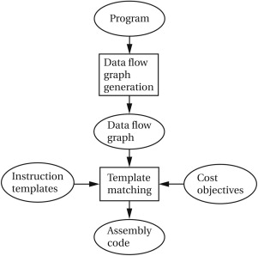
Instruction Selection (mapping vs. advanced)
Note: These advanced techniques will often require solving optimization problems on graphs that are NP-Hard!
Definitely out-of-scope! (It would require an advanced course on Graph Theory to simply explain some of them!)

Slide 8
Instruction Selection (Harder Version?)
Advanced compilers, however, might often use several intermediate representations in a row, instead of jumping straight from TAC to machine code.
Abstract Syntax Tree Representation
High-level Intermediate Representation (e.g. TAC)
Lower-level Intermediate Representations (e.g. SSA, RTL, VM, etc.)
Assembly code (our target code)
Machine code in binary (but technically more 50.002 than 50.051)

Slide 9
Intuition for register allocation
Let us assume we have successfully transformed our TAC code into a machine/target code.
This code has labeled registers to use Rn, but has assumed we had an infinite number of registers.
In practice, that is never the case.
Machine Code?
LOAD R1, a
LOAD R2, b
ADD R1, R1, R2
STORE t1, R1
LOAD R3, t1
LOAD R4, c
MUL R3, R3, R4
STORE t2, R3

Slide 10
Memory Hierarchy

