Slide 1

50.051 Programming Language Concepts W9-S2 Regular Expressions and Pattern Recognition in C
Matthieu De Mari

Slide 2
Regular Expressions
Definition (Regular Expressions, or RegEx):
Regular Expressions (or Regex) are a powerful tool for pattern matching and searching in text.
They are used in many programming languages and applications to find, extract, and manipulate text based on specific patterns.
Regular expressions can be seen as a concise way of describing a set of strings that share a certain structure or patterns.
Later on, RegEx will be very useful for us to recognize substrings of text that exhibit a certain pattern (they consist of a certain keyword, start with “, etc.).

Slide 3
Regular Expressions
Definition (Regular Language):
Regular Language consists of the possible strings that exhibit the pattern defined by a given Regular Expression.
For instance, if the Regular Expression consists of all the binary strings finishing with a 0…
…Then, all of these strings (100, 10100, 1110, 10, 1101010011010, etc.) will be considered Regular Language for the given Regular Expression we have defined above.

Slide 4
Technically, we have already played with RegEx FSMs! (Remember previous activities).
Can we use FSM to recognize to implement RegEx?
Yes!
Our Finite State Machines (FSM) can be used to recognize regular languages, which are sets of strings that can be described by regular expressions.
There is a strong connection between regular expressions and FSMs: for every regular expression, there exists an equivalent FSM that recognizes the same language.

Slide 5
Technically, we have already played with RegEx FSMs! (Remember this activity).
We would like to write an FSM with stopping states that will take strings x consisting of combinations of four characters: S, U, T and D.
Possible combinations for the string x include, among many others, “USD”, “SUUUUTD”, and the only acceptable input “SUTD”.
Draw a FSM state diagram, which:
Has 7 possible States (Start, S, U, T, D, Valid, Invalid),
Has 4 possible Actions (S, U, T, D),
Has the Start state defined as the starting state,
Has the Valid state defined as the only stopping state,
Has the FSM stop in this state, if and only x is SUTD; otherwise, it stops in another state (Invalid or something else).

Slide 6
The most basic RegEx
Definition (the most basic RegEx):
The most basic regex attempts to recognize a string s consisting of the single letter "a". Every other string (“A”, “aa”, “ba”, “”, etc.) is not considered as regular language for this regular expression.
This regular expression is then simply defined as “a”.

Slide 7
The most basic RegEx
This can be simply implemented with the FSM shown.
The FSM uses outputs and no stopping states, and will stop early when an output 0 is produced.
The only acceptable input strings, will therefore be the ones that never produce a 0 output.
That is s = “a”.
VALID
Any character/0
NOT VALID
a/1
Anything else/0

Slide 8
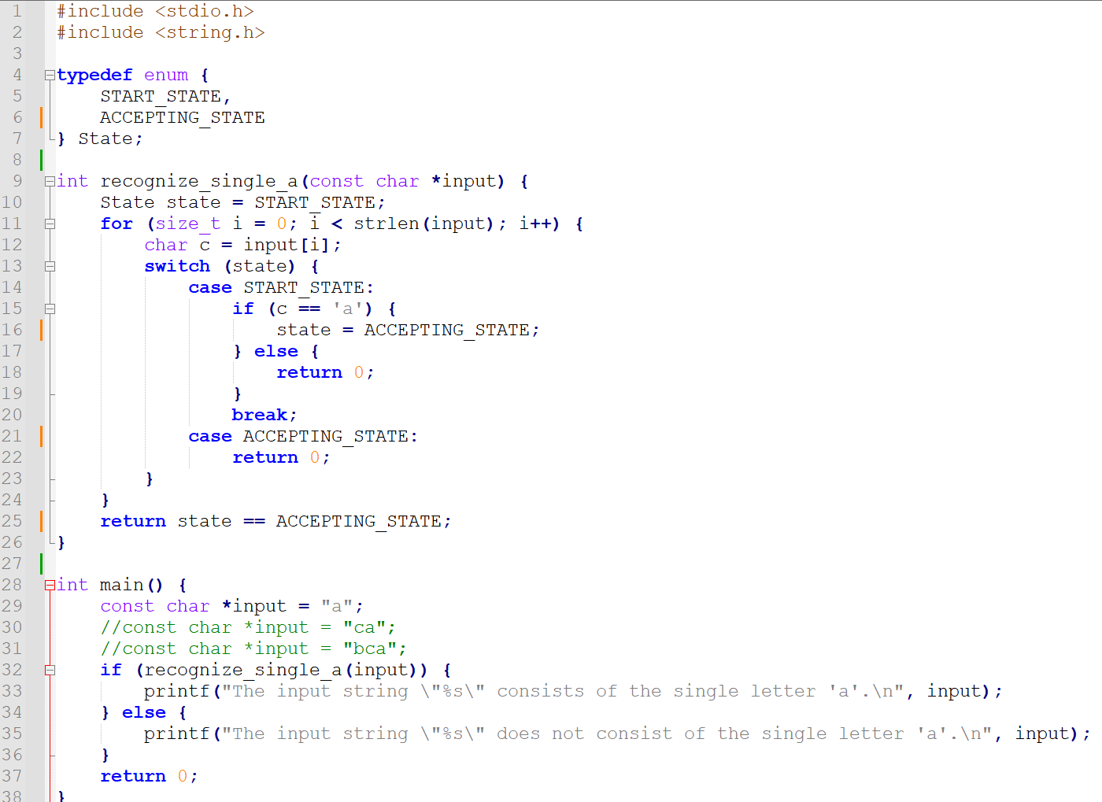

Slide 9
The most basic RegEx
This can be also be implemented as an FSM with stopping state being VALID.
We will then stop the FSM prematurely if the next state being produced at any given time is NOT_VALID.
(This is roughly equivalent).
VALID
Any character
NOT VALID
VALID
a
Anything else

Slide 10
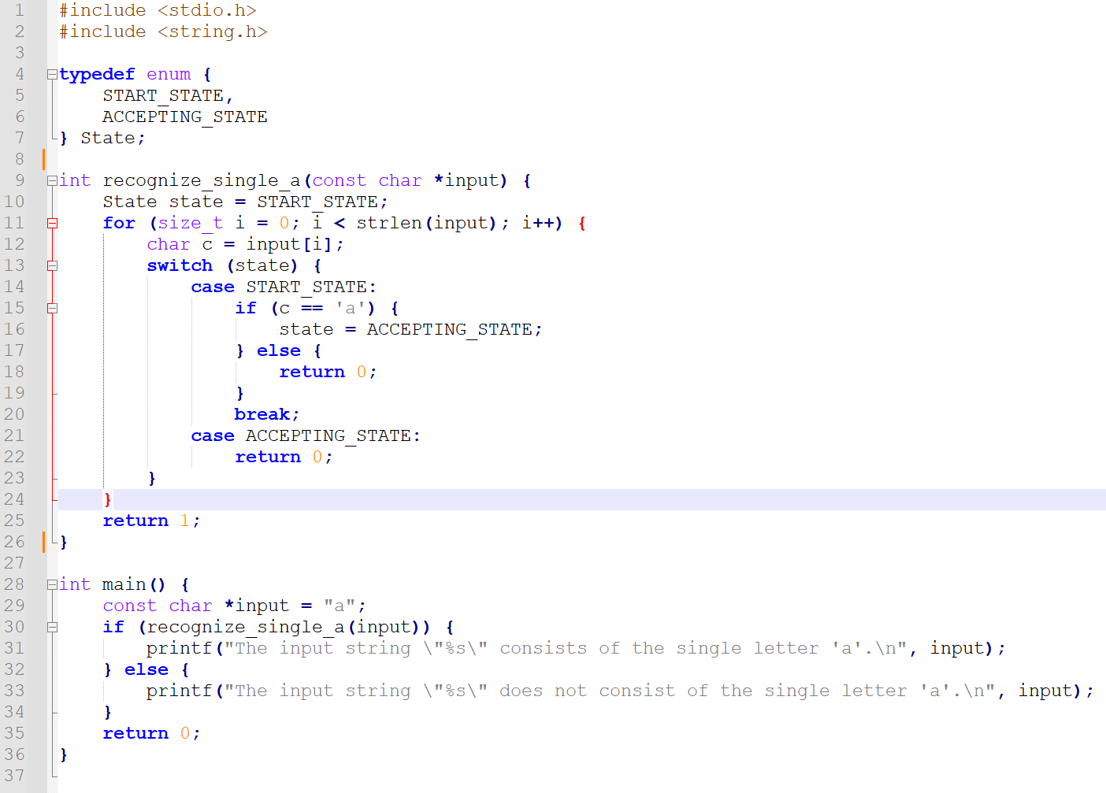

Slide 11
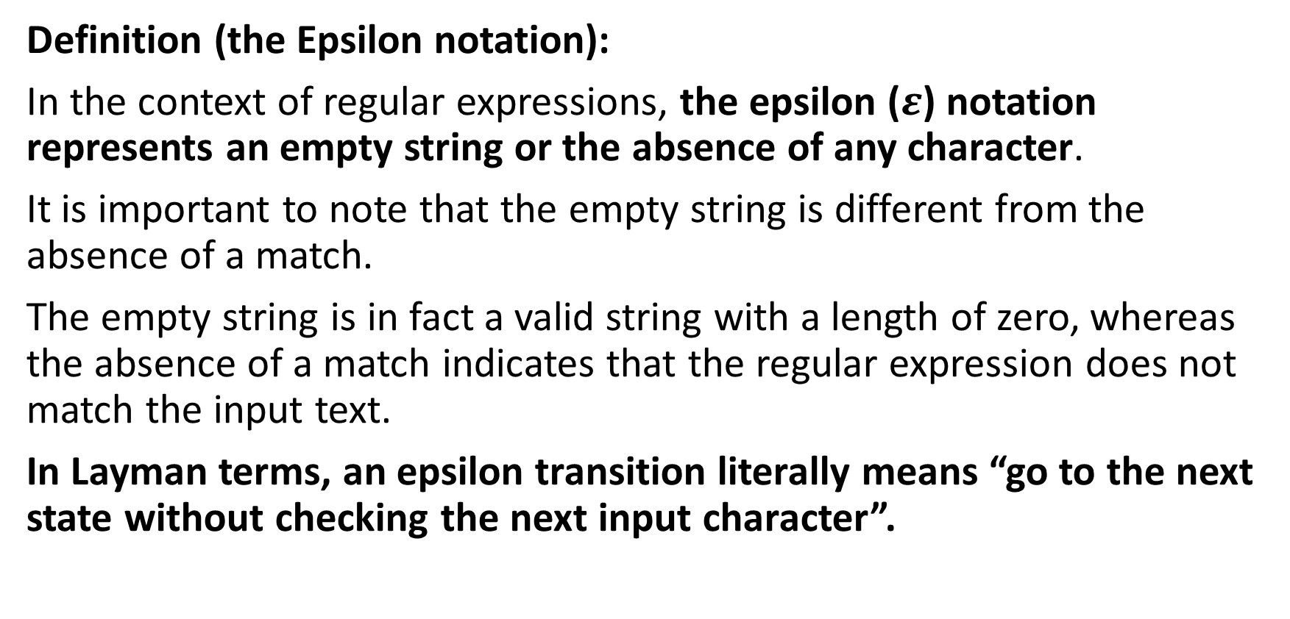
The infamous Epsilon notation
Definition (the Epsilon notation):
In the context of regular expressions, the epsilon ($ε$) notation represents an empty string or the absence of any character.
It is important to note that the empty string is different from the absence of a match.
The empty string is in fact a valid string with a length of zero, whereas the absence of a match indicates that the regular expression does not match the input text.
In Layman terms, an epsilon transition literally means “go to the next state without checking the next input character”.

