Slide 1

50.051 Programming Language Concepts W12-S2 Semantic Analysis and Intermediate Representations
Matthieu De Mari

Slide 2
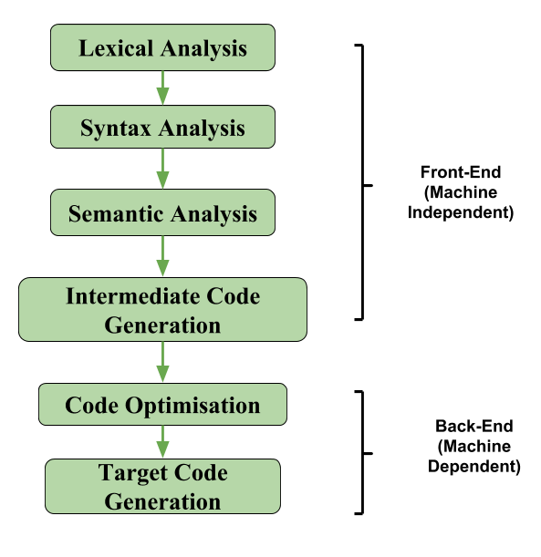
The front-end of a compiler
Semantic Analysis
Final step in the “front-end” phase, whose job is to check that the source code is legal.
Ensures that the program has a well-defined meaning.
Should catch all remaining errors that lexical analysis and syntax analysis could not catch.
Errors that require contextual information about the code.

Slide 3
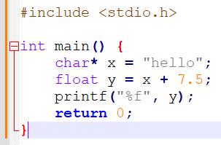
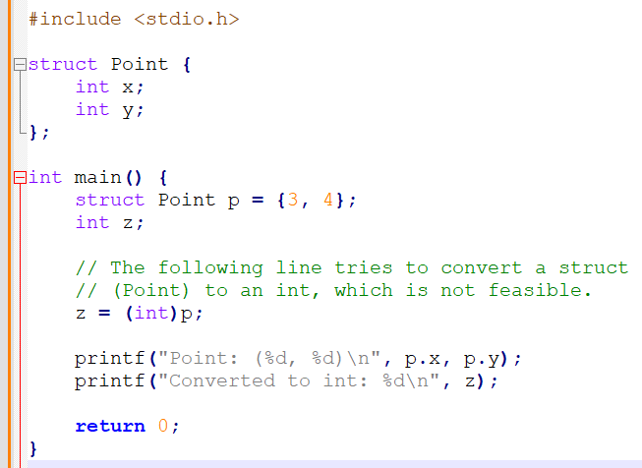
Examples of remaining errors
Type problems
An operation attempts to combine two invalid types together (e.g. summing a string and a float together).
An operation attempts to convert a variable of a certain type in another type that is not feasible.
Etc.

Slide 4
Examples of remaining errors
Important fact: These errors cannot be checked during the lexical analysis or the syntax analysis, as they require some context.
Cannot be checked by a context-free grammar.
Often depends on values and context, not syntax.
May sometimes require and involve computation.
What to do then?
Instead, will need to define a set of semantic rules for scoping and types explicitly.
And then, perform additional checks after parsing.
These checks will be implemented in the form of “if-else” checks.

Slide 5
Semantic analysis and ASTs
Objective: The answer to the semantic problems
Scope problems,
Type problems,
And more,…
And the checks to be conducted, both rely on the Abstract Syntax Tree produced by the syntax analysis step.

Slide 6
What are Types?
Definition (type):
This is a difficult definition, by here is my attempt.
A type is a classification that defines a set of values and the operations that can be performed on variables of said type (e.g. types methods and operators behaviours) .
It also defines a way to encode said information about the variable in the memory (e.g. char, short, long, int, long long, etc.)
In short, the purpose of a types system is to provide a way to describe and reason about data and their behaviour within a program.

Slide 7
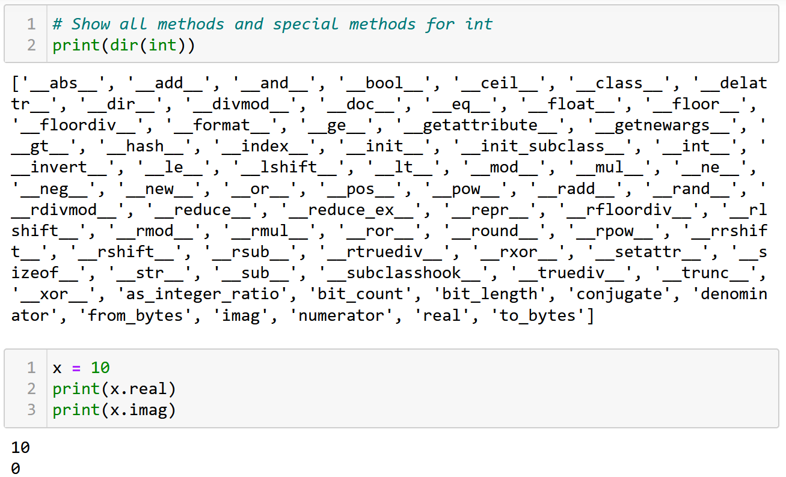
What are Types?
Definition (type):
This is a difficult definition, by here is my attempt.
A type is a classification that defines a set of values and the operations that can be performed on variables of said type (e.g. types methods and operators behaviours) .
It also defines a way to encode said information about the variable in the memory (e.g. char, short, long, int, long long, etc.)
In short, the purpose of a types system is to provide a way to describe and reason about data and their behaviour within a program.

Slide 8
Strong vs. weak type systems
Definition (Strong type system):
A strong type system strictly enforces rules about which types can be used in specific operations and contexts.
In languages with a strong type system, we typically see more explicit type declarations, and the compiler or runtime will enforce type constraints, often causing errors when there is a type mismatch.
This helps catch potential errors early, as well as promotes code readability and allows for better optimization.

Slide 9
Strong vs. weak type systems
Definition (Weak type system):
A weak type system is more lenient with type enforcement.
In languages with a weak type system, you may see implicit type conversions (coercions) and less strict rules about which types can be used in certain operations.
This can lead to more flexibility and shorter code, but also introduces the risk of subtle bugs and less predictable behaviour.

Slide 10
Strong vs. weak type systems
Strong vs. Weak defines a spectrum (not a binary classification).
C: will allow to sum together a char and an int, same thing with a float and an int. An implicit conversion will happen.
Python: will allow to sum together a float and an int using an implicit conversion. The char and int addition is not straightforward and requires an explicit Unicode conversion of the char using ord().
Strict languages (e.g. Haskell): will simply refuse to operate if the types do not exactly match.

Slide 11
Implicit vs. Explicit type conversion
Definition (Implicit type conversion):
Implicit type conversion, also known as type coercion or automatic type conversion, occurs when the compiler or runtime automatically converts a value of one type to another type without the programmer explicitly requesting the conversion.
This typically happens when performing operations with operands of different types, and the language's type system automatically promotes or converts one of the values to match the other.
Implicit type conversions can make code more concise, but they can also introduce unexpected behaviour if the conversion rules are not well-defined or understood.

Slide 12
Implicit vs. Explicit type conversion
Definition (Explicit type conversion):
Explicit type conversion, also known as type casting or manual type conversion, occurs when the programmer explicitly requests the conversion of a value from one type to another using language-specific syntax or functions.
This is often necessary in languages with strong type systems that do not allow implicit type conversions or when the programmer wants to override the default behaviour of implicit conversions.
Explicit type conversions provide more control and predictability, but they can also make the code more verbose and may introduce errors if not used carefully.

Slide 13
Strong vs. weak type systems
Strong vs. Weak defines a spectrum (not a binary classification).
C: will allow to sum together a char and an int, same thing with a float and an int. An implicit conversion will happen.
Python: will allow to sum together a float and an int using an implicit conversion. The char and int addition is not straightforward and requires an explicit Unicode conversion of the char using ord().
Strict languages (e.g. Haskell): will simply refuse to operate if the types do not exactly match. Explicit conversions only.
Which is better then? Another open debate, for you to decide!

Slide 14
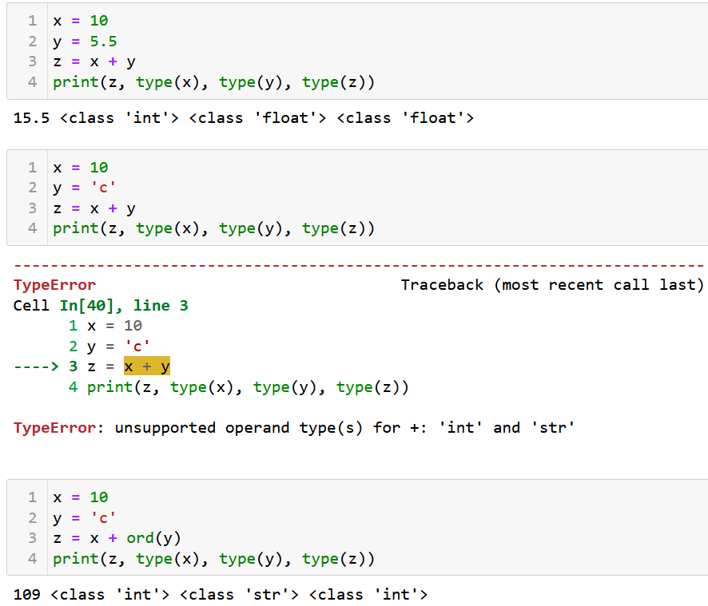
Strong vs. weak type systems
Strong vs. Weak defines a spectrum (not a binary classification).
C: will allow to sum together a char and an int, same thing with a float and an int. An implicit conversion will happen.
Python: will allow to sum together a float and an int using an implicit conversion. The char and int addition is not straightforward and requires an explicit Unicode conversion of the char using ord().
Strict languages (e.g. Haskell): will simply refuse to operate if the types do not exactly match. Explicit conversions only.
Which is better then? Another open debate.

Slide 15
Types errors
Type errors will typically occur in one of two scenarios:
An explicit method or operation is used on a type that does not support it (e.g. in Python the explicit conversion of a string “123.4” into int, using + operation between int ”7” and string “hello”, calling append() method on string, etc.).
And there is no implicit conversion that might resolve the issue above, if any (e.g. summing a char “c” and an int “7” in C, will simply require an implicit conversion, but this will not do in Python).
This can be implemented with an “if-else” again and a set of rules.

Slide 16
Static vs Dynamic type checking
Definition (Static vs. Dynamic type checking):
In Static Type Checking, types are checked at compile-time, errors are caught before program execution (e.g., Java, C++).
In Dynamic Type Checking, types are checked at run-time, errors are caught during program execution (e.g., Python, JavaScript).
In None (!) Type Checking, types are not checked and everything is processed in binary! (Ok, maybe not the best idea).
Which one is best? Another open debate.

Slide 17
Endless debate
There is an endless debate about the best type system to use.
Dynamic type checking systems make it easier to prototype.
Static type checking systems have fewer bugs.
None type checking is quite frankly a terrible idea.
Strongly-typed languages are often more robust.
Weakly-typed systems are often faster.
I am staying out of this!

Slide 18
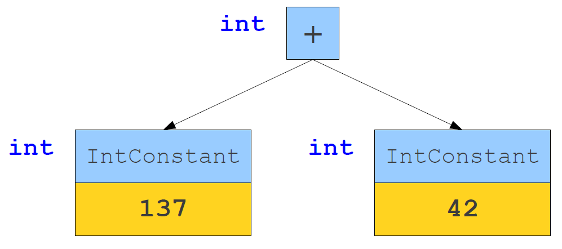
Types inference
Definition (types inference):
The bread-and-butter concept behind a types system is types inference, that is a logical set of pre-established rules that will define the behaviour to use for any operation on any given type.

Slide 19
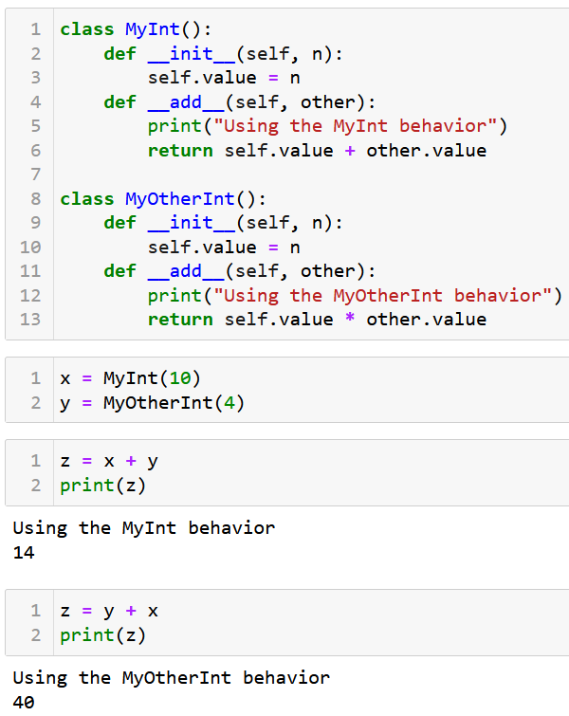
Types inference for operators (Python)
The case of Python
In the case of operators (+, *, -, /, etc.), the behaviour of a given operation “x operator y” is often decided by looking at the left-hand variable type first and calling its special method for said operator, here __add__().

Slide 20
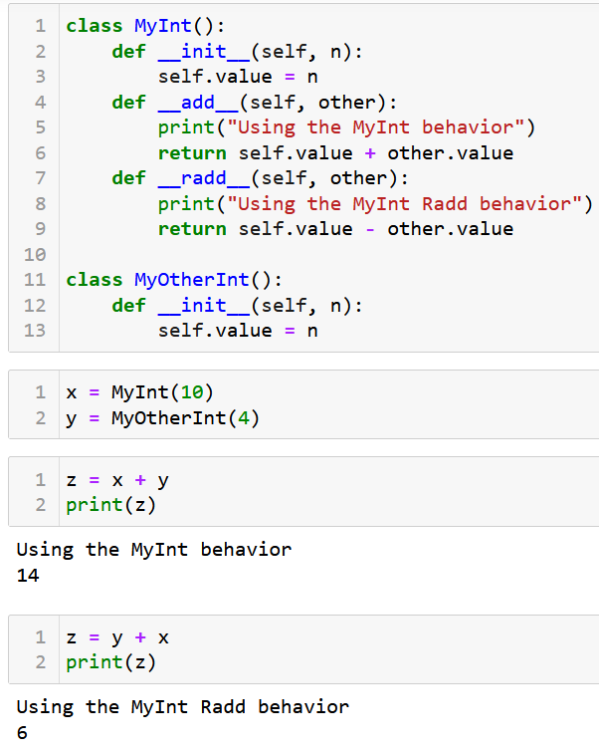
Types inference for operators (Python)
The case of Python
In the case of operators (+, *, -, /, etc.), the behaviour of a given operation “x operator y” is often decided by looking at the left-hand variable type first and calling its special method for said operator, here __add__().
If __add__() is not defined for left-hand type, try using the __radd__() for right-hand type.

Slide 21
Types inference for operators (Python)
The case of Python
In the case of operators (+, *, -, /, etc.), the behaviour of a given operation “x operator y” is often decided by looking at the left-hand variable type first and calling its special method for said operator, here __add__().
If __add__() is not defined for left-hand type, try using the __radd__() for right-hand type.
This behaviour is Python has to do with the way they designed their object-oriented structure for the programming language.
It defines clear types inferences rules for operator overloading.
It is, however, not universal and not the only framework.

Slide 22
Types inference for operators (C)
The case of C
In C, operator behaviour is different.
C follows specific rules for type promotion and conversion when performing operations with different types.
For example, when adding an int and a float, C will implicitly convert the int to a float before performing the addition.
Behaviour of operators in C is determined by the language's type system and promotion rules, rather than the left-hand operand's type alone.

Slide 23
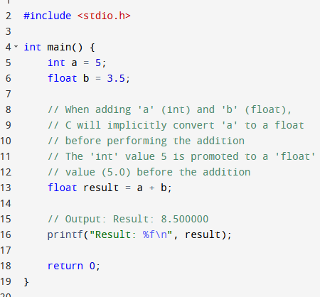
Types inference for operators (C)
The case of C
In C, operator behaviour is different.
C follows specific rules for type promotion and conversion when performing operations with different types.
For example, when adding an int and a float, C will implicitly convert the int to a float before performing the addition.
Behaviour of operators in C is determined by the language's type system and promotion rules, rather than the left-hand operand's type alone.

Slide 24
Types inference for operators (C)
The case of C
In C, operator behaviour is different.
C follows specific rules for type promotion and conversion when performing operations with different types.
For example, when adding an int and a float, C will implicitly convert the int to a float before performing the addition.
Behaviour of operators in C is determined by the language's type system and promotion rules, rather than the left-hand operand's type alone.
To some extent, operator overloading can also be made in C++ for custom objects.

Slide 25
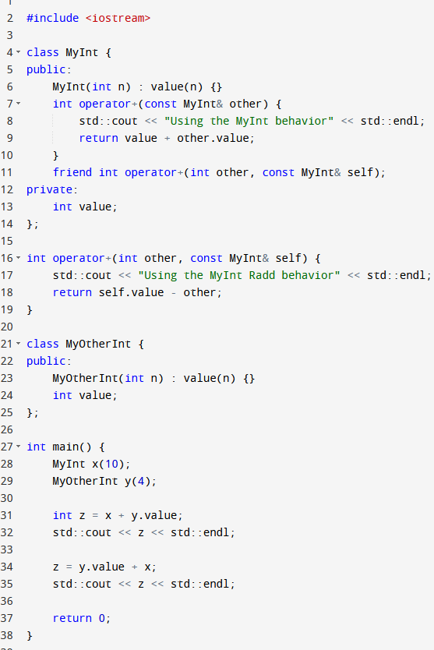
Types inference for operators (C)
The case of C
In C, operator behaviour is different.
C follows specific rules for type promotion and conversion when performing operations with different types.
For example, when adding an int and a float, C will implicitly convert the int to a float before performing the addition.
Behaviour of operators in C is determined by the language's type system and promotion rules, rather than the left-hand operand's type alone.
To some extent, operator overloading can also be made in C++ for custom objects.

Slide 26
Type Checking as Proofs
We can think of type checking in semantic analysis as proving claims about the types of expressions.
We begin with a set of axioms, then apply our inference rules to determine the types of expressions.
Many type systems can be thought of as proof systems.
Typically defined as ‘If … Then …” statements.

Slide 27
Some examples of types inference rules
Some examples of types inferences rules.
“If x is an identifier that refers to an object of type T, the expression x has type T.”
“If e is an integer constant, e has type int.”
“If the operands e1 and e2 of e1 + e2 are known to have types int and int, then e1 + e2 has type int.”

Slide 28
Formalism for Type Inference
We will represent our axioms and inference rules using the formalism below.
It reads as “If preconditions are true, then the can infer postconditions are true.”
We also denote “S ⊢ e : T” if the expression e in scope S has type T.
Preconditions
Postconditions

Slide 29
Formalism for Type Inference
We will represent our axioms and inference rules using the formalism below.
It reads as “If preconditions are true, then the can infer postconditions are true.”
We also denote “S ⊢ e : T” if the expression e in scope S has type T.
Preconditions
Postconditions

Slide 30
Some examples of types inference rules
Some examples of types inferences rules.
“True is of type Boolean, whatever the scope is (no preconditions).”
“If e is an integer constant in scope S, then e has type int.”
⊢ true : bool
e is an integer constant
S ⊢ e : int

Slide 31
Some examples of types inference rules
Some examples of types inferences rules
“If the operands e1 and e2 of e1 + e2 are known to have types int and int, then e1 + e2 has type int.”
S ⊢ e1 : int S ⊢ e2 : int
S ⊢ e1 + e2 : int

Slide 32
Some examples of types inference rules
Some examples of types inferences rules.
“If the operands e1 and e2 of e1 + e2 are known to have types int and float, then e1 + e2 has type float, but will require e1 to be converted implicitly to float.”
Can be used to introduce implicit conversions of types!
S ⊢ e1 : int S ⊢ e2 : float
S ⊢ e1 : float S ⊢ e1 + e2 : float

Slide 33
Operations tables
Many times, these rules can be assembled in result types tables, where each cell will indicate
If the operation is allowed,
What is the resulting type,
What is the operation to use for said types
If any implicit conversions must be made.
Op: + | bool | int | float | string
bool | ... | ... | ... | ...
int | ... | ... | ... | ...
float | ... | ... | ... | ...
string | ... | ... | ... | ...

Slide 34
Op: + | bool | int | float | string
bool | Res: bool Behav: or | Convert int to bool Res: bool Behav: or | Convert float to bool Res: bool Behav: or | Convert string to bool? Res: bool Behav: or
int | Convert int to bool Res: bool Behav: or | Res: int Behav: math. addition | Convert int to bool Res: float Behav: math. addition | Illegal, should trigger a type error
float | Convert float to bool Res: bool Behav: or | Convert int to bool Res: float Behav: math. addition | Res: float Behav: math. addition | Illegal, should trigger a type error
string | Convert string to bool? Res: bool Behav: or | Illegal, should trigger a type error | Illegal, should trigger a type error | Res: string Behav: concatenation

Slide 35
Some examples of types inference rules
When an identifier (e.g. a variable with name x) is called, a lookup procedure will check the symbol table for a given scope S (or multiple ones if LEGB).
Can also be used to resolve resulting types of operations mixing constants and identifiers!
x is in identifier called in scope S x appears in scope S with type int (S ⊢ x : int) S ⊢ 7 : int
S ⊢ x + 7 : int

Slide 36
Some examples of types inference rules
What if the identifier refers to a function?
Can also be used to resolve resulting types of function calls!
f is in identifier called in scope S f appears in scope S as a non-member function f expects types (T1, … , Tn) and returns type U S ⊢ ei : Ti for 1 <= i <= n
S ⊢ f(e1, …,en) : U

Slide 37
Some examples of types inference rules
Also works on Compound types (e.g. arrays) and their operations, for instance indexing.
Question about array bounds and index checking: Semantic analysis should also include checking that array indices are within bounds to avoid out-of-bounds errors at runtime. How would you modify statement above to illustrate that?
S ⊢ e1 : T[] S ⊢ e2 : int
S ⊢ e1[e2]: T

Slide 38
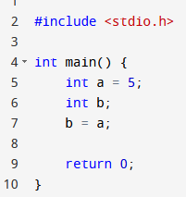
Some examples of types inference rules
How about assignments?
Question: Is this rule good enough to approve the assignment procedure in the code shown on the right ?
S ⊢ e1 : T S ⊢ e2 : T
S ⊢ e1 = e2 : T

Slide 39
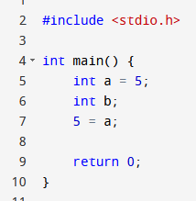
Some examples of types inference rules
How about assignments?
Question 2: How about this?
S ⊢ e1 : T S ⊢ e2 : T
S ⊢ e1 = e2 : T

Slide 40
Some examples of types inference rules
How about assignments?
Question 2: How about this?
Is “5 = a;” an acceptable syntax? And, therefore, something that would have escaped the syntax analysis phase?
S ⊢ e1 : T S ⊢ e2 : T
S ⊢ e1 = e2 : T

Slide 41
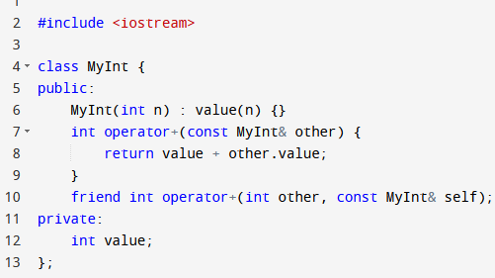
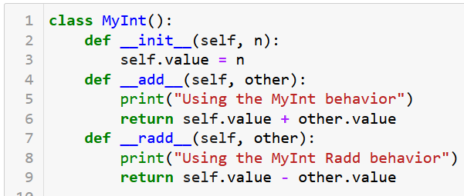
Defining custom classes
How do we factor in, any new classes the user might have defined into our inference rules?
Let us start with the simplest case, a custom class that does not inherit from anybody.

Slide 42
Defining custom classes
Let us start with the simplest case, a custom class that does not inherit from anybody.
In both cases, these class statements indicate to the compiler that there is a new type in town now, on top of the built-in ones!
Operator methods basically tell the compiler to amend operations table and account for new possible + behaviour!

Slide 43
Op: + | bool | int | float | string | MyInt
bool | Res: bool Behav: or | Convert int to bool Res: bool Behav: or | Convert float to bool Res: bool Behav: or | Convert string to bool? Res: bool Behav: or | Illegal, trigger a type error
int | Convert int to bool Res: bool Behav: or | Res: int Behav: math. addition | Convert int to bool Res: float Behav: math. addition | Illegal, should trigger a type error | Illegal, trigger a type error
float | Convert float to bool Res: bool Behav: or | Convert int to bool Res: float Behav: math. addition | Res: float Behav: math. addition | Illegal, should trigger a type error | Illegal, trigger a type error
string | Convert string to bool? Res: bool Behav: or | Illegal, trigger a type error | Illegal, trigger a type error | Res: string Behav: concatenation | Illegal, trigger a type error
MyInt | Illegal, should trigger a type error | Illegal, trigger a type error | Illegal, trigger a type error | Illegal, trigger a type error | Res: int Behav: in add method of MyInt class

Slide 44
Defining custom classes
Instructor
Assist. Prof.
TA
Lecturer
Simon
Matt
How do we factor in, any new classes the user might have defined into our inference rules?
How about classes that inherit from a single other class or type?
Will have to factor in the possible inheritance conversions for types and methods.

Slide 45
Properties of inheritance structures
In the definitions below, “convertible” means that type A can be converted to type B, 100% of the time (no shenanigans).
Reflexivity: Any type is convertible to itself.
Transitivity: If A is convertible to B and B is convertible to C, then A is convertible to C.
Antisymmetry: if A is convertible to B and B is convertible to A, then A and B are the same.

Slide 46
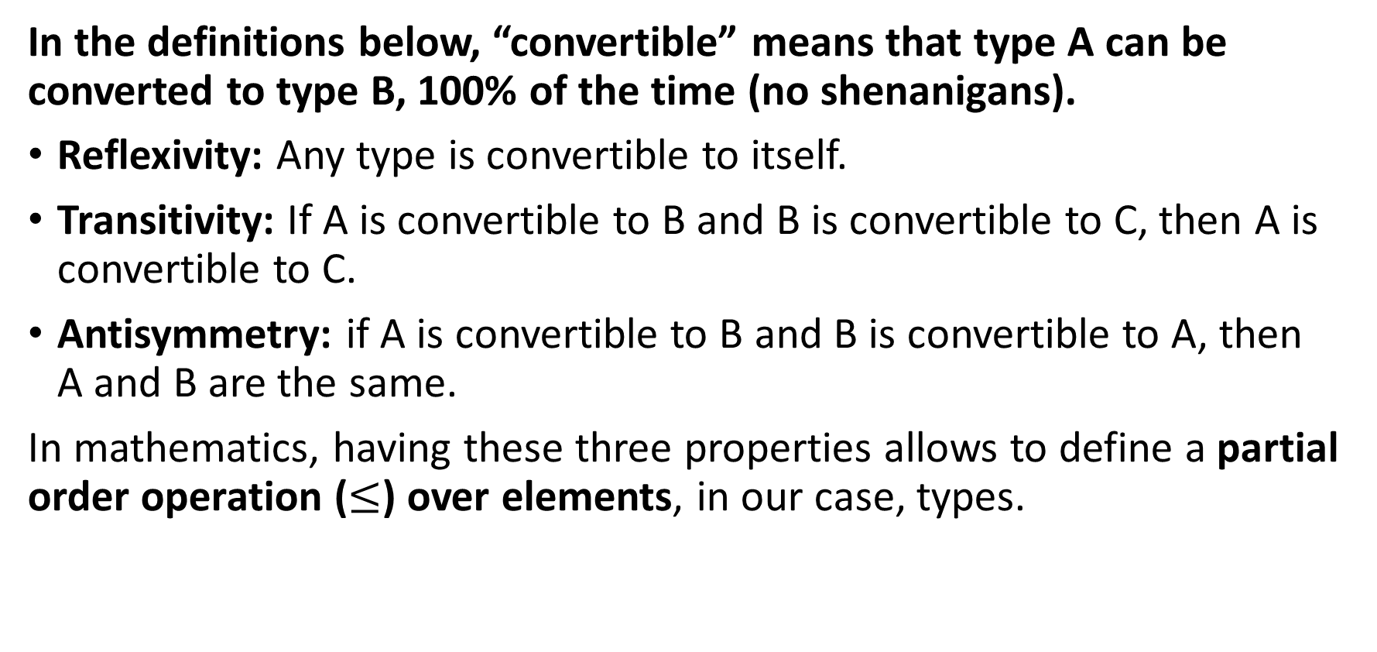
Properties of inheritance structures
In the definitions below, “convertible” means that type A can be converted to type B, 100% of the time (no shenanigans).
Reflexivity: Any type is convertible to itself.
Transitivity: If A is convertible to B and B is convertible to C, then A is convertible to C.
Antisymmetry: if A is convertible to B and B is convertible to A, then A and B are the same.
In mathematics, having these three properties allows to define a partial order operation ($≤$) over elements, in our case, types.

Slide 47
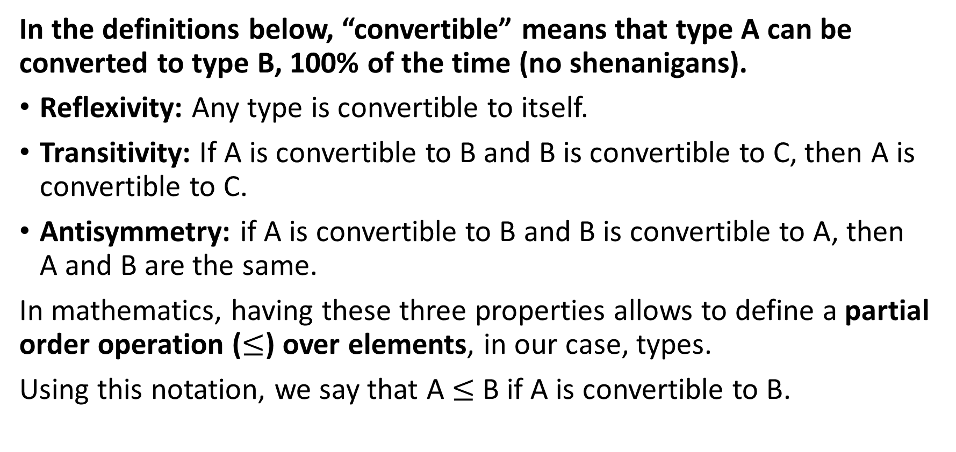
Properties of inheritance structures
In the definitions below, “convertible” means that type A can be converted to type B, 100% of the time (no shenanigans).
Reflexivity: Any type is convertible to itself.
Transitivity: If A is convertible to B and B is convertible to C, then A is convertible to C.
Antisymmetry: if A is convertible to B and B is convertible to A, then A and B are the same.
In mathematics, having these three properties allows to define a partial order operation ($≤$) over elements, in our case, types.
Using this notation, we say that A $≤$ B if A is convertible to B.

Slide 48
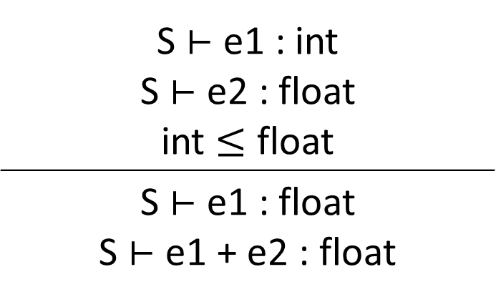

Properties of inheritance structures
This idea and the notation $≤$can be used to provide order among types and define possible implicit conversion rules in operations.
Typically added to operations tables!
S ⊢ e1 : int S ⊢ e2 : float int $≤$ float
S ⊢ e1 : float S ⊢ e1 + e2 : float

Slide 49
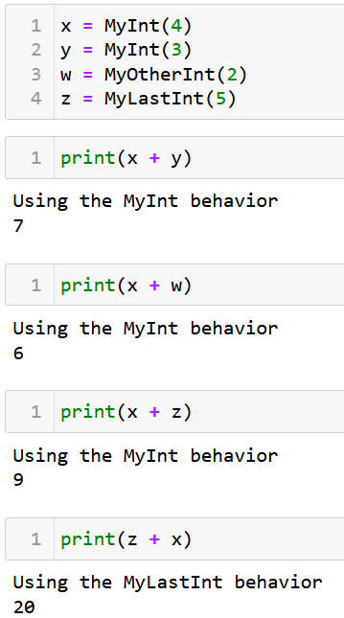
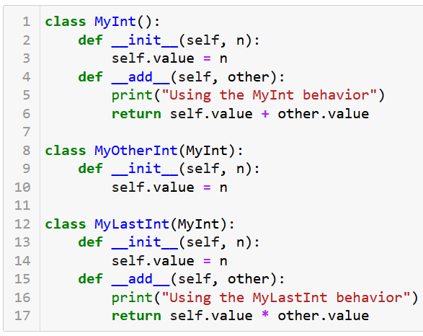
Careful about operations overloading

Slide 50
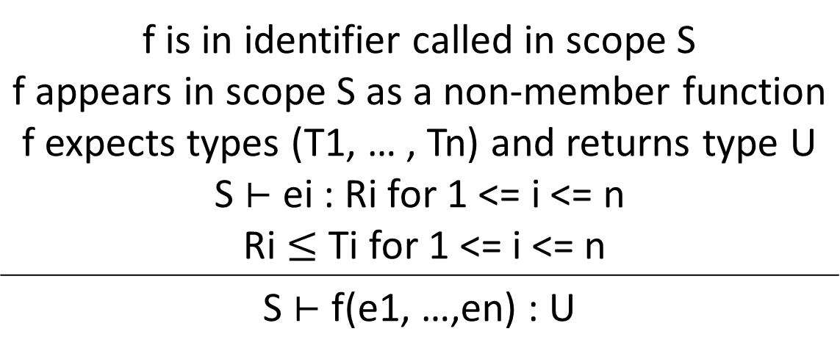
Some examples of types inference rules
Updated functions calls with implicit types conversions
f is in identifier called in scope S f appears in scope S as a non-member function f expects types (T1, … , Tn) and returns type U S ⊢ ei : Ri for 1 <= i <= n Ri $≤$ Ti for 1 <= i <= n
S ⊢ f(e1, …,en) : U

Slide 51
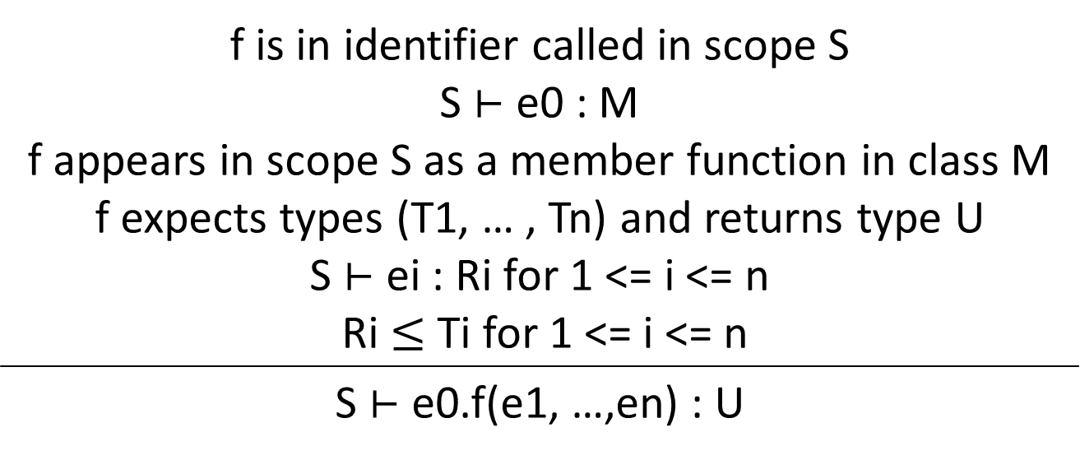
Some examples of types inference rules
Updated functions calls with implicit types conversions and member functions/methods of a class
f is in identifier called in scope S S ⊢ e0 : M f appears in scope S as a member function in class M f expects types (T1, … , Tn) and returns type U S ⊢ ei : Ri for 1 <= i <= n Ri $≤$ Ti for 1 <= i <= n
S ⊢ e0.f(e1, …,en) : U

Slide 52
Some examples of types inference rules
Open Question: How would you modify this to ensure that f is a method of class e0 or any parent class than e0 inherits from?
f is in identifier called in scope S S ⊢ e0 : M f appears in scope S as a member function in class M f expects types (T1, … , Tn) and returns type U S ⊢ ei : Ri for 1 <= i <= n Ri $≤$ Ti for 1 <= i <= n
S ⊢ e0.f(e1, …,en) : U

Slide 53
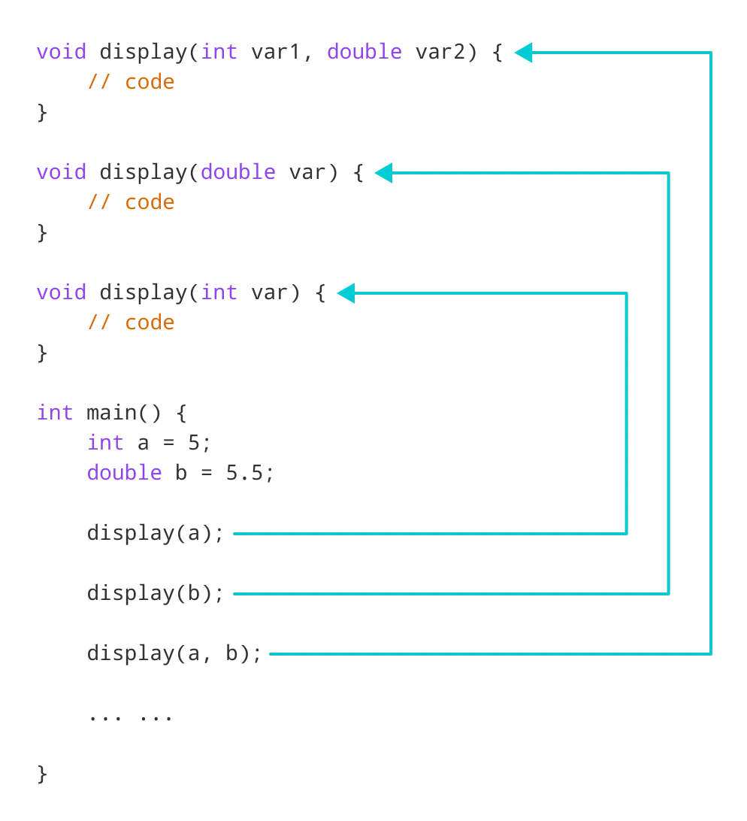
Defining custom classes
How do we factor in, any new classes the user might have defined into our inference rules?
Open question #1: How about classes that inherit from a multiple other classes or types?
Usually starts to become a mess at this point! (Which is why I am not really a big fan of multiple inheritance…)
Open question #2: How about function overloading/polymorphism?

Slide 54
Error reporting and recovery
Type errors will typically occur in one of two scenarios:
An explicit method or operation is used on a type that does not support it (e.g. in Python the explicit conversion of a string “123.4” into int, using + operation between int ”7” and string “hello”, calling append() method on string, etc.).
And there is no implicit conversion that might resolve the issue above, if any (e.g. summing a char “c” and an int “7” in C, will simply require an implicit conversion, but this will not do in Python).
This can be implemented with an “if-else” again and a set of rules we have defined we our types inference framework and tables.

Slide 55
Compiler Error Recovery
Definition (Compiler Error Recovery):
In modern compilers, compiler error recovery refers to the process of attempting to continue the semantic analysis despite type errors.
This allows the compiler to potentially detect and report multiple errors in a single compilation pass, saving the programmer time by reducing the need for multiple recompilations.
Limited in terms of possibilities, however, as semantic errors will often carry to other expressions…
For instance: E.g. if y uses x and x undefined, then y undefined, and if z uses y, then z undefined, etc.
How to bypass error, pretend code worked and continue execution?

Slide 56
Quiz time!
What is the main purpose of type checking during semantic analysis?
To optimize the generated machine code
To ensure that variables and expressions are used correctly according to their types
To find syntax errors in the code
To allocate memory for variables, matching the types requirements

Slide 57
Quiz time!
What is the main purpose of type checking during semantic analysis?
To optimize the generated machine code
To ensure that variables and expressions are used correctly according to their types
To find syntax errors in the code
To allocate memory for variables, matching the types requirements

Slide 58
Quiz time!
In the context of type systems, what does polymorphism refer to?
The ability of a single function or method to work with multiple types of arguments
The automatic conversion of one type to another when needed
The process of inferring the types of variables and expressions without explicit type annotations
The relationship between types and their subtypes

Slide 59
Quiz time!
In the context of type systems, what does polymorphism refer to?
The ability of a single function or method to work with multiple types of arguments
The automatic conversion of one type to another when needed
The process of inferring the types of variables and expressions without explicit type annotations
The relationship between types and their subtypes

Slide 60
Quiz time!
What is the term used to describe the process by which a programming language's type inference algorithm derives the types of expressions and variables based on the context in which they are used?
Type inference
Type coercion
Type instantiation
Type resolution

Slide 61
Quiz time!
What is the term used to describe the process by which a programming language's type inference algorithm derives the types of expressions and variables based on the context in which they are used?
Type inference
Type coercion
Type instantiation
Type resolution

Slide 62
Well-formedness
Definition (well-formedness):
In semantic analysis, well-formedness refers to a generic idea which aims to ensure that the structure and the meaning of a program written in a programming language are correct, logical, and follow the rules of the language.
We write WF(stmt) if statement stmt is well-formed.
For instance, consider the function: divide(a: int, b: int) -> float
Preconditions:
- WF(a) and a is an integer
- WF(b) and b is an integer
- b != 0 (to avoid division by zero)
Postconditions:
- Returns a float result, which is the division of a by b
- WF(result) and result == a / b

Slide 63
Well-formedness
For instance,
If you declare the type of a variable, e.g. integer, and later try to assign a value corresponding to a different type to that variable, this statement is then not well-formed. (Checked by type-checking).
Functions in a programming language usually expect a certain number of arguments with specific types. If you call a function with the wrong number or type of arguments, this statement is then not well-formed.
Well-formedness might check that a class has a constructor method defined, if the language requires it.
Etc.

Slide 64
Other tasks in semantic analysis
Beyond scope and types checking, there are many other tasks in Semantic Analysis, worth discussing:
Control-Flow: Checks that the control structures, such as loops and conditional statements, are used correctly, e.g. ensuring that every branch of an 'if-else' is reachable, and that loops have proper termination conditions, etc.
Access control and visibility: Checks that some attributes/methods of an object can be called at a given time, given their public, private, protected status.

Slide 65
Other tasks in semantic analysis
Beyond scope and types checking, there are many other tasks in Semantic Analysis, worth discussing:
Exception handling: Ensures that exceptions are properly caught and handled, and that appropriate error messages or fallback behaviour are in place.
Garbage collection and memory management: Ensures that you are freeing variables, that can be freed, and that you are freeing them the correct way. Somewhat related to scope?
And many other concepts!

Slide 66
Code is legal!
Definition (Legal Code):
A legal code is a program that adheres to all the rules of a programming language. It passed through various stages, including:
Lexical Analysis: The code is tokenized into meaningful symbols, keywords, identifiers, and literals according to the language's rules. No weird symbols have been used.
Syntax Analysis: The code follows the grammar rules and structural guidelines of the language, ensuring that keywords, punctuation, and language constructs are used correctly.
Semantic Analysis: The code is meaningful and adheres to the language's conventions, including well-formedness, type checking, identifier scoping, and control flow analysis.

Slide 67
Code is legal!
Definition (Legal Code):
A legal code is a program that adheres to all the rules of a programming language. It passed through various stages, including:
Lexical Analysis
Syntax Analysis
Semantic Analysis
Property: A code is considered legal if it satisfies the requirements of lexical analysis, syntax analysis, semantic analysis.

Slide 68
Code is legal!
Definition (Legal Code):
A legal code is a program that adheres to all the rules of a programming language. It passed through various stages, including:
Lexical Analysis
Syntax Analysis
Semantic Analysis
Property: A code is considered legal if it satisfies the requirements of lexical analysis, syntax analysis, semantic analysis.
A code that is deemed legal should be able to run correctly, after it has been transformed into machine code.

Slide 69
The end of the front-end?
Semantic Analysis
Final step in the “front-end” phase, whose job is to check that the source code is legal.
Ensures that the program has a well-defined meaning.
Should catch all remaining errors that lexical analysis and syntax analysis could not catch.
Errors that require contextual information about the code.

Slide 70
The end of the front-end?
Semantic Analysis
Final step in the “front-end” phase, whose job is to check that the source code is legal.
Ensures that the program has a well-defined meaning.
Should catch all remaining errors that lexical analysis and syntax analysis could not catch.
Errors that require contextual information about the code.
Next Lecture, Intermediate Code Generation!

Slide 71
Quiz time!
Which of the following is a responsibility of control flow analysis?
Verifying that every branch of an 'if-else' statement is reachable
Ensuring that variables are initialized before use
Checking that derived classes correctly override methods from their base classes
Ensuring proper use of access control modifiers

Slide 72
Quiz time!
Which of the following is a responsibility of control flow analysis?
Verifying that every branch of an 'if-else' statement is reachable
Ensuring that variables are initialized before use
Checking that derived classes correctly override methods from their base classes
Ensuring proper use of access control modifiers

Slide 73
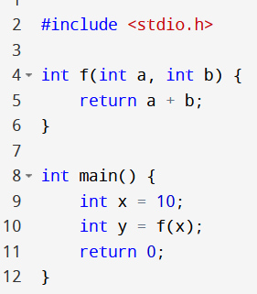
Quiz time!
Which aspect of semantic analysis would catch the error in this code snippet?
Control flow analysis
Data flow analysis
Well-formedness of functions
Inheritance and polymorphism

Slide 74
Quiz time!
Which aspect of semantic analysis would catch the error in this code snippet?
Control flow analysis
Data flow analysis
Well-formedness of functions
Inheritance and polymorphism

