Slide 1

50.051 Programming Language Concepts Course Introduction
Matthieu De Mari

Slide 2
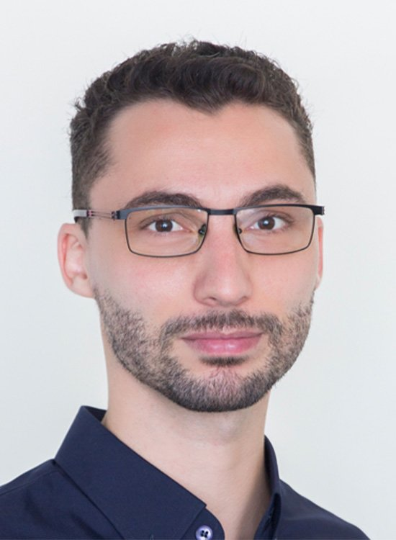
A quick word about instructors
Matthieu (Matt) De Mari
Senior Lecturer at SUTD (Python, Deep Learning, Prog. Language Concepts, Capstone, etc.)
Director of the Master of Science in Design and Artificial Intelligence for Enterprise (MSc DAI-E)
PhD from CentraleSupelec (France)
Email: matthieu_demari@sutd.edu.sg
Office @ SUTD: 2.401-07 (located in SUTD Academy/AI cluster).

Slide 3
A quick word about instructors
Dileepa Fernando
Lecturer at SUTD (Python, Software Engineering, Programming Language Concepts and more)
Computer Science and Design (CSD)
PhD from NUS
Email: dileepa_fernando@sutd.edu.sg
Office @ SUTD: 1.402.24

Slide 4
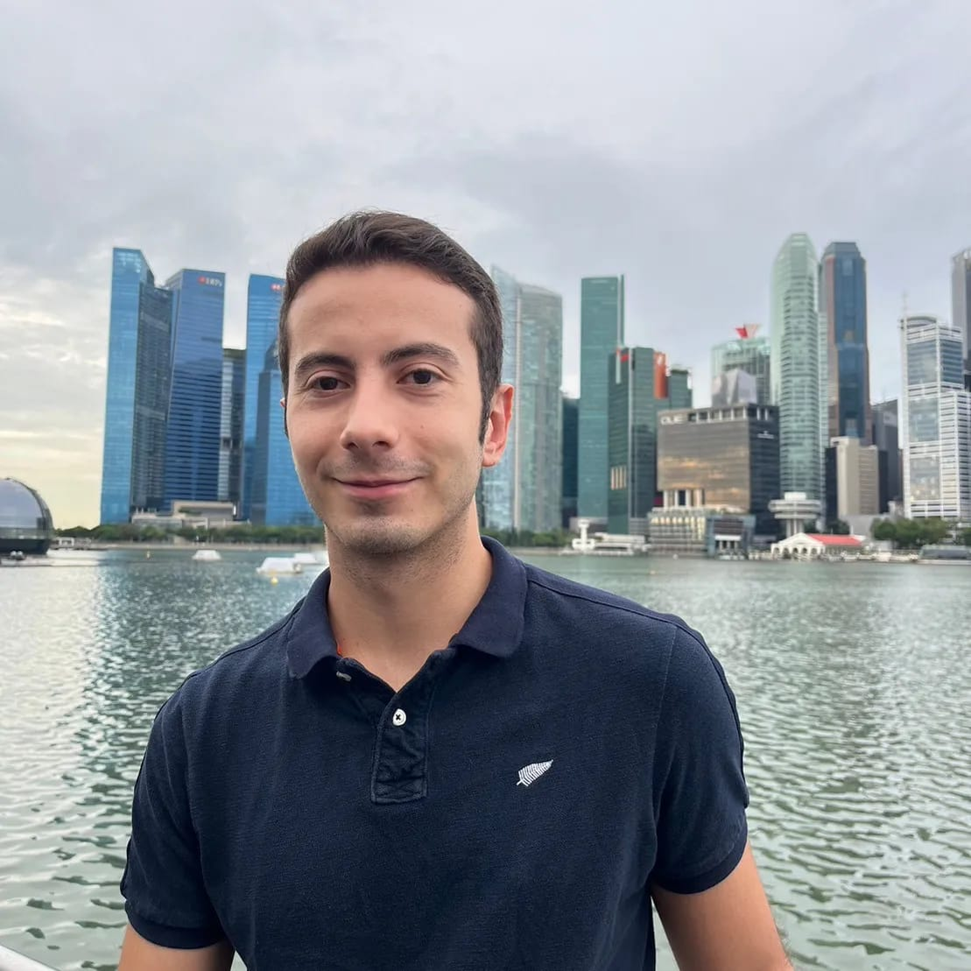
A quick word about instructors
Juan David Salazar Rodríguez (TA)
PhD candidate in the ASD pillar at the Singapore University of Technology and Design (SUTD)
Research on artificial intelligence as a collaborative agent in architectural education, focusing on LLMs, AI personas, and mixed reality systems to support design critique, reflection, and creative learning in studio-based pedagogy.
Contact: 1008372@mymail.sutd.edu.sg

Slide 5
Course Handout/Syllabus
Everything you need to know about the course is in the course handout on eDimension.
Might get updated with more details (dates, locations, etc.) about exams when OSA confirms this with us.
Before you ask any questions, check the course handout.

Slide 6
Course structure
Part 1: C programming + State Machines (6 weeks)
Everything about C
Memory Management
Finite State Machines and Regular Expressions
Part 2: Compiler Engineering & C++ (6 weeks)
Lexical/Syntaxic/Semantic Analysis
Intermediate Code Representations, Optimization and Backend
C++

Slide 7
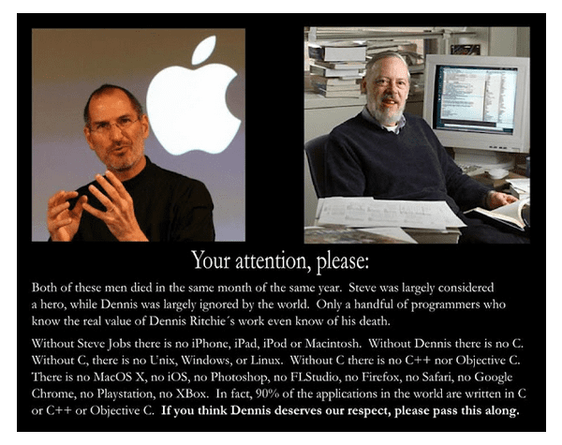
About C
C created in 1972 by Dennis Ritchie between 1969-1973
Called C as a successor to B
Imperative programming language
Program = set of statements
C inspired many other languages and is a good entry point for learning many additional languages (C++, Objective-C, Java, C#, PHP, etc.)

Slide 8
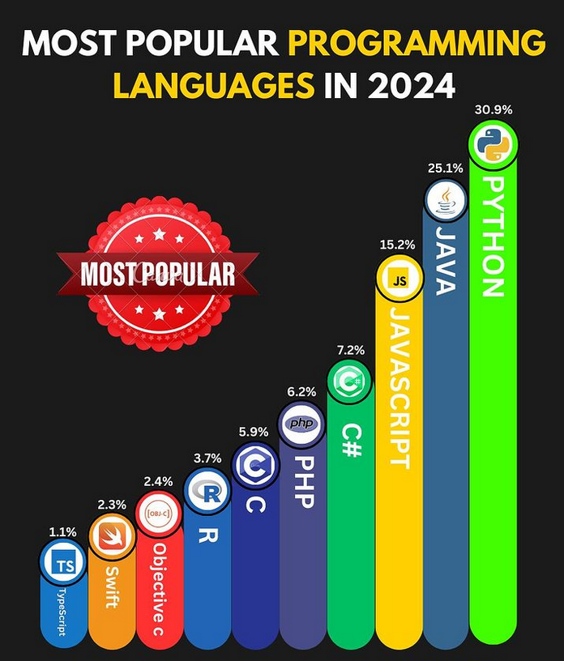
Why should I learn C?
C is still widely used for operating systems (Unix, Linux, Windows, Mac OS X, etc.)
Can be compiled on nearly any hardware
“Low level language”
Great for memory management
Small set of keywords
Still among the most popular and used languages, even in 2025.

Slide 9
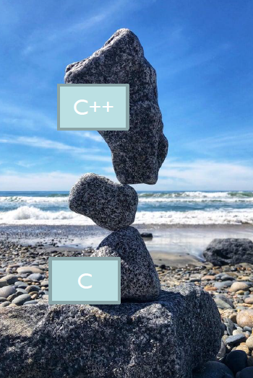
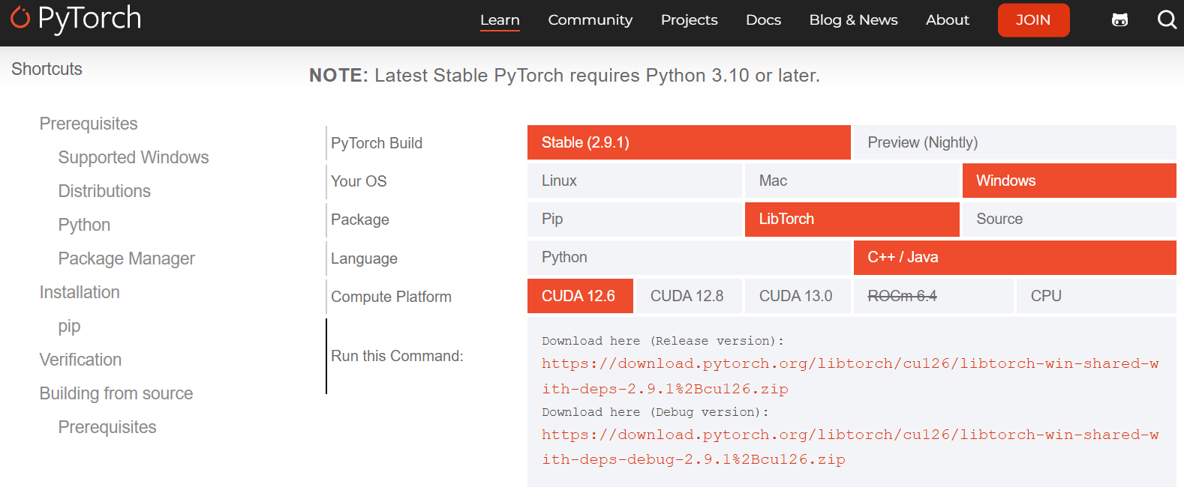
Why should I learn C++?
Created in 1985
C++ = ”C with Classes”
Kinda like Java
More “powerful”?
More complicated
If you know Java and C++, you will have no trouble understanding C#.
These days, C++ used in many AI frameworks (faster than Python for training/inference)

Slide 10
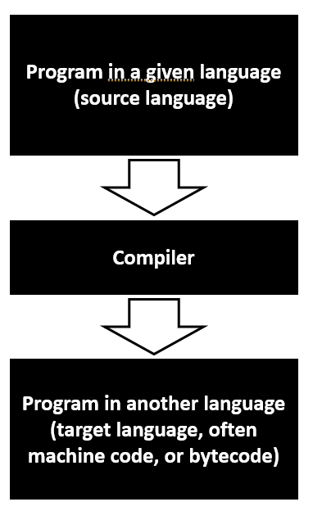
What is compilation?
Compilation = How to go from source code in any programming language to assembly
Tokenization
Lexical Analysis
Syntaxic Analysis
Semantic Analysis
Parsing
And more!
Compilers = Missing link between your beloved programming languages and 50.002 CompStruct

Slide 11
Why should you study compilers in a Computer Science degree?
A great introduction to techniques for translation and improvement of programs written in any programming language.
A fantastic practical exercise in software engineering.
Provides an understanding of what happens in the background when you press the “Run” button of your programs.
A way to understand where typical compilation errors come from.
A better understanding of the missing link between any programming course and the 50.002 Computation Structures one.
A much-needed introduction course to compilers, if one day you plan on writing your own programming language (please don’t!).

Slide 12
Final Grade
Practicals (20%): 6 individual assignments
Given in class, either check off in class or due 2 weeks after session
Group Project (20%): 4 students per group max
Instructions given in week 2-3
Class participation + Student Feedback (8+2%)
Midterm Exam (20%)
Final Exam (30%)
All details in the course handout.

