Slide 1

50.051 Programming Language Concepts W8-S3 Reminders on Finite State Machines (FSMs)
Matthieu De Mari

Slide 2
Finite State Machine
Definition (Finite State Machine):
A Finite State Machine (FSM), or finite automaton, is a mathematical model used to represent systems
that have a finite number of possible states,
and can transition between these states based on given inputs.
An FSM can be represented using a graph representation, known as a state diagram, which shows the possible states of the system and the transitions between them.
FSMs are used in a wide variety of applications (control systems, communication protocols, digital circuits, etc.). In our case, FSMs are at the center of the compiling process.

Slide 3
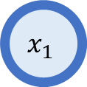
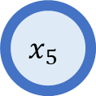
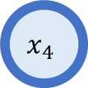
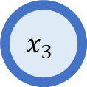
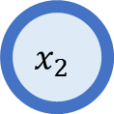
Graph theory
$$x_{2}$$
Definition (graph theory):
In mathematics, graph theory is the study of graphs objects, which are mathematical structures used to model pairwise relations between objects.
Graphs are one of the principal objects of study in discrete mathematics.
(Need a refresher? Check additional materials!)
$$x_{1}$$
$$x_{4}$$
$$x_{3}$$
$$x_{5}$$

Slide 4
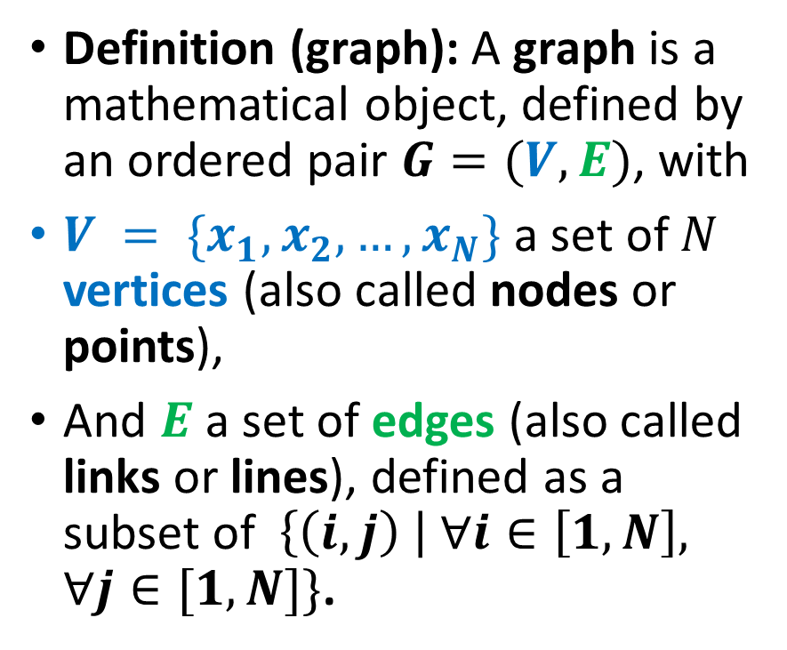
Graphs: a general and minimal definition
$$x_{2}$$
Definition (graph): A graph is a mathematical object, defined by an ordered pair $G=(V, E)$, with
$V = \{x_{1}, x_{2}, …, x_{N}\}$ a set of $N$ vertices (also called nodes or points),
And $E$ a set of edges (also called links or lines), defined as a subset of $\left\{\left(i,j\right) \right| ∀i∈\left[1,N\right], ∀j∈[1, N]\}$.
$$x_{1}$$
$$x_{4}$$
$$x_{3}$$
$$x_{5}$$

Slide 5
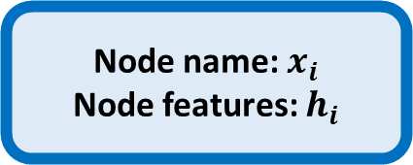
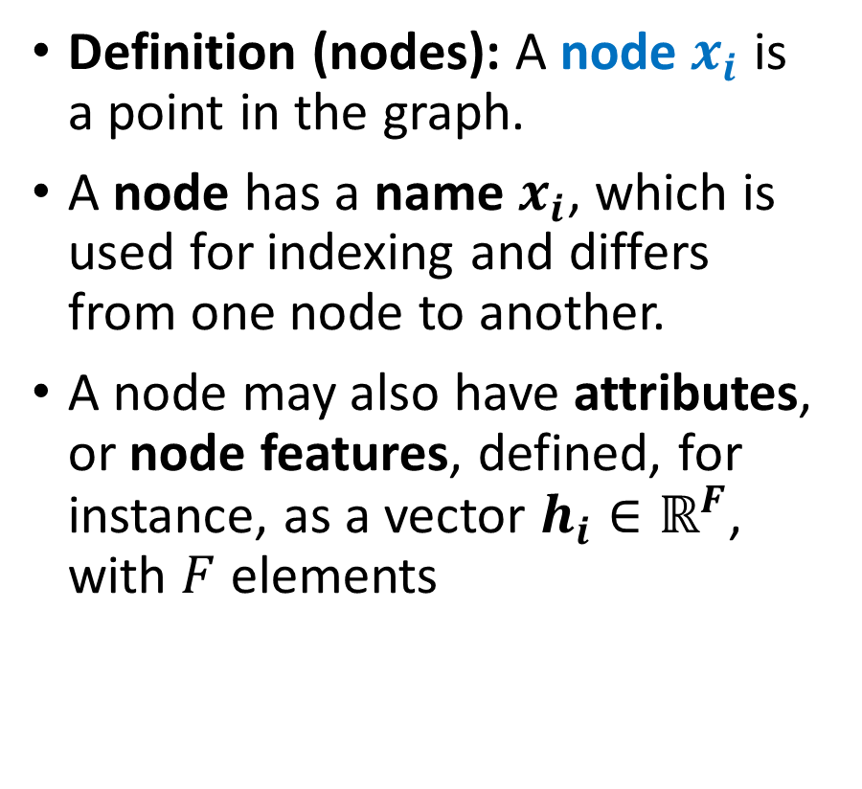
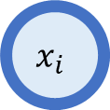
Nodes definition and attributes
$$x_{2}$$
Definition (nodes): A node $x_{i}$ is a point in the graph.
A node has a name $x_{i}$, which is used for indexing and differs from one node to another.
A node may also have attributes, or node features, defined, for instance, as a vector $h_{i}∈ℝ^{F}$, with $F$ elements
$$x_{1}$$
$$x_{4}$$
$$x_{3}$$
$$x_{5}$$
Node name: $x_{i}$
Node features: $h_{i}$
$$x_{i}$$

Slide 6

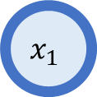


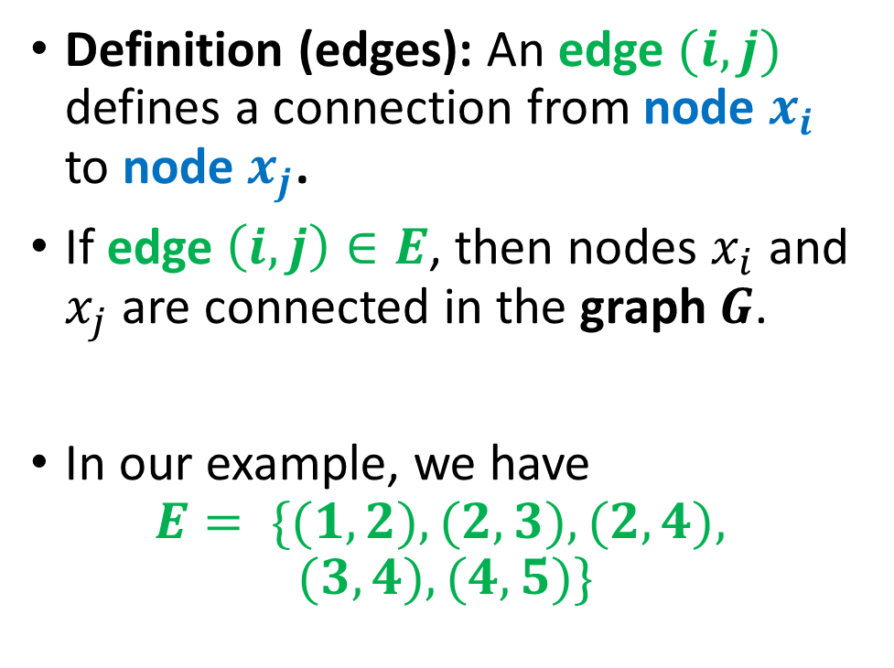
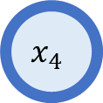

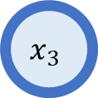



Edges definition
$$(1,2)$$
$$x_{2}$$
$$x_{1}$$
Definition (edges): An edge $(i,j)$ defines a connection from node $x_{i}$ to node $x_{j}$.
If edge $\left(i,j\right)∈E$, then nodes $x_{i}$ and $x_{j}$are connected in the graph $G$.
In our example, we have
$$E= \{(1,2), (2,3), (2,4),$$
$$(3,4), (4,5)\}$$
$$(2,4)$$
$$(2,3)$$
$$x_{4}$$
$$x_{3}$$
$$(3,4)$$
$$(4,5)$$
$$x_{5}$$

Slide 7
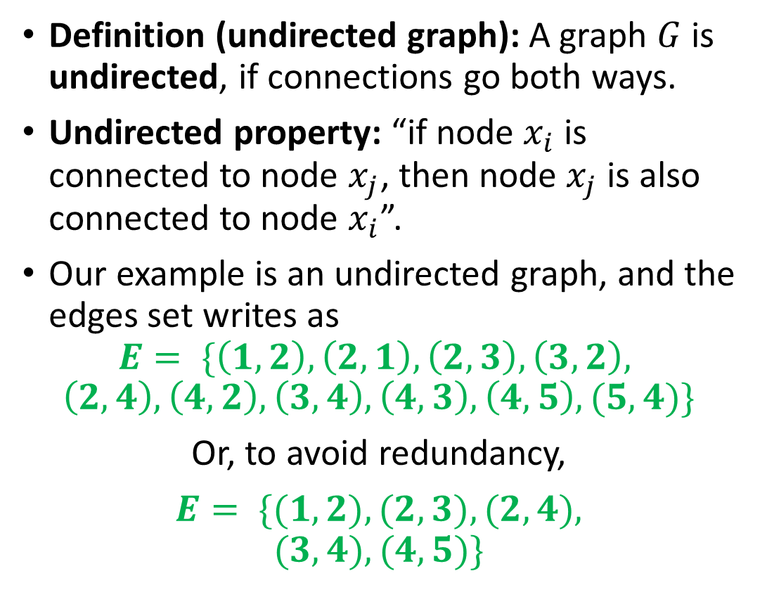
Undirected graph definition
$$(1,2)$$
$$x_{2}$$
Definition (undirected graph): A graph $G$ is undirected, if connections go both ways.
Undirected property: “if node $x_{i}$ is connected to node $x_{j}$, then node $x_{j}$is also connected to node $x_{i}$”.
Our example is an undirected graph, and the edges set writes as
$$E= \{\left(1,2\right), \left(2,1\right), \left(2,3\right), \left(3,2\right),$$
$$\left(2,4\right), \left(4,2\right), \left(3,4\right), \left(4,3\right), \left(4,5\right), (5,4)\}$$
Or, to avoid redundancy,
$E= \{(1,2), (2,3), (2,4),$
$$(3,4), (4,5)\}$$
$$x_{1}$$
$$(2,4)$$
$$(2,3)$$
$$x_{4}$$
$$x_{3}$$
$$(3,4)$$
$$(4,5)$$
$$x_{5}$$

Slide 8


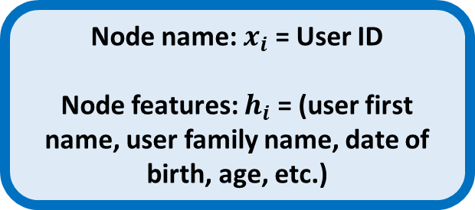

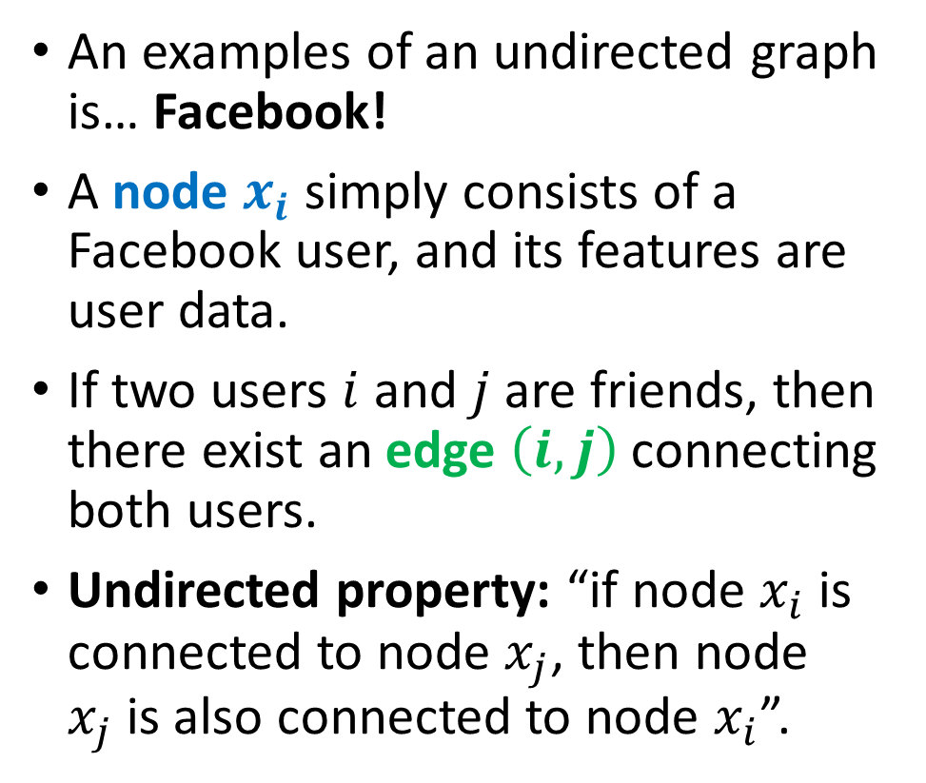

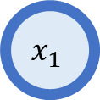

Examples of an undirected graph
An examples of an undirected graph is… Facebook!
A node $x_{i}$ simply consists of a Facebook user, and its features are user data.
If two users $i$ and $j$ are friends, then there exist an edge $\left(i,j\right)$ connecting both users.
Undirected property: “if node $x_{i}$ is connected to node $x_{j}$, then node $x_{j}$is also connected to node $x_{i}$”.
Node name: $x_{i}$ = User ID
Node features: $h_{i}$ = (user first name, user family name, date of birth, age, etc.)
$$(1,2)$$
$$x_{2}$$
$$x_{1}$$
$$(2,3)$$
$$x_{3}$$

Slide 9
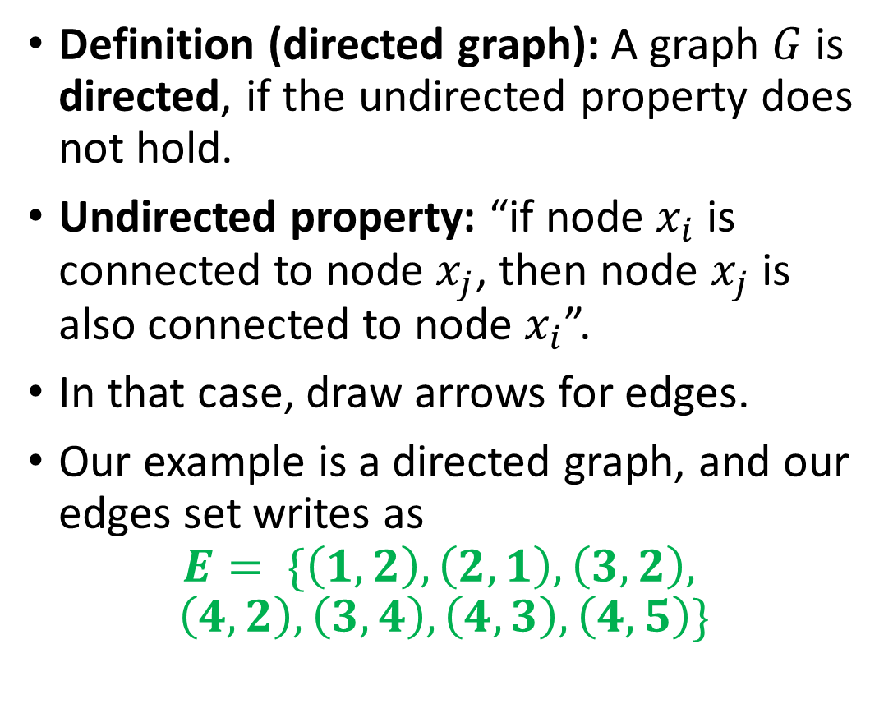
Directed graph definition
$$x_{2}$$
Definition (directed graph): A graph $G$ is directed, if the undirected property does not hold.
Undirected property: “if node $x_{i}$ is connected to node $x_{j}$, then node $x_{j}$is also connected to node $x_{i}$”.
In that case, draw arrows for edges.
Our example is a directed graph, and our edges set writes as
$$E= \{\left(1,2\right), \left(2,1\right), \left(3,2\right),$$
$$\left(4,2\right), \left(3,4\right), \left(4,3\right), \left(4,5\right)\}$$
$$x_{1}$$
$$x_{4}$$
$$x_{3}$$
$$x_{5}$$

Slide 10



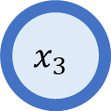
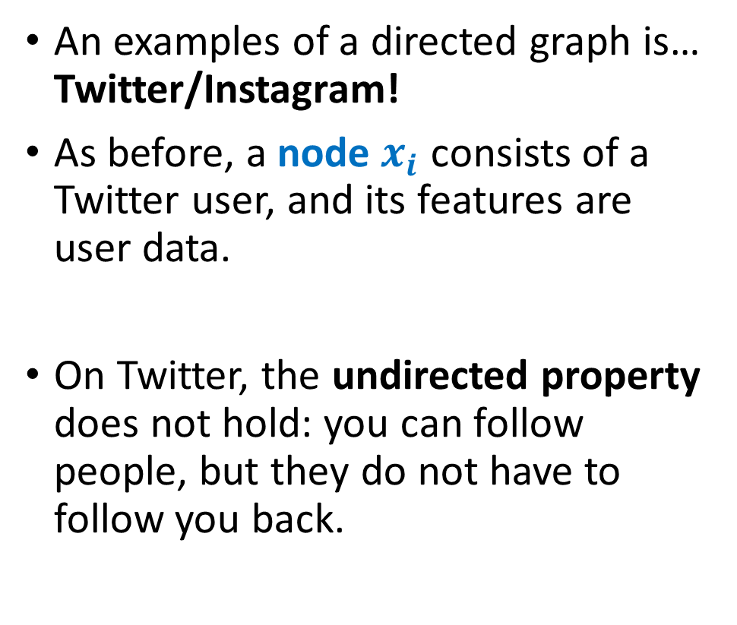
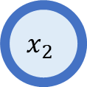

Examples of a directed graph
An examples of a directed graph is… Twitter/Instagram!
As before, a node $x_{i}$ consists of a Twitter user, and its features are user data.
On Twitter, the undirected property does not hold: you can follow people, but they do not have to follow you back.
Node name: $x_{i}$ = User ID
Node features: $h_{i}$ = (user first name, user family name, date of birth, age, etc.)
$$x_{2}$$
$$x_{1}$$
$$x_{3}$$

Slide 11
Back to our Finite State Machine
Definition (Finite State Machine):
A Finite State Machine (FSM), or finite automaton, is a mathematical model used to represent systems
that have a finite number of possible states,
and can transition between these states based on given inputs.
An FSM can be represented using a graph representation, known as a state diagram, which shows the possible states of the system and the transitions between them.
FSMs are used in a wide variety of applications (control systems, communication protocols, digital circuits, etc.). In our case, FSMs are at the center of the compiling process.

Slide 12
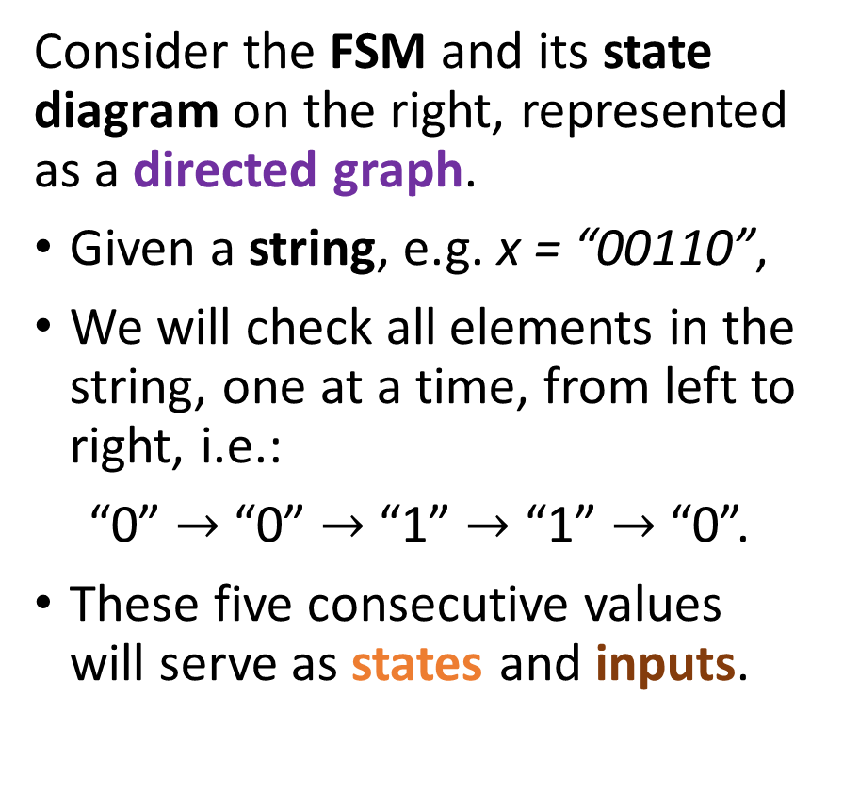
An example of an FSM
Consider the FSM and its state diagram on the right, represented as a directed graph.
Given a string, e.g. x = “00110”,
We will check all elements in the string, one at a time, from left to right, i.e.:
“0” $→$ “0” $→$ “1” $→$ “1” $→$ “0”.
These five consecutive values will serve as states and inputs.
Start
0
1

Slide 13
An example of an FSM
Consider the FSM and its state diagram on the right, represented as a directed graph.
Begin at start node, which is defined as a node, receiving an incoming arrow with no source.
Start
0
1

Slide 14
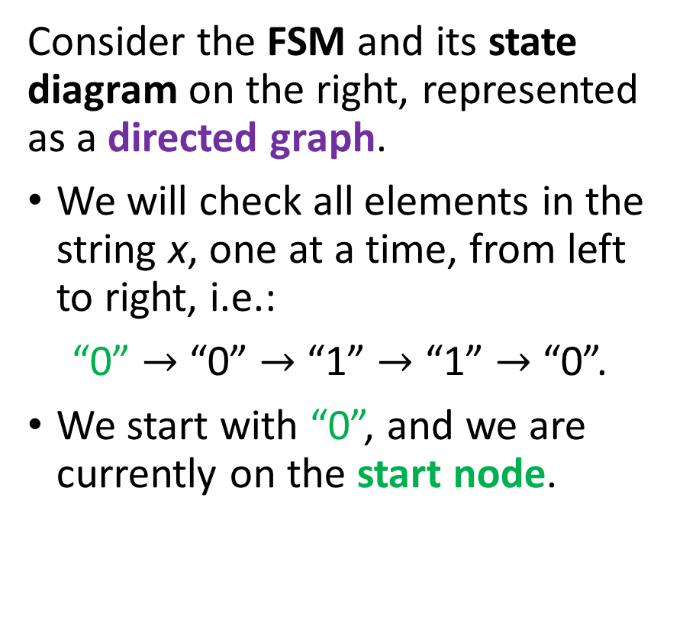
An example of an FSM
Consider the FSM and its state diagram on the right, represented as a directed graph.
We will check all elements in the string x, one at a time, from left to right, i.e.:
“0” $→$ “0” $→$ “1” $→$ “1” $→$ “0”.
We start with “0”, and we are currently on the start node.
Start
0
1

Slide 15
An example of an FSM
An then, move in the FSM state diagram, following a logic.
We first consider that this value “0” serves as input (or action) for this turn.
Logic, defined by the directed graph, for this FSM (could differ from one FSM to another):
“the input (or action) defines the next state (or node) you will move to during this turn.”
Start
0
1
0
1

Slide 16
An example of an FSM
For instance,
Following this logic, our first turn sees the input value “0”.
Moves from our current state, the start node,
To the next state, i.e. node “0”,
Following the directed edge, starting from the start node and labelled with “0”.
Start
0
1
0
1

Slide 17
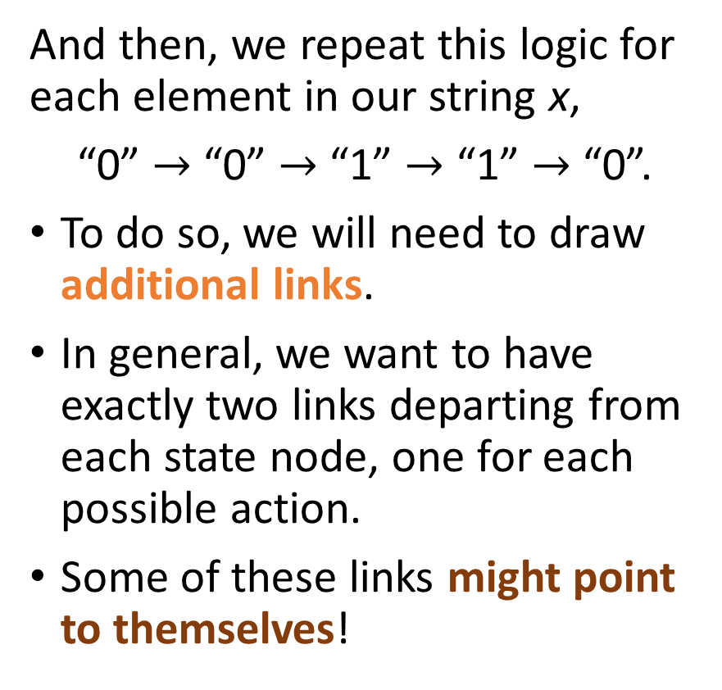
An example of an FSM
And then, we repeat this logic for each element in our string x,
“0” $→$ “0” $→$ “1” $→$ “1” $→$ “0”.
To do so, we will need to draw additional links.
In general, we want to have exactly two links departing from each state node, one for each possible action.
Some of these links might point to themselves!
Start
0
1
0
1
0
1
1
0

Slide 18
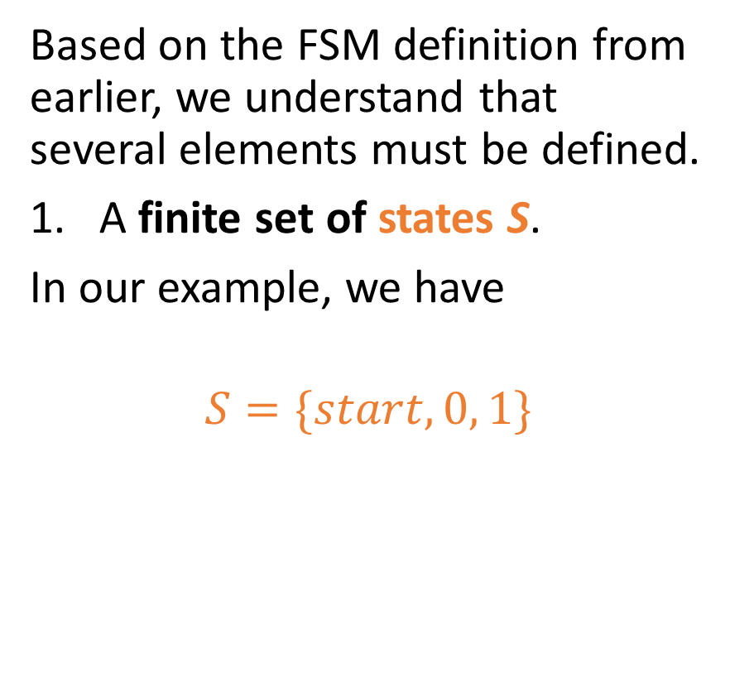
Elements of an FSM
Based on the FSM definition from earlier, we understand that several elements must be defined.
A finite set of states S.
In our example, we have
$$S=\{start, 0, 1\}$$
Start
0
1
0
1
0
1
1
0

Slide 19
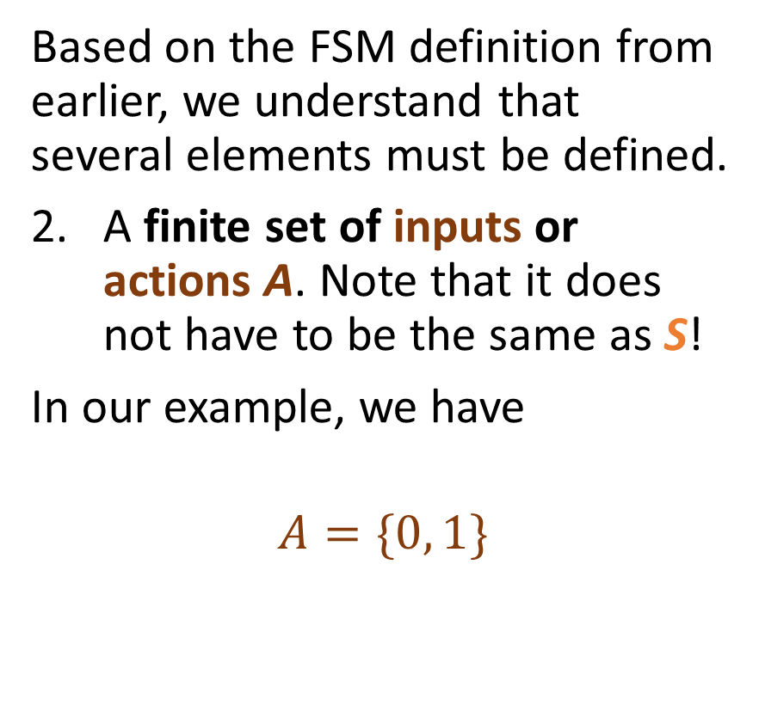
Elements of an FSM
Based on the FSM definition from earlier, we understand that several elements must be defined.
A finite set of inputs or actions A. Note that it does not have to be the same as S!
In our example, we have
$$A=\{0, 1\}$$
Start
0
1
0
1
0
1
1
0

Slide 20
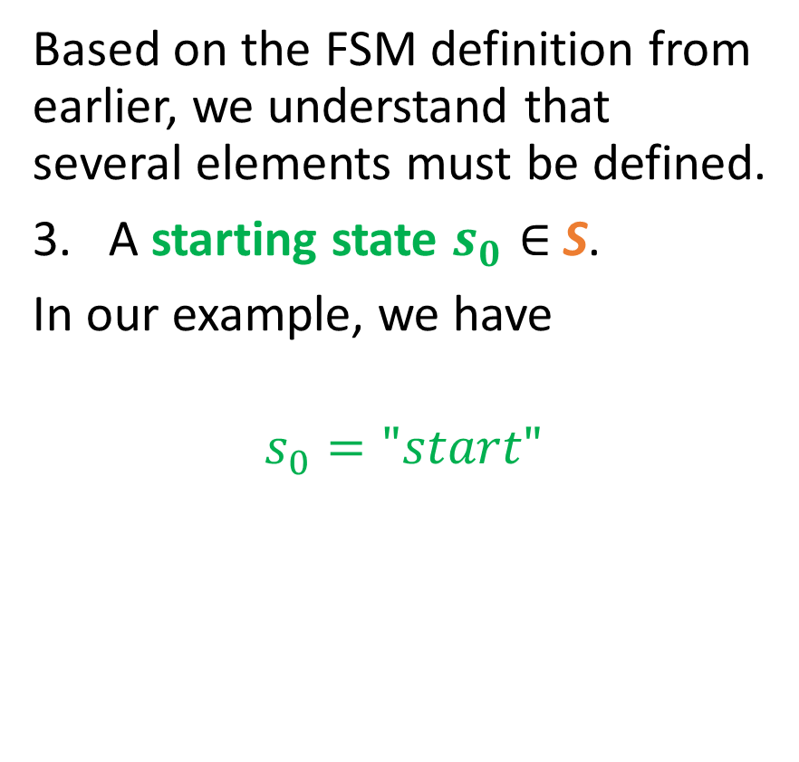
Elements of an FSM
Based on the FSM definition from earlier, we understand that several elements must be defined.
A starting state $s_{0}∈$S.
In our example, we have
$$s_{0}="start"$$
Start
0
1
0
1
0
1
1
0

Slide 21
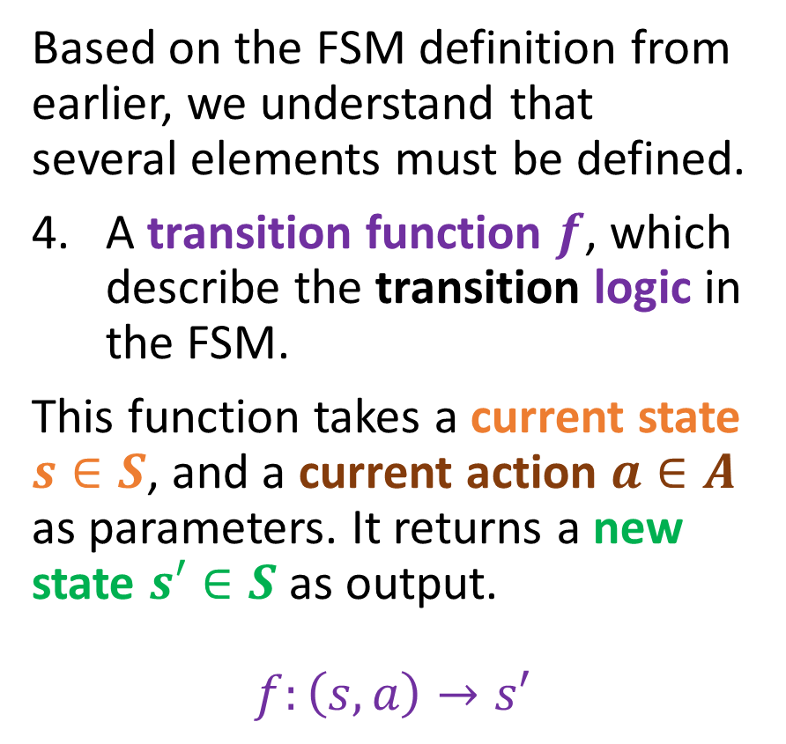
Elements of an FSM
Based on the FSM definition from earlier, we understand that several elements must be defined.
A transition function $f$, which describe the transition logic in the FSM.
This function takes a current state $s∈S$, and a current action $a∈A$ as parameters. It returns a new state $s′∈S$ as output.
$$f:\left(s, a\right)→s′$$
Start
0
1
0
1
0
1
1
0

Slide 22
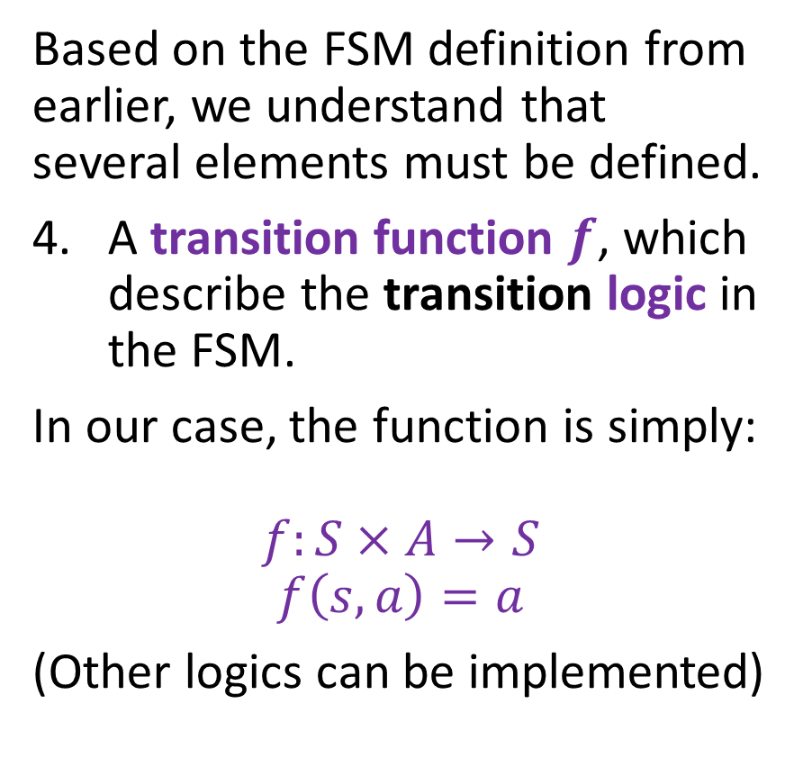
Elements of an FSM
Based on the FSM definition from earlier, we understand that several elements must be defined.
A transition function $f$, which describe the transition logic in the FSM.
In our case, the function is simply:
$$f:S×A→S$$
$$f\left(s,a\right)=a$$
(Other logics can be implemented)
Start
0
1
0
1
0
1
1
0

Slide 23
Elements of an FSM
Note: the transition function can also be expressed in the form of a transition table, as shown below.
Start
Current state | Input | Next state
Start | 0 | 0
Start | 1 | 1
0 | 0 | 0
0 | 1 | 1
1 | 0 | 0
1 | 1 | 1
0
1
0
1
0
1
1
0

Slide 24
Adding a stopping state
Definition (stopping states or accepting states):
In a finite state machine (FSM), a stopping state or accepting state is a special type of state node in which the FSM can terminate.
Stopping states can be represented in the state transition diagram by drawing a double circle around the state.
Definition (acceptable input):
In general, we will consider that the inputs string x (e.g. our “00110” from earlier) is an acceptable input, if and only if the final state after processing the string s with the FSM happens to be a stopping state or accepting state.

Slide 25
Adding a stopping state
Stopping states can be represented in the state transition diagram by drawing a double circle around the state, or by adding a label to the state to indicate that it is a stopping state.
In our example, the state 0 is now a stopping state, but 1 and Start are not.
Start
0
1
0
1
0
1
1
0

Slide 26
Adding a stopping state
As we will see later through practice, the FSM with stopping states can be used to perform specific tasks, such as recognizing patterns or processing data.
In a language recognizer FSM, the stopping state might be reached when the FSM has recognized a certain substring in the input string x.
Start
0
1
0
1
0
1
1
0

Slide 27
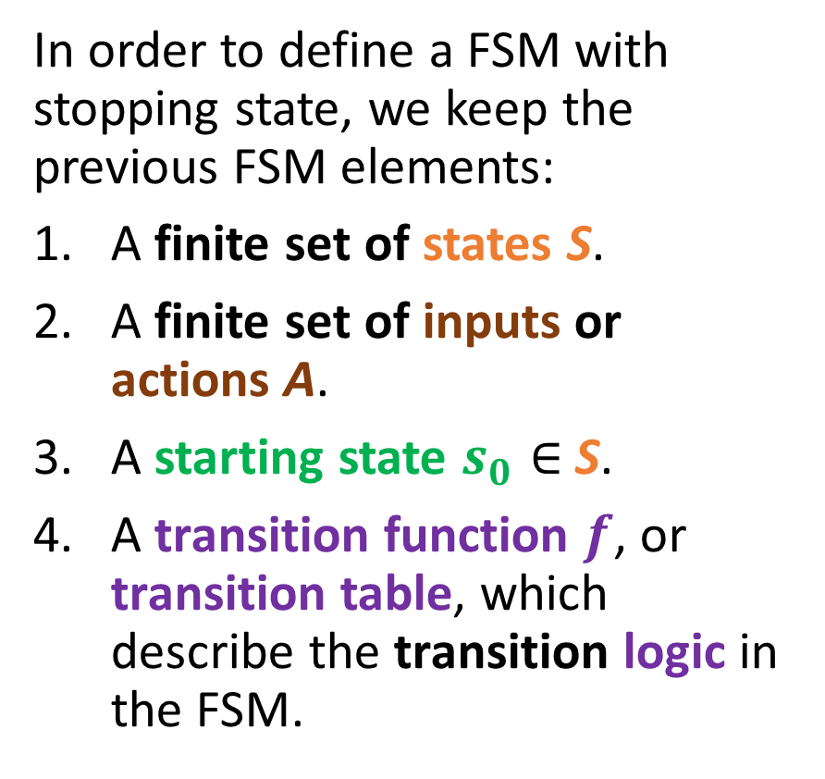
Elements of an FSM with stopping states
In order to define a FSM with stopping state, we keep the previous FSM elements:
A finite set of states S.
A finite set of inputs or actions A.
A starting state $s_{0}∈$S.
A transition function $f$, or transition table, which describe the transition logic in the FSM.
Start
0
1
0
1
0
1
1
0

Slide 28
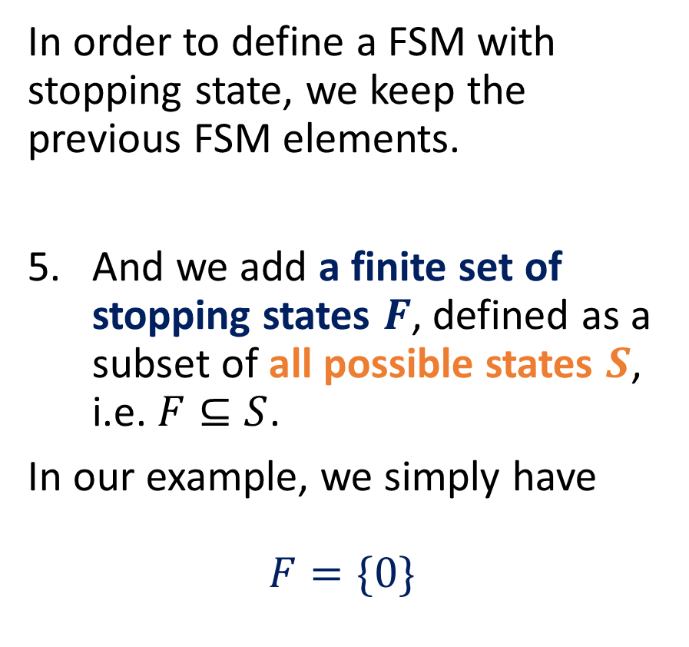
Elements of an FSM with stopping states
In order to define a FSM with stopping state, we keep the previous FSM elements.
And we add a finite set of stopping states $F$, defined as a subset of all possible states $S$, i.e. $F⊆S$.
In our example, we simply have
$$F=\{0\}$$
Start
0
1
0
1
0
1
1
0

Slide 29
Practice 1: Analysing our example FSM
Question 1: Looking at the FSM state diagram on the right, what are the acceptable inputs x that our FSM is checking?
Question 2: If these binary strings now encode an int number, what numbers does this FSM consider as acceptable inputs?
Start
0
1
0
1
0
1
1
0

Slide 30
Practice 1: Analysing our example FSM
Question 1: Looking at the FSM state diagram on the right, what are the acceptable inputs x that our FSM is checking?
Answer: We need to end on a final state being 0. In our case, this means that an acceptable string s simply consists of any binary string that ends with 0.
Start
0
1
0
1
0
1
1
0

Slide 31
Practice 1: Analysing our example FSM
Question 2: If these binary strings now encode an int number, what numbers does this FSM consider as acceptable inputs?
Answer: We need the bit of least importance to be 0. This means that the integer number input represented by the string s needs to be even to be acceptable.
Start
0
1
0
1
0
1
1
0

Slide 32
Practice 2: a simple FSM for word recognition
We would like to write an FSM with stopping states that will take strings x consisting of combinations of four characters: S, U, T and D.
Possible combinations for the string x include, among many others, “USD”, “SUUUUTD”, and the only acceptable input “SUTD”.
Draw a FSM state diagram, which:
Has 6 possible States (Start, S, U, T, D, Invalid),
Has 4 possible Actions (S, U, T, D),
Has the Start state defined as the starting state,
Has the D state defined as the only stopping state,
Has the FSM stop in this state D, if and only x is exactly “SUTD”; otherwise, it stops in another state (Invalid or something else).

Slide 33
Elements of an FSM with outputs
In general, outputs with stopping or accepting states are useful, but limited in terms of applications.
A stronger version of the FSM consists of the FSM with outputs.
It simply replaces the stopping states with outputs being produced every time an action is taken.
Start
0
1
0
1
0
1
1
0

Slide 34

Elements of an FSM with outputs
In order to define a FSM with outputs, we keep the previous FSM elements:
A finite set of states S.
A finite set of inputs or actions A.
A starting state $s_{0}∈$S.
A transition function $f$, or transition table, which describe the transition logic in the FSM.
Start
0
1
0
1
0
1
1
0

Slide 35
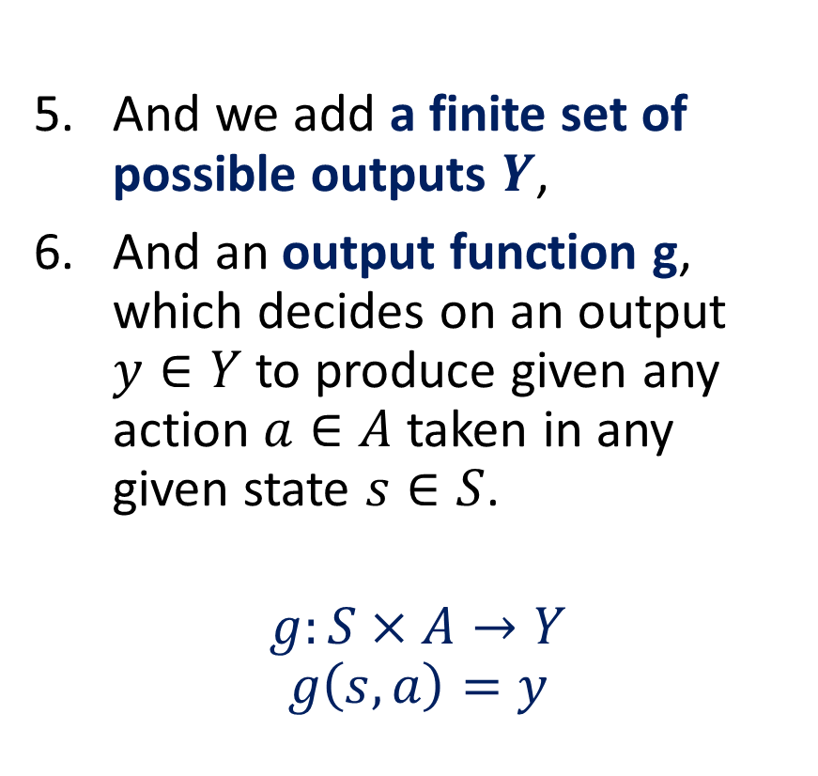
Elements of an FSM with outputs
And we add a finite set of possible outputs $Y$,
And an output function g, which decides on an output $y∈Y$ to produce given any action $a∈A$ taken in any given state $s∈S$.
$$g:S×A→Y$$
$$g\left(s,a\right)=y$$
Start
0
1
0
1
0
1
1
0

Slide 36
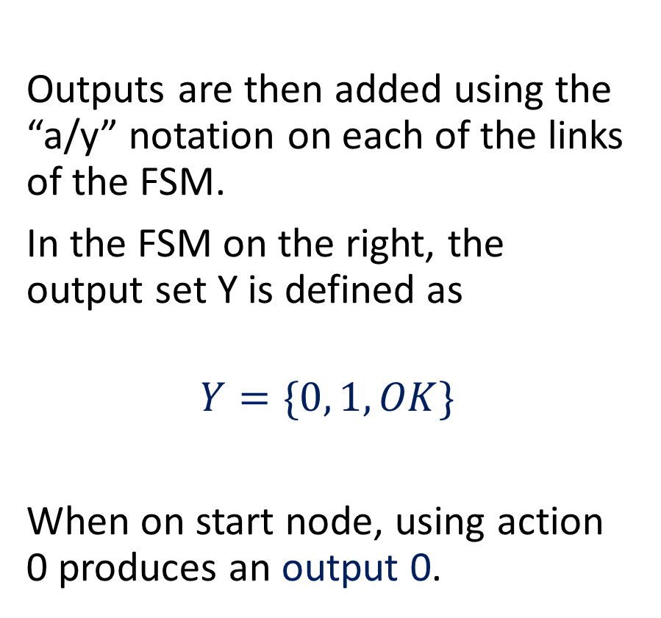
Elements of an FSM with outputs
Outputs are then added using the “a/y” notation on each of the links of the FSM.
In the FSM on the right, the output set Y is defined as
$$Y=\{0, 1, OK\}$$
When on start node, using action 0 produces an output 0.
Start
0/0
1/1
0/”OK”
1/1
0
1/1
1
0/0

Slide 37
Elements of an FSM with outputs
Could also define outputs in the form of a table of values to be produced if a given action a, is taken in a state s.
Similar to the transition table from earlier, which gave us the new state s’ if a given action a, is taken in a state s.
Start
0/0
1/1
0/”OK”
1/1
0
1/1
1
0/0

Slide 38
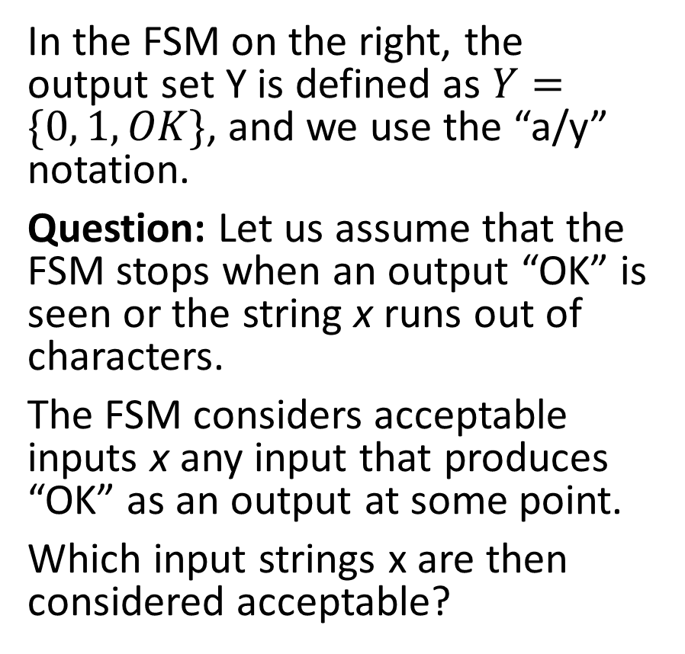
Practice 3
In the FSM on the right, the output set Y is defined as $Y=\{0, 1, OK\}$, and we use the “a/y” notation.
Question: Let us assume that the FSM stops when an output “OK” is seen or the string x runs out of characters.
The FSM considers acceptable inputs x any input that produces “OK” as an output at some point.
Which input strings x are then considered acceptable?
Start
0/0
1/1
0/”OK”
1/1
0
1/1
1
0/0

Slide 39
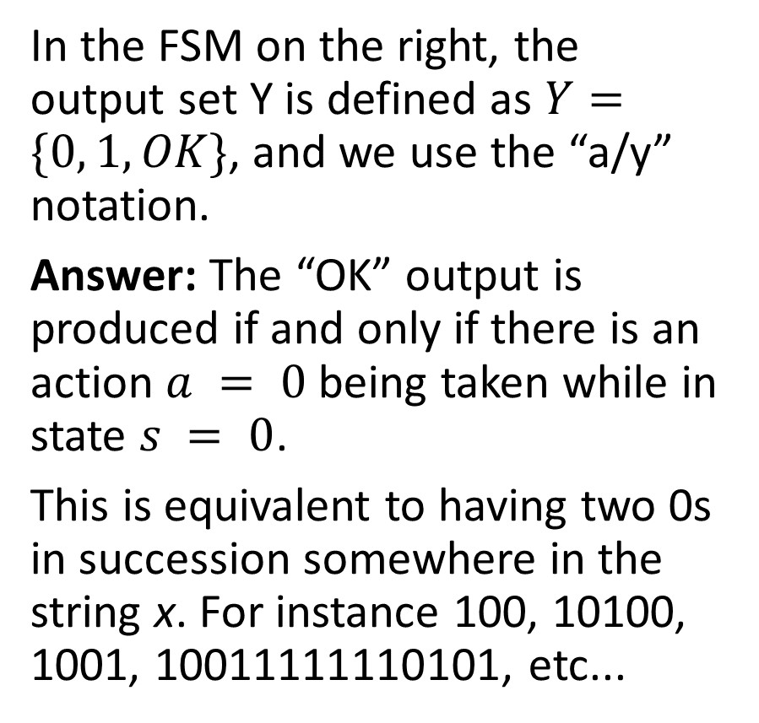
Practice 3
In the FSM on the right, the output set Y is defined as $Y=\{0, 1, OK\}$, and we use the “a/y” notation.
Answer: The “OK” output is produced if and only if there is an action $a = 0$ being taken while in state $s = 0$.
This is equivalent to having two 0s in succession somewhere in the string x. For instance 100, 10100, 1001, 10011111110101, etc...
Start
0/0
1/1
0/”OK”
1/1
0
1/1
1
0/0

Slide 40
Practice 4
Consider a vending machine and describe it as a FSM with outputs.
It takes three possible actions.
“0.5”: insert a 50 cents coin,
“1”: insert a 1 dollar coin,
“B”: press the machine button.
It also has four possible outputs:
“0.5”: give back a 50 cent coin to the user,
“1”: give back a 1 dollar coin to the user,
“B”: give a chocolate bar to the user,
“N”: do nothing.

Slide 41
Practice 4
We would like to define a vending machine that has the following logic.
Whenever a coin is inserted by the user, the total balance is updated (can be represented as a state of some sort?).
If the user has inserted 1.5 dollars in total and presses the button, a bar will be given and the balance will return to 0.
If the user presses the button but the balance is not yet 1.5 dollars, nothing happens.
If the user inserts a coin and the new balance exceeds the maximal allowed balance of 1.5 dollars, then the machine will return the last coin the user has inserted.
Question: What could the possible states for this FSM be? Draw a state diagram for this FSM.

Slide 42
More advanced FSMs?
Many variations to the state machines we have describe exist.
For instance,
Deterministic Finite State Machines (DFSMs): A deterministic finite state machine is a mathematical model used to represent a system that has a finite number of states and can transition between those states based on input.
It is basically another name for the FSMs (with no outputs) we have been playing with.

Slide 43
More advanced FSMs?
Many variations to the state machines we have describe exist.
For instance,
Mealy Machines: A Mealy machine is a finite state machine where the output is dependent on both the current state and the input. That is basically another name for our FSM with outputs!
Moore Machines: A Moore machine is a finite state machine where the output is dependent only on the current state. A special case of the Mealy machine.

Slide 44
More advanced FSMs?
Many variations to the state machines we have describe exist.
For instance,
Non-Deterministic Finite State Machines (NDFSMs): In a non-deterministic finite state machine, the machine can transition from one state to multiple states based on the input. This means that there can be multiple possible paths through the machine for a given input.
Clearer with an example.

Slide 45
More advanced FSMs?
As an example of a NDFSM, let us go back to our vending machine.
The NDFSM for this vending machine could have multiple paths, depending on the coins the user inserts and the order in which they are inserted.

Slide 46
More advanced FSMs?
Many variations to the state machines we have describe exist.
For instance,
Stochastic Finite State Machines (SFSMs): A stochastic finite state machine is a model used to represent a system that has a finite number of states, but where the transitions have randomness aspects included. This means that there will be probabilities of transitioning between states.

Slide 47
More advanced FSMs?
As an example of a SFSM...
Suppose we have a game where two players take turns.
On their turn, each player rolls a dice and moves their game piece forward a number of spaces equal to dice roll.
The game board has 20 spaces numbered 1 through 20, and the player wins if they reach space 20.
The transitions between the states are then determined by the probabilities of the dice rolls.
From the Start state, the machine transitions to the next state with equal probability corresponding to rolling a value between 1 and 6.
This SFSM can be used to simulate the game and determine the probabilities of the first player winning (this player starts and should probably have the advantage over the second player).

Slide 48
Practice 5
We would like to write an FSM with stopping states and no outputs that will take strings x consisting of combinations of four characters: Z, A, and M.
Possible combinations include “MAZ”, “AMAZ” and the only acceptable input “ZAMZAM”. The string “ZAMZAMZAMZAM” is not valid.
Draw a FSM state diagram, which:
Has possible States, which you are free to decide,
Has 3 possible Actions (Z, A, M),
Has the Start state defined as the starting state,
Has one stopping state,
Has the FSM stop in this state, if and only x is exactly “ZAMZAM”; otherwise, it stops in another state.

Slide 49
Practice 6
We would like to write an FSM with stopping states and no outputs that will take strings x consisting of combinations of four characters: Z, A, and M.
Possible combinations include “MAZ”, “AMAZ” and the only acceptable input “ZAMZAM”.
Draw a FSM state diagram, which:
Has possible States, which you are free to decide,
Has 3 possible Actions (Z, A, M),
Has the Start state defined as the starting state,
Has one stopping state,
Has the FSM stop in this state, if and only x contains the string “ZAM”; otherwise, it stops in another state.

Slide 50
Practice 7
How would you modify this FSM with stopping state, so that it considers as acceptable inputs any string x of 0 and 1, that have an even number of zeroes?
Start
0
1
0
1
0
1
1
0

Slide 51
Practice 8
Design an FSM that detects whether a binary input string x has an alternating bit pattern (e.g., "01010101" or "10101010").
The FSM should end in an accepting state if and only if the input string follows an alternating pattern.

Slide 52
Practice 9
Let us go back to the Practice 4 – Vending Machine example.
Question: What if we wanted for the machine to keep track of any amount of money we would have inserted and return the change only after the button has been pressed?
Could this be represented with a simple FSM?

Slide 53
Practice 10 (Final boss for today)
Create an FSM that accepts a string input x and checks if it meets specific password criteria, define below.
It should have at least a minimum length of 8,
At least one uppercase letter,
At least one lowercase letter,
And at least one digit.
The FSM should end in an "accepted" state if and only if the input string meets all the criteria.

