Slide 1

50.051 Programming Language Concepts W9-S3 Tokenization (Part 1)
Matthieu De Mari

Slide 2
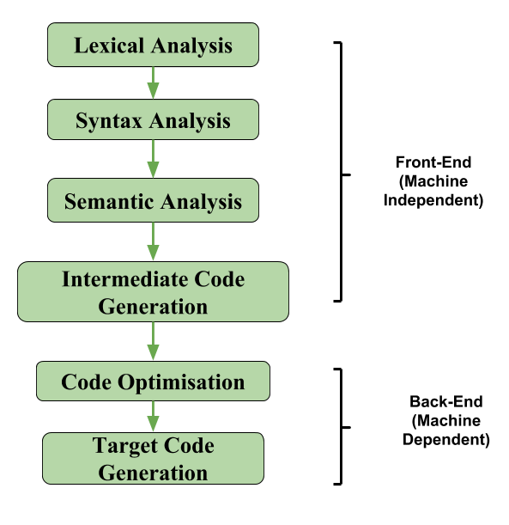
The front-end of a compiler
Definition (The front-end part of a compiler):
The front-end of a compiler is responsible for analysing the source code, and converting it into a form that can be used by the rest of the compiler.
It involves tasks, such as:
Lexical analysis,
Syntax analysis,
and Semantic analysis.

Slide 3
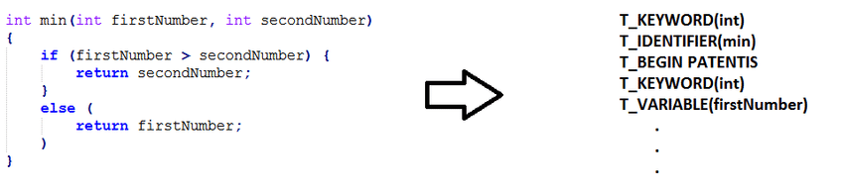
Lexical Analysis
Definition (Lexical Analysis):
During lexical analysis, the source code is broken down into tokens, which represent the individual components of the language.
It is sometimes referred to as scanning or tokenization.
KEYWORD (int)
IDENTIFIER (min)
PUNCTUATION (open_par)
KEYWORD (int)
VARIABLE (firstNumber)
…

Slide 4
Lexical Analysis
Definition (Tokens):
Tokens are the smallest individual units of a programming language that the compiler can recognize and understand. A token is a sequence of characters that has a specific meaning in the language, such as a keyword, identifier, operator, or punctuation symbol.
Keyword: A keyword is a reserved word in a programming language that has a special meaning and cannot be used as an identifier.
Examples of keywords in the C programming language:
int, double, long, ...
if, else, while, …
return, ...
etc.

Slide 5
Lexical Analysis
Definition (Tokens):
Tokens are the smallest individual units of a programming language that the compiler can recognize and understand. A token is a sequence of characters that has a specific meaning in the language, such as a keyword, identifier, operator, or punctuation symbol.
Identifier: An identifier is a name given to a variable, function, or other entity in a program. Will follow rules, such as starting with a letter or underscore and consisting of letters, digits, and underscores.
Examples of identifiers:
x, counter, variable_1,
myFunction,
etc.

Slide 6
Lexical Analysis
Definition (Tokens):
Tokens are the smallest individual units of a programming language that the compiler can recognize and understand. A token is a sequence of characters that has a specific meaning in the language, such as a keyword, identifier, operator, or punctuation symbol.
Literal: A value of some sort to be assigned to a variable.
Examples of literals in the C programming language:
12542
12654165.52
“hello”
Etc.

Slide 7
Lexical Analysis
Definition (Tokens):
Tokens are the smallest individual units of a programming language that the compiler can recognize and understand. A token is a sequence of characters that has a specific meaning in the language, such as a keyword, identifier, operator, or punctuation symbol.
Operator: An operator is a symbol that performs a specific operation on one or more values.
Examples of operators in the C programming language:
+, -, *, /,
=,
&&,
etc.

Slide 8
Lexical Analysis
Definition (Tokens):
Tokens are the smallest individual units of a programming language that the compiler can recognize and understand. A token is a sequence of characters that has a specific meaning in the language, such as a keyword, identifier, operator, or punctuation symbol.
Punctuation symbol: A punctuation symbol is a symbol used to separate or group different parts of a program
Examples of punctuation symbols in the C programming language
Braces {} and parentheses ()
Commas, semicolons,
Quotation marks,
Etc.

Slide 9
Steps for Lexical Analysis
Definition (Steps for Lexical Analysis):
During lexical analysis, the compiler reads the source code character by character and identifies each token.
It does so, based on its position and context within the code.
The compiler also uses a set of rules or patterns called regular expressions (something for Week 9), to recognize different types of tokens, such as keywords, identifiers, operators, and punctuation symbols.
Once the compiler has identified the tokens, it assigns each token a specific type/category, based on its role and meaning in the program.

Slide 10
First assumptions for our tokenizer
To keep things simple, we will make basic assumptions about the source code to be tokenized and how it has been written.
Some of them might be unrealistic, but we will relax them later on.
White spaces between all tokens, so that we can use a simple split operation using whitespaces and \n symbols as separators, to produce all the substrings to be analysed and used as tokens. We will eventually relax this constraint later on.
Start with basic tokens, e.g. keywords only. Later on, we will add new token types, starting with simple punctuations/operators (+ * - / ;), and then identifiers/literals.
No comments or include/pre-processing operations for now.

Slide 11
Scanning the source code, step by step
In this example, we demonstrate how to read a source code string from a source file named "source.c“. For instance, the code could simply consist of
int x = 1023 ;
Or
int while for if return intwhile
We use simple file I/O operations, as described on the right.
Open the file with fopen().
Find the file size by seeking to the end and getting the current position with ftell().
Rewind the file position to the beginning with rewind().
Allocate memory for the source code string.
Read the content of the file into the string with fread().
Null-terminate the string.
Close the file with fclose().

Slide 12
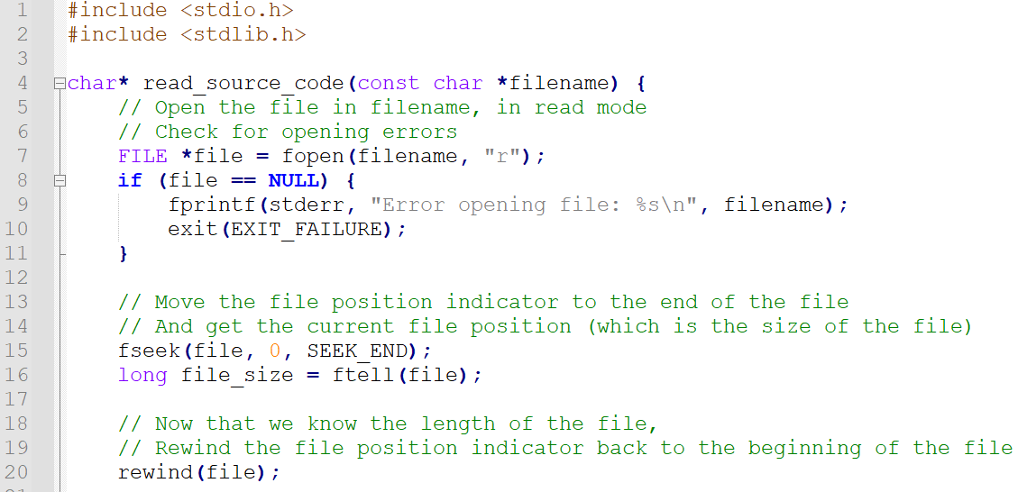
From Code files/1.

Slide 13
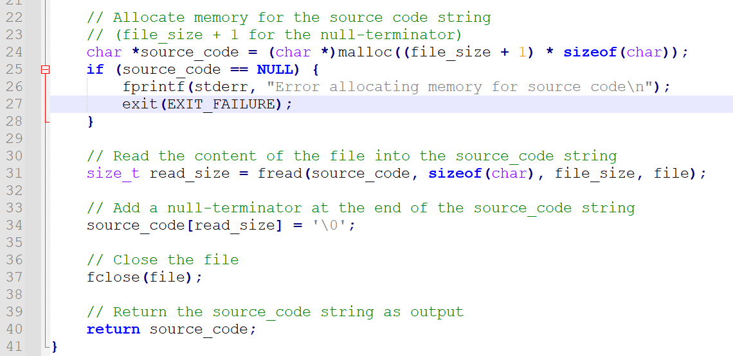

Slide 14
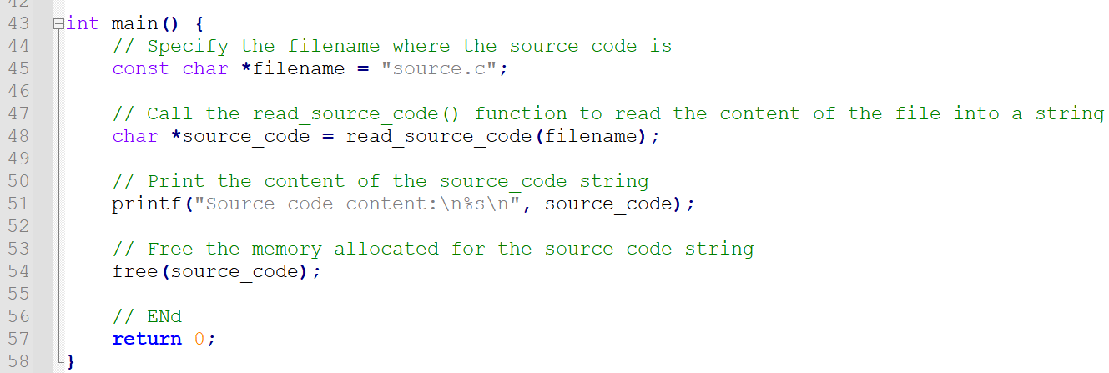


Slide 15
Defining a token object
So far,
We have a function that reads source code from an external file and stores the code in a string. Later on, we will split this string of code using whitespaces and \n symbols as separators.
It will decompose the source code string into lexemes, i.e. substrings of the source code corresponding to the different elements of the source code.
These lexemes then need to be classified as keywords, identifiers, literals, operators or punctuation.
int x = 1023 ;
“int”, “x”, “=“, “1023”, “;”

Slide 16
Defining a token object
Speaking of, we need to define Token Types (keyword, operators, etc.)
For simplicity, use an enumeration for different token types and list them with explicit names, in order.
Start simple, with KEWORD, IDENTIFIER, NUMBER, OPERATOR and UNKNOWN Token Types.
TOKEN(KEYWORD_INT, “int”), TOKEN(IDENTIFIER, “x” ), TOKEN(OPERATOR_ASSIGN, “=“), TOKEN(LITERAL_INT, “1023” ), TOKEN(END_OF_LINE, “;” )
“int”, “x”, “=“, “1023”, “;”

Slide 17
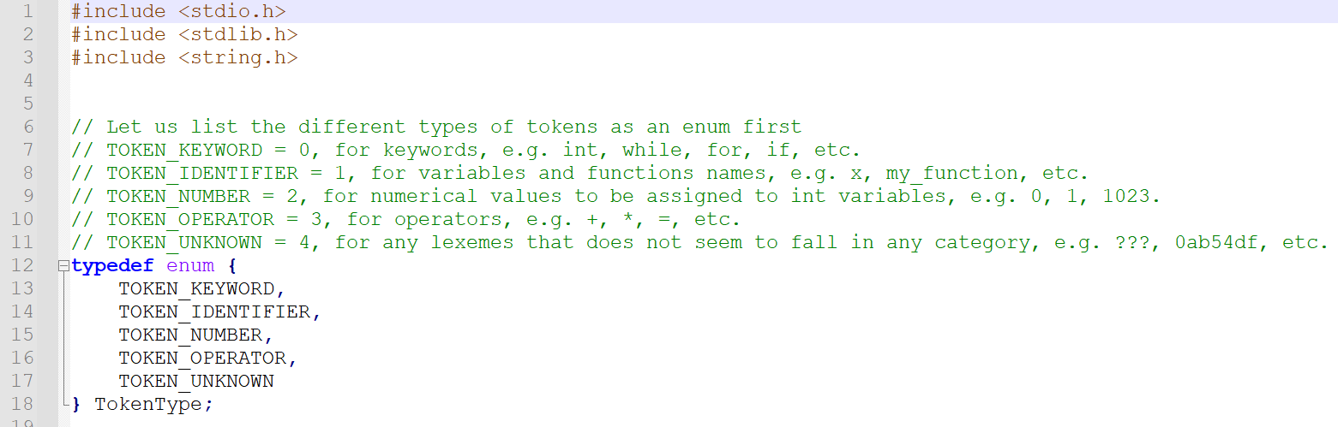
From Code files/2.

Slide 18
Defining a token object
Then, we need to define a Token object.
For simplicity, let us define a struct Token.
It will hold the token type and the lexeme for each of the substrings we have defined after the split.
For good practice we will also define a constructor function create_token() and a destructor function free_token() for these TokenType variables.

Slide 19
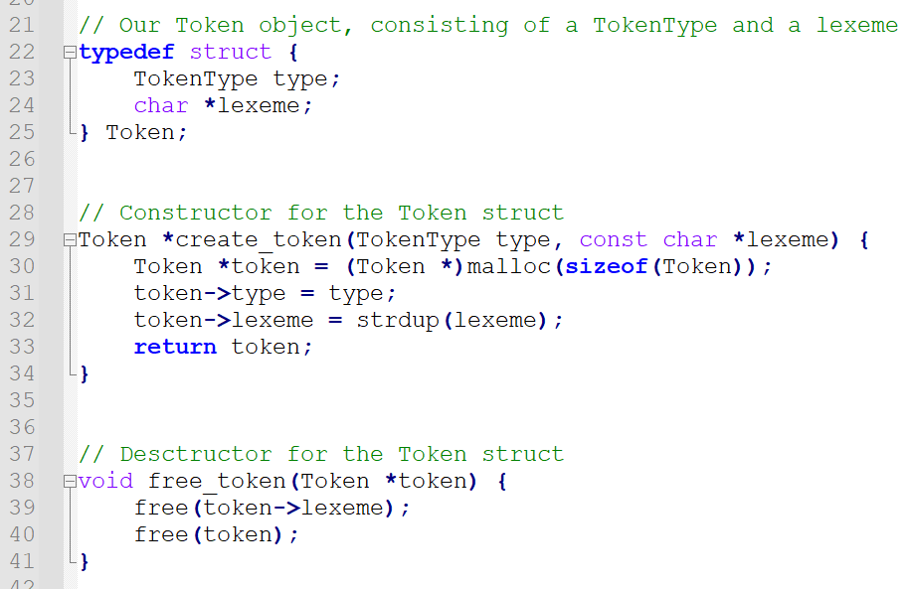

Slide 20
Using the Token object
In the main() function,
We start by defining an array of sample lexemes for each token type,
We then iterate through the TokenType enumeration,
Create tokens using the create_token() function,
And print the token information.
After printing the information, we free the memory allocated for the tokens using the free_token() function.
Important: at the moment, we are not yet able to recognize the Token types correctly! (That will be our next step!)

Slide 21
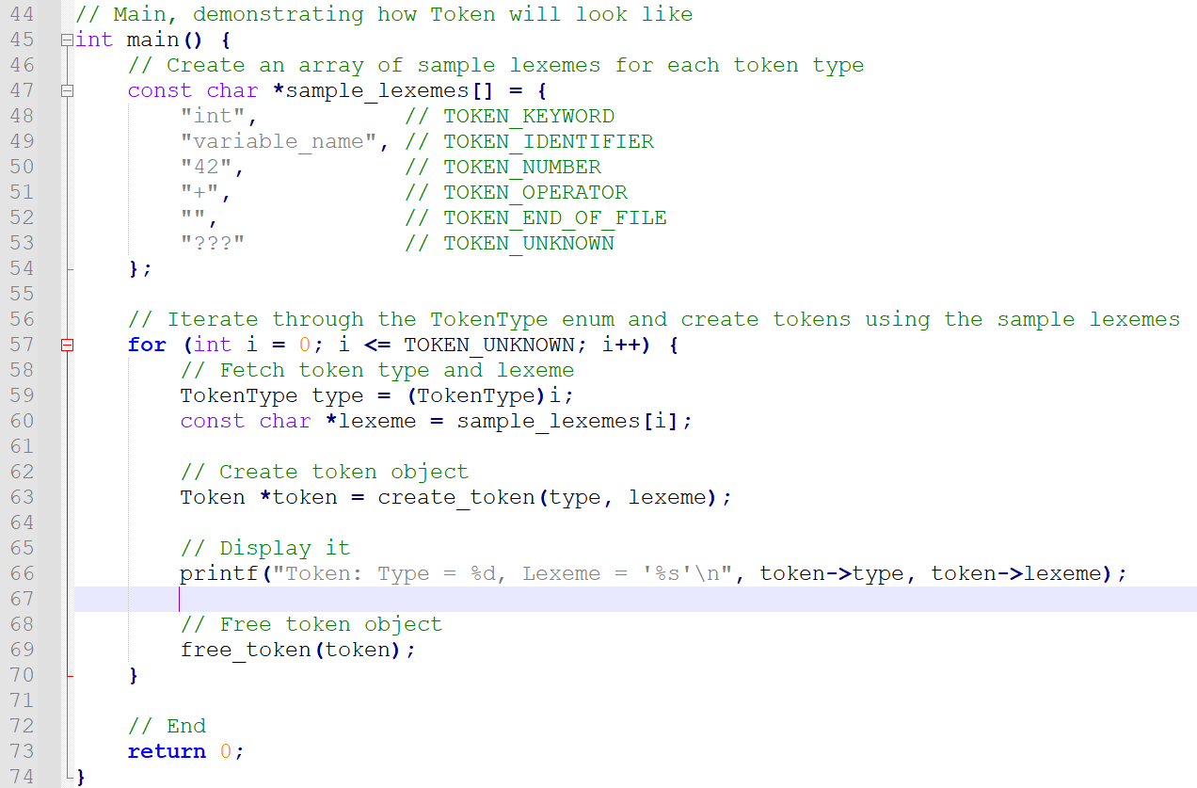
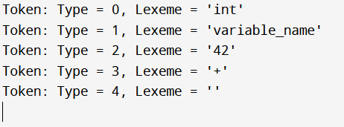

Slide 22
Recognizing Token Types for given Lexemes
Our next step is then to logically write functions that will recognize the Token Type of a given lexeme.
We need a function that receives a lexeme as input,
Checks if the lexeme matches the pattern of a given category,
And if it does, creates a Token entry with the TokenType that has been recognized and the given lexeme.

Slide 23
Recognizing Token Types for given Lexemes
Let us begin with the simplest Token Type to recognize: Keywords.
A lexeme x will be recognized as a Keword Token Type if and only if there is an exact match between the lexeme x and one of the possible keywords of C (“int”, “while”, “if”, “for”, “return”, etc.).
This means that we need to know about the full list of keywords to recognize in the C language.
Also, as a side note, this explains why keywords are reserved and cannot be used for variable names/functions in many programming languages.

Slide 24
Recognizing Token Types for given Lexemes
As we have seen earlier in a Practice activity,
This could be done with a simple FSM, which considers as acceptable inputs x the exact string “SUTD”, and nothing else.
As seen in the previous lecture, this FSM is exactly what happens behind the scenes for to the RegEx “^SUTD$”.
We start by implementing a Keyword recognition function, based on RegEx, and consider some of the possible keywords to demonstrate.
Our RegEx: “^(int|while|for|if|return)$”
(Normally, we should list waaay more keywords, but let us keep it simple.)

Slide 25
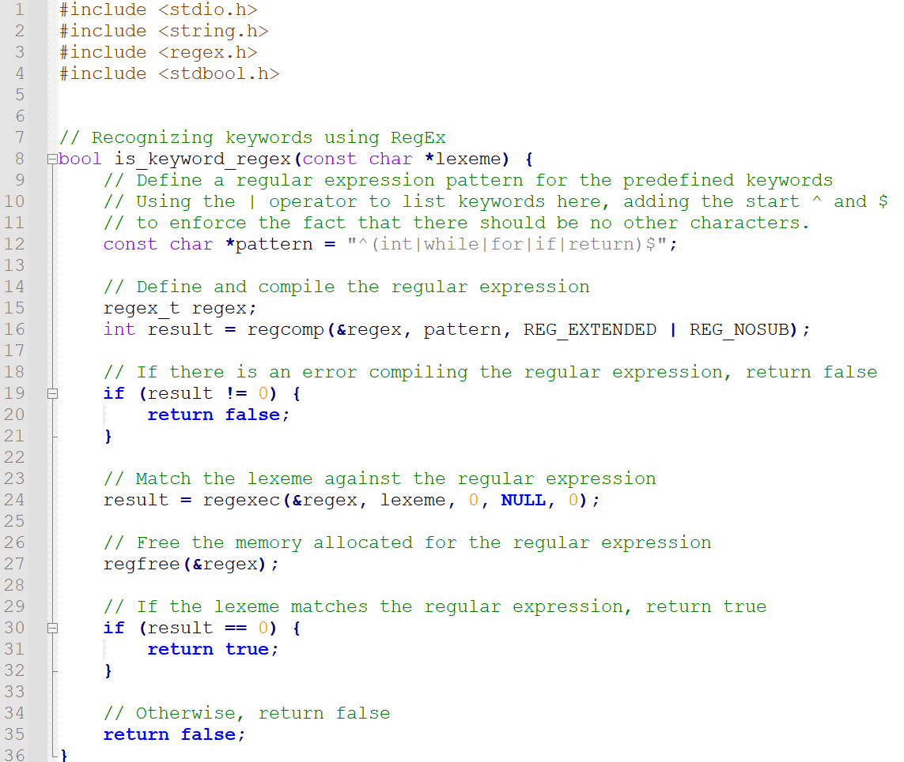
From Code files/3.

Slide 26
Recognizing keywords using strcmp
Since we are comparing strings and looking for exact matches here, we could also consider an alternate implementation,
Using strcmp(),
To compare our lexeme x
To all the possible keywords of the language that we would have previously assembled in a list.
(But to be honest, these strcmp() operations would be roughly similar to an FSM of some sort anyway, so not a big difference…)

Slide 27
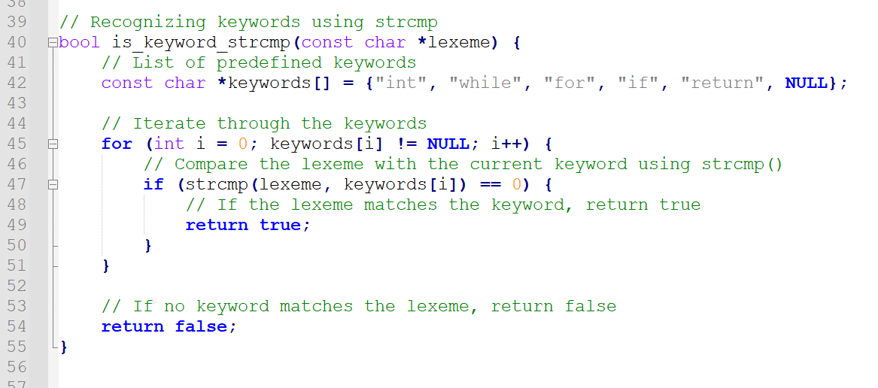

Slide 28
Strcmp vs. RegEx
In practice, we should prefer the strcmp() implementation over the RegEx, here.
Using regular expressions for this specific “exact match” case might be less efficient than using a strcmp() implementation.
Especially considering that the number of keywords is small and they have a simple structure.
Keep in mind, however, that regular expressions will be required for more complex token recognition tasks, such as recognizing identifiers or literals with specific patterns.
Either way, let us assemble and try to recognize keywords lexemes.

Slide 29
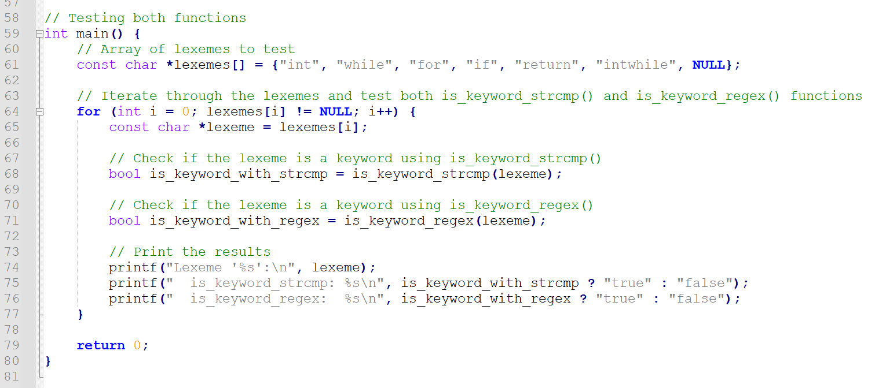

Slide 30
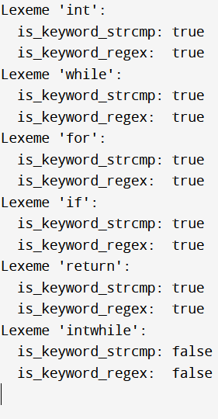

Slide 31
Our first Tokenizer
Let us assemble everything we have so far
A code that reads the code in a source.c file and puts it in a big string,
A code that splits the big string into lexemes, using whitespaces and \n symbols as separators.
An enum structure for storing the different TokenTypes,
A Token struct to store each lexeme and TokenType corresponding to the lexemes,
A code that can recognize if a lexeme is a KEYWORD or if it should be considered an UNKNOWN Token Type instead,
A code that repeats this operation for each lexemes and creates Tokens accordingly

Slide 32
Our first Tokenizer
Let us assemble everything we have so far
A code that reads the code in a source.c file and puts it in a big string,
A code that splits the big string into lexemes, using whitespaces and \n symbols as separators.
An enum structure for storing the different TokenTypes,
A Token struct to store each lexeme and TokenType corresponding to the lexemes,
A code that can recognize if a lexeme is a KEYWORD or if it should be considered an UNKNOWN Token Type instead,
A code that repeats this operation for each lexemes and creates Tokens accordingly
Let us assemble everything now!

Slide 33
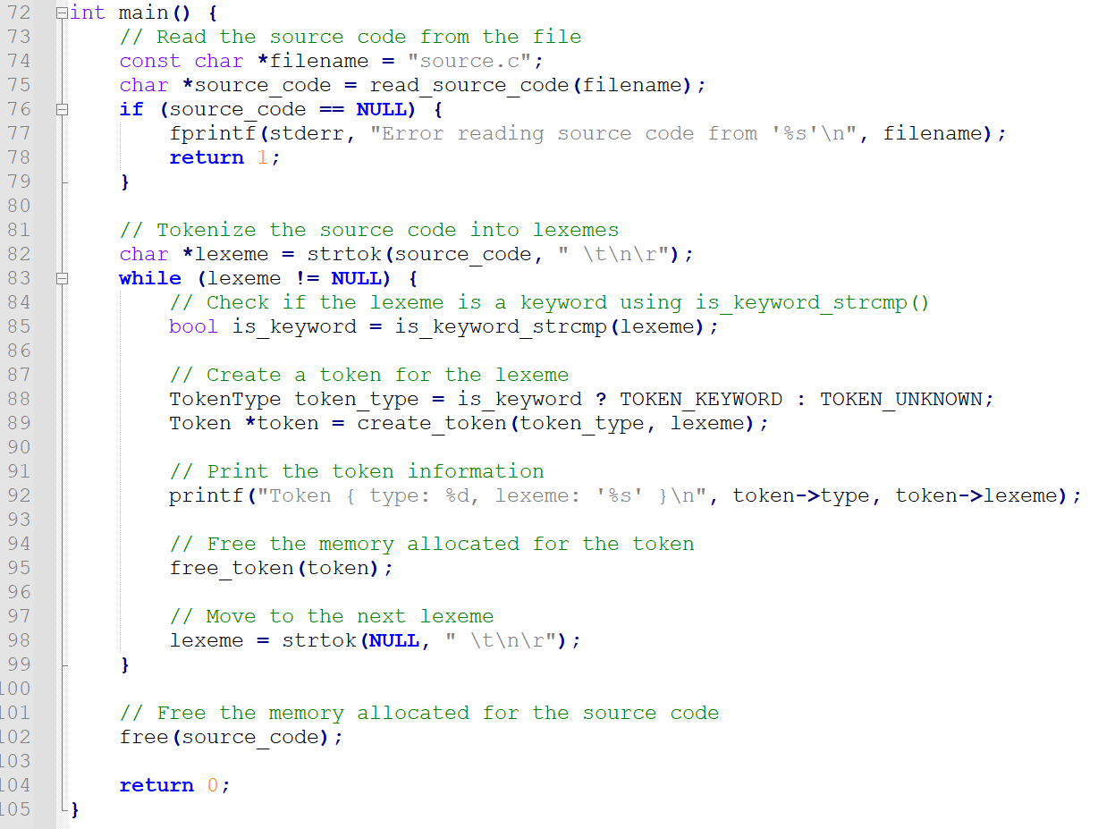
From Code files/4.

Slide 34
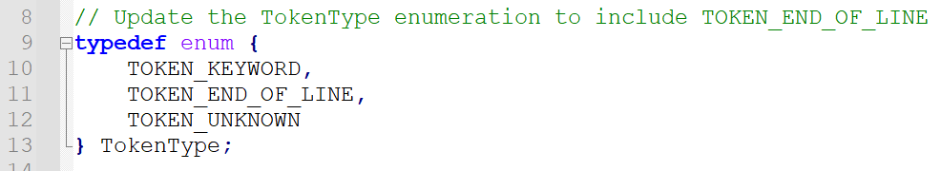
Recognizing Punctuation
Our next step will be to recognize punctuation, for instance the “;” used at the end of each line.
Technically, this is identical to recognizing keywords, except that we look for a match with the string “;” instead of – say – “int”.
This can be easily implemented by
Adjusting the Token Types to include a TOKEN_END_OF_LINE type,

Slide 35
Recognizing Punctuation
Our next step will be to recognize punctuation, for instance the “;” used at the end of each line.
Technically, this is identical to recognizing keywords, except that we look for a match with the string “;” instead of – say – “int”.
This can be easily implemented by
Adjusting the Token Types to include a TOKEN_END_OF_LINE type,
We again use a strcmp() operation to check if the lexeme exactly matches “;” ,
And if so, we will create a Token accordingly,
Otherwise check if it is a KEYWORD or UNKNOWN Token like before.

Slide 36
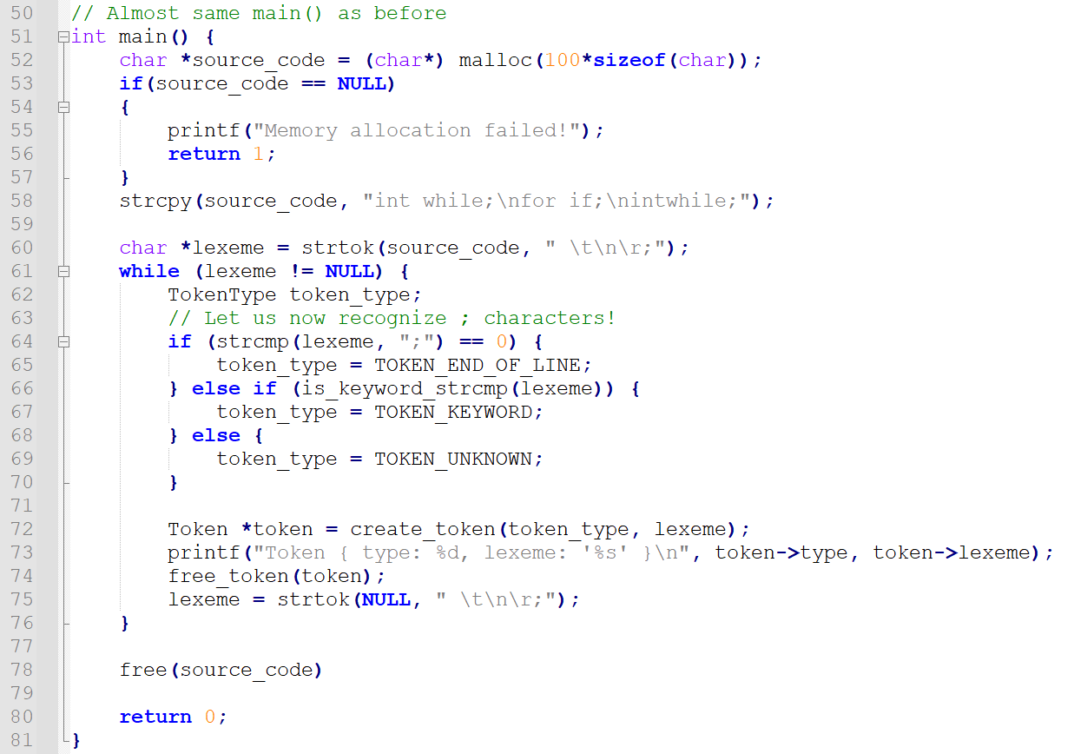

Slide 37
Quick question, why do we need ; anyway?
In C, the semicolon (;) typically serves as a statement delimiter, indicating the end of a statement or line.
It must be used and cannot be omitted, or the compiler will crash.
At the moment, we suspect that this will help the compiler to understand the structure of the code and determine where each statement begins and ends.
If C did not require semicolons, it would still be possible for a compiler to process the code, but the language would need to be designed differently, and additional rules would have to be introduced to determine the end of a statement (e.g. Python relies on indentation).

Slide 38
Quick question, why do we need ; anyway?
To be honest, the semicolon symbol does not significantly affect the tokenization process.
The sole purpose of the tokenizer is to break the input source code into individual lexemes,
Recognize the types of these lexemes and create Tokens with the appropriate types accordingly,
And the tokenizer does so, regardless of whether the syntax makes sense or not,
(I mean “int for while if return intwhile” seriously?)
And whether each line correctly finishes with semicolons or not.

Slide 39
Quick question, why do we need ; anyway?
The semicolon, however, serves as a statement delimiter, which will help the PARSER (our next step after tokenization) to correctly identify and group statements in the code.
This will typically allow the compiler to understand the structure of the code, distinguish between different statements, and later identify any syntax errors.
The semicolon symbol (;) then plays a crucial role in the PARSING phase by helping the compiler to correctly understand and represent the structure of the code.
But this SYNTAX analysis comes later, and it is not the job of the LEXICAL analysis (or TOKENIZATION) part.

Slide 40
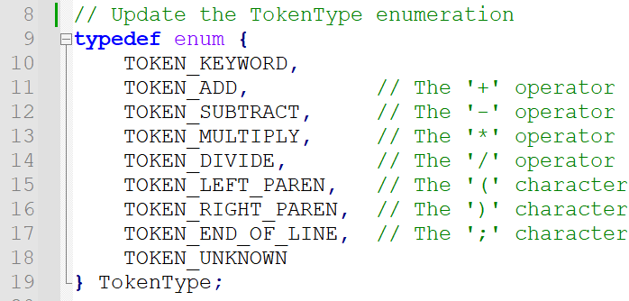
Recognizing additional punctuation/operators
As with the “;” symbol, most
punctuation signs (curly braces, parentheses, etc.)
or operators (e.g. “+”, “-”, “*”, “/”, etc.)
will consist of a single special character
We can then create Token Types for each of these operators, as before.

Slide 41
Quick question
Shall we use a single Token Type TOKEN_OPERATOR for all operators; or should we make more categories of Token Types (TOKEN_ADD, MULT, SUB, DIV, etc.)? Same thing for KEYWORDs and PUNCTUATION.
Some compilers may indeed use separate token types for each operator, as shown in the previous example.
However, other compilers might choose to use a single TOKEN_OPERATOR type instead, which will simplify the tokenization process, but may require additional work during the parsing to determine the specific type of operator.
This approach can be more efficient and flexible, as it reduces the number of distinct token types and allows the parser to handle various operators based on context.

Slide 42
Fair enough, what does GCC do then?
GCC uses a the most generic approach of the two and tends to categorize operators under a single token type TOKEN_OPERATOR.
It will later use the lexeme information to differentiate between them during the parsing phase.
For simplicity however, we will assume that different types of tokens will be implemented.
(This means, we should technically go back and define more Token Types for keywords, such as TOKEN_KEYWORD_INT, TOKEN_KEYWORD_WHILE, etc.)

Slide 43
Back to our additional punctuation/operators
As with the “;” symbol, most
punctuation signs (curly braces, parentheses, etc.)
or operators (e.g. “+”, “-”, “*”, “/”, etc.)
will consist of a single special character
We can then create Token Types for each of these operators, as before.

Slide 44
Back to our additional punctuation/operators
Another quick note:
Checking that each opened parenthesis gets closed is NOT the job of the TOKENIZER.
Just like before with “;”, this falls under the SYNTAX analysis category.
And will therefore be the job of the PARSING phase.

Slide 45
Back to our additional punctuation/operators
Another quick note:
Checking that each opened parenthesis gets closed is NOT the job of the TOKENIZER.
Question: BTW, is there any RegEx that could check that any opened parenthesis in the string x has been closed?

Slide 46
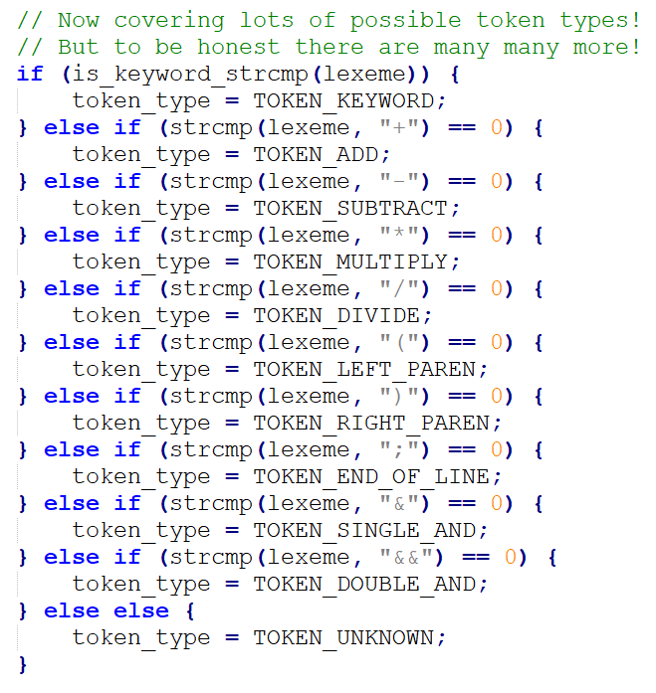
Found in main() function to match operators and additional punctuation symbols.
From Code files/6.

Slide 47
Recognizing identifiers
Identifier: An identifier is a name given to a variable, function, or other entity in a program.
In C, a valid identifier name should follow rules, such as
starting with a letter or underscore,
and consisting of letters, digits, and underscores.
Examples of valid identifiers:
x, counter, variable_1,
myFunction,
etc.

Slide 48
Recognizing identifiers
Is there a finite list of possible identifiers like for keywords, operators and punctuation signs?
No. And because of that reason, we cannot use a list of possible strings to match and a strcmp() method like before. We have no other choice, but to rely on RegEx to transcribe the grammar rules for identifiers.
Start with a letter or underscore,
and consist of letters, digits, and underscores (or what we called word characters earlier \w).

Slide 49
Recognizing identifiers
Is there a finite list of possible identifiers like for keywords, operators and punctuation signs?
No. And because of that reason, we cannot use a list of possible strings to match and a strcmp() method like before. We have no other choice, but to rely on RegEx to transcribe the grammar rules for identifiers.
Start with a letter or underscore,
and consist of letters, digits, and underscores (or what we called word characters earlier \w).
Possible RegEx for identifiers:
“^[a-zA-Z_][a-zA-Z0-9_]*$” or “^[a-zA-Z_]\\w*$”

Slide 50
Quick note on \w and others in RegEx
The C RegEx library expects two escape characters to be used \\w (or any other similar notation like \\d, \\s, etc.).
This means that the \\w in the RegEx below is not a typo.
“^[a-zA-Z_]\\w*$”
In some other RegEx engines, a simple \w might do (so be careful!).
“^[a-zA-Z_]\w*$”

Slide 51
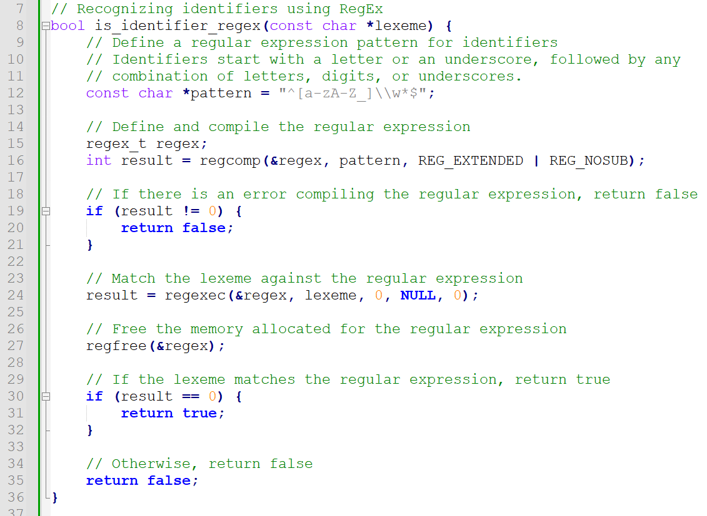
From Code files/7.

Slide 52
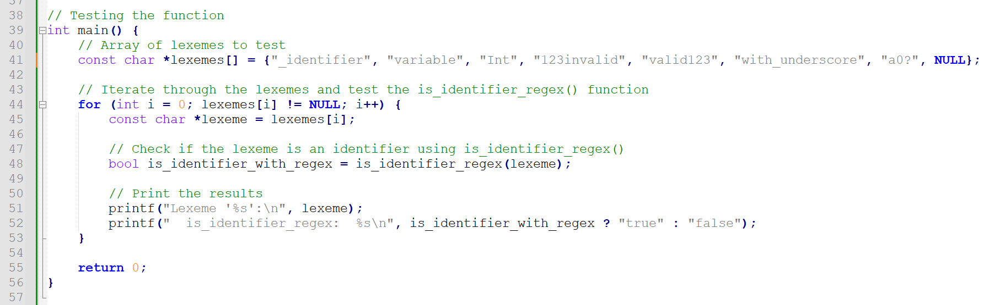

Slide 53
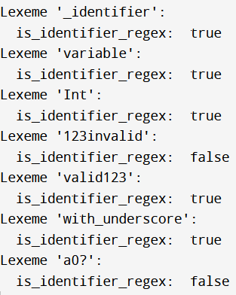

Slide 54
Recognizing literals
Literal: A value of some sort to be assigned to a variable.
Examples of literals in the C programming language:
12542
12654165.52
“hello”
Etc.

Slide 55
Recognizing integer literals
(Unsigned Integer) Literal: A numerical value of some sort to be assigned to an integer variable.
Examples of integer literals in the C programming language:
0, 42, 856841, Etc.
Examples of invalid integer literals in the C programming language:
-7
42.0
00123
0123followedbyletters

Slide 56
Recognizing unsigned integer literals
To recognize integer literals, we will have to rely on regular expression patterns to match
either a zero,
or a non-zero digit followed by a sequence of zero or more digits.
Possible RegEx for unsigned integer literals:
“^(0|[1-9][0-9]*)$” or “^(0|[1-9]\\d*)$”

Slide 57
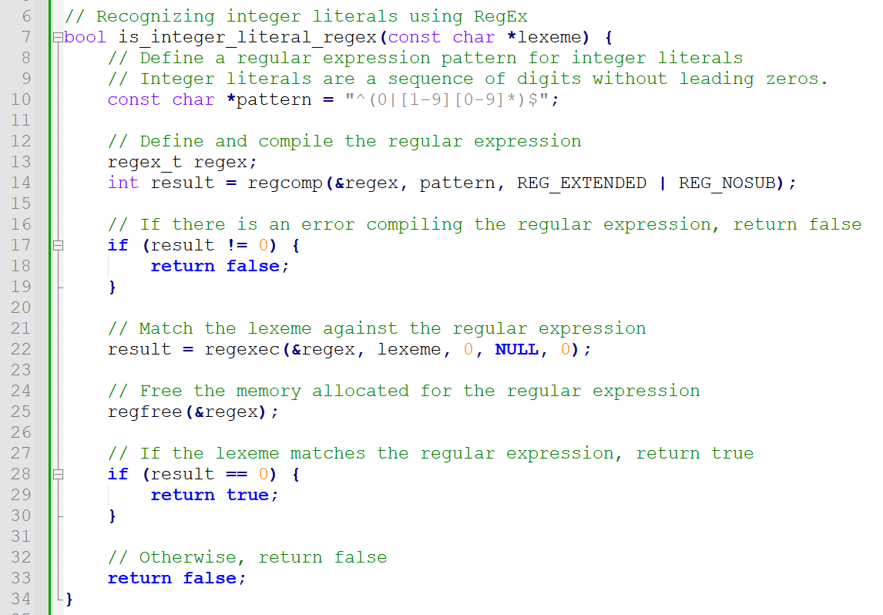
From Code files/8.

Slide 58
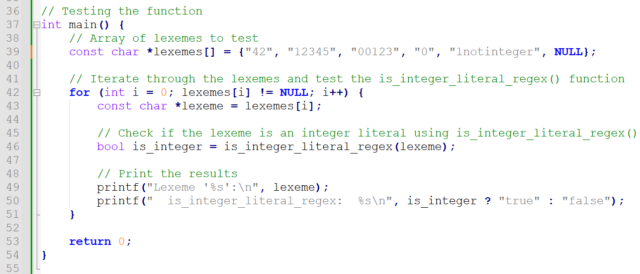

Slide 59
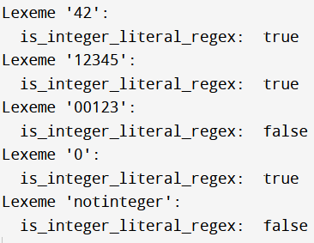

Slide 60
Practice: Recognizing more types of literals
Possible RegEx for unsigned integer literals:
“^(0|[1-9][0-9]*)$” or “^(0|[1-9]\\d*)$”
What would the RegEx look like if we wanted to recognize a signed float literal then?

Slide 61
Practice: Recognizing more types of literals
Possible RegEx for unsigned integer literals:
“^(0|[1-9][0-9]*)$” or “^(0|[1-9]\\d*)$”
What would the RegEx look like if we wanted to recognize a signed float literal then?
Valid: 0, 0.0, 7, -7, -4.25, +7.32, 147.687000, etc.
Invalid: 1.2.3, 03.14, 34t.023, 2.4f7, etc.

Slide 62
Practice: Recognizing more types of literals
Possible RegEx for unsigned integer literals:
“^(0|[1-9][0-9]*)$” or “^(0|[1-9]\\d*)$”
What would the RegEx look like if we wanted to recognize a signed float literal then?
“^[-+]?((0|[1-9]\\d*)(\\.\\d*)?)$”

Slide 63
Practice: Recognizing more types of literals
Possible RegEx for unsigned integer literals:
“^(0|[1-9][0-9]*)$” or “^(0|[1-9]\\d*)$”
What would the RegEx look like if we wanted to recognize a signed float literal then?
→ But what about exponential notations for signed float literals, e.g. 1e+5, 0.25e-17, etc.?
(Answer not provided, leaving it as a challenge!)

Slide 64
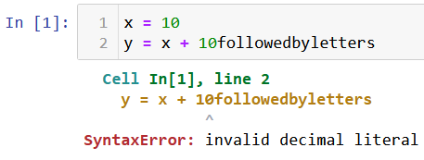
Additional information in Tokens
On top of the Token Type and lexeme, additional attributes could be added to the Token object, for instance:
The line number (which can be tracked by counting the number of \n that have been scanned during the splitting)
A positional index (indicating that the lexeme starts on position 7 of its line for instance).

Slide 65
Additional information in Tokens, and Errors!
This additional information could typically be used when an UNKNOWN token is recognized to produce an error message.
Python does that well, indicates the line at which the error occurred and – on the latest Python versions – might even indicate the location of the error using a ^ symbol.

Slide 66
Additional information in Tokens, and Errors!
These Error messages may in turn require more RegEx to recognize typical errors.
E.g. here, we are trying to add a decimal variable (x), with a literal reading as 10followedbyletters.
This 10followedbyletters lexeme violates the RegEx defined for int and float literals and gets caught.
The error message then displays that we have an “invalid literal”.

Slide 67
Additional information in Tokens, and Errors!
In some cases, it might even be worth writing a RegEx for recognizing a typical scenario of an invalid int literal!
For instance, RegEx for an invalid decimal literal that starts with at least one digit and is then followed by at least one non-digit character:
“^[0-9]+[^0-9]+”

Slide 68
Additional information in Tokens, and Errors!
Note: In some simple cases, this type of errors can be caught during tokenization.
And error messages can be implemented during Tokenization.
But most of the time, they will be caught by the Parser instead, during the Syntax Analysis step of the compilation (more on this later).

Slide 69
Conclusion
Let us call it a day for now. On the next lecture,
Conflict resolution in the case of ambiguous tokens that could be classified as more than one type.
Relaxing the hypothesis that all elements in code are nicely separated with whitespaces or \n symbols.
Error handling in the case of incorrect/unknown lexemes.
Recognizing and dropping comments
And more!

Slide 70
Quiz time!
What is the primary purpose of tokenization in compilers?
Parsing source code
Converting source code to machine code
Breaking source code into meaningful elements
Optimizing source code for performance

Slide 71
Quiz time!
What is the primary purpose of tokenization in compilers?
Parsing source code
Converting source code to machine code
Breaking source code into meaningful elements
Optimizing source code for performance

Slide 72
Quiz time!
Which of the following is NOT a typical step in tokenization?
Reading source code from a file
Identifying lexemes in the source code
Classifying tokens by type
Checking that each opening parenthesis is matching a closing parenthesis

Slide 73
Quiz time!
Which of the following is NOT a typical step in tokenization?
Reading source code from a file
Identifying lexemes in the source code
Classifying tokens by type
Checking that each opening parenthesis is matching a closing parenthesis (that would be the job of the SYNTAX analysis/PARSER)

Slide 74
Quiz time!
Which of the following is NOT a common token type in programming languages?
Keyword
Punctuation
Operator
Comment
Whitespace

Slide 75
Quiz time!
Which of the following is NOT a common token type in programming languages?
Keyword
Punctuation
Operator
Comment (We will not even bother writing tokens for code that has been commented!)
Whitespaces (?)

Slide 76
Quiz time!
Which of the following is NOT a common token type in programming languages?
Keyword
Punctuation
Operator
Comment (We will not even bother writing tokens for code that has been commented!)
Whitespace (We usually discard them, unless the language is Python, as they could use for indentation?)

Slide 77
If time allows, let us define our Tokenizer v1.0
Assemble all concepts from earlier to produce a Tokenizer v1.0, which:
Will receive a string “source.c” to indicate the name of the file to be tokenized.
Will read the code from the file and split it into lexemes assuming whitespaces and \n are used to separate all lexemes in code.
Will classify the lexemes, one at a time, and will create a Token struct for each lexeme, which will contain:
The TokenType,
The lexeme.
Eventually, will assemble all Token structs in an array of structs, which we are going to call our Tokens Stream, and is the output of the Tokenization task.

Slide 78
Tokenizer 1.0 → Tokenizer v1.1
Additional features of Tokenizer v1.1 (for extra challenge):
The Tokenizer should now use more token types.
Instead of having a single TOKEN_KEYWORD, it should have more Token types for keywords, such as TOKEN_KEYWORD_WHILE, TOKEN_KEYWORD_IF, etc.
Instead of a single TOKEN_OPERATOR, it should have TOKEN_OPERATOR_ADD, TOKEN_OPERATOR_MUL, etc.
Instead of a single TOKEN_PUNCTUATION, it should have TOKEN_PUNCT_OPENPAR, TOKEN_PUNCT_SEMICOLON, etc.
Instead of a single TOKEN_LITERAL, it should have several possible types of literals such as TOKEN_LITERAL_INT, TOKEN_LITERAL_FLOAT, TOKEN_LITERAL_CHAR, TOKEN_LITERAL_STRING.
This last part will probably require to come up with additional functions and RegEx to recognize new types such as floats, chars and strings.

Slide 79
Tokenizer 1.1 → Tokenizer v1.2
Additional features of Tokenizer v1.2 (for extra challenge):
The Token struct should now include a third attribute, of type int, corresponding to the line index on which the lexeme was found in the source code.
This will require to rework the string splitting part a bit and using a counter to keep track of the line index at which each lexeme was found.
Later on, we will also rework the Token struct definition as well as the constructor and destructor functions to include the line_number attribute.
Along with the stream of tokens the Tokenizer 1.0 should return a bool with value True if no Tokens of types UNKNOWN appear in the Tokens Stream; and False otherwise.
If a Token of type UNKNOWN appears, there should be an error message showing the problematic lexeme and the line index at which it appears in the source code.

