Slide 1

50.051 Programming Language Concepts W10-S2 Context Free Grammars (CFG)
Matthieu De Mari

Slide 2
Let us start with a problem
Consider the mathematical expressions below. Which ones are valid?
2+7+9
(3+4)+7
((6+9)+8)*2
6+2++7
8+3+
((4+3)+8
(7+2))(+6

Slide 3
Let us start with a problem
Consider the mathematical expressions below. Which ones are valid?
2+7+9
(3+4)+7
((6+9)+8)+2
6+2++7
8+3+
((4+3)+8
(7+2))(+6

Slide 4
Let us start with a problem
Question: Let us consider mathematical expressions, consisting of
single digit numbers,
+ operations,
along with opening and closing parentheses.
Can you write a RegEx to check whether such a given mathematical expression is valid or not?
Some examples of valid and invalid expressions (same expressions as before):
2+7+9
(3+4)+7
((6+9)+8)+2
6+2++7
8+3+
((4+3)+8
(7+2))(+6

Slide 5
Let us start with a problem
Can you write a RegEx to check whether such a given mathematical expression is valid or not?
No, unfortunately, RegEx is not powerful enough to do so.
Checking that requires to keep track of:
how many parentheses have been opened after having read n characters of the given input string,
how many have been closed after having read n characters of the given input string,
and in which order opened parentheses have been closed.

Slide 6
Let us start with a problem
Can you write a RegEx to check whether such a given mathematical expression is valid or not?
No, unfortunately, RegEx is not powerful enough to do so.
It is not possible to do so with a finite state machine.
After all, we could technically have any number of parentheses in the expression, not just any finite number of them. So how could we keep track of this with a RegEx that runs on finite state machines?

Slide 7
Let us start with a problem
Can you write a RegEx to check whether such a given mathematical expression is valid or not?
No, unfortunately, RegEx is not powerful enough to do so.
It is not possible to do so with a finite state machine.
After all, we could technically have any number of parentheses in the expression, not just any finite number of them. So how could we keep track of this with a RegEx that runs on finite state machines?
Important lesson: Syntax analysis tasks, e.g. checking parentheses, will typically require something more powerful than RegEx!
(But what then?)

Slide 8
I never expected I would be saying this in a CS course, but…

Slide 9
I never expected I would be saying this in a CS course, but…
Let us do some chemistry!

Slide 10
I never expected I would be saying this in a CS course, but…
Let us do some chemistry! (Nani the hell is going on here?!)

Slide 11

A chemical problem
Consider the chemistry expressions below (no ions). Which ones are valid?
$CO$
$H_{2}O$
$H^{2}O$
$C_{12}H_{22}O_{11}$
$C_{2} J_{8}$

Slide 12
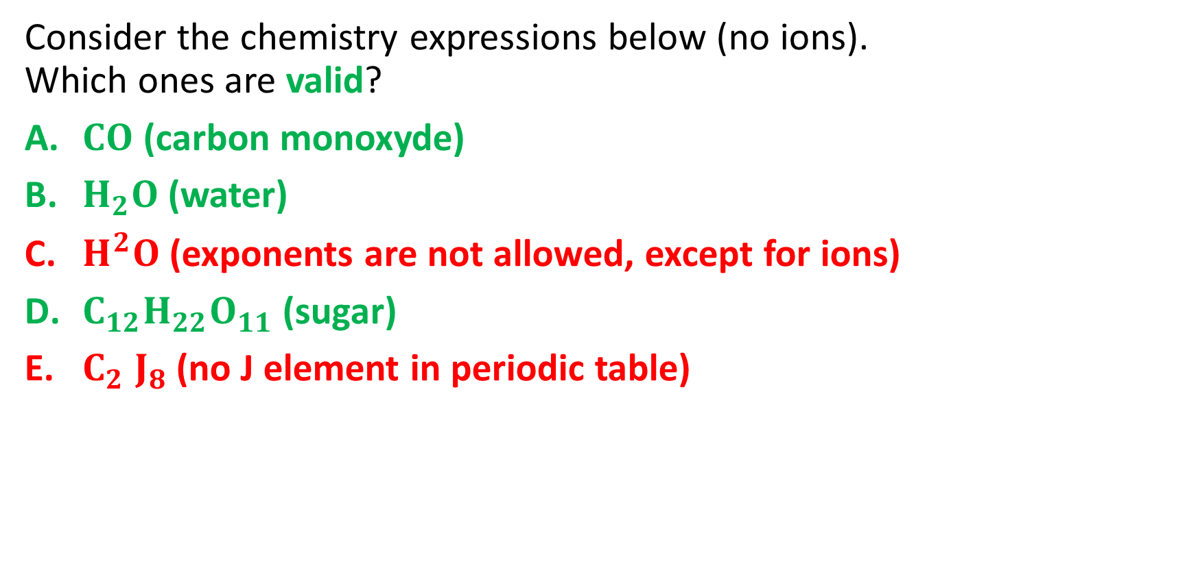
A chemical problem
Consider the chemistry expressions below (no ions). Which ones are valid?
$CO$ (carbon monoxyde)
$H_{2}O$ (water)
$H^{2}O$ (exponents are not allowed, except for ions)
$C_{12}H_{22}O_{11}$ (sugar)
$C_{2} J_{8}$ (no J element in periodic table)

Slide 13
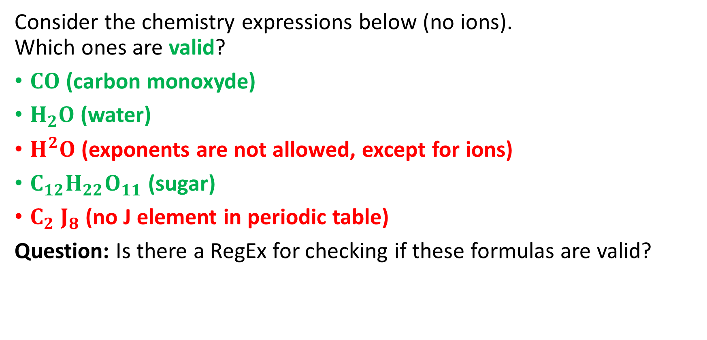
A chemical problem
Consider the chemistry expressions below (no ions). Which ones are valid?
$CO$ (carbon monoxyde)
$H_{2}O$ (water)
$H^{2}O$ (exponents are not allowed, except for ions)
$C_{12}H_{22}O_{11}$ (sugar)
$C_{2} J_{8}$ (no J element in periodic table)
Question: Is there a RegEx for checking if these formulas are valid?

Slide 14
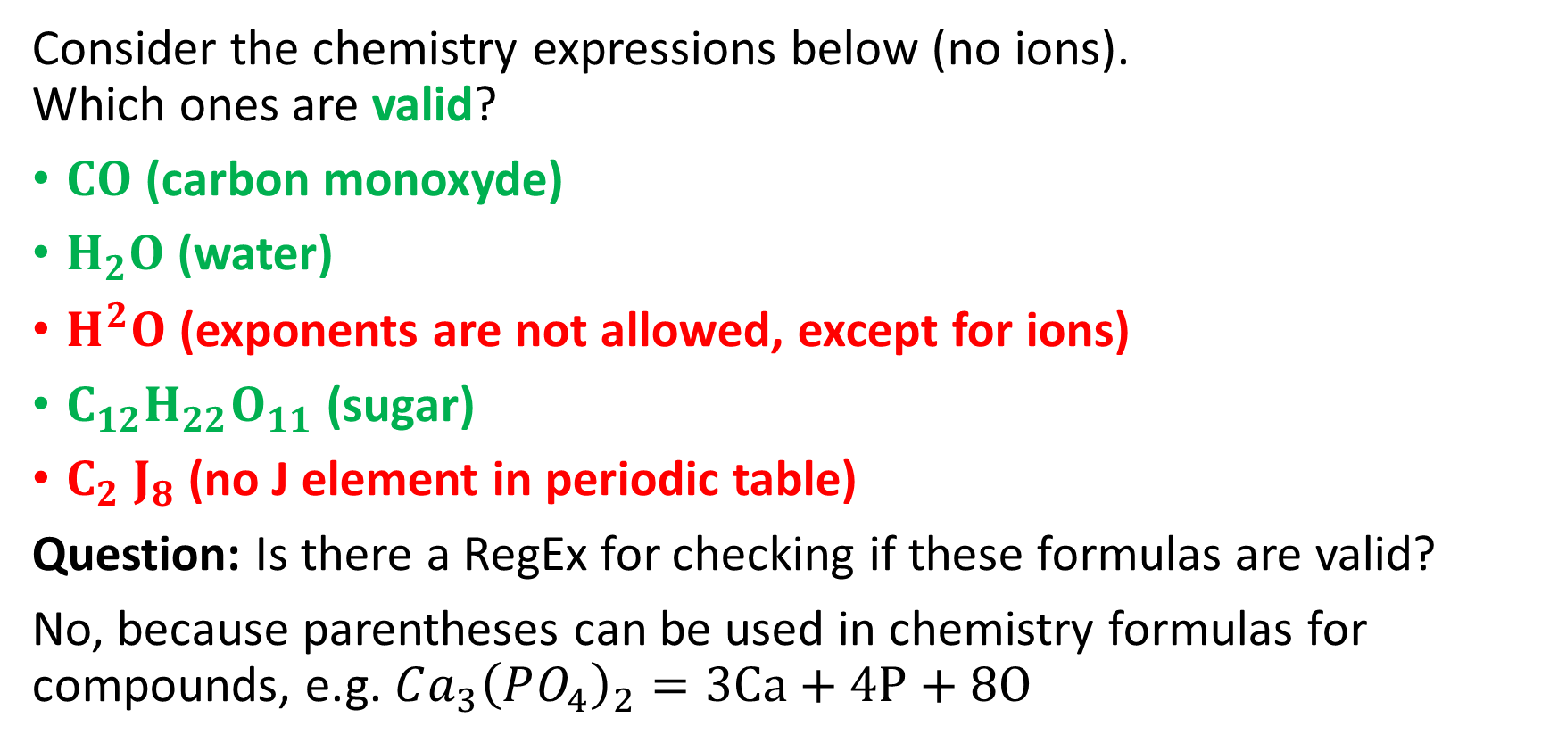
A chemical problem
Consider the chemistry expressions below (no ions). Which ones are valid?
$CO$ (carbon monoxyde)
$H_{2}O$ (water)
$H^{2}O$ (exponents are not allowed, except for ions)
$C_{12}H_{22}O_{11}$ (sugar)
$C_{2} J_{8}$ (no J element in periodic table)
Question: Is there a RegEx for checking if these formulas are valid?
No, because parentheses can be used in chemistry formulas for compounds, e.g. $Ca_{3}{\left(PO_{4}\right)}_{2}=3Ca+4P+8O$

Slide 15
Introducing Context Free Grammars
Definition (Context-Free Grammars):
A Context-Free Grammar (CFG) is a formal system used to generate and describe sets of strings based on a specific set of syntax rules.
It is particularly useful for defining the syntax of programming languages and the structure of natural languages.
The term "context-free" means that the production rules of the CFG are applied independently of the surrounding context.
A context free grammar is defined by four elements: a set of terminals and non-terminals, a start symbol and a set of production rules.

Slide 16
Elements of Context Free Grammars
Definition (Terminals and Non-Terminals):
Terminals are the basic symbols in a language that cannot be further divided.
In the case of our chemistry formulas, these would be elements symbols such as C, O, H, He, etc.
Non-terminals, on the other hand, represent syntactic patterns or intermediate structures in the language.
These can be further decomposed into sequences of terminals and non-terminals.

Slide 17
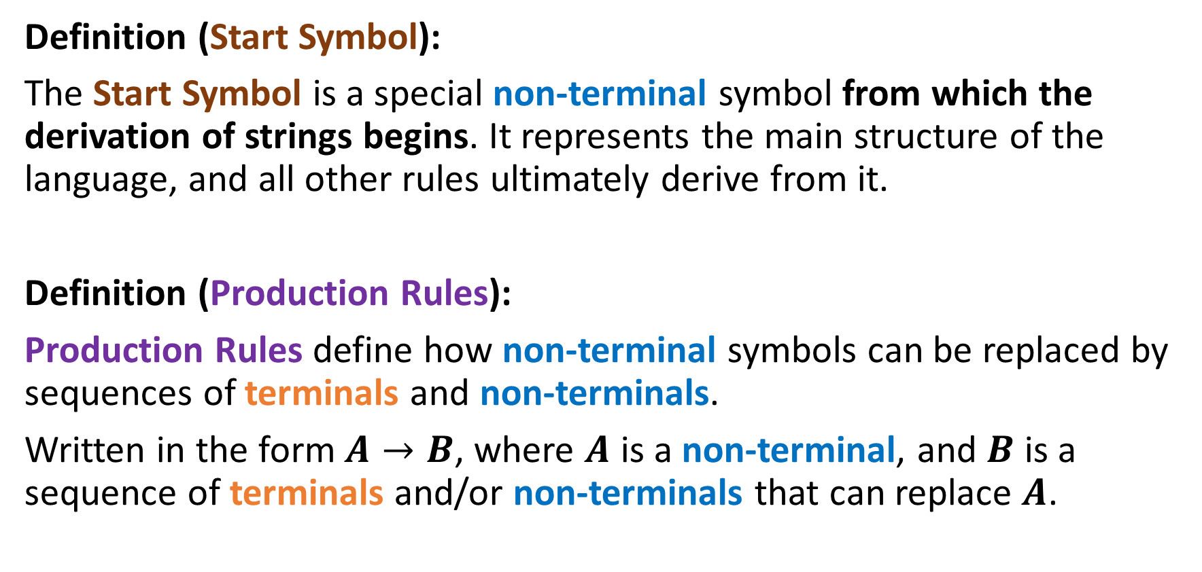
Elements of Context Free Grammars
Definition (Start Symbol):
The Start Symbol is a special non-terminal symbol from which the derivation of strings begins. It represents the main structure of the language, and all other rules ultimately derive from it.
Definition (Production Rules):
Production Rules define how non-terminal symbols can be replaced by sequences of terminals and non-terminals.
Written in the form $A→B$, where $A$ is a non-terminal, and $B$ is a sequence of terminals and/or non-terminals that can replace $A$.

Slide 18
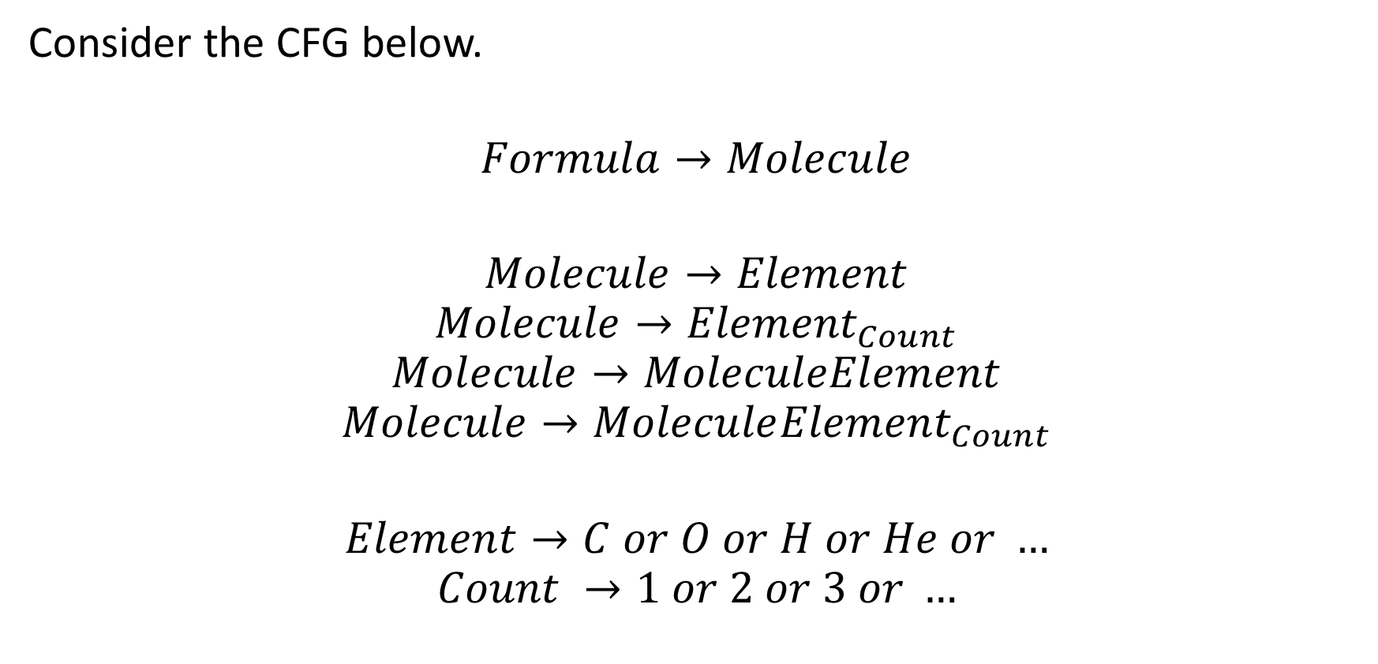
Back to our Chemistry
Consider the CFG below.
$$Formula→Molecule$$
$$Molecule→Element$$
$$Molecule→{Element}_{Count}$$
$$Molecule→MoleculeElement$$
$$Molecule→Molecule{Element}_{Count}$$
$$Element→C or O or H or He or …$$
$$Count →1 or 2 or 3 or …$$

Slide 19
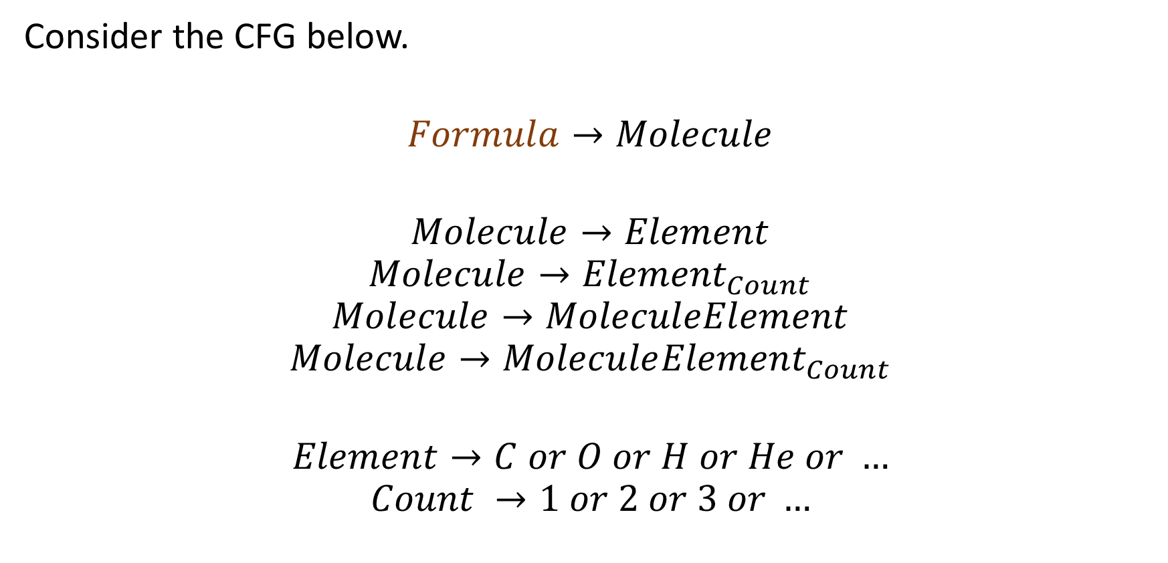
Back to our Chemistry
The symbol Formula is a Non-Terminal, which serves as a Start Symbol.
Consider the CFG below.
$$Formula→Molecule$$
$$Molecule→Element$$
$$Molecule→{Element}_{Count}$$
$$Molecule→MoleculeElement$$
$$Molecule→Molecule{Element}_{Count}$$
$$Element→C or O or H or He or …$$
$$Count →1 or 2 or 3 or …$$

Slide 20
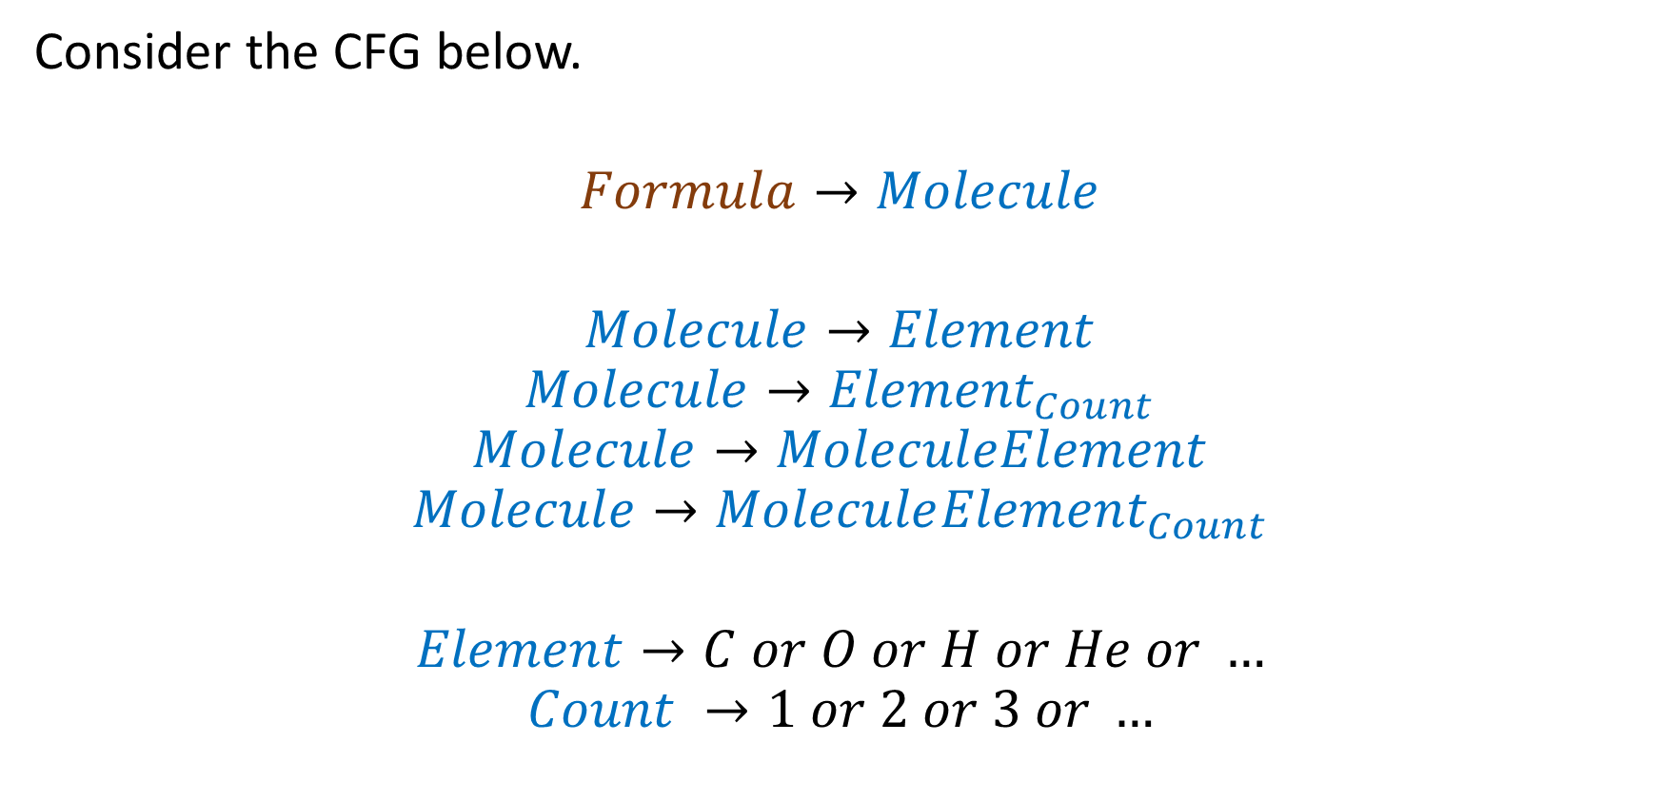
Back to our Chemistry
Any symbol written as
“Word” is a non-terminal.
Consider the CFG below.
$$Formula→Molecule$$
$$Molecule→Element$$
$$Molecule→{Element}_{Count}$$
$$Molecule→MoleculeElement$$
$$Molecule→Molecule{Element}_{Count}$$
$$Element→C or O or H or He or …$$
$$Count →1 or 2 or 3 or …$$

Slide 21
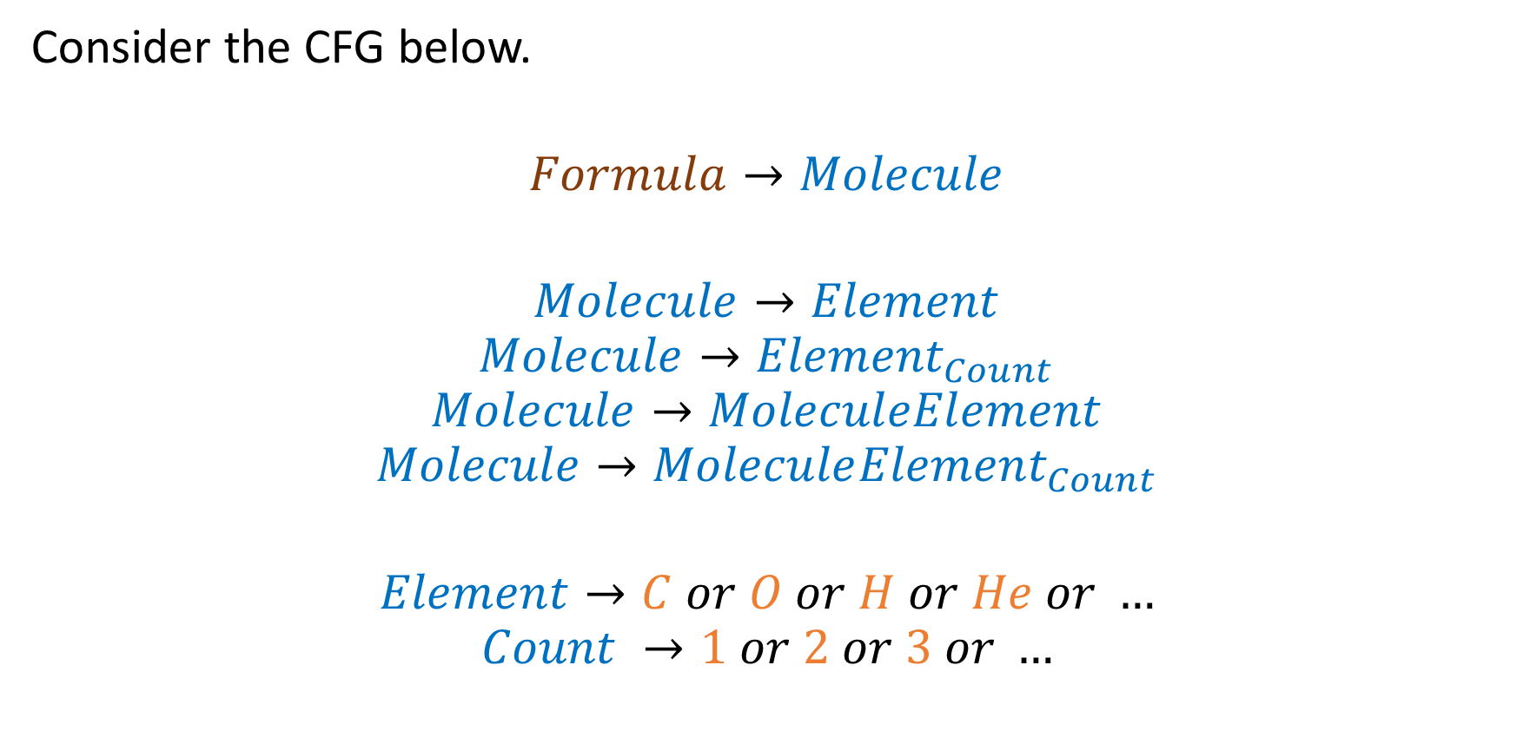
Back to our Chemistry
All the elements of the periodic table and the non-zero integer numbers can be used as terminals.
Consider the CFG below.
$$Formula→Molecule$$
$$Molecule→Element$$
$$Molecule→{Element}_{Count}$$
$$Molecule→MoleculeElement$$
$$Molecule→Molecule{Element}_{Count}$$
$$Element→C or O or H or He or …$$
$$Count →1 or 2 or 3 or …$$

Slide 22
Back to our Chemistry
We have defined 7 production rules.
Several production rules may appear and start with the same non-terminal.
Consider the CFG below.
$$Formula→Molecule$$
$$Molecule→Element$$
$$Molecule→{Element}_{Count}$$
$$Molecule→MoleculeElement$$
$$Molecule→Molecule{Element}_{Count}$$
$$Element→C or O or H or He or …$$
$$Count →1 or 2 or 3 or …$$

Slide 23
Back to our Chemistry
We may also use the keyword “or” for convenience
Consider the CFG below.
$$Formula→Molecule$$
$$Molecule→Element$$
$$Molecule→{Element}_{Count}$$
$$Molecule→MoleculeElement$$
$$Molecule→Molecule{Element}_{Count}$$
$$Element→C or O or H or He or …$$
$$Count →1 or 2 or 3 or …$$

Slide 24
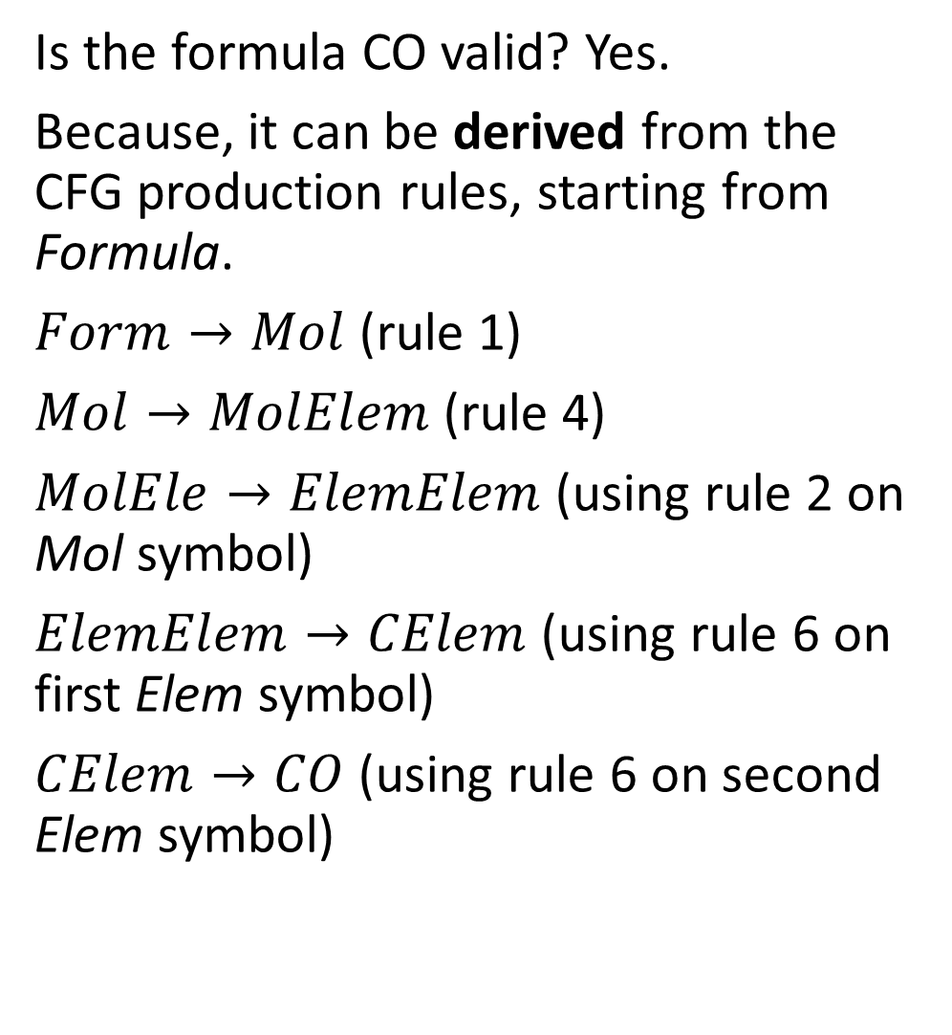
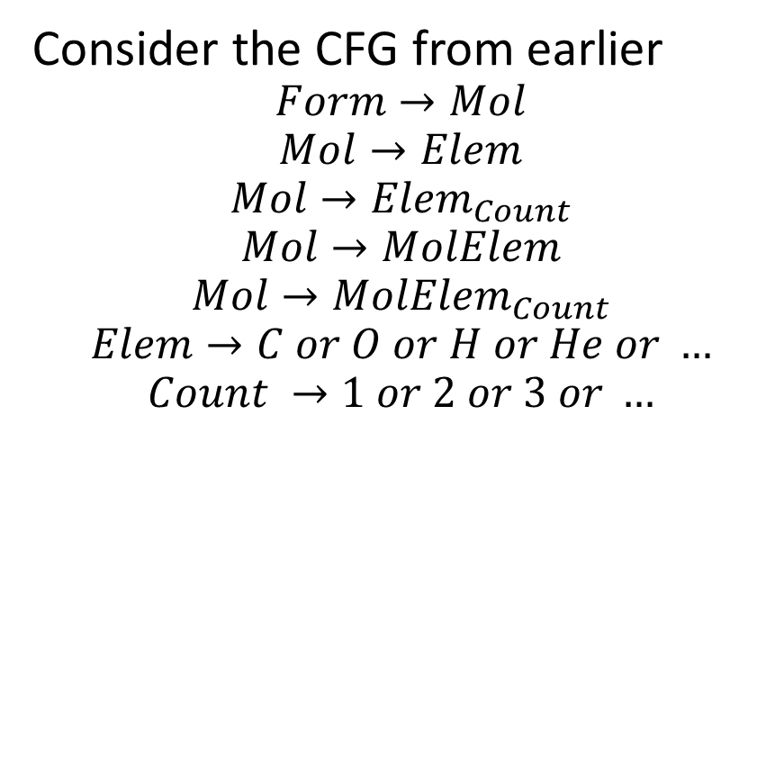
Back to our Chemistry
Is the formula CO valid? Yes.
Because, it can be derived from the CFG production rules, starting from Formula.
$Form→Mol$ (rule 1)
$Mol→MolElem$ (rule 4)
$MolEle→ElemElem$(using rule 2 on Mol symbol)
$ElemElem→CElem$ (using rule 6 on first Elem symbol)
$CElem→CO$ (using rule 6 on second Elem symbol)
Consider the CFG from earlier
$$Form→Mol$$
$$Mol→Elem$$
$$Mol→{Elem}_{Count}$$
$$Mol→MolElem$$
$$Mol→MolElem_{Count}$$
$$Elem→C or O or H or He or …$$
$$Count →1 or 2 or 3 or …$$

Slide 25
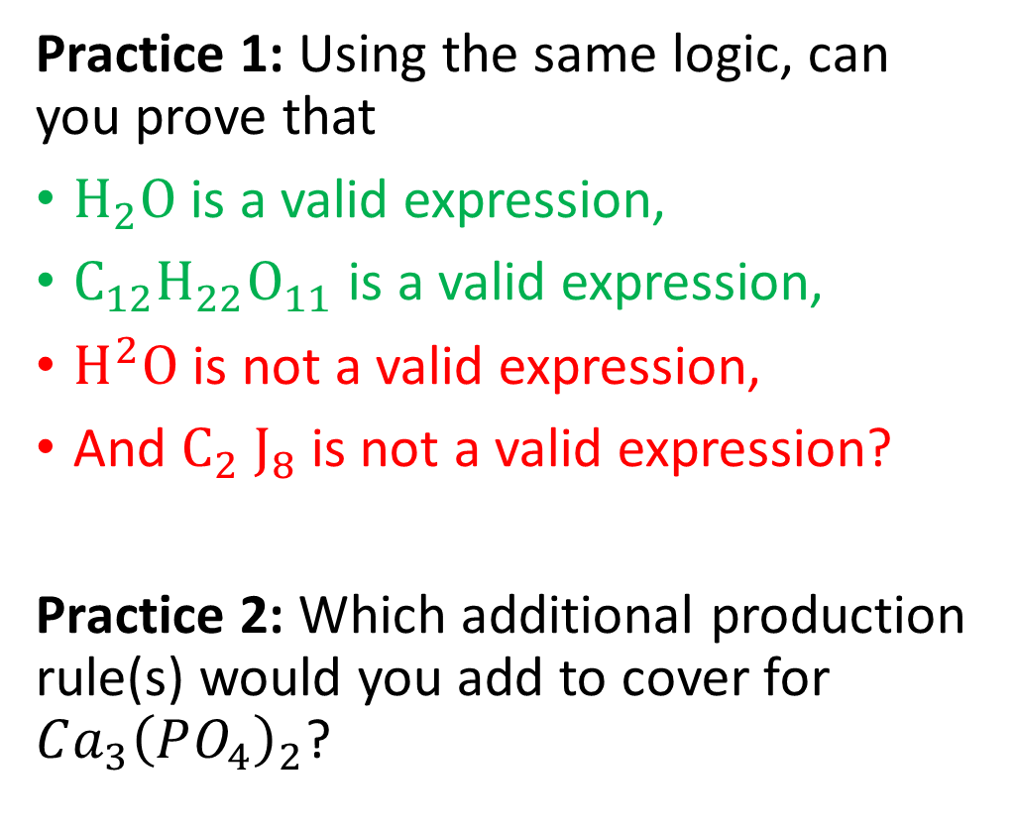
Practice 1 and 2
Consider the CFG from earlier
$$Form→Mol$$
$$Mol→Elem$$
$$Mol→{Elem}_{Count}$$
$$Mol→MolElem$$
$$Mol→MolElem_{Count}$$
$$Elem→C or O or H or He or …$$
$$Count →1 or 2 or 3 or …$$
Practice 1: Using the same logic, can you prove that
$H_{2}O$ is a valid expression,
$C_{12}H_{22}O_{11}$ is a valid expression,
$H^{2}O$ is not a valid expression,
And $C_{2} J_{8}$ is not a valid expression?
Practice 2: Which additional production rule(s) would you add to cover for $Ca_{3}{\left(PO_{4}\right)}_{2}$?

Slide 26
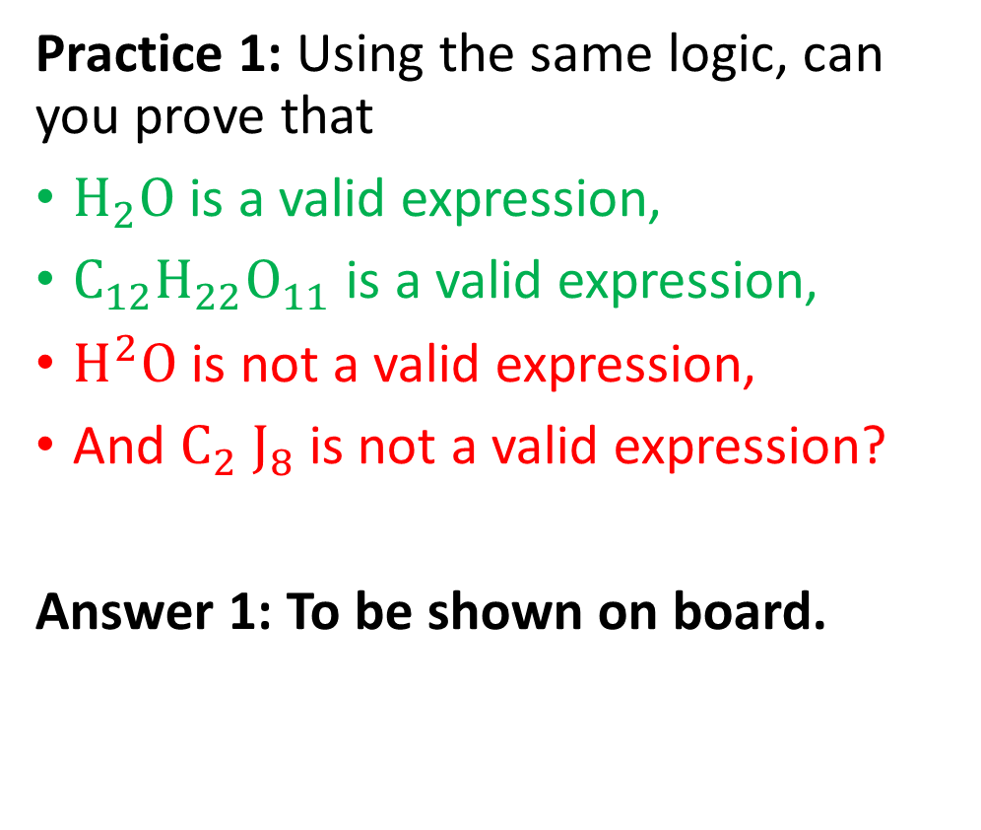
Practice 1 and 2
Consider the CFG from earlier
$$Form→Mol$$
$$Mol→Elem$$
$$Mol→{Elem}_{Count}$$
$$Mol→MolElem$$
$$Mol→MolElem_{Count}$$
$$Elem→C or O or H or He or …$$
$$Count →1 or 2 or 3 or …$$
Practice 1: Using the same logic, can you prove that
$H_{2}O$ is a valid expression,
$C_{12}H_{22}O_{11}$ is a valid expression,
$H^{2}O$ is not a valid expression,
And $C_{2} J_{8}$ is not a valid expression?
Answer 1: To be shown on board.

Slide 27
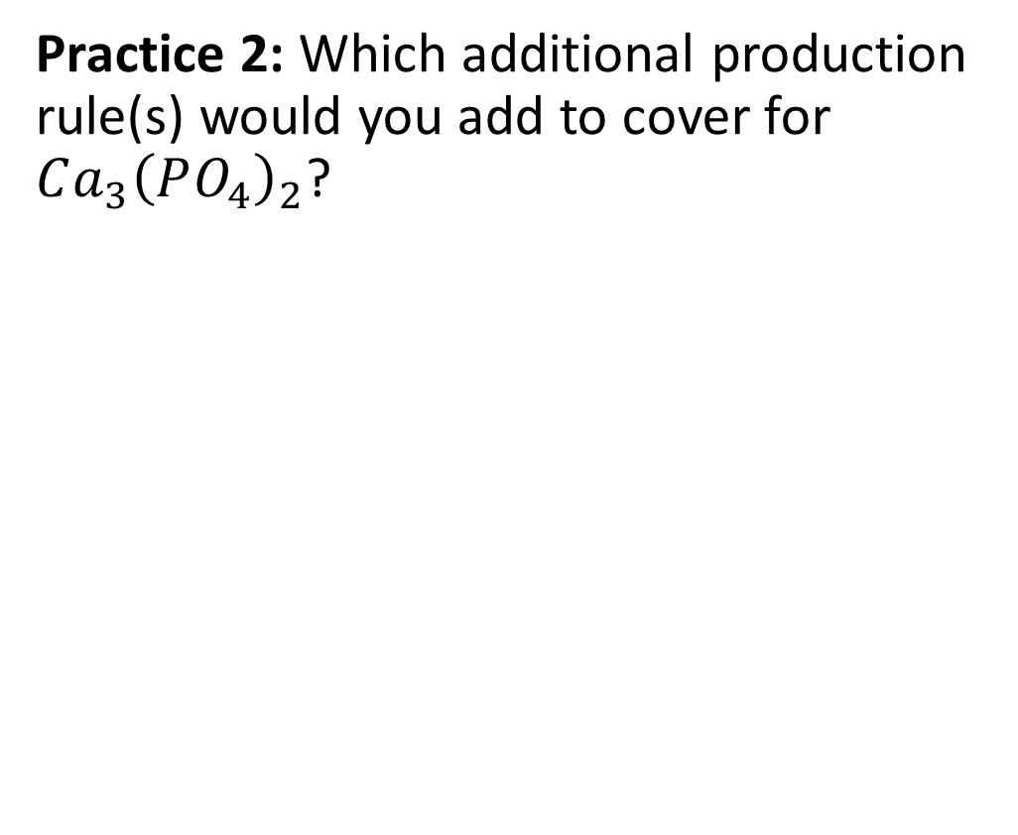
Practice 1 and 2
Consider the CFG from earlier
$$Form→Mol$$
$$Mol→Elem$$
$$Mol→{Elem}_{Count}$$
$$Mol→MolElem$$
$$Mol→MolElem_{Count}$$
$$Elem→C or O or H or He or …$$
$$Count →1 or 2 or 3 or …$$
Practice 2: Which additional production rule(s) would you add to cover for $Ca_{3}{\left(PO_{4}\right)}_{2}$?

Slide 28
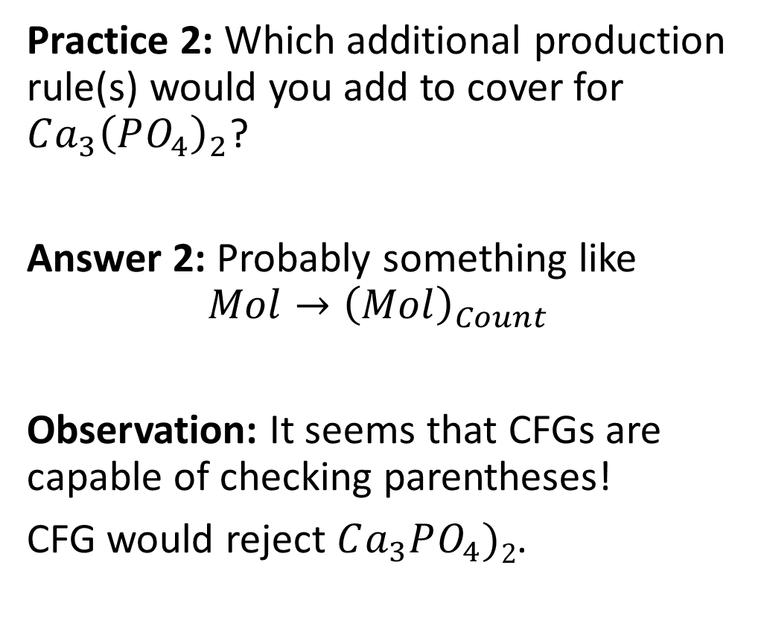
Practice 1 and 2
Consider the CFG from earlier
$$Form→Mol$$
$$Mol→Elem$$
$$Mol→{Elem}_{Count}$$
$$Mol→MolElem$$
$$Mol→MolElem_{Count}$$
$$Elem→C or O or H or He or …$$
$$Count →1 or 2 or 3 or …$$
Practice 2: Which additional production rule(s) would you add to cover for $Ca_{3}{\left(PO_{4}\right)}_{2}$?
Answer 2: Probably something like
$$Mol→{\left(Mol\right)}_{Count}$$
Observation: It seems that CFGs are capable of checking parentheses!
CFG would reject $Ca_{3}PO_{4})2$.

Slide 29
Derivation and Syntax Validity
Definition (Derivation):
In CFG, a derivation is a sequence of production rules that
starts from the start symbol,
and rewrites non-terminal symbols using production rules,
until only terminal symbols remain.
The resulting sequence of terminal symbols forms a string, called the result of the derivation.

Slide 30
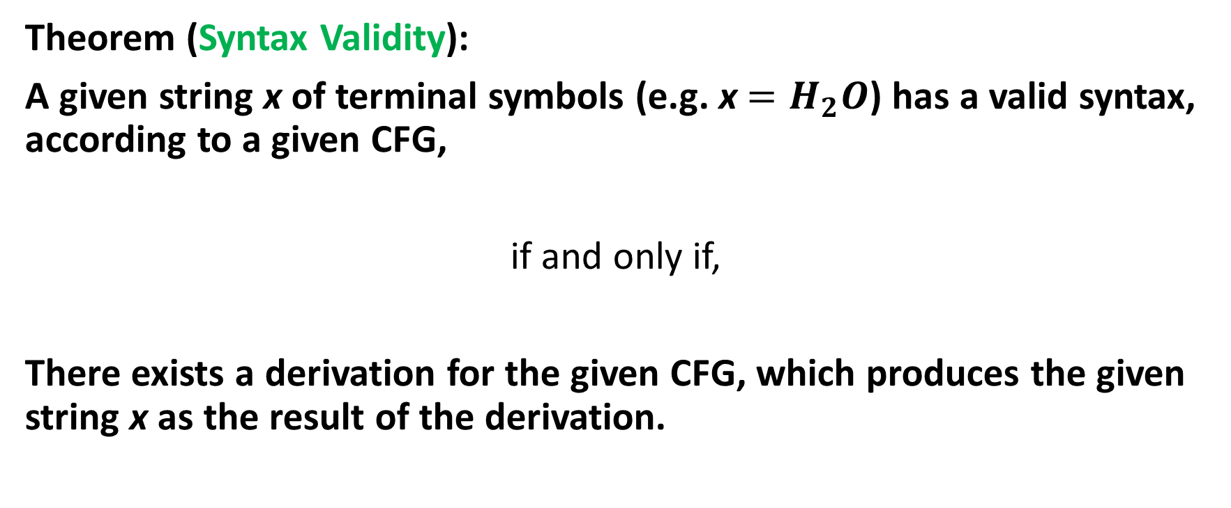
Derivation and Syntax Validity
Theorem (Syntax Validity):
A given string x of terminal symbols (e.g. x $=H_{2}O$) has a valid syntax, according to a given CFG,
if and only if,
There exists a derivation for the given CFG, which produces the given string x as the result of the derivation.

Slide 31
How is that useful for compilers?
Let us assume we have used our tokenizer on a given source code and we have obtained a tokens stream of some sort.
Which of the two tokens streams below shows that the code has a syntax problem of some sort?
Token(KEYWORD_INT, “int”), Token(IDENTIFIER, “x”), Token(EQSIGN, “=”), Token(INT_LITERAL, “1023”), Token(SEMICOL, “;”).
Token(KEYWORD_INT, “int”), Token(INT_LITERAL, “1023”), Token(EQSIGN, “=”), Token(IDENTIFIER, “x”), Token(SEMICOL, “;”).

Slide 32
How is that useful for compilers?
Let us assume we have used our tokenizer on a given source code and we have obtained a tokens stream of some sort.
Which of the two tokens streams below shows that the code has a syntax problem of some sort?
Token(KEYWORD_INT, “int”), Token(IDENTIFIER, “x”), Token(EQSIGN, “=”), Token(INT_LITERAL, “1023”), Token(SEMICOL, “;”).
Token(KEYWORD_INT, “int”), Token(INT_LITERAL, “1023”), Token(EQSIGN, “=”), Token(IDENTIFIER, “x”), Token(SEMICOL, “;”).
Equivalent question: Can you write "int 1023 = x;" in C?

Slide 33
How is that useful for compilers?
Let us assume we have used our tokenizer on a given source code and we have obtained a tokens stream of some sort.
Which of the two tokens streams below shows that the code has a syntax problem of some sort?
Token(KEYWORD_INT, “int”), Token(IDENTIFIER, “x”), Token(EQSIGN, “=”), Token(INT_LITERAL, “1023”), Token(SEMICOL, “;”).
Token(KEYWORD_INT, “int”), Token(INT_LITERAL, “1023”), Token(EQSIGN, “=”), Token(IDENTIFIER, “x”), Token(SEMICOL, “;”).
Equivalent question: Can you write "int 1023 = x;" in C? No, this statement is incorrect because it does not follow the proper syntax for declaring and initializing a variable in C, which is "int x = 1023;" .

Slide 34
How is that useful for compilers?
Let us assume we have used our tokenizer on a given source code and we have obtained a tokens stream of some sort.
Which of the two tokens streams below shows that the code has a syntax problem of some sort?
Token(KEYWORD_INT, “int”), Token(IDENTIFIER, “x”), Token(EQSIGN, “=”), Token(INT_LITERAL, “1023”), Token(SEMICOL, “;”).
This is fine.
Token(KEYWORD_INT, “int”), Token(INT_LITERAL, “1023”), Token(EQSIGN, “=”), Token(IDENTIFIER, “x”), Token(SEMICOL, “;”).
This one has a syntax problem (identifier appears on right hand side of the equal sign and literal value on the left hand side).

Slide 35
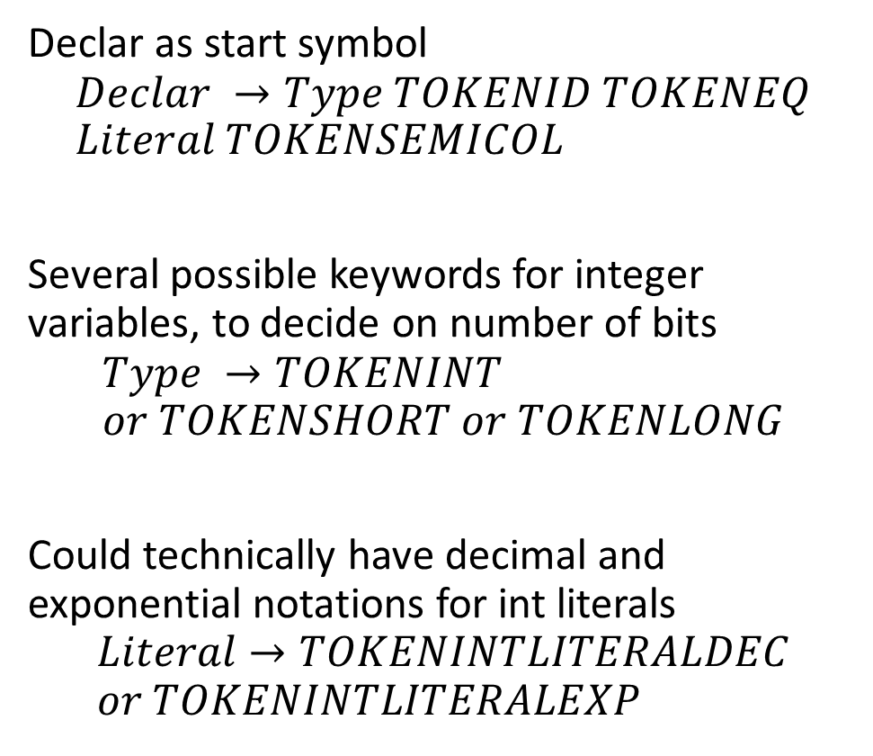
How is that useful for compilers?
Property: Programming languages are ruled by syntax rules, which can be described as CFGs.
For instance, when declaring a variable of type integer (using no arithmetic operations on the right hand side of the equal sign, only literals) the stream of tokens should follow a specific syntax described by the CFG on the right.
Declar as start symbol
$$Declar →Type TOKENID TOKENEQ \\ Literal TOKENSEMICOL$$
Several possible keywords for integer variables, to decide on number of bits
$$Type →TOKENINT \\ or TOKENSHORT or TOKENLONG$$
Could technically have decimal and exponential notations for int literals
$$Literal→TOKENINTLITERALDEC \\ or TOKENINTLITERALEXP$$

Slide 36
Practice 3
Question: Let us consider mathematical expressions, consisting of
single digit numbers,
+ operations,
along with opening and closing parentheses.
Can you write a CFG to check whether such a given mathematical expression has a valid syntax or not?
Some examples of valid and invalid expressions (same expressions as before):
2+7+9
(3+4)+7
((6+9)+8)+2
6+2++7
8+3+
((4+3)+8
(7+2))(+6

Slide 37
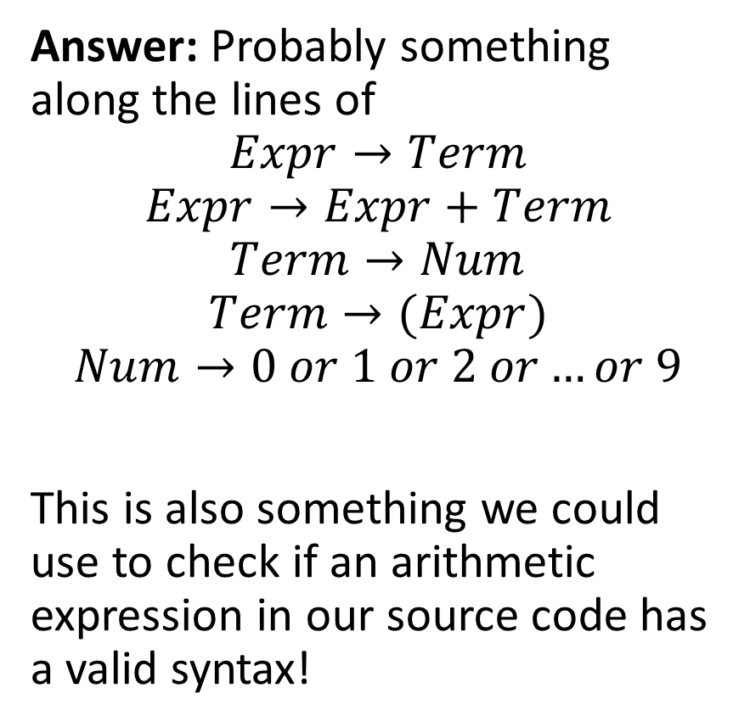
Practice 3
Question: Let us consider mathematical expressions, consisting of
single digit numbers,
+ operations,
along with opening and closing parentheses.
Can you write a CFG to check whether such a given mathematical expression has a valid syntax or not?
Answer: Probably something along the lines of
$$Expr→Term$$
$$Expr→Expr+Term$$
$$Term→Num$$
$$Term→(Expr)$$
$$Num→0 or 1 or 2 or…or 9$$
This is also something we could use to check if an arithmetic expression in our source code has a valid syntax!

Slide 38
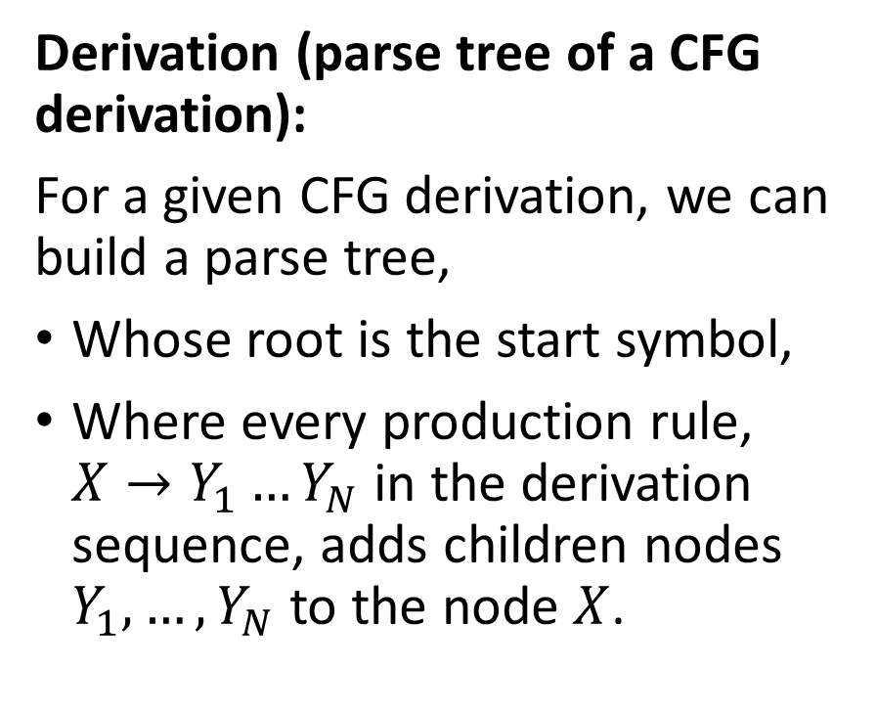
Parse tree of a derivation
Derivation (parse tree of a CFG derivation):
For a given CFG derivation, we can build a parse tree,
Whose root is the start symbol,
Where every production rule, $X→Y_{1}…Y_{N}$ in the derivation sequence, adds children nodes $Y_{1},…, Y_{N}$ to the node $X$.

Slide 39
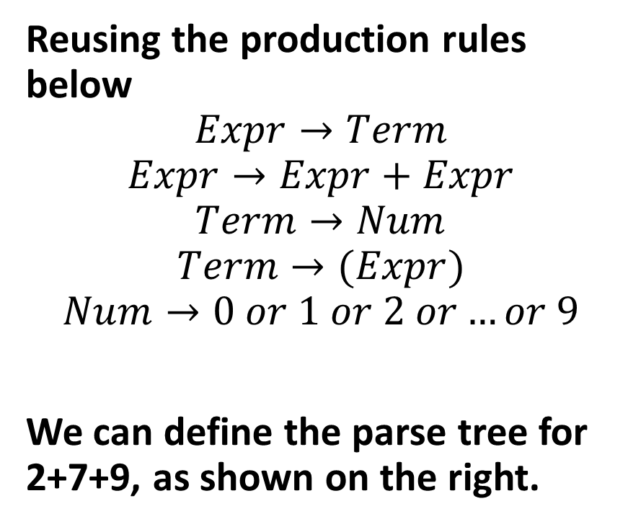
Parse tree of a derivation
Expr
Expr
+
Expr
Reusing the production rules below
$$Expr→Term$$
$$Expr→Expr+Expr$$
$$Term→Num$$
$$Term→(Expr)$$
$$Num→0 or 1 or 2 or…or 9$$
We can define the parse tree for 2+7+9, as shown on the right.
Expr
+
Expr
Term
Term
Term
Num
Num
Num
9
2
7

Slide 40
Parse tree of a derivation
Expr
Expr
+
Expr
Derivation (parse tree of a CFG derivation):
For a given CFG derivation, we can build a parse tree,
Whose root is the start symbol,
Where every production rule, $X→Y_{1}…Y_{N}$ in the derivation sequence, adds children nodes $Y_{1},…, Y_{N}$ to the node $X$.
Expr
+
Expr
Term
Term
Term
Num
Num
Num
9
2
7
This parse tree is interesting because it shows the order in which we should compute the different operations, starting with 2 and 7, then 2+7, and finally (2+7)+9.

Slide 41
Quick question
Assuming that a given string x has a valid syntax for a given CFG and admits a valid derivation…
Is the valid derivation unique?
Is there only one parse tree that could have been defined?

Slide 42
Quick question
Assuming that a given string x has a valid syntax for a given CFG and admits a valid derivation…
Is the valid derivation unique?
Is there only one parse tree that could have been defined?
In general, no, multiple valid derivations might do the trick…
And that ambiguity might even be a problem in certain scenarios…

Slide 43
Two parse trees for 2+7+9
Expr
Expr
Expr
+
Expr
Expr
+
Expr
Expr
+
Expr
Term
Term
Expr
+
Expr
Term
Term
Num
Num
Term
Term
Num
Num
9
2
Num
Num
2
7
7
9

Slide 44
Two parse trees for 2+7+9
Expr
Question: Does that make a difference?
Expr
Expr
+
Expr
Expr
+
Expr
Expr
+
Expr
Term
Term
Expr
+
Expr
Term
Term
Num
Num
Term
Term
Num
Num
9
2
Num
Num
2
7
7
9

Slide 45
Two parse trees for 2+7+9
Expr
Question: Does that make a difference?
At the moment, no, because the order does not matter.
Expr
Expr
+
Expr
Expr
+
Expr
Expr
+
Expr
Term
Term
Expr
+
Expr
Term
Term
Num
Num
Term
Term
Num
Num
9
2
Num
Num
2
7
7
9

Slide 46
Two parse trees for 2+7+9
Expr
But what if we were building parse trees for 2+7*9 instead?
Expr
Expr
*
Expr
Expr
+
Expr
Expr
+
Expr
Term
Term
Expr
*
Expr
Term
Term
Num
Num
Term
Term
Num
Num
9
2
Num
Num
2
7
7
9

Slide 47
Two parse trees for 2+7*9
Expr
But what if we were building parse trees for 2+7*9 instead?
The right tree represents 2+(7*9).
The left one represents (2+7)*9.
The order matters in that case!
Expr
Expr
*
Expr
Expr
+
Expr
Expr
+
Expr
Term
Term
Expr
*
Expr
Term
Term
Num
Num
Term
Term
Num
Num
9
2
Num
Num
2
7
7
9

Slide 48
Ambiguity
Definition (Ambiguity in a CFG derivation):
When using a CFG to check the syntax validity of an expression and building a parse tree, we say that a CFG is ambiguous if it can lead to two different parse trees with different results.
In the case of arithmetic expressions and programming languages, this means that
Two different derivations might exist,
Producing two different parse trees,
And the result of both operations following the two parse trees might differ and lead to different outcomes for a given program (not good!).

Slide 49
Checking ambiguity algorithmically
Theorem (On checking the ambiguity of a CFG algorithmically):
Let us consider a given CFG.
There is no algorithm to check if a given CFG is ambiguous or not.
This is known as the ambiguity problem for context-free grammars, and it is proven to be an undecidable problem.

Slide 50
Checking ambiguity algorithmically
Theorem (On checking the ambiguity of a CFG algorithmically):
Let us consider a given CFG.
There is no algorithm to check if a given CFG is ambiguous or not.
This is known as the ambiguity problem for context-free grammars, and it is proven to be an undecidable problem.
(Note: Similarly, there is no general algorithm that can determine whether a given program contains an infinite loop. This is known as the Halting problem, and means that you cannot define a compiler program that can check for the presence of infinite loops in the compiled source code.)

Slide 51
Checking ambiguity algorithmically
Theorem (On checking the ambiguity of a CFG algorithmically):
Let us consider a given CFG.
There is no algorithm to check if a given CFG is ambiguous or not.
This is known as the ambiguity problem for context-free grammars, and it is proven to be an undecidable problem.
There are however manual methods for designing CFGs that will be non-ambiguous.
We will investigate them on the next lecture.

Slide 52
Quiz time!
What is a Context-Free Grammar (CFG)?
A set of rules that can generate all strings in a language
A method for tokenizing source code
A formal system for describing the structure of a language
A technique for optimizing compiler performance

Slide 53
Quiz time!
What is a Context-Free Grammar (CFG)?
A set of rules that can generate all strings in a language
A method for tokenizing source code
A formal system for describing the structure of a language
A technique for optimizing compiler performance

Slide 54
Quiz time!
Which of the following best describes a production rule in a CFG?
A rule for scanning the input text
A rule for optimizing the generated code
A rule for reducing the number of steps in a computation
A rule for replacing a non-terminal symbol with a sequence of terminal and non-terminal symbols

Slide 55
Quiz time!
Which of the following best describes a production rule in a CFG?
A rule for scanning the input text
A rule for optimizing the generated code
A rule for reducing the number of steps in a computation
A rule for replacing a non-terminal symbol with a sequence of terminal and non-terminal symbols

Slide 56
Quiz time!
What is a derivation in the context of CFGs?
The process of breaking down a string into its constituent tokens
The process of generating code for a given input
The process of applying production rules to generate a string in the language
The process of defining and optimizing the structure of a parse tree

Slide 57
Quiz time!
What is a derivation in the context of CFGs?
The process of breaking down a string into its constituent tokens
The process of generating code for a given input
The process of applying production rules to generate a string in the language
The process of defining and optimizing the structure of a parse tree

Slide 58
Quiz time!
What is a parse tree?
A data structure for representing the structure of a language
A tree used for optimizing compiler performance
A tree representing the derivation of a string using a CFG
A tree used for breaking down a string into tokens

Slide 59
Quiz time!
What is a parse tree?
A data structure for representing the structure of a language
A tree used for optimizing compiler performance
A tree representing the derivation of a string using a CFG
A tree used for breaking down a string into tokens

Slide 60
Quiz time!
What is an ambiguous context-free grammar?
A grammar that can generate two different strings for the same derivation
A grammar whose production rules cannot produce a result string consisting of terminal symbols only
A grammar that generates only one parse tree for each string
A grammar that can generate more than one parse tree for the same string

Slide 61
Quiz time!
What is an ambiguous context-free grammar?
A grammar that can generate two different strings for the same derivation
A grammar whose production rules cannot produce a result string consisting of terminal symbols only
A grammar that generates only one parse tree for each string
A grammar that can generate more than one parse tree for the same string

