Slide 1

50.051 Programming Language Concepts W10-S3 From Context-Free Grammars to Syntax-Directed Translation
Matthieu De Mari

Slide 2
Introducing Context Free Grammars
Definition (Context-Free Grammars):
A Context-Free Grammar (CFG) is a formal system used to generate and describe sets of strings based on a specific set of syntax rules.
It is particularly useful for defining the syntax of programming languages and the structure of natural languages.
The term "context-free" means that the production rules of the CFG are applied independently of the surrounding context.
A context free grammar is defined by four elements: a set of terminals and non-terminals, a start symbol and a set of production rules.

Slide 3
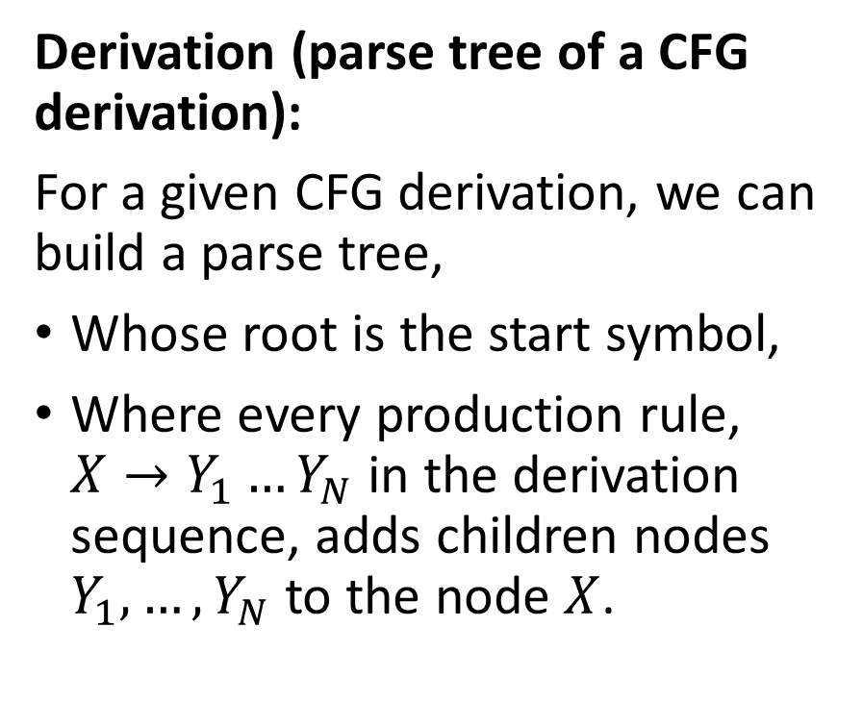
Parse tree of a derivation
Expr
Expr
+
Expr
Derivation (parse tree of a CFG derivation):
For a given CFG derivation, we can build a parse tree,
Whose root is the start symbol,
Where every production rule, $X→Y_{1}…Y_{N}$ in the derivation sequence, adds children nodes $Y_{1},…, Y_{N}$ to the node $X$.
Expr
+
Expr
Term
Term
Term
Num
Num
Num
9
2
7
This parse tree is interesting because it shows the order in which we should compute the different operations, starting with 2 and 7, then 2+7, and finally (2+7)+9.

Slide 4
Ambiguity
Definition (Ambiguity in a CFG derivation):
When using a CFG to check the syntax validity of an expression and building a parse tree, we say that a CFG is ambiguous if it can lead to two different parse trees with different results.
In the case of arithmetic expressions and programming languages, this means that
Two different derivations might exist,
Producing two different parse trees,
And the result of both operations following the two parse trees might differ and lead to different outcomes for a given program (not good!).

Slide 5
Checking ambiguity algorithmically
Theorem (On checking the ambiguity of a CFG algorithmically):
Let us consider a given CFG.
There is no algorithm to check if a given CFG is ambiguous or not.
This is known as the ambiguity problem for context-free grammars, and it is proven to be an undecidable problem.
(Note: Similarly, there is no general algorithm that can determine whether a given program contains an infinite loop. This is known as the Halting problem, and means that you cannot define a compiler program that can check for the presence of infinite loops in the compiled source code.)

Slide 6
Ambiguous grammars and compilers
Ambiguous grammars can cause significant problems in compilers.
They make it challenging to derive the intended meaning or structure of the input program.
Moreover, they can lead to incorrect parsing, which may result in incorrect code generation or even compiler crashes.
Therefore, it is crucial to eliminate ambiguity in context-free grammars used in compiler design.
While checking that a CFG might be ambiguous is impossible algorithmically, there are however manual methods for designing CFGs that will be non-ambiguous.

Slide 7
Ambiguous grammars and compilers
Not all context-free grammars can be made non-ambiguous.
Most CFGs used in programming, such as the CFG for checking balanced parentheses or the CFG for arithmetic expressions, can be represented using non-ambiguous grammars (that’s a relief!).
But, ultimately, it is your responsibility as a programming language designer to define rules for the syntax of your programming language that can be translated into non-ambiguous CFGs!
Keep in mind that ambiguous grammars can often appear more concise or easier to define than their non-ambiguous counterparts. However, the problems they cause in compiler design often outweigh the benefits of simplicity or conciseness.

Slide 8
Ambiguous grammars and compilers
To ensure that there is only one correct parse tree for a given string, it is essential to eliminate ambiguity in the grammar.
Some techniques for resolving ambiguity in CFGs manually:
Rewriting the grammar entirely,
Introducing precedence,
Introducing associativity rules.

Slide 9
Rewriting a CFG
All approaches to eliminate ambiguity will require to rewrite the grammar. And to do so, in a way that eliminates the multiple parse trees for a given input string.
The rewriting task involves following simple rules that will:
Restructure the production rules,
And/or introduce new non-terminal symbols to more clearly define the intended structure of the language.
By doing this, we ensure that there is only one possible derivation for each string, leading to a unique parse tree.

Slide 10
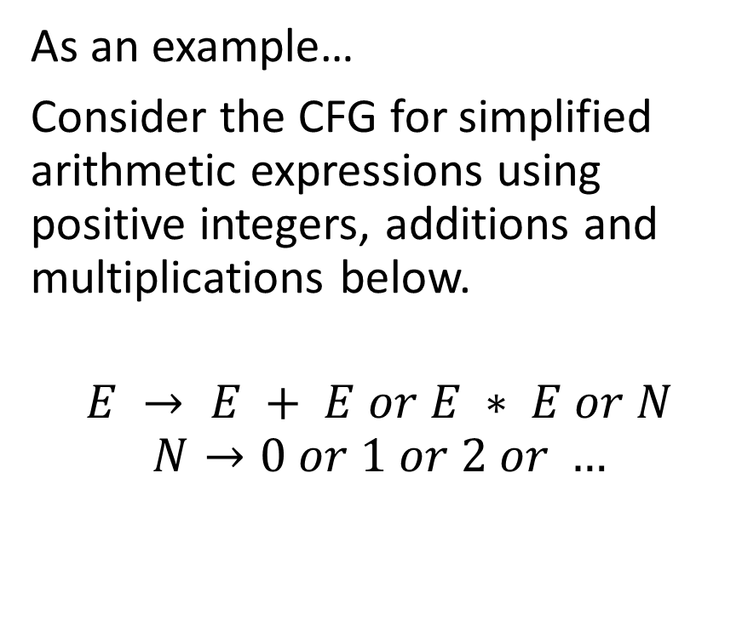
A first disambiguation example
As an example…
Consider the CFG for simplified arithmetic expressions using positive integers, additions and multiplications below.
$$E → E + E or E ∗ E or N$$
$$N→0 or 1 or 2 or …$$
This grammar is ambiguous, because it does not specify the precedence of + and *.
As we have seen in the previous lesson, it might lead to two different parse trees for the string 2*3+7, with completely different behaviours corresponding to two operations:
(2*3)+7
2*(3+7)

Slide 11
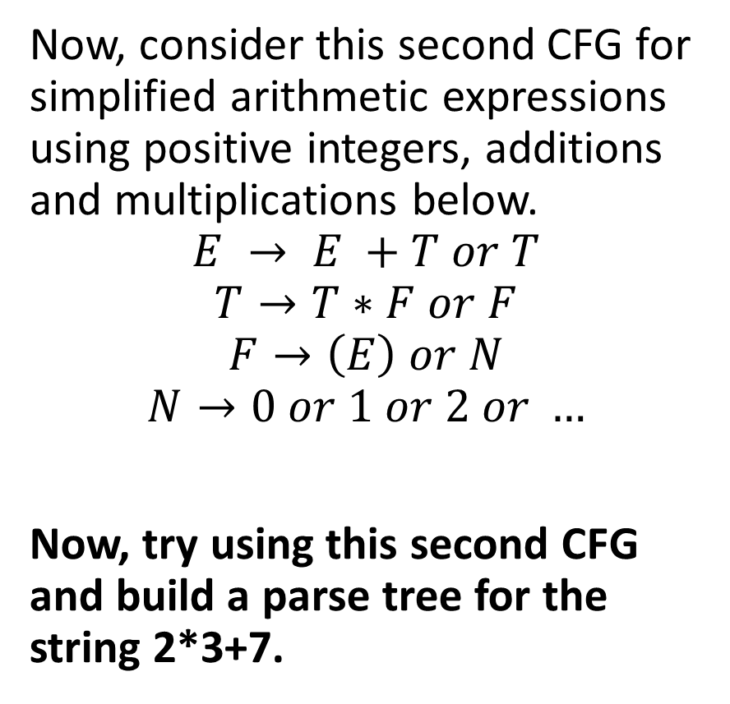
A first disambiguation example
Now, consider this second CFG for simplified arithmetic expressions using positive integers, additions and multiplications below.
$$E → E +T or T$$
$$T→T∗F or F$$
$$F→\left(E\right) or N$$
$$N→0 or 1 or 2 or …$$
Now, try using this second CFG and build a parse tree for the string 2*3+7.

Slide 12
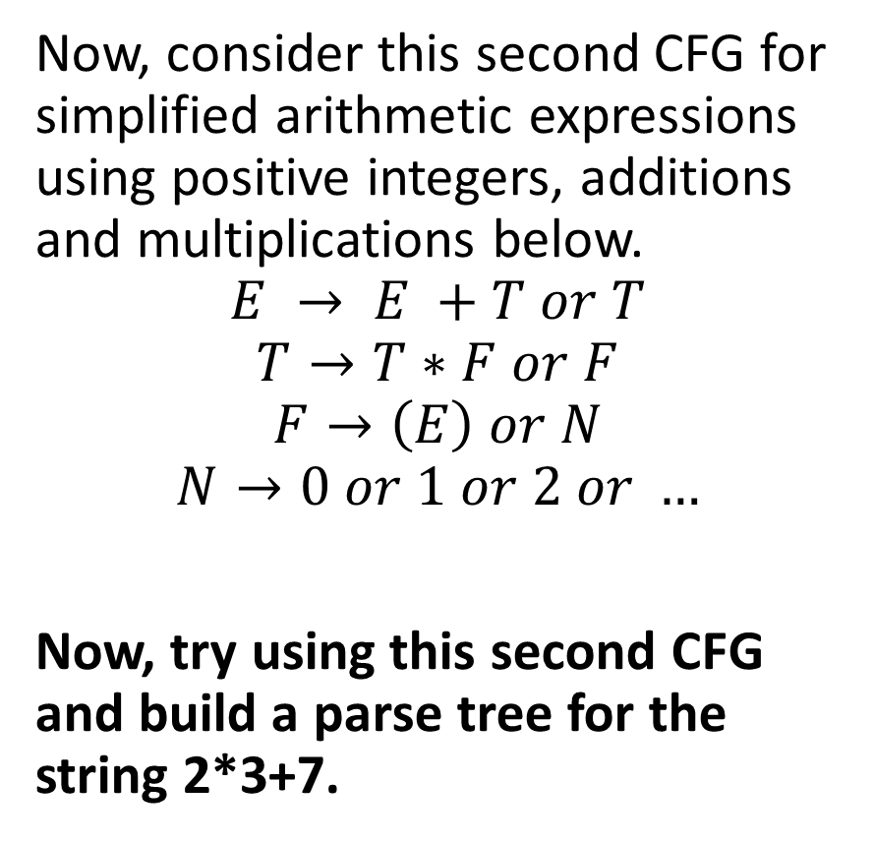
A first disambiguation example
Only one possible tree and correct precedence!
Now, consider this second CFG for simplified arithmetic expressions using positive integers, additions and multiplications below.
$$E → E +T or T$$
$$T→T∗F or F$$
$$F→\left(E\right) or N$$
$$N→0 or 1 or 2 or …$$
Now, try using this second CFG and build a parse tree for the string 2*3+7.
E
E
+
T
T
*
F
F
F
N
N
N
3
7
2

Slide 13
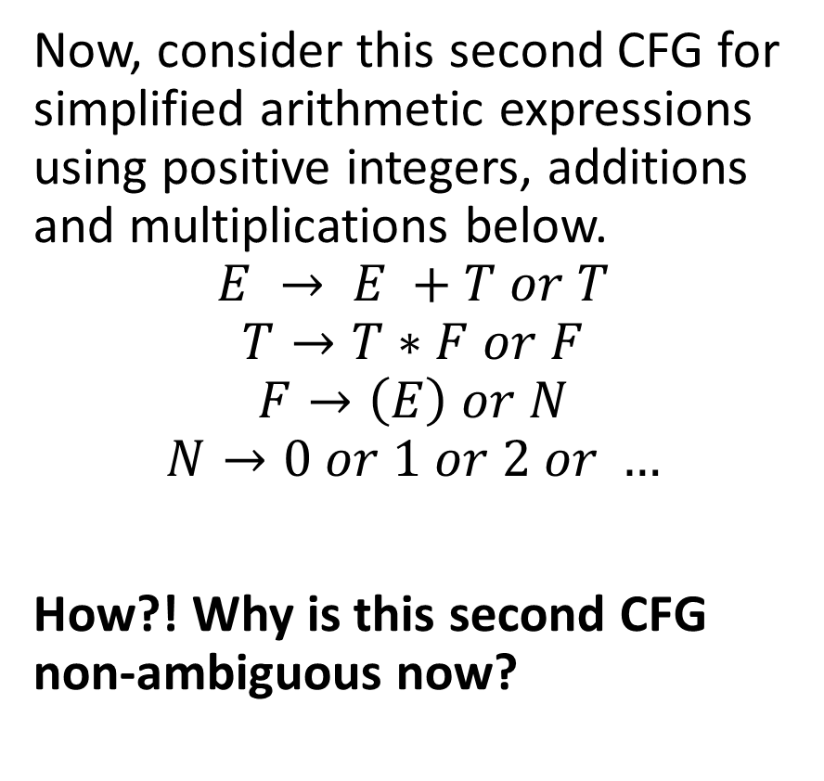
A first disambiguation example
Now, consider this second CFG for simplified arithmetic expressions using positive integers, additions and multiplications below.
$$E → E +T or T$$
$$T→T∗F or F$$
$$F→\left(E\right) or N$$
$$N→0 or 1 or 2 or …$$
How?! Why is this second CFG non-ambiguous now?
We introduced new non-terminal symbols T and F to represent terms and factors, respectively.
By doing so, we effectively established that multiplication has higher precedence than addition, as the * operator is now closer to the leaves of the parse tree.
Only one parse tree for each arithmetic expression!

Slide 14
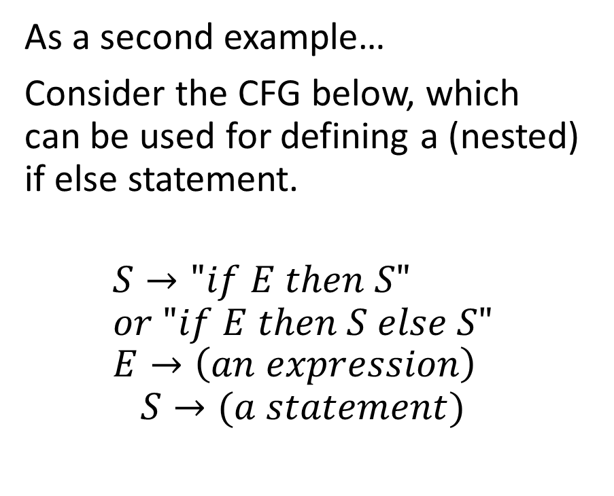
A second disambiguation example
As a second example…
Consider the CFG below, which can be used for defining a (nested) if else statement.
$$S→"if E then S" \\ or "if E then S else S" \\ E→\left(an expression\right)$$
$$S→(a statement)$$
This grammar is ambiguous and can lead to a problem called the dangling else problem.
Consider the string of tokens “if a then if b then s1 else s2”.
Which if does the else refer to?

Slide 15
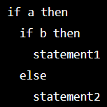
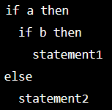
A second disambiguation example
As a second example…
Consider the CFG below, which can be used for defining a (nested) if else statement.
$$S→"if E then S" \\ or "if E then S else S" \\ E→\left(an expression\right)$$
$$S→(a statement)$$
This grammar is ambiguous and can lead to a problem called the dangling else problem.
Consider the string of tokens “if a then if b then s1 else s2”.
Which if does the else refer to?

Slide 16

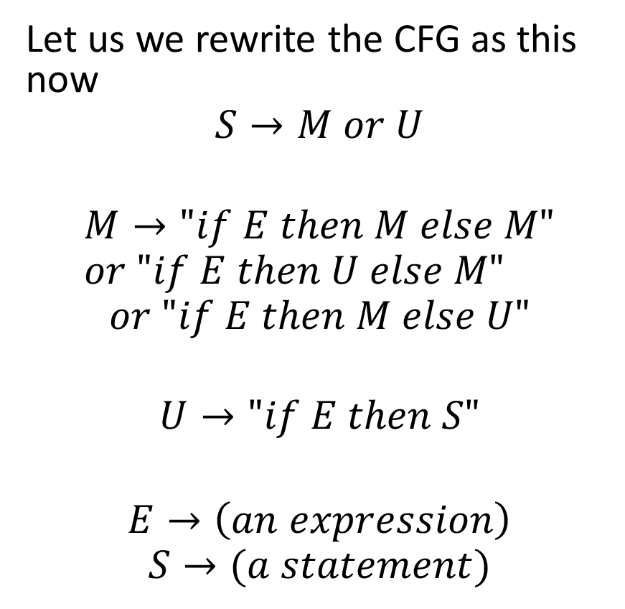
A second disambiguation example
Let us we rewrite the CFG as this now
$$S→M or U$$
$$M→"if E then M else M" \\ or "if E then U else M"$$
$$or "if E then M else U"$$
$$U→"if E then S"$$ $$E→\left(an expression\right)$$
$$S→(a statement)$$
This CFG is no longer ambiguous, as it now establishes a precedence: The first if that has not yet a matching else will now receive the else clause.

Slide 17
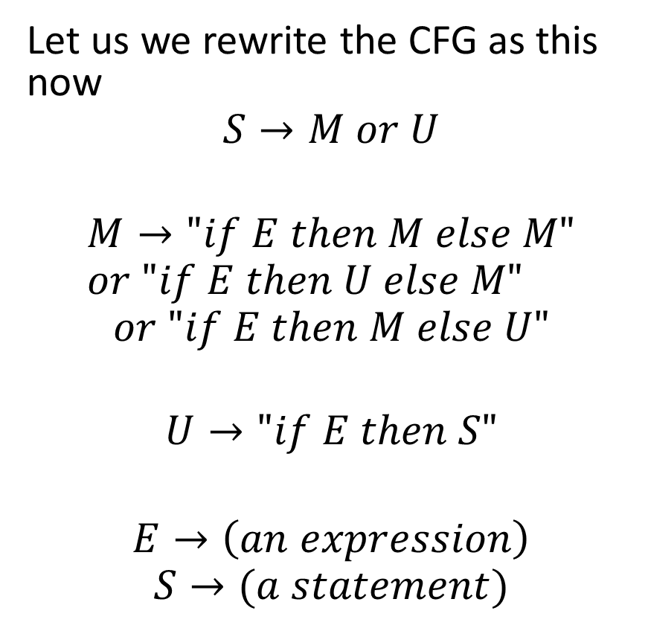
A second disambiguation example
Let us we rewrite the CFG as this now
$$S→M or U$$
$$M→"if E then M else M" \\ or "if E then U else M"$$
$$or "if E then M else U"$$
$$U→"if E then S"$$ $$E→\left(an expression\right)$$
$$S→(a statement)$$
This CFG is no longer ambiguous, as it now establishes a precedence: The first if that has not yet a matching else will now receive the else clause.
But wait, is that even correct to have such a precedence rule?!

Slide 18
A second disambiguation example
But wait, is that even correct to have such a precedence rule?!
This CFG is no longer ambiguous, as it now establishes a precedence: The first if that has not yet a matching else will now receive the else clause.

Slide 19
A second disambiguation example
But wait, is that even correct to have such a precedence rule?!
No it is not.
In fact that is the reason why programming languages will use additional delimiters for such statements.
In C, { and }.
In Python, indentation.
These delimiters should appear in the CFG production rules!
This CFG is no longer ambiguous, as it now establishes a precedence: The first if that has not yet a matching else will now receive the else clause.

Slide 25
The unspoken problem
Given a CFG and a string x whose syntax needs to be verified
We understand how to use production rules and apply them manually to eventually find the string x.
We understand how to derive a parse tree for the derivation
We understand how to add syntax-directed rules to our production rules.
We understand how to use syntax-directed rules to transform our parse tree into an Abstract Syntax Tree.
We are good with the syntax analysis right?

Slide 26
The unspoken problem
We are good with the syntax analysis right?
Oh my dear, if only…
We need an algorithm to find a valid derivation, for any given CFG and any string x whose syntax needs to be verified!
Small tiny teeny issue: This is absolutely not an easy problem algorithmically speaking! Will take us the next three lectures…!
And we will not even dare to implement said algorithms…!

