Slide 1



The COVID-19 challenge
A collaborative platform to aid the COVID19 response
M. Rolland mj.rolland@gmail.com
August 28, 2020

Slide 2
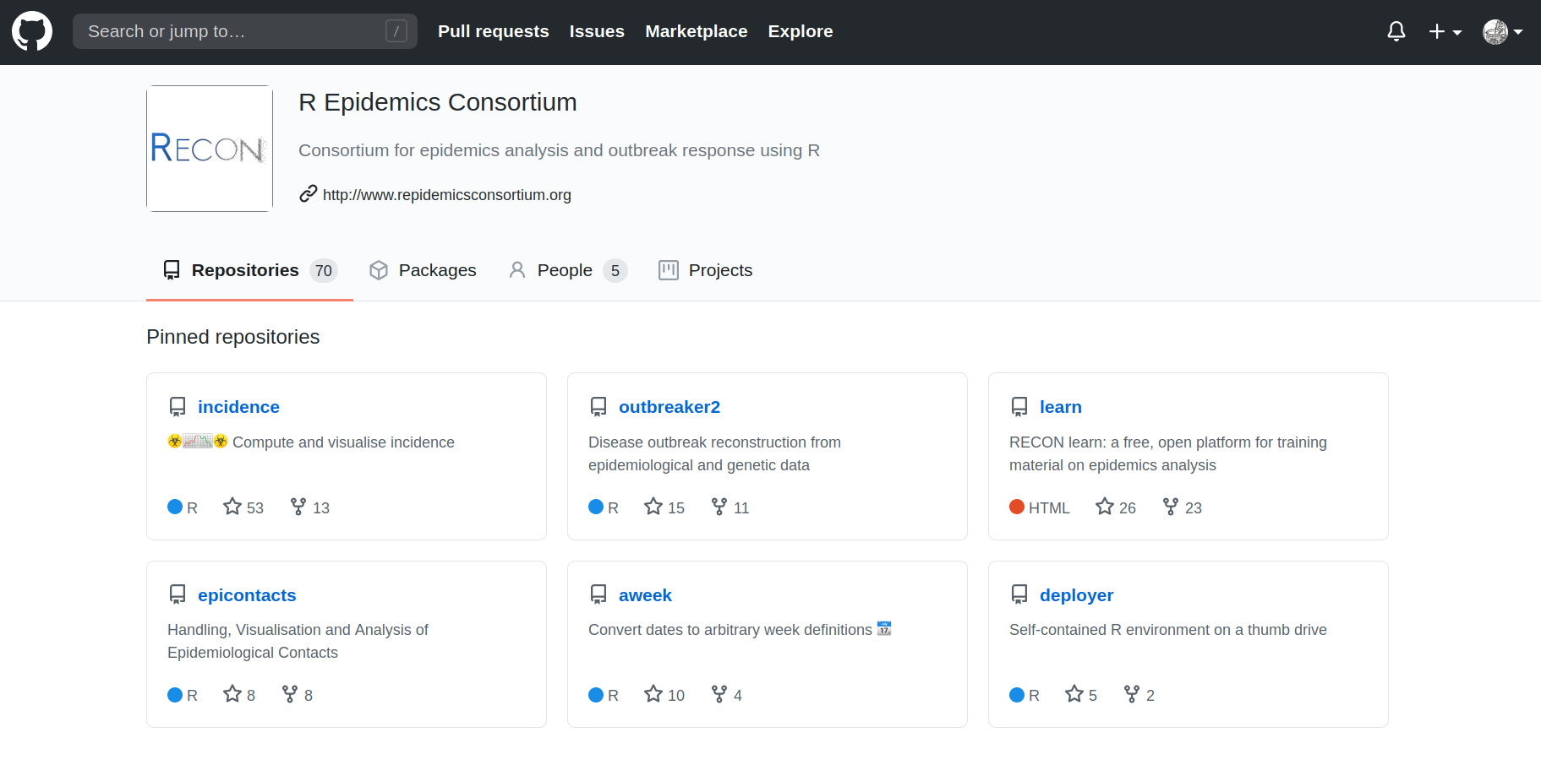

Slide 3

RECON and COVID19
Recon and covid19 examples, plots, photos

Slide 4
The covid19 challenge
Lack of feedback from the field
Lack of communication with the R community
https://github.com/reconhub/covid19hub
Fig1

Slide 5
Task definition
A modification for an existing function
Suggestion for a new package
Request for a new function/functionality in an existing package
A new Rmarkdown analysis template
An ad hoc function, not necessarily inside an existing package (but discouraged, add to packages where possible)
Training resources (practicals, lectures, videos, ...)
Code reviews for existing code
Testing existing features
Limited to COVID-19 specific tasks

Slide 6
Task lifecycle
 | Field agent | R programmer | Project board | Package maintainer
1 | Opens task
2 |  |  | Validates task
3 |  | Assigns him/herself task
4 | Resolve task
5 |  | Pull request
6 |  |  |  | Merge code to package
7 | Closes task

Slide 8
DEMO

Slide 9
Ongoing questions

Slide 10
Milestones
Initial release: Septembre 2020
Second release: October 2020

Slide 11
Join the response against COVID19!
Add recon twitter + covid19 twitter
Presentation link:
Platform link: www.tasks.repidemicsconsortium.org
RECON website: https://github.com/reconhub/covid19hub/issues
RECON packages: https://github.com/reconhub/
RECON issues: https://github.com/reconhub/covid19hub/issues
My email
My github
Presentation abstract: https://sites.google.com/view/dscc-19/call-to-action-matthieu-rolland?authuser=0

