Slide 1

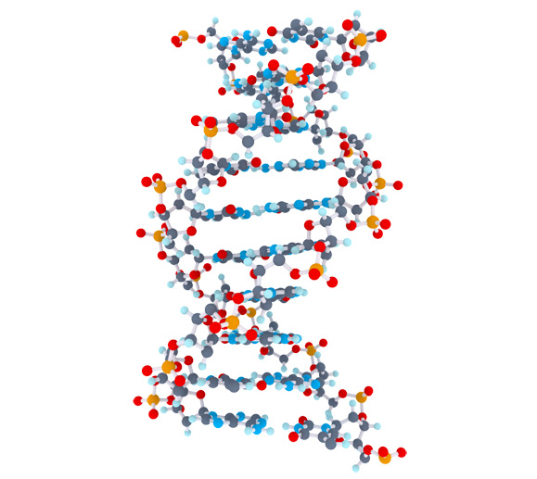
Celiac Disease Triggers
1
Matthijs Knigge

Slide 2
Overview
2
Project goal
Mendelian Randomization
Methods
Data
Pipeline
Preliminary results
Future steps

Slide 3
Project Goal
3
Inspect > 60.000 clinical parameters to;
Find potential clinical parameters to evaluate causal effects on celiac disease
Identification of factors that cause or protect Celiac Disease

Slide 4



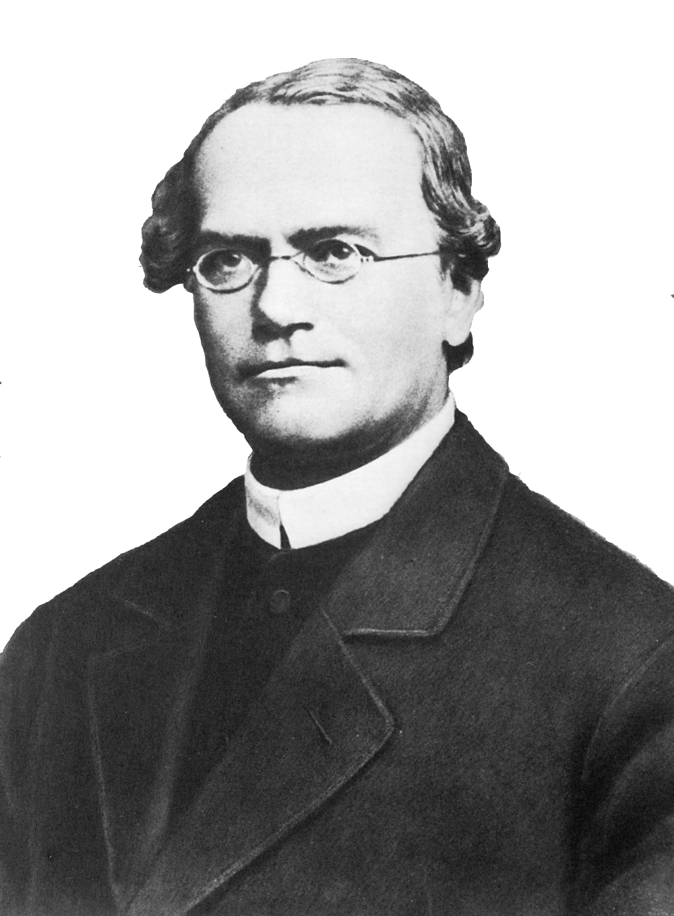







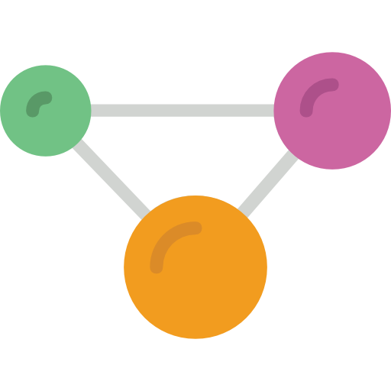


Mendelian Randomization (MR)
Randomized Controlled Trials (RCT)
4
Sample
Sample
Random assignment of subjects
Random allocation of alleles
Case
Control
Genotype
AA
Genotype
aa
Target effects
Protein effects
Outcome

Slide 5


Methods
5
Two-Sample MR | - Estimate causal effect between different samples - Summary-level data from GWAS can be used | - Cannot test for confounding - No overall causal estimate - Assumes genetic variants are uncorrelated (not in linkage disequilibrium) | - Causal estimate between genetic variants
Inverse-Variance Weighted method (IVW) | - Overall causal estimate between exposure and outcome - Summary-level data from GWAS can be used | - Assumes causal estimates provide independent evidence (no correlation) - Cannot test for confounding | - Overall causal estimate between exposure and outcome
MR-egger method | - Can test for confounding (correlation between variants) - Can test for a causal effect - An estimate of the overall causal effect | - Needs 3 or more genetic variants | - Overall causal estimate - MR-egger causal test - Overall pleiotropic effect
Bidirectional MR | - Can determine when genetic variant exhibits primary effect on the exposure, or the effect is secondary to the outcome | - difficulty in the presence of genetic variants that influence each other | - MR analysis in both directions, that ascertains direction of causal relationship

Slide 6
Data
6
 | Type | Amount of Phenotypes | Direction
Celiac, Trynka 2011 | GWAS Immunochip | 1 | Outcome
Celiac, Dubois 2010 | GWAS Immunochip | 1 | Outcome
The NHGRI-EBI GWAS catalog | Publicated GWAS | 2893 | Exposure
MRbase Metabolite | GWAS on metabolites in whole blood | 121 | Exposure
MRbase Proteins | GWAS on protein levels whole blood | 47 | Exposure
MRbase Gene Expression levels | GWAS on gene identifiers in 44 different tissues | 32432 | Exposure
MRbase Methylation levels | GWAS on methylation levels in whole blood across 5 time points | 33256 | Exposure
Publicated GWAS | GWAS | 1308 | Exposure
Total | 70059

Slide 7


Pipeline
7
SNP | effect_allele | beta | se | p
rs61733845 | T | 0.03536714 | 0.04432255 | 2.465e-06
rs1320571 | A | 0.01882175 | 0.04265126 | 6.590e-01
.... | .... | …. | …. | ….
GWAS
Celiac 2011. Gosia Trynka et al
SNP | effect_allele | beta | se | p
rs314253 | C | -0.0201900 | 0.002646 | 2.471-14
rs7775397 | G | -0.0369352 | 0.004845 | 2.721e-14
.... | …. | …. | …. | ….
GWAS
HDL, LDL, Triglycerides. Willer CJ et al. Discovery and refinement of loci associated with lipid levels. Nat. Genet. 2013. doi:10.1038/ng.2797
Outcome = Celiac Disease, Exposure = HDL, LDL, Triglycerides

Slide 8
Mendelian Randomization setup
8
SNP
Exposure phenotype
Outcome phenotype
Confounders
Rules that need to be met before using a genetic variant in the MR framework
The genetic variant must be associated with the exposure of interest
The genetic variant must not be associated with confounders
The genetic variant may only affect the outcome through the exposure

Slide 9
Pipeline
9
Data input
Operation
GWAS exposure
Select genome-wide significance on exposure
First core assumption
Remove variants without Beta/Log odds on exposure
1000 Genomes
Query missing alleles by reference on exposure
GWAS outcome
Find overlap between exposure and outcome
Harmonize Exposure on Outcome
- Positive align exposure
- Align outcome on exposure
- Remove palindromic SNPs

Slide 10
10

Slide 11
Preliminary results
9

Slide 12
Future steps
10

