Slide 1

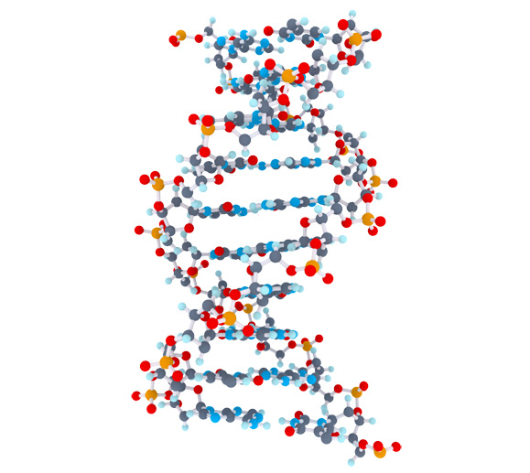
Celiac Disease Triggers
1
Matthijs Knigge

Slide 2
Overview
2
Project goal
Mendelian Randomization
Methods
Data
Pipeline
Preliminary results
Future steps

Slide 3
Project Goal
3
Inspect > 60.000 clinical parameters to;
Find potential clinical parameters to evaluate causal effects on celiac disease
Identification of factors that cause or protect Celiac Disease

Slide 4



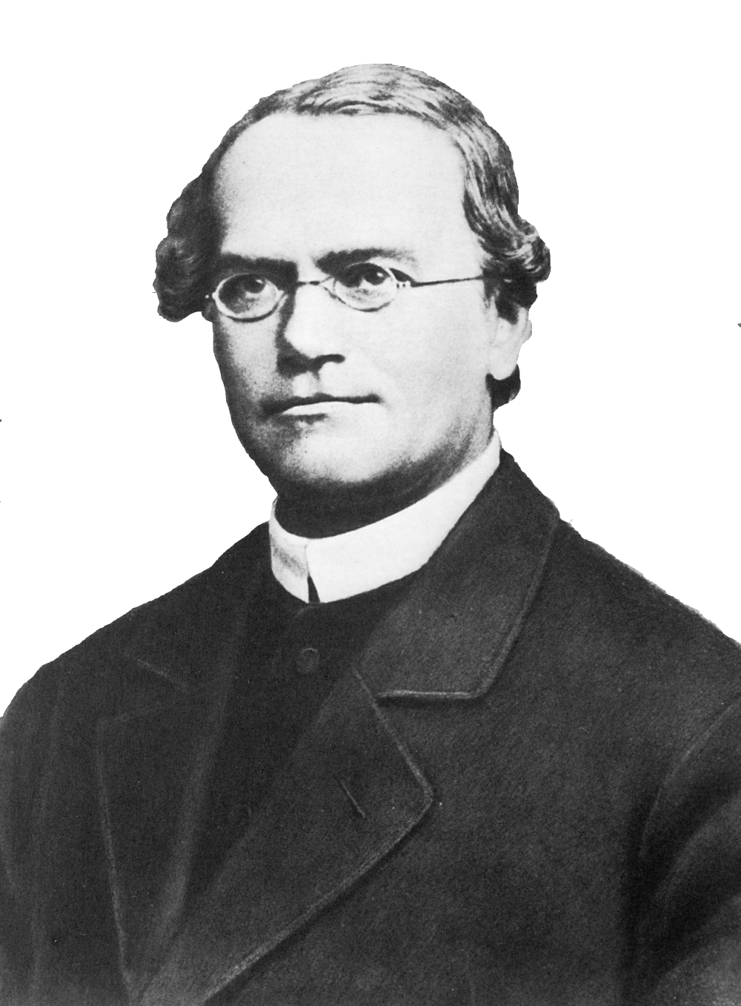







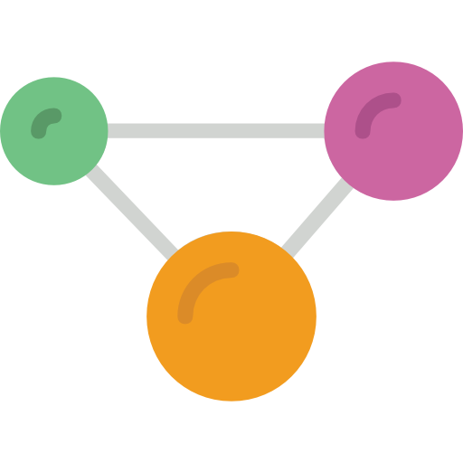


Mendelian Randomization (MR)
Randomized Controlled Trials (RCT)
4
Sample
Sample
Random assignment of subjects
Random allocation of alleles
Case
Control
Genotype
AA
Genotype
aa
Target effects
Protein effects
Outcome

Slide 5


Methods
5
Two-Sample MR | - Estimate causal effect between different samples - Summary-level data from GWAS can be used | - Cannot test for confounding - No overall causal estimate - Assumes genetic variants are uncorrelated (not in linkage disequilibrium) | - Causal estimate between genetic variants
Inverse-Variance Weighted method (IVW) | - Overall causal estimate between exposure and outcome - Summary-level data from GWAS can be used | - Assumes causal estimates provide independent evidence (no correlation) - Cannot test for confounding | - Overall causal estimate between exposure and outcome
MR-egger method | - Can test for confounding (correlation between variants) - Can test for a causal effect - An estimate of the overall causal effect | - Needs 3 or more genetic variants | - Overall causal estimate - MR-egger causal test - Overall pleiotropic effect
Bidirectional MR | - Can determine when genetic variant exhibits primary effect on the exposure, or the effect is secondary to the outcome | - difficulty in the presence of genetic variants that influence each other | - MR analysis in both directions, that ascertains direction of causal relationship

Slide 6
Data
6
 | Type | Amount of Phenotypes | Direction
Celiac, Trynka 2011 | GWAS Immunochip | 1 | Outcome
Celiac, Dubois 2010 | GWAS Immunochip | 1 | Outcome
The NHGRI-EBI GWAS catalog | Publicated GWAS | 2893 | Exposure
MRbase Metabolite | GWAS on metabolites in whole blood | 121 | Exposure
MRbase Proteins | GWAS on protein levels whole blood | 47 | Exposure
MRbase Gene Expression levels | GWAS on gene identifiers in 44 different tissues | 32432 | Exposure
MRbase Methylation levels | GWAS on methylation levels in whole blood across 5 time points | 33256 | Exposure
Publicated GWAS | GWAS | 1308 | Exposure

Slide 7


Pipeline
7
SNP | effect_allele | beta | se | p
rs61733845 | T | 0.03536714 | 0.04432255 | 2.465e-06
rs1320571 | A | 0.01882175 | 0.04265126 | 6.590e-01
.... | .... | …. | …. | ….
GWAS
Celiac 2011. Gosia Trynka et al
SNP | effect_allele | beta | se | p
rs314253 | C | -0.0201900 | 0.002646 | 2.471-14
rs7775397 | G | -0.0369352 | 0.004845 | 2.721e-14
.... | …. | …. | …. | ….
GWAS
HDL, LDL, Triglycerides. Willer CJ et al. Discovery and refinement of loci associated with lipid levels. Nat. Genet. 2013. doi:10.1038/ng.2797
Outcome = Celiac Disease, Exposure = HDL, LDL, Triglycerides

Slide 8
Mendelian Randomization setup
8
SNP
Exposure phenotype
Outcome phenotype
Confounders
Rules that need to be met before using a genetic variant in the MR framework

Slide 9
Preliminary results
9

Slide 10
Future steps
9

