Slide 1
Celiac Disease Triggers
Matthijs Knigge

Slide 2
Summary
Project goal
Methods
Data
Pipeline
Preliminary results
Future steps

Slide 3
Project goal
Inspect potential clinical parameters to evaluate causal effects on celiac disease
Identification of factors that cause or protect Celiac Disease

Slide 4
Methods
Mendelian Randomization
Inverse Variance Weigthed Method
MR-egger Method

Slide 5
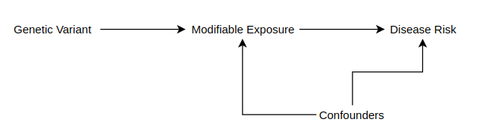
Mendelian Randomization
Natural Randomized Process
Similarities to Randomized Controlled Trials (RCTs)

Slide 6
Inverse Variance Weighted Method

Slide 7
MR-egger method

