Slide 1
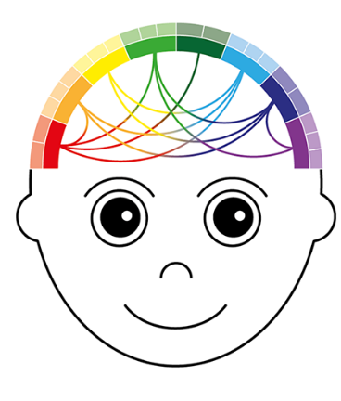


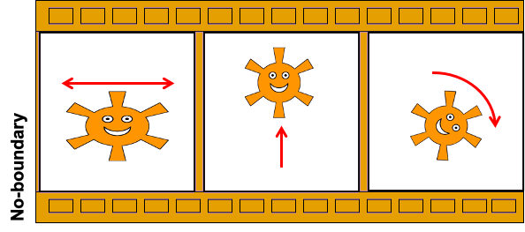
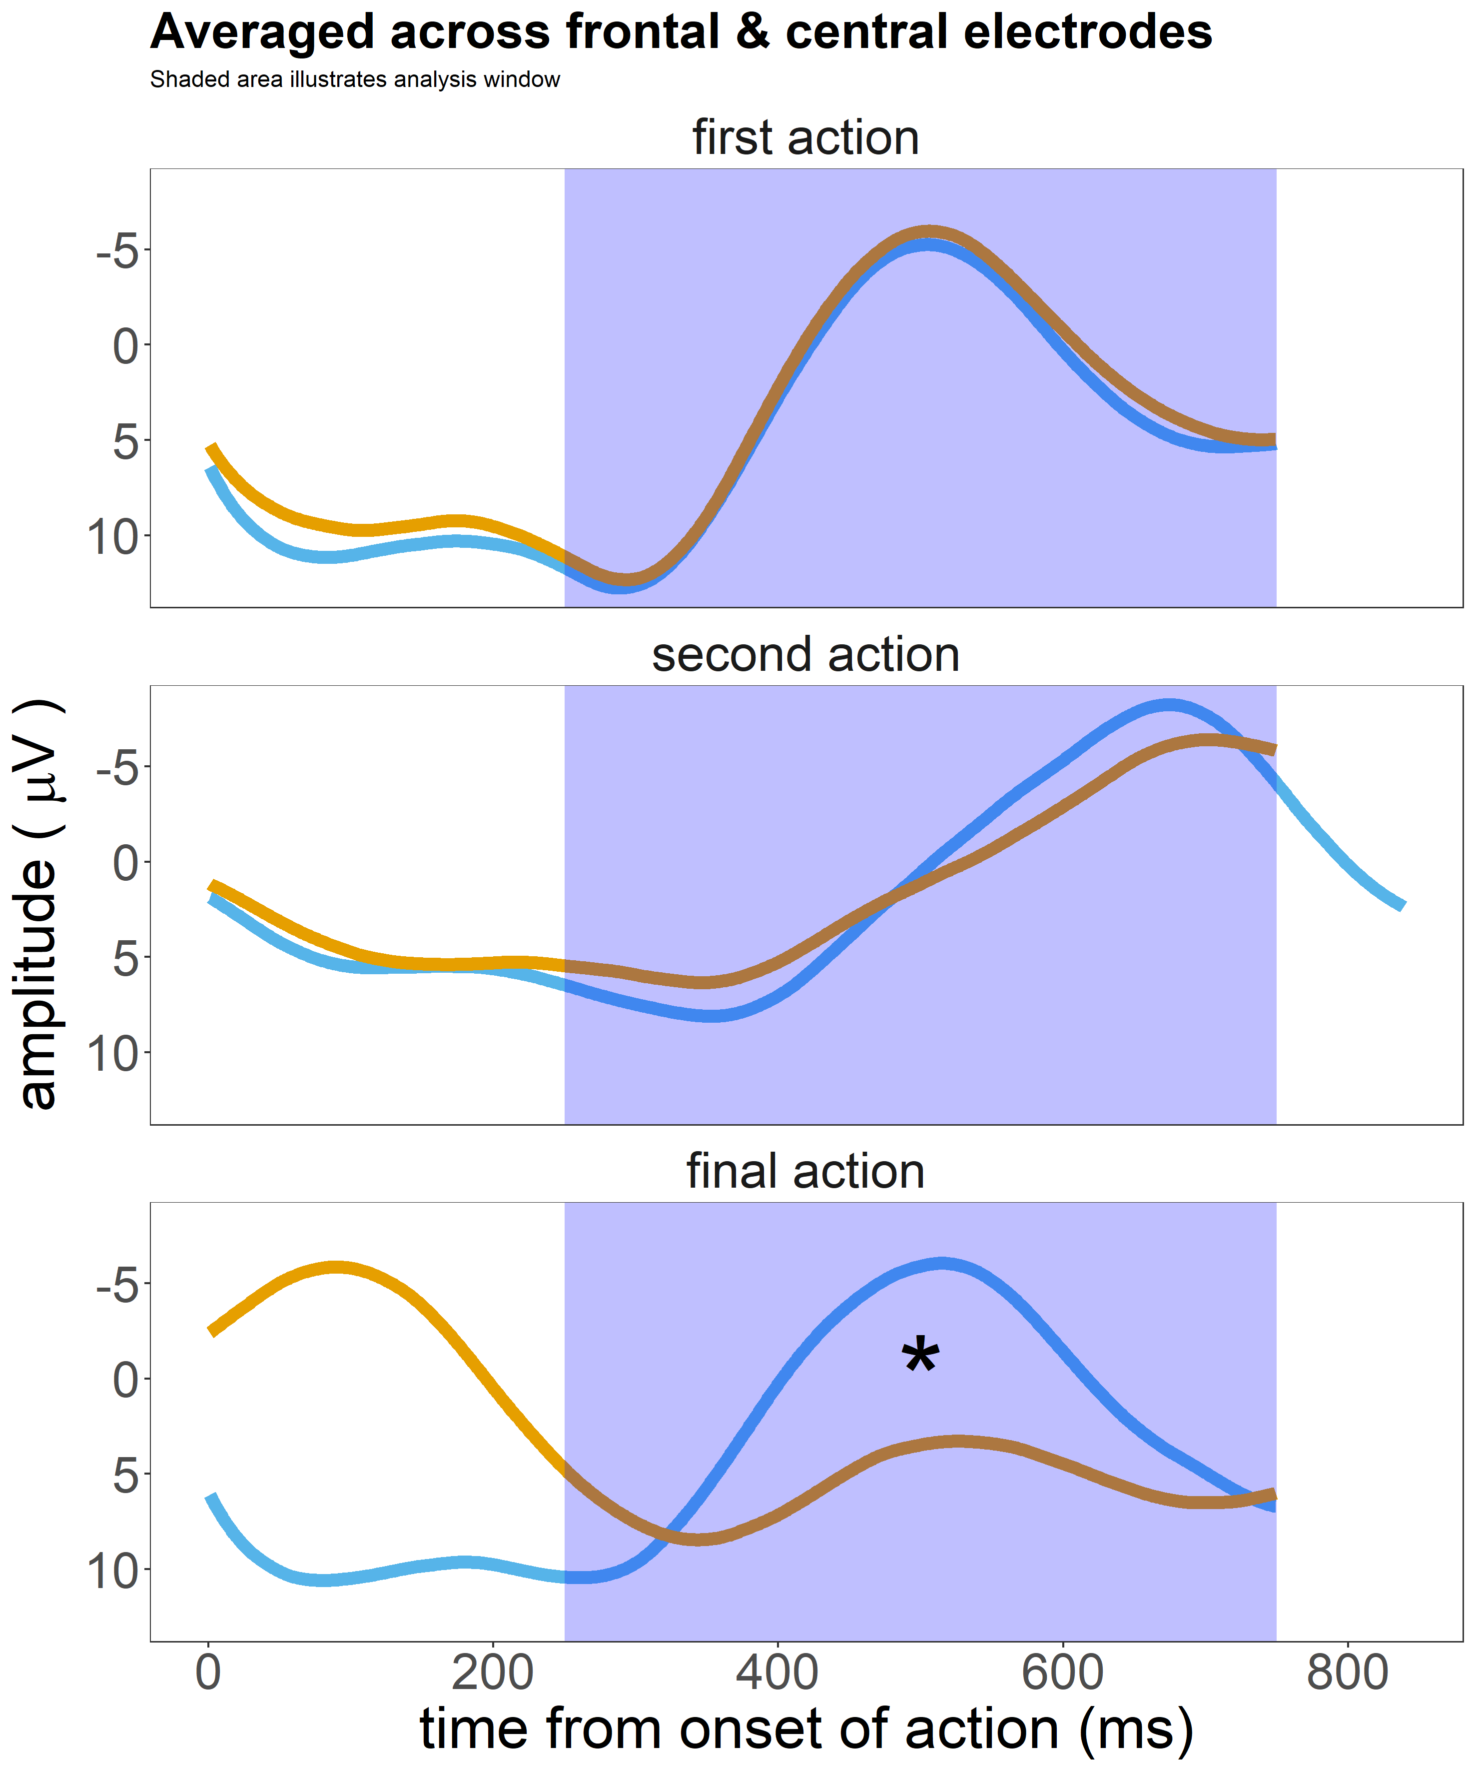
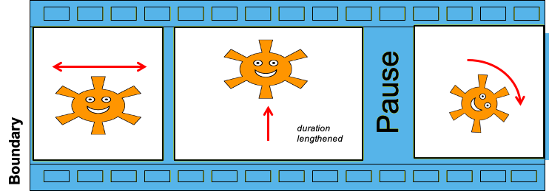

The effect of kinematic boundary cues on action sequence processing during infancy: An ERP study
Matt Hilton, Isabell Wartenburger & Birgit Elsner
University of Potsdam, Germany.
+
Please visit the supplementary website www.matthilton.de/ICIS2020 for a more in-depth description of the background, experiment and analyses.
BACKGROUND
We are interested in how infants process boundaries between individual actions of an action sequence.
Work with adults suggests that kinematic cues (properties of the movement) can signal the location of boundaries in action sequences.^{1*}
Two kinematic boundary cues are pause and pre-boundary lengthening.
RESEARCH QUESTIONS
Are 12-month-old infants sensitive to kinematic boundary cues?
Do kinematic boundary cues modulate processing of the subsequent action?
METHODS
Stimuli: cartoon videos of an animated character performing a sequence of three actions (e.g. stretch then jump then turn).
No-boundary trials contained no kinematic boundary cues.
Boundary trials contained a boundary between the second and final action, signaled by pre-boundary lengthening and pause.
12-month-old infants (N = 27; M_{age} = 11.7 months; SD_{age} = 0.7 months; 48% girls) were presented with both trial types in a randomized order, while we recorded EEG.
The Closure Positive Shift (CPS): an ERP component initially discovered as a marker of processing prosodic boundary cues in speech.²
CPS: a broadly-distributed positive shift in the ERP, beginning at the onset of boundary cues, and lasting approximately 500 ms.³
Recently, the CPS has been found in in 6-8-month-old infants as a response to prosodic boundaries in speech.⁴
We have also found a CPS-like positivity in response to kinematic boundary cues in adults.¹
This component likely reflects attentional/memory processes related to the segmentation of the action sequence.⁵
RESULT
The onset of the pause is followed by a positive shift in the boundary condition across our three regions of interest.
CONCLUSION
12-month old infants are sensitive to kinematic boundary cues.
Kinematic boundary cues evoke a similar EEG response as boundary cues in speech.
No-boundary
Boundary
F3,
Fz,
F4.
CPS?
C3,
Cz,
C4.
CPS?
P3,
Pz,
P4.
CPS?
The Negative Central (Nc) component is a marker of attention to and encoding of a stimulus.⁶
Nc: fronto-central negative peak approx. 250-750 ms following stimulus onset.
The Nc recently found to be related to action processing during infancy.⁷
RESULT
We found an Nc-like component in response to all actions except the final action in the no-boundary condition.
CONCLUSION
Kinematic boundary cues modulate encoding of the actions that follow.
First evidence of a role of kinematic boundary cues in early action processing.
Shaded area shows Nc analysis window
Matt.hilton@
uni-potsdam.de
+ DFG Research Group FOR 2253 Crossing the Borders
* References available at www.matthilton.de/ICIS2020
@Matthilton90

