Slide 1

NTHU Course Selecting System
GROUP 12
Member : 章竣雲、黃彥鈞、林鼎翔、魏士勛、許鈞崴、潘柏育、李承翰

Slide 2
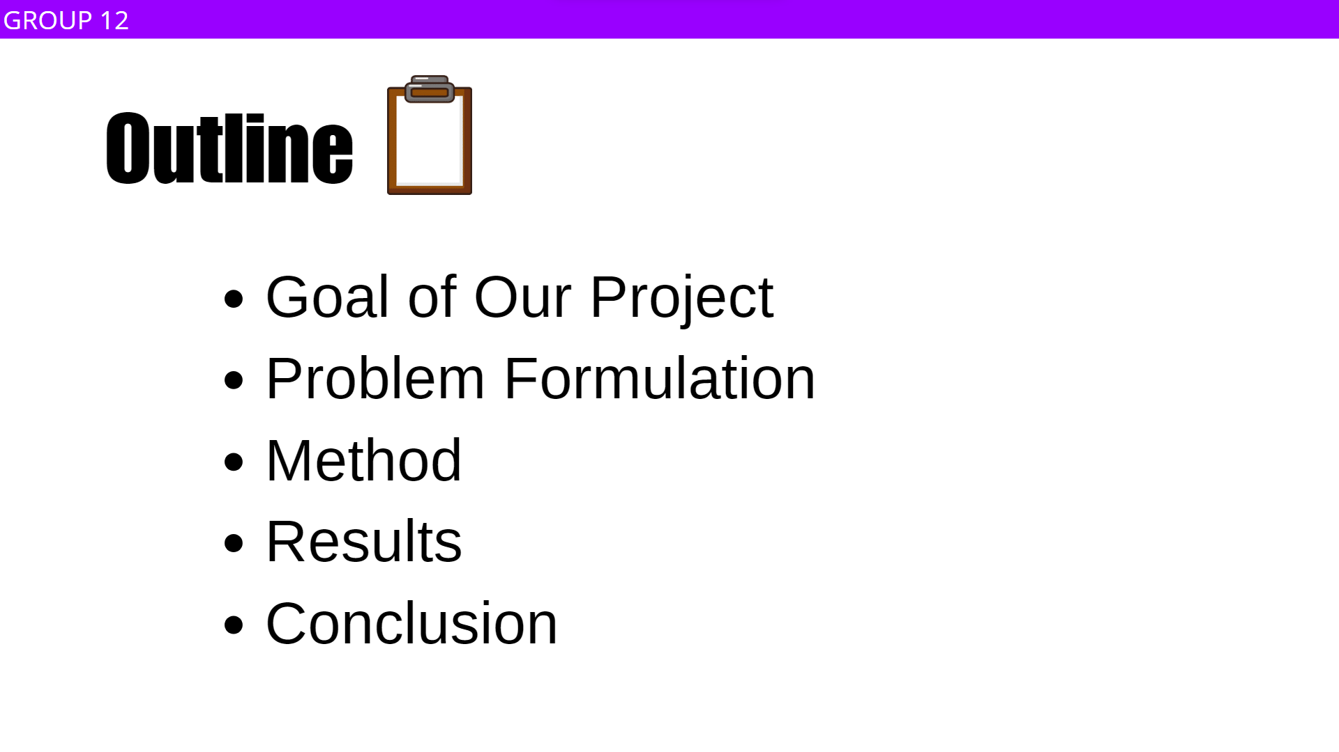
Outline
GROUP 12
Goal of Our Project
Problem Formulation
Method
Results
Conclusion

Slide 3
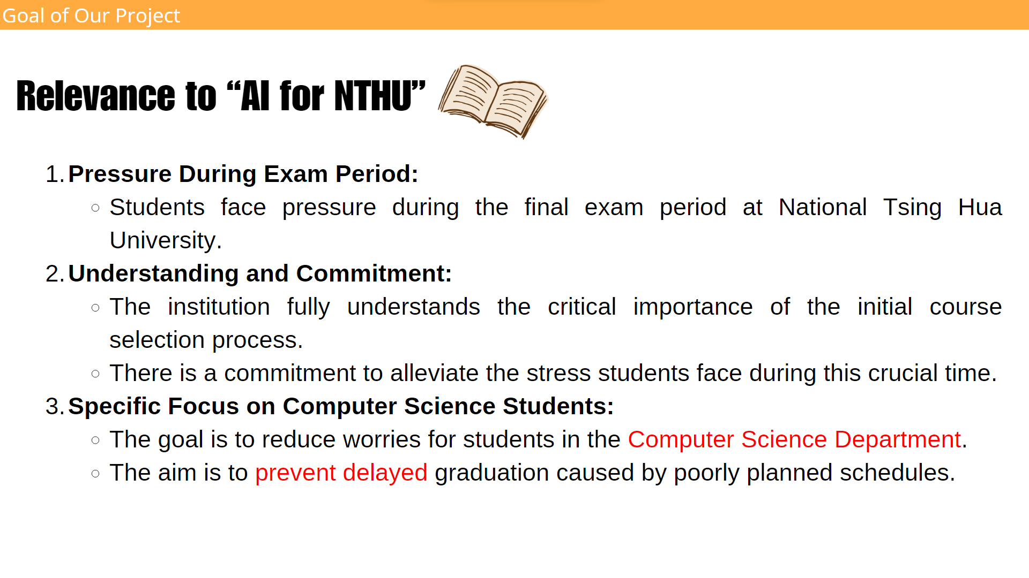
Relevance to “AI for NTHU”
Goal of Our Project
During the final exam period at National Tsing Hua University (NTHU), each student faces the pressure of exams, and the timing of initial course selection coincides with this period. We fully understand the critical importance of the initial course selection process at NTHU and are committed to alleviating the stress students face during this time.
Therefore, our goal is to reduce the worries of students in the Computer Science Department of NTHU in selecting courses, ensuring they don't face delayed graduation due to poorly planned schedules.

Slide 4
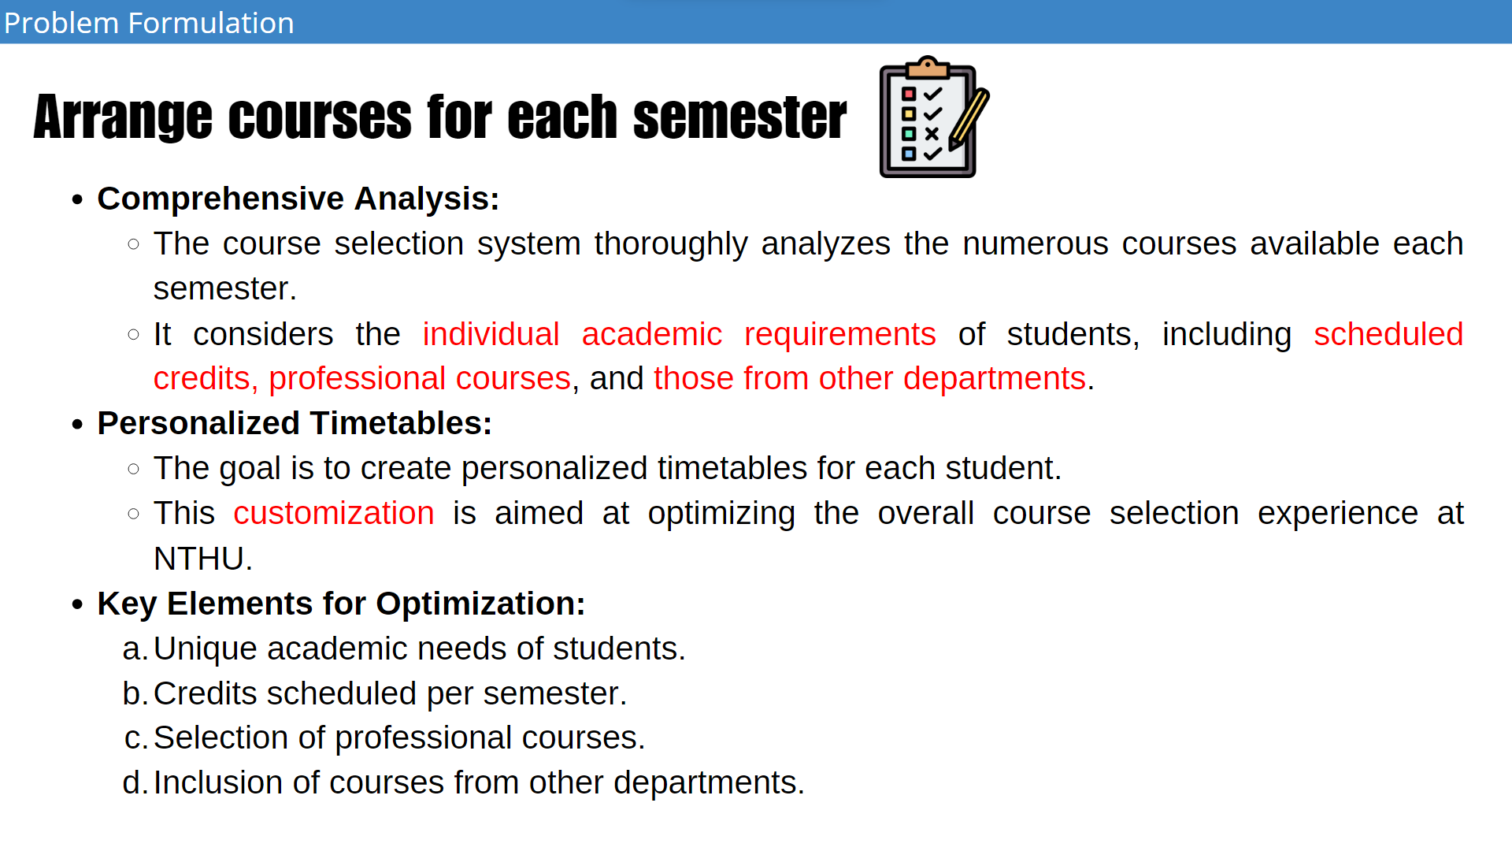
Arrange courses for each semester
Problem Formulation
This course selecting system will analyze the multitude of courses offered each semester, taking into full consideration the unique academic needs of each student, which are closely linked to their credits scheduled each semester, selected professional courses and courses from other departments.
Through these key elements, we aim to create personalized timetables for each student, optimizing the course selection experience at NTHU.

Slide 5
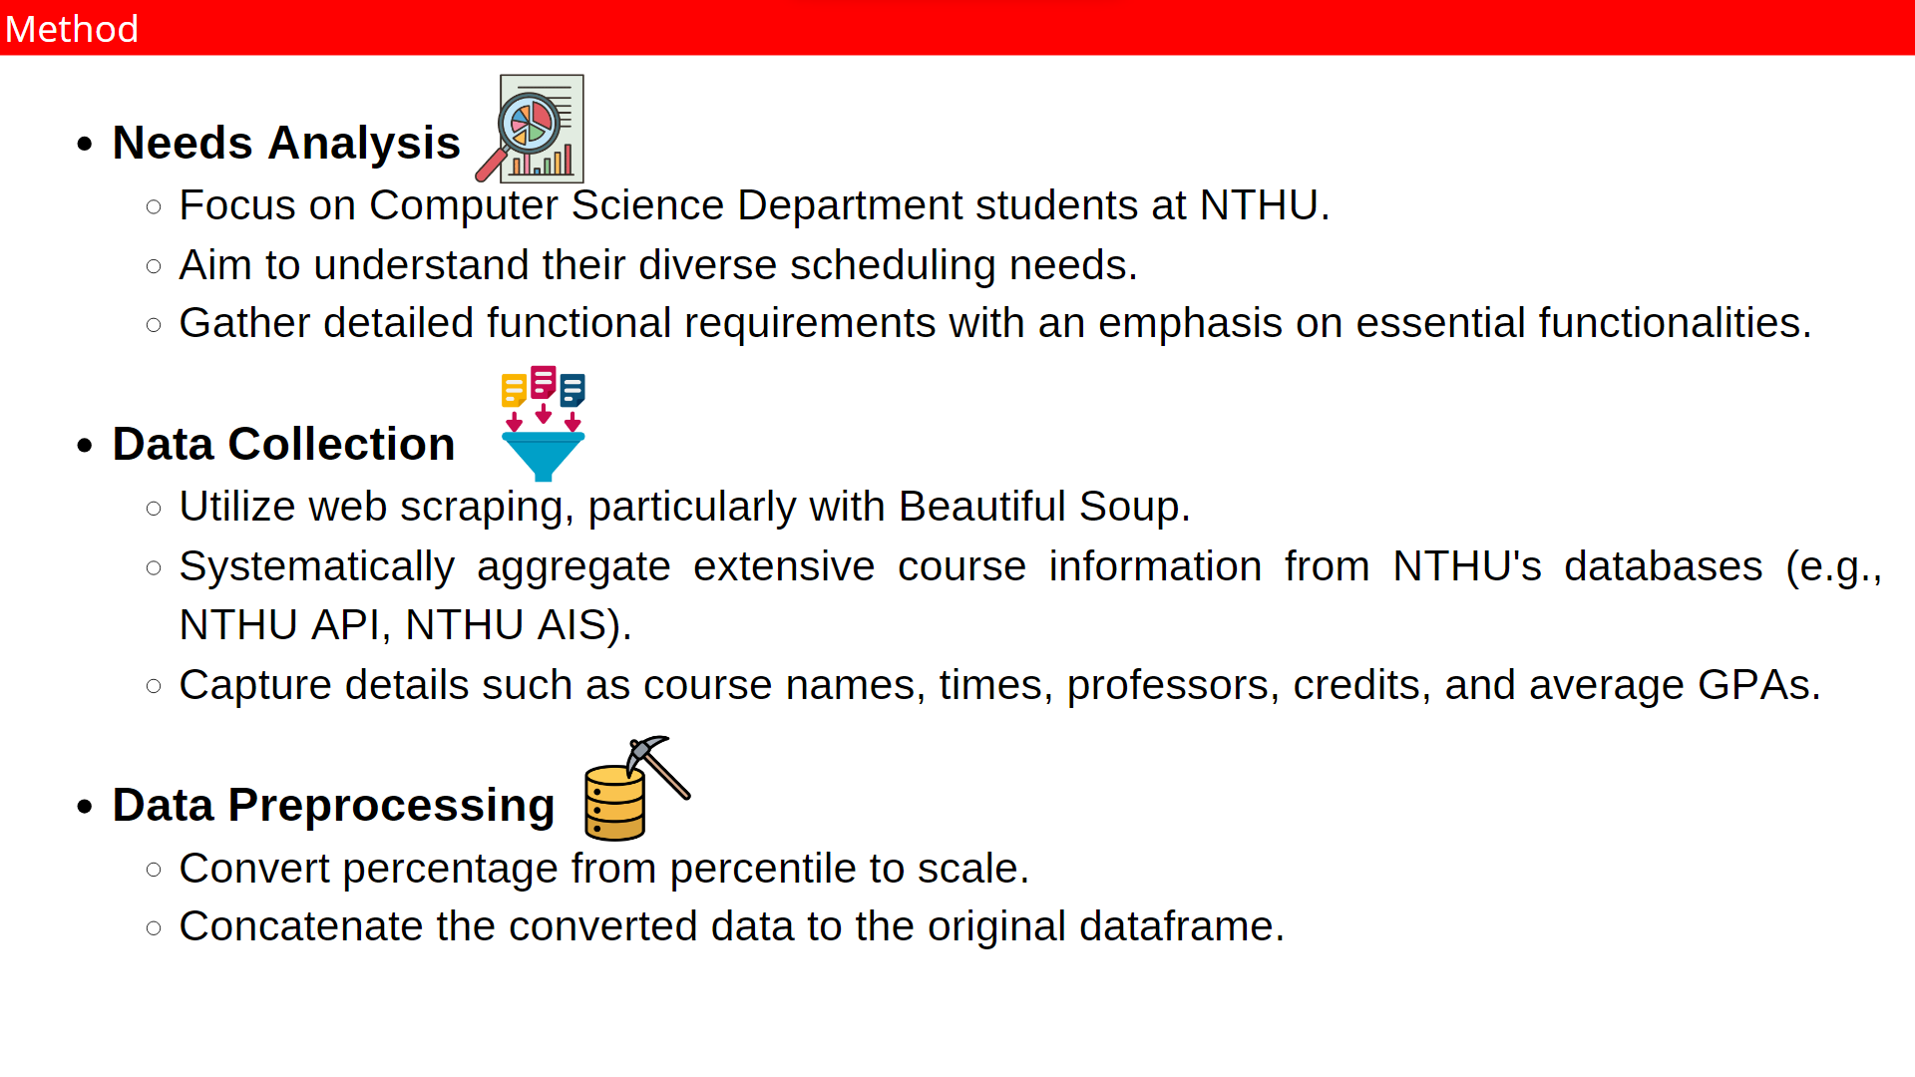
Method
Needs Analysis :
We focus on students in the Computer Science Department of NTHU to understand their diverse scheduling needs. We gather detailed functional requirements, emphasizing on essential functionalities.
Data Collection :
The data collection process will involve a systematic aggregation of extensive course information from NTHU's databases (e.g. NTHU API, NTHU AIS) by web scrapying with beautiful soup, capturing details like course names, times, professors, credits, and average GPAs.
Data Preprocessing :
Convert percentage from percentile to scale and concat to the original dataframe.

Slide 6
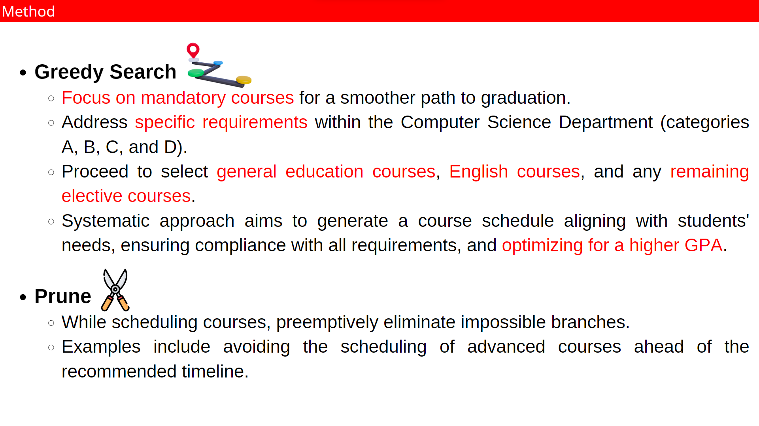
Method
Greedy Search :
To ensure a smoother path to graduation, we will initially focus on arranging mandatory courses. Subsequently, we will address the specific requirements within the Computer Science Department, including categories A, B, C, and D.
After satisfying these requirements, we will proceed to select general education courses, English courses, and finally, any remaining elective courses. This systematic approach aims to generate a course schedule that aligns with the students' needs, ensuring compliance with all requirements and optimizing for a higher GPA.
Prune :
When scheduling courses, we will preemptively eliminate impossible branches, such as taking advanced courses ahead of schedule.

Slide 7
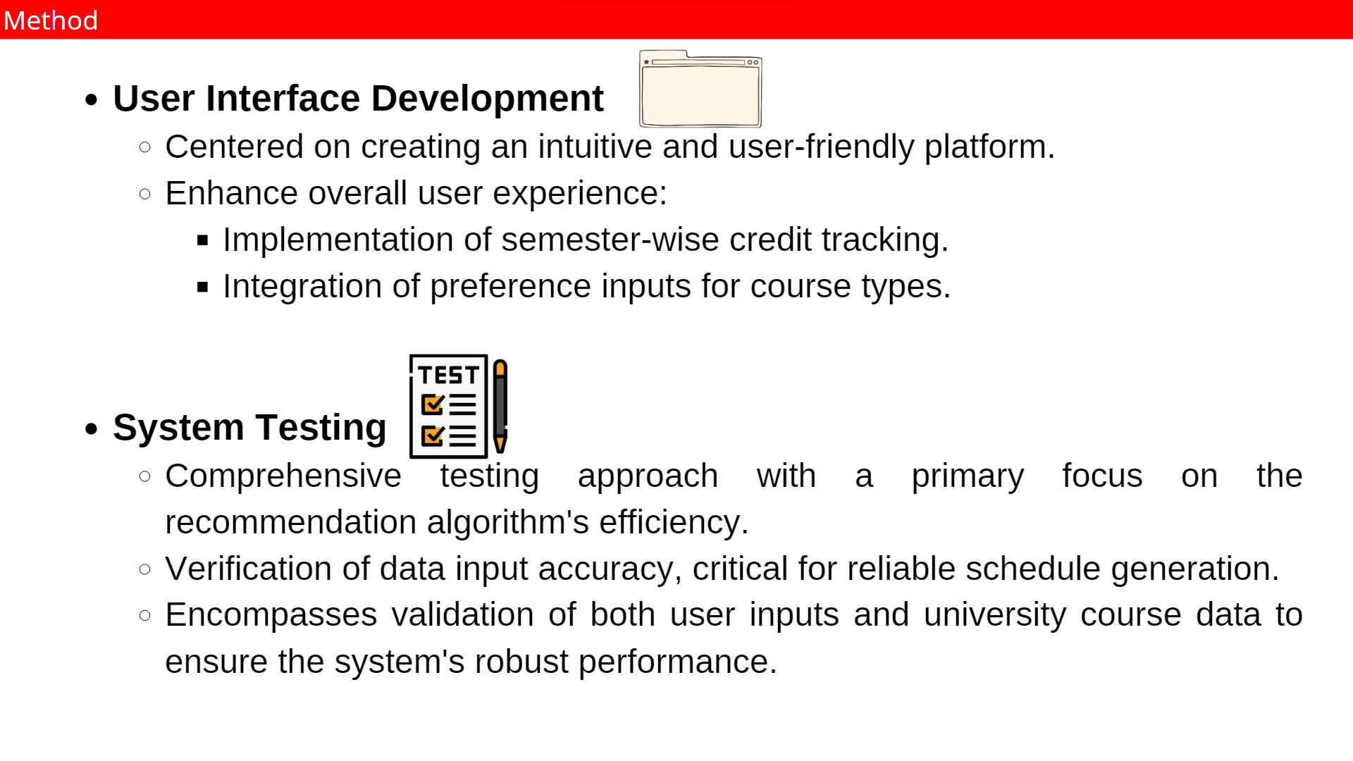
Method
User Interface Development :
The development of the user interface will be centered on creating an intuitive and user-friendly platform accessible to students in the Computer Science Department of NTHU. Key features such as credits of every semester, preference inputs for course types will be implemented to enhance user experience.
System Testing :
Testing will be comprehensive, focusing first on the efficiency of the recommendation algorithm to ensure it generates optimal schedules. The accuracy of data input, crucial for reliable schedule generation, will be rigorously verified, encompassing both user inputs and university course data.

Slide 8
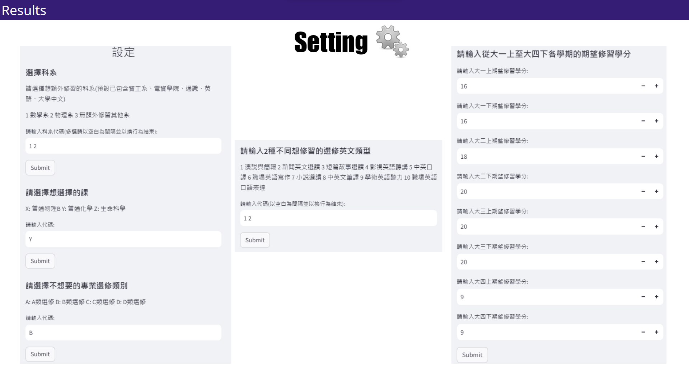

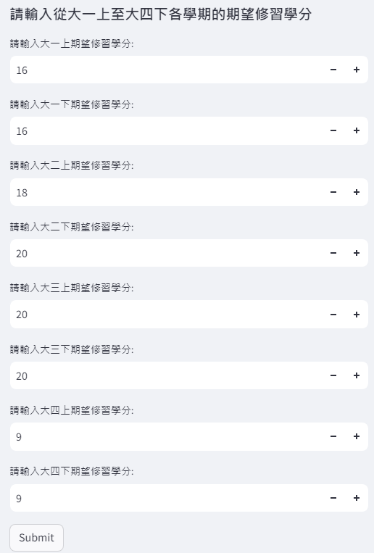
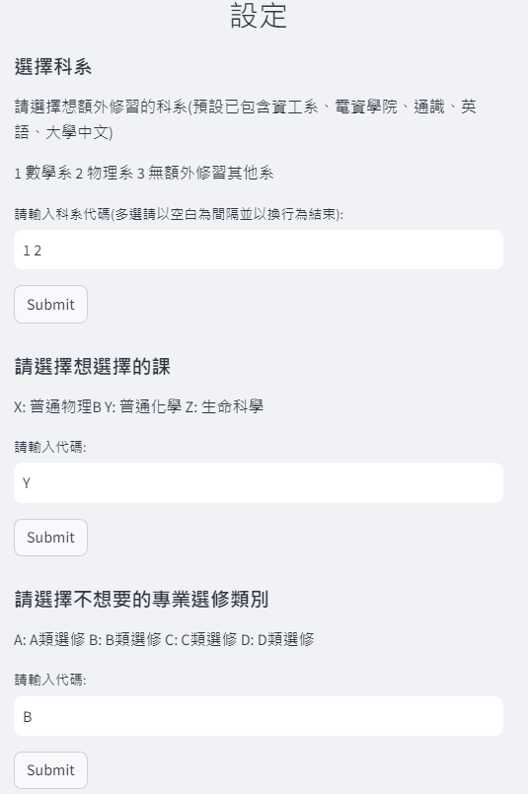
Setting
Results

Slide 9
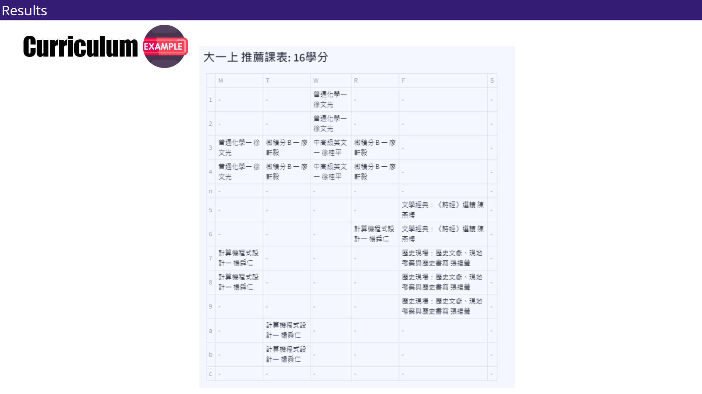
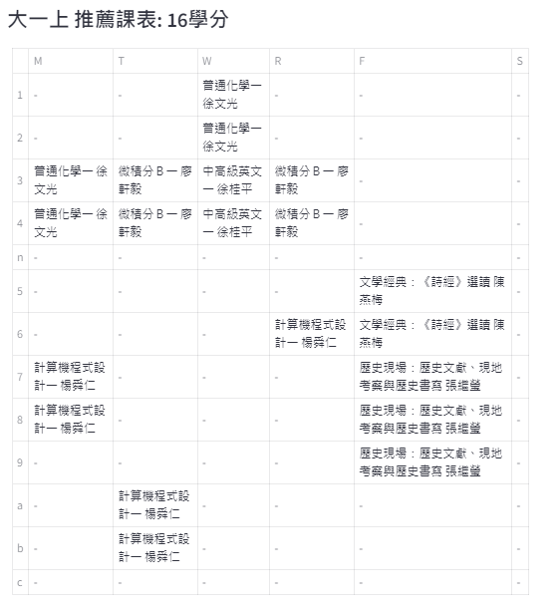
Curriculum
Results

Slide 10
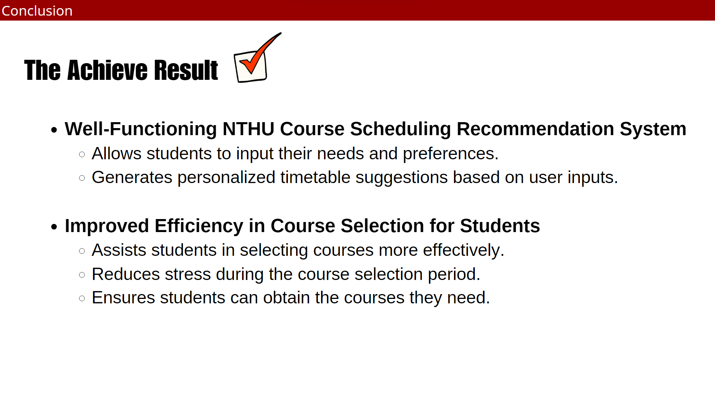
The Achieve Result
Conclusion
A Well-Functioning NTHU Course Scheduling Recommendation System :
The course selecting system allows students to input their needs and preferences, and then generates personalized timetable suggestions.
Improved Efficiency in Course Selection for Students :
The course selecting system can assist students in selecting courses more effectively, reducing the stress during the course selection period, and ensuring that they can obtain the courses they need.

Slide 11
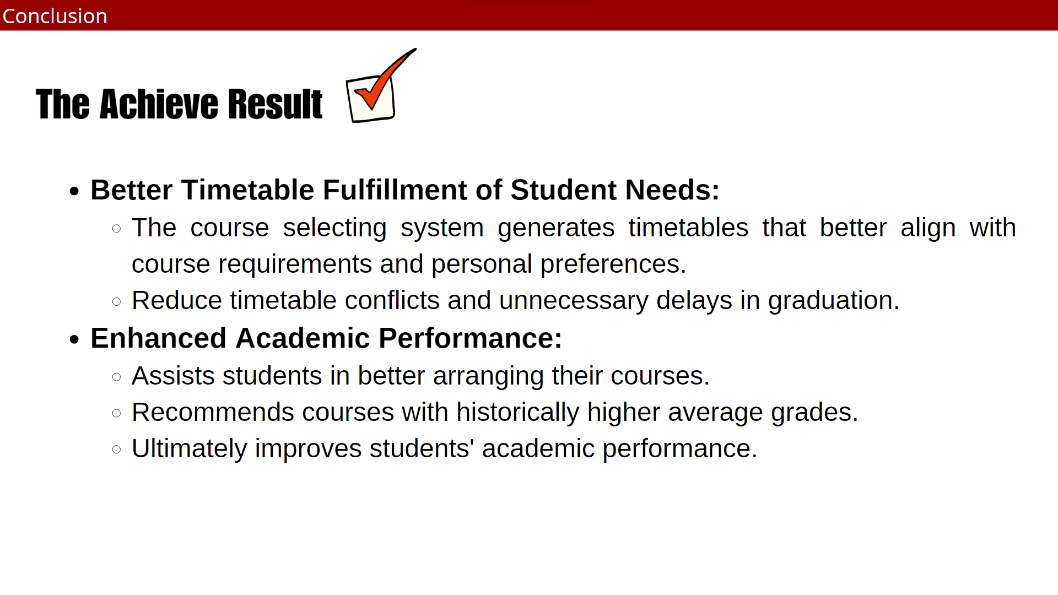
The Achieve Result
Conclusion
Better Timetable Fulfillment of Student Needs :
The course selecting system generate timetables that better meet the course requirements and personal preferences of students, reducing timetable conflicts and unnecessary delays in graduation.
Enhanced Academic Performance :
This course selecting system will help students better arrange their courses, recommending courses with historically higher average grades, ultimately improving students' academic performance.

Slide 12

THE END
GROUP 12

