Slide 1

Matthis van Treeck & Florian Thimm
DB2

Slide 2
Data Model and schema I
MongoDB uses “Flexible documents that map directly to objects in code”.
(JSON = Javascript Object Notation)
(https://www.mongodb.com/)
“MongoDB is considered schemaless because it does not require a rigid, pre-defined schema” (But you can define it)
(https://www.mongodb.com/resources/basics/unstructured-data/schemaless)
NoSQL

Slide 3

JSON
Human-readable
Structured and unstructured data in the same document
You can nest JSON to store complex data objects
JSON has a flexible and dynamic schema
Documents map to objects in most popular programming languages
(converted to bson)

Slide 4
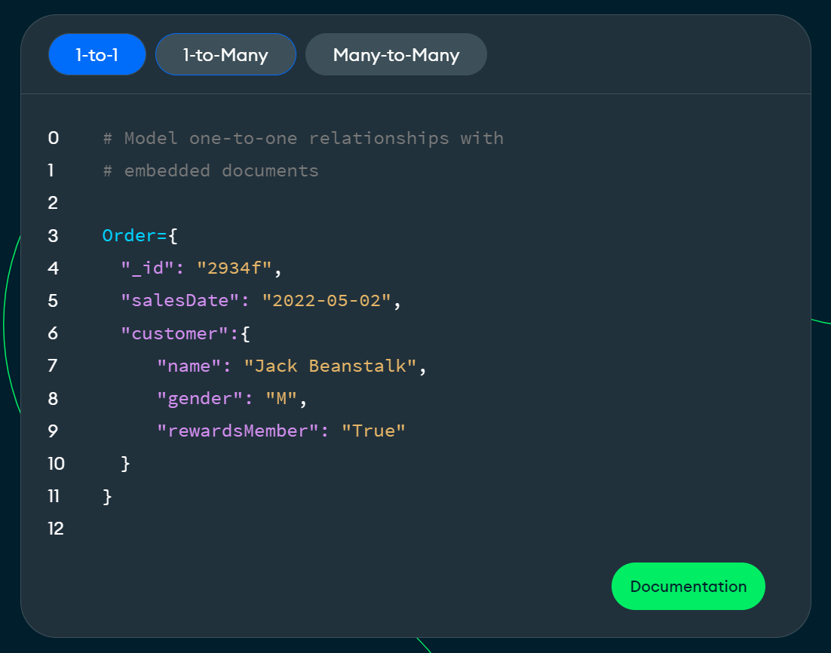
Data Model and schema II
JSON (BSON)
Automatically indexed (id)
What a document looks like (1 to 1)
Field: Value
Source: https://www.mongodb.com

Slide 5
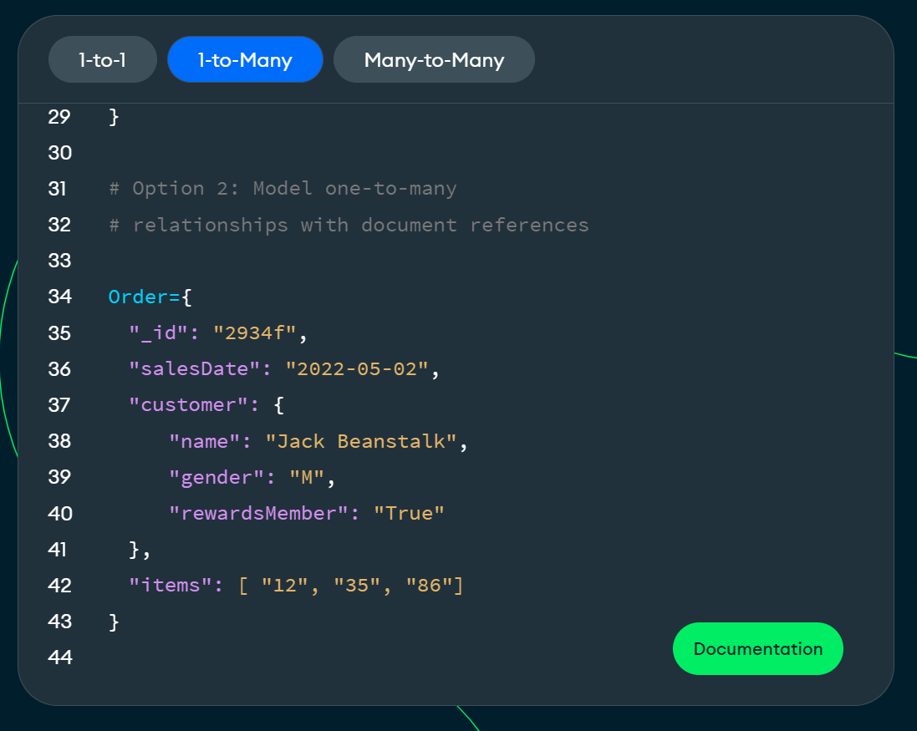
Data Model and schema II
What a document looks like (1 to Many)
Source: https://www.mongodb.com

Slide 6
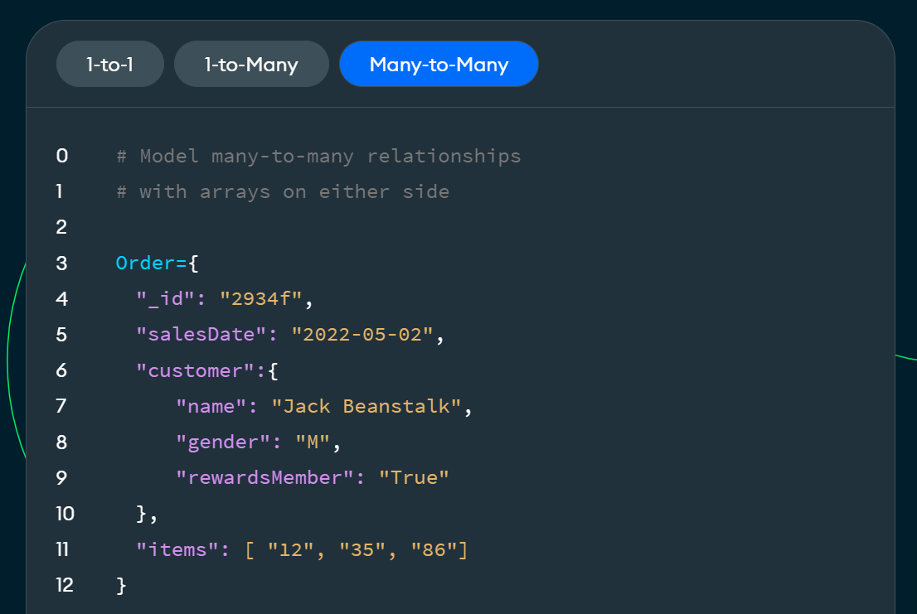
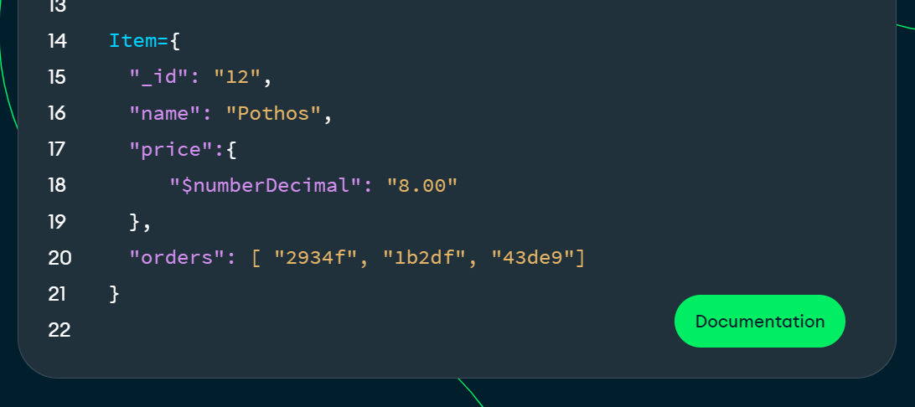
Data Model and schema II
What a document looks like (Many to Many)
Source: https://www.mongodb.com

Slide 7
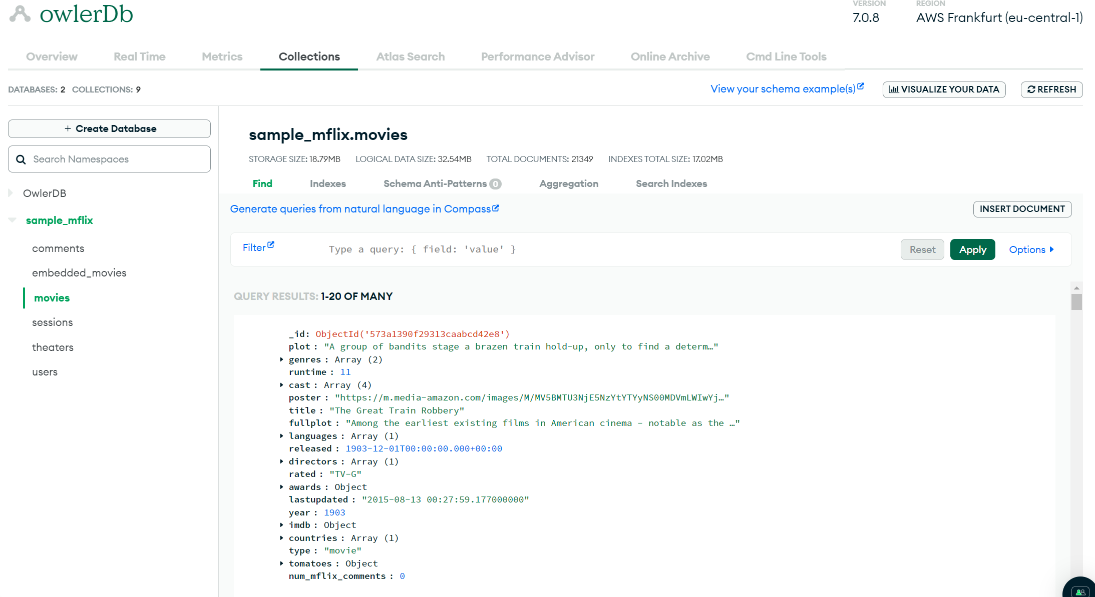
DB
Collections
Documents

Slide 8
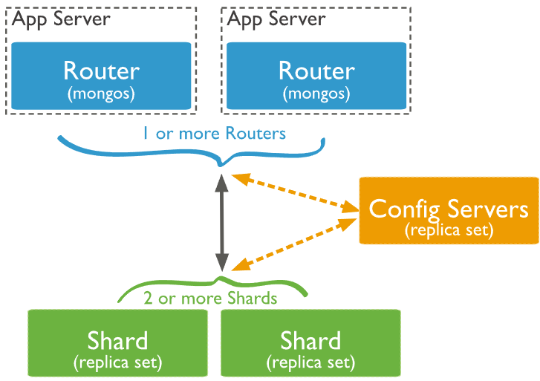
Sharding
Sharding
Config Server
Shards
Downsides
https://www.mongodb.com/docs/manual/core/sharded-cluster-shards/

Slide 9
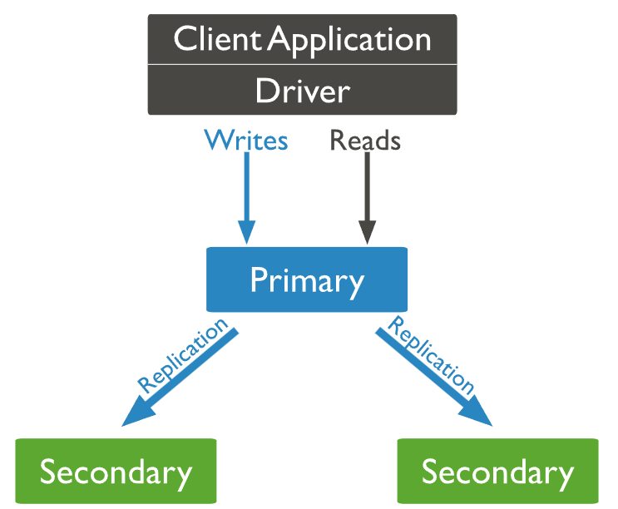
Replication
Replica sets
Primary node
Secondary nodes
Downsides
https://www.mongodb.com/docs/manual/replication/

Slide 10
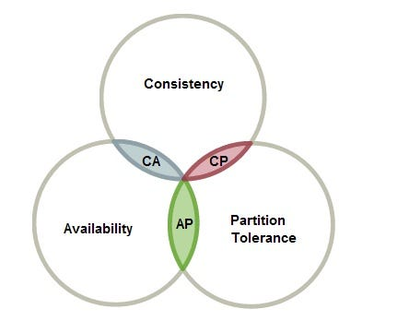
CAP and Consistency
High availibilty/partion tolerance
Eventual consistency
Optionally consistency over availibilty
Strict consistency
ACID
https://www.geeksforgeeks.org/where-does-mongodb-stand-in-the-cap-theorem/
https://www.mongodb.com/docs/manual/core/read-isolation-consistency-recency/
https://www.mongodb.com/docs/manual/core/causal-consistency-read-write-concerns/

Slide 11
Security
Authentication/Authorization
Access Control
Encryption

Slide 12
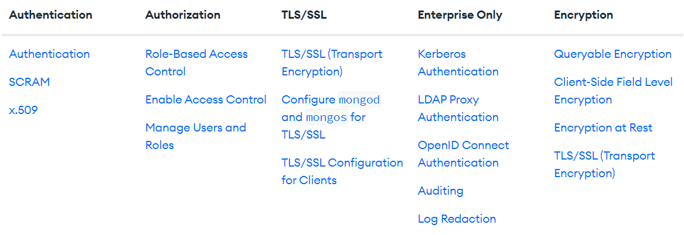
Security
https://www.mongodb.com/docs/manual/security/

Slide 13
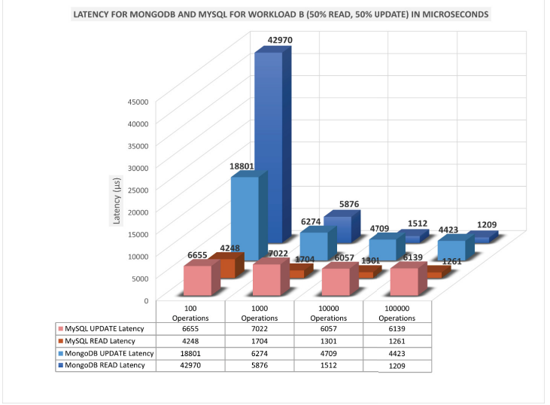
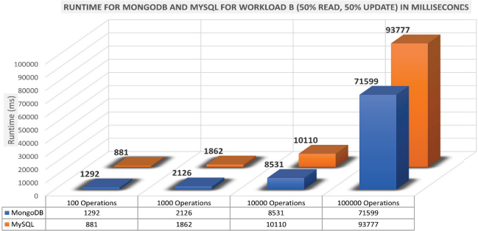
Performance MySQL
Latency
Runtime
https://www.diva-portal.org/smash/get/diva2:1738800/FULLTEXT01.pdf

Slide 14
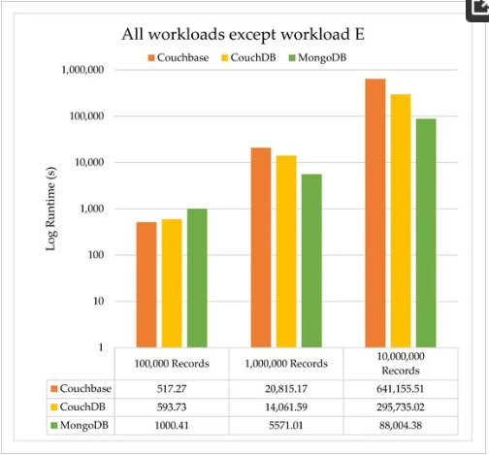
Performance other NoSQL
https://www.mdpi.com/1999-4893/16/2/78

Slide 15

When to use MongoDB
General-purpose database
"The Database for programmers"
Use MongoDB when you have:
Lots of unstructured/Complex Data
Data structures that evolve (Agile)
Needs for a Highly scalable and fast DB (Online Games, Social Media Platforms)

Slide 16

Use Case
Needs to be fast
Documents may have completely different fields
New products would constantely require changes to the schema
Lots of unstructured data
Personalized Views through unstructured data

Slide 17
Companies that Use MongoDB
Ebay
EA
BOSCH
Delivery Hero
SEGA
Facebook

Slide 18
History
Founded by Dwight Merriman, Eliot Horowitz, and Kevin Ryan
Started in 2007 formerly known as 10gen
Switched to open source model in 2009
2013 they officially became "MongoDB"
2017 They became a publicly traded company

Slide 19
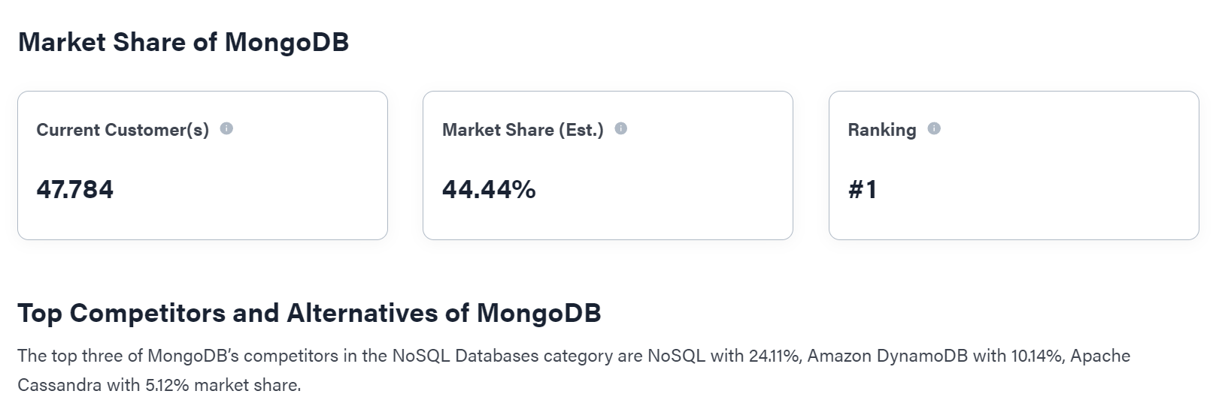
Market Share of NOSQL DBMS
https://6sense.com/tech/nosql-databases/mongodb-market-share

Slide 20
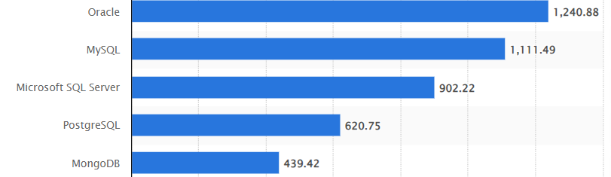
Ranking of the most popular database management systems worldwide, as of September 2023
https://www.statista.com/statistics/809750/worldwide-popularity-ranking-database-management-systems/

Slide 21
Demo
Schema Definition
Aggregate functions (complex Queries)
Geo Location queries
Joins

