Slide 1

Library Traffic
Team ID: s23-02
Matthew Hughes and Joseph Terranova
Projects class, Professor Hanh Pham, Spring 2023

Slide 2
Outline
1. Problem Description
1.1 Business Context and Goals
1.2 Technical Requirements
1.3 Your Responsibilities
2. Technologies
2.1 Newly Learned Skills/Technologies
3. Plan
3.1 Ideas for Solution (Architecture + Protocols)
3.2 Programming/Coding Components
3.3 Schedule

Slide 3
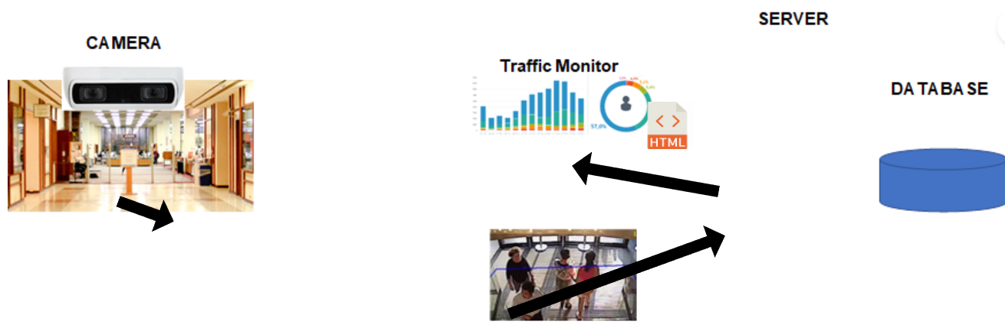
Problem Description
The Traffic Camera will count the amount of people who cross its detection line. Inward counts as an enter. Outward counts as an exit.
Then the camera will store the counting data in an excel file which the user will then manually upload to our sites database.
This data will then be propagated to our website which will display the data in our graphing dashboard.

Slide 4
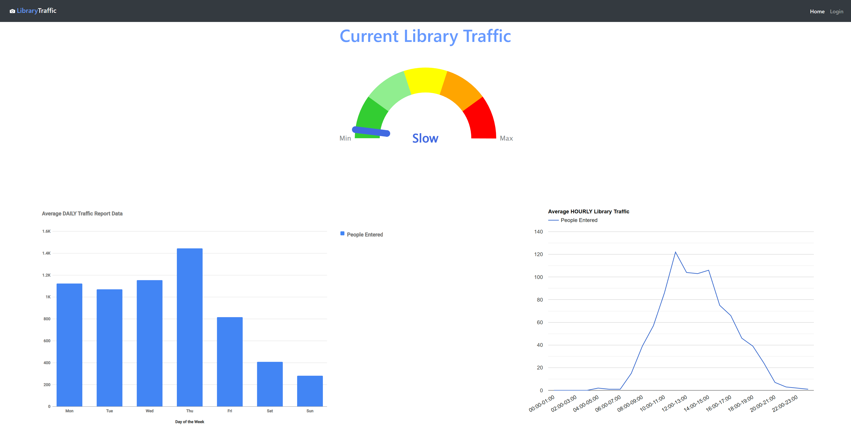
1.1 Business Context and Goals
Communicating with clients to hash out any issues that were previously known as well as obtaining feedback for the project
Discussing the future of the project and what actions should be taken to keep the project on the right course
Goals:
Allow Users and staff alike to view the current traffic of the library based on the predictions made by the software
Fix any bugs and have the transfer of camera data to the SUNY New Paltz database become more fluid

Slide 5
1.2 Technical Requirements
Processing:​
Login​
Input Username and Password​
Check database for matching credentials
If True create a new session​
Admin​
Website data management
Camera data management
User management
Analytics
Environment
Desktop web browser
Internet connection
System Components
User Interface
Any desktop web browser
Data
Input:
The camera (above the entrance of the library) captures images of people entering and exiting the library
Output:
Graphs illustrate traffic volume over a specified time to help for analysis
Hardware
No additional hardware needed

Slide 6

1.3 Responsibilities
Matthew Hughes:
Clean up user interface
Expand functionality of camera data transfer
Joseph Terranova:
Fix the filter
Test downloading and uploading buttons

Slide 7
2. Technologies
MySQL – create tables and store website data
Front End/User Interface
HTML – main structure of the website
CSS – basic styling
Bootstrap – CSS framework for a responsive webpage
Back End/Database
PHP – used to query the database and to help create a more dynamic webpage

Slide 8
2.1 Newly Learned Skills and Technologies
Joseph Terranova:
MySQL
PHP, specifically for creating queries.
Matthew Hughes:
PHP
Understanding and reworking pre-existing code.

Slide 9
3. Plan
Originally the plan was to simply fix any prevalent bugs and improve the UI then proceed with implementing new features such as data analytics and an easier way to move the data from the camera to the database. However, after trying to implement different fixes for the queries/filters as well as noticing how prevalent the bugs are and the difficulty they are causing, our new plan is to fix the foundation of the code and implement better logic so that the queries and transferring of data will become a lot smoother and less likely to have future issues. The starting point will be creating new tables that contain both the exit data and entry data rather than keeping them separate.

Slide 10
3. Plan Continued...
With that said, properly commenting on the logic being used so that there will be less confusion when working on the project, as it stands there is little to no comments which has created difficulty in getting a grasp on what the previous teams that worked on this were attempting to do.

Slide 11
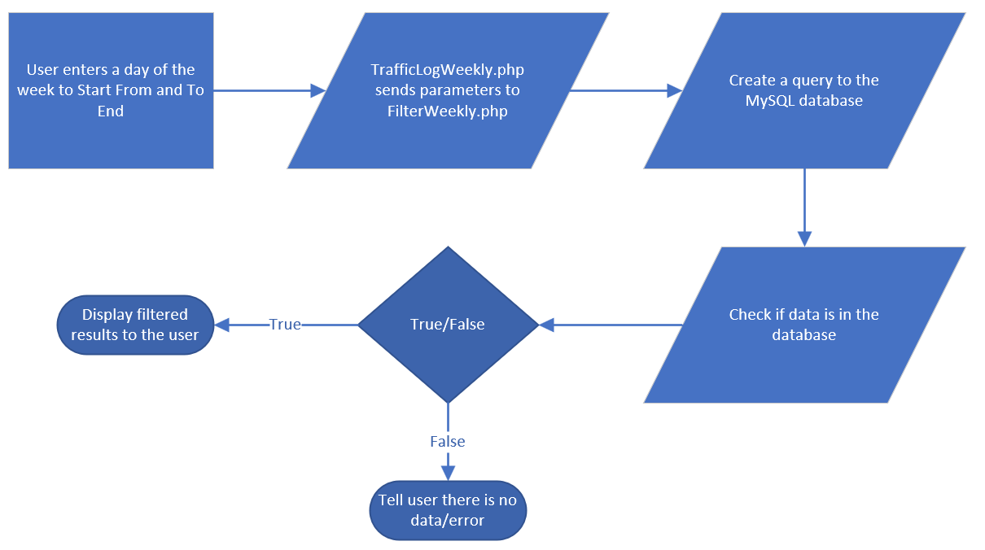
3.1 Ideas For Solution (Architecture + Protocols)
Make the code more sustainable for future groups
For a solution we propose to create a navbar file and a config file so rather than including the code within every file that needs it we can simply make a include statement to those files.
Unifying database tables to reduce complexity
The TrafficLog pages (daily, weekly, monthly and annually) each require a separate filter file. The request is sent by the given TrafficLog page, and a query is made to the database. After gathering the data, it is displayed to the user.
Filter protocol

Slide 12
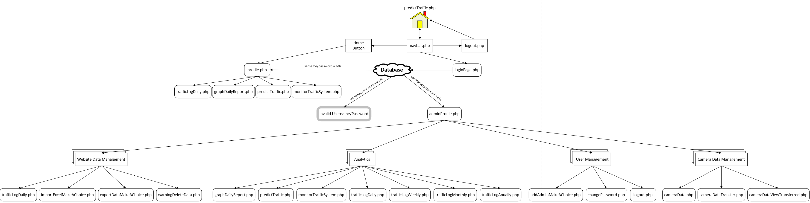
3.1 Ideas For Solution (Architecture + Protocols) Continued...
Library Traffic Architecture

Slide 13
3.2 Programming/Coding Components
Front End
HTML
CSS
Back End
PHP
MySQL
Frameworks
Bootstrap

Slide 14
3.3 Schedule
Date 2/5 2/12 2/19 | Task Speak with supervisor about project Plan out necessary steps and give out tasks Switch over to the new database
2/26 | Use a config file to connect to said database and reorganize files/ file structure
3/5 | Talk to clients and get more information about the system and what they need
3/12 | Continue to fix UI and work on filter and work on automating the transfer of data
3/19 | Work on midterm and continue fixing the website and a automatic transfer of data
3/26 | Work on midterm report and slides

Slide 15
3.3 Schedule Continued..
Date | Task
4/2 | Speak with clients about the necessary changes that need to be made
4/9 | Fix underlying foundation issues/ Change database tables
4/16 | Implement new code to the filters to work with new tables
4/23 | Work on transferring camera data to database/ add comments
4/30 | Bug fixes/clean up
5/7 | Final preparation

Slide 16
Demo
https://cs.newpaltz.edu/p/s23-02/v2/v4-traffic/

