Slide 1
Classroom Unit 2: (L)ockdown and (E)valuation

Slide 2
“Over the past decade, there were at least 180 shootings at K-12 schools across the US.”
https://edition.cnn.com/interactive/2019/07/us/ten-years-of-school-shootings-trnd/

Slide 3
“The median age of school shooters is 16.”
https://www.washingtonpost.com/graphics/2018/local/school-shootings-database/

Slide 4
Most school shooting incidents last less than fifteen minutes.
https://journals.sagepub.com/doi/pdf/10.1177/2158244014525425

Slide 5
Discussion
Think of various types of safety drills you have trained for e.g. tornado, fire. What are the differences between the various types of drills and how do they compare to a hypothetical active shooter situation?

Slide 6
(L)OCKDOWN

Slide 7
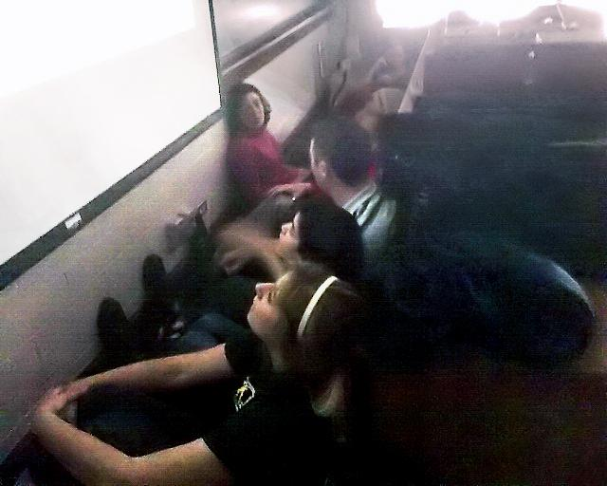
Students locked down during Virginia Tech Shooting in 2007.

Slide 8
Lockdown Protocol
1. Teachers would gather any students from hallways that were in close proximity to their classrooms and then lock the classroom door.
2. Any windows into the classroom would be darkened.
3. Students would gather in the corner farthest from the door and out of sight from the hallway.
4. Students would be instructed to be absolutely quiet.
5. Everyone would stay that way until law enforcement came to release everyone from the classroom.
https://pdfs.semanticscholar.org/e682/f3cea232b66de8a9284b0e29210985ed6aa3.pdf?_ga=2.27804540.1701441260.1571559182-939610737.1571559182

Slide 9
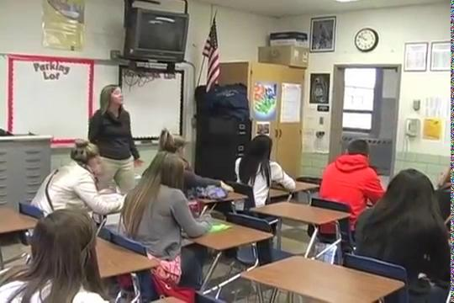

Slide 10
Lockdown protocol should be just one of the options and not the standard practice.

Slide 11

Research Finds Traditional Lockdown is No Longer a Viable Stand-Alone Solution

Slide 12
Lockdown Scenario
An active shooter will approach the classroom. Participants will be able to hide wherever they want.
The activity will last five minutes.

Slide 13
Response
What did you learn from the lockdown exercise? How effective did you find it?

Slide 14
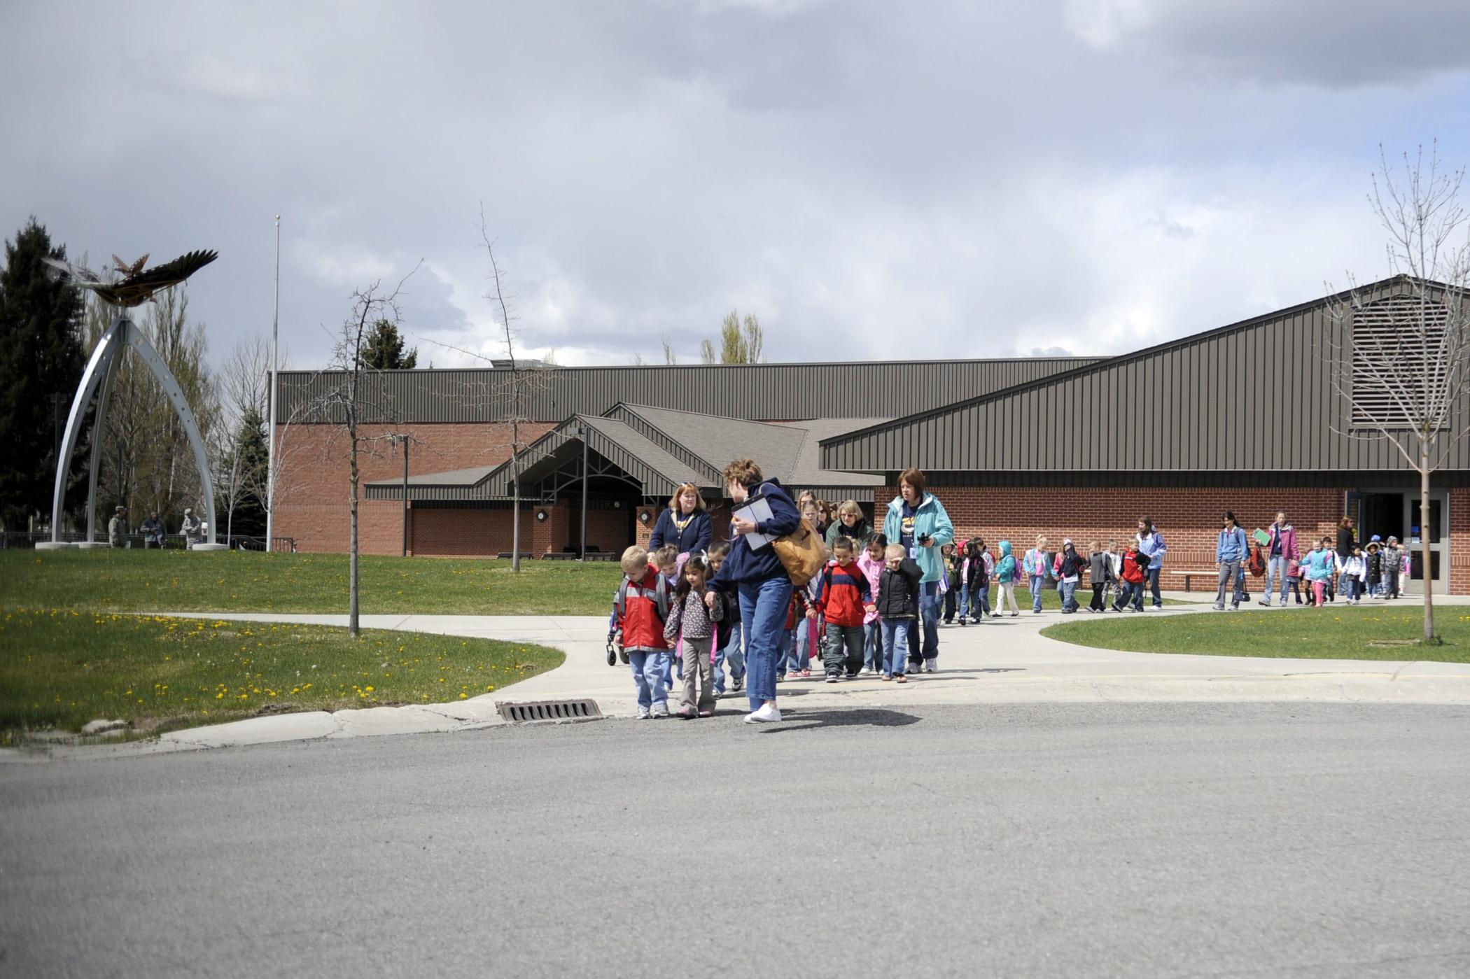
(E)vacuation

Slide 15
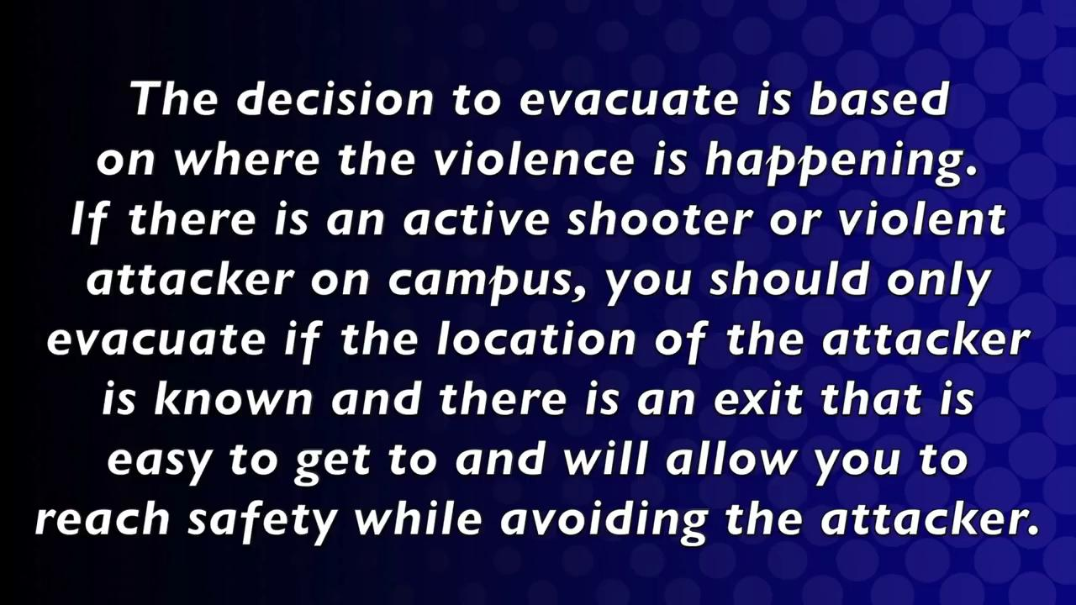

Slide 16
Evacuation now!
Evacuation means getting out of the danger zone to the rally points as soon possible.

Slide 17
It is critically important to know your school buildings layout well in order to determine the best escape route.

Slide 18
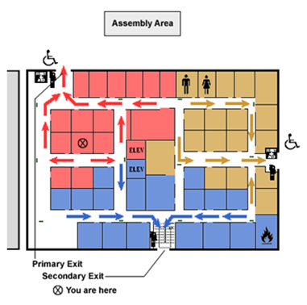
How well do you remember your school’s exit route?
https://www.osha.gov/SLTC/emergencypreparedness/gettingstarted_evacuation.html

Slide 19
Your escape route will depend on your location within the compound and the direction the shooter is approaching from.

Slide 20
It is of the utmost importance that the evacuation procedure be planned well in advance and practiced periodically. The safe location/rally points should be well known.

Slide 21
Remember people with disabilities!
Make when your evacuation plans are developed that allowances are made for people with specials needs and disabilities. Communication and practice are particularly key in this regard.
https://www.alicetraining.com/wp-content/uploads/2016/07/evacuation-of-pwd-and-emergent-limitations-2nd-edn-by-lee-wilson.pdf

Slide 22
Given the school zone you are assigned to, you should be able identify the correct safe location.

Slide 23
You should attempt to clear the room. (If someone is not willing to move, don’t let them hold you back.)

Slide 24
Make sure personal belongings are left behind. The most stuff you try to carry, the slower you will go. Forget it and run!

Slide 25
However, teachers should secure the class roster. This is critically important so there is a record of who was where at a given point.

Slide 26
Attendance should be taken at the designated safe location. After the event is concluded, everyone will need to be accounted for.

Slide 27
Evacuation Scenario
Participants are to determine the most appropriate escape route and evacuate the room as quickly as possible using the proper procedures.
The exercise will last for seven minutes.

Slide 28
Response
What did you learn from the evacuation exercise? How effective did you find it?

