Slide 1
ELT2- Social Media Technologies for Teaching and Learning
Group 5: Jenni, Libby, and Matt

Slide 2
1.
Home Improvement
Concrete Staining & Sealing Concrete
Notes:
I chose a home improvement video, because, as mentioned in my bio, I’m a do-it-yourself person, and am working on finishing my basement.

Slide 3
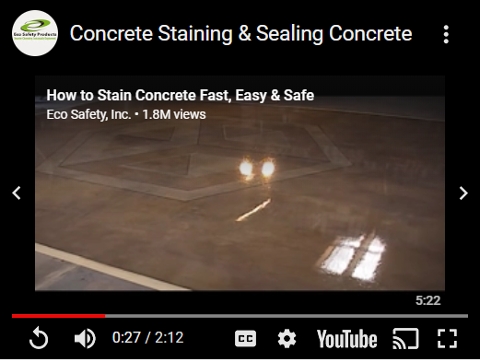
TARGET AUDIENCE
Beginners to Professionals
DIYers
Self-Motivated
Desire Ease of Use
Desire Green Products
youtu.be/1gWNp_B-dhw
Notes:
Not everyone likes projects, however, in terms of a target audience, this is meant for a broad range of skill sets for people who are interested in improvement projects for themselves or others.

Slide 4

“The Best Just Got Easier”
Notes:
The appeal is upfront, for example: attention grabbing quote; green product branding

Slide 5
STRENGTHS - MULTIPLE
Pros:
Concise, focused, well paced
Visually and aurally aligned
Sequentially based
Each step was clearly described using three modalities, including its purpose
Best practices were provided
Notes:
In this case, using three modalities worked out well due to the brevity of each modality, and didn’t add extraneous load.

Slide 6
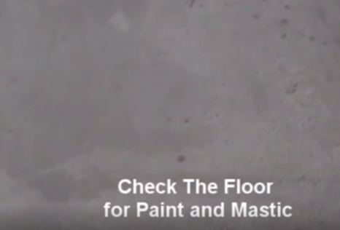
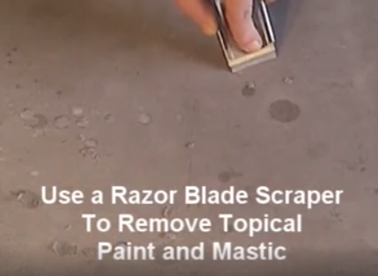
STEP PRESENTATION
A single action conveyed with spoken word, written word, and visual image
Followed by instruction on how to carry out the action as easily as possible
Notes:
Best practice, or prerequisite, example

Slide 7
WEAKNESSES - FEW
Cons:
Small amount of missing information
EX: How messy is this? Is there a proper way to protect surrounding walls, etc.?
Notes:
Was this truly a weakness, or omitted because it was extraneous?

Slide 8

COGNITIVE LOAD
 | CONCRETE STAINING WITH ECO SAFETY PRODUCTS 5:21 VIDEO
INTRINSIC | •Moderate load for a beginner, well distributed segments, sequentially presented tasks •Possibly a moderate load for a professional if they are more familiar with a different method
GERMANE | Uses and skills can be applied in a variety of locations, techniques are very similar
EXTRINSIC | None

Slide 9
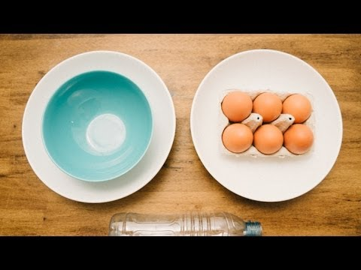
Video 2: How to Separate Egg White and Egg Yolk
Watch
Video

Slide 10
Questions:
1. Who might be the target audience of the clip?
Entry level cooks on an international level
Anyone who has to make a meringue pie during Thanksgiving
2. What is the strength of the video clip in terms of its instructional quality?
There is no extraneous information in this video. It is straight to the point.
It starts out (visually) with the supplies that you need and goes straight into the steps to master the skill.
You do not need to be able to read English to understand the steps of this video. It can be used for a non English speaking audience.
It shows the efficiency of the new instruction compared with the traditional way of separating yolks.
The music is a nice touch and keeps the learner engaged in the process.

Slide 11
Questions:
4. What can be added, or removed, in order to improve the clip’s instructional quality?
From a design principal, it is never safe to assume that the learner understands the context or background of a previous method. This video assumes that the learner understands how to separate eggs in the traditional way. He does not take time to explain what he is doing with the egg shells.. A more clear explanation of this could be added.
3. What is the weakness of this video clip in terms of its instructional quality?
In the end when they were comparing the speed of the egg process, they did not need to drag out the time for the traditional method to be completed. The viewer gets the point well before the time ends.

Slide 12
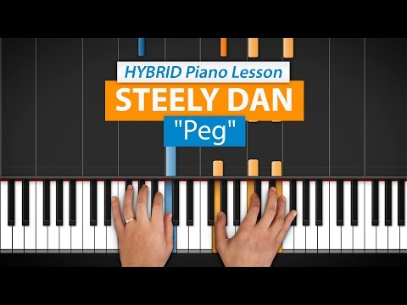
Video 3: How To Play Steely Dan’s “Peg”

Slide 13
Who might be the target audience of the clip?
The target audience for this clip would be intermediate to advanced level piano players.
While there is some music theory, a knowledge of theory isn’t absolutely necessary to learn from the video.

Slide 14
What is the strength of the video clip in terms of its instructional quality?
The video uses an overhead camera angle so viewers can see what the instructor is playing.
There are also animations which highlight which notes he is playing and how long they are to be held (sustained).

Slide 15
What is the weakness of this video clip in terms of its instructional quality?
I see no glaring weakness in terms of the instructional quality for this video.

Slide 16
What can be added, or removed, in order to improve the clip’s instructional quality?
The instructional quality was pretty effective as is. The designer didn’t include any onscreen text, which would have distracted from the playing. The inclusion of the narration enhanced the learning experience. Someone who wasn’t knowledgeable about music theory could have safely ignored the narrative and still learned a lot.

Slide 17
THANKS!
Any questions?
You can find us at:
annlf2@illinois.edu
mcswain4@illinois.edu
hunte2@illinois.edu

Slide 18
CREDITS
Presentation template by SlidesCarnival (Special thanks to all the people who made and released these awesome resources for free)
EcoSafety, Inc. “How to Stain Concrete Fast, Easy & Safe”. YouTube, June 4, 2010, https://www.youtube.com/watch?v=1gWNp_B-dhw
A Cool Way to Separate Eggs, YouTube, Nov 13, 2013,
https://www.youtube.com/watch?v=iAp8pEaWB1Y
HDpiano. “"Peg" by Steely Dan | HDpiano (Part 1)”. Youtube
YouTube, November 2, 2014, https://www.youtube.com/watch?v=WppcfDt1vRE

