Slide 1

Developer Portfolio
Masterclass
Reminder – All calls are recorded for quality monitoring, training and safeguarding purposes.
Notes:
v2.1.1
1023

Slide 2
OBJECTIVES
What is a portfolio – Do’s and Don’ts – what to include
HTML – Sass –JavaScript – Mixins – Media queries - Figma
Code a long and build a minimalistic portfolio
GitHub

Slide 3

WHAT MAKES A GOOD PORTFOLIO
Notes:
WHAT MAKES THE GOOD PORTFOLIO
Ask the learners what they think makes a good portfolio?

Slide 4
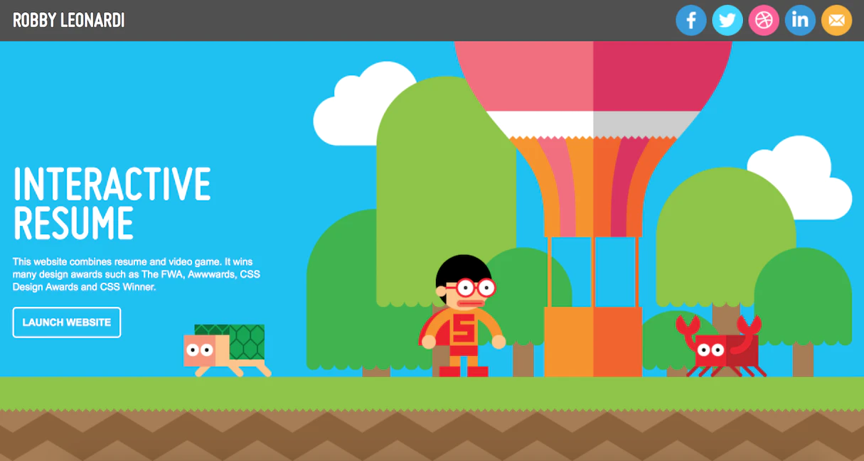
WHAT MAKES A GOOD PORTFOLIO
Make it Unique
Showcase your skills
Have quality projects
Relevant content (no waffle)
Simplicity
Quality over Quantity

Slide 5
GROUP ACTIVITY
Compare 3 portfolio’s.
I have provided 3 links to 3 portfolio’s, talk about them in your group, what do you like, what don’t you like, what makes them good or bad.
We will discuss together once finished.
20 mins
Notes:
https://robbowen.digital/
https://robbowen.digital/
https://www.raoul-gaillard.com/
DISCUSS in with the group once they have finished.

Slide 6
DO’s and Don’ts
Do’s
Do plan ahead.
Do have a clean and consistent design.
Do include the names of your skills
Do showcase your work
Do include a call to action
Don’ts
Don’t overwhelm users with too many animations
Don’t neglect accessibility and responsiveness
Don’t ramble on forever
Don’t clutter your work section
Don’t set it and forget it
Don’t make a static page
Notes:
Do plan ahead
Before you even open your code editor you need to have a strong plan in place, what color scheme, what font, what sections do you want, how will you describe yourself and your work? What kind of images will you need. You need to visualise your finished website.
Do have a clean and consistent design.
Many portfolio websites come with brash colors, inconsistent spacing and font sizes, or are simply messy and unorganized. Unless you're into brutalist design, this is not something you want.
While you're in the planning phase, do some research about what constitutes good design. Find a good combination of colors and stick to it. Set some typography and spacing rules for yourself and follow them religiously
Do include the names of your skills
Sure, you and other developers might be aware that a light blue atom symbol stands for React.js, or that a single green leaf stands for MongoDB. But if your goal is to find clients or a job, you need to think a little more about your target audience.
Hiring managers or potential clients might not be familiar with all of the technologies in your skillset, and they might not recognize their logos at first glance. For this reason, make sure you find a way to include the actual names of your skills.
Do showcase your work
Instead of simply including a link to your GitHub profile, consider showcasing some of your projects directly on your website. This makes it much easier for users to see what you're capable of, as they don't have to go to an external website and manually check your repositories.
The main things you should include when showcasing a project are:
a screenshot (if applicable)
the project's name
links to a live preview and to the GitHub repository
a short description of the functionality and/or the technologies used
Do include a call to action
A call to action is a well known marketing tool meant to prompt a user's response and increase their engagement. Whether you're looking for a job, clients or other developers to collaborate with, make sure you encourage your users to get in touch with you, and provide the means to do so.
Don’t overwhelm users with too many animations
Having too many or too complex animations will not only be incredibly distracting for your users, but it will also significantly impact the performance of your website, especially if they are not done correctly or your users aren't using the most high-end devices.
Don’t neglect accessibility and responsiveness
Your portfolio website should provide the best experience possible for all users. Make sure you learn about accessibility and try to incorporate at least some techniques that will make your page more accessible, not only for people with disabilities, but also for people who might have old devices, slow connections and so on.
In terms of responsiveness, keep in mind that almost 60% of web traffic happens on mobile devices. This means that on average, your users are more likely to be visiting your website from a mobile phone instead of a laptop or desktop computer.
A good approach is mobile-first design. This means that you build your website to look good on mobile devices first, and then you scale up to bigger screens. On a personal note, I find it easier to transform a small-screen design into a large-screen design, rather than the other way around.
Don’t ramble on forever
There is no need to write your entire life story in your About section, or to describe in detail the trials and tribulations you went through while building your latest project. Your users will want to see you and your work at a glance, rather than read an entire essay. For lengthier texts, consider creating a blog section for your page
Don’t clutter your work section
While showcasing your work is important, you don't need to overload your website with every single project you've ever built. Instead, stick to a few that you're most proud of, and provide a link to see the rest of your work (for example, a link to your GitHub profile).
Don’t set it and forget it
Your portfolio website is something that you should always return to and update frequently. Learned a new skill? Update your website. Built a new project? Update your website. The list goes on. Your portfolio website is a reflection of yourself. Make sure it always reflects the present you, not the past you.

Slide 7
WHAT TO INCLUDE
Notes:
Get learners to talk about what they would include in their portfolio

Slide 8
What to include
BIO
CONTACT INFORMATION
PROJECTS
EXPERIENCE
SKILLS
SOCIAL MEDIA LINKS
AWARDS AND RECOGNITION
DOCUMENTED SOURCE CODE
DOWNLOADABLE RESUME
Notes:
BIO
our bio is your chance to flesh yourself out as a person with information that, while valuable, might not fit in your resume. Highlight the elements of your professional story that make you unique. Include your hobbies, both related and unrelated to web development, to convey something about who you are.
CONTACT INFORMATION
Add your contact information at the top of your portfolio so potential employers don’t have any trouble finding it when they want to schedule an interview. Along with your name, you’ll want to include:
Your phone number
Email address
Professional social media accounts
As this information is likely already in your resume or on LinkedIn, providing it in your portfolio won’t increase your risk of identity fraud or sacrifice your privacy. Some people also choose to share their mailing addresses, though that’s not required.
PROJECTS
While describing your projects, make sure you provide details. Every project has a story behind it, and you want to help the employer understand some of the nuances that made it — and the work you did — special. For example, you could discuss the company you did it for, the specifics of the project, and any challenges or problems you were charged with solving.
Adding images of your work, like screenshots of a website before and after your contribution, can also help illustrate your capabilities.
EXPERIENCE
Showcase some projects you’ve worked on, but keep it to the type of project you would like to work on again.
For instance, maybe you used to be a marketing strategist. However, now you want to land a job as a Ruby on Rails developer.
Make sure to emphasize projects/work experience related to Ruby on Rails. Otherwise, employers might assume that you’re still interested in working with marketing.
The same can be said for LinkedIn: only feature previous work and skills you want to be hired for.
(Bonus: include testimonials from previous employers/clients to take your experience section to the next level.)
SKILLS
Don’t go crazy. Include only your strongest skills, and ones that will prove useful in the type of job you’re looking for.
Example: if you’re looking for back-end development work, you can probably leave out your Photoshop expertise. Instead, emphasize the skillsets these positions are looking for. (Unsure? Check out job postings online to see the listed skills; have your portfolio/online resume match as much as possible. Of course, don’t ever list a skill you don’t really have! That will come back to bite you.)
SOCIAL MEDIA LINKS
For developers, there are two social media networks that are basically non-negotiable:
Github
Linkedin
Of course, feel free to list a Twitter handle if you have one. It’s also not a bad idea to link to your Stack Overflow profile—but only if you are an active user and have a high reputation score.
Adding relevant social media accounts is a way for potential employers to get a better idea about your personality and what you’re like beyond your “About me” section.
AWARDS AND RECOGNITION
Have you written for any well-known tech blogs? Won any hackathons or related competitions? Presented any talks at big conferences?
These, and any other special accolades, can certainly be added to your online website. They can help set you apart from the competition enough to give you an extra edge when it comes to hiring time. Plus, everyone likes to be #1…so this is the perfect way to inform people about your big wins without sounding braggy!
However, it’s probably best to avoid any “small fish” awards like your A+ in high school computer class. Don’t look desperate.
DOCUMENTED SOURCE CODE
Again, it’s all about context on your portfolio site…and off it.
If you’re including links to your repositories on Github, make sure you provide context/documentation so people don’t have to struggle to understand what is going on with the project.
You can do this in the readme.md. Explain what the project is as well as how to use it.
This isn’t only helpful to employers, but also for anyone wanting to use whatever it is you created!
DOWNLOADABLE RESUME
Always make sure to have a downloadable resume as well.

Slide 9

WHERE TO START
Notes:
WHERE TO START???
Ask the learners where they think they should start?

Slide 10
PLAN & DESIGN
RESEARCH
What is your USP
What You need to include
DESIGN
What colours?
What style?
Develop wireframe
Develop prototype
Notes:
PLAN AND DESIGN
RESEARCH
Look around google, get some inspiration. Remember DO NOT copy but you can take elements that you think are nice
What is your USP
What is going to make yours unique. I good tip is to think about what you are passionate about and put that into the design. What do you think is going to represent who you are? E.g. I like gaming could I include something into the design element there?
What you need to include
Get your projects together, any images you think you are going to need and stick them in a folder. What are you going to include in your BIO, CONTACT, SKILLS etc.. Make sure you have all this info to hand before you start the build.
What colours?
You should really only have a max colour palette of 3 colours. Do not go wild with colours. A good website to use is https://coolors.co/

Slide 11

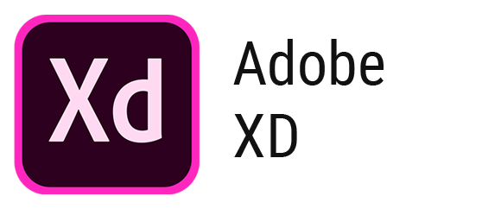

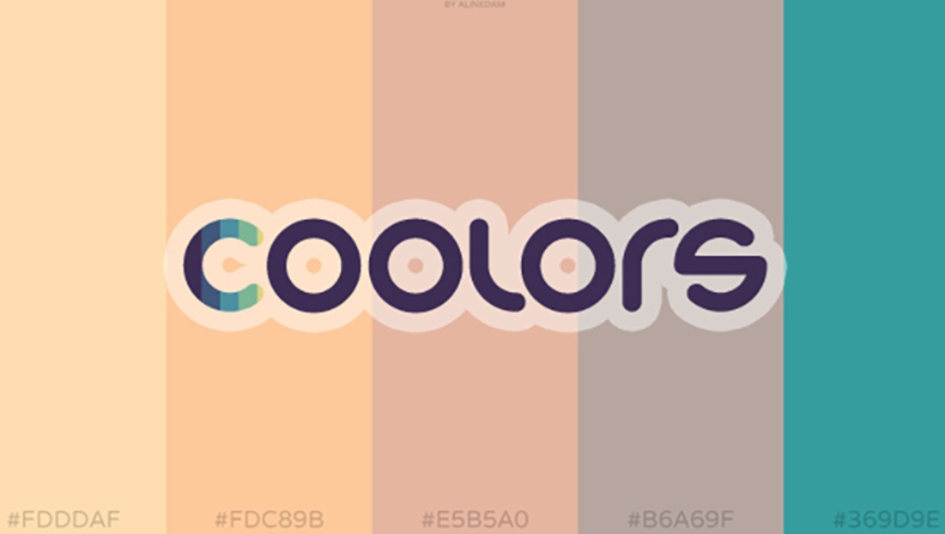
DESIGN TOOLS
Coolors.co
Figma.com
Sketch.com
Adobe xd

Slide 12

DEVELOPMENT
LANGUAGES
HTML
SASS / CSS
JAVASCRIPT
TOOLS
VSCODE
NODE.JS
GITHUB
Notes:
DEVELOPMENT
Need to have vscode and node.js downloaded. If they want to use other IDE’s that is fine but the study guide is in vs code.
Find out the students experience with the languages.

Slide 13
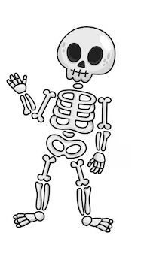
WHAT IS HTML <p></p>
Stands for HYPERTEXT MARKUP LANGUAGE
Describes the structure of a Web page
Consists of a series of ELEMENTS
Elements tell the bowser how to display content
Elements are defined by TAGS a start tag and an end tag
A web browsers purpose is to read the HTML documents and display them correctly.
Also known as the skeleton of the web page

Slide 14
HTML STRUCTURE
<!DOCTYPE html> <html> <head> <title>Page Title</title> </head> <body> <h1>My First Heading</h1> <p>My first paragraph.</p> </body> </html>
Notes:
HTML STRUCTURE
Talk through how the structure works.

Slide 15

WHAT IS CSS <style> color: “red”; </style>
Stands for CASCADING STYLE SHEETS
CSS is the language we use to STYLE our HTML document
Describes how HTML elements should be displayed
External stylesheets are stored in CSS files
Allows us to avoid INLINE STYLING.
Known as the ADJECTIVE of web development

Slide 16
CSS STRUCTURE
Mystyle.css file
<!DOCTYPE html> <html> <head> <link rel="stylesheet" href="mystyle.css"> </head> <body> <h1>This is a heading</h1> <p>This is a paragraph.</p> </body> </html>
p { color: red; text-align: center; }
h1 { color: green; }
body { background-color: lightblue; }
Notes:
HTML STRUCTURE
Talk through how the structure works.

Slide 17
CSS SELECTORS
Mystyle.css file
<!DOCTYPE html> <html> <head> <link rel="stylesheet" href="mystyle.css"> </head> <body> <h1>This is a heading</h1> <p id="para1">Hello World!</p>
<p class="center">Red and center-aligned paragraph.</p> </body> </html>
#para1 { text-align: center; color: red; }
.center { text-align: center; color: red; }
Body{ text-align: center; Background-color: blue; }
Notes:
HTML STRUCTURE
Talk through how the structure works.

Slide 18

WHAT IS JAVASCRIPT const myName = “matt”;
Javascript is the world’s most popular programming language
Javascript is the programming language of the WEB
Known as the VERB of the WEB
Used when you want an event to take place
For example, a button click.

Slide 19
JAVASCRIPT STRUCTURE
myscript.js file
<!DOCTYPE html> <html> <head> <link rel="stylesheet" href="mystyle.css"> </head> <body> <h1>This is a heading</h1> <p id="para1">Hello World!</p>
<p class="center">Red and center-aligned paragraph.</p>
<button id=“btn”>Click me</button> <script src="myScript.js"></script> </body> </html>
Const btn = document.getElementById(“btn”);
btn.addEventListener(“click”, changeText);
changeText = () => { document.getElementById(“para1”).innerHTML += “javascript did this!”;
}
Notes:
HTML STRUCTURE
Talk through how placing the script tag in different places makes a difference to how the javascript loads.
Talk through the example on the right and explain how its an example of DOM manipulation which they will be using a lot in their portfolio project.

Slide 20
JAVASCRIPT and the DOM
Document Object Model
<!DOCTYPE html> <html> <head> <link rel="stylesheet" href="mystyle.css"> </head> <body> <h1>This is a heading</h1> <p id="para1">Hello World!</p>
<p class="center">Red and center-aligned paragraph.</p>
<button id=“btn”>Click me</button> <script src="myScript.js"></script> </body> </html>
DOM Methods
Document.getElementByID(id)
Document.getElementsByTagName(name)
Document.getElementsByClassName(name)
Document.querySelector(#idname / .classname)
DOM Properties
Element.innerHTML = new html content
Element.attribute = new value
Element.style.property = new style
Notes:
Javascript and the dom
HTML is made up of tree of objects. With Javascript we can gain access to them and manipulate them using functions and event listeners. This is what we are referencing when talking about the DOM
DOM METHODS
These are actions you can perform on HTML elements
DOM PROPERTIES
These are values of HTML elements that you can set or change.

Slide 21

WHAT IS SASS
Stands for Syntactically Awesome Stylesheet
Sass is an extension to CSS
Sass is a CSS pre-processor
Sass is compatibale with all versoins of CSS
Sass is better for the organization of stylesheets
Lets you use features like variables, nested rules, mixins, imports, functions and other things that CSS doesn’t have.
Notes:
WHAT IS SASS
Pre-processor just means that the sass files are compiled into a main CSS file on build.
If the students are not comfortable using SASS they do not have to for this course but it is recommended as it is a useful skill in the industry.

Slide 22
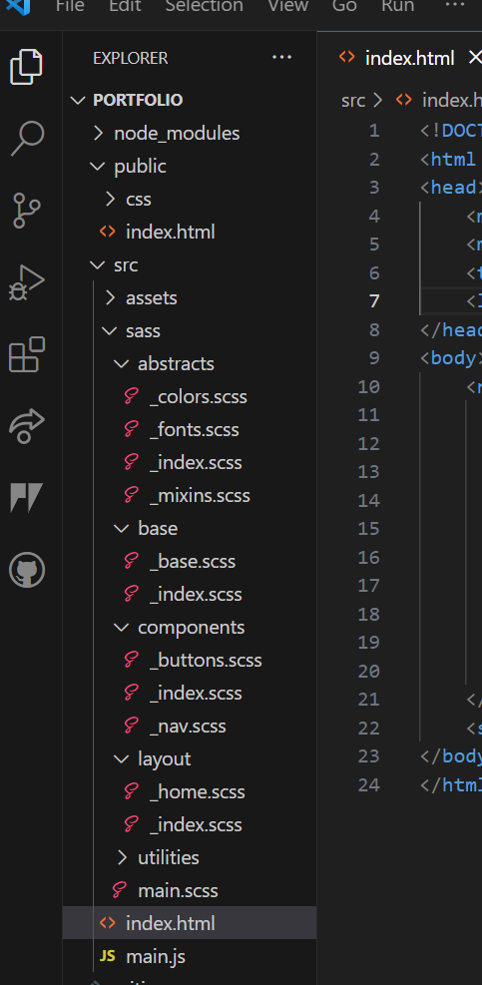
SASS Features PARTIALS
Ability to separate our stylesheets into separate files/folders
You can then link them all to a main.scss file

Slide 23
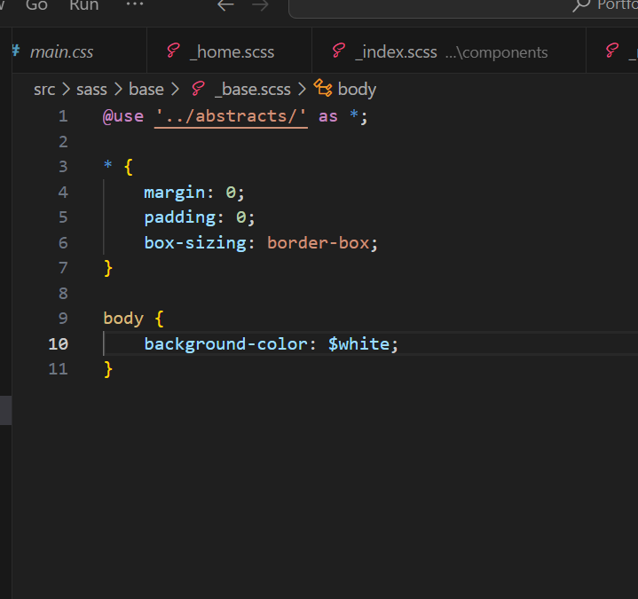
SASS Features @USE
Ability to use other stylings from other files
This helps to keep the code inside each file to a minimum
Notes:
SASS FEATURES
@USE is used instead of @import which is now deprecated. Use allows you to include stylings from other files.
In this case in the body section you can see a variable called $white – now this is not declared in this _base.scss file it is located in the abstracts folder. So we can bring those files through for the _base.scss file to have access to.

Slide 24
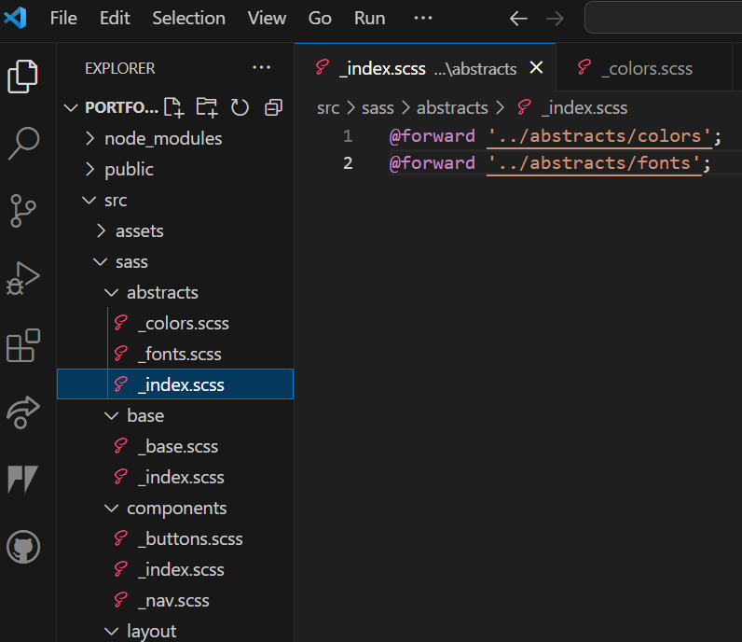
SASS Features @FORWARD
@forward allows us to be able to send files to other locations.
Notes:
SASS FEATURES
@FORWARD is used to be able to “forward” the files to different files. You can create a _index.scss file that you can put all your @forward commands in and then you only have to reference the FOLDER when using them

Slide 25
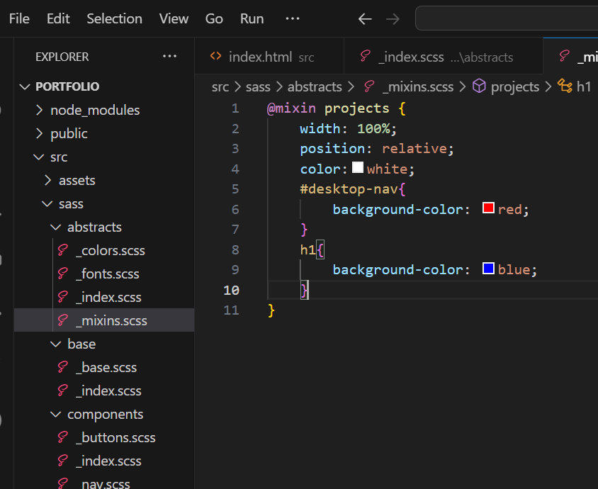
SASS Features MIXINS
A way to apply the same stylings to multiple elements without having to re write code
You use the @mixin keyword and then call the mixin whatever you want
Apply the stylings inside to your relevant elements
Notes:
SASS FEATURES

Slide 26
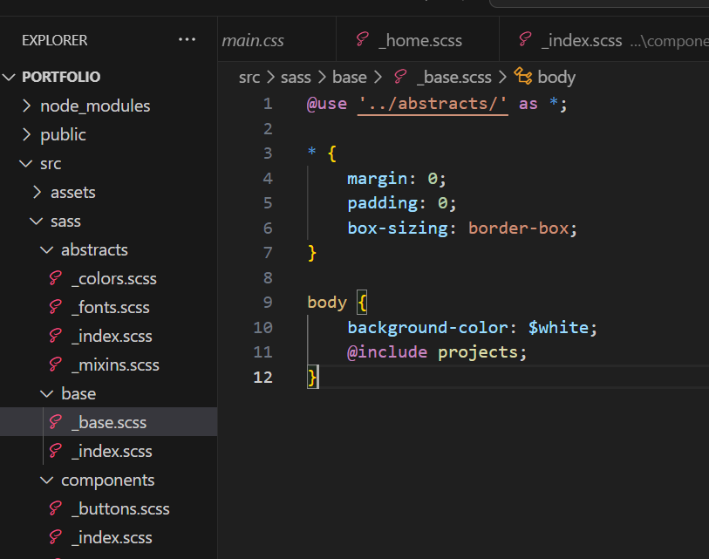
SASS Features MIXINS
To use it all you need to do is us the @include key word and reference the mixin name
This will then apply all the stylings to that element
Normally these are used on wrappers or containers as you want to effect multiple elements
Notes:
SASS FEATURES
@FORWARD is used to be able to “forward” the files to different files. You can create a _index.scss file that you can put all your @forward commands in and then you only have to reference the FOLDER when using them

Slide 27
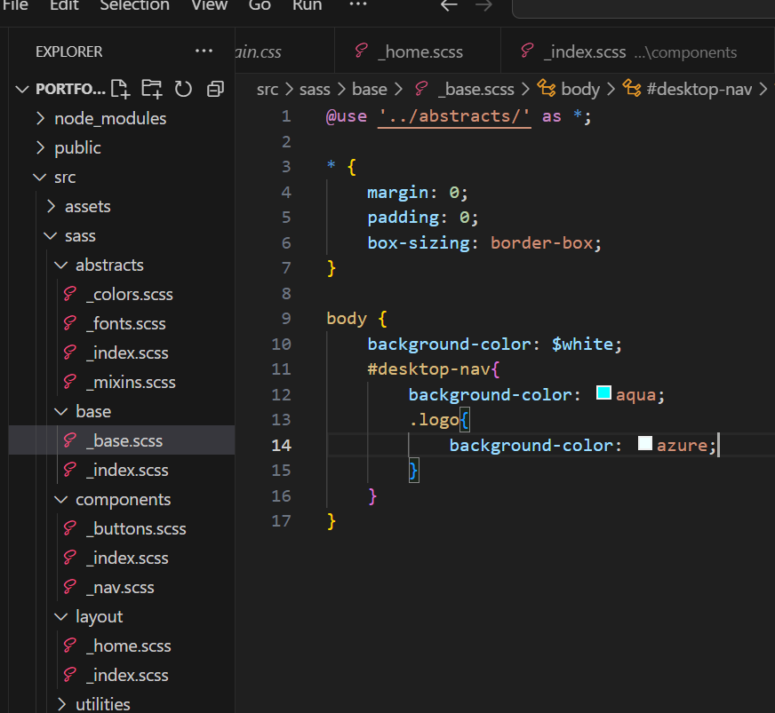
SASS Features NESTING
We can nest styles inside each other
Good for saving space
Also good for keeping blocks of related code together
Notes:
SASS FEATURES
@FORWARD is used to be able to “forward” the files to different files. You can create a _index.scss file that you can put all your @forward commands in and then you only have to reference the FOLDER when using them

Slide 28

WHAT IS GITHUB
Important to know difference between GIT and GITHUB
GIT is a version control system that allows developers to track changes in their code
GITHUB is a web-based hosting service for git repositories
There are a number of features you can use with GITHUB but for today we are just going to be using it to host and store our code.
Notes:
WHAT IS GITHUB
Git is a version control system that allows developers to track changes in their code. GitHub is a web-based hosting service for git repositories. In simple terms, you can use git without Github, but you cannot use GitHub without Git.

Slide 29
SETTING UP GITHUB

Slide 30

SETTING UP GITHUB DESKTOP
Notes:
SETTING UP GITHUB DESKTOP
Download github desktop from google and make sure to link to your google account with google auth or simply sign in.

Slide 31
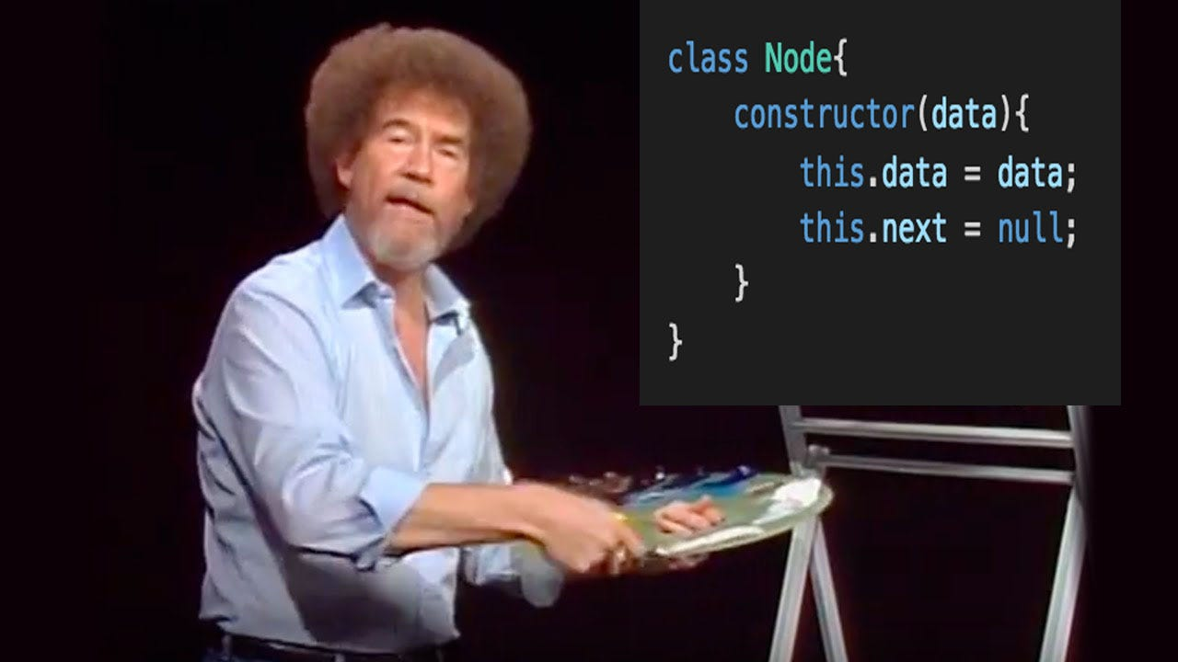
CODE ALONG
Notes:
SETTING UP DEV ENVIRONMENT
Walk the learners through how to set up the dev environment.
STEP 1.
Download visual studio code, link in the links pod.
STEP 2.
Download node.js, link in the links pod
STEP 3.
Go to github desktop and open a new repository through the file tab.
Name your repository whatever you like and select a location to save it on your system.
Add a read.me file and then click create repository. On th enext page click Publish repository, untick keep this code private and then click on publish repository. Then click open visual studio code.
STEP 4.
ADD extensions – CODE RUNNER – LIVE SERVER – PRETTIER

Slide 32
ACTIVITY
Have a go at building your contact page
60 Mins

