Slide 1
Basics of Machine Learning
Chapter 1

Slide 2
Machine learning is a way for computer systems to perform tasks using algorithms that learn from data, rather than being explicitly programmed with instructions.

Slide 3
Algorithms
Chapter 1.1

Slide 4
Definition: Algorithm
Input
Transformation
Output
An algorithm performs a series of defined steps or transformations on an input to produce a desired output.

Slide 5







Example: Recipe
Ingredients (input) undergo baking (transformation) and become a cake (output)

Slide 6
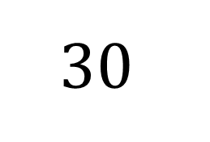
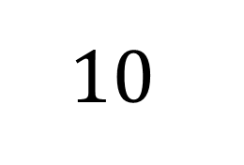

Example: Numbers
$$10$$
$$∙3/+20$$
$$30$$

Slide 7
All Good Things Come In Threes
your age
+5
-your age
$·$2
·2
-4
÷2
?

Slide 8

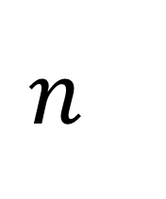



Collatz Conjecture
repeat
odd
$$∙3+1$$
$$n : positive integer$$
/
$$n$$
odd
or
even
$$until n=1$$
even
$$÷2$$
repeat

Slide 9

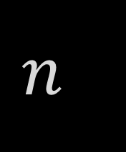



Collatz Conjecture
Decision-Making
repeat
odd
$$∙3+1$$
$$n : positive integer$$
/
$$n$$
odd
or
even
$$until n=1$$
even
$$÷2$$
repeat

Slide 10
Collatz Conjecture
Iteration/Loop
repeat
odd
$$∙3+1$$
$$n : positive integer$$
/
$$n$$
odd
or
even
$$until n=1$$
even
$$÷2$$
repeat

Slide 11

Collatz Conjecture
Example for $n = 19$

Slide 12
Machine learning is a way for computer systems to perform tasks using algorithms that learn from data, rather than being explicitly programmed with instructions.

Slide 13
Data Utilisation
Chapter 1.2

Slide 14
What is Data?
Data is any piece of information
temperature
income
date
location
colour
age
gender
height
name
score

Slide 15
Types of data
categorical data
distinct categories
(colours, groups, etc.)
structured data
specific format in tables
(e.g. numerical data in Excel files)
discrete/continuous data
countable/measurable
(number of students in a class, temperature, etc.)
unstructured data
No predefined format
(e.g. videos)

Slide 16
Types of data
categorical data
distinct categories
(colours, groups, etc.)
structured data
specific format in tables
(e.g. numerical data in Excel files)
discrete/continuous data
countable/measurable
(number of students in a class, temperature, etc.)
unstructured data
No predefined format
(e.g. videos)

Slide 17
Types of data
categorical data
distinct categories
(colours, groups, etc.)
structured data
specific format in tables
(e.g. numerical data in Excel files)
discrete/continuous data
countable/measurable
(number of students in a class, temperature, etc.)
unstructured data
No predefined format
(e.g. videos)

Slide 18
Data Preprocessing
Cleaning
Removing duplicates
Handling missing values
Correcting inconsistencies
Transformation
Formatting properly
Scaling suitably
Standardising

Slide 19
Customer Data
ID | Name | Age | Location | Income | Height
001 | Alice | 46 | Berlin | 75000 | 175
002 | Frank | 23 | France | 90000 | -
003 | Diana | - | Zurich | 65000 | 169
004 | Bob | 24 | Basel | 40000 | 154
005 | Daisy | 37 | - | 55000 | 187
006 | Alice | 46 | Vienna | - | 176
007 | - | 19 | Munich | 60000 | 182
008 | Daniel | 25 | Lugano | 80000 | 163

Slide 20
Duplicates
ID | Name | Age | Location | Income | Height
001 | Alice | 46 | Berlin | 75000 | 175
002 | Frank | 23 | France | 90000 | -
003 | Diana | - | Zurich | 65000 | 169
004 | Bob | 24 | Basel | 40000 | 154
005 | Daisy | 37 | - | 55000 | 187
006 | Alice | 46 | Vienna | - | 176
007 | - | 19 | Munich | 60000 | 182
008 | Daniel | 25 | Lugano | 80000 | 163

Slide 21
Duplicates
ID | Name | Age | Location | Income | Height
001 | Alice | 46 | Berlin | 75000 | 175
002 | Frank | 23 | France | 90000 | -
003 | Diana | - | Zurich | 65000 | 169
004 | Bob | 24 | Basel | 40000 | 154
005 | Daisy | 37 | - | 55000 | 187
006 | - | 19 | Munich | 60000 | 182
007 | Daniel | 25 | Lugano | 80000 | 163

Slide 22
Missing Values
ID | Name | Age | Location | Income | Height
001 | Alice | 46 | Berlin | 75000 | 175
002 | Frank | 23 | France | 90000 | -
003 | Diana | - | Zurich | 65000 | 169
004 | Bob | 24 | Basel | 40000 | 154
005 | Daisy | 37 | - | 55000 | 187
006 | - | 19 | Munich | 60000 | 182
007 | Daniel | 25 | Lugano | 80000 | 163

Slide 23
Missing Values
ID | Name | Age | Location | Income | Height
001 | Alice | 46 | Berlin | 75000 | 175
002 | Frank | 23 | France | 90000 | 181
003 | Diana | 52 | Zurich | 65000 | 169
004 | Bob | 24 | Basel | 40000 | 154
005 | Daisy | 37 | Cologne | 55000 | 187
006 | Jason | 19 | Munich | 60000 | 182
007 | Daniel | 25 | Lugano | 80000 | 163

Slide 24
Inconsistencies
ID | Name | Age | Location | Income | Height
001 | Alice | 46 | Berlin | 75000 | 175
002 | Frank | 23 | France | 90000 | 181
003 | Diana | 52 | Zurich | 65000 | 169
004 | Bob | 24 | Basel | 40000 | 154
005 | Daisy | 37 | Cologne | 55000 | 187
006 | Jason | 19 | Munich | 60000 | 182
007 | Daniel | 25 | Lugano | 80000 | 163

Slide 25
Inconsistencies
ID | Name | Age | Location | Income | Height
001 | Alice | 46 | Berlin | 75000 | 175
002 | Frank | 23 | Paris | 90000 | 181
003 | Diana | 52 | Zurich | 65000 | 169
004 | Bob | 24 | Basel | 40000 | 154
005 | Daisy | 37 | Cologne | 55000 | 187
006 | Jason | 19 | Munich | 60000 | 182
007 | Daniel | 25 | Lugano | 80000 | 163

Slide 26
Formatting
ID | Name | Age | Location | Income | Height
001 | Alice | 46 | Berlin | 75000 | 175
002 | Frank | 23 | Paris | 90000 | 181
003 | Diana | 52 | Zurich | 65000 | 169
004 | Bob | 24 | Basel | 40000 | 154
005 | Daisy | 37 | Cologne | 55000 | 187
006 | Jason | 19 | Munich | 60000 | 182
007 | Daniel | 25 | Lugano | 80000 | 163

Slide 27
Formatting
ID | Name | Age | Location | Income | Height
001 | Alice | 46 | Berlin | 75,000 | 175
002 | Frank | 23 | Paris | 90,000 | 181
003 | Diana | 52 | Zurich | 65,000 | 169
004 | Bob | 24 | Basel | 40,000 | 154
005 | Daisy | 37 | Cologne | 55,000 | 187
006 | Jason | 19 | Munich | 60,000 | 182
007 | Daniel | 25 | Lugano | 80,000 | 163

Slide 28
Scaling
ID | Name | Age | Location | Income | Height
001 | Alice | 46 | Berlin | 75,000 | 175
002 | Frank | 23 | Paris | 90,000 | 181
003 | Diana | 52 | Zurich | 65,000 | 169
004 | Bob | 24 | Basel | 40,000 | 154
005 | Daisy | 37 | Cologne | 55,000 | 187
006 | Jason | 19 | Munich | 60,000 | 182
007 | Daniel | 25 | Lugano | 80,000 | 163

Slide 29
Scaling
ID | Name | Age | Location | Income | Height
001 | Alice | 46 | Berlin | 75,000 | 1.75
002 | Frank | 23 | Paris | 90,000 | 1.81
003 | Diana | 52 | Zurich | 65,000 | 1.69
004 | Bob | 24 | Basel | 40,000 | 1.54
005 | Daisy | 37 | Cologne | 55,000 | 1.87
006 | Jason | 19 | Munich | 60,000 | 1.82
007 | Daniel | 25 | Lugano | 80,000 | 1.63

Slide 30
Standardising
ID | Name | Age | Location | Income | Height
001 | Alice | 46 | Berlin | 75,000 | 1.75
002 | Frank | 23 | Paris | 90,000 | 1.81
003 | Diana | 52 | Zurich | 65,000 | 1.69
004 | Bob | 24 | Basel | 40,000 | 1.54
005 | Daisy | 37 | Cologne | 55,000 | 1.87
006 | Jason | 19 | Munich | 60,000 | 1.82
007 | Daniel | 25 | Lugano | 80,000 | 1.63

Slide 31
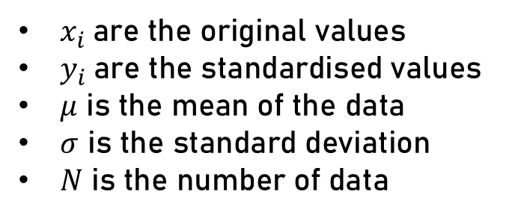
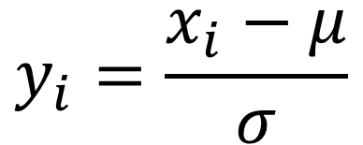
Standardising
Age
46
23
52
24
37
19
25
Standardising ensures all properties contribute equally, preventing larger scales (like age) from dominating smaller ones (like height). It is typically applied to datasets with varying scales.
$$y_{i}=\frac{x_{i}−μ}{σ}$$
$x_{i}$are the original values
$y_{i}$are the standardised values
$μ$ is the mean of the data
$σ$ is the standard deviation
$N$ is the number of data

Slide 32
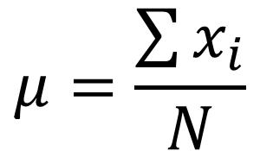
Standardising
Age
46
23
52
24
37
19
25
Standardising ensures all properties contribute equally, preventing larger scales (like age) from dominating smaller ones (like height). It is typically applied to datasets with varying scales.
$$μ=\frac{\sum{x_{i}}}{N}$$
$x_{i}$are the original values
$y_{i}$are the standardised values
$μ$ is the mean of the data
$σ$ is the standard deviation
$N$ is the number of data

Slide 33
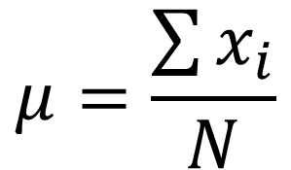
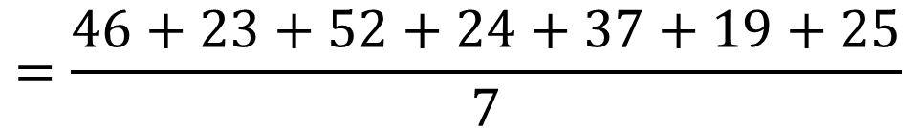
Standardising
Age
46
23
52
24
37
19
25
Standardising ensures all properties contribute equally, preventing larger scales (like age) from dominating smaller ones (like height). It is typically applied to datasets with varying scales.
$$μ=\frac{\sum{x_{i}}}{N}$$
$$=\frac{46+23+52+24+37+19+25}{7}$$
$x_{i}$are the original values
$y_{i}$are the standardised values
$μ$ is the mean of the data
$σ$ is the standard deviation
$N$ is the number of data

Slide 34
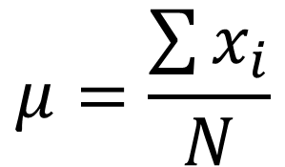

Standardising
Age
46
23
52
24
37
19
25
Standardising ensures all properties contribute equally, preventing larger scales (like age) from dominating smaller ones (like height). It is typically applied to datasets with varying scales.
$$μ=\frac{\sum{x_{i}}}{N}$$
$$≈32.29$$
$x_{i}$are the original values
$y_{i}$are the standardised values
$μ$ is the mean of the data
$σ$ is the standard deviation
$N$ is the number of data

Slide 35
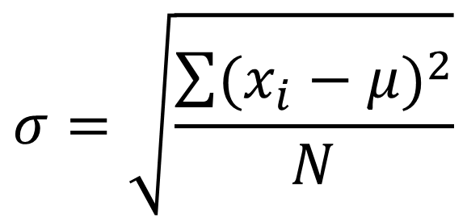
Standardising
Age
46
23
52
24
37
19
25
Standardising ensures all properties contribute equally, preventing larger scales (like age) from dominating smaller ones (like height). It is typically applied to datasets with varying scales.
$$σ=\sqrt{\frac{\sum{{(x_{i}−μ)}^{2}}}{N}}$$
$x_{i}$are the original values
$y_{i}$are the standardised values
$μ$ is the mean of the data
$σ$ is the standard deviation
$N$ is the number of data

Slide 36
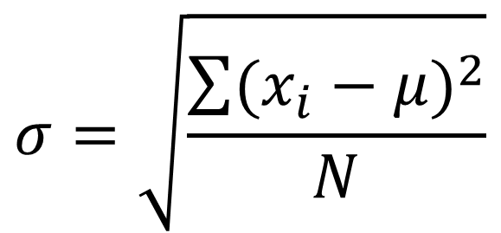
Standardising
Age
46
23
52
24
37
19
25
Standardising ensures all properties contribute equally, preventing larger scales (like age) from dominating smaller ones (like height). It is typically applied to datasets with varying scales.
$$σ=\sqrt{\frac{\sum{{(x_{i}−μ)}^{2}}}{N}}$$
$$=\sqrt{\frac{{(46−32.29)}^{2}+{(23−32.29)}^{2}+{(52−32.29)}^{2}+{(24−32.29)}^{2}+{(37−32.29)}^{2}+{(19−32.29)}^{2}+{(25−32.29)}^{2}}{7}}$$
$x_{i}$are the original values
$y_{i}$are the standardised values
$μ$ is the mean of the data
$σ$ is the standard deviation
$N$ is the number of data

Slide 37
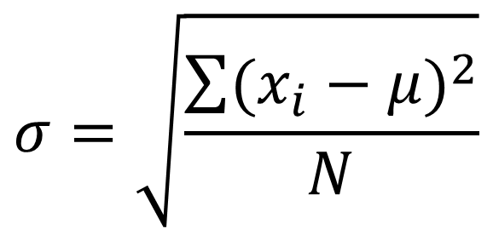

Standardising
Age
46
23
52
24
37
19
25
Standardising ensures all properties contribute equally, preventing larger scales (like age) from dominating smaller ones (like height). It is typically applied to datasets with varying scales.
$$σ=\sqrt{\frac{\sum{{(x_{i}−μ)}^{2}}}{N}}$$
$$≈12.27$$
$x_{i}$are the original values
$y_{i}$are the standardised values
$μ$ is the mean of the data
$σ$ is the standard deviation
$N$ is the number of data

Slide 38
Standardising
Age
46
23
52
24
37
19
25
Standardising ensures all properties contribute equally, preventing larger scales (like age) from dominating smaller ones (like height). It is typically applied to datasets with varying scales.
$$y_{i}=\frac{x_{i}−μ}{σ}$$
$x_{i}$are the original values
$y_{i}$are the standardised values
$μ$ is the mean of the data
$σ$ is the standard deviation
$N$ is the number of data

Slide 39
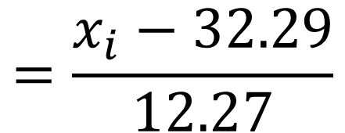
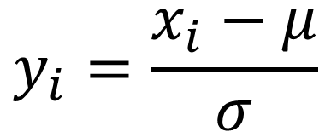
Standardising
Age
46
23
52
24
37
19
25
Standardising ensures all properties contribute equally, preventing larger scales (like age) from dominating smaller ones (like height). It is typically applied to datasets with varying scales.
$$y_{i}=\frac{x_{i}−μ}{σ}$$
$$=\frac{x_{i}−32.29}{12.27}$$
$x_{i}$are the original values
$y_{i}$are the standardised values
$μ$ is the mean of the data
$σ$ is the standard deviation
$N$ is the number of data

Slide 40
Standardising
Age
1.12
-0.76
1.61
-0.67
0.38
-1.08
-0.59
Standardising ensures all properties contribute equally, preventing larger scales (like age) from dominating smaller ones (like height). It is typically applied to datasets with varying scales.
$$y_{i}=\frac{x_{i}−μ}{σ}$$
$$=\frac{x_{i}−32.29}{12.27}$$
$x_{i}$are the original values
$y_{i}$are the standardised values
$μ$ is the mean of the data
$σ$ is the standard deviation
$N$ is the number of data

Slide 41
Standardising
ID | Name | Compared Age | Location | Income | Height
001 | Alice | 1.12 | Berlin | 75,000 | 1.75
002 | Frank | -0.76 | Paris | 90,000 | 1.81
003 | Diana | 1.61 | Zurich | 65,000 | 1.69
004 | Bob | -0.67 | Basel | 40,000 | 1.54
005 | Daisy | 0.38 | Cologne | 55,000 | 1.87
006 | Jason | -1.08 | Munich | 60,000 | 1.82
007 | Daniel | -0.59 | Lugano | 80,000 | 1.63

Slide 42
Use of Data for ML
Supervised Learning
Unsupervised Learning
Labelled data
Output known
More human intervention
Unlabelled data
Output unknown
Less human intervention

Slide 43



Supervised Learning
learning vocab with flashcards
Recall
Check
Learn

Slide 44
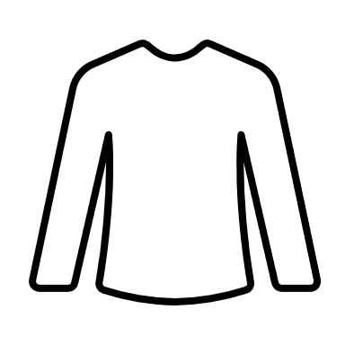




Unsupervised Learning
organising your closet
Analyse
Cluster
Organise

Slide 46

Resource Hub

