Slide 1
Supervised Learning
Chapter 2

Slide 2



Supervised Learning
learning vocab with flashcards
Recall
Check
Learn

Slide 3
Data
Conventional Programming
Answers
Rules
Data
Supervised Learning
Rules
Answers

Slide 4
Linear Regression
Chapter 2.1

Slide 5
Linear Regression is a supervised learning algorithm that models the relationship between variables by fitting a straight line to predict continuous values.

Slide 6
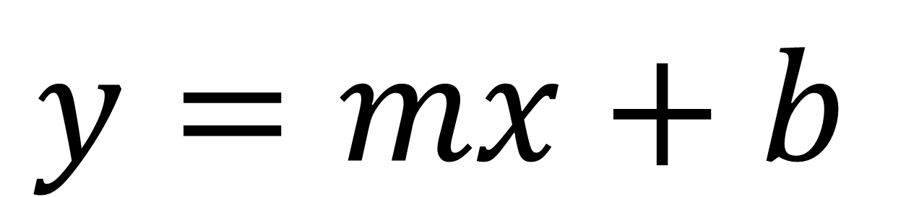
How Does Linear Regression Work
independent variable
y-intercept
also known as the bias
$$y=mx+b$$
slope
gradient of the line
dependent variable

Slide 7
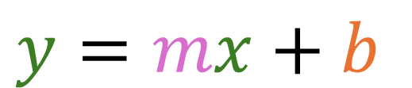
How Does Linear Regression Work
y
$$y=mx+b$$
x

Slide 8
How Does Linear Regression Work
y
$$y=mx+b$$
x

Slide 9
How Does Linear Regression Work
y
$$y=mx+b$$
x

Slide 10
How Does Linear Regression Work
y
$$y=mx+b$$
x

Slide 11
Linear regression is a supervised learning algorithm that models the relationship between variables by fitting a straight line to predict continuous values.

Slide 12
Caffeine Data Set: Features
Student | Jeremy | Noah | Alyssa | Daniel | Sofia | Colin | Gracie | Anne | Jamal | Trisha
Caffeine Intake | 0mg | 100mg | 150mg | 40mg | 250mg | 120mg | 300mg | 175mg | 210mg | 80mg
Participations per lesson | 0.5 | 1.5 | 2.5 | 1.0 | 4.0 | 2.0 | 4.5 | 2.5 | 3.0 | 1.5

Slide 13
Caffeine Data Set: Points
line of best fit

Slide 14
How to Find the Line of Best Fit
Where the line best fits the data points on the grid...
But how is this achieved?

Slide 15


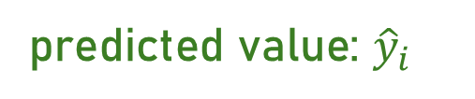
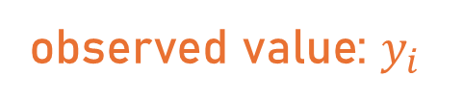
What Is the Squared Error
y
observed value: $y_{i}$
predicted value: ${\hat{y}}_{i}$
error
difference between observed
and predicted value
x

Slide 16
What Is the Squared Error
y
observed value: $y_{i}$
predicted value: ${\hat{y}}_{i}$
squared error
ensures all values are positive and penalises larger differences more heavily
x

Slide 17
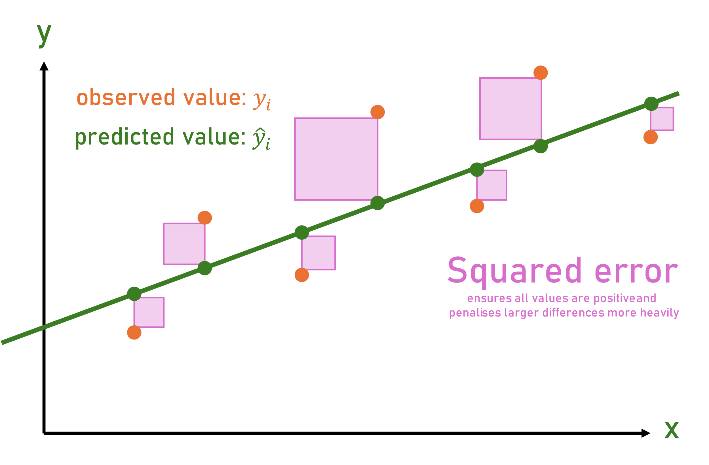
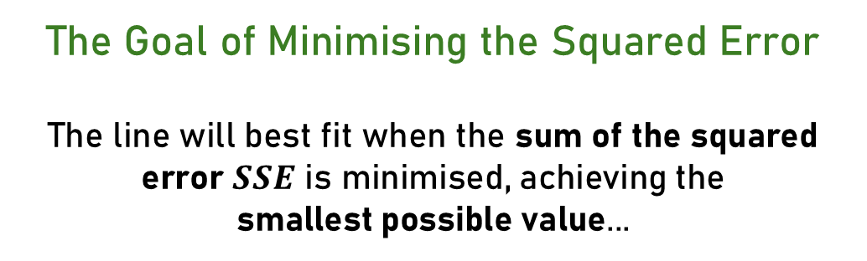
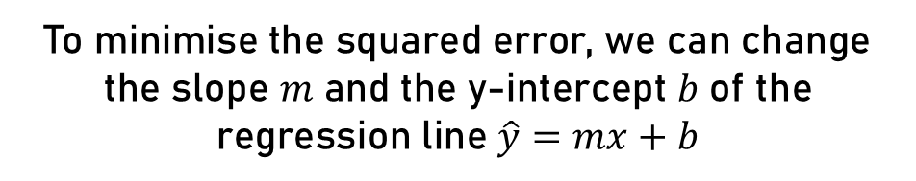
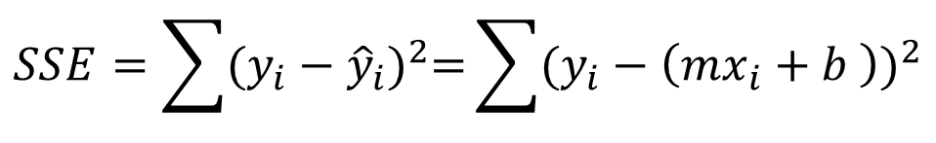
What Is the Squared Error
The Goal of Minimising the Squared Error
The line will best fit when the sum of the squared error $SSE$ is minimised, achieving the
smallest possible value...
$$SSE=\sum{{(y_{i}−{\hat{y}}_{i})}^{2}=}\sum{{(y_{i}−\left(mx_{i}+b \right))}^{2}}$$
To minimise the squared error, we can change the slope 𝑚 and the y-intercept 𝑏 of the regression line $\hat{y}=mx+b$

Slide 18

How to Optimise the Squared Error
y
$$SSE=$$
x

Slide 19
How to Optimise the Squared Error
y
changing the y-intercept
$$SSE=$$
x

Slide 20
How to Optimise the Squared Error
y
changing the y-intercept
$$SSE=$$
x

Slide 21
How to Optimise the Squared Error
y
changing the y-intercept
$$SSE=$$
x

Slide 22
How to Optimise the Squared Error
y
changing the slope
$$SSE=$$
x

Slide 23
How to Optimise the Squared Error
y
changing the slope
$$SSE=$$
x

Slide 24
How to Optimise the Squared Error
y
changing the slope
$$SSE=$$
x

Slide 25
Linking to More Complex Functions
y
The least squares method can also fit non-linear relationships, often requiring complex neural networks to approximate the function...
x

Slide 26
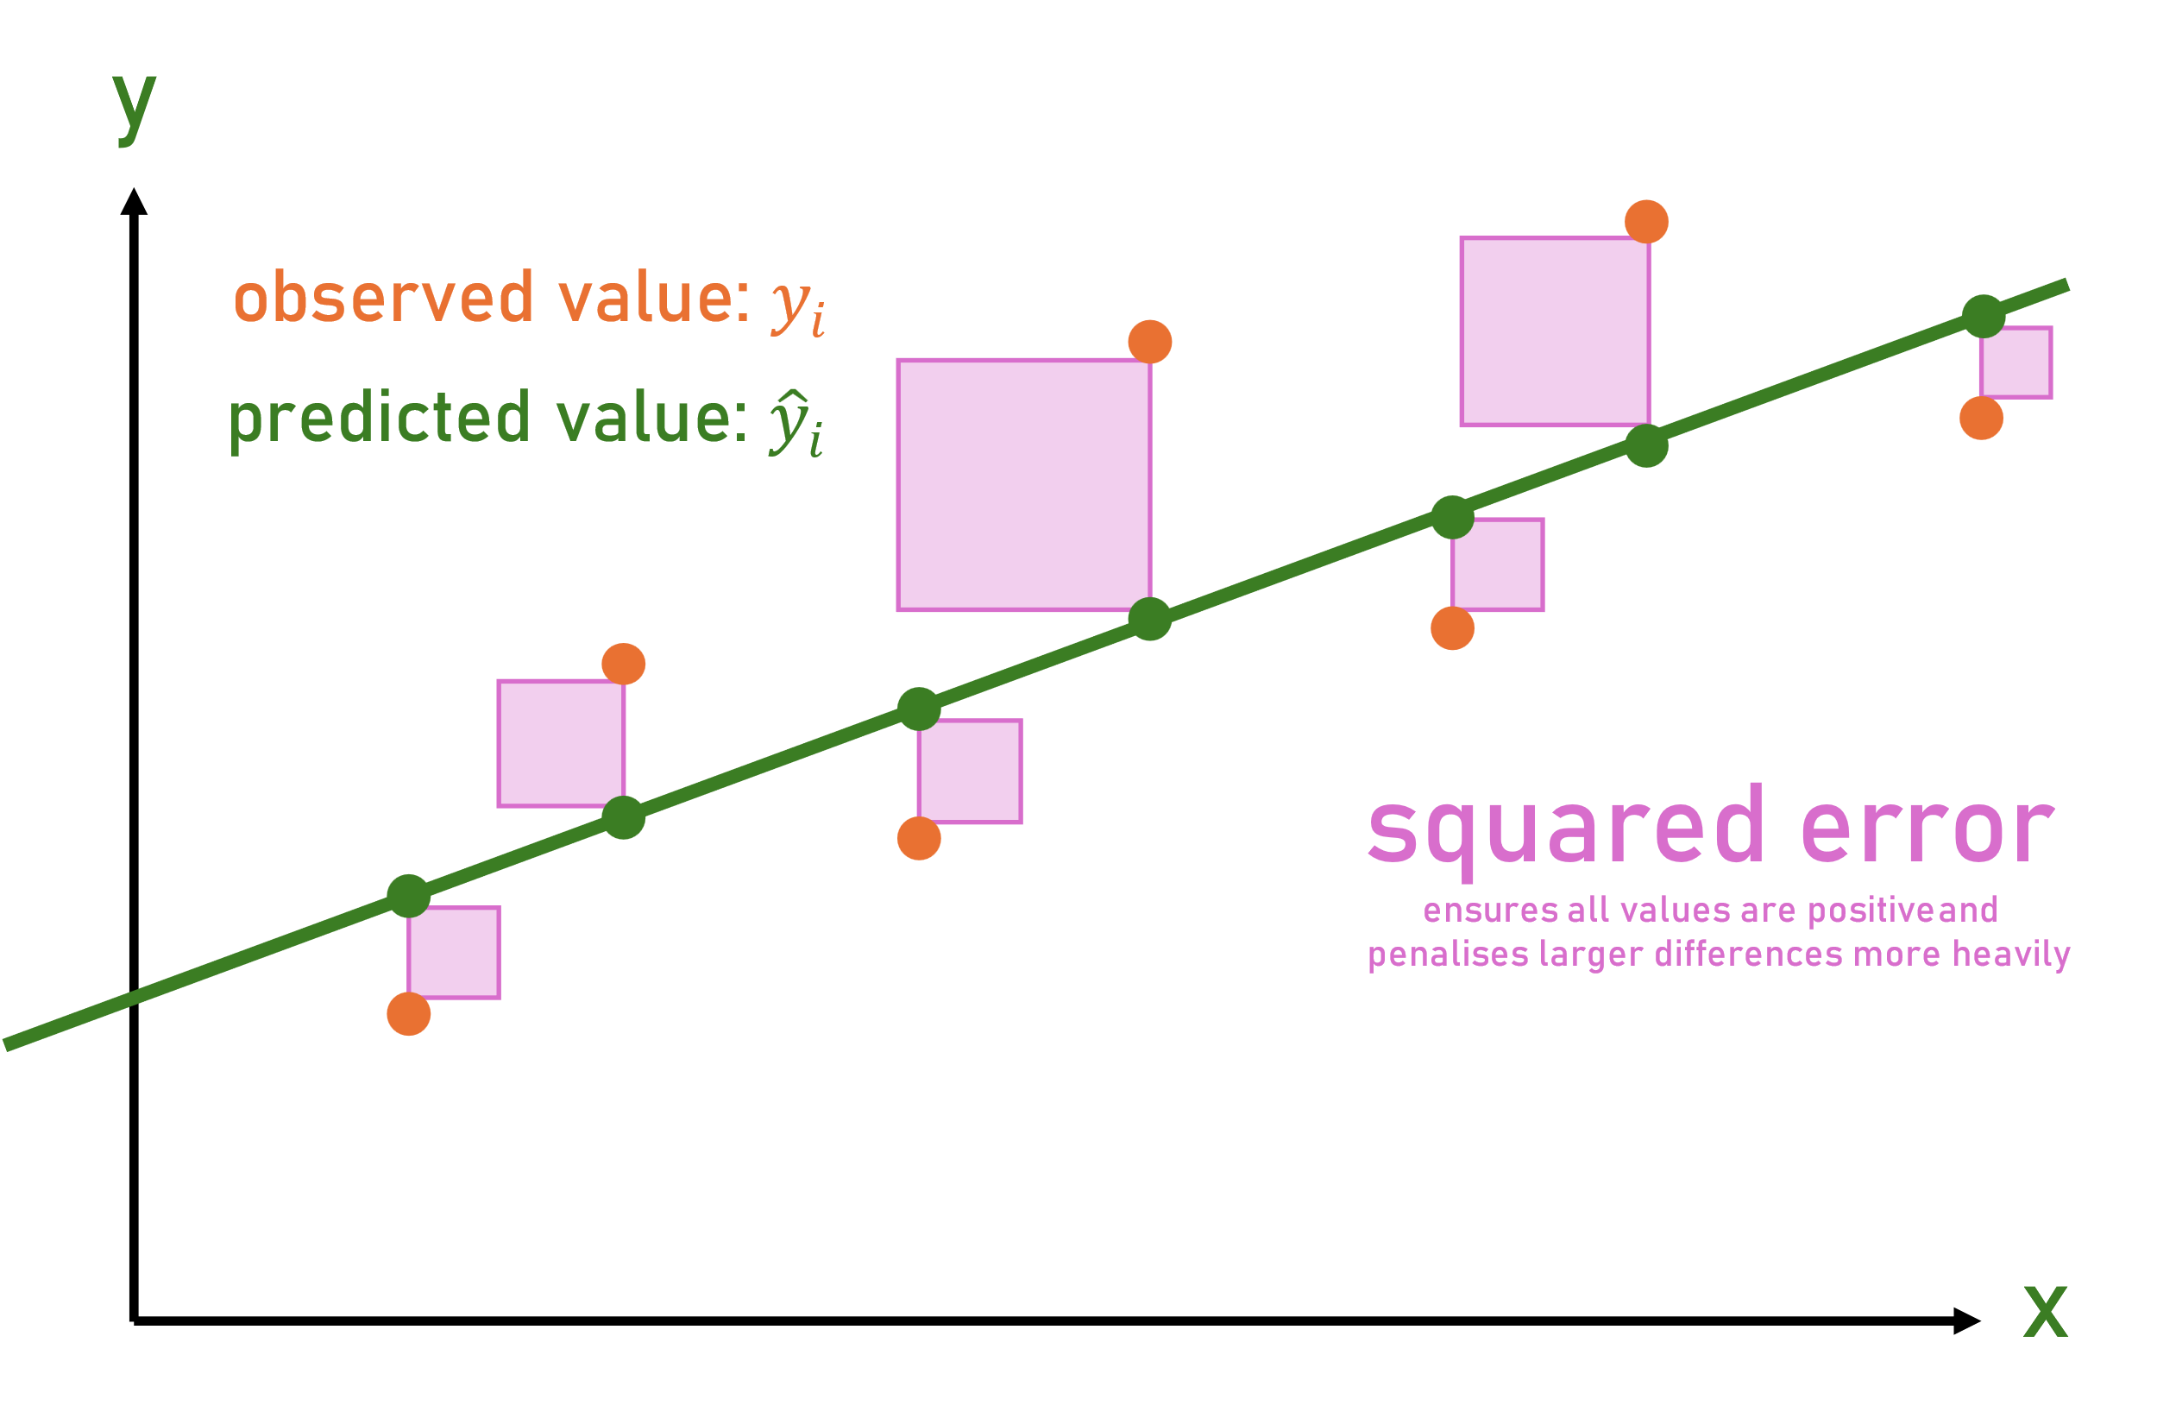
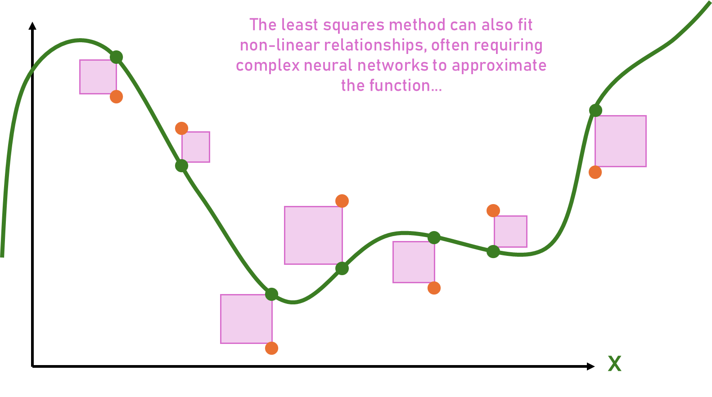


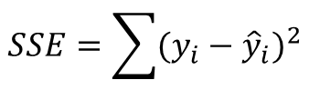
Linking to More Complex Functions
The least squares method identifies the point where the error for the dependent variable is minimised and works for any type of equation.
$$SSE=\sum{{(y_{i}−{\hat{y}}_{i})}^{2}}$$
$$y=mx+b$$
$$y=a_{n}x^{n}+…+a_{2}x^{2}+a_{1}x+b$$

Slide 27
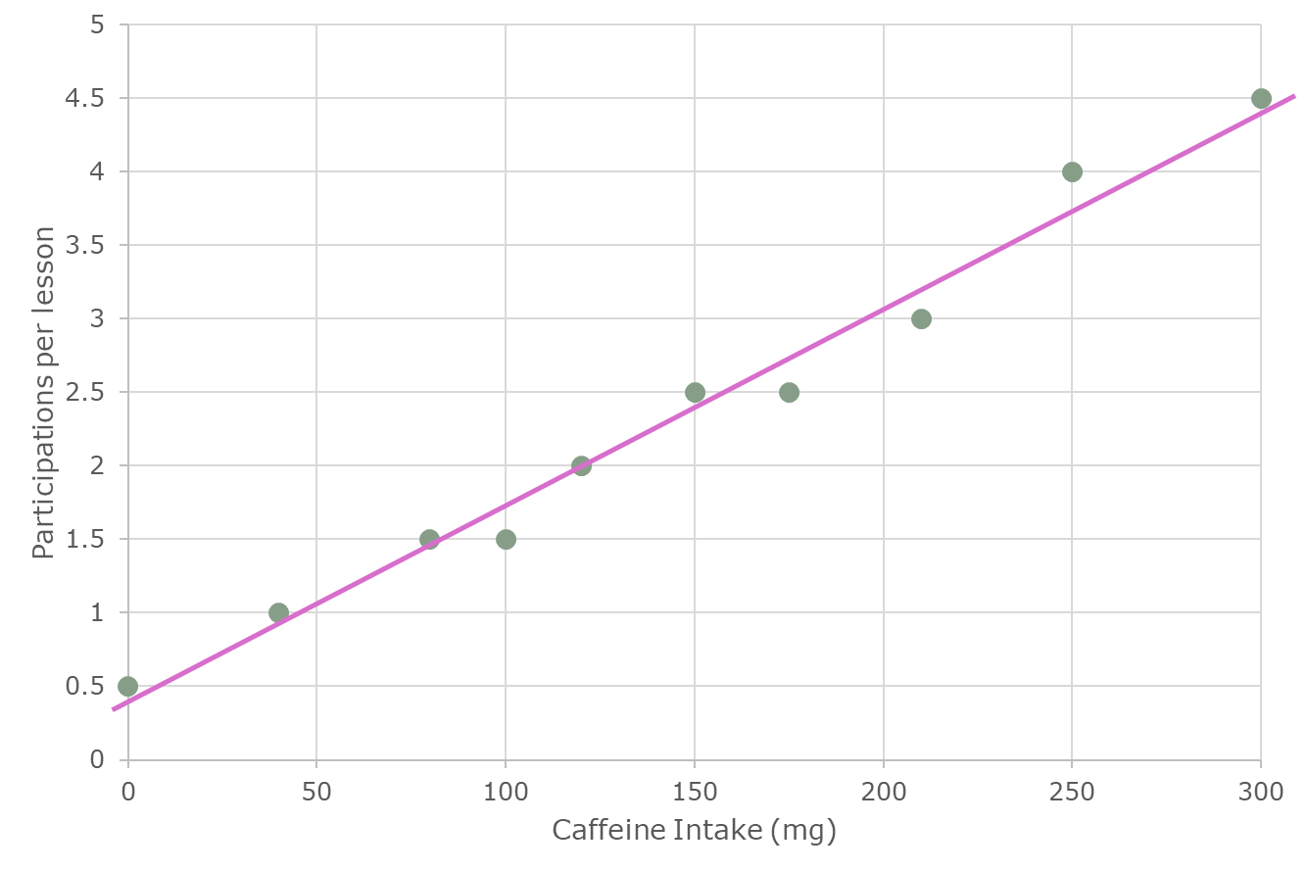
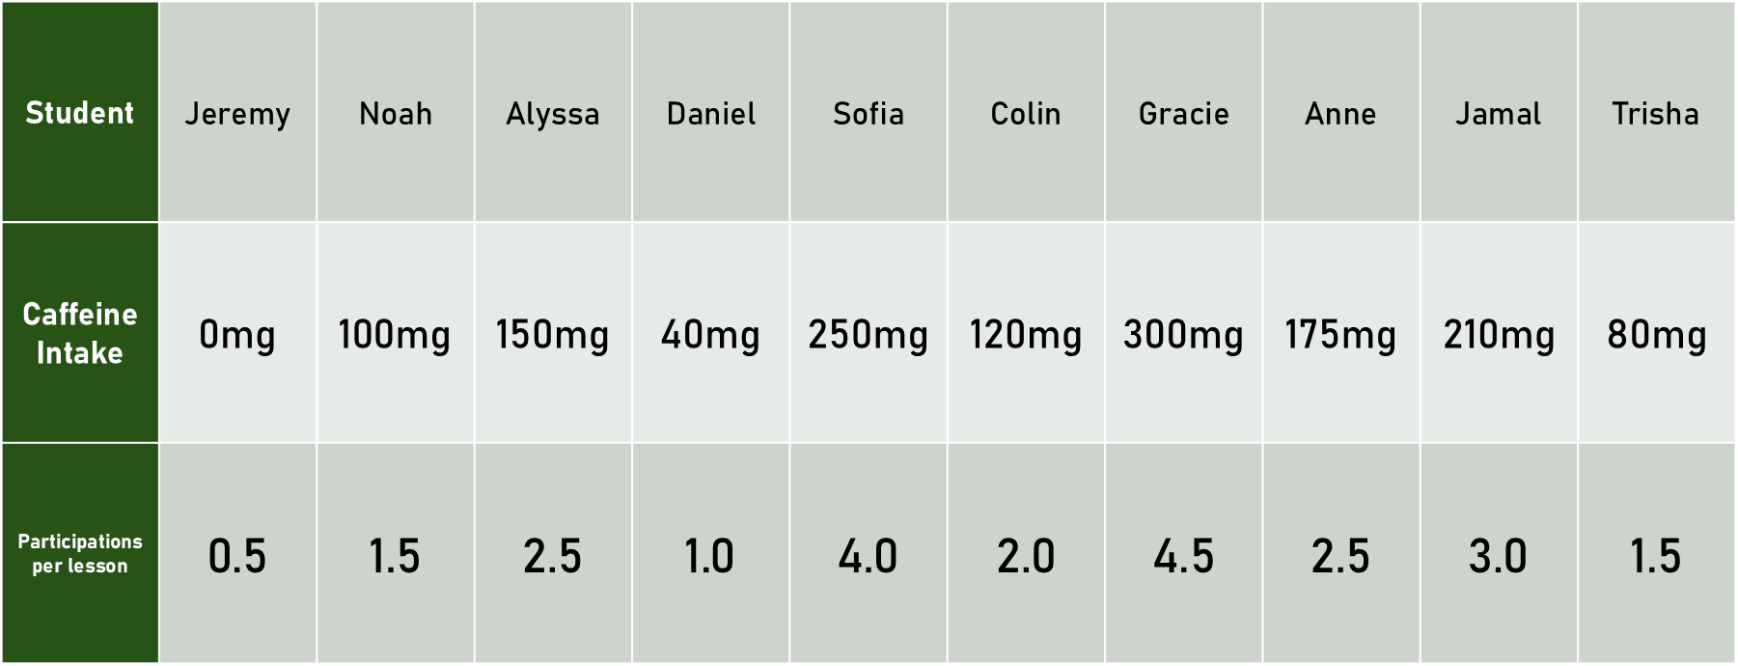
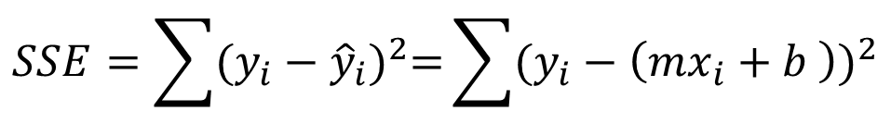
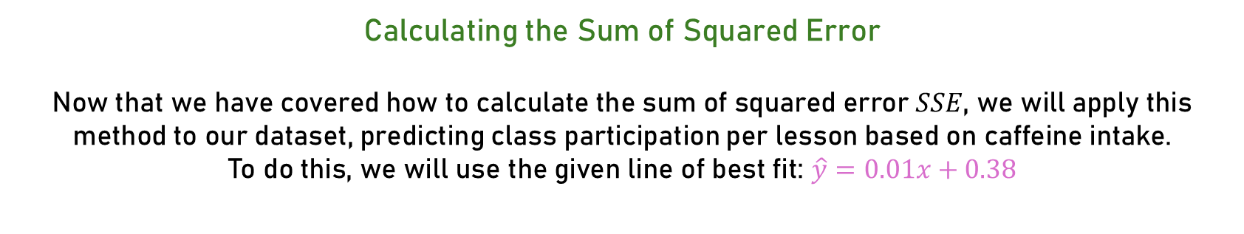
Caffeine Data Set: Calculations
Calculating the Sum of Squared Error
Now that we have covered how to calculate the sum of squared error $SSE$, we will apply this method to our dataset, predicting class participation per lesson based on caffeine intake.
To do this, we will use the given line of best fit: $\hat{y}=0.01x+0.38$
$$SSE=\sum{{(y_{i}−{\hat{y}}_{i})}^{2}=}\sum{{(y_{i}−\left(mx_{i}+b \right))}^{2}}$$

Slide 28




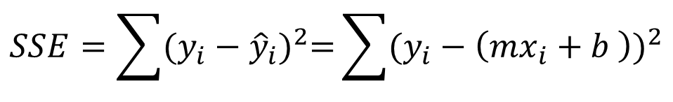





Caffeine Data Set: Calculations
$$SSE=\sum{{(y_{i}−{\hat{y}}_{i})}^{2}=}\sum{{(y_{i}−\left(mx_{i}+b \right))}^{2}}$$
$${(0.5−\left(0.01·0 +0.38 \right))}^{2}$$
$${+ (1.5−\left(0.01·100+0.38 \right))}^{2}$$
$$+ {(2.5−\left(0.01·150+0.38 \right))}^{2}$$
$${+ (1.0−\left(0.01·40 +0.38 \right))}^{2}$$
$$+{ (4.0−\left(0.01·250+0.38 \right))}^{2}$$
$${+ (2.0−\left(0.01·120+0.38 \right))}^{2}$$
$${+ (4.5−\left(0.01·300+0.38 \right))}^{2}$$
$${+ (2.5−\left(0.01·175+0.38 \right))}^{2}$$
$${+ (3.0−\left(0.01·210+0.38 \right))}^{2}$$
$${+ (80−\left(0.01·80 +0.38 \right))}^{2} ≈6216.15$$

Slide 29
How to Find the Line of Best Fit
By adjusting the slope and y-intercept, the sum of squared errors can be minimised. However, how can this be achieved efficiently, without testing every possible combination?

Slide 30
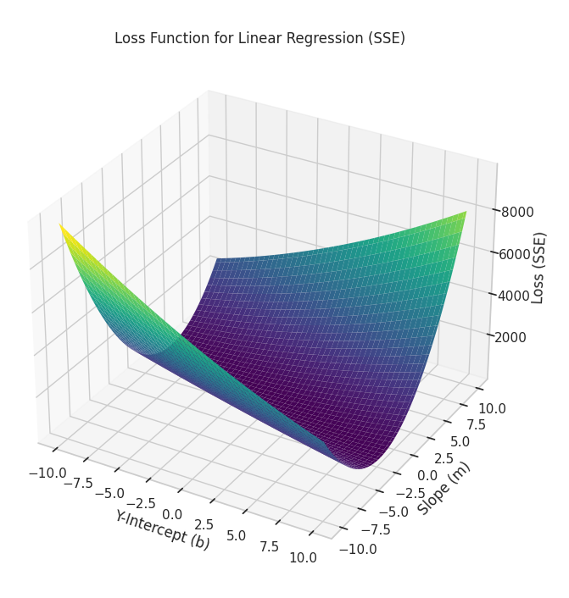
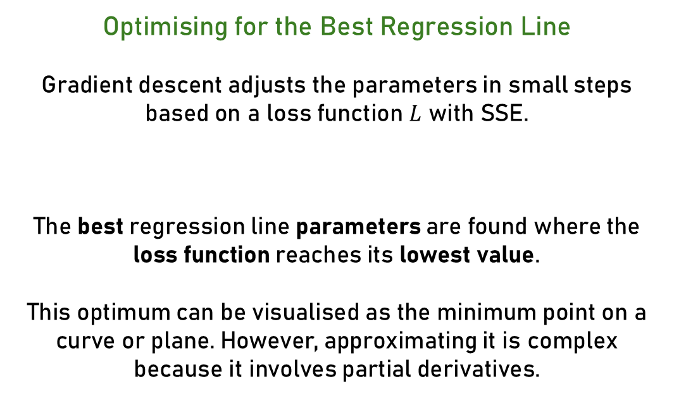


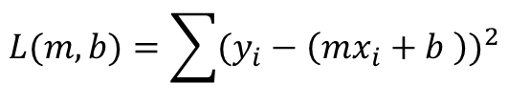
Introduction to Gradient Descent
Optimising for the Best Regression Line
Gradient descent adjusts the parameters in small steps based on a loss function $L$ with SSE.
The best regression line parameters are found where the loss function reaches its lowest value.
This optimum can be visualised as the minimum point on a curve or plane. However, approximating it is complex because it involves partial derivatives.
$$L(m,b)=\sum{{(y_{i}−\left(mx_{i}+b \right))}^{2}}$$
$$For the intercept b: \frac{∂L}{∂b}$$
$$For the slope m: \frac{∂L}{∂m}$$

Slide 31
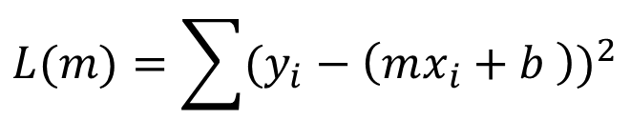

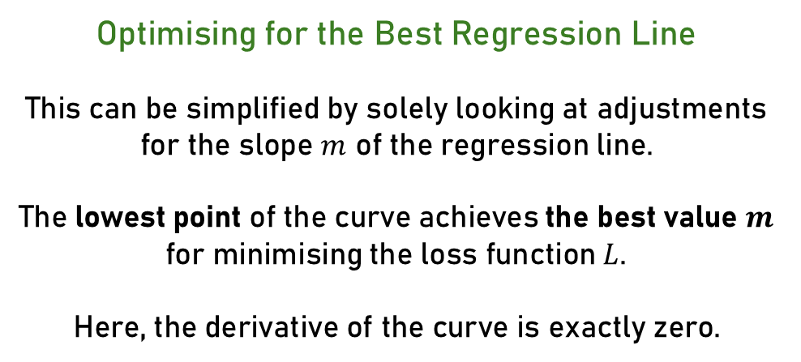

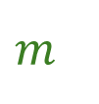
Introduction to Gradient Descent
$$L(m)=\sum{{(y_{i}−\left(mx_{i}+b \right))}^{2}}$$
$$L$$
Optimising for the Best Regression Line
This can be simplified by solely looking at adjustments for the slope $m$ of the regression line.
The lowest point of the curve achieves the best value $m$ for minimising the loss function $L$.
Here, the derivative of the curve is exactly zero.
$$L^{′}\left(m\right)=0$$
$$m$$

Slide 33
Decision Tree Classification
Chapter 2.2

Slide 34
Decision Tree Classification is a supervised learning algorithm where a computer system constructs a tree-like model to classify data.

Slide 35
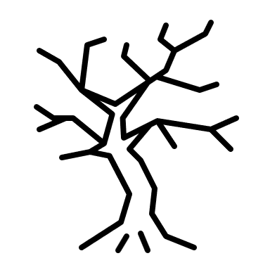
What Are Decision Trees

Slide 36
What Are Decision Trees

Slide 37
What Are Decision Trees
3 layers

Slide 38
What Are Decision Trees
root node
internal nodes
branches
leaf nodes

Slide 39
Decision tree classification is a supervised learning algorithm where a computer system constructs a tree-like model to classify data.

Slide 40
Are You Allowed to Drive
Age?
>18
<18
Exam?
No
passed
failed
Yes
No

Slide 41
Are You Allowed to Drive
Age?
>18
<18
Exam?
No
Features
individual properties of data
passed
failed
Yes
No

Slide 42
Are You Allowed to Drive
Age?
>18
<18
Exam?
No
Thresholds
specific values to split data at
passed
failed
Yes
No

Slide 43
Decision tree classification is a supervised learning algorithm where a computer system constructs a tree-like model to classify data.

Slide 44
School Data Set: Features
Student | Jeremy | Noah | Alyssa | Daniel | Sofia | Colin | Gracie | Anne | Jamal | Trisha
Average Score | 65% | 70% | 82% | 67% | 92% | 23% | 96% | 47% | 75% | 46%
Hours Studied | 3 | 1 | 3 | 2 | 4 | 1 | 5 | 4 | 2 | 1
Passed? | No | Yes | Yes | No | Yes | No | Yes | Yes | Yes | No

Slide 45
School Data Set: Points
Thresholds
that split the values best
passed
failed

Slide 46
How to Find the Best Thresholds
Where the data is separated in the quickest and most efficient way... But how is this achieved?

Slide 47


What is Entropy
It measures how mixed or impure data is.
Low Entropy
High Entropy

Slide 48
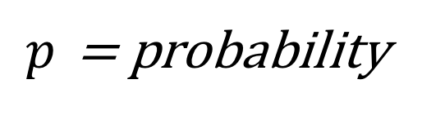
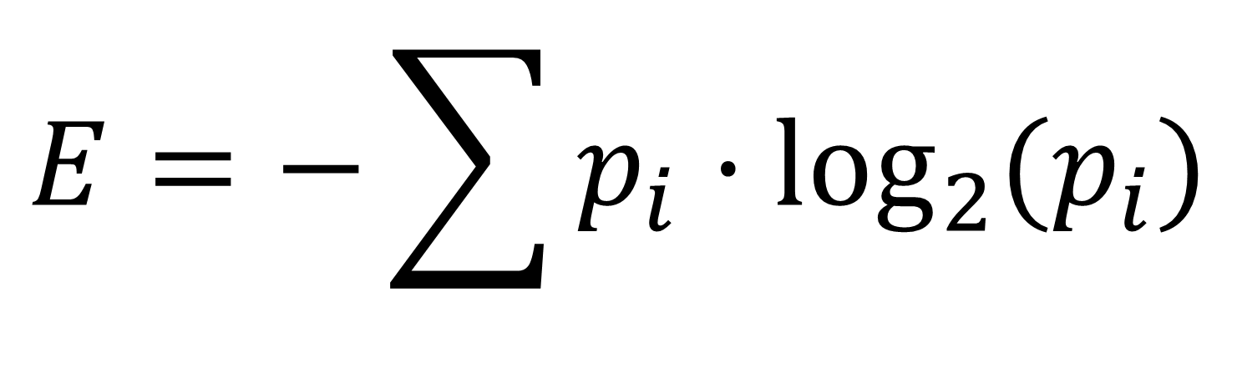
What is Entropy?
It measures how mixed or impure data is.
$$E=−\sum{p_{i}·\log_{2}{(p_{i}})}$$
$p$ = probability

Slide 49

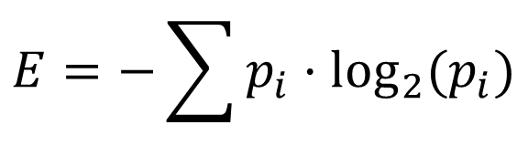
What is Entropy
It measures how mixed or impure data is.
$$E=−\sum{p_{i}·\log_{2}{(p_{i}})}$$
$E=−\left(\frac{1}{10}·\log_{2}\left(\frac{1}{10}\right)+\frac{9}{10}·\log_{2}\left(\frac{9}{10}\right)\right)$ $≈0,47$
$$≈0,47$$

Slide 50

What is Entropy
It measures how mixed or impure data is.
$$E=−\sum{p_{i}·\log_{2}{(p_{i}})}$$
$E=−\left(\frac{4}{10}·\log_{2}\left(\frac{4}{10}\right)+\frac{6}{10}·\log_{2}\left(\frac{6}{10}\right)\right)$ $≈0,97$
$$≈0,97$$

Slide 51
What is Entropy
$E=−\left(\frac{1}{10}·\log_{2}\left(\frac{1}{10}\right)+\frac{9}{10}·\log_{2}\left(\frac{9}{10}\right)\right)$ $≈0,47$
Low Entropy
High Entropy
0
1
$E=−\left(\frac{4}{10}·\log_{2}\left(\frac{4}{10}\right)+\frac{6}{10}·\log_{2}\left(\frac{6}{10}\right)\right)$ $≈0,97$

Slide 52
What is Information Gain
Information gain is the reduction in entropy that results from splitting the data at a specific threshold.

Slide 53
What is Information Gain
School Data Set:
Initial Entropy ≈ 0.97
Students that passed
> 2.5 hours studied
< 2.5 hours studied
Students that failed
Left Entropy ≈ 0.72
Right Entropy ≈ 0.97

Slide 54
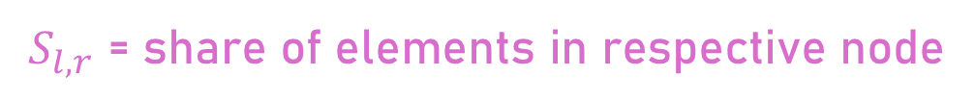
What is Information Gain
School Data Set:
$$Information Gain=Initial Entropy−\left(S_{l}·Left Entropy+S_{r}·Right Entropy\right)$$
$S_{l,r}$ = share of elements in respective node

Slide 55
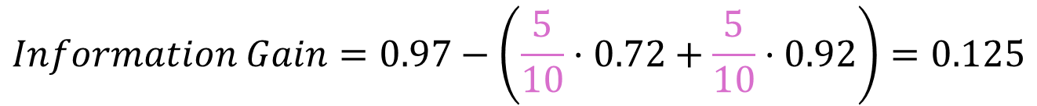
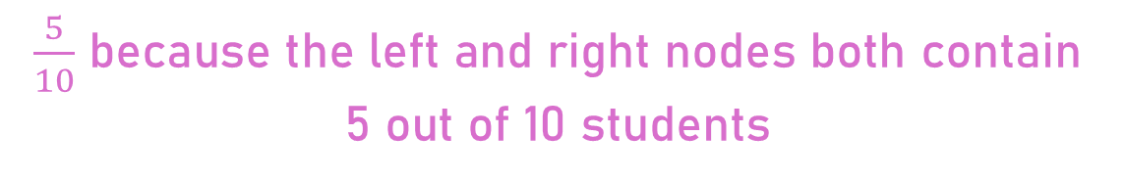
What is Information Gain
School Data Set:
$$Information Gain=0.97−\left(\frac{5}{10}·0.72+\frac{5}{10}·0.92\right)=0.125$$
$\frac{5}{10}$ because the left and right nodes both contain 5 out of 10 students

Slide 56
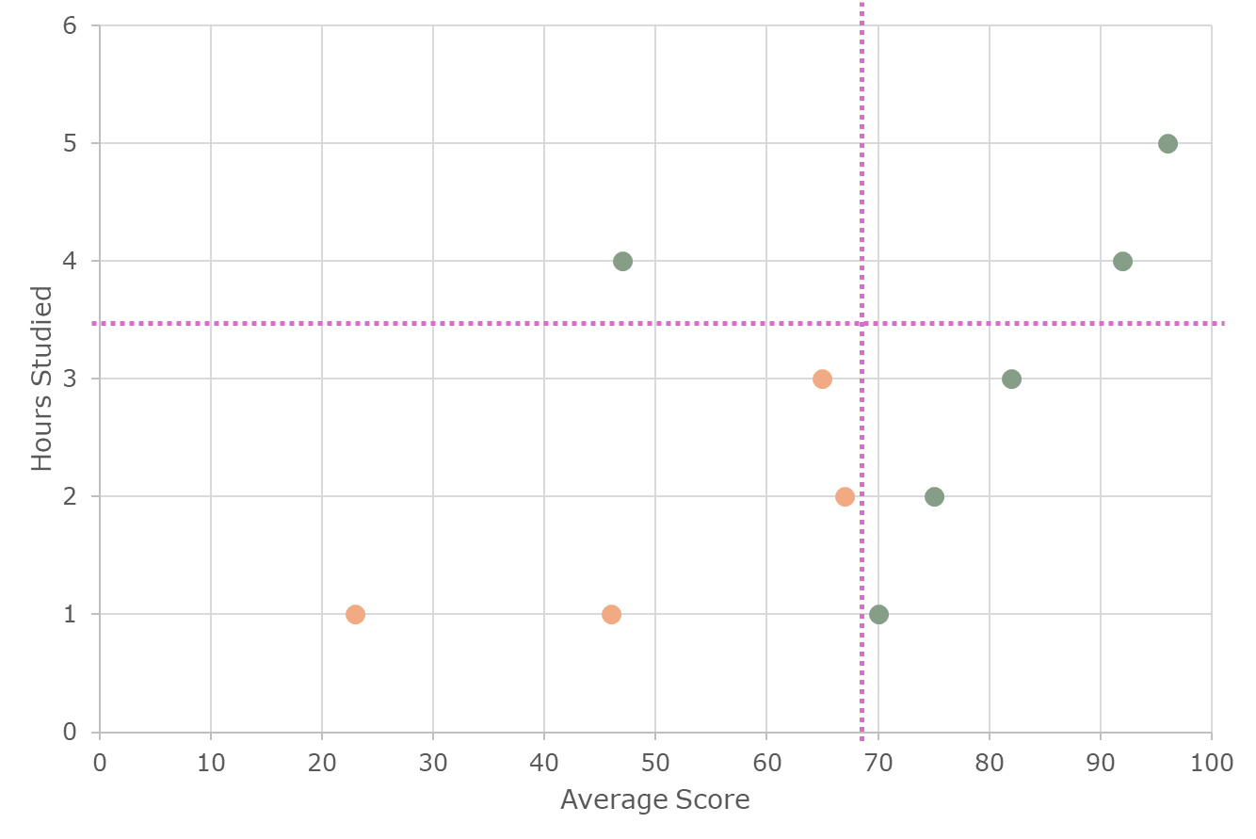
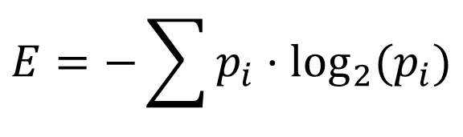
School Data Set: Calculations
Calculate the information gain for the predefined best thresholds:
< 68.5 for average score
> 68.5 for average score
< 3.5 hours studied
> 3.5 hours studied
$$E=−\sum{p_{i}·\log_{2}{(p_{i}})}$$

Slide 57



School Data Set: Calculations
$E=−\left(\frac{6}{10}·\log_{2}\left(\frac{6}{10}\right)+\frac{4}{10}·\log_{2}\left(\frac{4}{10}\right)\right)$ $≈0,97$
< 68.5 for average score
> 68.5 for average score
$E=−\left(\frac{1}{5}·\log_{2}\left(\frac{1}{5}\right)+\frac{4}{5}·\log_{2}\left(\frac{4}{5}\right)\right)$ $≈0,72$
$E=−\left(\frac{5}{5}·\log_{2}\left(\frac{5}{5}\right)\right)$ $=0$
< 3.5 hours studied
> 3.5 hours studied
$E=−\left(\frac{4}{4}·\log_{2}\left(\frac{4}{4}\right)\right)$ $=0$
$E=−\left(\frac{1}{1}·\log_{2}\left(\frac{1}{1}\right)\right)$ $=0$

Slide 58
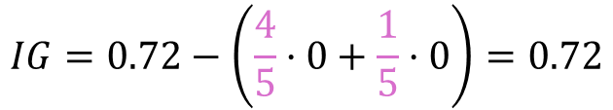
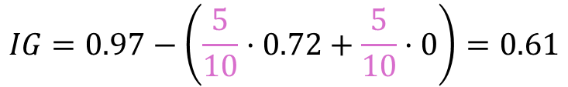
School Data Set: Calculations
$$IG=0.97−\left(\frac{5}{10}·0.72+\frac{5}{10}·0\right)=0.61$$
< 68.5 for average score
> 68.5 for average score
< 3.5 hours studied
> 3.5 hours studied
$$IG=0.72−\left(\frac{4}{5}·0+\frac{1}{5}·0\right)=0.72$$

Slide 59
School Data Set: Calculations
Calculate the information gain for the predefined best thresholds:
< 68.5 for average score
> 68.5 for average score
< 3.5 hours studied
> 3.5 hours studied
$$E=−\sum{p_{i}·\log_{2}{(p_{i}})}$$

Slide 60
How to Find the Best Thresholds
These thresholds provide the highest information gain.
But how does the computer know?

Slide 61
How to Find the Best Thresholds
The computer recursively iterates through every combination of features and thresholds and calculates the information gain to find the optimal pair.

Slide 62
How to Find the Best Thresholds

Slide 63
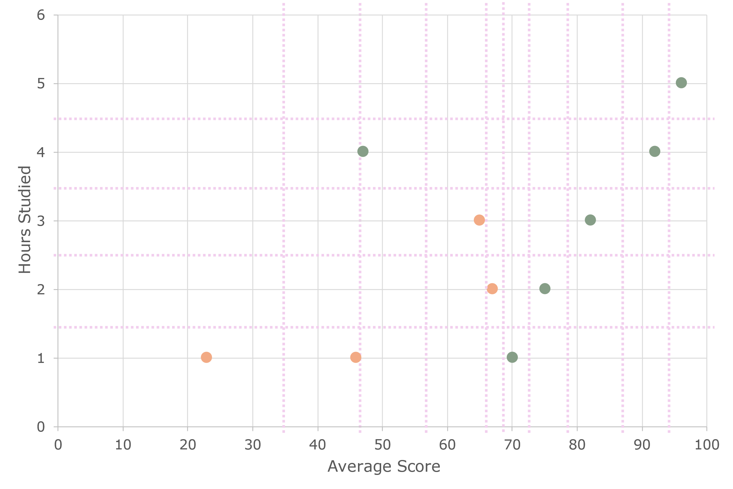

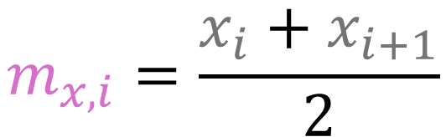
How to Find the Best Thresholds
1. Calculate all possible thresholds
For the two features Hours Studied & Average Score, we calculate all the midpoints between consecutive sorted values:
$$m_{x,i}=\frac{x_{i}+x_{i+1}}{2}$$

Slide 64
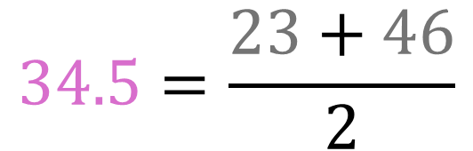
How to Find the Best Thresholds
1. Calculate all possible thresholds
For the two features Hours Studied & Average Score, we calculate all the midpoints between consecutive sorted values:
$$34.5=\frac{23+46}{2}$$

Slide 65
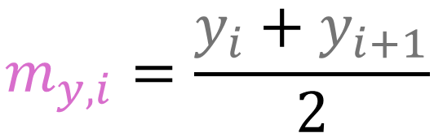
How to Find the Best Thresholds
1. Calculate all possible thresholds
For the two features Hours Studied & Average Score, we calculate all the midpoints between consecutive sorted values:
$$m_{y,i}=\frac{y_{i}+y_{i+1}}{2}$$

Slide 66
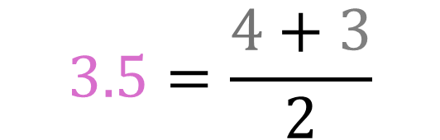
How to Find the Best Thresholds
1. Calculate all possible thresholds
For the two features Hours Studied & Average Score, we calculate all the midpoints between consecutive sorted values:
$$3.5=\frac{4+3}{2}$$

Slide 67

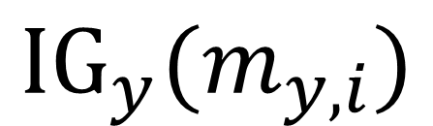
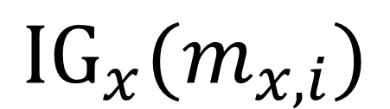
How to Find the Best Thresholds
2. Information gain for every split
For each threshold compute the information gain:
$${IG}_{x}(m_{x,i})$$
$$\&$$
$${IG}_{y}(m_{y,i})$$

Slide 68
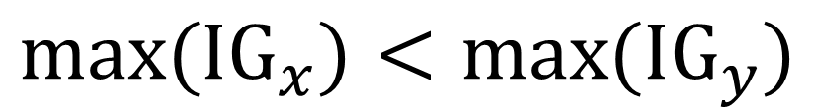
How to Find the Best Thresholds
3. Split on the optimal pair
Choose the feature-threshold pairs, that give the highest information gain and finally compare them to determine the optimal split
$${max(IG}_{x})<{max(IG}_{y})$$
The information gain for the y-component Hours Studied is larger. Therefore, split there first!

Slide 70
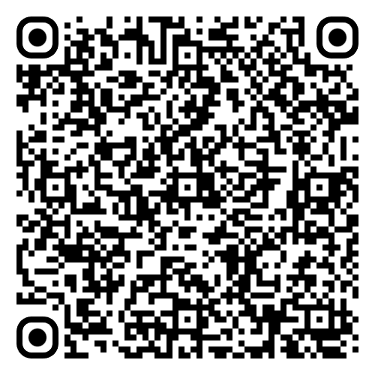
Resource Hub

