Slide 1
Unsupervised Learning
Chapter 3

Slide 2





Unsupervised Learning
organising your closet
Analyse
Cluster
Organise

Slide 3
k-Means Clustering
Chapter 3.1

Slide 4
K-means clustering is an unsupervised learning algorithm that groups data based on similarity using cluster centres to represent each group.

Slide 5

How Does k-Means Clustering Work

Slide 6

How Does k-Means Clustering Work
Individual data points
measured on any scale or range

Slide 7



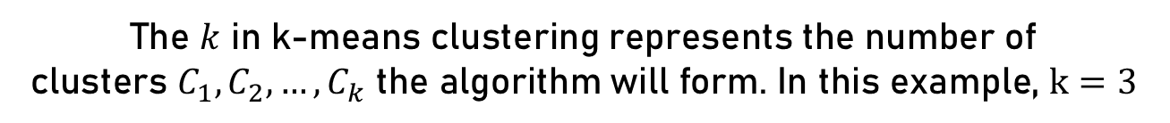



How Does k-Means Clustering Work
The $k$ in k-means clustering represents the number of
clusters ${C_{1},C_{2},…,C}_{k}$ the algorithm will form. In this example, $k=3$
$$C_{1}$$
$$C_{2}$$
$$C_{3}$$
This data can easily be grouped into three clusters by eye:

Slide 8
K-means clustering is an unsupervised learning algorithm that groups data based on similarity using cluster centres to represent each group.

Slide 9
How Does k-Means Clustering Work
Random selection
of three starting clusters

Slide 10
How Does k-Means Clustering Work
Assign each point to the nearest starting cluster
by determining the shortest distance to the starting clusters

Slide 11
Relationship of Data Points
$$distance=\left|point−intial cluster\right|$$
1
2
3
4
5
6
Determining the distance
of the first point to the initial clusters

Slide 12
Relationship of Data Points
$$distance=\left|point−intial cluster\right|$$
1
2
3
4
5
6
The shortest distance
determines the colour/cluster of the point

Slide 13
Relationship of Data Points
$$distance=\left|point−intial cluster\right|$$
1
2
3
4
5
6
Determining the distance
of the second point to the initial clusters

Slide 14
Relationship of Data Points
$$distance=\left|point−intial cluster\right|$$
1
2
3
4
5
6
The shortest distance
determines the colour/cluster of the point

Slide 15
Relationship of Data Points
$$distance=\left|point−intial cluster\right|$$
1
2
3
4
5
6
Repeat for every point
by determining the shortest distance to the initial clusters

Slide 16



Relationship of Data Points
$$C_{1}$$
$$C_{2}$$
$$C_{3}$$

Slide 17

Relationship of Data Points
$$C_{1}$$
$$C_{2}$$
$$C_{3}$$
Find the cluster centres
for all the respective clusters${ C_{1},C_{2},…,C}_{k}$

Slide 18



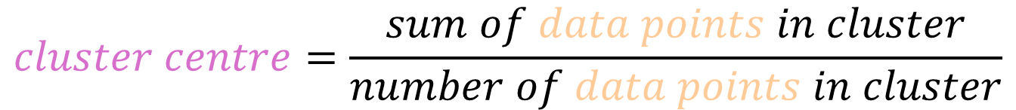



Define the Cluster Centre as Mean
$$μ_{2}$$
$$x_{1}$$
$$x_{2}$$
$$x_{3}$$
$$x_{4}$$
$$C_{2}$$
$$cluster centre=\frac{sum of data points in cluster}{number of data points in cluster}$$

Slide 19
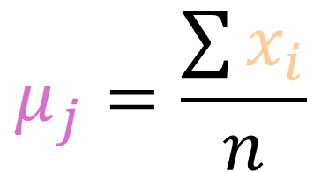
Define the Cluster Centre as Mean
$$μ_{2}$$
$$x_{1}$$
$$x_{2}$$
$$x_{3}$$
$$x_{4}$$
$$C_{2}$$
$$μ_{j}=\frac{\sum{x_{i}}}{n}$$

Slide 20
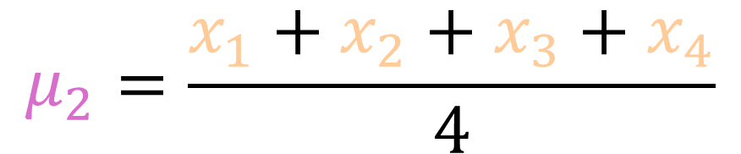
Define the Cluster Centre as Mean
$$μ_{2}$$
$$x_{1}$$
$$x_{2}$$
$$x_{3}$$
$$x_{4}$$
$$C_{2}$$
$$μ_{2}=\frac{x_{1}+x_{2}+x_{3}+x_{4}}{4}$$

Slide 21



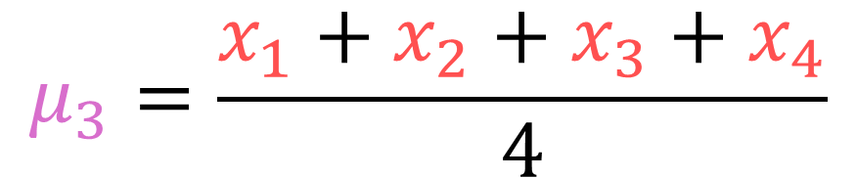



Define the Cluster Centre as Mean
$$μ_{3}$$
$$x_{1}$$
$$x_{2}$$
$$x_{3}$$
$$x_{4}$$
$$C_{3}$$
$$μ_{3}=\frac{x_{1}+x_{2}+x_{3}+x_{4}}{4}$$

Slide 22

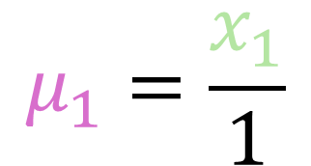

Define the Cluster Centre as Mean
$$μ_{1}=x_{1}$$
$$C_{1}$$
$$μ_{1}=\frac{x_{1}}{1}$$

Slide 23



Define the Cluster Centre as Mean
$$μ_{1}$$
$$μ_{2}$$
$$μ_{3}$$
$$C_{1}$$
$$C_{2}$$
$$C_{3}$$

Slide 24



Define the Cluster Centre as Mean
$$μ_{1}$$
$$μ_{2}$$
$$μ_{3}$$
$$C_{1}$$
$$C_{2}$$
$$C_{3}$$
Assign each point to the nearest cluster centre
by determining the shortest distance to the cluster centres

Slide 25

Relationship of Data Points
$$distance=\left|point−cluster centre\right|$$
$$μ_{1}$$
$$μ_{2}$$
$$μ_{3}$$
1
2
3
4
5
6
7
8
9
Determining the distance
of the the first point to the cluster centres $μ_{j}$

Slide 26
Relationship of Data Points
$$distance=\left|point−cluster centre\right|$$
$$μ_{1}$$
$$μ_{2}$$
$$μ_{3}$$
1
2
3
4
5
6
7
8
9
The shortest distance
determines the colour/cluster of the point

Slide 27
Relationship of Data Points
$$distance=\left|point−cluster centre\right|$$
$$μ_{1}$$
$$μ_{2}$$
$$μ_{3}$$
1
2
3
4
5
6
7
8
9
Determining the distance
of the the first point to the cluster centres $μ_{j}$

Slide 28
Relationship of Data Points
$$distance=\left|point−cluster centre\right|$$
$$μ_{1}$$
$$μ_{2}$$
$$μ_{3}$$
1
2
3
4
5
6
7
8
9
The shortest distance
determines the colour/cluster of the point

Slide 29
Relationship of Data Points
$$distance=\left|point−cluster centre\right|$$
$$μ_{1}$$
$$μ_{2}$$
$$μ_{3}$$
1
2
3
4
5
6
7
8
9
Repeat for every point
by determining the shortest distance to the cluster centres

Slide 30
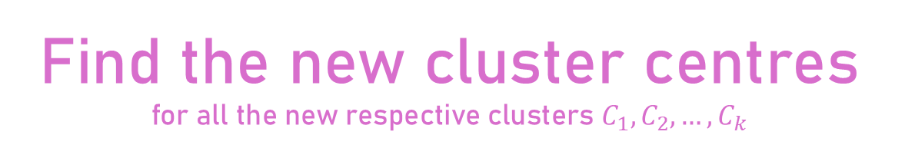




Define the Cluster Centre as Mean
$$μ_{1}$$
$$μ_{2}$$
$$μ_{3}$$
1
2
3
4
5
6
7
8
9
$$C_{1}$$
$$C_{2}$$
$$C_{3}$$
Find the new cluster centres
for all the new respective clusters${ C_{1},C_{2},…,C}_{k}$

Slide 31
Define the Cluster Centre as Mean
$$μ_{1}$$
$$μ_{2}$$
$$μ_{3}$$
1
2
3
4
5
6
7
8
9
$$C_{1}$$
$$C_{2}$$
$$C_{3}$$
Assign each point to the nearest cluster centre
by determining the shortest distance to the cluster centres

Slide 32
Define the Cluster Centre as Mean
$$μ_{1}$$
$$μ_{2}$$
$$μ_{3}$$
1
2
3
4
5
6
7
8
9
$$C_{1}$$
$$C_{2}$$
$$C_{3}$$
No change in clustering
during this iteration indicates that we are done

Slide 33






Compare the Clusterings
1
2
3
4
5
6
7
8
9
$$C_{1}$$
$$C_{2}$$
$$C_{3}$$
This new clustering is much worse than the one we identified by eye…
1
2
3
4
5
6
7
8
9
$$C_{1}$$
$$C_{2}$$
$$C_{3}$$

Slide 34
Compare the Clusterings
1
2
3
4
5
6
7
8
9
We can determine the quality of the clustering by adding up the variance of each clusters:
Total variance of new clustering

Slide 35
Compare the Clusterings
1
2
3
4
5
6
7
8
9
Total variances of both clusterings
1
2
3
4
5
6
7
8
9

Slide 36
Compare the Clusterings
The clustering is the best when the variance is the smallest:
1
2
3
4
5
6
7
8
9

Slide 37
Compare the Clusterings
To find the clustering with this smallest variance, the computer can iterate the whole process again with different random starting clusters…
1
2
3
4
5
6
7
8
9

Slide 38
Compare the Clusterings
…eventually leading to the optimal clustering!
1
2
3
4
5
6
7
8
9

Slide 39
How Does k-Means Clustering Work
K-means clustering not only works in one dimension…

Slide 40
How Does k-Means Clustering Work
…but in two or more dimensions as well!

Slide 41



How Does k-Means Clustering Work
This data again can easily be grouped into three clusters by eye:
$$C_{3}$$
$$C_{2}$$
$$C_{1}$$

Slide 42
How Does k-Means Clustering Work
Let’s see how a computer clusters in two dimensions with k-means…

Slide 43
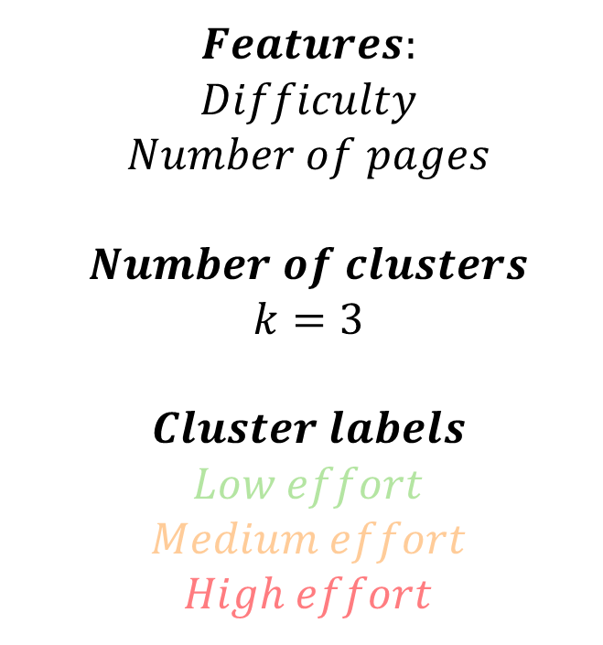
Homework Data Set: Instructions
$$Features:$$
$$Difficulty$$
$$Number of pages$$
$$Number of clusters$$
$$k=3$$
$$Cluster labels$$
$$Low effort$$
$$Medium effort$$
$$High effort$$

Slide 44
Homework Data Set: Calculations
Random selection
of three starting clusters

Slide 45
Homework Data Set: Calculations
Assign each point to the nearest starting cluster
by determining the shortest distance to the starting clusters

Slide 46
Homework Data Set: Calculations
Determining the distance
of a point to the initial clusters

Slide 47
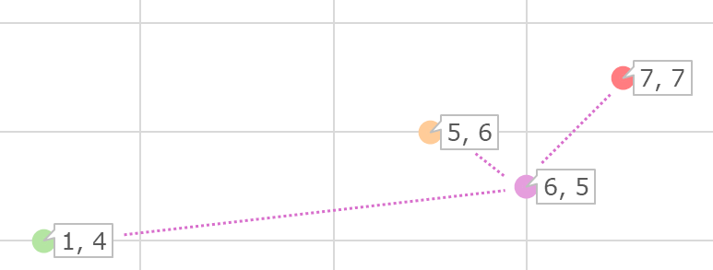
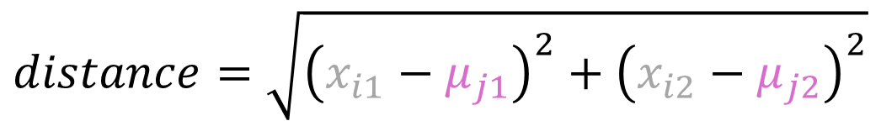
Homework Data Set: Calculations
$$distance=\sqrt{{\left(x_{i1}−μ_{j1}\right)}^{2}+{\left(x_{i2}−μ_{j2}\right)}^{2}}$$
Determining the distance
of a point to the initial clusters

Slide 48
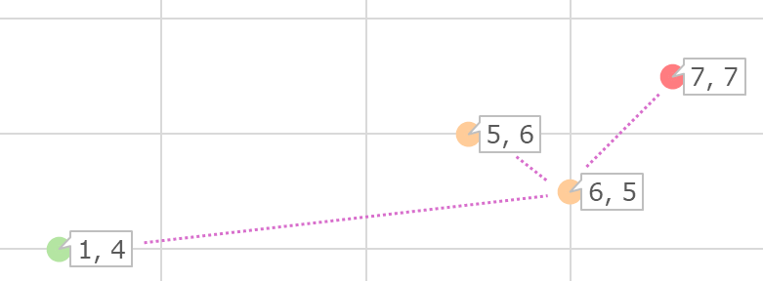



Homework Data Set: Calculations
$$distance=\sqrt{{\left(x_{i1}−μ_{j1}\right)}^{2}+{\left(x_{i2}−μ_{j2}\right)}^{2}}$$
$$d≈2.24$$
$$d≈1.41$$
$$d≈5.10$$
The shortest distance
determines the colour/cluster of the point

Slide 49
Homework Data Set: Calculations
Repeat for every point
by determining the shortest distance to the initial clusters

Slide 50
Homework Data Set: Calculations
Repeat for every point
by determining the shortest distance to the initial clusters

Slide 51



Homework Data Set: Calculations
$$C_{3}$$
$$C_{2}$$
$$C_{1}$$

Slide 52

Homework Data Set: Calculations
Find the cluster centres
for all the respective clusters $C_{1},C_{2},…,C_{k}$
$$C_{3}$$
$$C_{2}$$
$$C_{1}$$

Slide 53
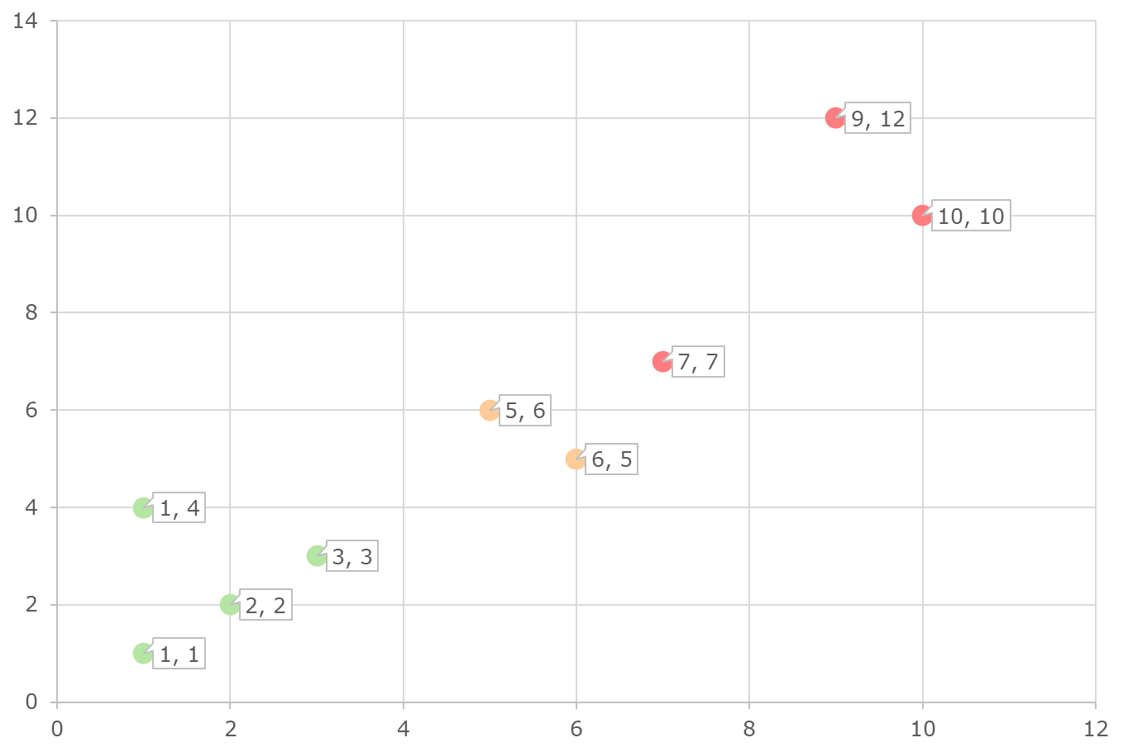





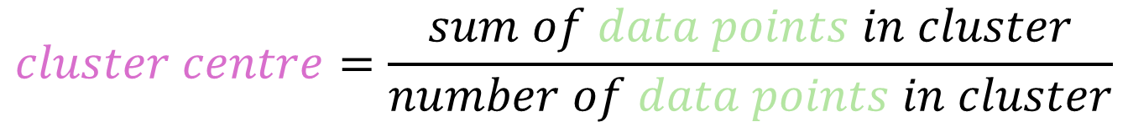

Homework Data Set: Calculations
$$\vec{x_{1}}$$
$$\vec{x_{4}}$$
$$\vec{μ_{1}}$$
$$\vec{x_{3}}$$
$$C_{1}$$
$$\vec{x_{2}}$$
$$cluster centre=\frac{sum of data points in cluster}{number of data points in cluster}$$

Slide 54
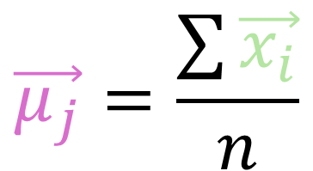
Homework Data Set: Calculations
$$\vec{x_{1}}$$
$$\vec{x_{4}}$$
$$\vec{μ_{1}}$$
$$\vec{x_{3}}$$
$$C_{1}$$
$$\vec{x_{2}}$$
$$\vec{μ_{j}}=\frac{\sum{\vec{x_{i}}}}{n}$$

Slide 55
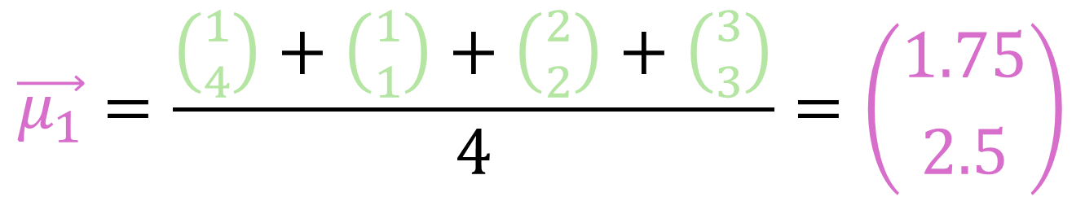
Homework Data Set: Calculations
$$\vec{x_{1}}$$
$$\vec{x_{4}}$$
$$\vec{μ_{1}}$$
$$\vec{x_{3}}$$
$$C_{1}$$
$$\vec{x_{2}}$$
$$\vec{μ_{1}}=\frac{\left({1 \atop 4}\right)+\left({1 \atop 1}\right)+\left({2 \atop 2}\right)+\left({3 \atop 3}\right)}{4}=\left({1.75 \atop 2.5}\right)$$

Slide 56
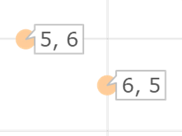




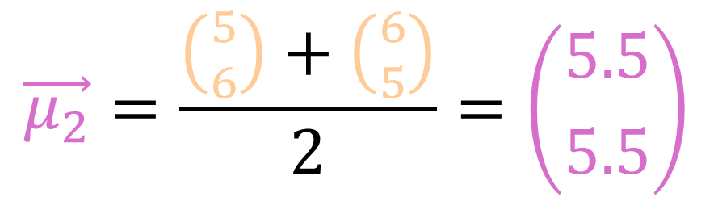
Homework Data Set: Calculations
$$\vec{x_{1}}$$
$$\vec{μ_{2}}$$
$$C_{2}$$
$$\vec{x_{2}}$$
$$\vec{μ_{2}}=\frac{\left({5 \atop 6}\right)+\left({6 \atop 5}\right)}{2}=\left({5.5 \atop 5.5}\right)$$

Slide 57
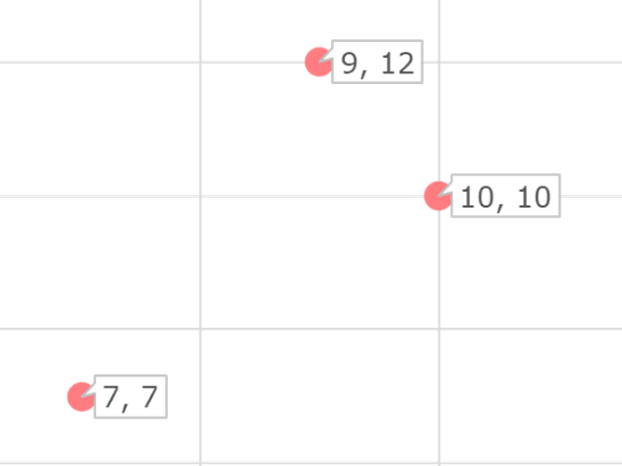





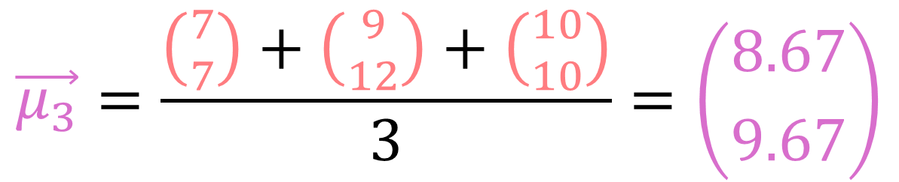
Homework Data Set: Calculations
$$\vec{x_{2}}$$
$$\vec{x_{3}}$$
$$\vec{μ_{3}}$$
$$C_{3}$$
$$\vec{x_{1}}$$
$$\vec{μ_{3}}=\frac{\left({7 \atop 7}\right)+\left({9 \atop 12}\right)+\left({10 \atop 10}\right)}{3}=\left({8.67 \atop 9.67}\right)$$

Slide 58
Homework Data Set: Calculations

Slide 59
Homework Data Set: Calculations
Assign each point to the nearest cluster centre
by determining the shortest distance to the cluster centres

Slide 60
Homework Data Set: Calculations
Assign each point to the nearest cluster centre
by determining the shortest distance to the cluster centres

Slide 61

Homework Data Set: Calculations
Find the new cluster centres
for all the new respective clusters $C_{1},C_{2},…,C_{k}$

Slide 62
Homework Data Set: Calculations
Assign each point to the new nearest cluster centre
by determining the shortest distance to the new cluster centres

Slide 63
Homework Data Set: Calculations
No change in clustering
during this iteration indicates that we are done

Slide 64



Homework Data Set: Calculations
$$C_{3}$$
$$C_{2}$$
$$C_{1}$$

Slide 66
Naive Bayes
Text Prediction
Chapter 3.2

Slide 67
Naive Bayes for text prediction is an unsupervised learning algorithm that
iteratively applies Bayes’ theorem
for estimating the next word.

Slide 68
Natural Language Processing
Tasks like text prediction are part of natural language processing (NLP), a branch of artificial intelligence that enables computers to understand and generate human language. ChatGPT for example is an application of this.
Text Input
Text Prediction
Text Output
Step-by-step: How does a simple version of text prediction work?

Slide 69
Text Preparation: Normalisation
Normalisation is the first thing to do for preprocessing text in NLP.
The text data, also known as corpus, is converted to a standard format,
for example:
convert to lowercase
remove punctuation
The student reads a book, and the teacher writes down a task.

Slide 70
Text Preparation: Normalisation
Normalisation is the first thing to do for preprocessing text in NLP.
The text data, also known as corpus, is converted to a standard format,
for example:
convert to lowercase
remove punctuation
the student reads a book and the teacher writes down a task .

Slide 71
Text Preparation: Tokenisation
Tokenisation is the next essential step for preprocessing.
It breaks down text in smaller pieces (tokens), like words or syllables.
We will use this method!
Tokenisation in words:
the student reads a book and the teacher writes down a task
Tokenisation in sub-word components:
the student reads a book and the teacher writes down a task

Slide 72
Why Is this Algorithm Naive
“Naive” in naive Bayes refers to the algorithm’s simplifying assumption that all words in a corpus are independent from each other.
the student reads a book and the teacher writes down a task
The probability that a word follows the previous one is
considered unrelated from the broader context.

Slide 73
Naive Bayes for text prediction is an unsupervised learning algorithm that
iteratively applies Bayes’ theorem
for estimating the next word.

Slide 74
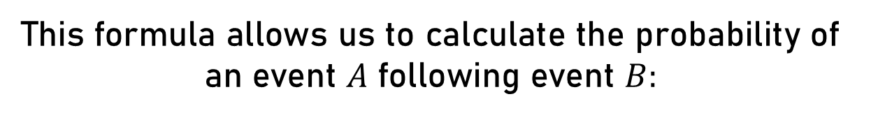
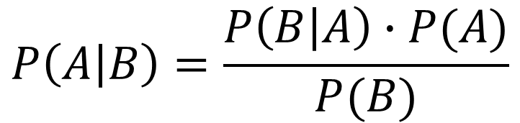
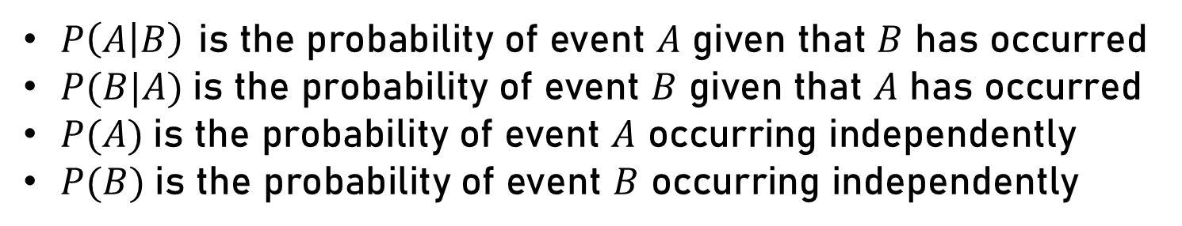
What Is Bayes’ Theorem
This formula allows us to calculate the probability of an event $A$ following event $B:$
$$P\left(A | B\right)=\frac{P\left(B | A\right)∙P(A)}{P(B)}$$
$P\left(A | B\right)$ is the probability of event $A$ given that $B$ has occurred
$P(B|A)$is the probability of event $B$ given that $A$ has occurred
$P(A)$is the probability of event $A$ occurring independently
$P(B)$is the probability of event $B$ occurring independently

Slide 75
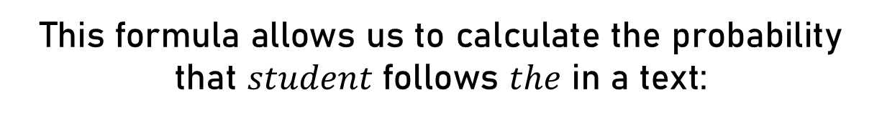
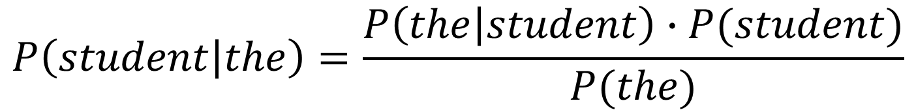
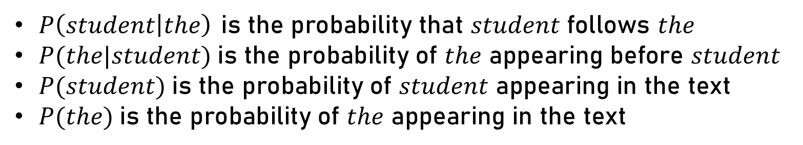
What Is Bayes’ Theorem
This formula allows us to calculate the probability that $student$ follows $the$ in a text:
$$P\left(student | the\right)=\frac{P\left(the | student\right)∙P(student)}{P(the)}$$
$P\left(student | the\right)$ is the probability that $student$ follows $the$
$P(the|student)$is the probability of $the$ appearing before $student$
$P(student)$is the probability of $student$ appearing in the text
$P(the)$is the probability of $the$ appearing in the text

Slide 76
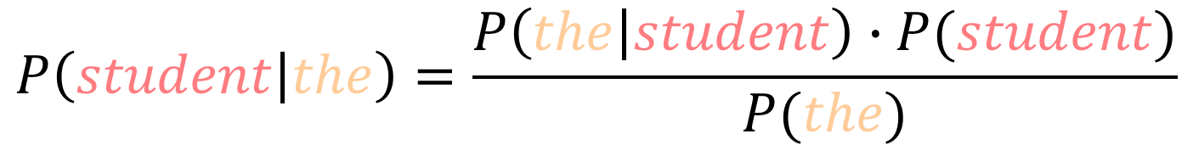
What Is Bayes’ Theorem
the student reads a book and the teacher writes down a task
$$P\left(student | the\right)=\frac{P\left(the | student\right)∙P(student)}{P(the)}$$
$$P\left(the|student\right)=1.0 (1 out of 1 time \text{"}\text{the}\text{"} comes before "student")$$
$$P\left(student\right)=0.08\overline{3} (1 out of 12 words in the text are \text{"}\text{student}")$$
$$P\left(the\right)=0.1\overline{6} (2 out of 12 words in the text are "\text{the}\text{"})$$

Slide 77
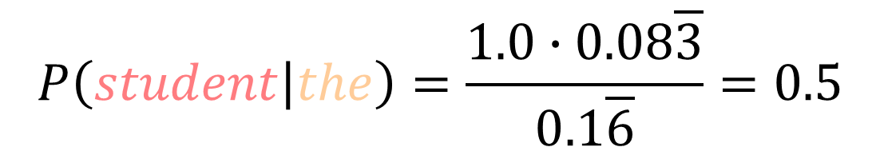
What Is Bayes’ Theorem
the student reads a book and the teacher writes down a task
$$P\left(student | the\right)=\frac{1.0∙0.08\overline{3}}{0.1\overline{6}}=0.5$$
$$P\left(the|student\right)=1.0 (1 out of 1 time \text{"}\text{the}\text{"} comes before "student")$$
$$P\left(student\right)=0.08\overline{3} (1 out of 12 words in the text are \text{"}\text{student}")$$
$$P\left(the\right)=0.1\overline{6} (2 out of 12 words in the text are "\text{the}\text{"})$$

Slide 78
What Is Bayes’ Theorem
the student reads a book and the teacher writes down a task
$$P\left(student | the\right)=\frac{1.0∙0.08\overline{3}}{0.1\overline{6}}=0.5$$
$∴$ There is a 50% probability that $student$ follows $the$
$P(student|the)$ is called a transition probability.

Slide 79
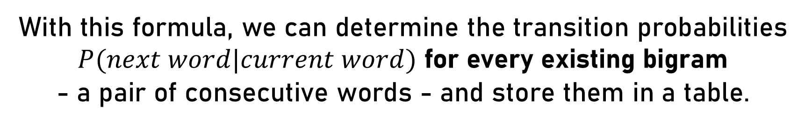
Building Transition Probabilities
$P(student|the)$ is called a transition probability.
With this formula, we can determine the transition probabilities $P(next word|current word)$ for every existing bigram
- a pair of consecutive words - and store them in a table.

Slide 80


Building Transition Probabilities
the student reads a book and the teacher writes down a task
$$current word$$
 | the | student | reads | a | book | and | teacher | writes | down | task
the | - | - | - | - | - | 1.0 | - | - | - | -
student | 0.5 | - | - | - | - | - | - | - | - | -
reads | - | 1.0 | - | - | - | - | - | - | - | -
a | - | - | 1.0 | - | - | - | - | - | 1.0 | -
book | - | - | - | 0.5 | - | - | - | - | - | -
and | - | - | - | - | 1.0 | - | - | - | - | -
teacher | 0.5 | - | - | - | - | - | - | - | - | -
writes | - | - | - | - | - | - | 1.0 | - | - | -
down | - | - | - | - | - | - | - | 1.0 | - | -
task | - | - | - | 0.5 | - | - | - | - | - | -
$$following word$$

Slide 81





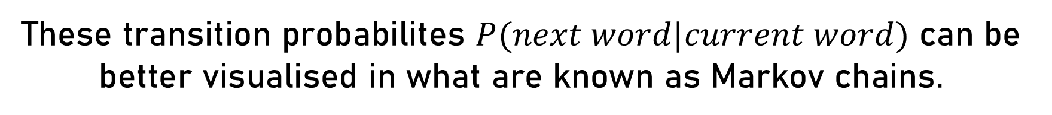






Building Transition Probabilities
the student reads a book and the teacher writes down a task
$$1.0$$
student
reads
$$0.5$$
$$1.0$$
$$1.0$$
$$1.0$$
$$0.5$$
$$0.5$$
the
and
book
a
task
$$0.5$$
$$1.0$$
$$1.0$$
$$1.0$$
teacher
writes
down
These transition probabilites $P(next word|current word)$ can be better visualised in what are known as Markov chains.

Slide 82
Building Transition Probabilities
the student reads a book and the teacher writes down a task
$$1.0$$
student
reads
$$0.5$$
$$1.0$$
$$1.0$$
$$1.0$$
$$0.5$$
$$0.5$$
the
and
book
a
task
$$0.5$$
$$1.0$$
$$1.0$$
$$1.0$$
teacher
writes
down
These transition probabilites $P(next word|current word)$ can be better visualised in what are known as Markov chains.

Slide 83
Building Transition Probabilities
the student reads a book and the teacher writes down a task
$$1.0$$
student
reads
$$0.5$$
$$1.0$$
$$1.0$$
$$1.0$$
$$0.5$$
$$0.5$$
the
and
book
a
task
$$0.5$$
$$1.0$$
$$1.0$$
$$1.0$$
teacher
writes
down
These transition probabilites $P(next word|current word)$ can be better visualised in what are known as Markov chains.

Slide 84
Building Transition Probabilities
the student reads a book and the teacher writes down a task
$$1.0$$
student
reads
$$0.5$$
$$1.0$$
$$1.0$$
$$1.0$$
$$0.5$$
$$0.5$$
the
and
book
a
task
$$0.5$$
$$1.0$$
$$1.0$$
$$1.0$$
teacher
writes
down
These transition probabilites $P(next word|current word)$ can be better visualised in what are known as Markov chains.

Slide 85





Temperature Adjustment
For larger text data, a single token may have transition probabilities leading to multiple words.
My favourite subject is
$$0.4$$
$$0.3$$
$$0.2$$
$$0.075$$
$$0.025$$
French
Sports
Maths
History
English

Slide 86
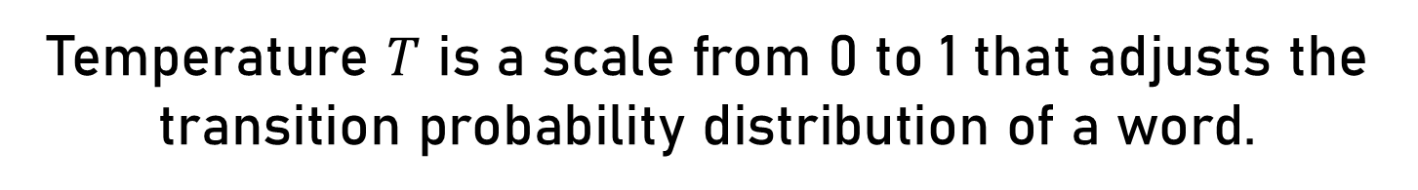
Temperature Adjustment
Temperature $T$ is a scale from 0 to 1 that adjusts the transition probability distribution of a word.
My favourite subject is
$$0.4$$
$$0.3$$
$$0.2$$
$$0.075$$
$$0.025$$
French
Sports
Maths
History
English

Slide 87

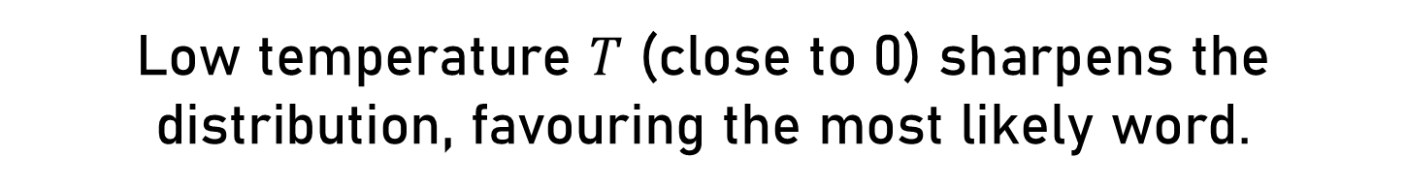




Temperature Adjustment
Low temperature $T$ (close to 0) sharpens the distribution, favouring the most likely word.
My favourite subject is
$$0.9$$
$$0.04$$
$$0.02$$
$$0.01$$
$$0.03$$
French
Sports
Maths
History
English

Slide 88

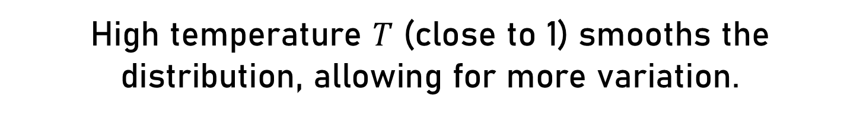




Temperature Adjustment
High temperature $T$ (close to 1) smooths the distribution, allowing for more variation.
My favourite subject is
$$0.29$$
$$0.19$$
$$0.17$$
$0.2$1
$$0.14$$
French
Sports
Maths
History
English

Slide 89
Temperature Adjustment
Temperature $T$ is a scale from 0 to 1 that adjusts the transition probability distribution of a word.
My favourite subject is
$$0.4$$
$$0.3$$
$$0.2$$
$$0.075$$
$$0.025$$
French
Sports
Maths
History
English

Slide 90
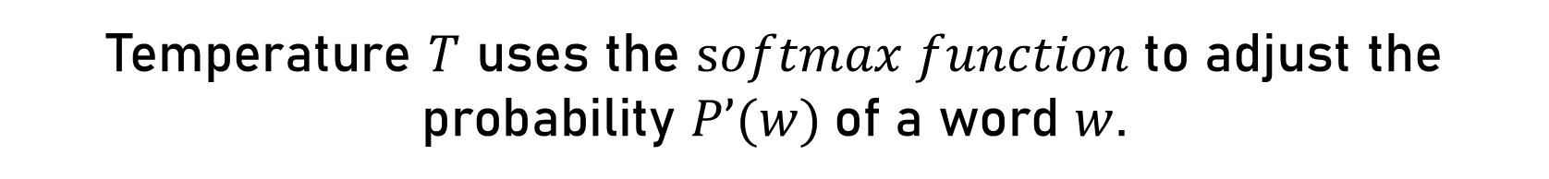
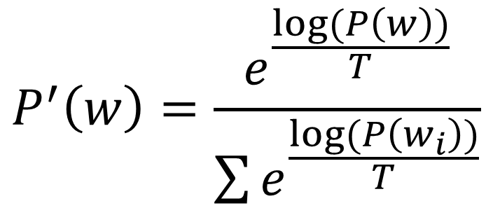
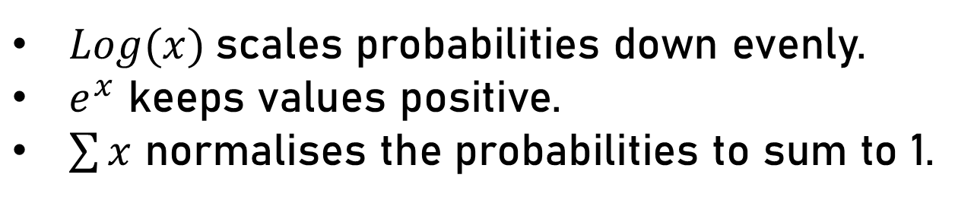
Temperature Adjustment
Temperature $T$ uses the $softmax function$to adjust the probability $P’(w)$of a word $w$.
$$P^{′}\left(w\right)=\frac{e^{\frac{log⁡(P\left(w\right))}{T}}}{\sum{e^{\frac{log⁡(P\left(w_{i}\right))}{T}}}}$$
$Log(x)$scales probabilities down evenly.
$e^{x}$ keeps values positive.
$\sum{x}$ normalises the probabilities to sum to 1.

Slide 91
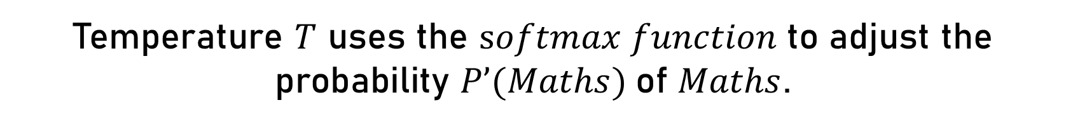
Temperature Adjustment
Temperature $T$ uses the $softmax function$to adjust the probability $P’(Maths)$of $Maths$.
$$P^{′}\left(Maths\right)=\frac{e^{\frac{log⁡(P\left(Maths\right))}{T}}}{e^{\frac{log⁡(P\left(French\right))}{T}}+e^{\frac{log⁡(P\left(Sports\right))}{T}}+e^{\frac{log⁡(P\left(Maths\right))}{T}}+e^{\frac{log⁡(P\left(History\right))}{T}}+e^{\frac{log⁡(P\left(English\right))}{T}}}$$
$Log(x)$scales probabilities down evenly.
$e^{x}$ keeps values positive.
$\sum{x}$ normalises the probabilities to sum to 1.

Slide 92
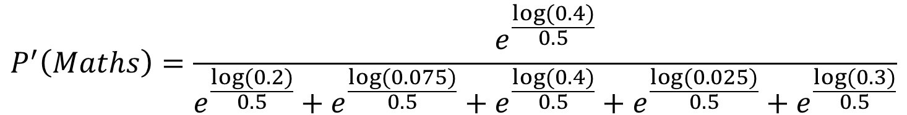
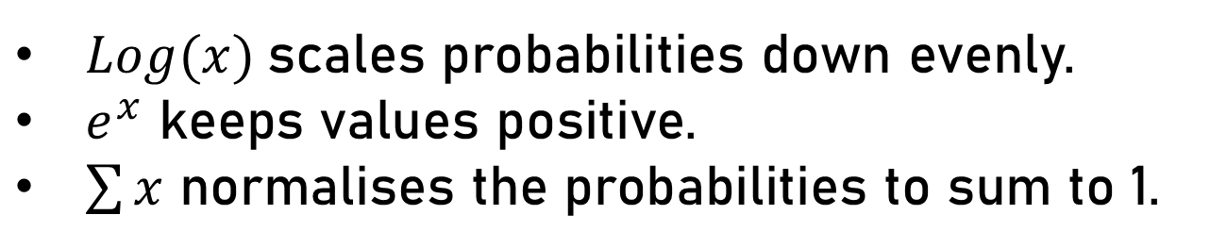
Temperature Adjustment
$P’(Maths)$of $Maths$ for $T=0.5$
$$P^{′}\left(Maths\right)=\frac{e^{\frac{log⁡(0.4)}{0.5}}}{e^{\frac{log⁡(0.2)}{0.5}}+e^{\frac{log⁡(0.075)}{0.5}}+e^{\frac{log(0.4)}{0.5}}+e^{\frac{log⁡(0.025)}{0.5}}+e^{\frac{log⁡(0.3)}{0.5}}}$$
$Log(x)$scales probabilities down evenly.
$e^{x}$ keeps values positive.
$\sum{x}$ normalises the probabilities to sum to 1.

Slide 93
Temperature Adjustment
$P’(Maths)$of $Maths$ for $T=0.5$
$$P^{′}\left(Maths\right)=\frac{0.159}{0.04+0.0056+0.159+0.0006+0.09}=0.54$$
$Log(x)$scales probabilities down evenly.
$e^{x}$ keeps values positive.
$\sum{x}$ normalises the probabilities to sum to 1.

Slide 94
Text Prediction Model: Training
The training phase is when our text prediction model learns the transition probabilities from the given text corpus:
The entire
Romeo and Juliet script
Turn text into word-tokens
Stored in a table for
later retrieval
Text Corpus
Preprocessing
Tokenisation
Naive Bayes
Transition Probabilities
Convert to lowercase
Remove punctuation
Apply Bayes’ theorem to every bigram

Slide 95
Text Prediction Model: Inference
The inference phase is when our text prediction model generates
an output based on a user input:
O Romeo, Romeo, wherefore art thou...
If the word is not in a bigram, use a random one
Scale based on the temperature value
User Input
Extract Context
Check Validity
Transition Probability
Temperature Adjustment
Predict Word
Since only bigrams matter, the last word of the input is extracted
Retrieve word transition probabilities from the table
…romeo

Slide 96
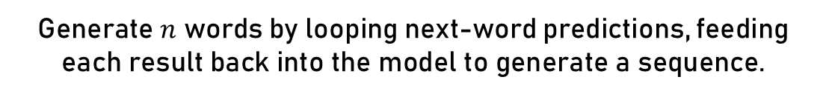
Text Prediction Model: Inference
The inference phase is when our text prediction model generates
an output based on a user input:
How can we generate more than just one word?
User Input
Extract Context
Check Validity
Transition Probability
Temperature Adjustment
Predict Word
Generate $n$ words by looping next-word predictions, feeding each result back into the model to generate a sequence.

Slide 97
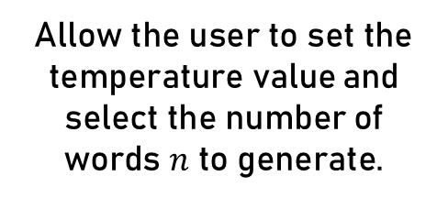
Text Prediction Model: Inference
The inference phase is when our text prediction model generates
an output based on a user input:
How to enable more user customisation?
User Input
Extract Context
Check Validity
Transition Probability
Temperature Adjustment
Predict Word
Allow the user to set the temperature value and select the number of words $n$ to generate.
Generate $n$ words by looping next-word predictions, feeding each result back into the model to generate a sequence.

Slide 98
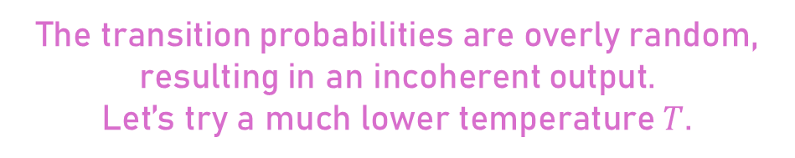
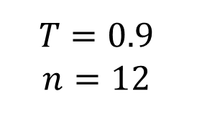
Text Prediction Model: Evaluation
User Input
Model Output
O Romeo, Romeo, wherefore art thou...
…romeo and saw one being morning a much so when well that
$$T=0.9$$
$$n=12$$
The transition probabilities are overly random, resulting in an incoherent output.
Let’s try a much lower temperature $T$.

Slide 99
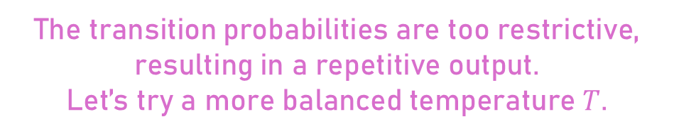
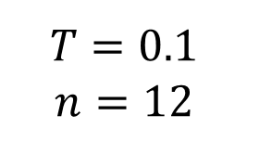
Text Prediction Model: Evaluation
User Input
Model Output
O Romeo, Romeo, wherefore art thou...
…romeo and i will i will i will i will i will
$$T=0.1$$
$$n=12$$
The transition probabilities are too restrictive, resulting in a repetitive output.
Let’s try a more balanced temperature $T$.

Slide 100
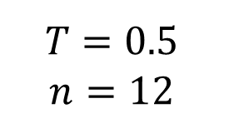
Text Prediction Model: Evaluation
User Input
Model Output
O Romeo, Romeo, wherefore art thou...
…romeo saw the lady capulet and parted either part while he was
$$T=0.5$$
$$n=12$$
This is the best achievable output, but
the text remains unclear and lacks coherence…

Slide 101
Text Prediction Model: Evaluation
…romeo saw the lady capulet and parted either part while he was
This is the best achievable output, but
the text remains unclear and lacks coherence…
The output is poor because our naive Bayes algorithm uses only bigrams, which limits context and prevents coherence.
A more complex approach is required for better results…

Slide 103

Resource Hub

