Slide 1
MERIDIAN TELECOM
Platform Engineer
Take-Home Assignment
Platform Architecture and Software specifications
Mattia Vincenzi
Date: 24/09/2026
Notes:
Opening title slide. Replace the placeholder with the candidate's first and last name before sending or presenting.

Slide 2
MERIDIAN TELECOM
Requirements and Open Points
Platform Goals
Hard Constraints
✓
Resume conversations without losing progress or repeating
actions.
•
Team: 2 Platform Engineers (AWS/Managed Kubernetes).
•
Resilience: 99.9% Availability · RPO < 1 minute · RTO < 10 minutes.
✓
Support missing document uploads and manual reviews.
•
Security: Confidential data must remain in the selected region.
✓
Guarantee no duplicate charges, shipments, or premature
activations.
•
To Confirm (Assumptions): Single-AZ failure scope, provider guarantees, and regional model availability at launch.
Chat/Offer
Identity Check
Payment
SIM Delivery
Activation
1/10
Notes:
The central problem is coordinating a process that lasts much longer than a conversation. A customer can return after days and must find the same progress and pending actions. The platform keeps the interaction fast and makes operations recoverable. The assumptions bound the proposal and require confirmation; the targets remain requirements to demonstrate. Mention the journey from offer to identity, payment, shipment and activation, including waits, data corrections and customer updates.

Slide 3
MERIDIAN TELECOM
Requirements and Open Points
Platform Goals
Hard Constraints
✓
Resume conversations without losing progress or repeating
actions.
•
Team: 2 Platform Engineers (AWS/Managed Kubernetes).
•
Resilience: 99.9% Availability · RPO < 1 minute · RTO < 10 minutes.
✓
Support missing document uploads and manual reviews.
•
Security: Confidential data must remain in the selected region.
✓
Guarantee no duplicate charges, shipments, or premature
activations.
•
To Confirm (Assumptions): Single-AZ failure scope, provider guarantees, and regional model availability at launch.
Chat/Offer
Identity Check
Payment
SIM Delivery
Activation
Wait State: The transition can be blocked for weeks
  Orchestration decoupled from active chat session
  Memory should be externalized from chatbot-app component
1/10
Notes:
The central problem is coordinating a process that lasts much longer than a conversation. A customer can return after days and must find the same progress and pending actions. The platform keeps the interaction fast and makes operations recoverable. The assumptions bound the proposal and require confirmation; the targets remain requirements to demonstrate. Mention the journey from offer to identity, payment, shipment and activation, including waits, data corrections and customer updates.

Slide 4
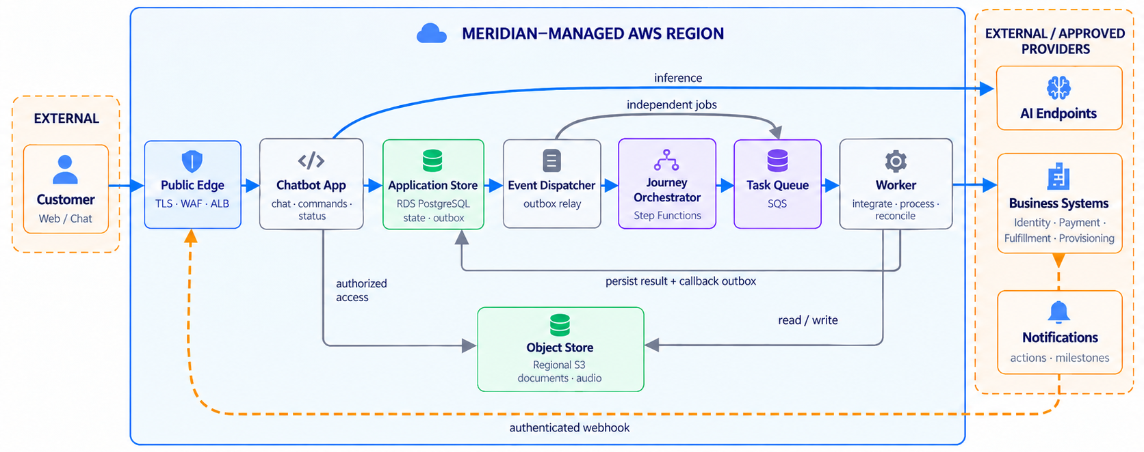
MERIDIAN TELECOM
High Level Architecture: Components and Responsabilities
2/10
Notes:
Follow a concrete request. The API records the command and the request to start processing in one transaction. The dispatcher starts the workflow, the workflow sends a task to the queue, and a worker performs the integration and records the outcome. A callback lets the workflow continue. Waiting for days does not occupy workers. Returning customers read persisted state. S3 contains documents and audio. Essential notifications link back to the authenticated area. Distinguish message acceptance from completed conversational response.

Slide 5
MERIDIAN TELECOM
High Level Architecture: Components and Responsabilities
Components deployed on EKS
2/10
Notes:
Follow a concrete request. The API records the command and the request to start processing in one transaction. The dispatcher starts the workflow, the workflow sends a task to the queue, and a worker performs the integration and records the outcome. A callback lets the workflow continue. Waiting for days does not occupy workers. Returning customers read persisted state. S3 contains documents and audio. Essential notifications link back to the authenticated area. Distinguish message acceptance from completed conversational response.

Slide 6
MERIDIAN TELECOM
High Level Architecture: Components and Responsabilities
Managed Services
2/10
Notes:
Follow a concrete request. The API records the command and the request to start processing in one transaction. The dispatcher starts the workflow, the workflow sends a task to the queue, and a worker performs the integration and records the outcome. A callback lets the workflow continue. Waiting for days does not occupy workers. Returning customers read persisted state. S3 contains documents and audio. Essential notifications link back to the authenticated area. Distinguish message acceptance from completed conversational response.

Slide 7
MERIDIAN TELECOM
High Level Architecture: Components and Responsabilities
External providers
2/10
Notes:
Follow a concrete request. The API records the command and the request to start processing in one transaction. The dispatcher starts the workflow, the workflow sends a task to the queue, and a worker performs the integration and records the outcome. A callback lets the workflow continue. Waiting for days does not occupy workers. Returning customers read persisted state. S3 contains documents and audio. Essential notifications link back to the authenticated area. Distinguish message acceptance from completed conversational response.

Slide 8
MERIDIAN TELECOM
Choices and their trade-offs
Decision
Why
Alternatives
Trade-off
Managed orchestration - Step Functions Standard
Manage waits, timers, and resumptions with less software to maintain.
Custom workflow in PostgreSQL; Temporal.
AWS dependency, transition costs, and expressiveness limits.
Recoverable state and actions - PostgreSQL, outbox, and idempotency
Preserve progress and pending deliveries; handle duplicates with stable identities and reconciliation.
State read from workflow history; separate read store. Both require safeguards for external actions.
Polling, reconciliation logic, and provider guarantees to verify.
Spike absorption - SQS and EKS workers
Buffer slow work and scale background processing independently from chat.
Processing work inside requests; orchestration for every independent job.
AWS dependency; Queueing delay, redelivery, and backlog control within provider quotas.
Resilient managed baseline - two AZs and RDS Multi-AZ
Reduce maintenance and failure impact for a small team.
Single-AZ to save cost; self-managed services for more control.
Higher minimum cost and AWS dependency; recovery still to demonstrate.
3/10
Notes:
For two Platform Engineers, reducing infrastructure software to maintain is a priority. A custom workflow needs timer and recovery tooling. Temporal is credible when orchestration needs justify the operational investment. The outbox avoids saving a purchase without starting processing, but it does not remove duplicates. SQS separates slow work from chat. Be explicit about the resilient baseline cost and the lock-in accepted for operational benefit. EKS is a constraint. Redis and dedicated GPUs are deferred.

Slide 9
MERIDIAN TELECOM
Choices and their trade-offs
Decision
Why
Alternatives
Trade-off
Managed orchestration - Step Functions Standard
Manage waits, timers, and resumptions with less software to maintain.
Custom workflow in PostgreSQL; Temporal.
AWS dependency, transition costs, and expressiveness limits.
Recoverable state and actions - PostgreSQL, outbox, and idempotency
Preserve progress and pending deliveries; handle duplicates with stable identities and reconciliation.
State read from workflow history; separate read store. Both require safeguards for external actions.
Polling, reconciliation logic, and provider guarantees to verify.
Spike absorption - SQS and EKS workers
Buffer slow work and scale background processing independently from chat.
Processing work inside requests; orchestration for every independent job.
AWS dependency; Queueing delay, redelivery, and backlog control within provider quotas.
Resilient managed baseline - two AZs and RDS Multi-AZ
Reduce maintenance and failure impact for a small team.
Single-AZ to save cost; self-managed services for more control.
Higher minimum cost and AWS dependency; recovery still to demonstrate.
Operational focus
For two Platform Engineers, reduce infrastructure software to maintain.
3/10
Notes:
For two Platform Engineers, reducing infrastructure software to maintain is a priority. A custom workflow needs timer and recovery tooling. Temporal is credible when orchestration needs justify the operational investment. The outbox avoids saving a purchase without starting processing, but it does not remove duplicates. SQS separates slow work from chat. Be explicit about the resilient baseline cost and the lock-in accepted for operational benefit. EKS is a constraint. Redis and dedicated GPUs are deferred.

Slide 10
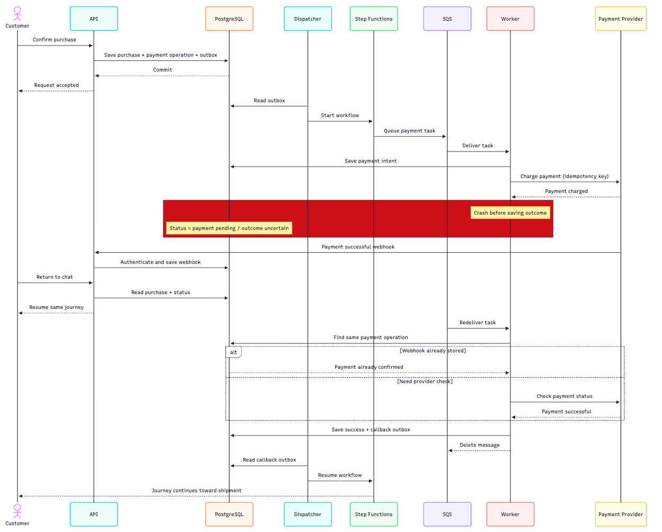
MERIDIAN TELECOM
Failure example: The payment succeeds, but the worker stops (1/2)
4/10
Notes:
The task can be redelivered, but the worker recovers the same operation. It looks for authoritative confirmation through the stored webhook or provider status lookup. When it knows the outcome, it records the result and callback. Retrying the callback delivers the outcome without repeating the payment. Webhooks are authenticated and stored before responding to the provider. The customer resumes the same purchase. Idempotency retention, status lookup and authenticated correlation are provider guarantees to confirm. This is a walkthrough, not an executed test. Step Functions semantics do not by themselves guarantee external exactly-once effects.

Slide 11
MERIDIAN TELECOM
Failure example: The payment succeeds, but the worker stops (2/2)
4/10
Notes:
The task can be redelivered, but the worker recovers the same operation. It looks for authoritative confirmation through the stored webhook or provider status lookup. When it knows the outcome, it records the result and callback. Retrying the callback delivers the outcome without repeating the payment. Webhooks are authenticated and stored before responding to the provider. The customer resumes the same purchase. Idempotency retention, status lookup and authenticated correlation are provider guarantees to confirm. This is a walkthrough, not an executed test. Step Functions semantics do not by themselves guarantee external exactly-once effects.

Slide 12
MERIDIAN TELECOM
Resilience and recovery targets
Target | Protection | Required Validation
99.9% Availability | Replicas and node capacity distributed across two Availability Zones. | Chat and status reads survive the loss of a single zone with temporary degradation in background processing.
RPO < 1 min, RTO < 10 min | RDS Multi-AZ failover and client reconnection. | Measure the exact time required to restore usable conversations and pending work after a database primary failure.
Seamless Deployments | Versioned workflows; backward-compatible schemas and workers. | Open, weeks-long customer journeys successfully survive a rolling update or rollback.
Limitations
  Multi-AZ does not automatically prove targets.
  Recovery targets assume infrastructure failures within one region.
  Coverage for data corruption and regional outages remains to be agreed and validated.
5/10
Notes:
Multi-AZ supports the strategy, but does not prove the targets by itself. Measure when conversations, status and pending work become usable after pod, node, database and AZ failures. The surviving zone must retain enough capacity and connectivity, accepting that background work can be slower. A journey started weeks earlier must continue with compatible workers and schema. Test backup restore separately. Do not claim logical corruption or regional outage recovery without agreement and evidence. Business waits are not downtime.

Slide 13
MERIDIAN TELECOM
Security, observability and operational responsibility
1. Protect access
2. Constrain AI & data
3. Preserve auditability
4. Operate daily
Authenticate customers, operators and provider callbacks.
Validate model-proposed actions in application code.
Keep unsampled audit records of agent runs, approvals and external actions.
Service dashboard: availability, latency, errors and infrastructure health.
Keep workloads and databases private; expose API via TLS/WAF/ALB.
Treat external content as untrusted and bound AI usage.
Correlate logs and traces by journey/operation ID.
Journey dashboard: queue/outbox age, stalled journeys, uncertain outcomes and provider throttling.
Enforce journey ownership and least-privilege access.
Keep confidential data within approved regional paths.
Redact personal data and tokens; define retention and deletion.
Telemetry: application logs + service/infrastructure metrics + OpenTelemetry traces → regional monitoring, dashboards and alarms
6/10
Notes:
Every request must be authorized against the customer's journey. Verify residency for inference, providers, logs, backups and support access. Protect uploads and secrets, and remove sensitive data from telemetry. The audit record preserves agent runs, model versions, approvals and external actions; it does not depend on trace sampling. Distinguish legitimate waits from stuck processes and assign alert ownership. Platform provides execution, monitoring and operational tooling; AI Engineers own workflow and reconciliation logic; Business owns customer exceptions.

Slide 14
MERIDIAN TELECOM
Security, observability and operational responsibility
1. Protect access
2. Constrain AI & data
3. Preserve auditability
4. Operate daily
Authenticate customers, operators and provider callbacks.
Validate model-proposed actions in application code.
Keep unsampled audit records of agent runs, approvals and external actions.
Service dashboard: availability, latency, errors and infrastructure health.
Keep workloads and databases private; expose API via TLS/WAF/ALB.
Treat external content as untrusted and bound AI usage.
Correlate logs and traces by journey/operation ID.
Journey dashboard: queue/outbox age, stalled journeys, uncertain outcomes and provider throttling.
Enforce journey ownership and least-privilege access.
Keep confidential data within approved regional paths.
Redact personal data and tokens; define retention and deletion.
Telemetry: application logs + service/infrastructure metrics + OpenTelemetry traces → regional monitoring, dashboards and alarms
Ownership
Platform Engineers
AI Engineers
Business Systems
Agree alert ownership and escalation coverage before launch.
Infrastructure, IAM, alerts, capacity.
Workflow logic, model selection, integrations, reconciliation.
Manual review queues and customer exceptions.
6/10
Notes:
Every request must be authorized against the customer's journey. Verify residency for inference, providers, logs, backups and support access. Protect uploads and secrets, and remove sensitive data from telemetry. The audit record preserves agent runs, model versions, approvals and external actions; it does not depend on trace sampling. Distinguish legitimate waits from stuck processes and assign alert ownership. Platform provides execution, monitoring and operational tooling; AI Engineers own workflow and reconciliation logic; Business owns customer exceptions.

Slide 15
MERIDIAN TELECOM
Scaling gradually but according to external limits
≈100 launch users → path to 100,000 users
Thousands of concurrent sessions · Hundreds of thousands of daily tasks
Chat App
Workers
Nodes
Growth signal:
active requests and latency
Growth signal:
backlog, job duration, and drain time
Growth signal:
pod capacity demand
©©
©©
Start Simple
If evidence confirm
Workloads share nodes, with requests/limits protecting chat from CPU-heavy processing.
Scale workers on backlog; scale nodes via Managed Node Groups and Cluster Autoscaler.
SQS absorbs spikes while capacity starts. HPA on app signals needs a metrics adapter.
Monitoring
Dedicated CPU-nodes fro CPU intensive workloads
GPU devices for Meridian-managed inference models
Caching, database access optimization etc…
Limits:
DB connections
Provider quotas
AI budget.
7/10
Notes:
The number of users alone does not size the platform. We need task duration, concurrency, bursts and model mix. At launch, workloads share nodes with requests and limits. Workers scale on backlog and drain time; nodes scale through Managed Node Groups and Cluster Autoscaler; application signals need an adapter or KEDA. SQS absorbs bursts while capacity starts. Limit replicas and provider calls. Add CPU pools, caches or GPUs only when measurements justify them.

Slide 16
MERIDIAN TELECOM
Initial Cost Estimation
Baseline costs
Variable costs
EKS control plane
≈€60–70/mo
Additional compute capacity
≈€70/node/mo
Estimated launch infrastructure
€600–700
Initial worker nodes
≈€130-150/mo
AI inference and business-provider usage
excluded
per month
RDS Multi-AZ baseline
≈€230-250/mo
Storage growth and data transfer
≈€25-50/mo
Budget with contingency
€700–850/month
NAT gateways and ALB hourly charges
≈€100-130/mo
Requests, workflow transitions, logs and traces
≈€30-95/mo
Sources: Ireland, September 2026. Includes baseline and assumed initial usage; excludes AI/business-provider fees and appendix items.
8/10
Notes:
Amounts come from the solution assumptions, not from a validated invoice. Resilience and Kubernetes create a minimum cost even with few users. Capacity and usage must be verified; the budget is not a hard cap. Platform controls infrastructure and capacity; AI Engineers control model selection and consumption. The overall economic view includes retries and abandoned journeys. Tag spend by environment and component, apply alerts and limits, and compare cheaper baselines against recovery and operational effort.

Slide 17



MERIDIAN TELECOM
Delivery Roadmap Estimation
Weeks 1–2
Weeks 3–5
Weeks 6–8
Foundations
Complete journey
Launch readiness
Phase
Main activities
Expected outcome
Confirm recovery scope and provider guarantees.
Set up Terraform, security, CI, telemetry.
Infrastructure ready for integration; critical assumptions reviewed.
Foundations
Complete journey
Integrate the customer journey, reconciliation, notifications and manual review. Start failure testing.
Customers can resume their journey; uncertain outcomes reach review.
Launch readiness
Test load, recovery and deployment compatibility.
Evidence to assess launch readiness, with operational ownership agreed.
9/10
Notes:
Use reviewed Terraform with remote S3 state, encryption and locking. CI checks infrastructure, application and workflows. Platform and AI teams build one complete journey early and exercise its failures: concurrent confirmations, duplicate, early and late events, lost callbacks, provider unavailability, restarts and deployments. Verify sustainable load, cost and alert ownership. Failures of correctness, residency or recovery block launch. These are planned checks, not tests already executed.

Slide 18
MERIDIAN TELECOM
AI usage and decisive confirmations
Tools
  ChatGPT: general discussion, image generation for presentation,
  Codex (GPT-5.6 Terra e GPT-6 Astra): architecture and solution design, decision and trade-off evaluation. Review of solution against requirements.
  NotebookLM: image and table generation for presentation.
repo /
AI working rules and review criteria: e.g.
“Treat assignment.md as the source of truth”, “Prefer the simplest credible solution for a two-engineer team”, “Ask for decisions”
Example of usage:
Accepted suggestions: Transactional outbox pattern, managed orchestrator.
Delegated: Review of alternativesm drafting and cost verification.
Deferred/Rejected: GPU self-hosting since launch, Redis cache and complex custom orchestration.
•
AGENTS.md
•
assignment.md
Authoritative requirements; unchanged
•
solution.md
Proposal, assumptions, decisions and validation gaps
10/10
Notes:
AI supported analysis and preparation; the decisions remain my responsibility. I kept document checks separate from operational guarantees still to be demonstrated. The confirmations that most affect feasibility are recovery scope, provider guarantees and ownership of review and escalation. Region and residency remain launch conditions even if not all are repeated in the main talk. Leave this slide visible for the discussion.

Slide 19
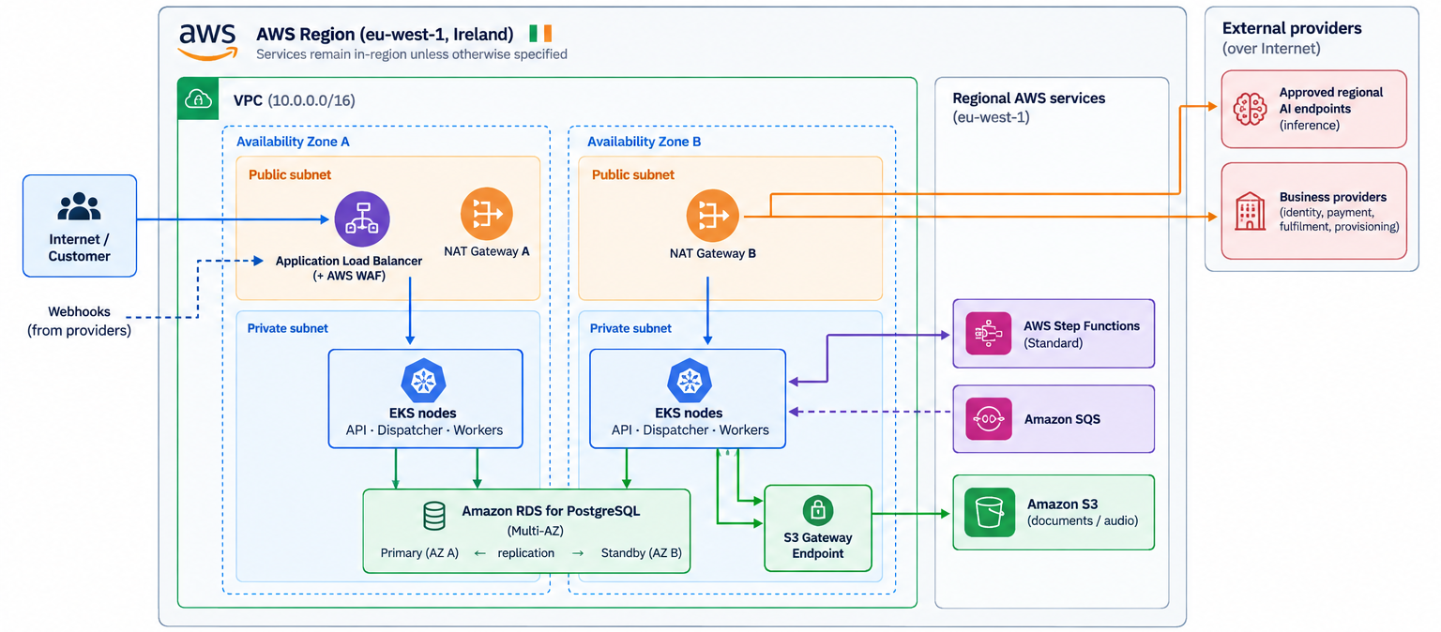
MERIDIAN TELECOM
Network and platform view
Backup A
Notes:
Corrected network view: distinguish Region and VPC. Show public subnets for ALB and NAT, private subnets for EKS and RDS, two AZs, one NAT per AZ, S3 gateway endpoint and regional S3 outside the VPC. SQS and Step Functions are regional managed services outside subnets. WAF is associated with the ALB, not shown as a subnet appliance. Provider connectivity through NAT does not equal residency approval; controls and contracts are still needed.

Slide 20
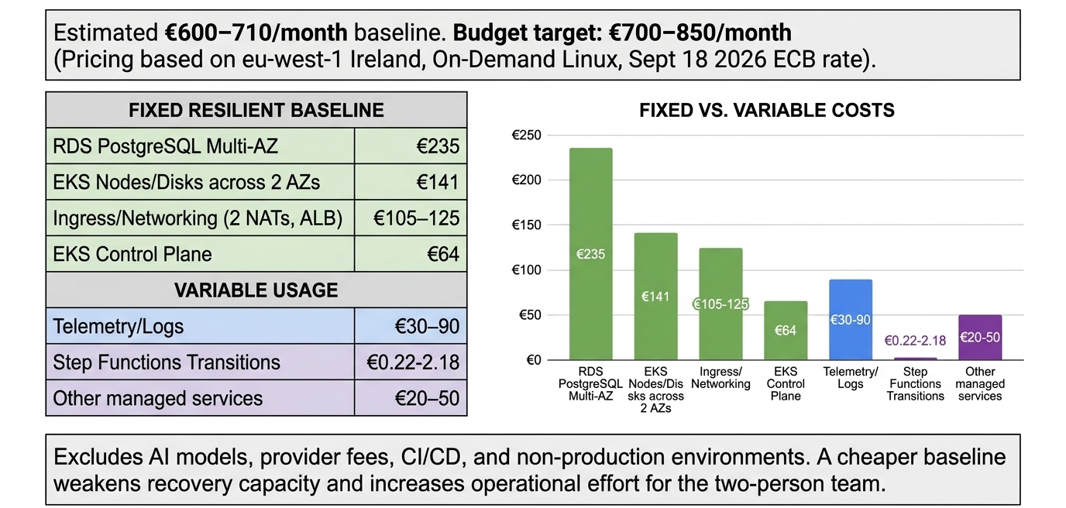

Slide 21
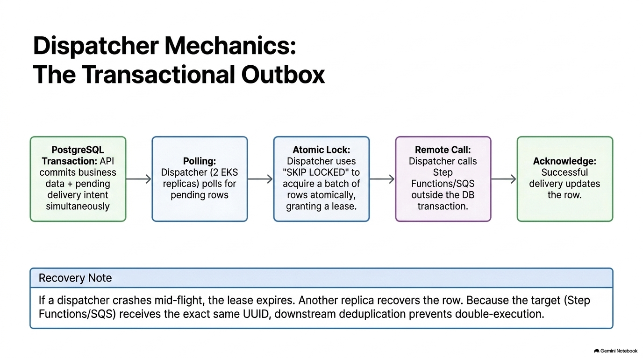

Slide 22
BACKUP
State, outbox and orchestration alternatives
Backup B — deeper discussion
State ownership
Transactional outbox
When to revisit
Step Functions owns execution position, waits and timers. PostgreSQL owns conversation, business facts, operation records and status summary. Providers provide evidence of external effects.
API writes accepted work and outgoing request in one transaction. Dispatcher delivers starts, callbacks, jobs and notifications. Duplicate delivery remains possible, so stable IDs and idempotency are required.
Custom workflow if AWS lock-in or cost dominates. Temporal if stronger workflow programming needs outweigh operation cost. Separate queues/pools if measured priority or contention requires it.
Risk
Mitigation
API crash after accepting work
Outbox entry remains and dispatcher starts delivery.
Dispatcher crash after remote send
Stable execution IDs and reconciliation prevent duplicate workflow effect.
Backup B
Durable journeys. Connected experiences.
Notes:
Use this slide only if asked for more detail on why the outbox is necessary and what it does not solve. It prevents loss of accepted work between a database commit and a remote call, but it does not guarantee exactly-once delivery. Stable operation identifiers, provider idempotency and reconciliation remain required.

Slide 23
BACKUP
Cost detail and exclusions
Backup C — calculation from solution.md
Cost area
Launch assumption
Monthly EUR
EKS control plane
$0.10/hour × 730
€64
EKS nodes + disks
Two m6i.large, one per AZ; two 30 GB gp3 disks
€141
RDS PostgreSQL
db.m6g.large Multi-AZ including one standby; 50 GB gp3
€235
Ingress + network
Two NAT GWs, ALB, IPv4, basic WAF, modest transfer
€105–125
Telemetry
10–30 GB logs, 50–200 metrics, alarms, limited traces
€30–90
Step Functions + other
Illustrative transitions plus allowance for S3/SQS/ECR/KMS/DNS
€20–52
Rounded total: about €595–707/month; budget range: €700–850/month.
Excludes VAT, paid support, non-prod, CI, identity / notifications, AI and business-provider fees.
Backup C
Durable journeys. Connected experiences.
Notes:
Cost detail is taken from the documented estimate. Public AWS prices were checked on 18 September 2026, with Ireland eu-west-1, one production environment, on-demand Linux nodes, standard EKS/PostgreSQL support, 730 hours/month and no credits, commitments or free-tier deductions. Telemetry and other services remain allowances, not a validated bill.

Slide 24
BACKUP
Launch validation matrix
Backup D — evidence required before launch
Area
Evidence required before launch
Owner focus
Journey continuity
Disconnects, restarts and long waits preserve conversation and pending actions; interrupted responses recover.
Platform + AI
Safe external actions
Payment crash example, duplicate/early/late events, lost callbacks, provider outages; no duplicate charge/shipment.
AI + Business
Deployment compatibility
Old waiting journey resumes across workflow, worker and schema updates, including rollback.
Platform + AI
Recovery
Inject pod/node/AZ/database failures and measure customer-visible recovery and state loss against targets.
Platform
Security and load
Isolation, upload controls, regional paths, secret protection, auditability and mixed workload capacity/cost.
Platform + Security
Planned tests, not results. Correctness, residency or recovery failures block launch.
Backup D
Durable journeys. Connected experiences.
Notes:
This is the evidence matrix for launch readiness. Use it to make clear what is planned versus what has been demonstrated. The strongest validation priorities are journey continuity, safe external effects, deployment compatibility, recovery measurement, security and sustainable load.

Slide 25
BACKUP
Assumptions and open questions
Backup E — items to confirm
Recovery and availability
Residency and providers
Provider contracts
Failure scope, monthly measurement, success/latency criteria, logical corruption and regional outage scope.
Selected region, model endpoints, provider access, telemetry, backups and support access.
Idempotency retention, status lookup, authenticated callbacks, correlation identifiers and rate limits.
Operations
Capacity and budget
IdP, notification channel, retention/deletion, reviewer ownership, response times and on-call coverage.
Traffic shape, job duration, model mix, latency expectations, quota increases and budget envelope.
These assumptions do not relax the assignment requirements; unresolved recovery, residency or provider guarantees can block launch.
Backup E
Durable journeys. Connected experiences.
Notes:
Keep this slide available for discussion. It collects the material uncertainties that affect the design: recovery scope, residency, provider contracts, operational ownership and traffic/cost assumptions. Emphasize that these do not relax the requirements; they define what must be confirmed or demonstrated.

