Slide 1

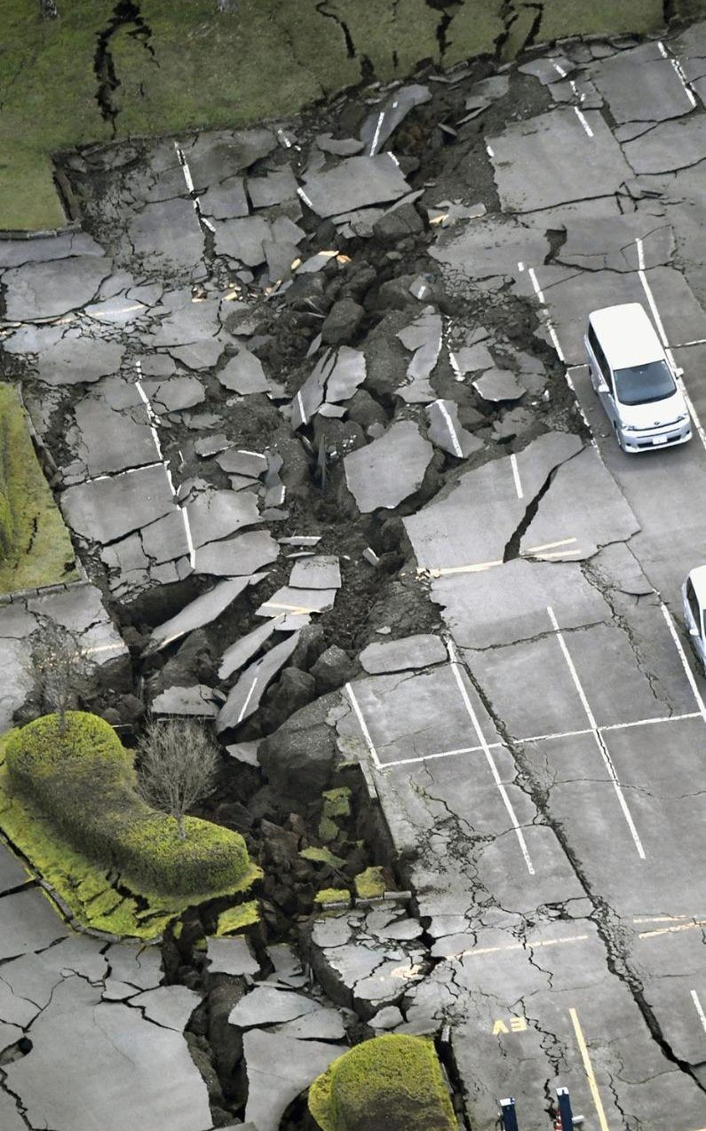
Laboratory of Advanced Programming
Distributed Fault-Tolerant Seismic Analysis Platform
By LTM group
Students:
Giorgini Tommaso 1998519 Maucione Mattia 2007209 Balducci Lorenzo 1993639
Submitted to:
Prof. Mecella Massimo
Distributed Fault-Tolerant Seismic Analysis Platform
1

Slide 2
Mission
Raw seismic streams alone do not support operational decision-making.
Our platform transforms continuous seismic data into immediate operational value by detecting suspicious activity in real time, classifying it consistently, and preserving every relevant event for later investigation.
Even when one or more processing nodes become unavailable, the system continues to deliver insights, historical visibility, and reliable monitoring continuity.
Distributed Fault-Tolerant Seismic Analysis Platform
2

Slide 3
Project Goal
Ingest live measurements from an external seismic simulator.
Redistribute a normalized stream to replicated processing nodes
Classify events through FFT-based frequency analysis.
Persist consolidated results in PostgreSQL.
Expose live and historical visibility through a single dashboard.
Distributed Fault-Tolerant Seismic Analysis Platform
3

Slide 4
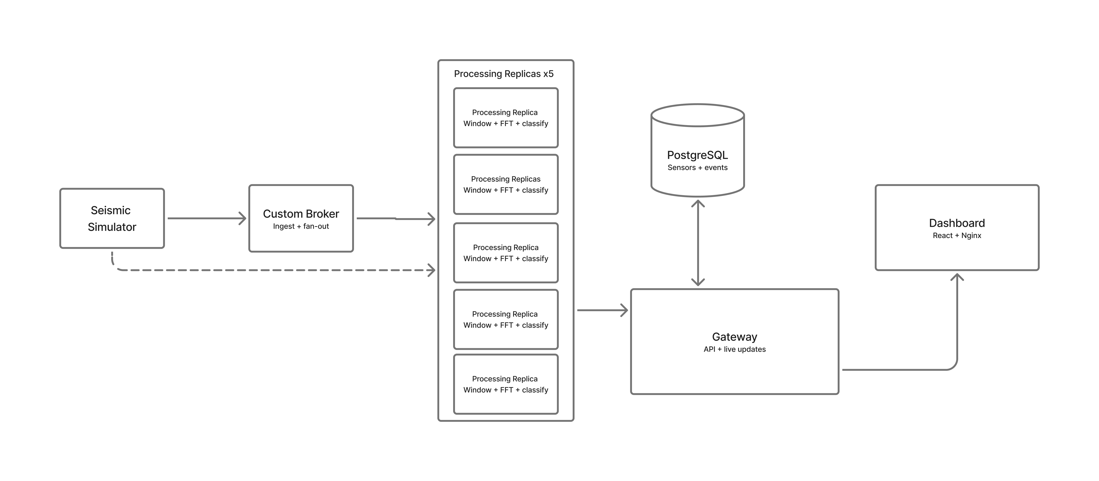
System Overview
Distributed Fault-Tolerant Seismic Analysis Platform
5

Slide 5
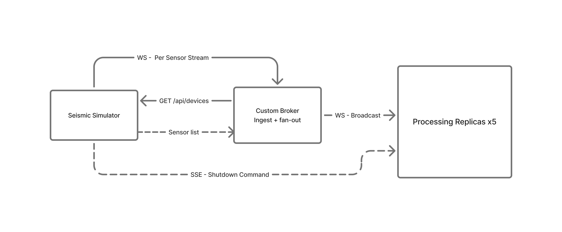
Broker Ingestion and Fan-Out
Step 1
Step 2
Step 3
Step 4
The broker discovers available sensors from the simulator through GET /api/devices/
It opens one upstream WebSocket stream for each sensor and continuously receives raw seismic samples.
Each sample is normalized into a shared measurement envelope enriched with sensor metadata and timestamps.
The broker broadcasts the same envelope to every connected replica, enabling parallel fault-tolerant processing.
Distributed Fault-Tolerant Seismic Analysis Platform
10

Slide 6
Broadcast Envelope
Measurement envelope: Broker → Replicas
{
"sensor_id": "sensor-08",
"sensor_name": "DC North Perimeter",
"category": "datacenter",
"region": "Replica Datacenter",
"coordinates": {
"latitude": 45.4642,
"longitude": 9.19
},
"measurement_unit": "mm/s",
"sampling_rate_hz": 20.0,
"timestamp": "2026-03-25T00:00:00.000000+00:00",
"value": 0.123456
}
Distributed Fault-Tolerant Seismic Analysis Platform
8

Slide 7
Replicated Processing and Fault Tolerance
Replica 2
Five identical processing services receive the same measurement stream from the broker.
Each replica analyzes all sensors independently and will detect the same events.
Replica failures don’t reduce throughput of the system until there is no replica alive: healthy nodes keep forwarding detections to the gateway.
Replica 1
Broker
Replica 3
Replica 5
Replica 4
Distributed Fault-Tolerant Seismic Analysis Platform
11

Slide 8
Detection and Classification Logic
200
20
100
Noise threshold
Ignore frequencies below 0.5 Hz and amplitudes below 0.01 mm/s
samples per sliding window
new samples between analyses
cooldown samples after a detection
0.5 - 3.0 Hz
Earthquake
3.0 - 8.0 Hz
Conventional explosion
>= 8.0 Hz
Nuclear-like
Distributed Fault-Tolerant Seismic Analysis Platform
12

Slide 9
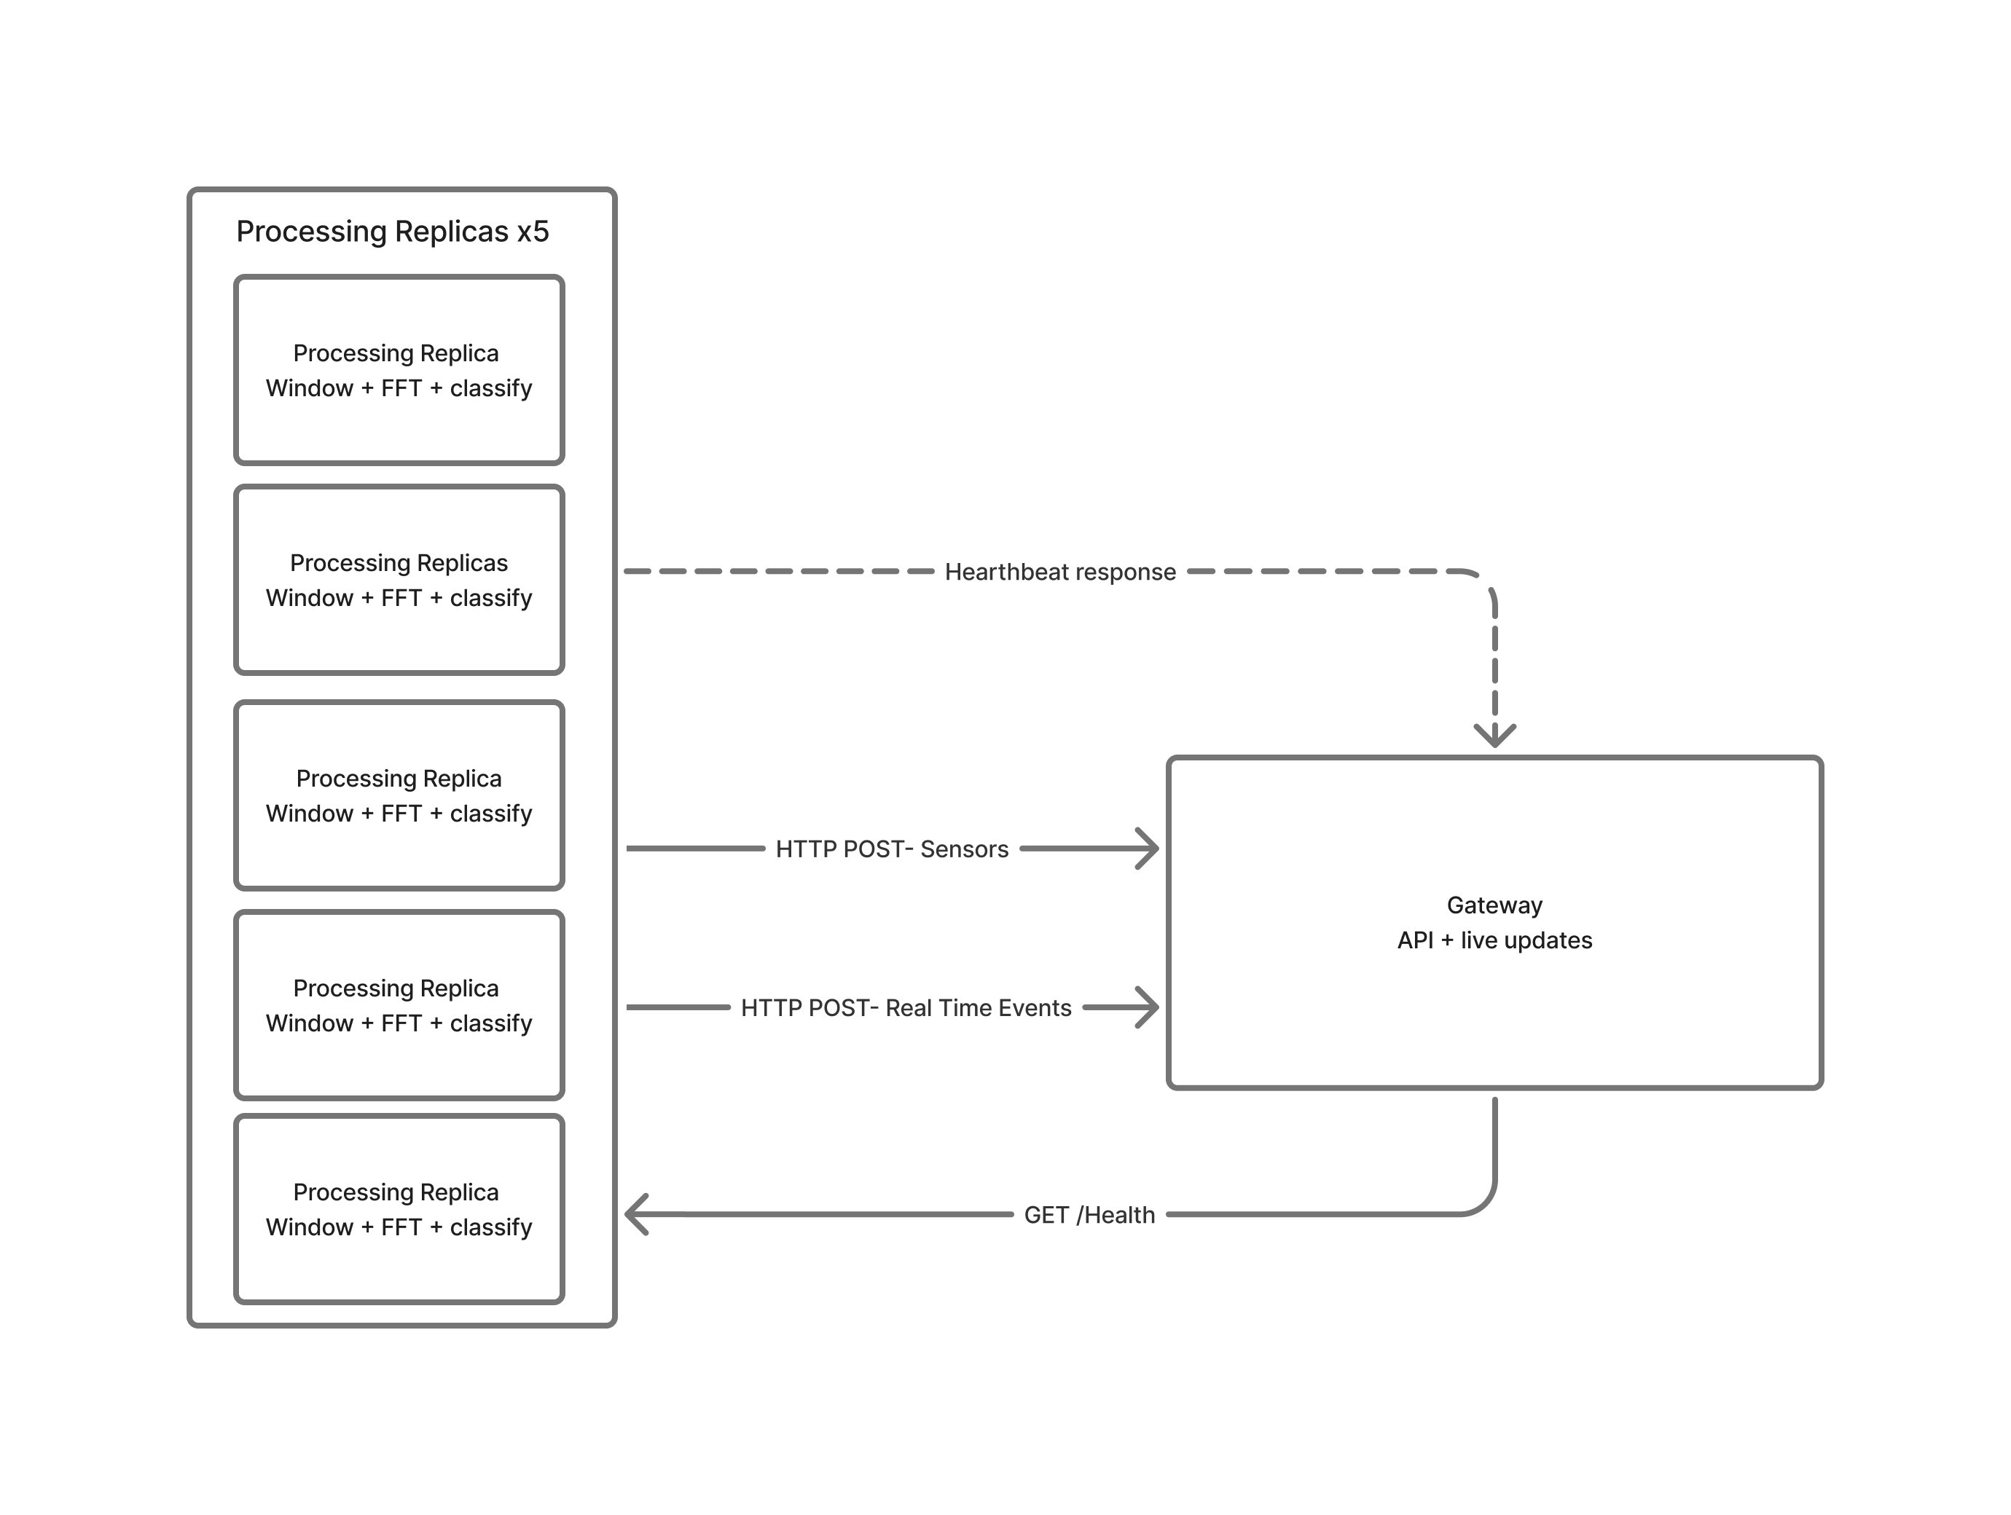
Gateway: Replicas and Deduplication
POST /api/sensors + POST /api/events
Gets sensor and event data from the replicas
Deduplicate the multiple events received from the different replicas on the UNIQUE events.event_id key, for duplicate-safe storage
Health Check
Periodically ask (every 5s) each replica for an heartbeat
Distributed Fault-Tolerant Seismic Analysis Platform
13

Slide 10
Detected Event Envelope
Detected event envelope: Replica → Gateway
{
"event_id": "sha256(sensor_id|timestamp|event_type)",
"sensor_id": "sensor-08",
"sensor_name": "DC North Perimeter",
"category": "datacenter",
"region": "Replica Datacenter",
"coordinates": {
"latitude": 45.4642,
"longitude": 9.19
},
"measurement_unit": "mm/s",
"event_type": "earthquake",
"last_sample_timestamp": "2026-03-25T00:00:09.950000+00:00",
"peak_frequency": 1.6,
"peak_amplitude": 4.0
}
Distributed Fault-Tolerant Seismic Analysis Platform
8

Slide 11
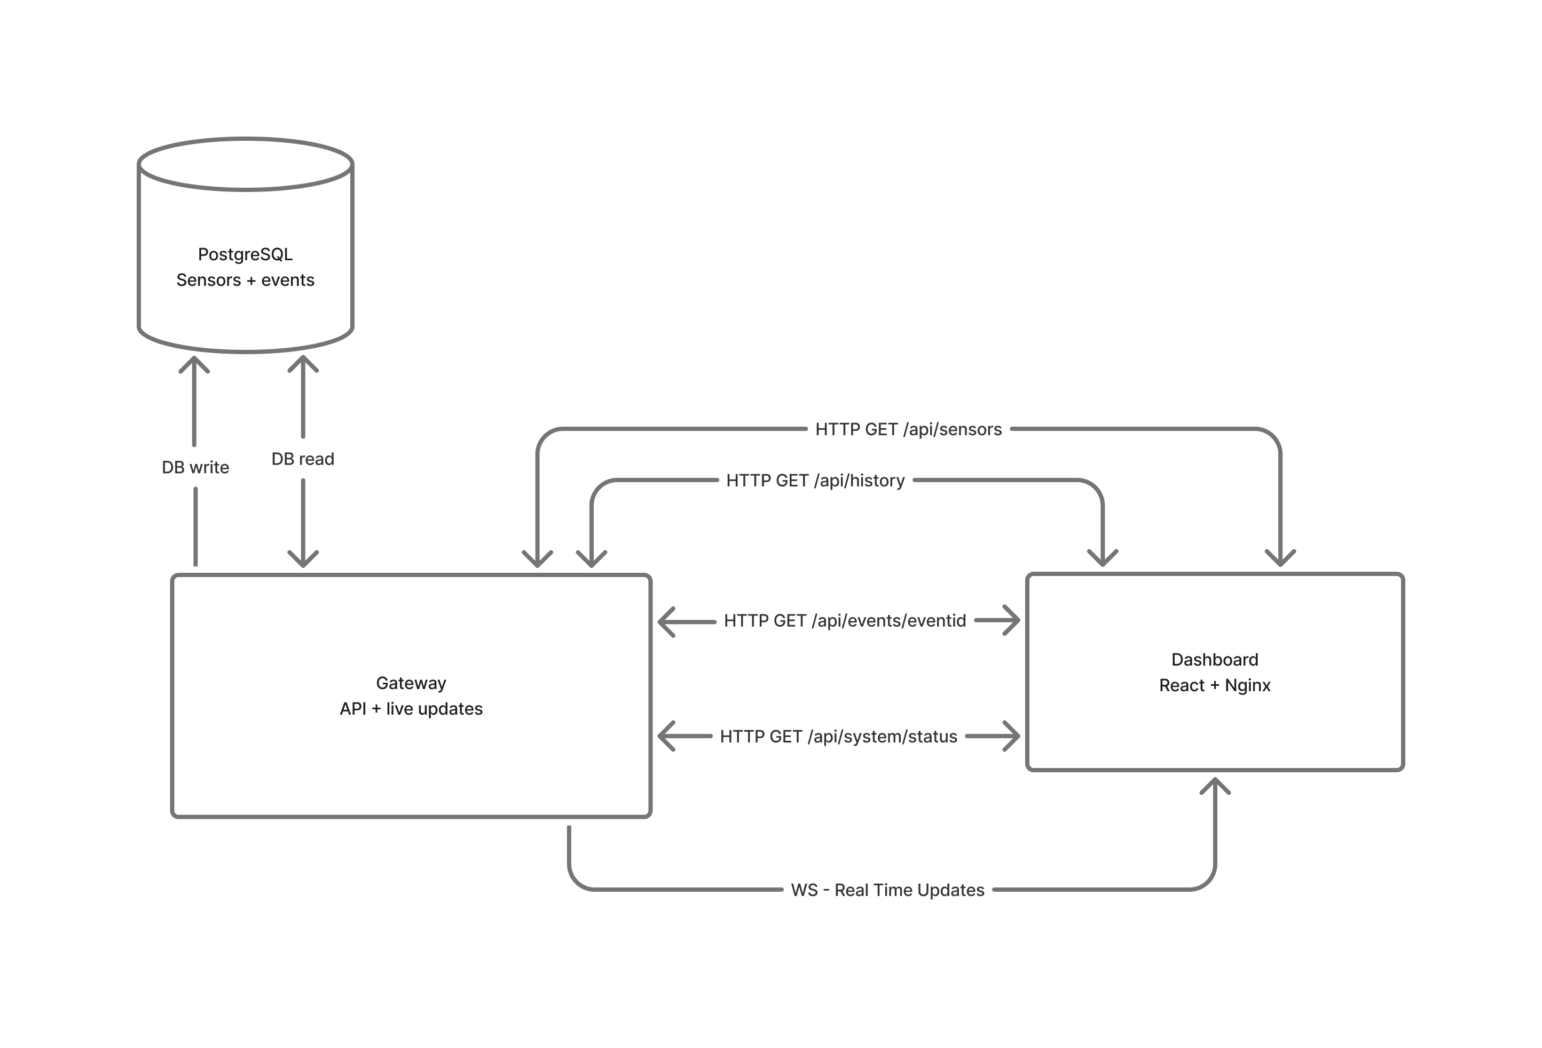
Gateway: Database & Frontend
PostgreSQL stores the persistent platform state through two tables: sensors and events.
The gateway writes deduplicated sensor and event data to the database and reads the same persisted data to serve frontend queries.
Every historical query, event detail request, sensor list, and live update passes through the gateway.
Distributed Fault-Tolerant Seismic Analysis Platform
14

Slide 12
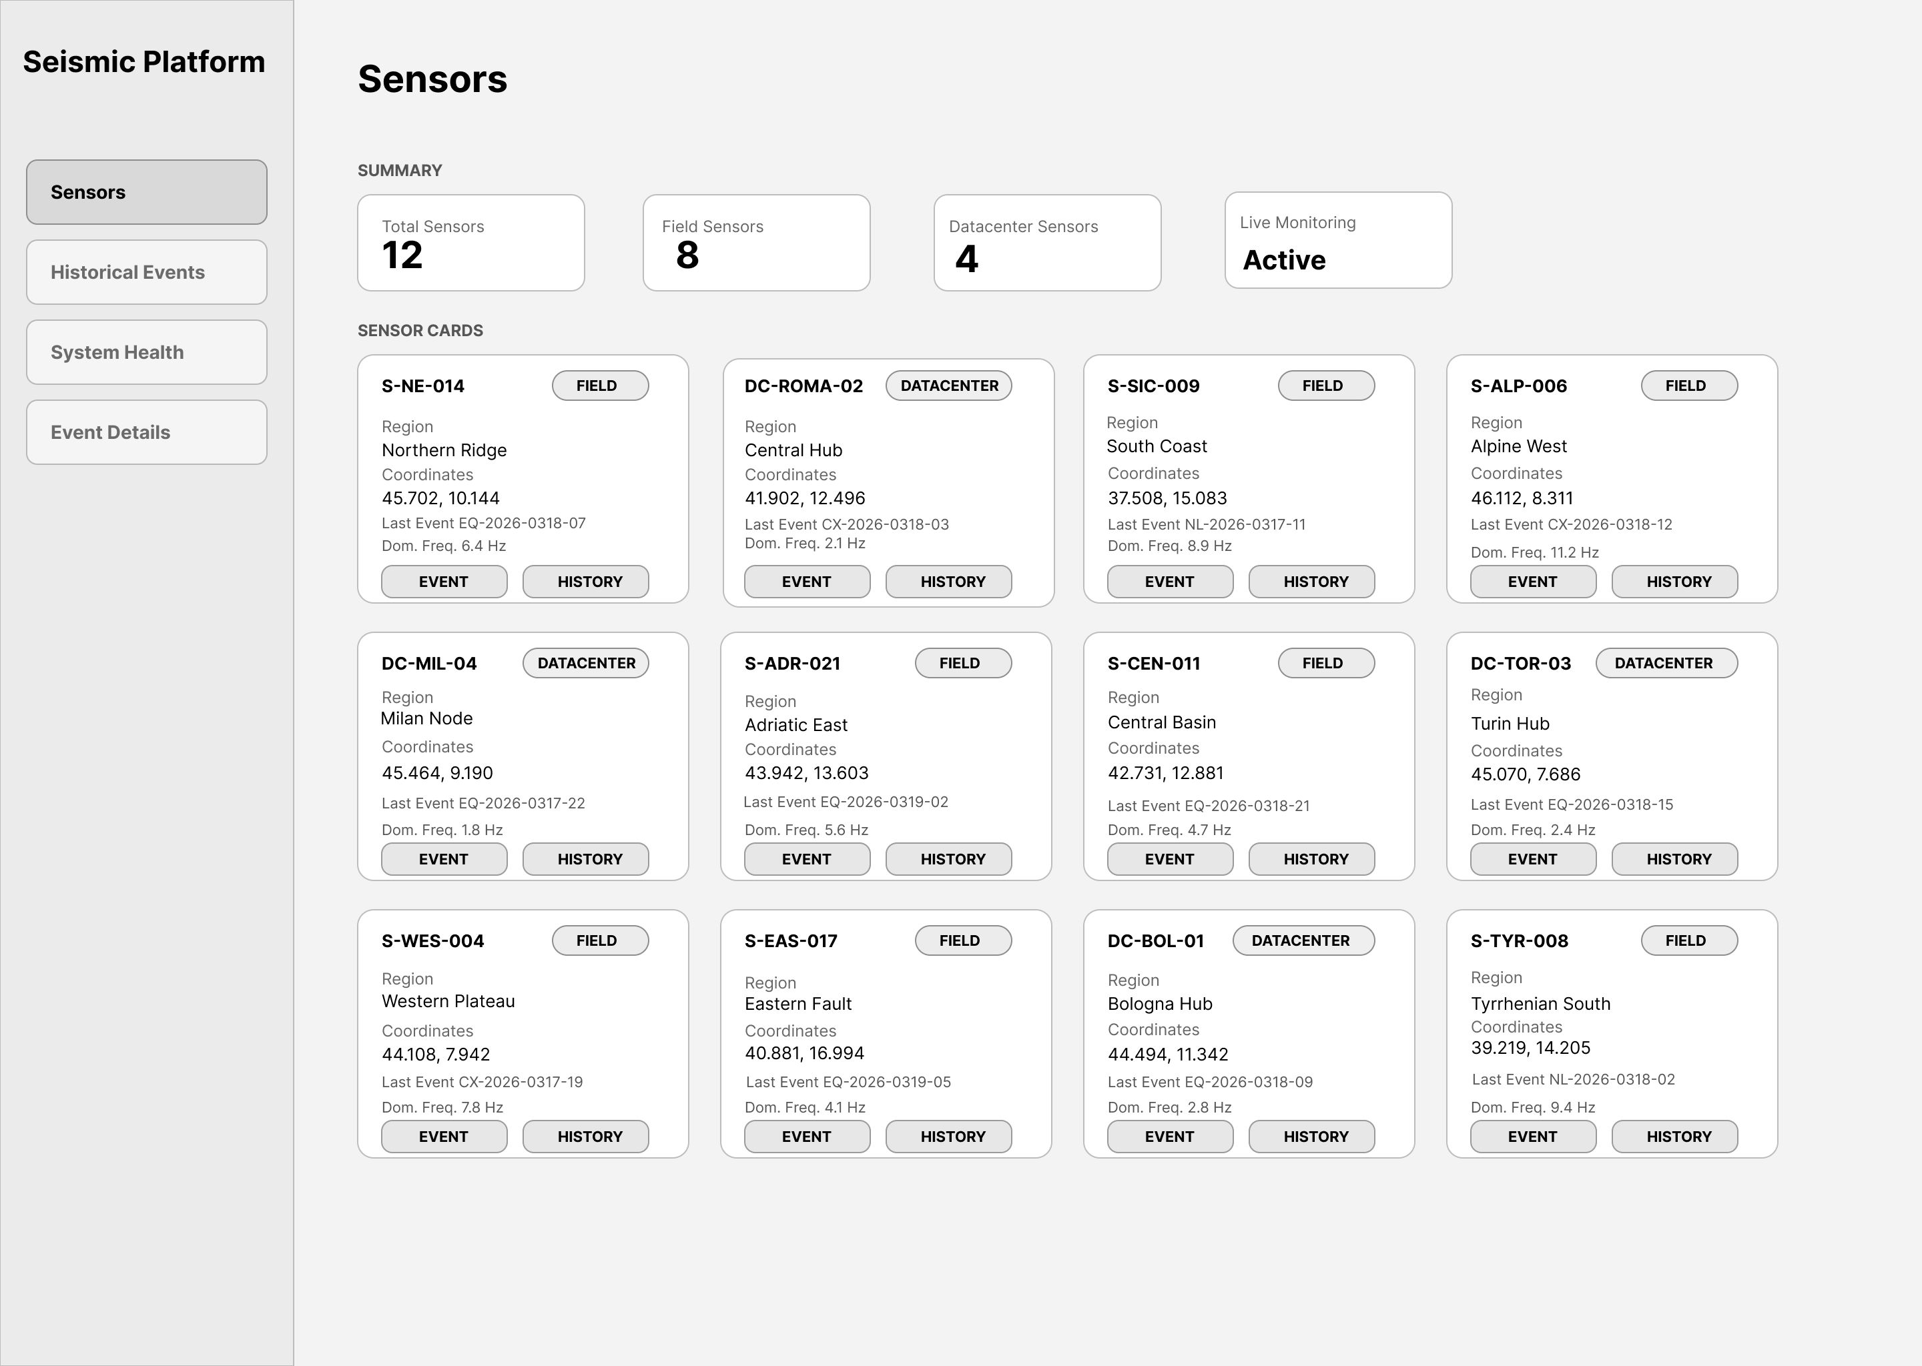
Frontend: Sensors states
Distributed Fault-Tolerant Seismic Analysis Platform
15

Slide 13
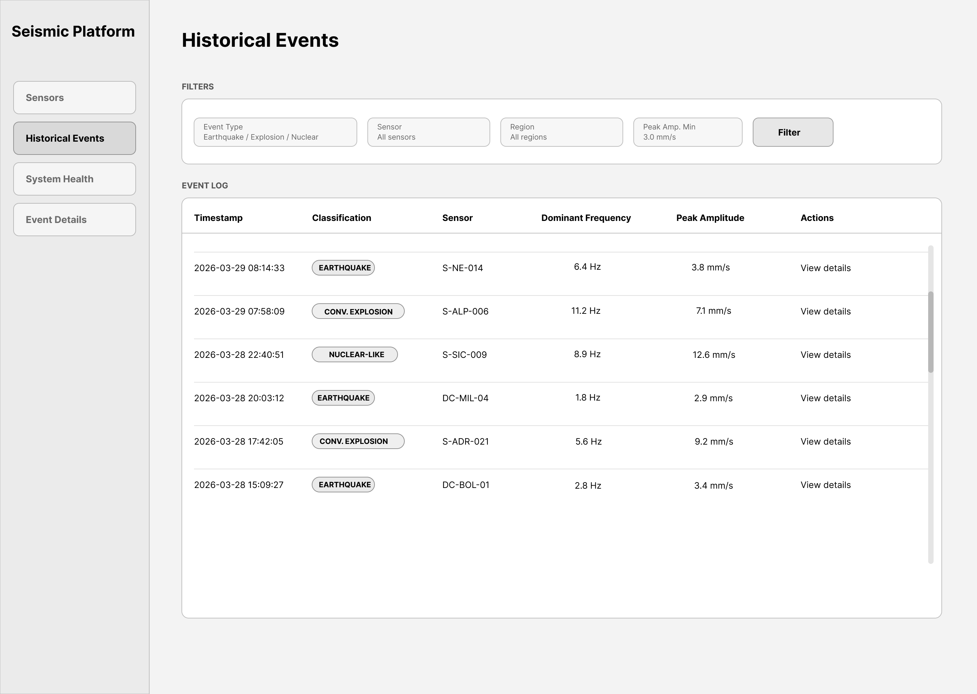
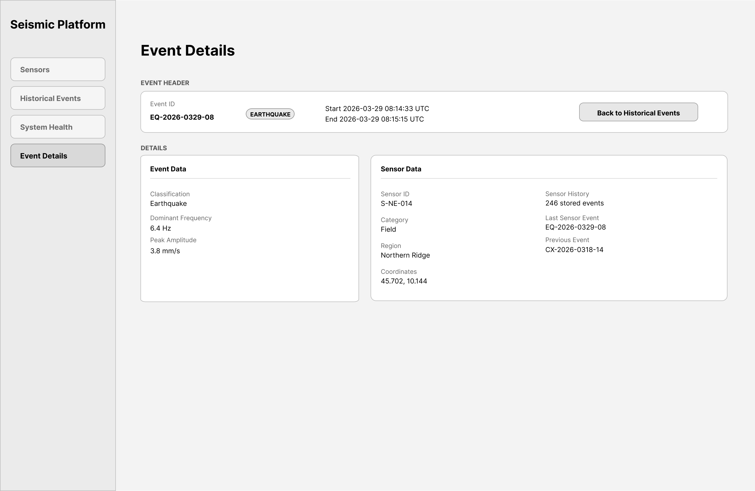
Frontend: Historical investigation workflow
Historical Events
Event Details
Filters and live-compatible updates keep the event list actionable during investigations without losing continuity.
The details view combines classification, dominant frequency, amplitude, coordinates, and sensor context in one place.
Distributed Fault-Tolerant Seismic Analysis Platform
16

Slide 14
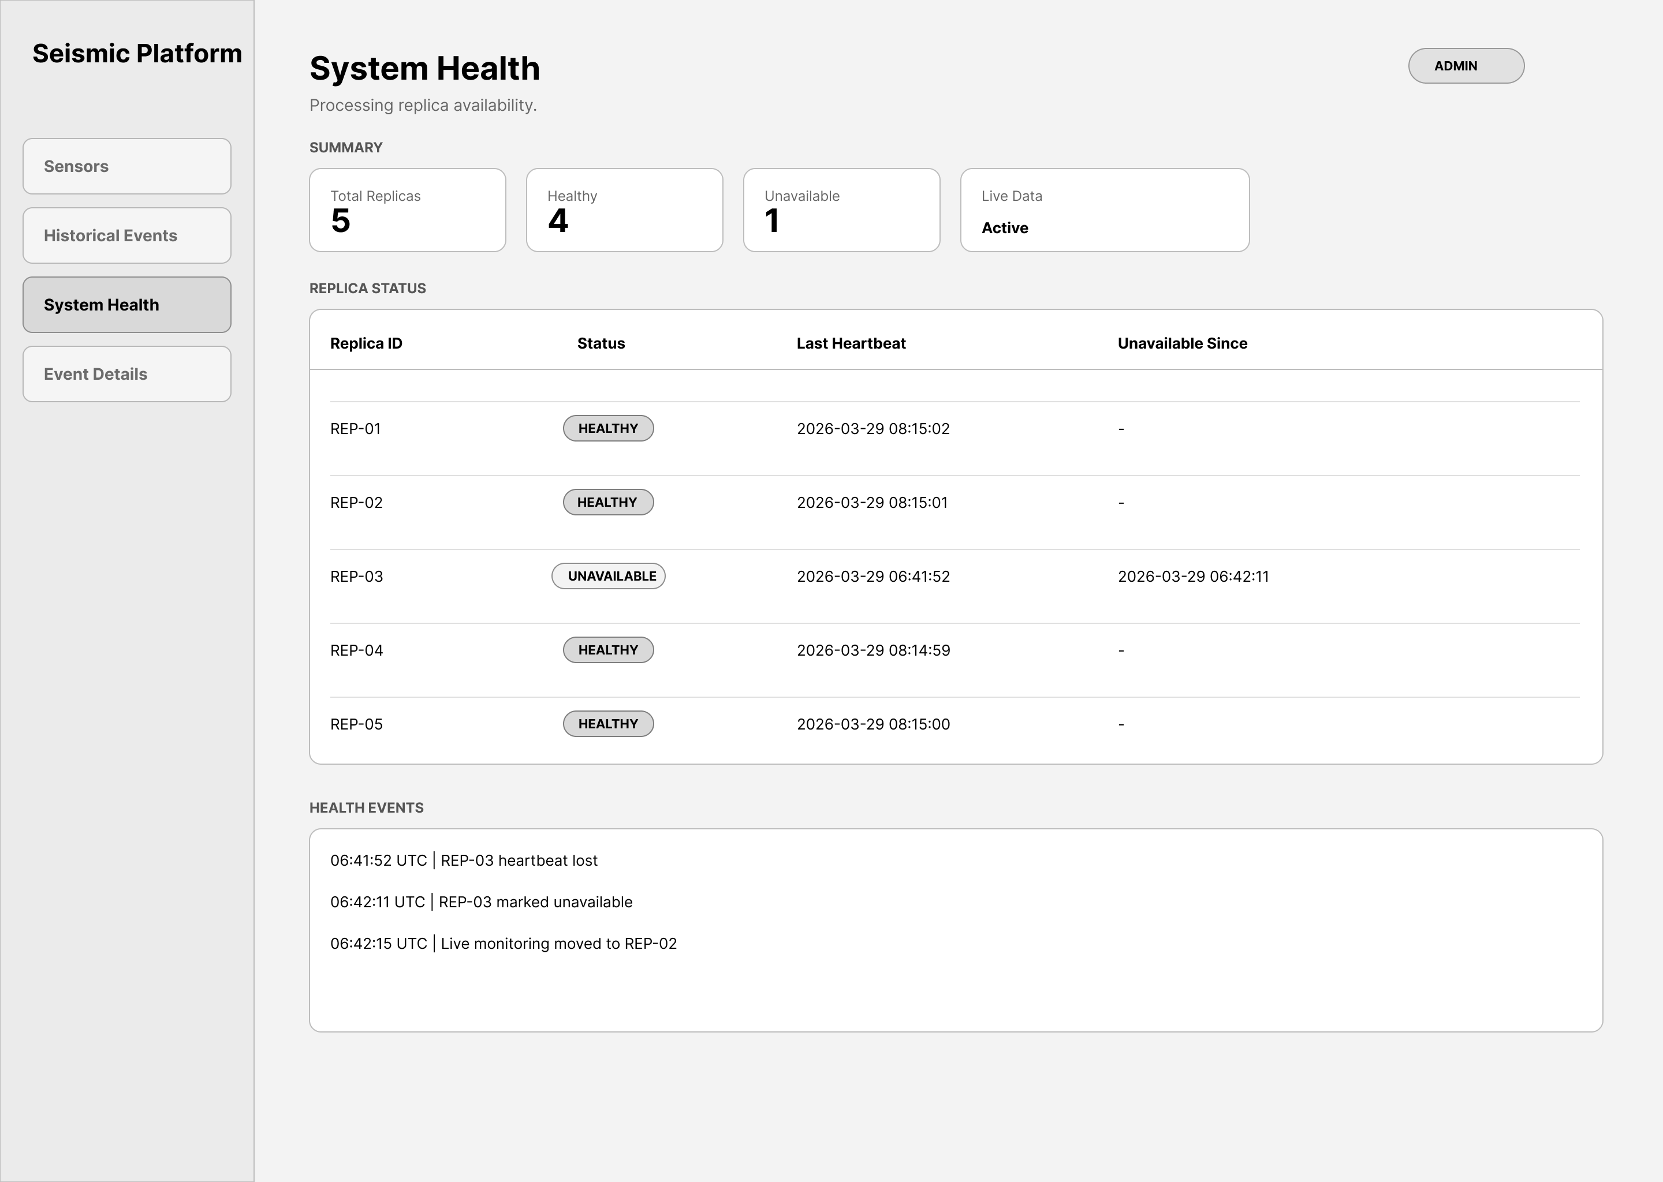
Frontend: System Health and degraded operation
The System Health page gives to the administrators:
a live view of replica availability, heartbeat status
unavailable-since timestamps
recent cluster events,
helping them maintain awareness even under degraded processing conditions.
Distributed Fault-Tolerant Seismic Analysis Platform
17

Slide 15
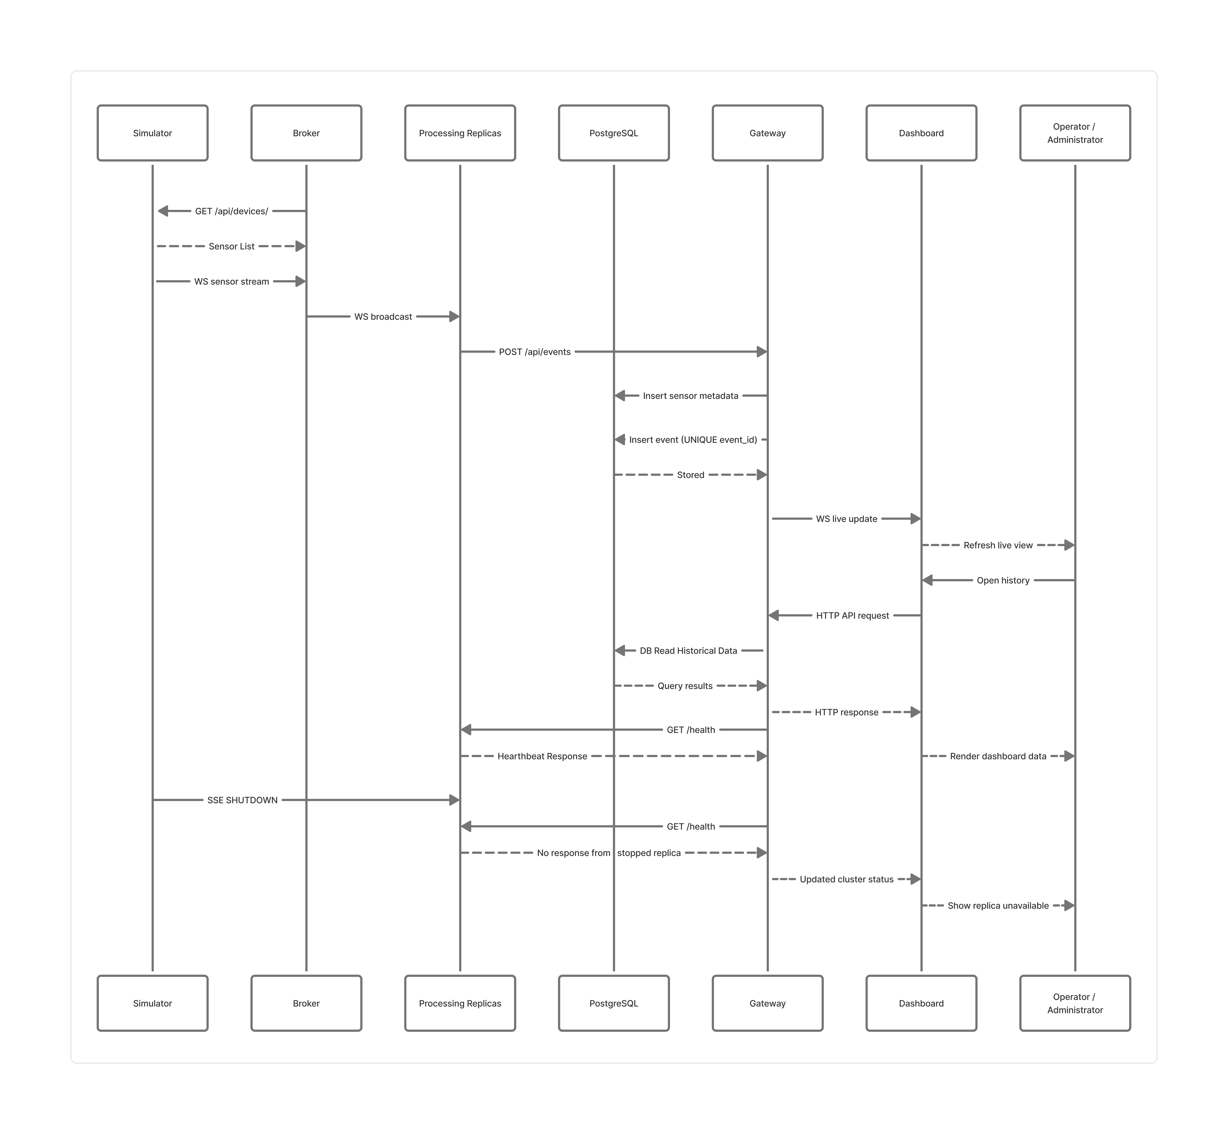
End-to-End Runtime Data Flow
Distributed Fault-Tolerant Seismic Analysis Platform
6

Slide 16
Thank you :)
Distributed Fault-Tolerant Seismic Analysis Platform
6

