Slide 1

Computational Imaging for Medical Image Super-Resolution
Computational Imaging
2025-2026
Dipartimento di Informatica - Scienza e Ingegneria (DISI)
Professors
Elena Loli Piccolomini
Davide Evangelista
Gruppo H
Pietro Cimino
Mattia Boffa

Slide 2

Description of the Project
Goal
Task Formulation
Address CT image super-resolution as an inverse problem, comparing classical (model-based) and modern (learning-based) reconstruction methods under the same experimental conditions.
y = K(x) + e
x : high-resolution ground-truth image
K : downscaling operator
e : additive Gaussian noise
y : degraded low-resolution observation
Dataset
Mayo dataset (CT slices), grayscale images
All images resized to 256×256
Split into training / validation (85% / 15%, random_state=42 only End-to-End) / test sets
Degradation parameters tested: scale: 2, 4
Noise level: 0.005, 0.01
Group H | Computational Imaging 2025-26
2

Slide 3
Methodology
Being a two-student group, three of the four required method families were implemented (variational, end-to-end, generative).
Variational
End-to-End
Generative
Total p-Variation (TpV)
Attention U-Net
GAN + DPS
Chambolle-Pock algorithm, unconstrained TpV regularization
Regularization parameter λ and exponent p ∈ {0.1, 0.4}
150 iterations for configuration
Grid search over λ, p and noise level derived from the trace
Encoder-decoder with PixelShuffle upsampling
Attention gates fuse skip connections with decoder features
Residual formulation: predicts noise, x_hat = y − f(y)
Loss: weighted MSE + Fourier-domain loss + SSIM loss
Reconstruction: optimize latent z of the frozen generator
Data-fidelity loss ||K(G(z)) - y||² / (2σ²) and 1000 steps
Group H | Computational Imaging 2025-26
3

Slide 4
Implementation
Data pipeline
Attention U-Net — Training Setup
Custom MayoDataset class: loads grayscale PNGs, resizes to 256×256
Degraded observation built with IPPy DownScaling operator + injected Gaussian noise
For the U-Net, the LR image is resized back to 256×256 before being fed to the network
Features: 64 → 128 → 256 → 512 (encoder/bottleneck)
Decoder: Attention Gates + PixelShuffle upsampling
Loss: 0.8·MSE + 1·FourierLoss + 1·SSIMLoss
Optimizer: Adam, lr = 5e-4
Scheduler: CosineAnnealingLR (T_max = 4)
8 epochs, batch size 32, best model saved on validation loss
The same setup is keeping for all models
Training infrastructure
Custom MyTrainer class: training/validation loop, best-model saving
Logs losses and metrics to JSON, saves training/validation loss plots
Common evaluation for all methods: PSNR and SSIM (IPPy.utilities.metrics)
GAN — Training Setup
Adam: lr 3e-4 (G) / 5e-5 (critic)
50 epochs, batch size 32
Group H | Computational Imaging 2025-26
4

Slide 5
Introduce the Experiments
Application
Experimental Grid
Super-resolution of abdominal CT slices from the Mayo low-dose CT dataset (single-channel, 256×256).
Parameter | Values tested
Downscale factor | 2, 4
Noise level σ | 0.005, 0.01
TpV exponent p | 0.1, 0.4
Image size | 256 × 256
Degradation model
Downscaling operator K, scale factor: 2, 4
Additive Gaussian noise, level σ ∈ {0.005, 0.01}, added after downscaling
Same degraded observations used consistently across all methods for a fair comparison
Test-set images kept separate from training and validation throughout.
Group H | Computational Imaging 2025-26
5

Slide 6
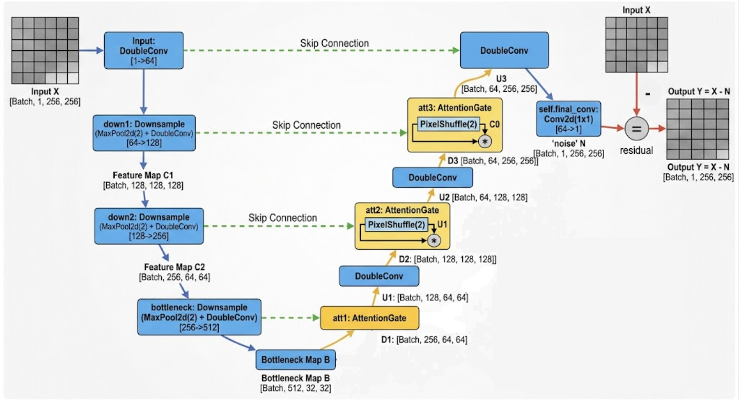
Implementation End-to-End (UNet)
U-Net architecture with Attention Gates:
Downsampling: The image gets smaller, but it learns more features (channels).
Bottleneck: The image is at its smallest size here.
Upsampling: The opposite of downsampling. The image gets bigger again to build the final result.
Skip Connections: These act like a bridge. They copy detailed information from the first part to the last part.
Attention Gates: A smart filter for the bridge. It highlights the good information and ignores the useless parts.
The network estimates the noise present in the input image, which is then subtracted from the input using a residual learning approach.
Group H | Computational Imaging 2025-26
4

Slide 7
End-to-End (U-Net) — Quantitative Results
Average PSNR / SSIM on the first batch of test set, and on the single reference image 0.png (Attention U-Net, 8 epochs)
Scale | Noise σ | Test set (PSNR / SSIM) | 0.png (PSNR / SSIM)
×2 | 0.005 | 33.19 dB / 0.9460 | 33.57 dB / 0.9487
×2 | 0.01 | 39.78 dB / 0.9723 | 39.90 dB / 0.9734
×4 | 0.005 | 33.98 dB / 0.9199 | 34.25 dB / 0.9212
×4 | 0.01 | 33.74 dB / 0.9139 | 34.00 dB / 0.9154
Key Findings
PSNR/SSIM stay close (or improve) when moving from ×2 to ×4, showing the network compensates for the coarser degradation
Scale ×2, noise 0.01 is the best result overall (39.78 dB / 0.9723) — notably higher than ×2, noise 0.005
Single-image (0.png) metrics are consistently with the test set batch average
Each (scale, noise) combination corresponds to an independently trained model checkpoint (4 variants).
Group H | Computational Imaging 2025-26
10

Slide 8
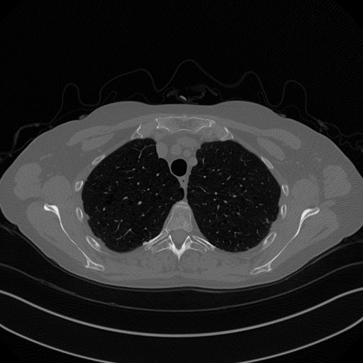
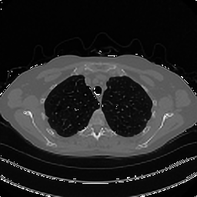
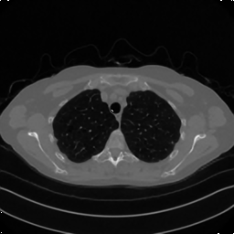
U-Net — Visual Comparison (Scale ×2)
Single test image (0.png) — Ground truth vs. U-Net reconstruction
Noise level σ = 0.005
Noise level σ = 0.01
512×512 reference
PSNR 33.57 dB | SSIM 0.9487
Group H | Computational Imaging 2025-26
11
512×512 reference
PSNR 39.90 dB | SSIM 0.9734

Slide 9


U-Net — Visual Comparison (Scale ×4)
Single test image (0.png) — Ground truth vs. U-Net reconstruction
Noise level σ = 0.005
Noise level σ = 0.01
512×512 reference
PSNR 34.25 dB | SSIM 0.9212
Group H | Computational Imaging 2025-26
12
512×512 reference
PSNR 34.00 dB | SSIM 0.9154

Slide 10
TpV — Quantitative Results
Average PSNR / SSIM on the first batch of test set (Chambolle-Pock, 150 iterations, best λ = 9×10⁻²)
Scale | Noise σ | p = 0.1 (PSNR / SSIM) | p = 0.4 (PSNR / SSIM)
×2 | 0.005 | 31.06 dB / 0.8956 | 31.32 dB / 0.8932
×2 | 0.01 | 30.88 dB / 0.8870 | 31.19 dB / 0.8882
×4 | 0.005 | 26.85 dB / 0.7790 | 27.13 dB / 0.7845
×4 | 0.01 | 26.78 dB / 0.7725 | 27.06 dB / 0.7785
Key Findings
λ = 9e-2 is the best regularization weight across every scale/noise combination tested
p = 0.4 consistently outperforms p = 0.1 (both PSNR and SSIM)
Performance is dominated by the downscale factor: ×2 reaches ~31 dB, ×4 drops to ~27 dB
Sensitivity to noise level (0.005 vs 0.01) is comparatively small
λ ∈ {1e-3, 8e-2, 9e-2} tested for scale ×4; λ ∈ {5e-3, 9e-2, 4e-1} for scale ×2 (test-set batch average)
Group H | Computational Imaging 2025-26
7

Slide 11

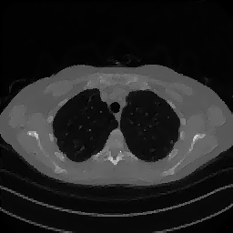

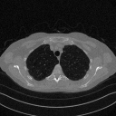


TpV — Visual Comparison (Scale ×2)
Single test image (0.png) — Ground truth vs. corrupted observation vs. TpV reconstruction (λ = 9×10⁻²)
Noise level σ = 0.005
512×512 reference
×2, σ=0.005
PSNR 31.29 dB | SSIM 0.8937
PSNR 31.53 dB | SSIM 0.8913
Noise level σ = 0.01
512×512 reference
×2, σ=0.01
PSNR 31.08 dB | SSIM 0.8842
PSNR 31.47 dB | SSIM 0.8874
Group H | Computational Imaging 2025-26
8

Slide 12


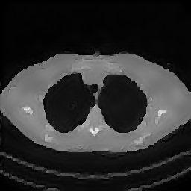


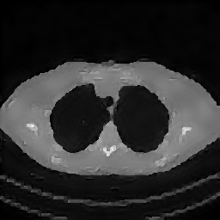
TpV — Visual Comparison (Scale ×4)
Single test image (0.png) — Ground truth vs. corrupted observation vs. TpV reconstruction (λ = 9×10⁻²)
Noise level σ = 0.005
512×512 reference
×4, σ=0.005
PSNR 27.03 dB | SSIM 0.7737
PSNR 27.28 dB | SSIM 0.7780
Noise level σ = 0.01
512×512 reference
×4, σ=0.01
PSNR 27.06 dB | SSIM 0.7709
PSNR 27.24 dB | SSIM 0.7737
Group H | Computational Imaging 2025-26
9

Slide 13
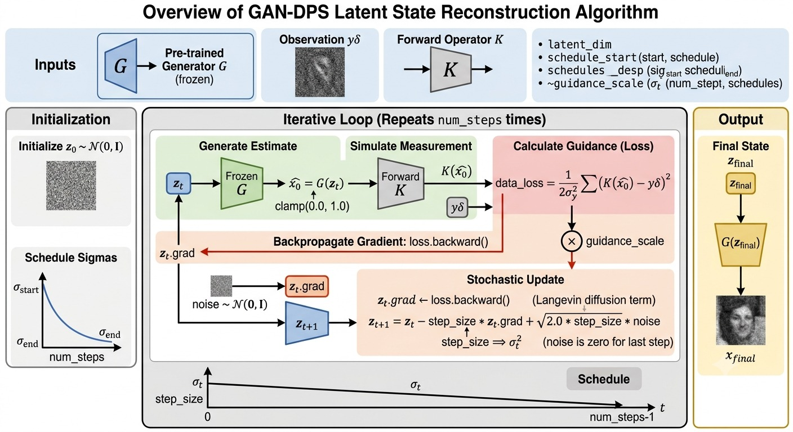
Implementation GAN
Group H | Computational Imaging 2025-26
4

Slide 14
GAN + DPS — Quantitative Results
Average PSNR / SSIM on the first batch of test set (latent optimization, 1000 steps, η = 1e-2)
Scale | Noise σ | Test set (PSNR / SSIM)
×2 | 0.005 | 19.70 dB / 0.5795
×2 | 0.01 | 20.00 dB / 0.5872
×4 | 0.005 | 19.72 dB / 0.5769
×4 | 0.01 | 20.24 dB / 0.5909
Key Findings
Clearly the weakest method: ~20 dB PSNR vs. ~27–31 dB for TpV and ~33–40 dB for U-Net
Reconstructions are overly smooth: the generator prior recovers the overall anatomy but loses fine lung texture and detail (visible in the following slides)
Nearly insensitive to scale (×2 vs ×4) and noise level (0.005 vs 0.01): the bottleneck is the expressiveness of the frozen generator, not the degradation severity
Data-fidelity loss ||K(G(z)) − y||² / (2σ²) optimized the latent z of the frozen generator; K = downscaling operator matching each scale.
Group H | Computational Imaging 2025-26
13

Slide 15
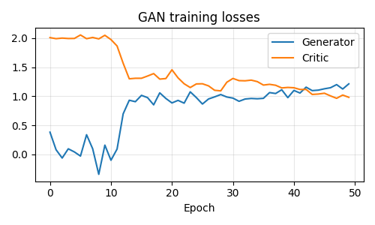
GAN + DPS — Training Dynamics
Generator / Critic losses over 50 epochs
Reading the curves
Critic loss starts near 2.0 and drops sharply around epoch 10–13
Generator loss rises from a negative region and stabilizes around 1.0–1.2
Both losses fluctuate but remain roughly balanced after epoch ~15, indicating stable adversarial training without collapse
Group H | Computational Imaging 2025-26
14

Slide 16
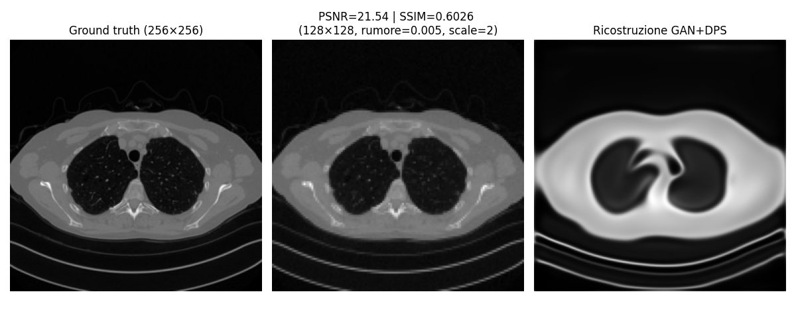
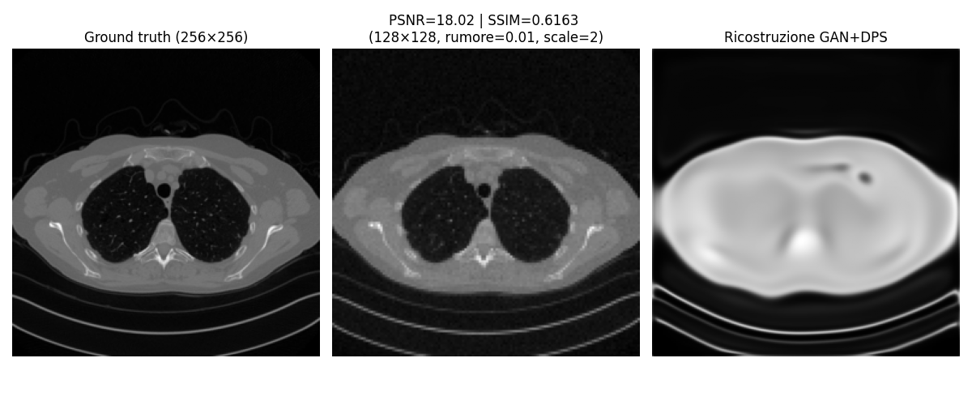
GAN + DPS — Visual Comparison (Scale ×2)
Single test image (0.png) — Ground truth | Noisy low-resolution observation | GAN+DPS reconstruction
Group H | Computational Imaging 2025-26
15

Slide 17
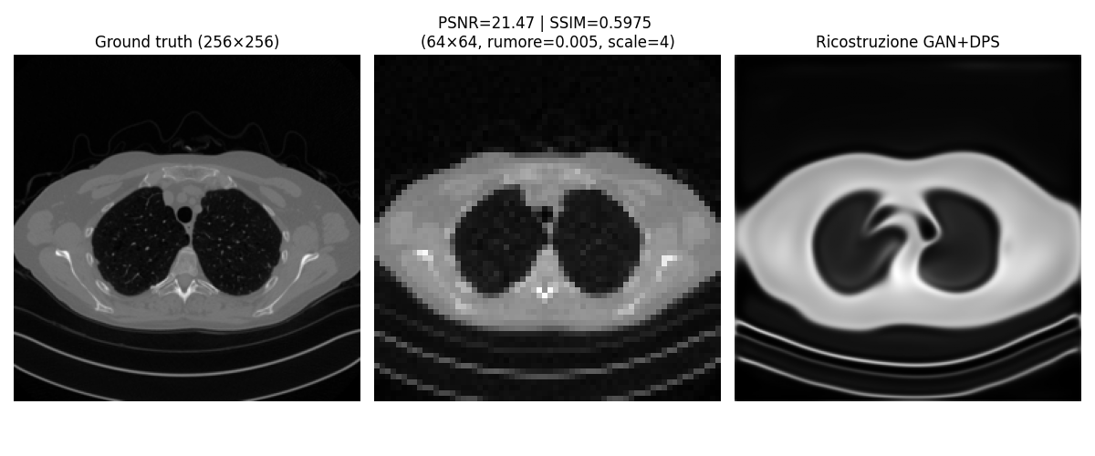
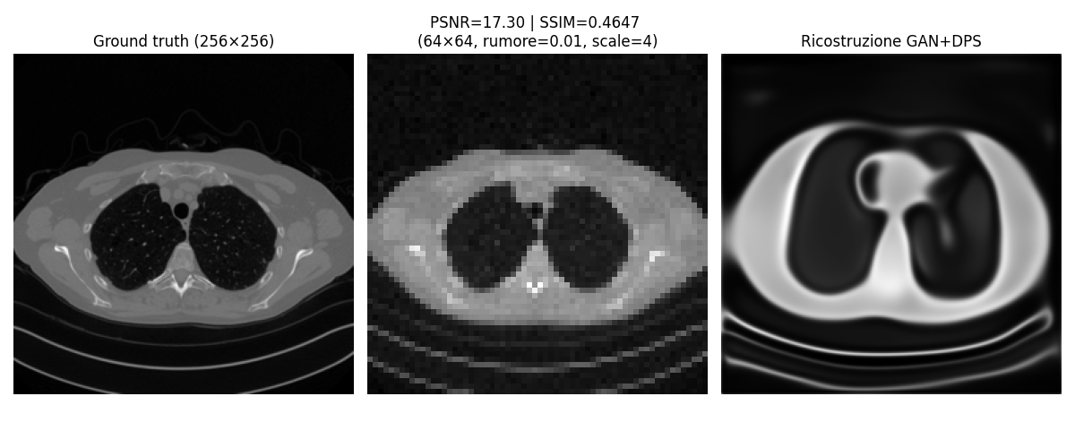
GAN + DPS — Visual Comparison (Scale ×4)
Single test image (0.png) — Ground truth | Noisy low-resolution observation | GAN+DPS reconstruction
Group H | Computational Imaging 2025-26
16

Slide 18
Cross-Method Comparison — Numerical Results
Average and best PSNR / SSIM per method, across all four scale/noise configurations tested
Configurations | Avg PSNR (dB) TpV | Avg PSNR (dB) E2E | Avg PSNR (dB) GAN+DPS | Avg SSIM TpV | Avg SSIM E2E | Avg SSIM GAN+DPS
Scale 2, Noise 0.005 | 31.32 | 33.19 | 19.70 | 0.8932 | 0.9460 | 0.5795
Scale 2, Noise 0.01 | 31.19 | 39.78 | 20.00 | 0.8882 | 0.9723 | 0.5872
Scale 4, Noise 0.005 | 27.13 | 33.98 | 19.72 | 0.7845 | 0.9199 | 0.5769
Scale 4, Noise 0.01 | 27.06 | 33.74 | 20.24 | 0.7785 | 0.9139 | 0.5909
Key Findings
U-Net delivers the strongest performance on PSNR
The SSIM gap mirrors PSNR
Even without any training data, TpV stays within ~6 dB of the learned U-Net, and clearly ahead of the GAN inversion
GAN+DPS is nearly insensitive to scale/noise, confirming its bottleneck is the generator’s expressiveness, not the degradation
TpV values use the best-performing exponent (p = 0.4); U-Net and GAN+DPS values are test-set averages as reported on the previous slides
Group H | Computational Imaging 2025-26
17

Slide 19
Cross-Method Comparison — Visual Overview
(scale 2, noise 0.005)
Ground truth vs. best reconstruction from each method, on the same test image (0.png)
Ground Truth
TpV (Variational)
U-Net (End-to-End)
GAN + DPS (Generative)
0.png — 512×512 reference
×2, σ=0.005, p = 0.4
×2, σ=0.005
×2, σ=0.005
PSNR 31.32 dB | SSIM 0.8932
PSNR 33.19 dB | SSIM 0.9460
PSNR 19.70 dB | SSIM 0.5795
Group H | Computational Imaging 2025-26
18

Slide 20
Cross-Method Comparison — Visual Overview
(scale 2, noise 0.01)
Ground truth vs. best reconstruction from each method, on the same test image (0.png)
Ground Truth
TpV (Variational)
U-Net (End-to-End)
GAN + DPS (Generative)
0.png — 512×512 reference
×2, σ=0.01, p = 0.4
×2, σ=0.01
×2, σ=0.01
PSNR 31.19 dB | SSIM 0.8882
PSNR 39.78 dB | SSIM 0.9723
PSNR 20.00 dB | SSIM 0.5872
Group H | Computational Imaging 2025-26
18

Slide 21
Cross-Method Comparison — Visual Overview
(scale 4, noise 0.005)
Ground truth vs. best reconstruction from each method, on the same test image (0.png)
Ground Truth
TpV (Variational)
U-Net (End-to-End)
GAN + DPS (Generative)
0.png — 512×512 reference
×4, σ=0.005, p = 0.4
×4, σ=0.005
×4, σ=0.005
PSNR 27.13 dB | SSIM 0.7845
PSNR 33.98 dB | SSIM 0.9199
PSNR 19.72 dB | SSIM 0.5769
Group H | Computational Imaging 2025-26
18

Slide 22
Cross-Method Comparison — Visual Overview
(scale 4, noise 0.01)
Ground truth vs. best reconstruction from each method, on the same test image (0.png)
Ground Truth
TpV (Variational)
U-Net (End-to-End)
GAN + DPS (Generative)
0.png — 512×512 reference
×4, σ=0.01, p = 0.4
×4, σ=0.01
×4, σ=0.01
PSNR 27.06 dB | SSIM 0.7785
PSNR 33.74 dB | SSIM 0.9139
PSNR 20.24 dB | SSIM 0.5909
Group H | Computational Imaging 2025-26
18

Slide 23
Conclusions
U-Net (End-to-End) is the best-performing method overall: PSNR ranging from 33 dB to nearly 40 dB, with SSIM consistently above 0.91 — clearly outperforming the other two methods in every configuration tested.
TpV (Variational) is a solid runner-up: it stays within ~6 dB of U-Net despite using no training data at all — a notable result for a purely model-based method.
GAN + DPS (Generative) is the weakest method (~20 dB PSNR), producing overly smooth reconstructions that lose fine texture detail: the bottleneck is the expressiveness of the frozen generator, not the severity of the degradation.
Group H | Computational Imaging 2025-26
19

Slide 24
Bibliography
To be completed with references used for the project.
Group H | Computational Imaging 2025-26
20

