Slide 1
Large-Scale and Multi-Structured Databases Project Design Reviook
Arancio Febbo Salvatore
Di Donato Mattia
Giorgi Matteo

Slide 2
Application Highlights
The application we want to propose is a review network which stores information about books. There are two main actors, users and authors and both will be able to view books and also monitor their own activities. Everyone can write reviews but only authors can publish books. The application will suggest to users related books, based on similar users, which can be saved in the ”wants to read” list.
User can:
Login/Register
Browse information about a:
Users
Authors
Books
Review a book
Vote a review
Follow another user/author
Authors can add new books
View statistics on their Homepage and the suggested books

Slide 3
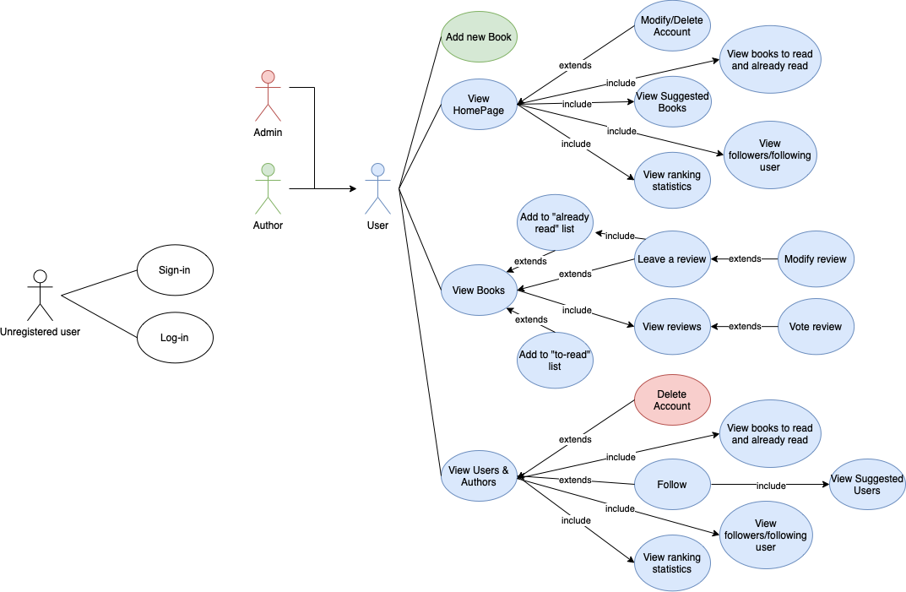
Actors and main supported functionalities

Slide 4
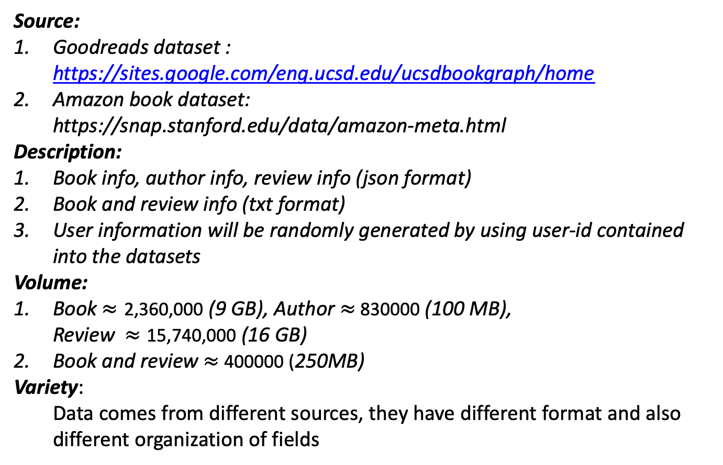
Dataset Description
Source:
Goodreads dataset : https://sites.google.com/eng.ucsd.edu/ucsdbookgraph/home
Amazon book dataset:
https://snap.stanford.edu/data/amazon-meta.html
Description:
Book info, author info, review info (json format)
Book and review info (txt format)
User information will be randomly generated by using user-id contained into the datasets
Volume:
Book $≈\text{2,360,}\text{000}$ (9 GB), Author $≈$830000 (100 MB),
Review $≈\text{15,7}\text{40}\text{,}\text{000}$ (16 GB)
Book and review $≈$ 400000 (250MB)
Variety:
Data comes from different sources, they have different format and also different organization of fields

Slide 5
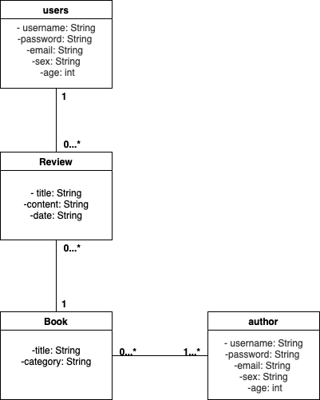
Preliminary UML Class Diagram

Slide 6
Requirements and Entities handled by Document DB
Entities:
Book, User, Author, Review
Requirements:
View book information and related review
Insert book, user, author, review
Modify review
Delete user/author
Ranks users with more frequent valid reviews based on the likes they received
View for each author, average rating on each published category
View for each user, average rating given to each category
View for each year and category the number of published books

Slide 7
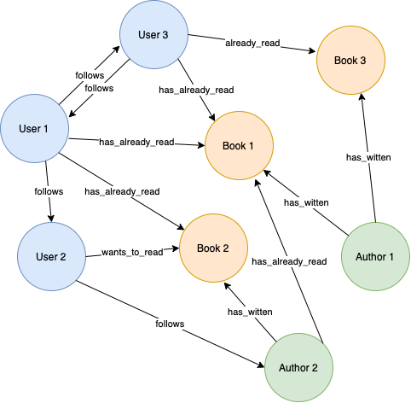
Requirements and Entities handled by Graph DB
Entities:
Book, User, Author
Requirements:
View the user’s/ author's followers
View the user’s/ author's followings
View the books I've read
View the books I want to read
View recommended books to users
View recommended authors to users
View the most desired/popular books

Slide 8
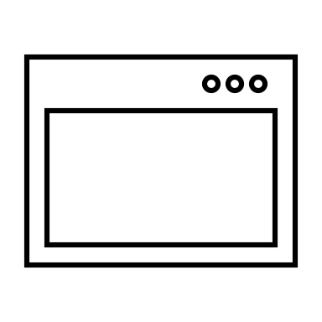


Software Architecture Preliminary Idea
Front-End : JavaFX
Programming Language : Java
DBMS : MongoDB & Neo4J

