Slide 1
From Code First to TDD (w/ examples)
Mattia Richetto
@mattiaerre

Slide 2
Agenda
Code First
(Unit) Testing Frameworks
Test First
Unit Testing
TDD
Q&A

Slide 3
Code First 1/2
From developers “I don’t test. I’m a developer. I create”
From managers “I don’t want to pay developers to test. That’s why I pay testers.”

Slide 4
Code First 2/2
I need to create a web page that is showing a list of players with their first name, last name and shirt number
Demo (CFTFTDD.CF.WEB)

Slide 5
Test First 1/2
Why test?
Because writing test is easier than running the application!
Miško Hevery @mhevery

Slide 6
(Unit) Testing Frameworks 1/2
Unit Test Runner
SUT
Unit Test Lib
Unit Test F.work

Slide 7
(Unit) Testing Frameworks 2/2
NUnit - http://www.nunit.org/
Microsoft Unit Test Framework - http://msdn.microsoft.com/en-us/library/ms243147(v=vs.80).aspx
xUnit - https://github.com/xunit/xunit
Qunit - https://qunitjs.com/

Slide 8
Test First 2/2
Every player should also have a property called FullName using this pattern: {FirstName} {LastName}
Demo (CFTFTDD.WEB.TEST)

Slide 9
Unit Testing 1/2
In computer programming, unit testing is a method by which individual units of source code, sets of one or more computer program modules together with associated control data, usage procedures, and operating procedures are tested to determine if they are fit for use. Intuitively, one can view a unit as the smallest testable part of an application.
Wikipedia

Slide 10
Unit Testing 2/2
[...] it’s a test that only tests a single path through a single method. More importantly, it’s a test that has zero dependencies on infrastructure, or on code outside of your control.
Steve Smith @ardalis

Slide 11
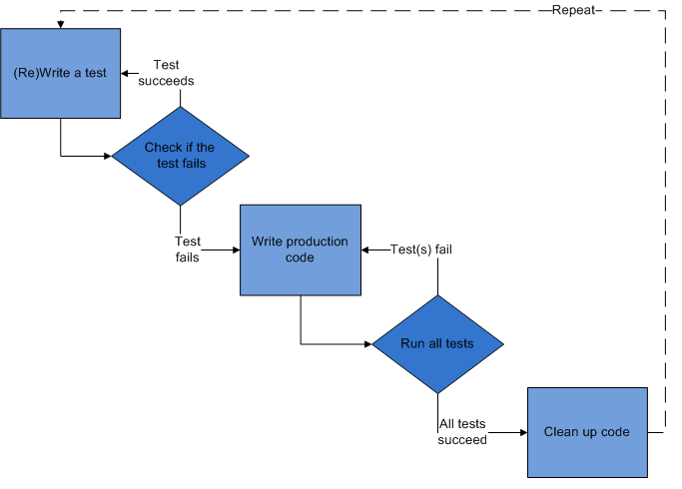
TDD 1/4

Slide 12
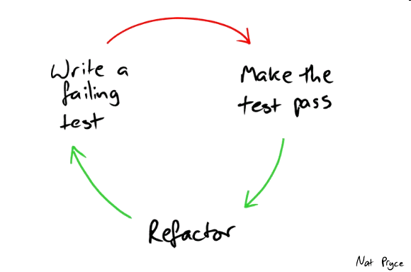
TDD 2/4

Slide 13
TDD 3/4
Every player should also have a property called LineupLabel using this pattern: #{ShirtNumber} {FirstName} {LastName}
Demo (CFTFTDD.CORE.TEST)

Slide 14

TDD 4/4

Slide 15
Q&A
Thank you and happy TDD-ing!

Slide 16
Credits & Links
http://pluralsight.com/training/Courses/TableOfContents/test-first-development-1
http://en.wikipedia.org/wiki/Unit_testing
http://ardalis.com/unit-test-or-integration-test-and-why-you-should-care
http://upload.wikimedia.org/wikipedia/en/9/9c/Test-driven_development.PNG
http://wrozka.github.io/ppppp-pair-programming/img/red-green-refactor.png
https://github.com/mattiaerre/cf-tf-tdd
http://bit.ly/1fghDRk

