Slide 1


ANALYSIS OF THE ORDER DYNAMICS IN THE ELECTRICITY SPOT MARKET
MATTIA GASTOLDI
ROBERTO GASTOLDI
GABRIELE GIMMILLARO
FARHAN FEBRI RAHMAT
ELIAS KRISTIANSEN REKKEDAL

Slide 2
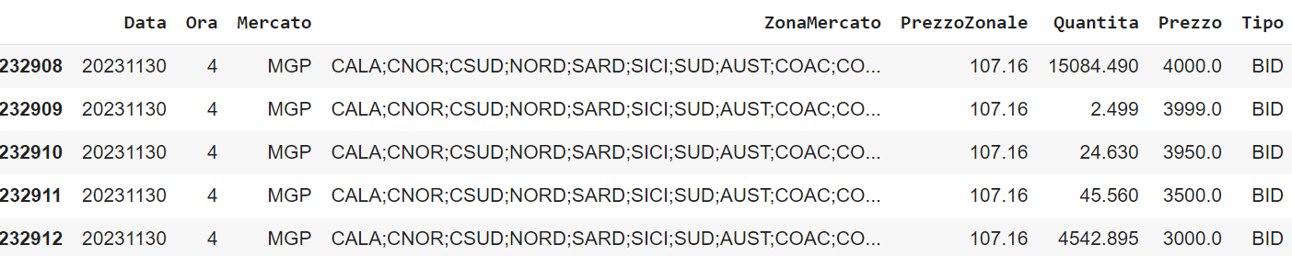
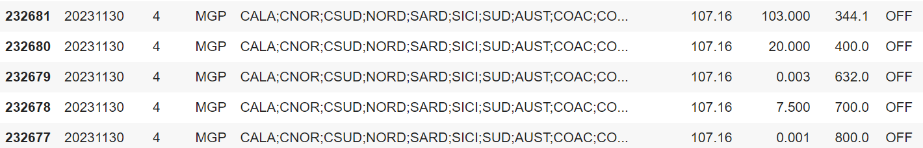
ABOUT THE DATA
Dataset: Offer – Demand Dataset proposed by Professor Koechlin
Data Description:

Slide 3
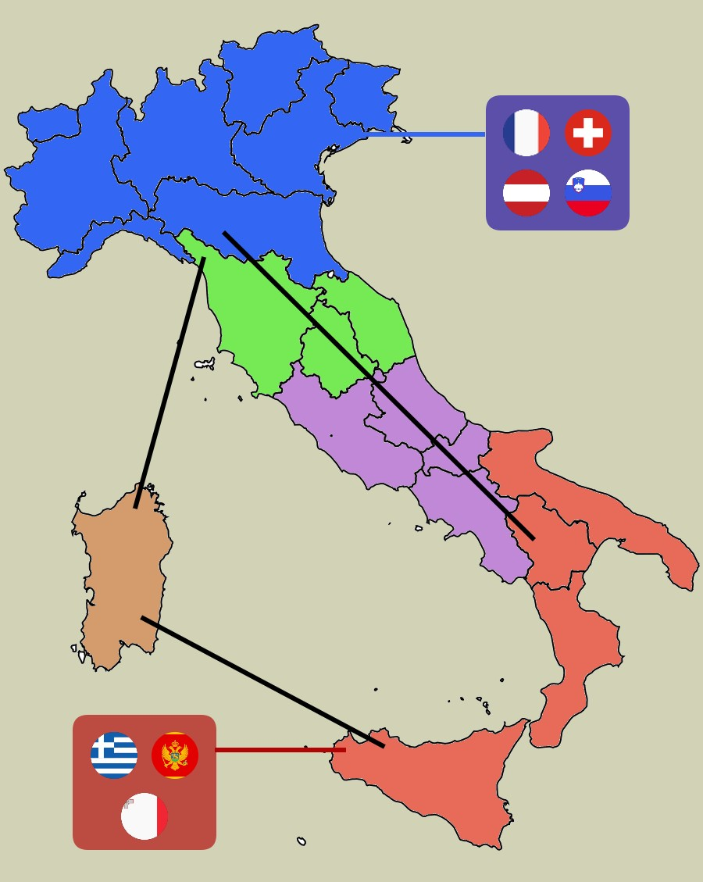
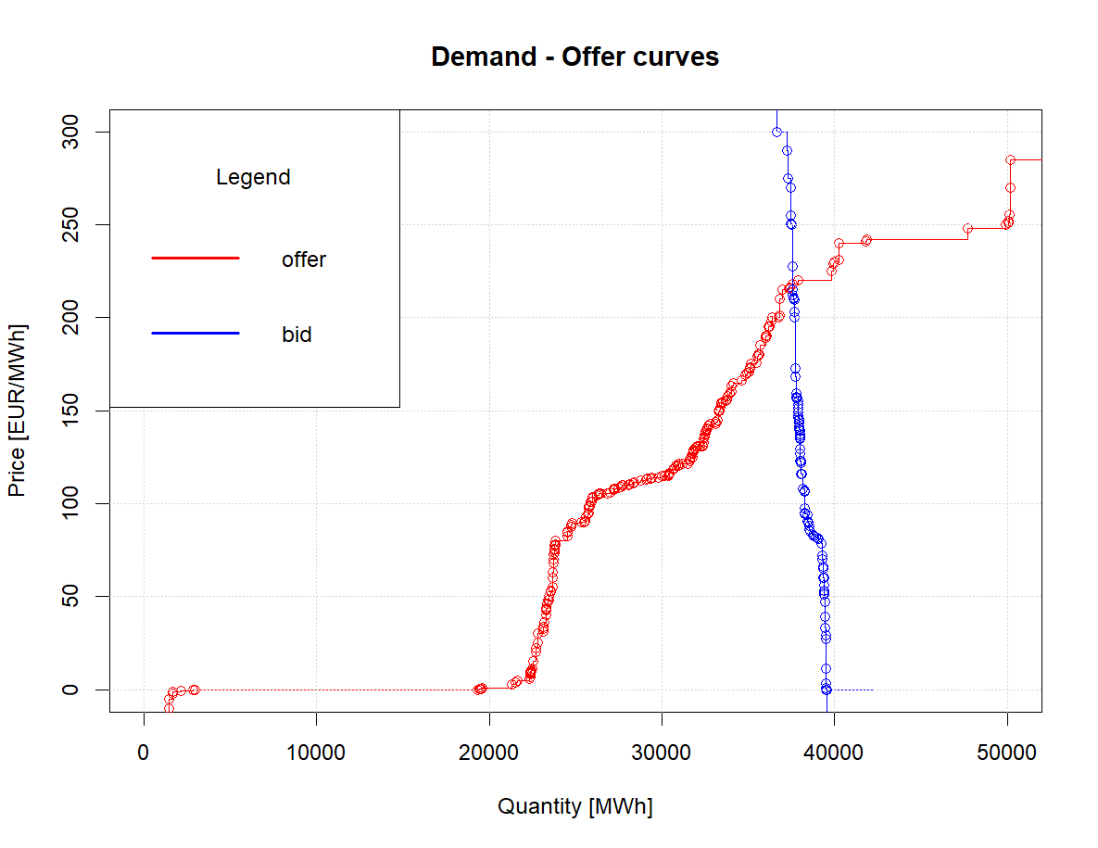
CURVES
ZONES
Date: 23/10/2023
Hour: 10:00 AM

Slide 4
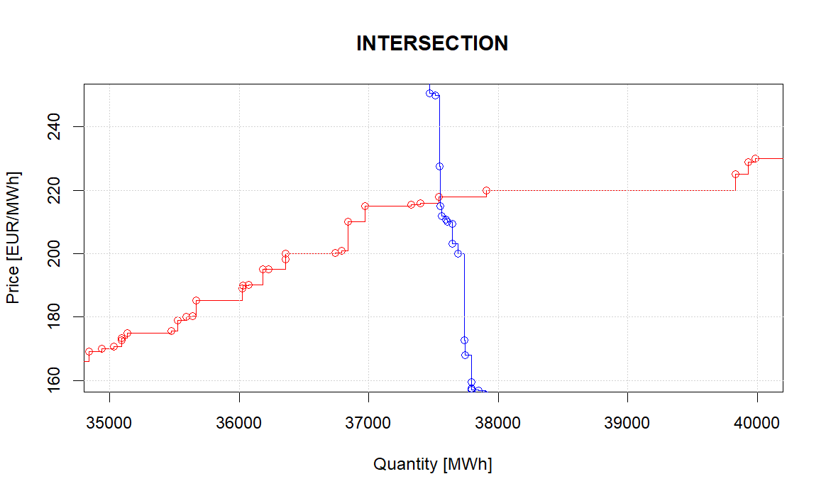
GUIDE LINE
EXPLORATORY DATA ANALYSIS
FUNCTIONAL DATA ANALYSIS
CORRELATION WITH EXTERNAL VARIABLES
PREDICTION
Intersection ~ PrezzoZonale

Slide 5
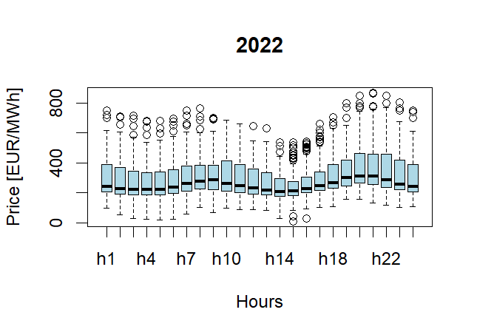
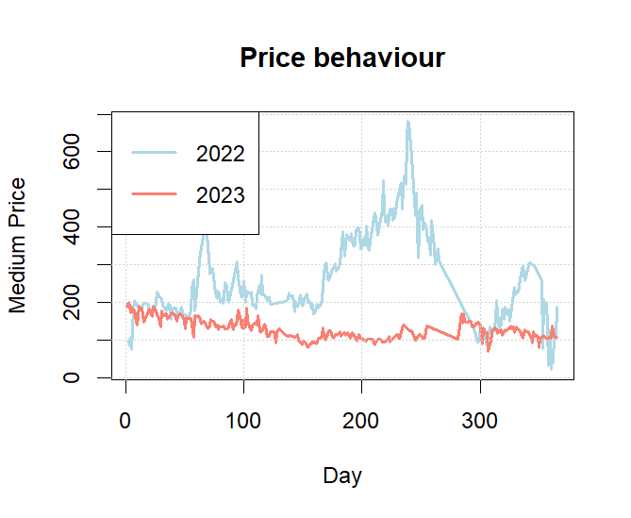
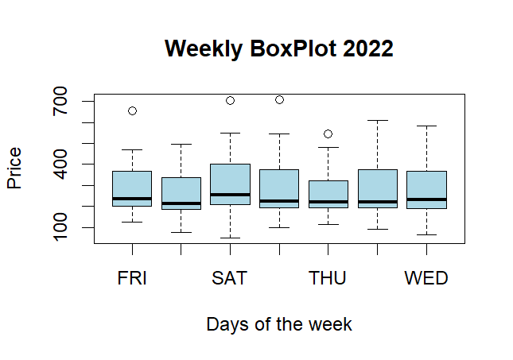
WORK IN PROGRESS
GRAPHICAL EXPLORATION OF THE DATA: INTERPRETATION
EXPLORATORY DATA ANALYSIS
FUNTIONAL DATA ANALYSIS
CORRELATION
PREDICTION

Slide 6
NEXT CHALLENGES
EXPLORATORY DATA ANALYSIS
SMOOTHING
FUNCTIONAL PRINCIPAL COMPONENT ANALYSIS
K-MEANS
FUNTIONAL DATA ANALYSIS
CORRELATION
PREDICTION
GAS PRICE
LOAD AND RENEWABLE GENERATION FORCAST
FUNCTIONAL (AUTO)REGRESSION MODELS

