Slide 1


ANALYSIS OF THE ELECTRICITY SPOT MARKET IN ITALY
15th November 2024
Nonparametric Statistics
MSc. Mathematical Engineering
Mattia Gastoldi, 10794648

Slide 2


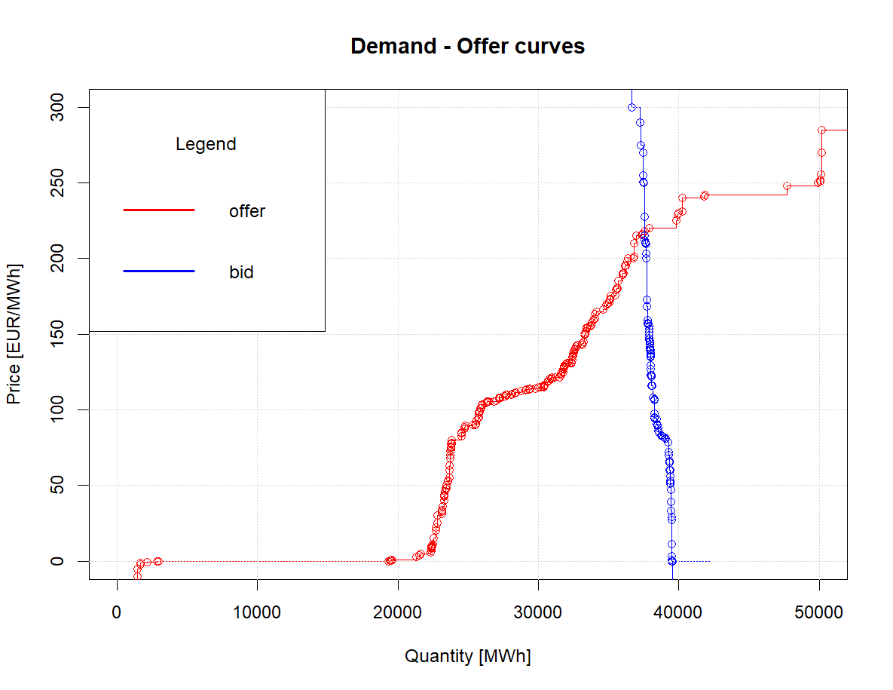





ABOUT THE DATA
Dataset:
Offer – Demand Dataset provided by Dr. Guillaume Koechlin* The data have been collected by Gestore dei Mercati Energetici (GME)
Time Period: 2007 - 2024
Data Features:
Day
Quantity [MWh]
Hour
we obtain a subdataset
Price [€/MWh]
Fixing
Zone
Type ∈ {OFF, BID}
* PhD candidate in Data Analytics and Decision Science, Dept. of Mathematics - MOX Lab, Politecnico di Milano

Slide 3
THE GOALS
ANALYSIS OF THE ENVIROMENT: - Identify trends and tendency in the Electricity Market - Identify which factors can be significant in determining the final price.
PREDICTION: - Predict both curves of Suppy and Demand for the next day, given the observed curves in the previous time instants.

Slide 4
EXPECTED WORKFLOW
DATA PREPARATION
Data Processing
Quick Data Exploration
Time-Series Regression
Suppy-Demand Curves Smoothing
Functional Data Exploration
NONPARAMETRIC REGRESSION
FUNCTIONAL INFERENCE
Local Functional Inference on Time-Series Functions
Local Functional Inference on Supply-Demand functional representative curves
FUNCTIONAL
PREDICTION
Auto Regressive Functional Model
NOTE: It could require to identify and implement proper methods to treat missing functional observations

